Slide 1

ePIC Collaboration News
J. Lajoie, S. Dalla Torre
March 20, 2025

Slide 2
Hey John, start the recording….

Slide 3
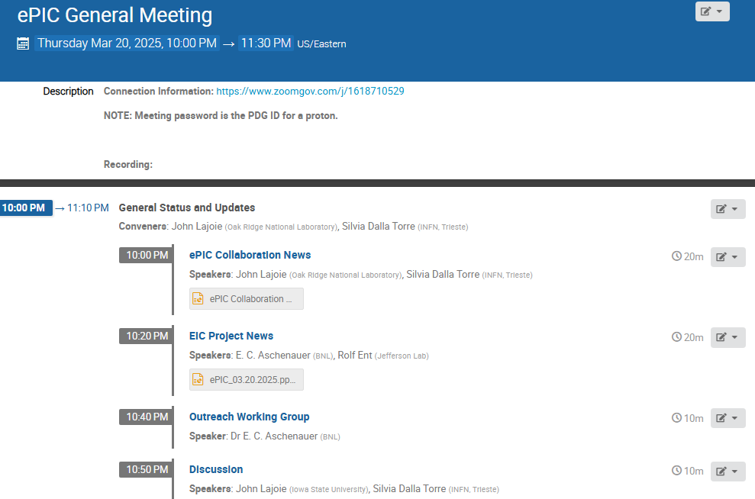
Agenda
News and updates from the SP Office, Project and Outreach WG.

Slide 4

ePIC Collaboration News
Lots of few-slide news items to go-through today. There’s a lot happening in the collaboration!

Slide 5
ePIC preTDR Timeline

Slide 6
preTDR in 2025 Timeline
Version 1 (chapter 8) to be reviewed by TC Office, specific criticisms and suggestions to DSC’s by end of March
Version 1 (chapter 2) to be reviewed by SP Office, specific criticisms and suggestions to PWG’s by end of March
Version 2 due mid-July (Collaboration Meeting)
  Version 2 internal/external review Aug-Oct.
  Comments tracked and feedback given to reviewers
Editorial Board formed by end of July
  Silvia to co-chair, 3-5 additional people
  Board is responsible for overseeing Version 2 review process
  Board is responsible for final editing pass (typos, language, consistency)
preTDR Version 2.1 by early December 2025

Slide 7
Analysis/Technical Notes

Slide 8
Analysis/Technical Notes
Within ePIC we need a mechanism to document ongoing work so that it doesn’t get lost/forgotten.
  Within collaborations this is typically an analysis or technical note
What do I mean by an “analysis or technical note” ?
  Written document that preserves some work/study/information
  The content of these notes can vary widely:
    It can be a note by a summer student on the outcome of a simulation study
    It can be a comprehensive note supporting a preliminary result or a publication
    It can be the results of a test beam
    It can be a technical note on a reconstruction algorithm
    …
Notes like this are for the collaboration only, and encompass any effort within the collaboration (TC, S&C, AC)
There should be a low bar to creating analysis/technical notes
  We want to encourage people to document important work!
  Should become an expectation that work is preserved in a note, not in slides

Slide 9
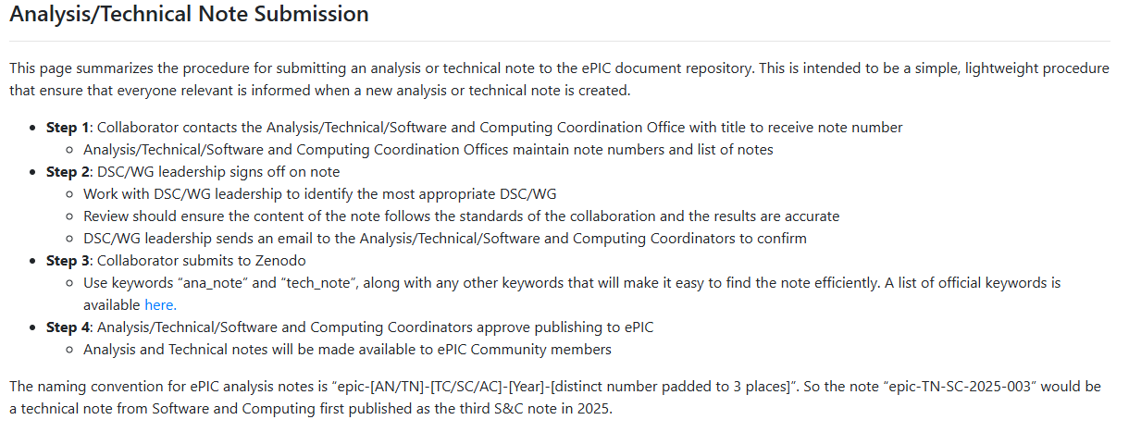
Procedure for
Analysis/Technical Notes
Procedure discussed in coordinator meeting, as well as TC/S&C/AC meetings.
https://www.epic-eic.org/documents/note_process.html
First technical note already requested:
Julien Bettane – "Design, Assembly, Integration, and Installation of the Backward ECal“
Assigned as epic-TN-TC-2025-001.

Slide 10
ePIC Publication Plan

Slide 11
ePIC Publication Plan
Completing
preTDR
process design phase
structuring the
effort
draft ePIC pre-TDR
ePIC pre-TDR (CD-2)
writing
(TDR/notes)
Preparing papers for
publication
Mid Jan.24
Late 2025
Mid Mar.24
End Oct. 24
Late 2024
It is still our intent to publish a super-set of the material prepared for the preTDR.
  Longer articles on subsystems, physics performance, etc.
  Important for collaborators to have a published product for all their hard work!
According to the projections shown at the Frascati meeting, we should be at ~70% design maturity by end of 2025, ~90% after July 2026
Need a publication plan that is flexible to accommodate these timescales

Slide 12

Possibility: NIM Special Issue I
JGL Discussed the possibility of a NIM-A special issue with William Barletta (Editor), Christian Joram (NIM-A Editor in Chief), Tanur Sinha (Publisher):
Q: What ePIC is thinking of …
  NIM special issue would be a set of more detailed articles that the TDR would allow on the detector subsystems in ePIC, their design and performance.
  Physics Working Groups would like to include articles on the performance of ePIC for various parts of the EIC science program.
  Combined, this would make a comprehensive overview of the design and performance of ePIC.
  The timescale would be such that articles would start to be available in fall of 2025 and we should be able to complete the set in early-mid 2026.
A: “That sounds like an excellent approach and also makes the refereeing much more tractable. We can certainly keep the submission portal open for the length of time that you envision. We will be most pleased to be a part of this exciting project for nuclear physics.”
  NIM editors/publisher are enthusiastic and supportive

Slide 13
Special Issue Considerations:
Plan discussed in coordination and EB meetings
Impact:
  NIM: 1.5, JINST 1.3
Open Access requirements:
  What are the Open Access requirements of the various international funding agencies in ePIC?
    DOE has very specific requirements
  Elsevier has many existing agreements
  CERN requires Open Access, has an Open Access Fund
  What level?
    Green – “as accepted” made available
    Gold – “as published” made available
Need to understand/discuss what agreements ePIC would fall under

Slide 14
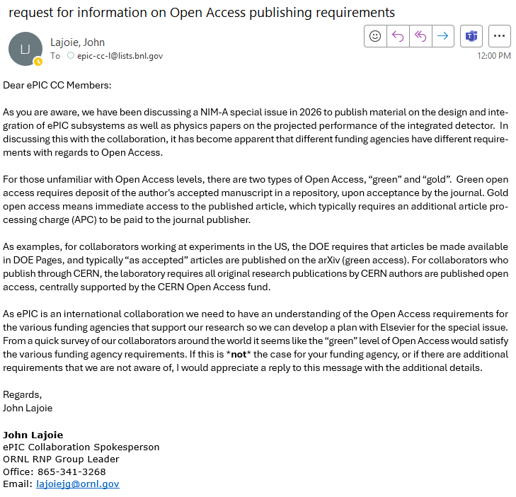
CC Request for
Information
Email to CC today:
Need to understand requirements of the various funding agencies

Slide 15
NIM Special Issue
Next Steps:
  Present to the collaboration and get feedback (today)
  Follow-up discussions in TIC, S&C and AC meetings
  Understand Open Access requirements and path
Assuming we go forward with NIM-A Special Issue:
  Fill out and send in Special Issue Information Form
  Discussion on format of special issue:
    Multiple subsystem articles? Combined articles (tracking, calorimetry, PID)?
    Settle a list of contributions, put together teams to write the articles
  Select Guest Editors from within ePIC:
    Guest Editors will shepherd the review process
    Should be selected from amongst us, but this means work
    Final decision rests with Editor-In-Chief

Slide 16
TC Office News

Slide 17
Direct contacts with DSCs, according to identified priorities
Direct conversations with DSCs
  Either by joining DSC meetings or in dedicated conversation
For each of the 15 DSCs + the CC WG electr./r-o/DAQ, a TC-Office member identified, who is following the DSC “general” meetings (these meetings have different periodicity: weekly, be-weekly, monthly)
  Starting ~ mid February
For each of the 15 DSCs + the CC WG electr./r-o/DAQ, a meeting with DSLs and DSTCs + organized
  Single events, but line open upon DSC request
  Starting: ~ mid February
  Ended: March 14th

Slide 18
Addressing needs crosscutting many/all subsystems , according to identified priorities
Attention to information of general interest about mechanics and integration:
  Monthly report on integration updates from the Project Engineers at the TIC meeting on March 3rd
Activity started with COOLING
  Andy’s Jung talk at the TIC meeting on Feb. 24th
    Andy mentioned the too poor information for progressing effectively
  Prescription for a revisited survey on cooling needs by DSCs presented at the TIC meeting on March 3rd
    The survey is progressing too slowly → dedicated session at the TIC meeting on March 31st
To the DSC’s:
Fill out what information you can and come the March 31st TIC with questions.
It’s just as important to get a handle on what you don’t know as what you do know!
Detector Parameters and Services per Subsystem.xlsx

Slide 19
preTDR strategy and timelines
A main responsibility of TC-Office
Preserving the goal of preTDR completion by the end of 2025
Integrating the suggestions received at the TIC meeting on Feb. 17
Completing the picture in order to include in the global strategy also chapter 2 (agreed upon by ACs)

Slide 20
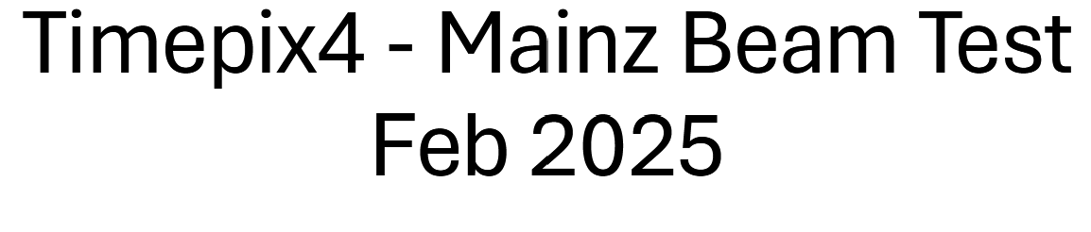
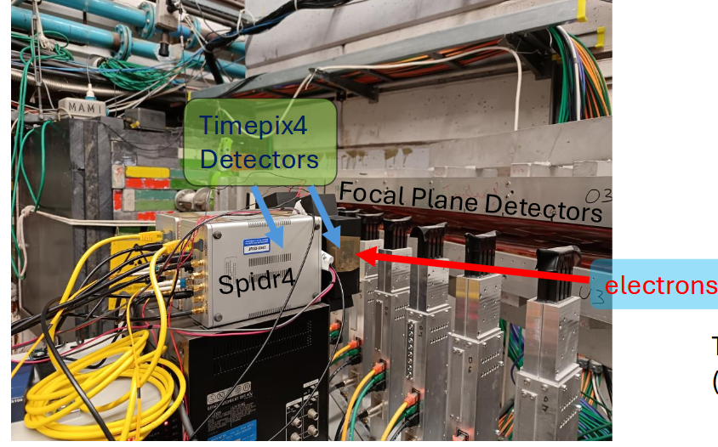
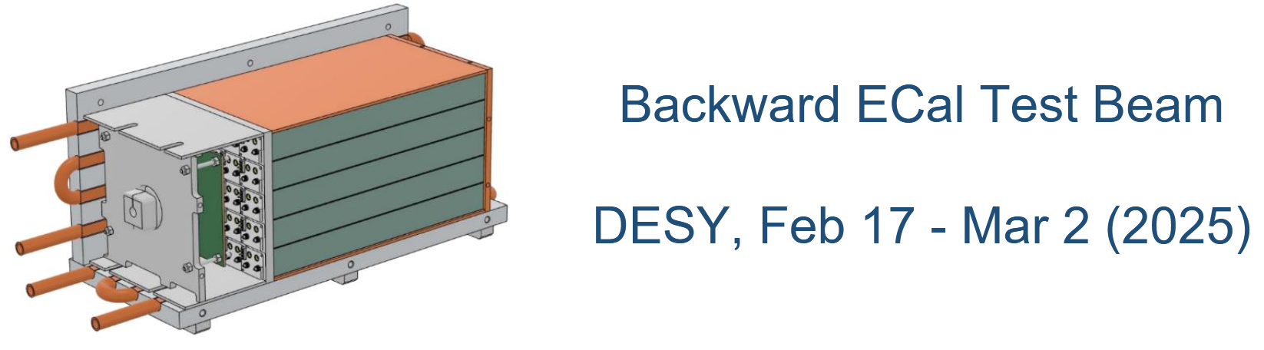
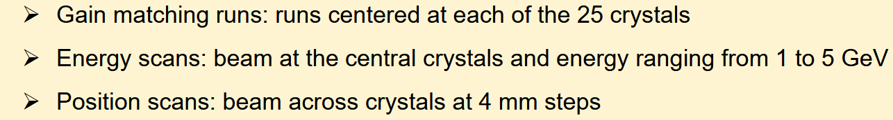
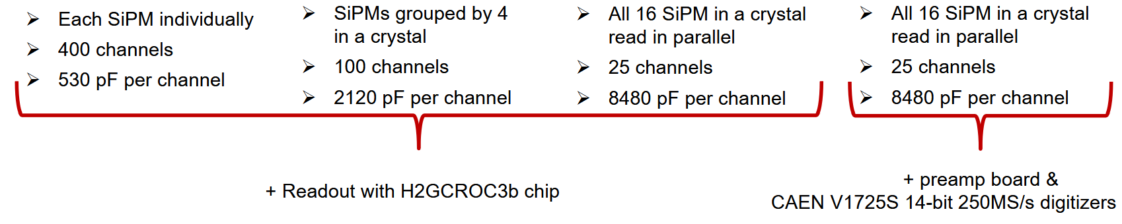
Internal dissemination of subsystem activities at TIC meetings
2 reports of successful test beams, initial information
TimePix4 at MAMI (Main
EEEMCal
Studied:
Coincidences
Cluster shapes
Efficiencies and rates
4 r-o configurations,
3 with ASIC (H2GCROC), 1 with COTs

Slide 21
DSL/Convener Changes

Slide 22
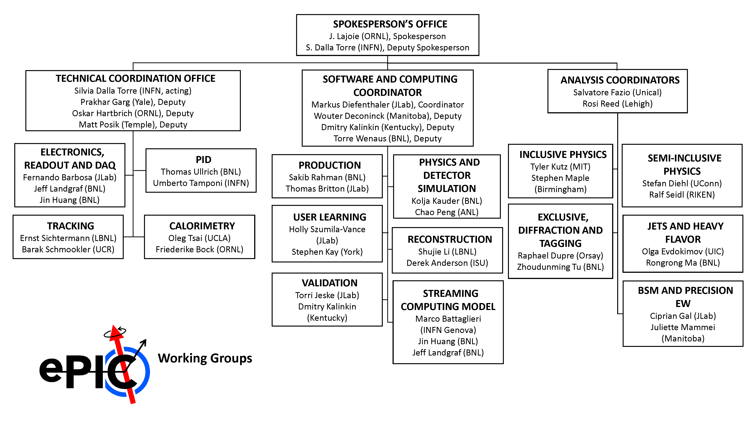
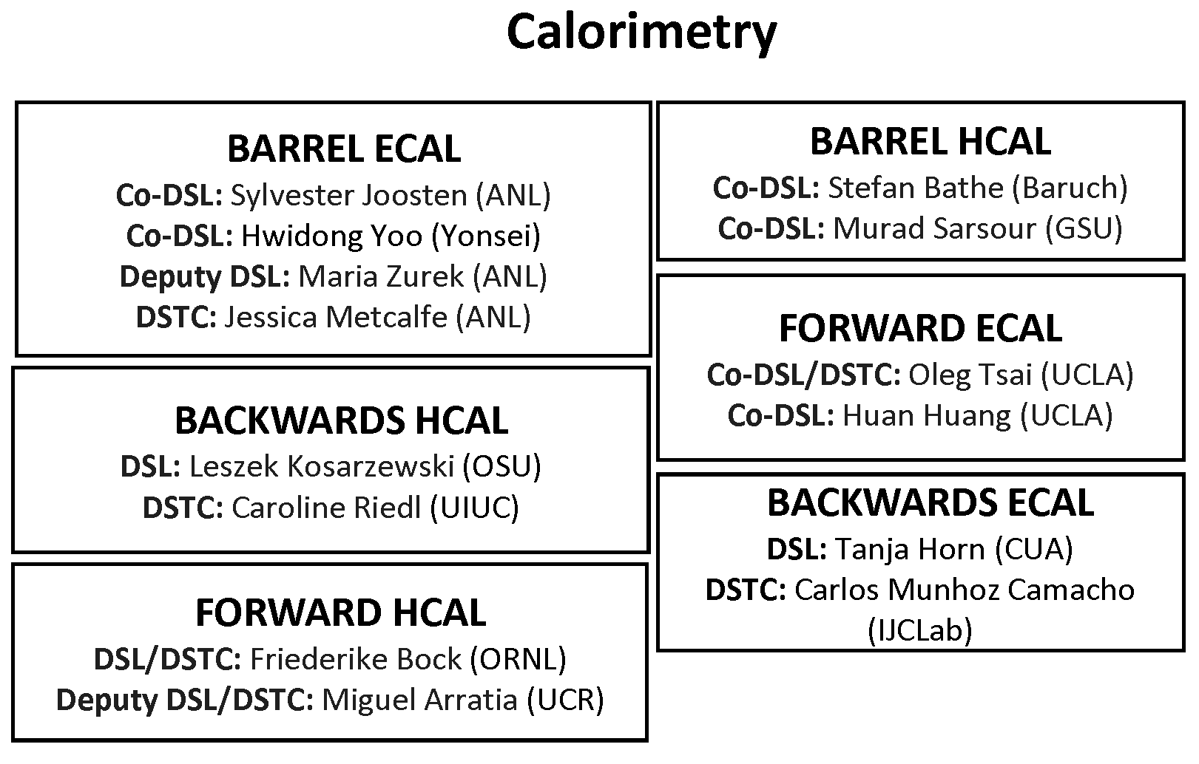
Changes I
Jin Huang and Megan Connors have been elected as co-spokespersons of sPHENIX – congratulations! Murad Sarsour will take over for Megan as Barrel HCal Co-DSL.
Software & Computing in discussions with a candidate for Streaming Computing Model WG convener (pending CC endorsement).
Caroline Riedl will be DSTC for the backwards HCal

Slide 23
Other Items

Slide 24

Welcome Seoul National University!
Following their presentation at the January 23rd Collaboration Council meeting in Frascati, the CC has voted to admit Seoul National University to the ePIC Collaboration!

Slide 25
Next Early Science Workshop
The next ePIC Early Science Workshop is scheduled for April 24-25th at Stony Brook University
  This will be a hybrid meeting
  Indico: https://indico.cfnssbu.physics.sunysb.edu/event/410/
  Early Career Support: https://forms.gle/CoC64dM4B8koduwm9
    Deadline for requesting support is March 14th
Talks in the morning/early afternoon to facilitate online participation
Agenda developing – contact Rosi and Sal with contributions
Many thanks to Abhay and CFNS for support!

Slide 26
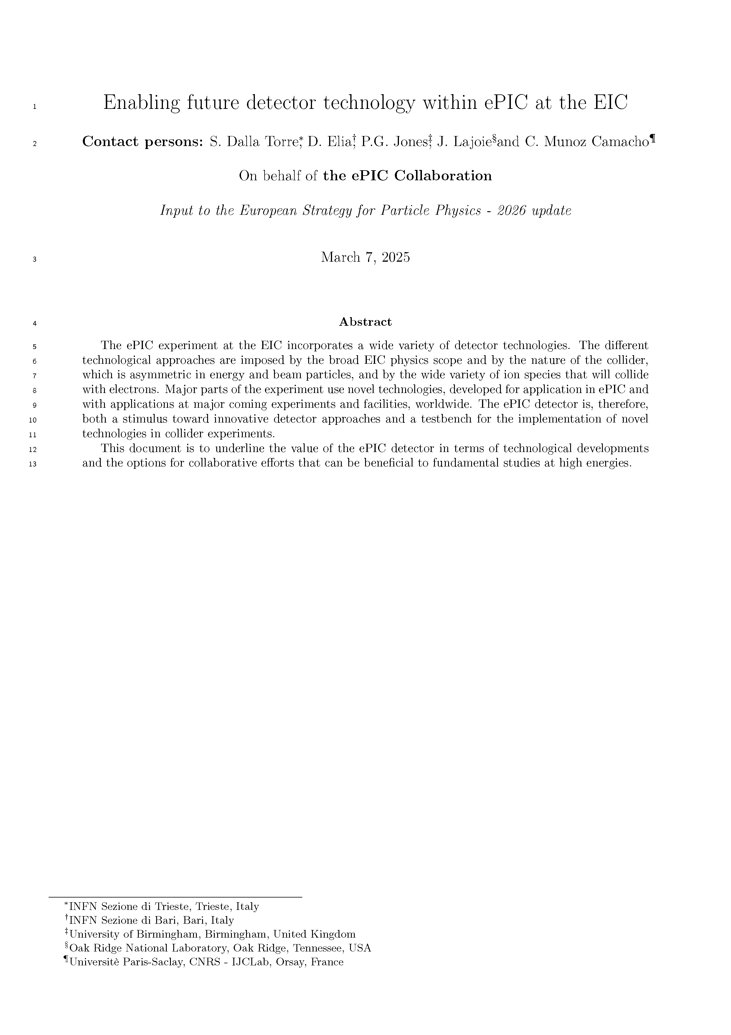
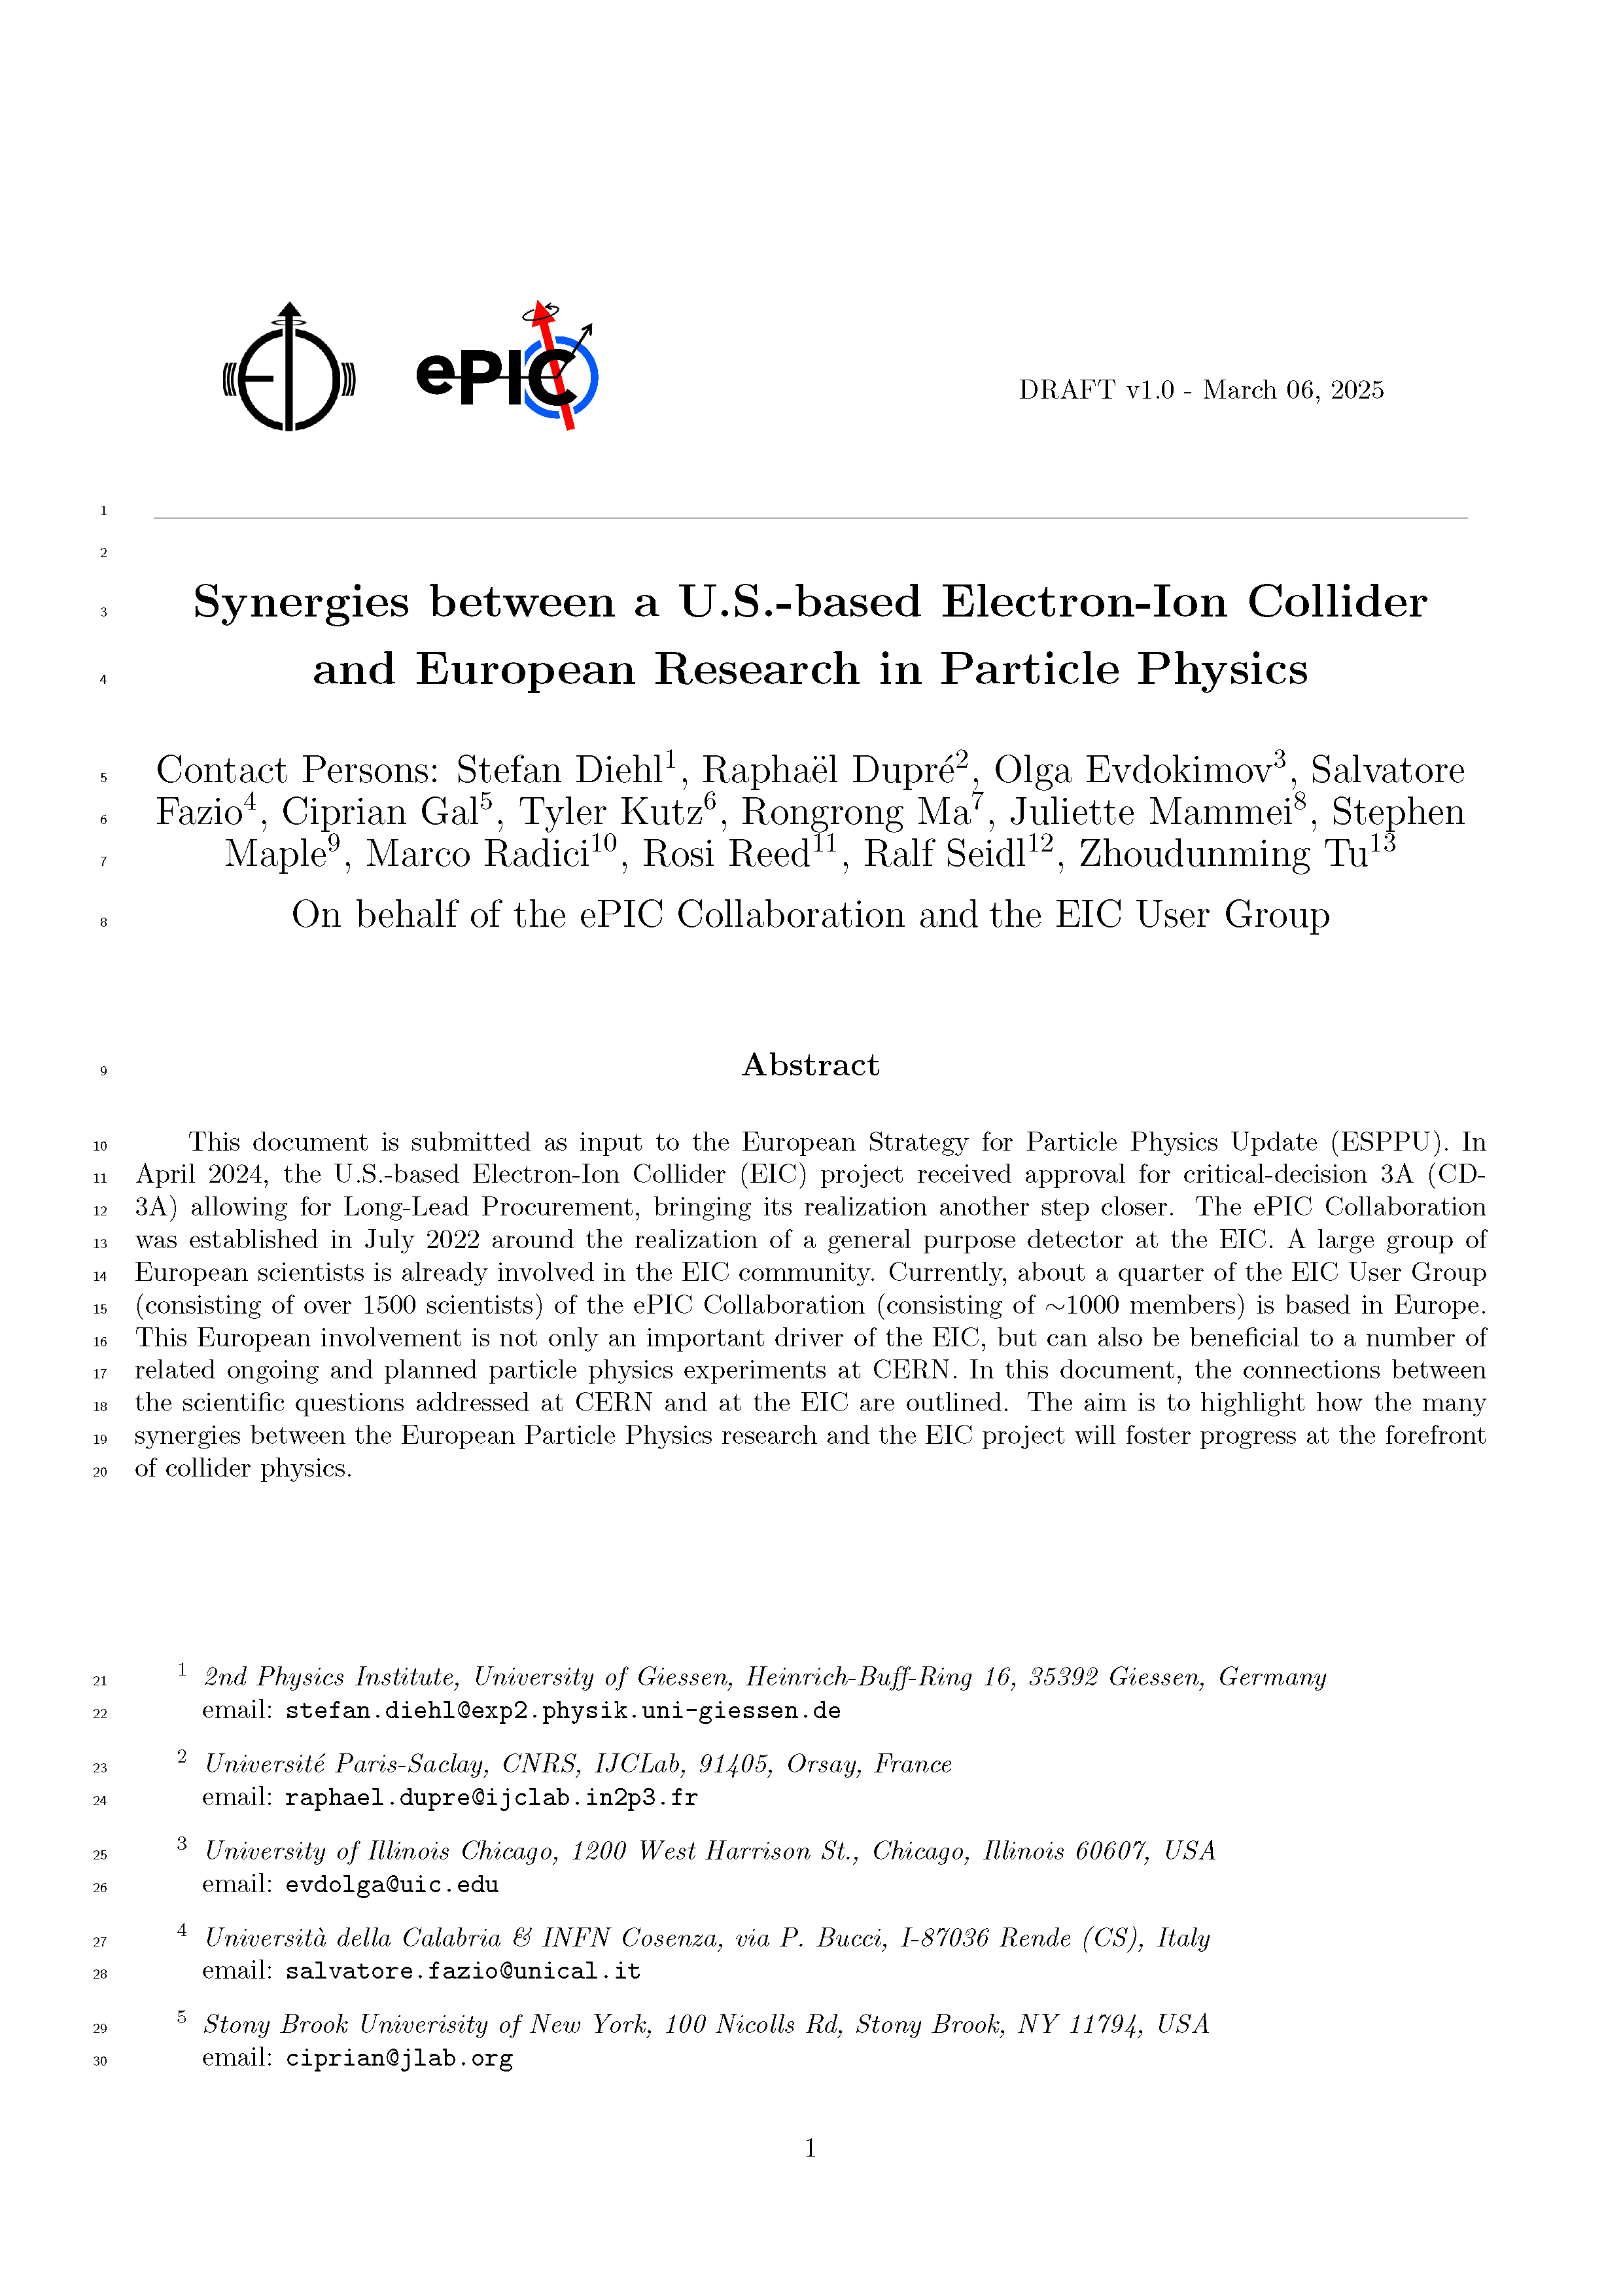
EPPSU White Papers
Two EPPSU white papers in preparation directly by the collaboration:
  “Enabling future detector technology within ePIC at the EIC”
  “Synergies between a U.S.-based Electron-Ion Collider and European Research in Particle Physics”
Two additional papers (DIS and Accelerator) also in preparation
Out for collab review
Due March 30th

Slide 27
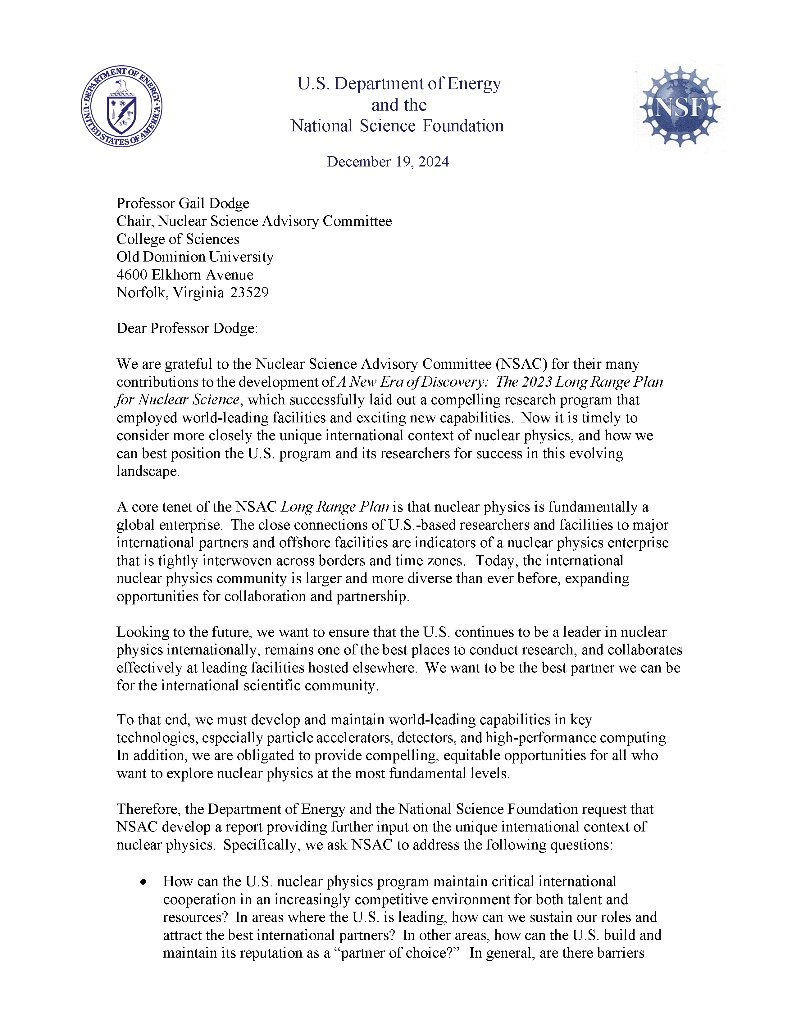
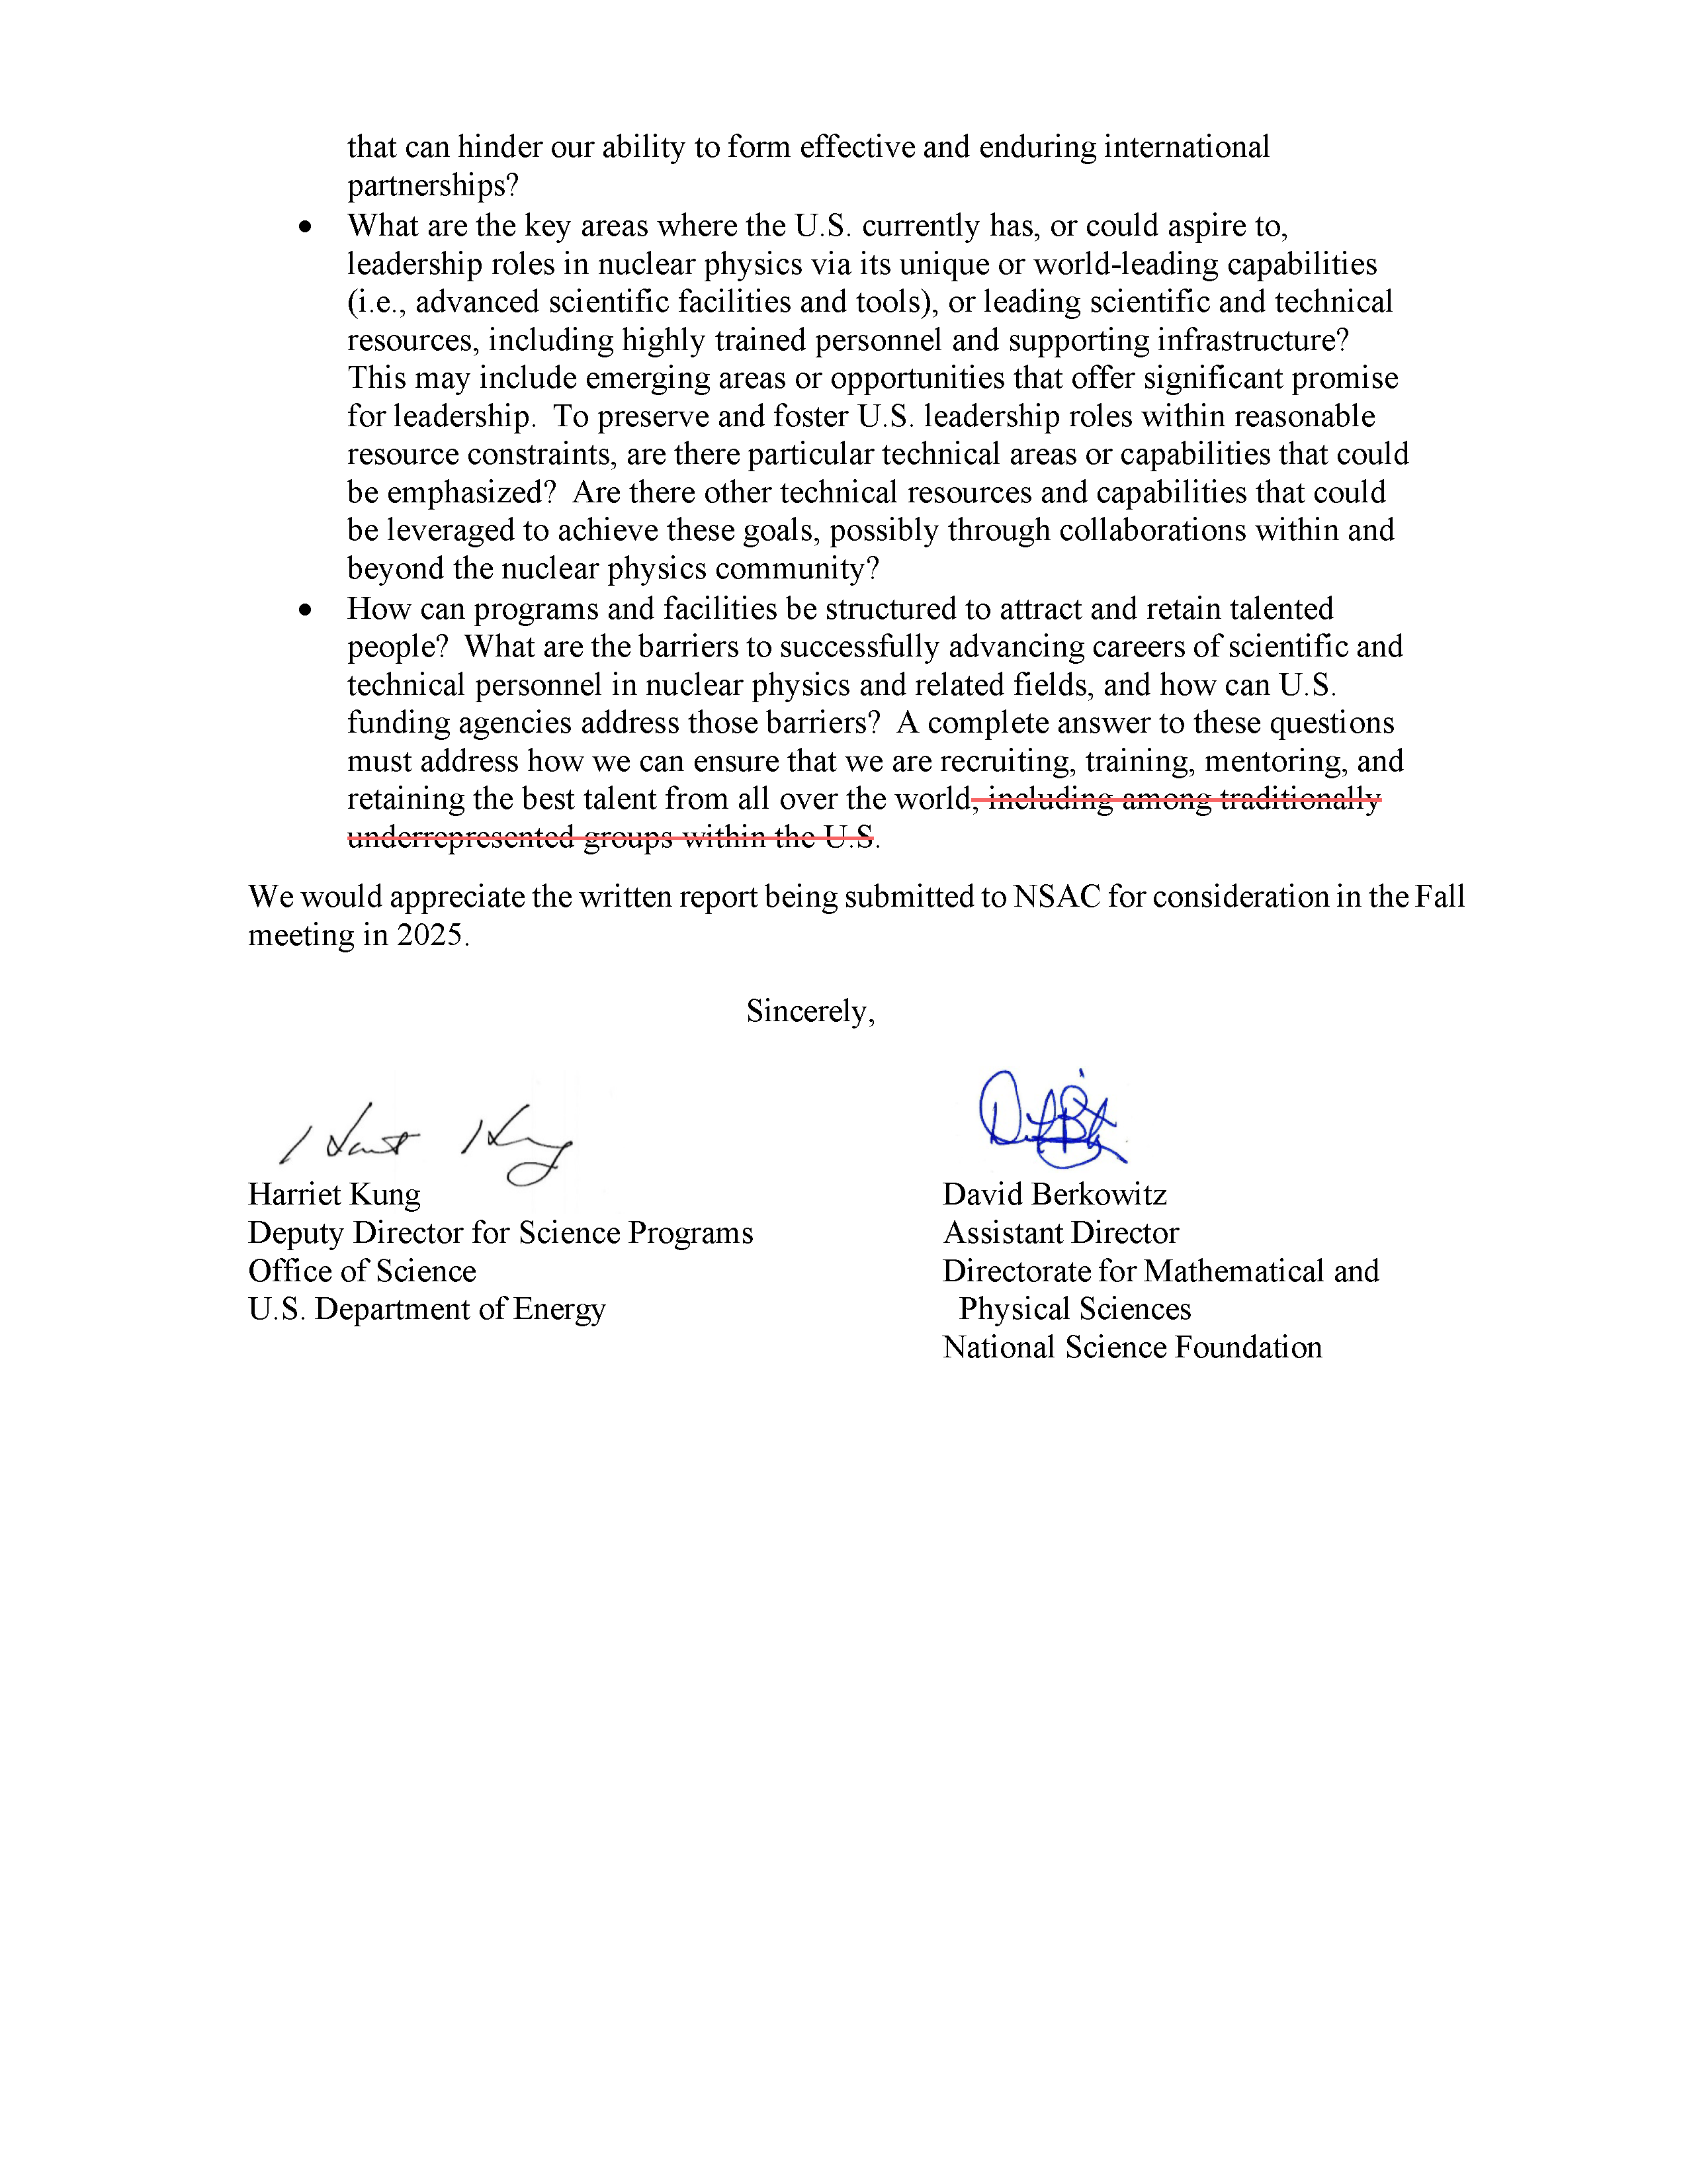
NSAC Subcommittee
Subcommittee led by Ian Cloet (ANL) asked to U.S. leadership, competitiveness and international cooperation in Nuclear Physics
  Similar to BES, HEP papers
Timely and important to EIC. Working to coordinate input to the committee at a broad level.

Slide 28

ORCID
Long email to collaboration sent Feb 24th
TLDR: ORCID is not required by ePIC, but for CC members it will allow them to update the information for their institution members in the collaboration database.
Required for BNL registration starting March 31st, 2025
https://orcid.org/

Slide 29
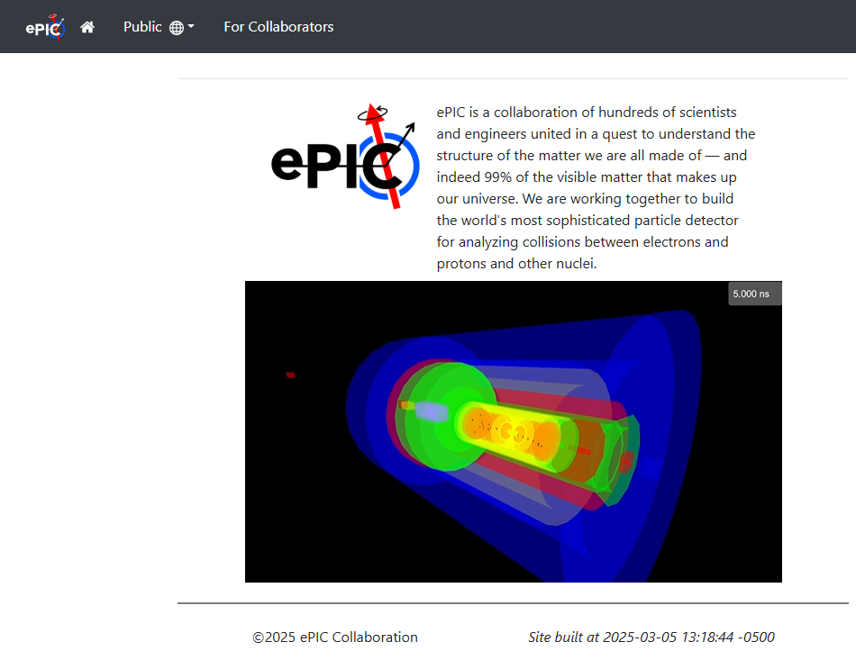
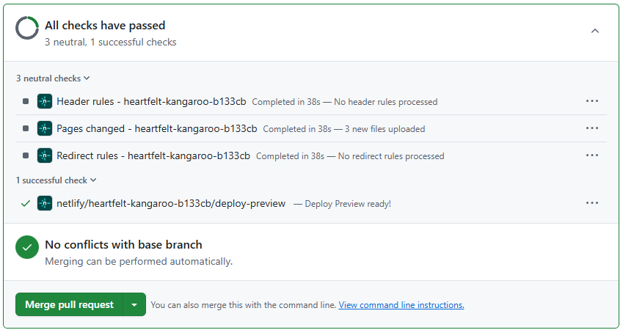
ePIC Website
Lots of changes – check it out!
  Information updated/kept up to date
New event display video from Sean Preins:
  https://youtu.be/H8Mqj3K66cU
New preview feature for pull requests – no need to install/maintain Jekyll.
  Easy to edit in Markup, commit
  and pull request to view
  Contact Maxim
  (potekhin@bnl.gov)
  for assistance

Slide 30
Next CC Meeting
Next CC meeting April 4th, 2025 at 10:30AM ET
Two (Three?) new institutions will petition to join ePIC
Further discussions on the Publication and Results Policies
Analysis of Membership Survey data
Agenda coming soon at https://indico.bnl.gov/event/26907/

Slide 31
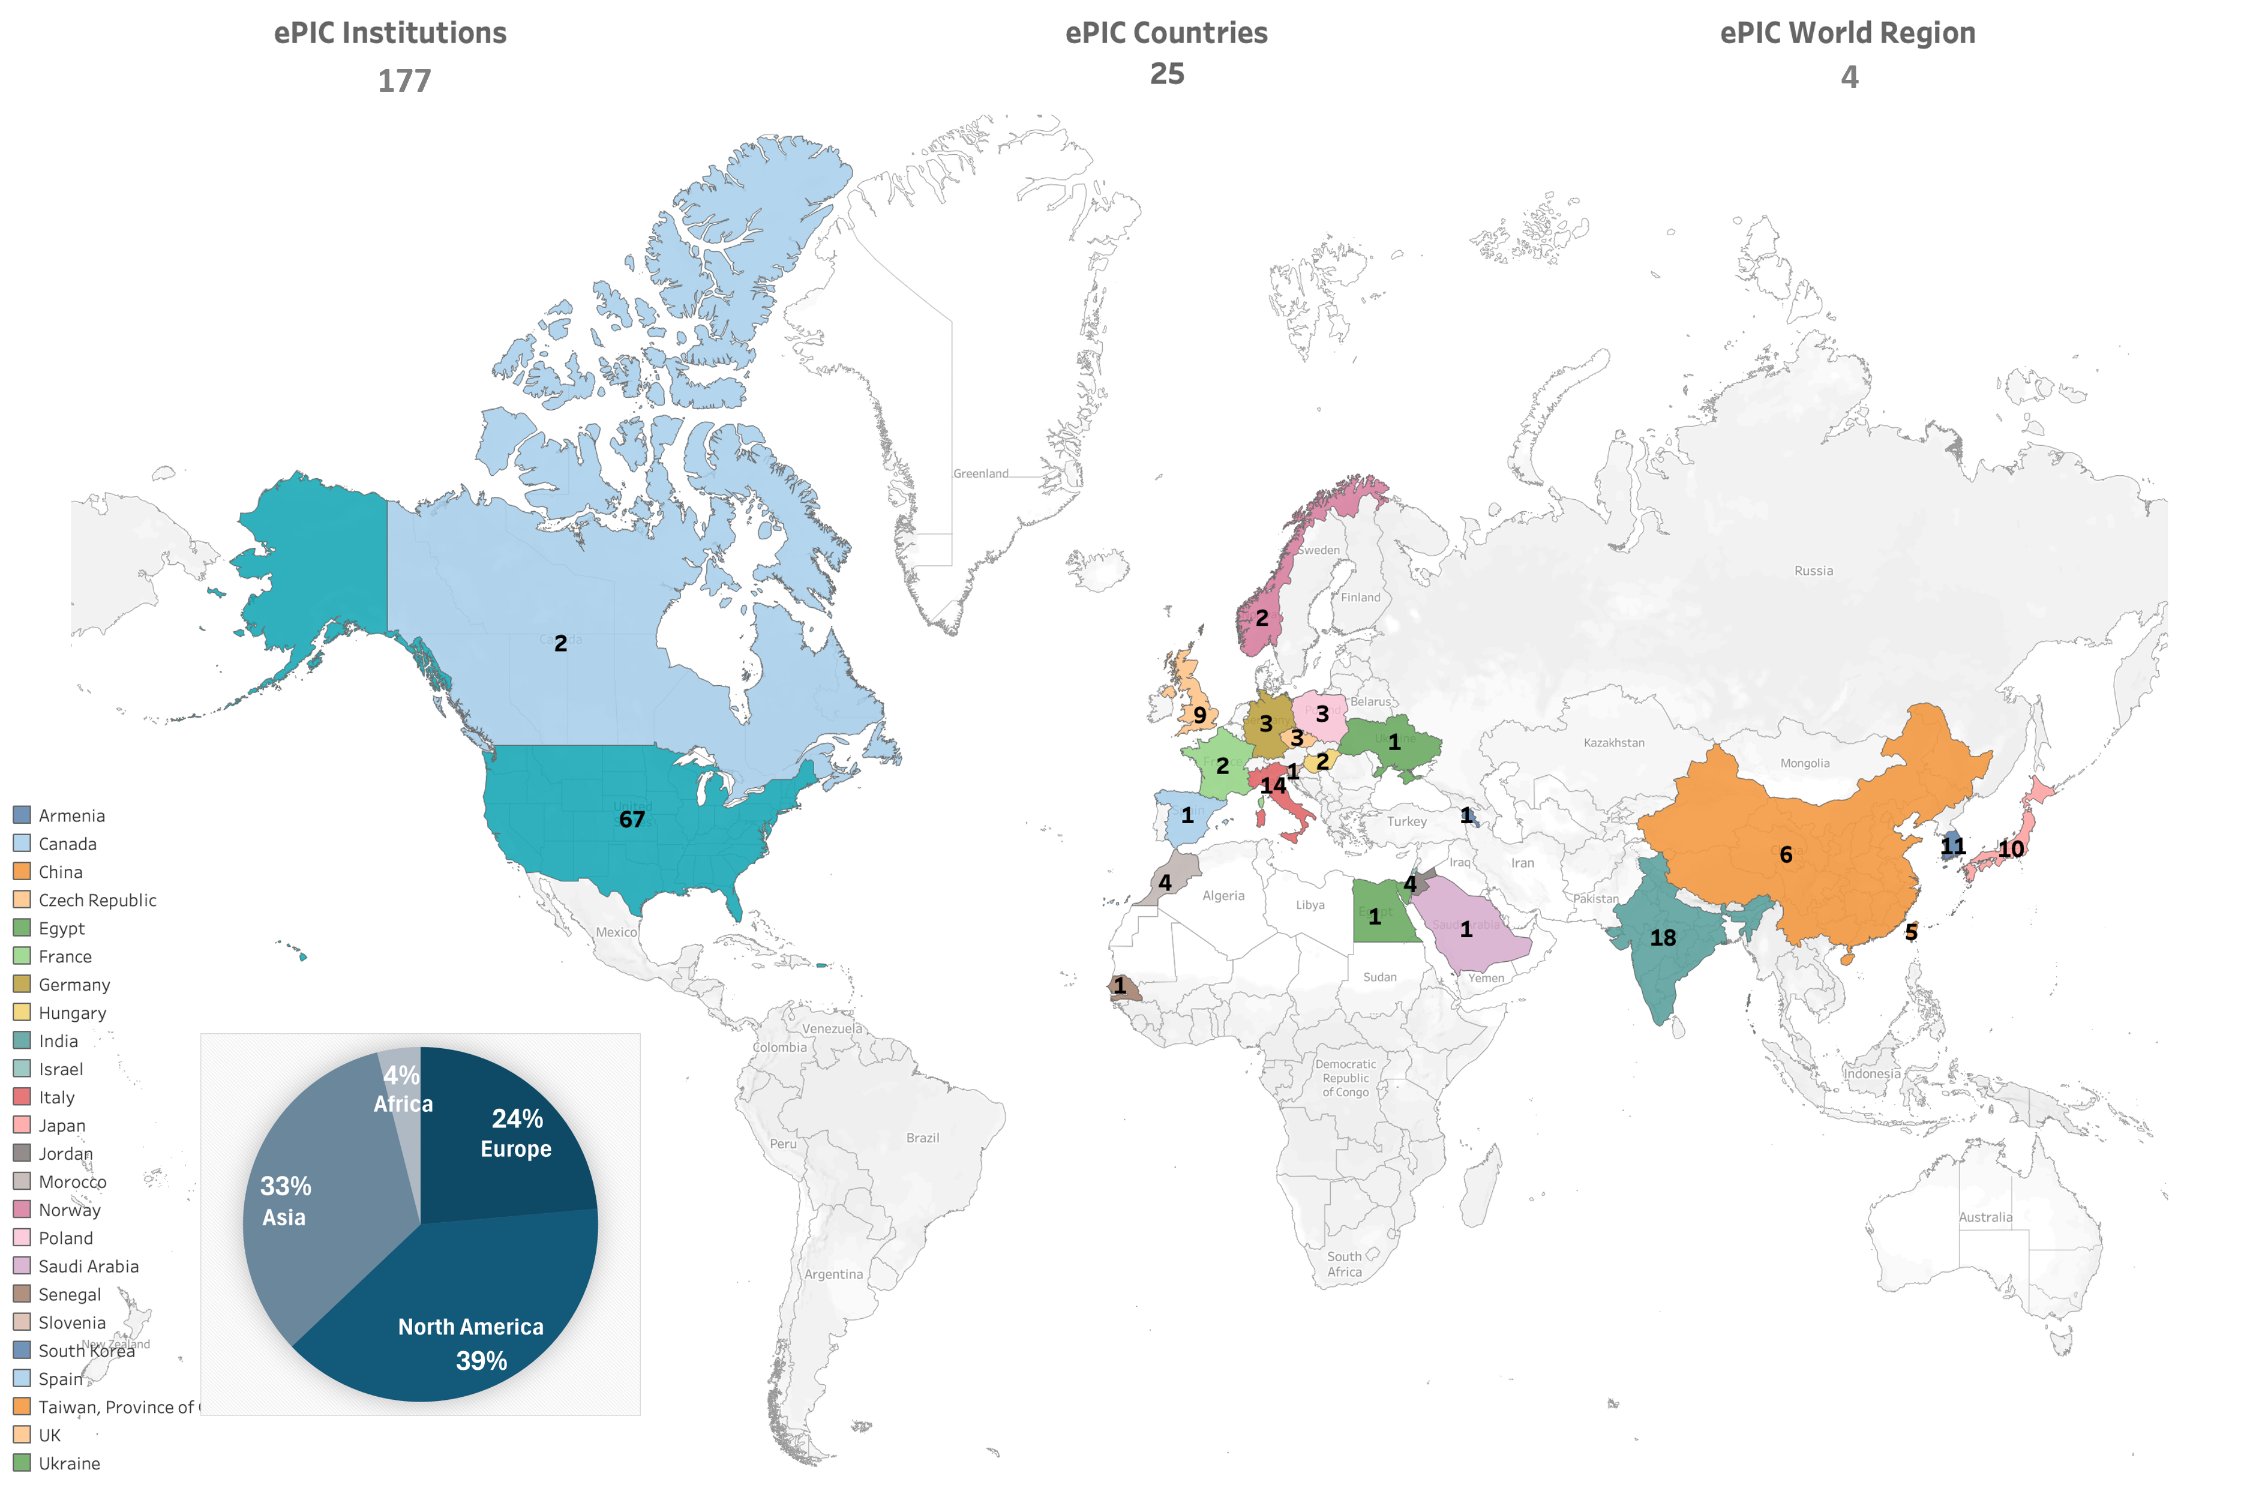
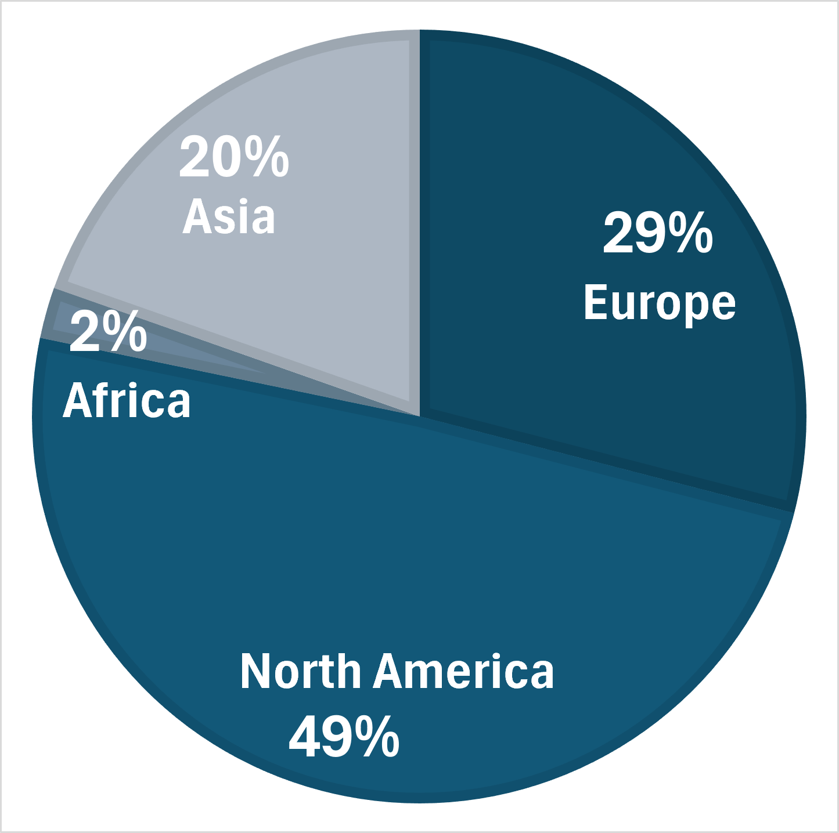
1030 Collaborators:

Slide 32
Coming Soon
Next collaboration meeting – Week of July 14th @ JLab
REMINDER: Call for Jan. 2026 Collab. Meeting Host due March 31st
  So far one expression of interest…
At future GM’s: Reports from Coordination Offices
  S&C and AC: April 4th/17th
EIC RRB Meeting Announced – June 5-6 in Prague
  https://www.bnl.gov/eic-rrbmeeting/index.php

Slide 33
Detector and Project Reviews planned for 2025:
From Elke and Rolf
Preliminary Design Reviews (60% design maturity equivalent, called PDR, PDR2 or PDR3, pending the subsystem)
  PDR2: MPGD Tracking Detectors (6.10.03.02) – Summer 2025 – exact timing linked to progress on first engineering test articles
  PDR2: Silicon Tracking Detectors (6.10.03.01) – Fall 2025 – After early results of ITS3 ER2
  PDR2: Cherenkov-based Particle Identification Detectors (6.10.04; pfRICH, hpDIRC, dRICH) – April 1-2, 2025
  PDR2: AC-LGAD-based Particle Identification Detectors (6.10.04; BTOF, FTOF, common systems) – Fall 2025
  PDR3: Barrel EM Cal (6.10.05.02) – ~August 2025
  PDR2: Backward HCAL (6.10.06.01) – ~September 2025
  PDR: Magnet Cryogenics and infrastructure (6.10.07) – September/October 2025
  PDR3: Electronics/DAQ-computing (6.10.08. 6.10.09.01) – Late August 2025 – this does not include slow controls
  PDR: DAQ-Slow Controls (6.10.09.02) – November/December 2025 – Later to ensure integration DAQ in the collider common platform
  PDR: Integration, Infrastructure and Installation (6.10.10) – September/October – everything outside GST, includes cradle, HCAL, etc.
  PDR: Integration, Infrastructure and Installation (6.10.10) – November/December 2025 – everything inside GST
  PDR3: IR Integration and Auxiliary Detectors (6.10.11) – November/December 2025 – includes 6.10.14 lumi detector
  PDR2: Polarimetry (6.10.014) – September/October 2025
Final Design Reviews (FDR):
  FDR: Backward & Forward EM Calorimetry, Barrel & Forward HCAL (6.10.05.01; 6.10.05.03; 6.10.06.02; 6.10.06.03) – May 2025
Project Reviews:
  OPA CD-3B Review – January 7-9, 2025
  DAC Meeting – Comprehensive look to design status and readiness for CD-2: 3 days to split topics. June 11-13 @ BNL.
  DOE IPR focused on SP Status – 29th & 30th of July
  Collider Subproject and Status Director's Review – October 21st – 23rd, 2025
  DOE IPR and ICR – January 13th – 16th, 2026
Other Meetings:
  Detector R&D Day hosted by ePIC and EIC Project: 16-17April 2025
  5th RRB Meeting: June 5-6, 2025 – Prague, Czech
  6th RRB Meeting: November 4th & 5th 2025, BNL

Slide 34

Parting Thoughts
ePIC is moving forward on a number of collaboration priorities
  Completing the preTDR in 2025 is a critical effort
  Working to develop the Early Science program
Next ePIC General Meeting Friday, Apr. 4th, 2025 @ 10:30AM ET

Slide 35


Slide 36


2025 -2026
PDR2: Polarimetry
Sept./Oct 2025
PDR: DAQ - Slow
Controls
Nov./Dec. 2025
ePIC Early Physics Workshop
April 24-25, 2025
DOE IPR: SP Status 29-30th July, 2025
PDR2: Backwards HCal
~Sept. 2025
ePIC pre-TDR
V2.1
PDR3: Barrel EMCal
~August 2025
5th EIC RRB Meeting
June 5-6th 2025
ePIC Software and
Computing Review
~Oct 2025
ePIC Software and
Computing Review Check-in
~May 2025
DOE IPR and ICR, 13-16th Jan., 2026
PDR2: Cerenkov PID
April 1-2, 2025
PDR3: IR Integ. & Aux. Det
Nov./Dec. 2025
PDR3: Elec./DAQ
August 2025 (late)
PDR: Magnet/Cryo Infrastructure
Sept./Oct. 2025
2025
2026
Frascati
Jan 20-24,2025
Collider Subproject and Status Director's Review
21-23 Oct., 2025
CD-2/3 Review
~ mid 2026
EICUG/ePIC Collab. Mtg. July 14-18
FDR: Backward & Forward EM Calorimetry, Barrel & Forward HCAL
May 2025
PDR: Integ. + Installation
(outside GST)
Nov/Dec 2025
PDR2: Si Tracking Detectors
Fall 2025
10th Detector Advisory Committee
June 11-13th 2025
PDR2: MPGD Detectors
Summer 2025
Detector R&D Day (ePIC/Project)
16-17th April 2025
PDR2: AC-LGAD Detectors
Fall 2025
PDR: Integ. + Installation
(inside GST)
Nov/Dec 2025
6th EIC RRB Meeting
Nov. 4-5th 2025

Slide 37
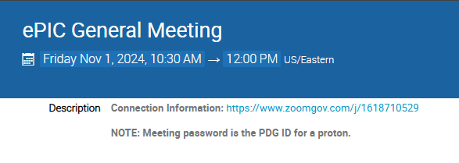
New Zoom Link
The Zoom link for the General Meeting now requires a password
We decided to do this after a TIC meeting was Zoom-bombed
  All our Indico pages are public, so this offers another hurdle for a would-be
  bomber (not a guarantee)
    Old link had password embedded to allow one-click access
  Hopefully this is not
  overly cumbersome for
  our collaborators

Slide 38
ePIC Resources
Public Website - https://www.bnl.gov/eic/epic.php
Mailing Lists – https://lists.bnl.gov/mailman/listinfo
Indico Agenda - https://indico.bnl.gov/category/402/
  ePIC Software and Computing: https://indico.bnl.gov/category/435/
Wiki - https://wiki.bnl.gov/EPIC
ePIC Software Training:
  Landing Page: https://eic.github.io/documentation/landingpage.html
  Tutorials: https://eic.github.io/documentation/tutorials.html
Mattermost: https://chat.epic-eic.org
ePIC Zenodo Community: https://zenodo.org/communities/epic

Slide 39


EICUG Membership
The EICUG is a vital organization to promote the interests of the EIC community!
  Without the EICUG we would never have gotten far enough to form ePIC!
Please register your institution!
Check with your EICUG IB representative to get registered as a member
https://www.eicug.org/content/join.html

Slide 40
NIM Special Issue III
Role of a guest editor | Editors | Elsevier
Guide for guest editors | Editors | Elsevier
Declaration of Interests
Special issues – frequently asked questions
A short guide to guest editing a journal special issue - YouTube

Slide 41
Common Themes from Priority Discussion
There is a need for better communication within the
collaboration, across multiple different entities
  Not a single problem with a single solution - something
  that we need to continually work on. Tailor the
  communication to collaboration needs
  (newsletter, minutes of meetings, etc.)
  Accelerate development of and transition to the website
Actions Underway:
  Discussions underway on future development of ePIC website:
    Current version functional not very visually appealing or engaging
    Public face of ePIC needs to be dynamic
    Need to seek collaboration feedback
  Coordinators discussion meeting “best practices”
    S&C has meeting minutes for all WG’s
  Proposing new time for evening GM (next slide)
Sub-bullets are examples that support the priority but are not exhaustive.
Actions listed not exhaustive.

Slide 42
Common Themes from Priority Discussion
Evolve technical coordination into less of a reporting body, with a proactive coordinating effort supporting the DSC’s
  Organize and coordinate preTDR effort
  Increase the direct engagement of the TC-Office with DSCs and CC WGs,
  TC Office presence in DSC meetings
  Set standards/requirements for DSC internal reviews, assist with organization
  Facilitate communication with CAMs and EIC Project
  Organize common solutions – cooling, grounding, database,…
Actions Underway:
  Increased TC presence in DSC meetings
  Individual meetings with DSC leadership (through mid-March)
  Coordination effort for CERN test beams in 2025
Sub-bullets are examples that support the priority but are not exhaustive.
Actions listed not exhaustive.

Slide 43
Common Themes from Priority Discussion
Need a better way to grow/onboard analysis efforts
  Not just software! Onboard analysis as well
  Common reconstruction tools facilitate higher-level
  analysis efforts
  Use Early Science studies as a focus for efforts in analysis
  and engagement with theory
Actions Underway:
  PWG’s working to implement analysis tutorials
  AC working with TC Office on performance studies
  S&C will be reaching out to DSCs on software plans.
  Planning Early Science workshop in late April
Sub-bullets are examples that support this priority but are not exhaustive.
Actions listed not exhaustive.

Slide 44
Common Themes from Priority Discussion
Need to define a set of 2025 milestones for progress in simulations
  This includes simulation framework, fidelity to the mechanical design, inclusion of backgrounds, and reconstruction and common tools
  Work with DSC’s to set software goals, SCC to support
  Define how we work towards simulation reconstruction in timeframes
Actions Underway:
  S&C/AC agreed on priorities and people identified
    Report at next General Meeting
Workforce and Engagement
  Need to increase workforce and support engagement across all three coordination offices
Actions Underway:
  Analysis tutorials in preparation ahead of summer
  students
  Analysis of membership survey underway
Actions listed not exhaustive.
Sub-bullets are examples that support this priority but are not exhaustive.

Slide 45
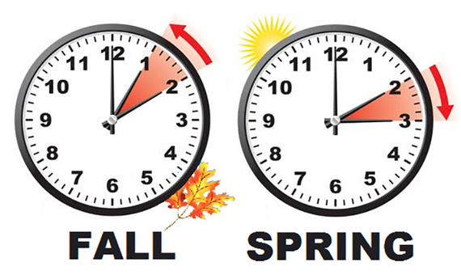
Daylight Savings Time
The U.S. will “spring forward” at 2AM ET on March 9th
Europe will “spring forward” at 2AM CET on March 30th
China, India, Japan, Taiwan, and Saskatchewan, do not observe DST
This transition will cause some confusion during March
I don’t trust myself to do the conversion:
  https://www.worldtimebuddy.com/

Slide 46
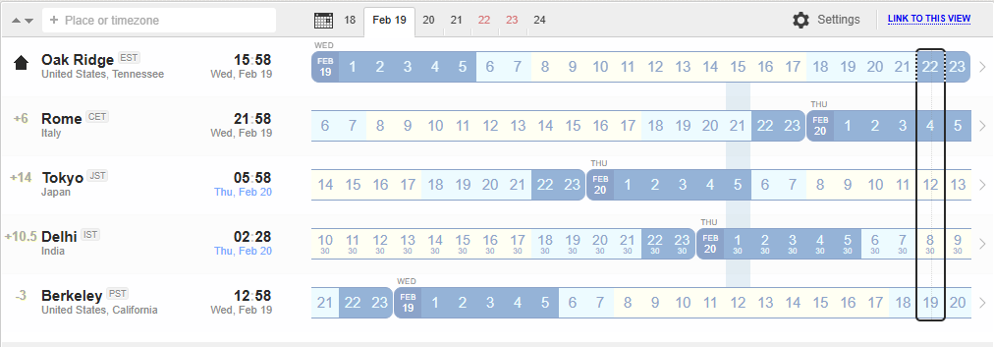
New Time for Evening General Meetings
Current Meeting Times:
Fridays:
10:30 AM ET
Thursdays:
7:30 PM ET
Current evening meeting time is not serving its purpose
NOTE: It is not expected that everyone attend all General Meetings!
New Evening Meeting Time:
Thursdays:
10 PM ET

Slide 47
Notes in Publication Policy:
Analysis notes are explicitly mentioned in draft publication policy:
No conflict. Pub. Committee Chairs notified of draft procedures.

Slide 48
preTDR in 2025 Timeline
Version 1 (chapter 8) to be reviewed by TC Office, specific criticisms and suggestions to DSC’s by end of March
Version 1 (chapter 2) to be reviewed by SP Office, specific criticisms and suggestions to PWG’s by end of March
Version 2 due mid-July (Collaboration Meeting)
  Version 2 internal/external review Aug-Oct.
  Comments tracked and feedback given to reviewers
Editorial Board formed by end of July
  Silvia co-chair, 3-5 additional people
  Board is responsible for overseeing Version 2 review process
  Board is responsible for final editing pass (typos, language, consistency)
preTDR Version 2.1 by early December 2025
DSCs and WGs have ~ 3-3.5 months to prepare Version2
Version2 is the last version requested for preTDR !

