Slide 1

ePIC Collaboration News
J. Lajoie, S. Dalla Torre
May 15th, 2025

Slide 2
Hey John, start the recording….

Slide 3
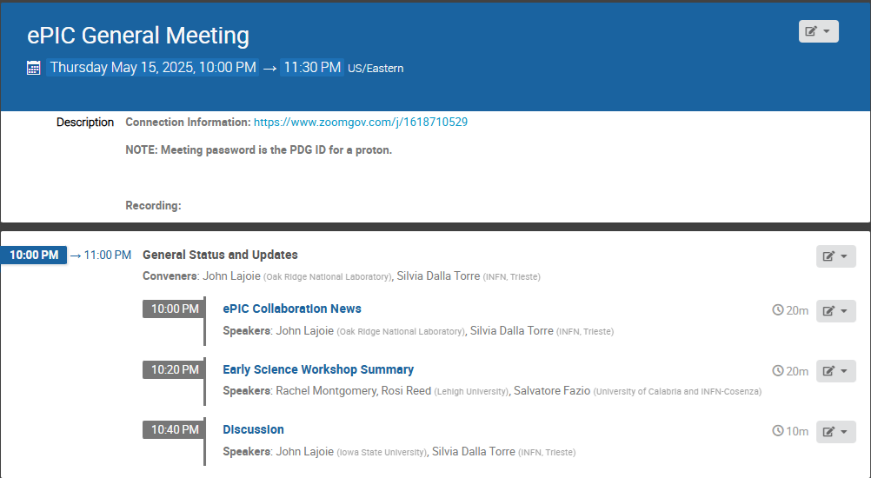
Agenda
News and updates from the collaboration.
Last meeting in this time slot was
March 20th!

Slide 4





Welcome New Institutions!
Texas Southern University
  Presented by Nissem Abdelrahman
Johannes Gutenberg University Mainz
  Presented by Tyler Kutz
Mount Allison University
  Presented by David Hornidge
University of Hawaii at Manoa
  Presented by Jennifer Ott

Slide 5
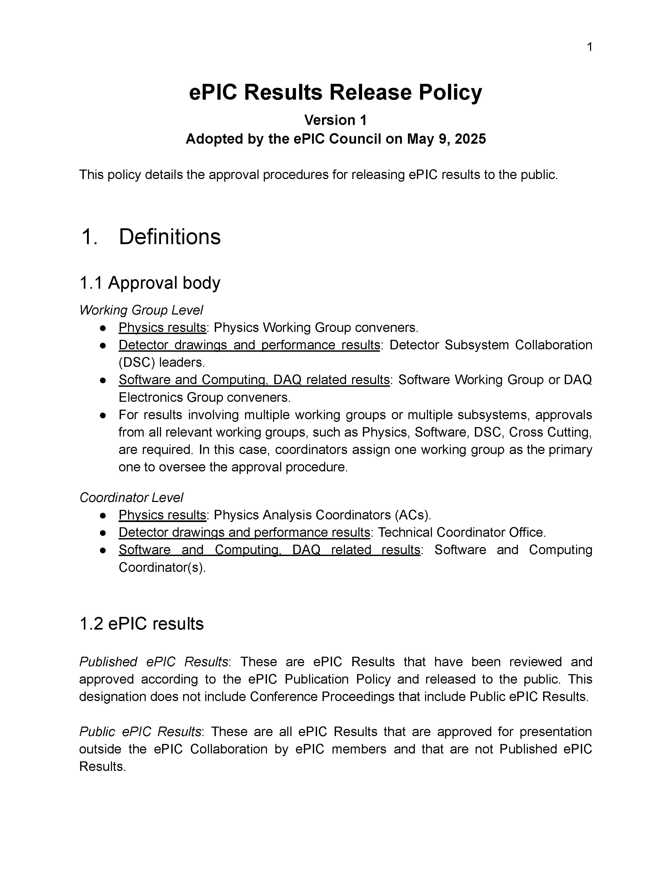
ePIC Results Policy Passed by CC Vote
Last discussed at April 4th CC Meeting:
  https://indico.bnl.gov/event/26907/
Available in Zenodo:
  https://zenodo.org/records/15390156
Don’t have a Zenodo account?
  Create one at zenodo.org
  Email SP Office or a coordinator to be invited to ePIC community

Slide 6
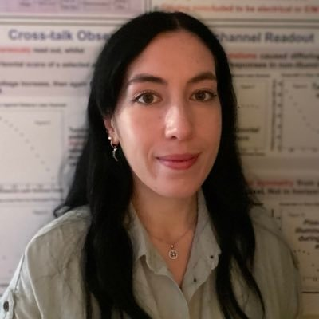
New Physics Analysis Coordinator
Rosi Reed has taken on substantial responsibilities as sPHENIX Run Coordinator for this year
  Rosi will step back to Deputy Physics Analysis Coordinator
  This helps maintain continuity within Physics Analysis Coordination
The Spokesperson’s Office nominates Rachel Montgomery as a new Physics Analysis Co-Coordinator:
  Lecturer in Nuclear and Hadron Physics at University of Glasgow
  Former ePIC Diffractive and Exclusive Physics WG Convener
  Will ramp up by the end of the current academic semester

Slide 7
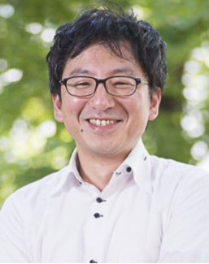
New Streaming Computing Model WG Convener
Jin Huang has been elected as sPHENIX co-spokesperson, along with Megan Connors
  Jin held convener positions in both the Electronics, Readout & DAQ CC WG and the Streaming Computing Model WG. This helped provide communication and continuity between these two important groups.
After discussions with the remaining Electronics, Readout & DAQ CC WG conveners, an additional convener here is not necessary
  Jeff Landgraf is a co-convener in both WG’s
The Spokesperson’s Office nominates Taku Gunji as a new
Streaming Computing Model WG convener
  Associate Professor at the University of Tokyo, CNS
  SPADI Alliance member

Slide 8



2025 -2026
DOE OPA Status
5-7th August, 2025
PDR2: Polarimetry
Sept./Oct 2025
ePIC Early Physics Workshop
April 24-25, 2025
10th Detector Advisory Committee
June 11-13th 2025
PDR: DAQ - Slow
Controls
Nov./Dec. 2025
PDR2: Backwards HCal
~Sept. 2025
ePIC pre-TDR
V2.1
PDR3: Barrel EMCal
~August 2025
PDR2: Cerenkov PID
April 1-2, 2025
FDR: BABAR DIRC Bar Refurbishment
ePIC Software and
Computing Review
~Oct 2025
ePIC Software and
Computing Technical Interchange – May 12th
DOE IPR and ICR, 13-16th Jan., 2026
PDR3: IR Integ. & Aux. Det
Nov./Dec. 2025
PDR3: Elec./DAQ
August 2025 (late)
PDR: Magnet/Cryo Infrastructure
Sept./Oct. 2025
2025
2026
Frascati
Jan 20-24,2025
EICUG/ePIC Collab. Mtg. July 14-18
Collider Subproject and Status Director's Review
21-23 Oct., 2025
CD-2/3 Review
~ mid 2026
EICO
2-4th April 2025
PDR: Integ. + Installation
(outside GST)
Nov/Dec 2025
FDR: Backward & Forward EM Calorimetry, Barrel & Forward HCAL
July 2025
PDR2: Si Tracking Detectors
Fall 2025
5th EIC RRB Meeting
June 5-6th 2025
PDR2: MPGD Detectors
Summer 2025
Detector R&D Day (ePIC/Project)
16-17th April 2025
PDR2: AC-LGAD Detectors
Fall 2025
PDR: Integ. + Installation
(inside GST)
Nov/Dec 2025
6th EIC RRB Meeting
Nov. 4-5th 2025

Slide 9
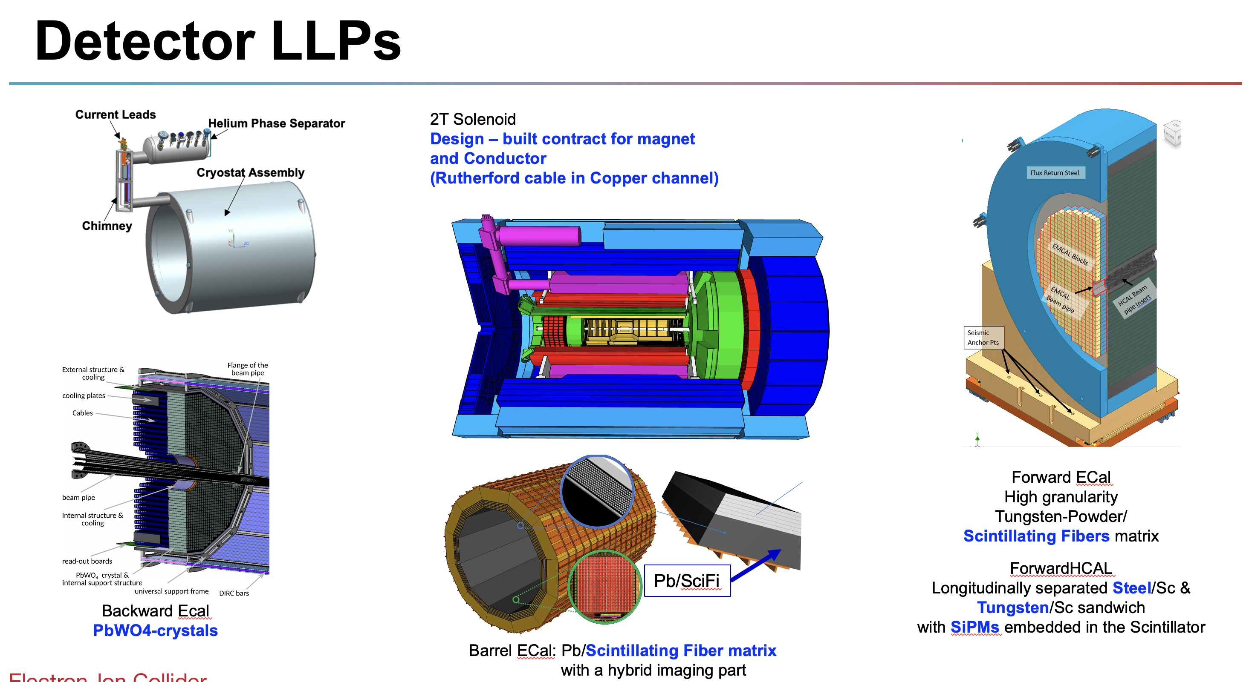
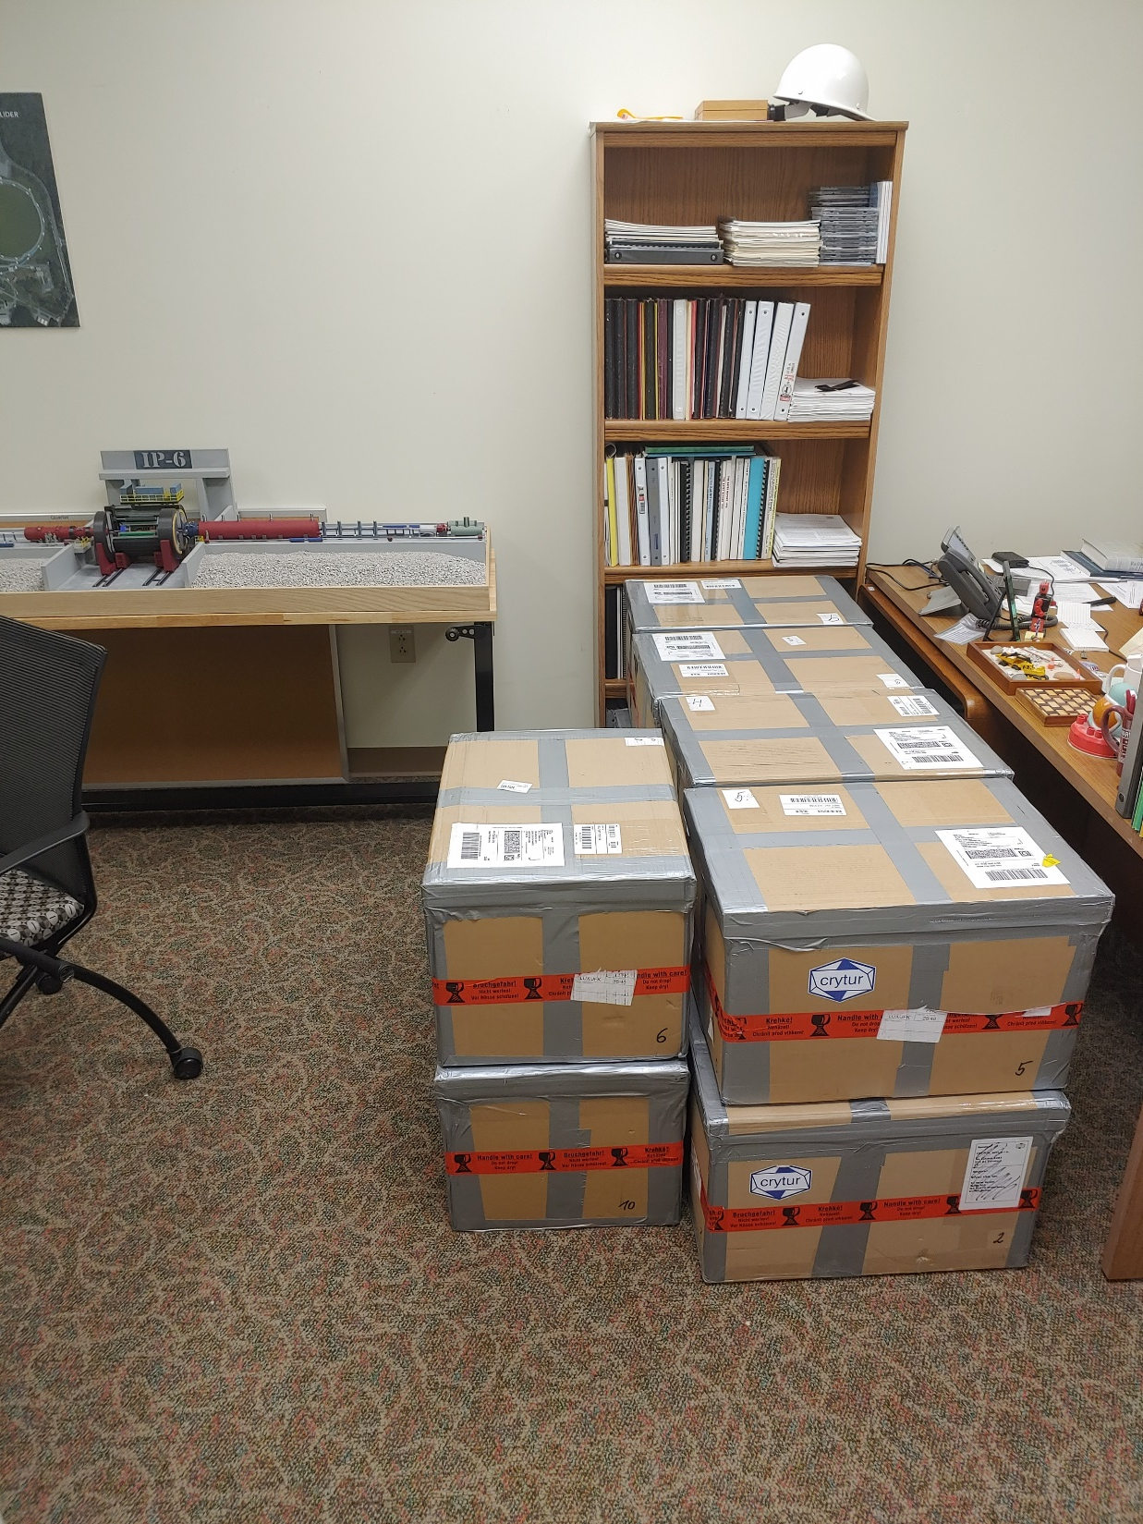
Construction has started! (CD-3A)
(slide from 5/2 Project News presentation)
Lead Tungstate Crystals for the Detector Backward Electro-Magnetic (EM) Calorimeter
Scintillating Fibers for the Detector Barrel and Forward EM Calorimeters
Silicon Photomultipliers for the Detector Forward Hadronic Calorimeter
Steel and Tungsten for the Detector Forward Hadronic Calorimeter
Detector Solenoid Magnet Design and Fabrication and Conductor
140 PbWO4 crystals in – quality tests completed, all crystals (CRYTUR) passed specifications.
Forward ECal: first batch of 100 scintillating fibers in – quality tests show fibers do not pass specifications; discussions with vendor (Luxium) ongoing who is investigating issue;
  Final evaluation barrel EMCal scintillating fiber contract completed – two vendors Luxium and Kuraray – one of the two vendors does not meet specifications. Vendor who meets the specs is more expensive ~30%, price negotiations ongoing → increased cost will a “Programmatic Change Request” and approval of contingency use.
Contract signed --> expect first SiPM delivery by end of the year
All engineering test articles are finalized → contract going through different stages of approval
Procurement working on submitting conductor contract documents to Thomas Jefferson (DOE) Site Office; INFN working on magnet tender with JLab and CEA engineers reviewing documents
My office on Tuesday April 1, 2025
The first shipment of PbWO4 crystals arrived at Jefferson Lab, consisting of 11 boxes of 10 crystals each. This CD-3A Long-Lead Procurement is done through BNL, but the crystals first are delivered to Jefferson Lab for their Quality Control tests.

Slide 10
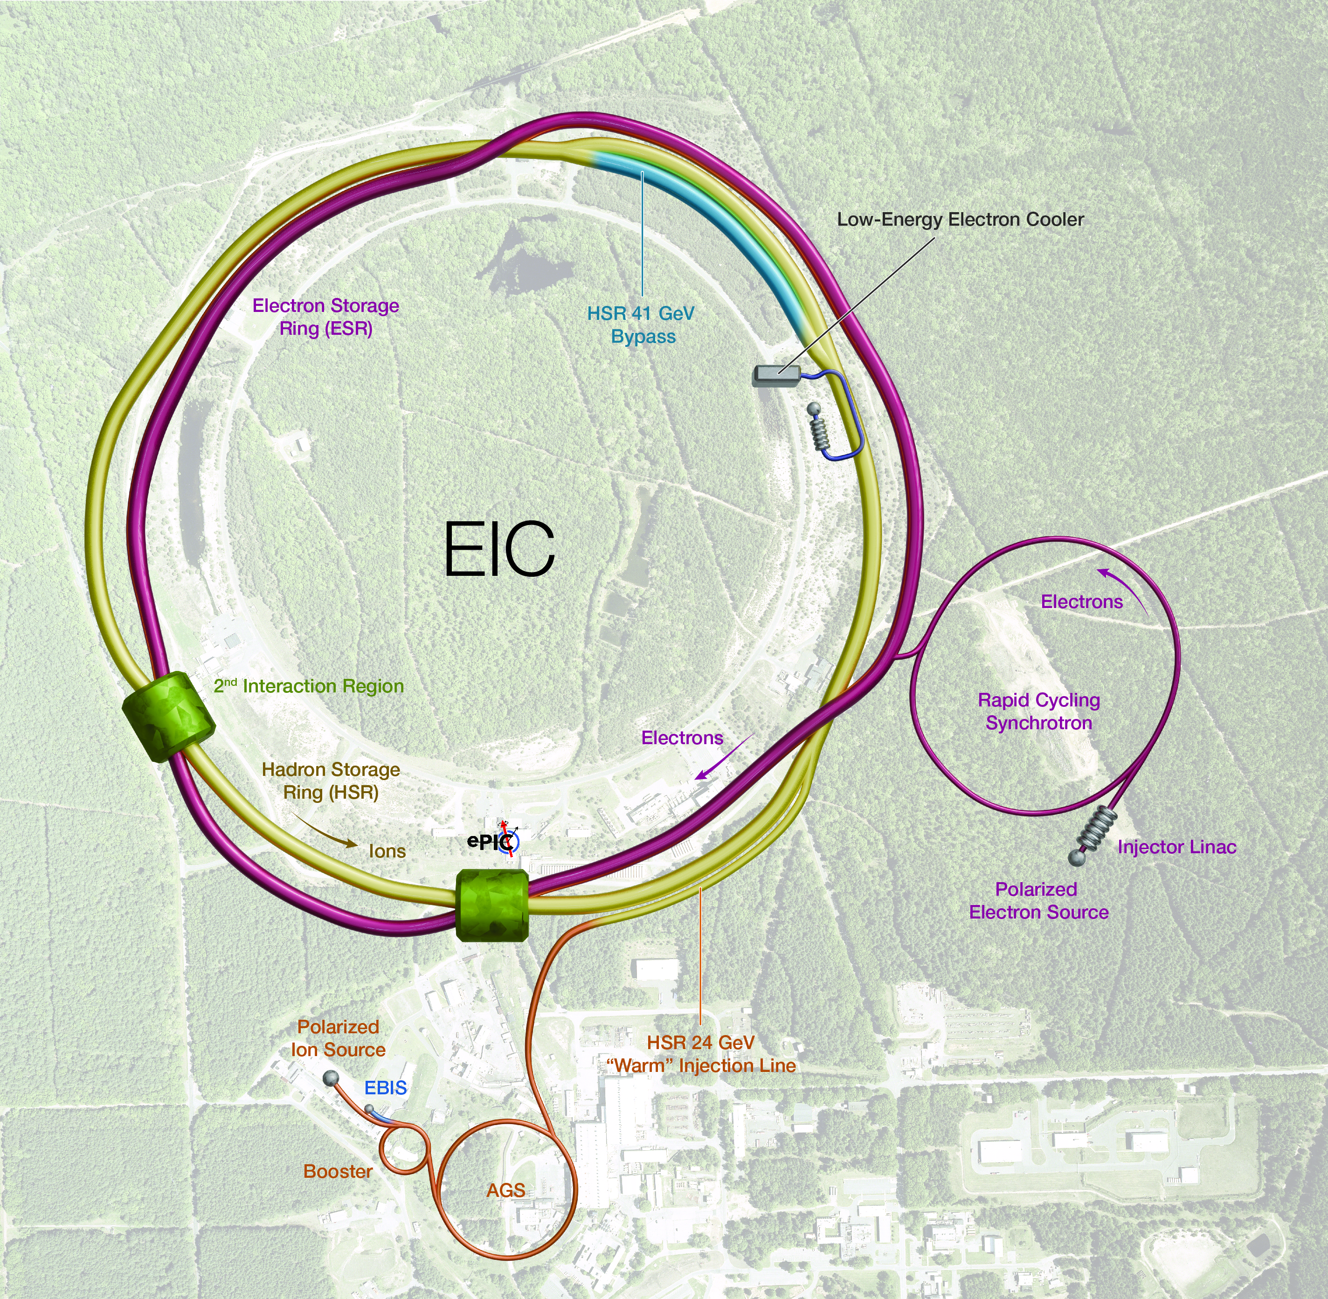
Asset-Oriented Hierarchy of Subprojects – Elevator Speech
SP0: global – work performed to date, CD-3A, CD-3B, Project Office, etc. (also includes pre-ops)
SP1: accelerator rings – all scope that if one adds an interaction region insert provides hadron beams and if one also adds an electron injector allows collisions.
SP2: integrated interaction region section – scope that includes section with IR magnets (SP2A) and the ePIC detector (SP2B).
SP3: electron injector – scope that delivers 5-10 GeV electron beams to the electron storage ring and allows a non-invasive 18 GeV enhancement; completion allows start of EIC science during commissioning.
SP4: full capability – scope that delivers mission need and allows full execution of the NSAC/NAS science.
  RF modules (18 GeV, E_{CM} ~ 140 GeV), RF power (18 GeV, lumi), 41 GeV bypass (E_{CM} ~ 30 GeV), etc.
EIC scope interface
(slide from 5/2 Project News presentation)

Slide 11
Slide from Jim Yeck: EIC Project Priorities for 2025 and 2026
Priorities for 2025 include:
  Execute the CD-3A and CD-3B procurements.
  Prepare plans for addressing the “portfolio” of project dependencies including the Removal and Repurposing (R&R) of RHIC facilities (IP6 prepared for ePIC).
  Define subprojects and prepare a CD-2 quality performance baseline for the entire project (all subprojects).
  Conduct reviews to assess status of CD-2 preparation for each subproject and prepare the collider subproject for DOE approvals in 2026.
RHIC will run through December 2025 and the R&R work will immediately proceed.
Complete the DOE reviews needed to start EIC construction in 2026 with the approval of the collider subproject. Detector should be baseline ready.
(slide from 5/2 Project News presentation)

Slide 12
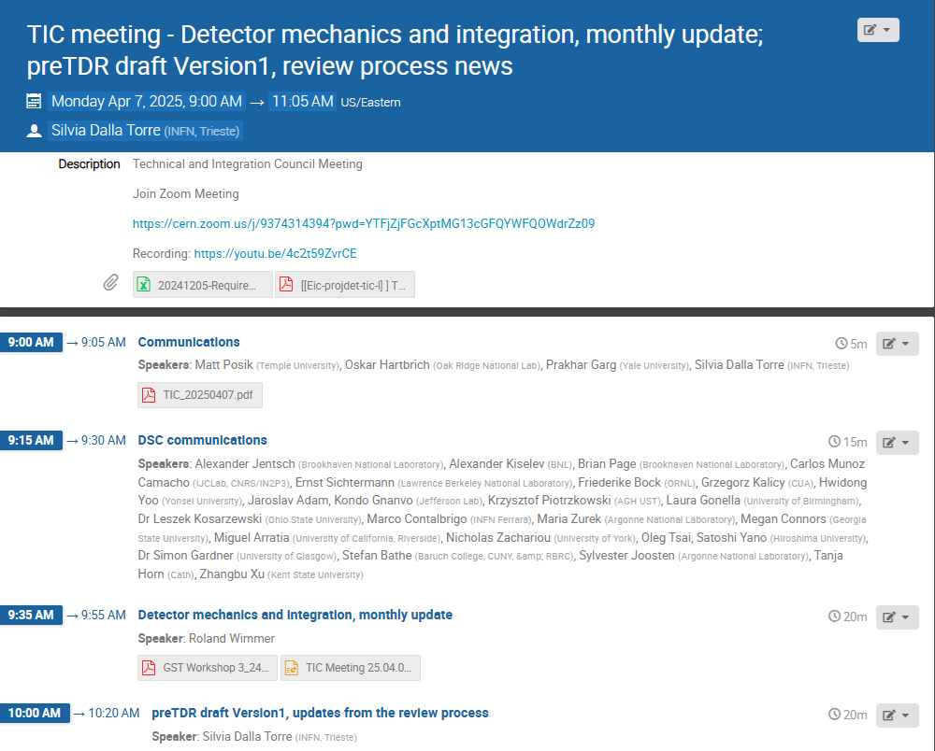
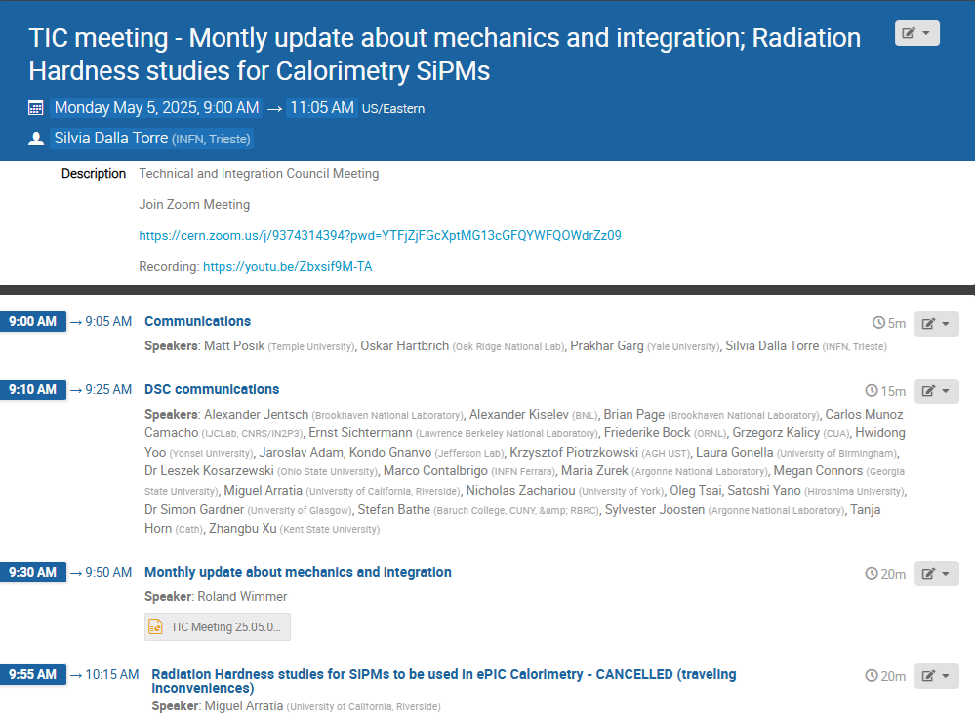
News from the TC Office
Monthly updates
from EIC Project
Engineers:
  Apr. 7th, May 5th
GST Workshop
Cradle Update
Services
Reuse, SOW’s
Vault for ePIC

Slide 13
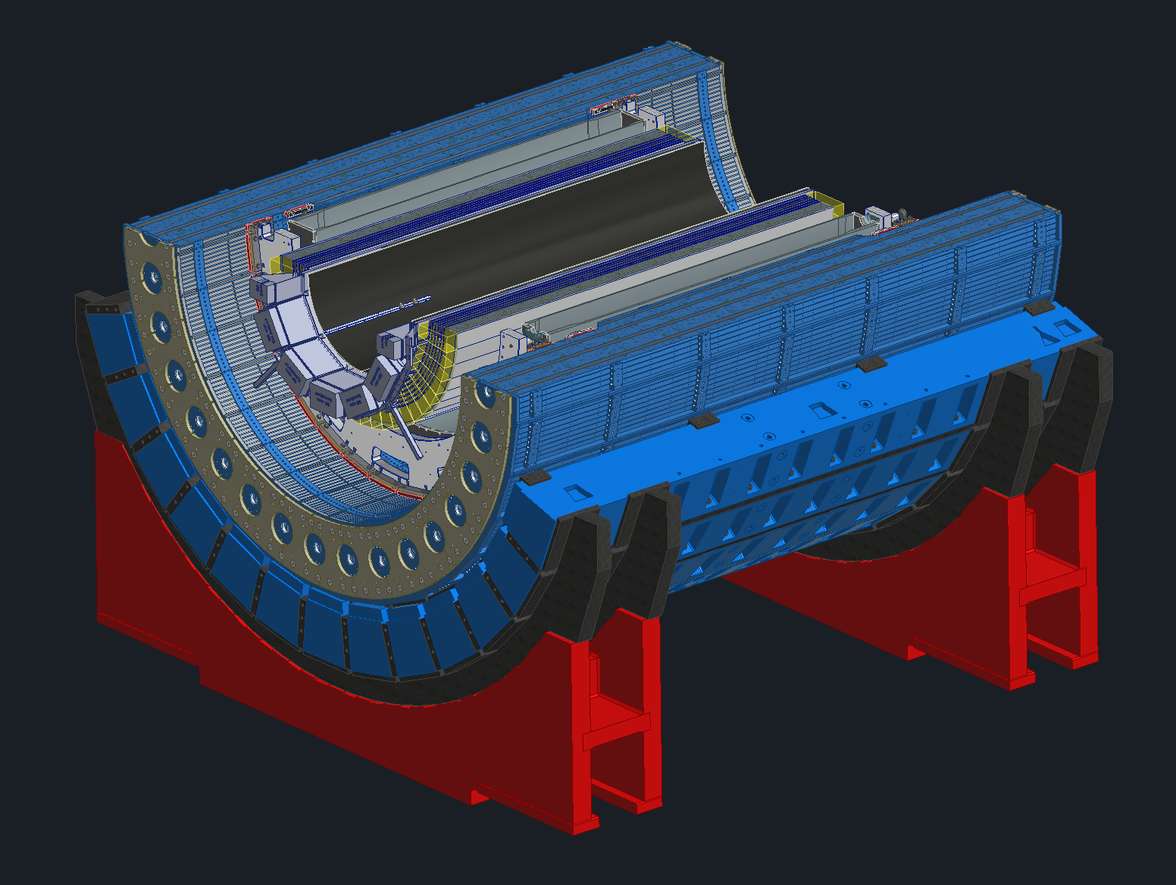
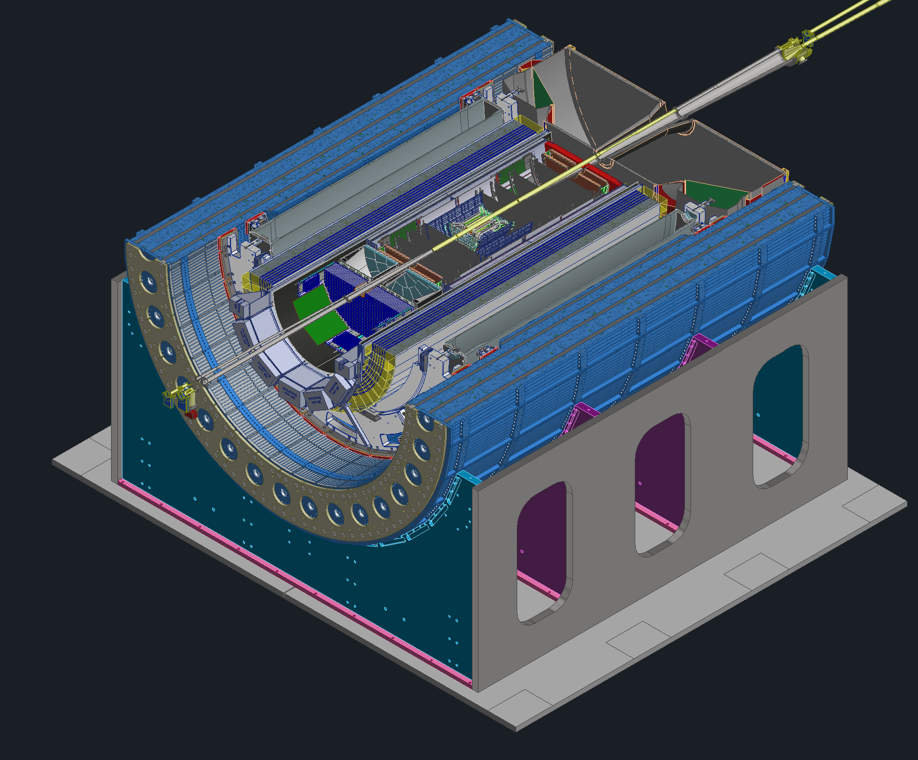
Cradle Updates
OLD
New proposed cradle design
Planning on reusing the sPHENIX support webs (shown in purple and teal)
Will use new base, the old sPHENIX base wont work with our track setup
New design pros
  Incorporating 8mrad rotation will be much easier
  Much less weight due to less steel
  Magnet group had concerns about too much steel on the bottom of the detector
NEW
(slide from 4/7 Integration presentation)

Slide 14
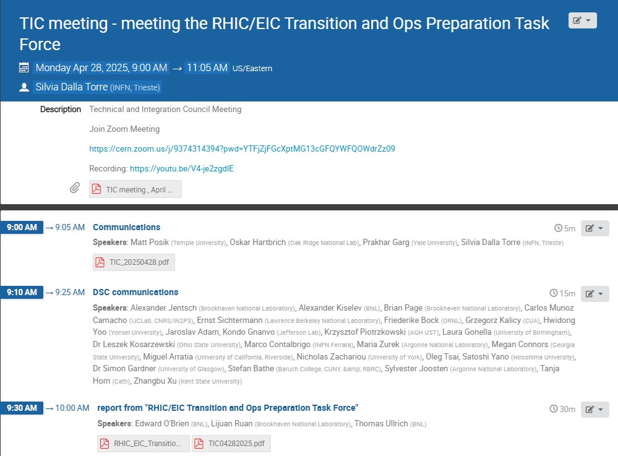
RHIC/EIC Transition and OPS Preparation Task Force
Meeting with Ed O’Brien,
Lijuan Ruan and Thomas
Ullrich April 28th
Goals:
  Providing support for the EIC project
  and the ePIC experiment
  Assisting the ALD in developing a plan
  for off-project dependencies
  The charge covers a wide range of topics
  implying interactions multiple entities,
  including lab management, the EIC
  project and the ePIC Collaboration

Slide 15
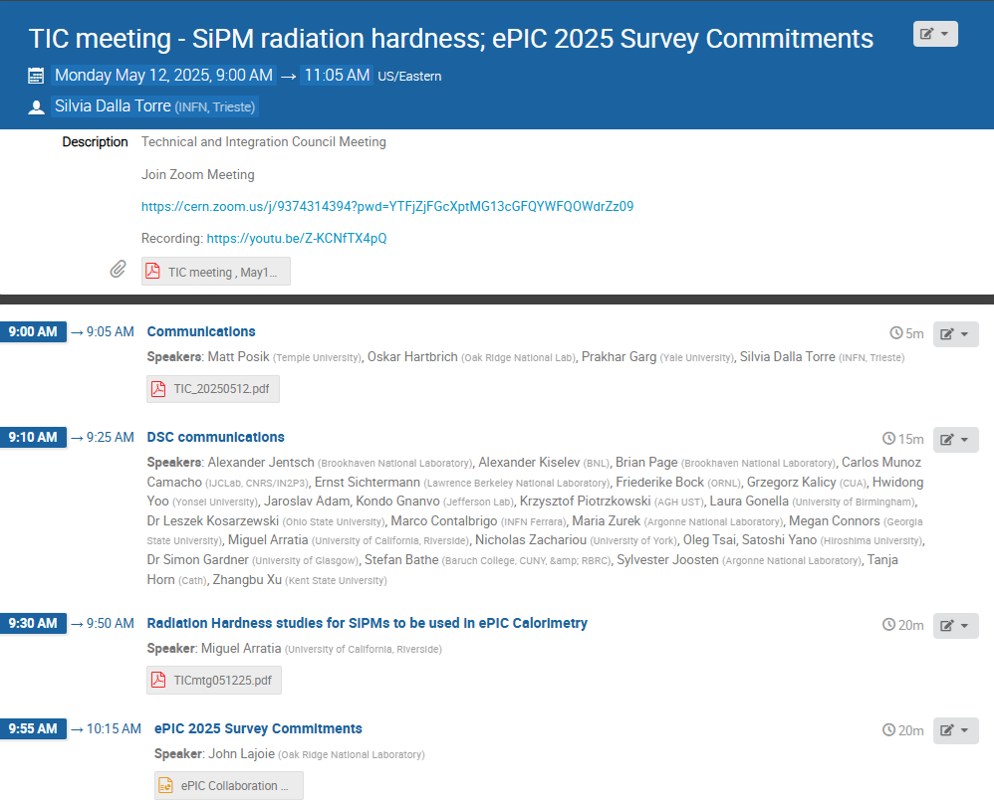
SiPM Radiation Hardness Studies – May 12th
Summary report of the irradiation campaign
Irradiation campaigns and thermal annealing exercises with attention to the dark count rates
All types of SiPMs foreseen in ePIC calorimeters have been studied.
Data available in Zenodo
Request to check also the possible variation of PDE (photon detection efficiency)
From irradiation studies to simulation of ePIC calorimetry performance
  A dedicated workfest at the Summer ePIC meeting?

Slide 16
Other Detector-Related Meetings
In the last weeks:
  Cherenkov PID PDR : April 1-2, 2025
  4th BIC In-person Workshop : April 9-11, 2025
  ePIC R&D Day : April 16-17, 2025
Coming soon:
  TIC Meeting May 19th: QA and QC, Common scenarios to be adopted for luminosity, radiation doses, background assumptions for the preTDR
  DAC review : June 11-13th, 2025
  Calorimetry Workshop : first week of June, 2025
  SVT Summer Workfest July 9–11, 2025

Slide 17
Internal Review of preTDR v1 (Chapter 8)
The Reviewing process of the preTDR draft Version1 is largely completed
  e-mail to DSLs on April 25th
Goal of the review: provide indication and guidance for the next (hopefully last) preTDR draft Version2 due by July 11th, 2025 (before the Summer ePIC Collaboration meeting)
Outcome of the review:
  Global Prescriptions for all DSCs
    Direct link: General Perscriptions - Google Drive
  Specific comments for each DSC in the repository:
    pre-TDR_TC_Comments - Google Drive
    Please, answer to each point addressed in the review by adding your feedback directly in the files

Slide 18
preTDR 2025 Timeline
Version 1 (chapter 8) reviewed by TC-Office, specific comments and suggestions to DSC’s made available on April 25th
Version 1 (chapter 2) comments and suggestions to PWG’s by SP-Office
Version 2 due by July 11th (Collaboration Meeting)
  Version 2 internal/external review Aug-Oct.
  Comments tracked and feedback given to reviewers
Editorial Board formed by end of July
  Silvia co-chair, 3-5 additional people
  Board is responsible for overseeing Version 2 review process
  Board is responsible for final editing pass (typos, language, consistency)
preTDR Version 2.1 by early December 2025

Slide 19
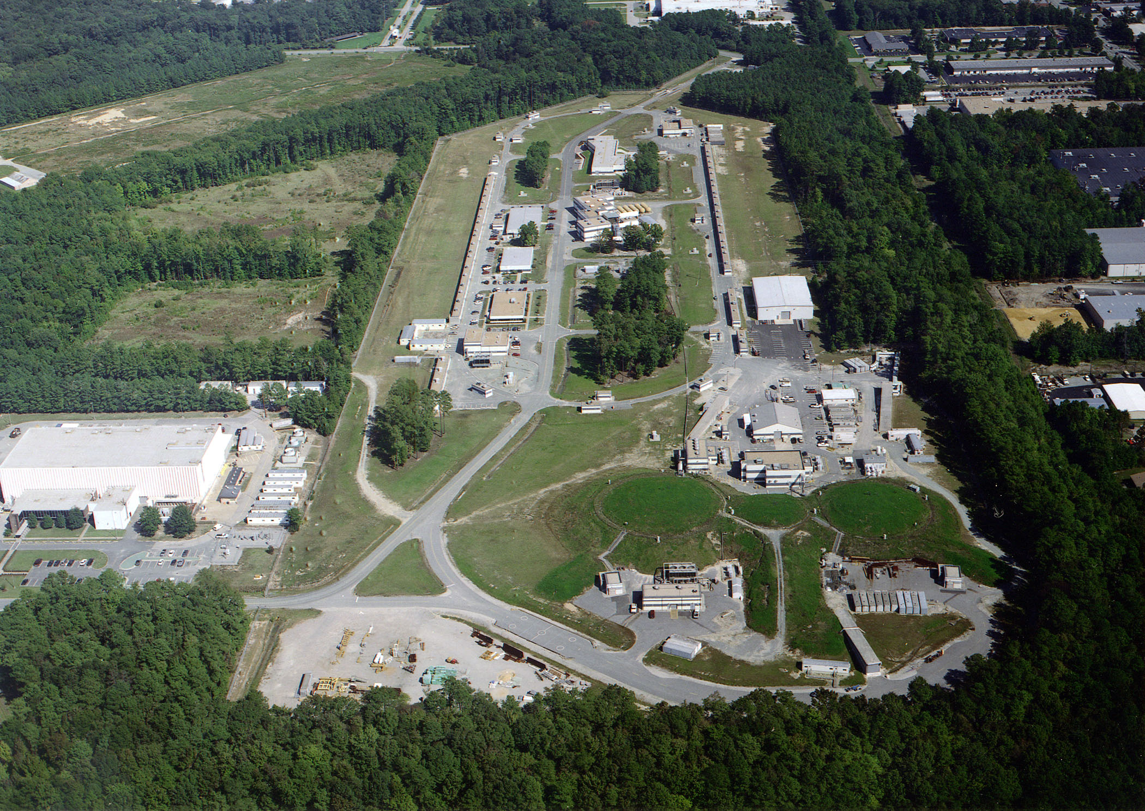
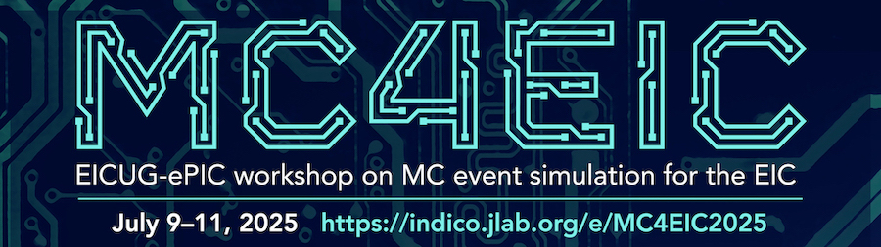
Summer 2025 EICUG/ePIC Collaboration Meeting
July 14-18th at JLab
  $350 in-person (includes lunches)
EICUG Early Career Workshop
July 11-13th
Registration is now open:
https://indico.jlab.org/event/934/
Detailed agenda and call work workfests coming soon
NOTE: Collaboration Meeting follows
MC4EIC July 9-11th
https://indico.jlab.org/event/930/

Slide 20
July 2025 Meeting Block Schedule
Early Career Workshop
Summer 2025 Joint EICUG/ePIC Collaboration Meeting
 | F July 11th | S | S | M July 14th | T | W | Th | F
Morning Sessions | Last part of MC4EIC | 2nd Session | 4th Session | Joint ePIC/ EICUG Plenary | Parallel/ Workfests | Parallel/ Workfests | ePIC CC Meeting | ePIC Closing Plenary
Lunch | Not Provided | Provided | Not Provided | Provided | Provided | Provided | Provided | Not Provided
Afternoon Sessions | 1st Session | 3rd Session | ( free ) | Accelerator/ JLab physics talks | EICUG/ Awards | Parallel/ Workfests | Parallel/ Workfests | ( free )
Goal is to integrate the EICUG/ePIC sessions as much as makes sense, make the agenda accessible to JLab users.

Slide 21
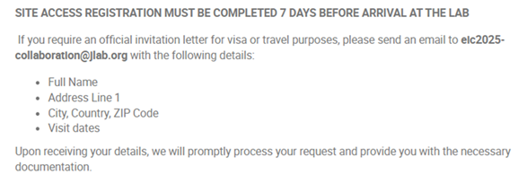
Collaboration Meeting Notes:
Govt. rate ($110/day) at the nearby Marriot for all conference attendees:
  Accommodations
There are some rooms at the JLab residence facility blocked that people can share (approx. half Marriot rate).
  Residence Facility
This meeting at a national lab - please note a REAL ID or passport will be required for visiting the lab.
Apply for site access at least 7 days prior to arrival:
  Apply for Site Access
Invitation letters available on request
Many thanks to Doug Higinbotham!

Slide 22
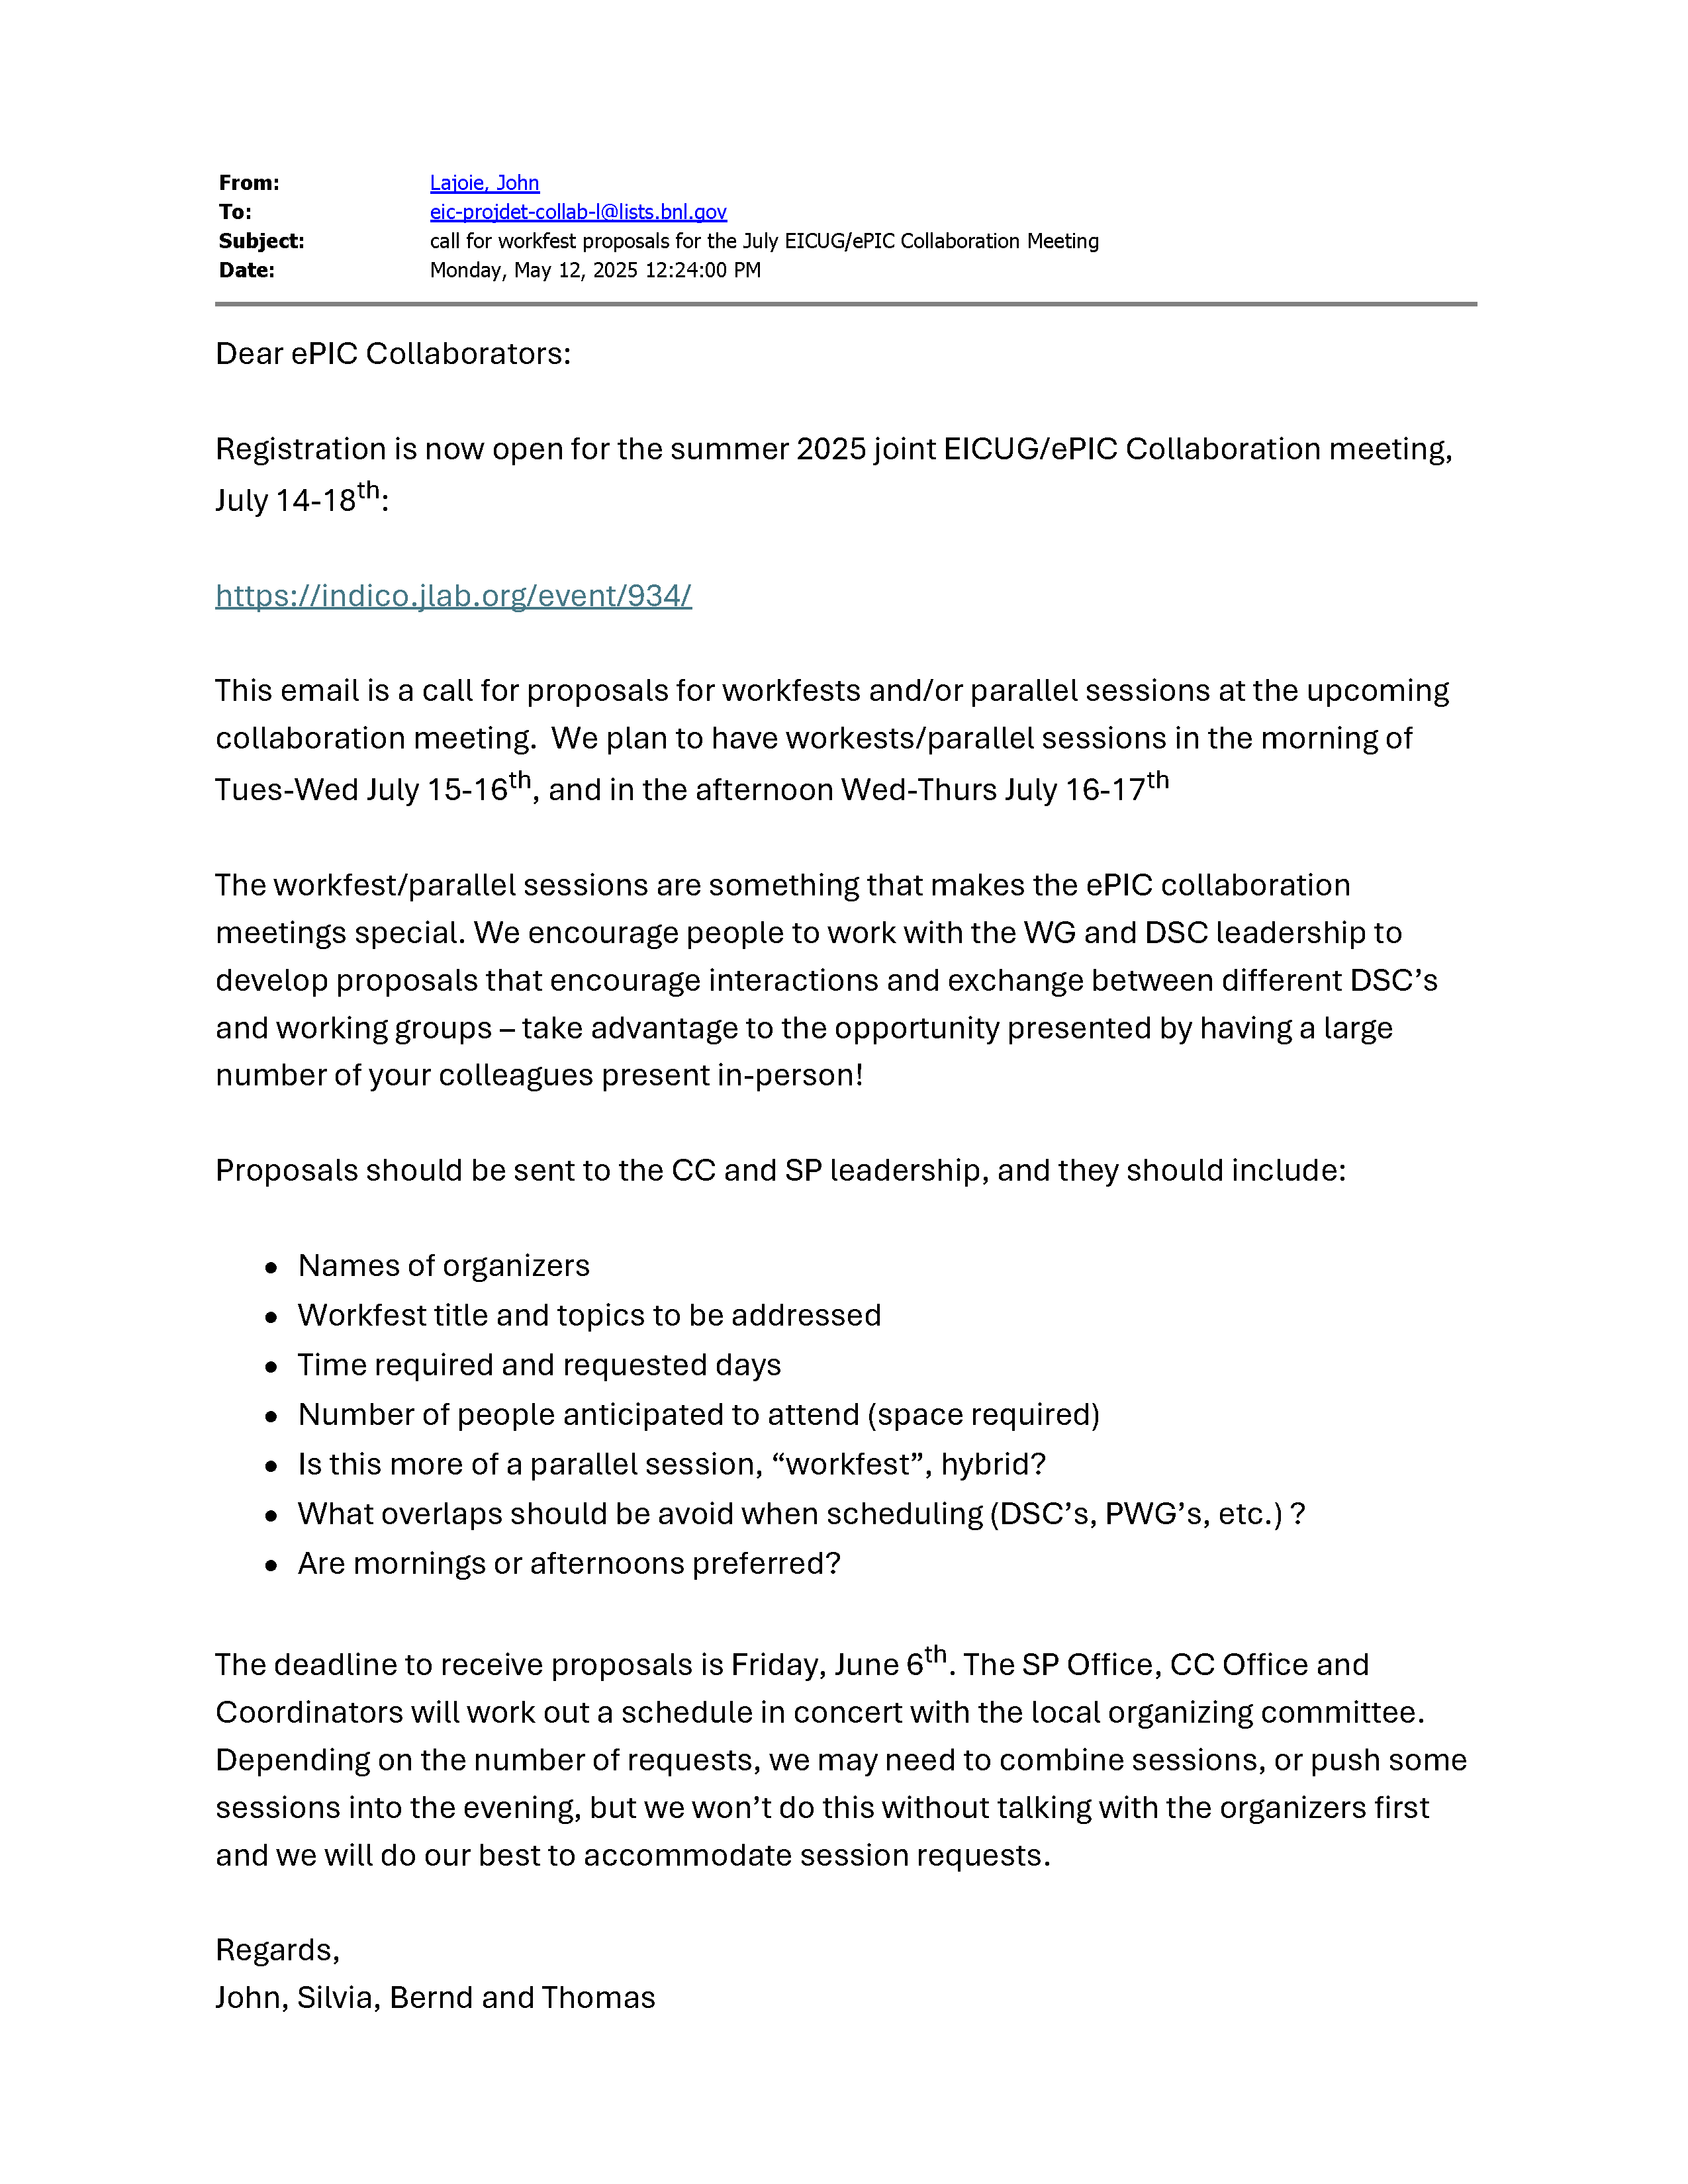
Call for Workfest
Proposals
Email to collaboration 5/12:
  Emphasis on cross-cutting activities that address high priority issues in ePIC
Proposals due June 6th

Slide 23
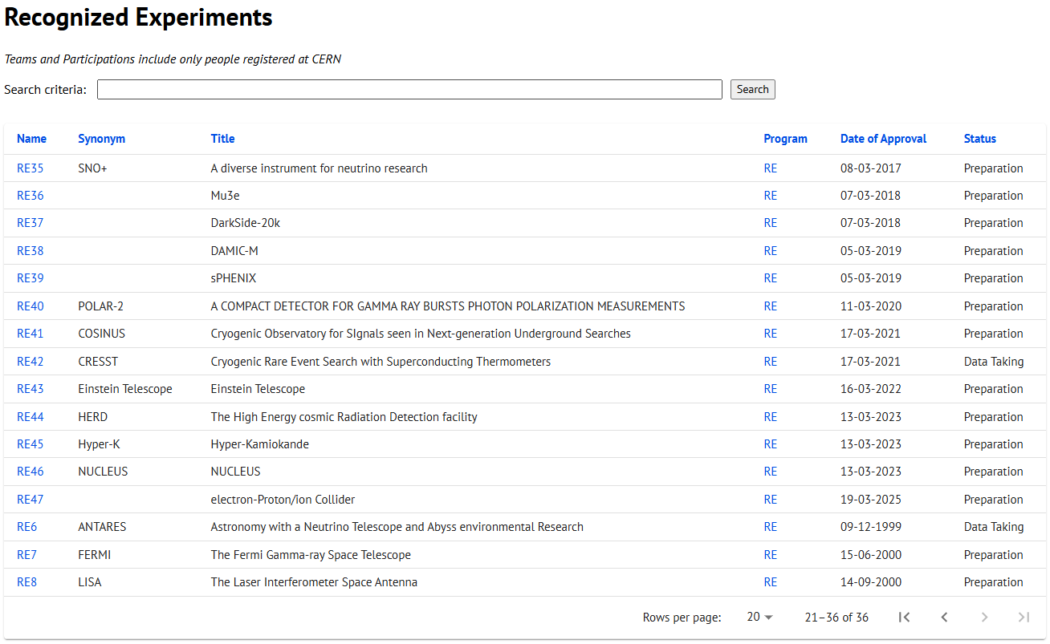
CERN Recognized Experiment Status: RE47
ePIC now appears in the CERN Grey Book database as RE47:
https://greybook.cern.ch/experiment/recognized
Two steps to get ePIC Collaborators registered at CERN:
CC Representative needs to register as team leader with
CERN Users Office:
  https://usersoffice.web.cern.ch/
  https://usersoffice.web.cern.ch/team-leaders-corner
  Users.Office@cern.ch
CC member can then certify registrations of team members
Contact us if you run into problems!

Slide 24
Results from 2025 Survey
Working with Peter Steinberg to convert commitments to an Excel spreadsheet/pivot table
  Name/Institution/Interest (no FTE)
  Useful to identify workforce in the collaboration that is not optimally engaged
Made available to DSL’s, Conveners and Coordinators
  Presentation at May 12th TIC meeting

Slide 25
Projections from 2025 Survey
GUIDANCE FOR INFORMATION TO BE FILLED IN THE TABLE
Fill the table with total workforce that you plan to dedicate to ePIC - expressed in FTE - of the nine different personnel types. Do not include personnel paid by EIC/ePIC R&D, PED or construction funds. The information requested is for any effort on behalf of the ePIC Collaboration, not just construction of ePIC.
Also please identify the two main areas of efforts of your group contributing to ePIC for each year. We expect this will evolve year to year, and we also understand that most groups do not have firm plans past the next few years.
For the purposes of this survey, please assume a constant total level of effort for your group, across all activities (both ePIC and non-ePIC), for the time period of the projection. Assume that there are no increases in students, postdocs or faculty working on ePIC due to new positions, but only redirection of effort from other group activities that may be winding down. In this way the overall effort on ePIC may increase over time, as workforce is redirected from other projects.
For purposes of this survey assume that the first physics run of ePIC is in 2034.
In addition to commitments for 2025, also requested projections for how collaborations might see the evolution of their engagement in ePIC
~70% of institutions responded
  Same fraction US/international

Slide 26
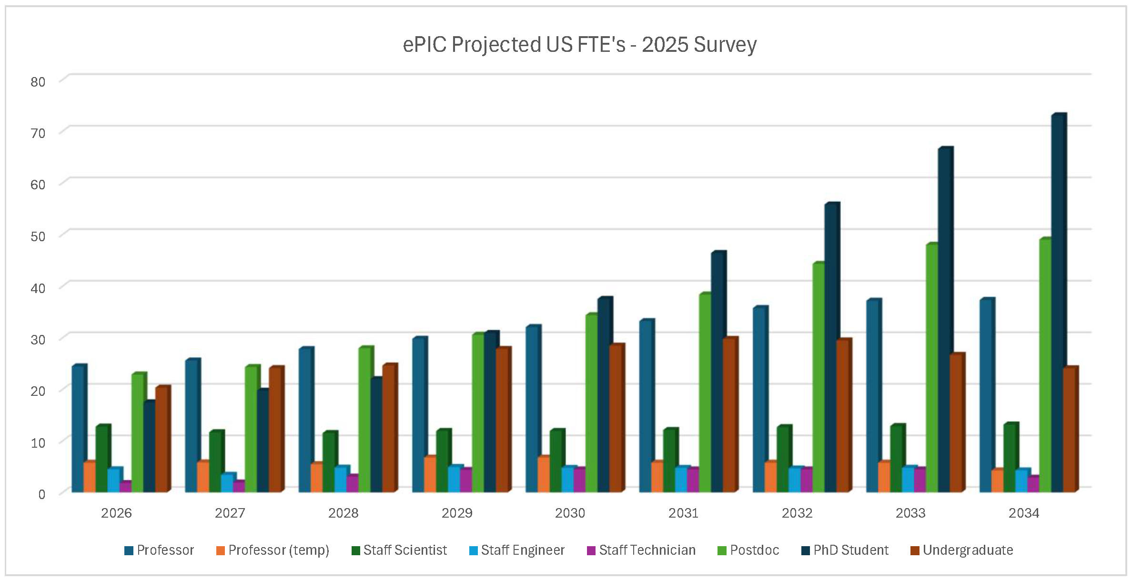
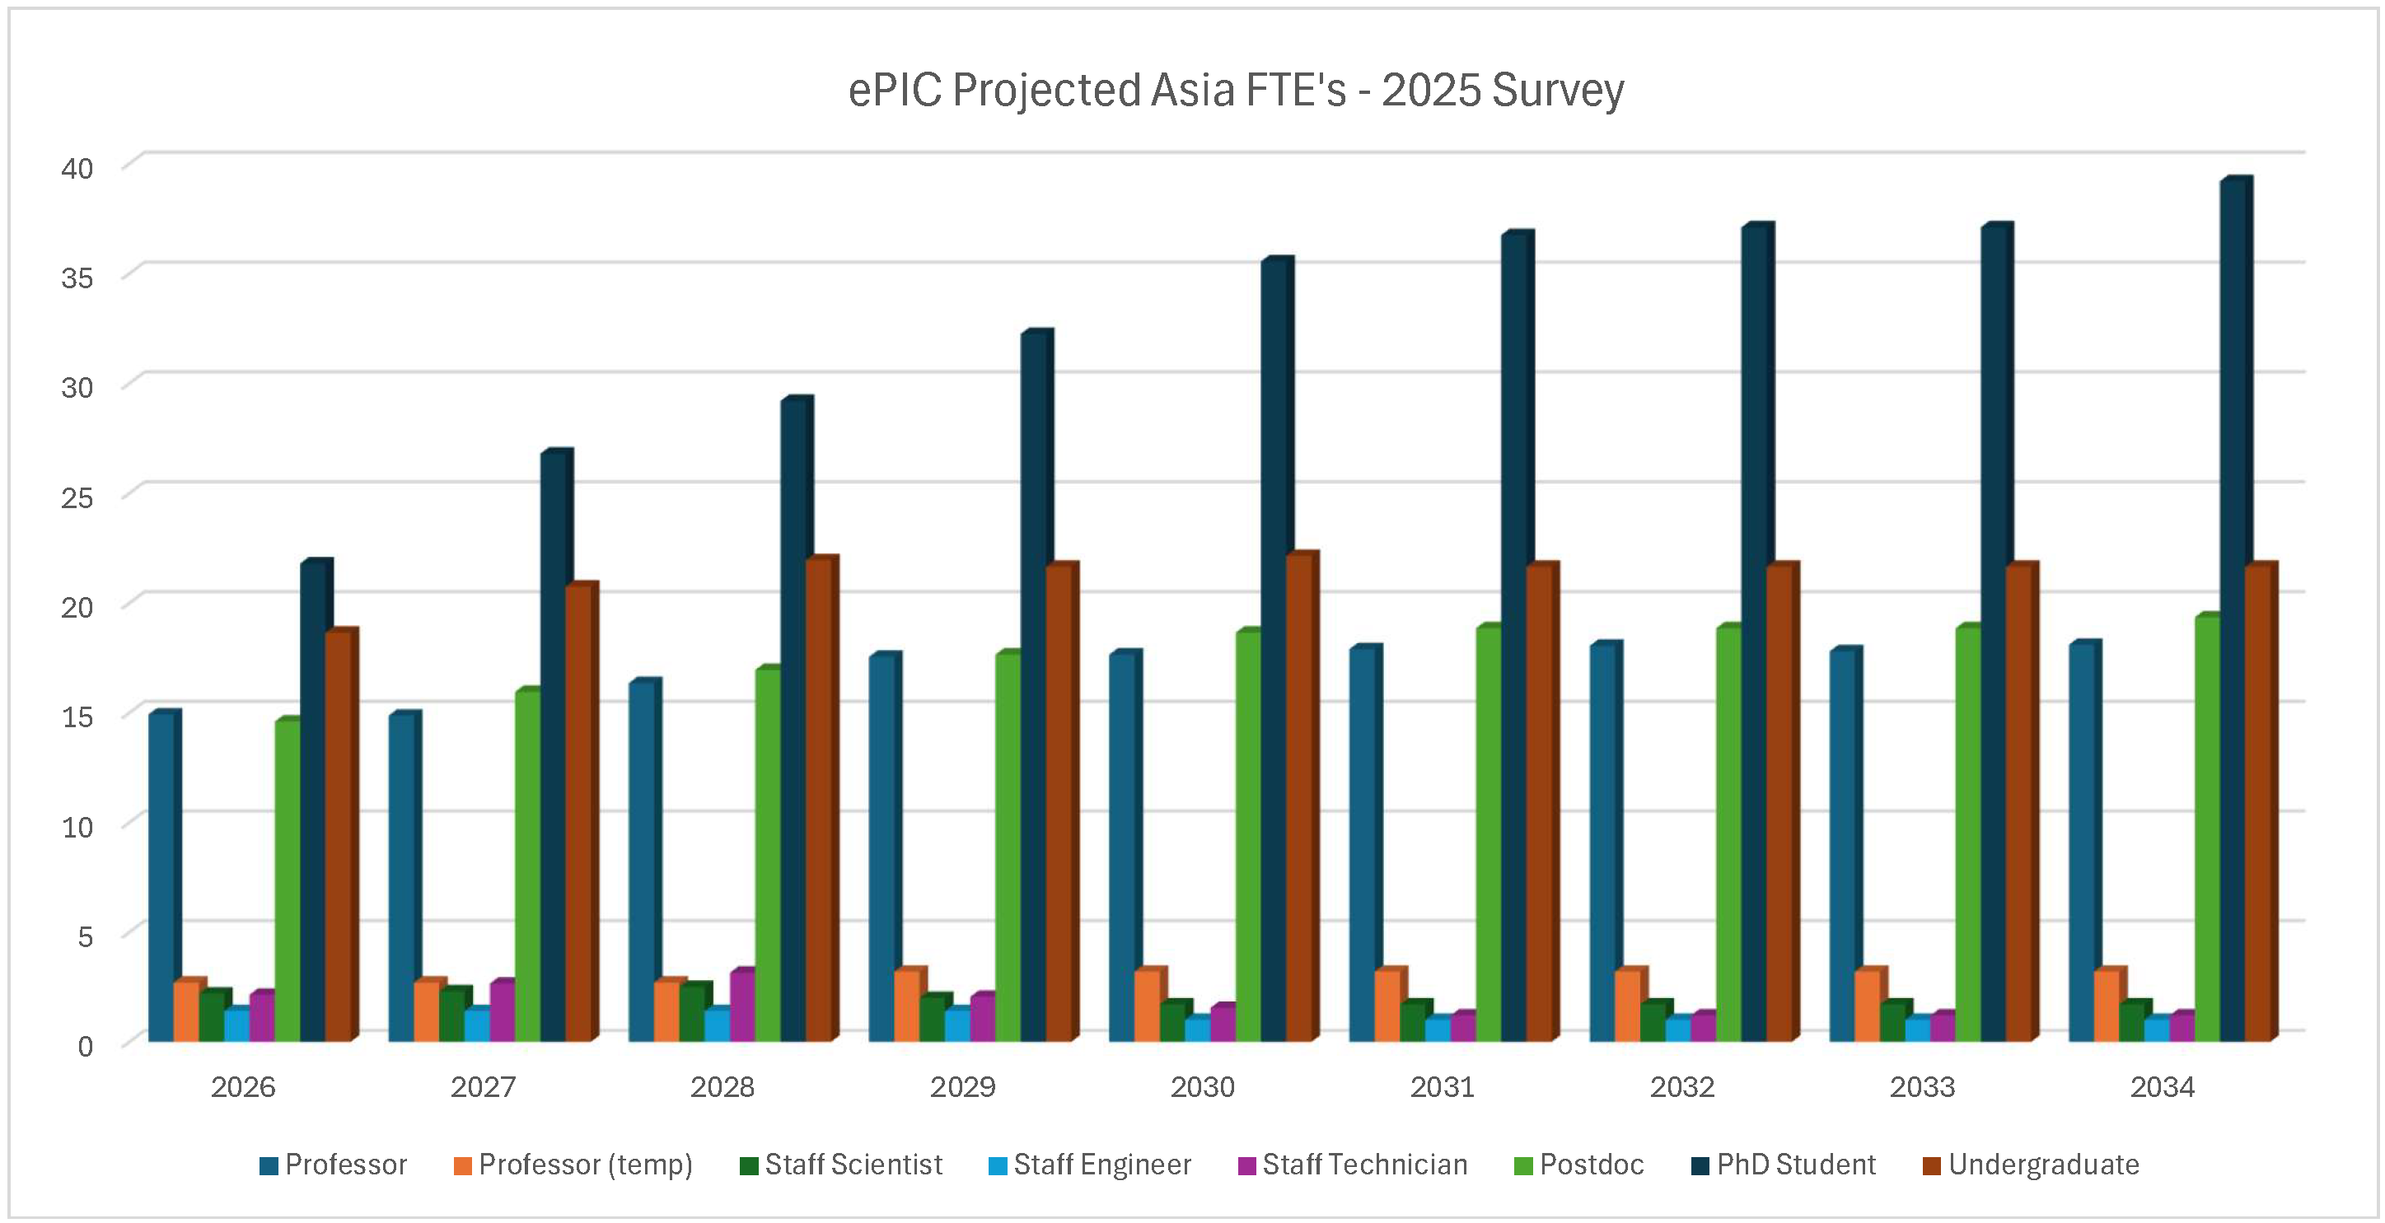
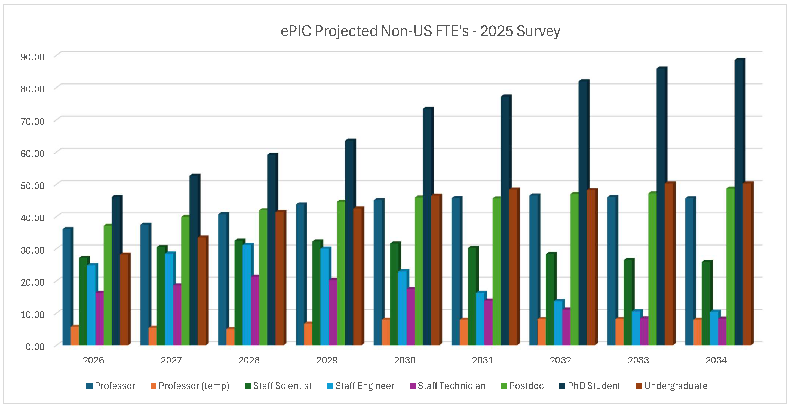
Projections Results from 2025 Survey
Both US and international institutions project the effort will scale up as we move into construction, especially students and postdocs, although there are differences in details.
Project to more than double the number of PhD’s on ePIC by the time we are taking data.
This information can be useful as we discuss ramping up support for the collaboration.

Slide 27
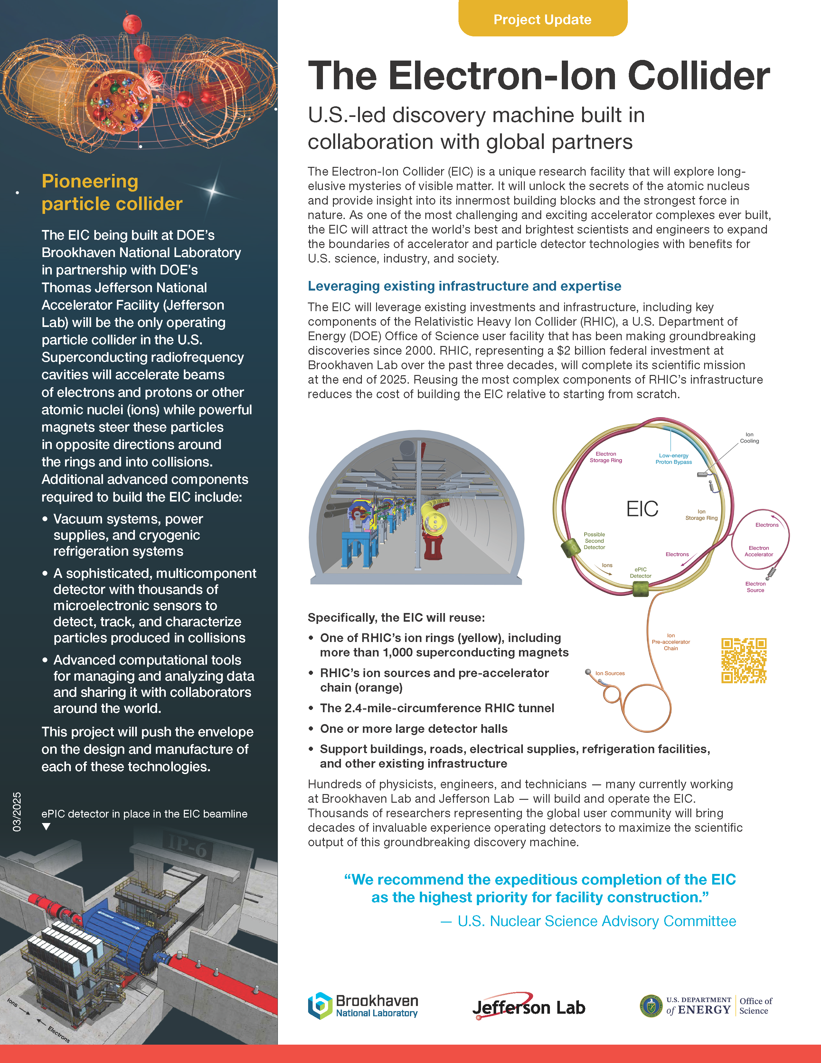
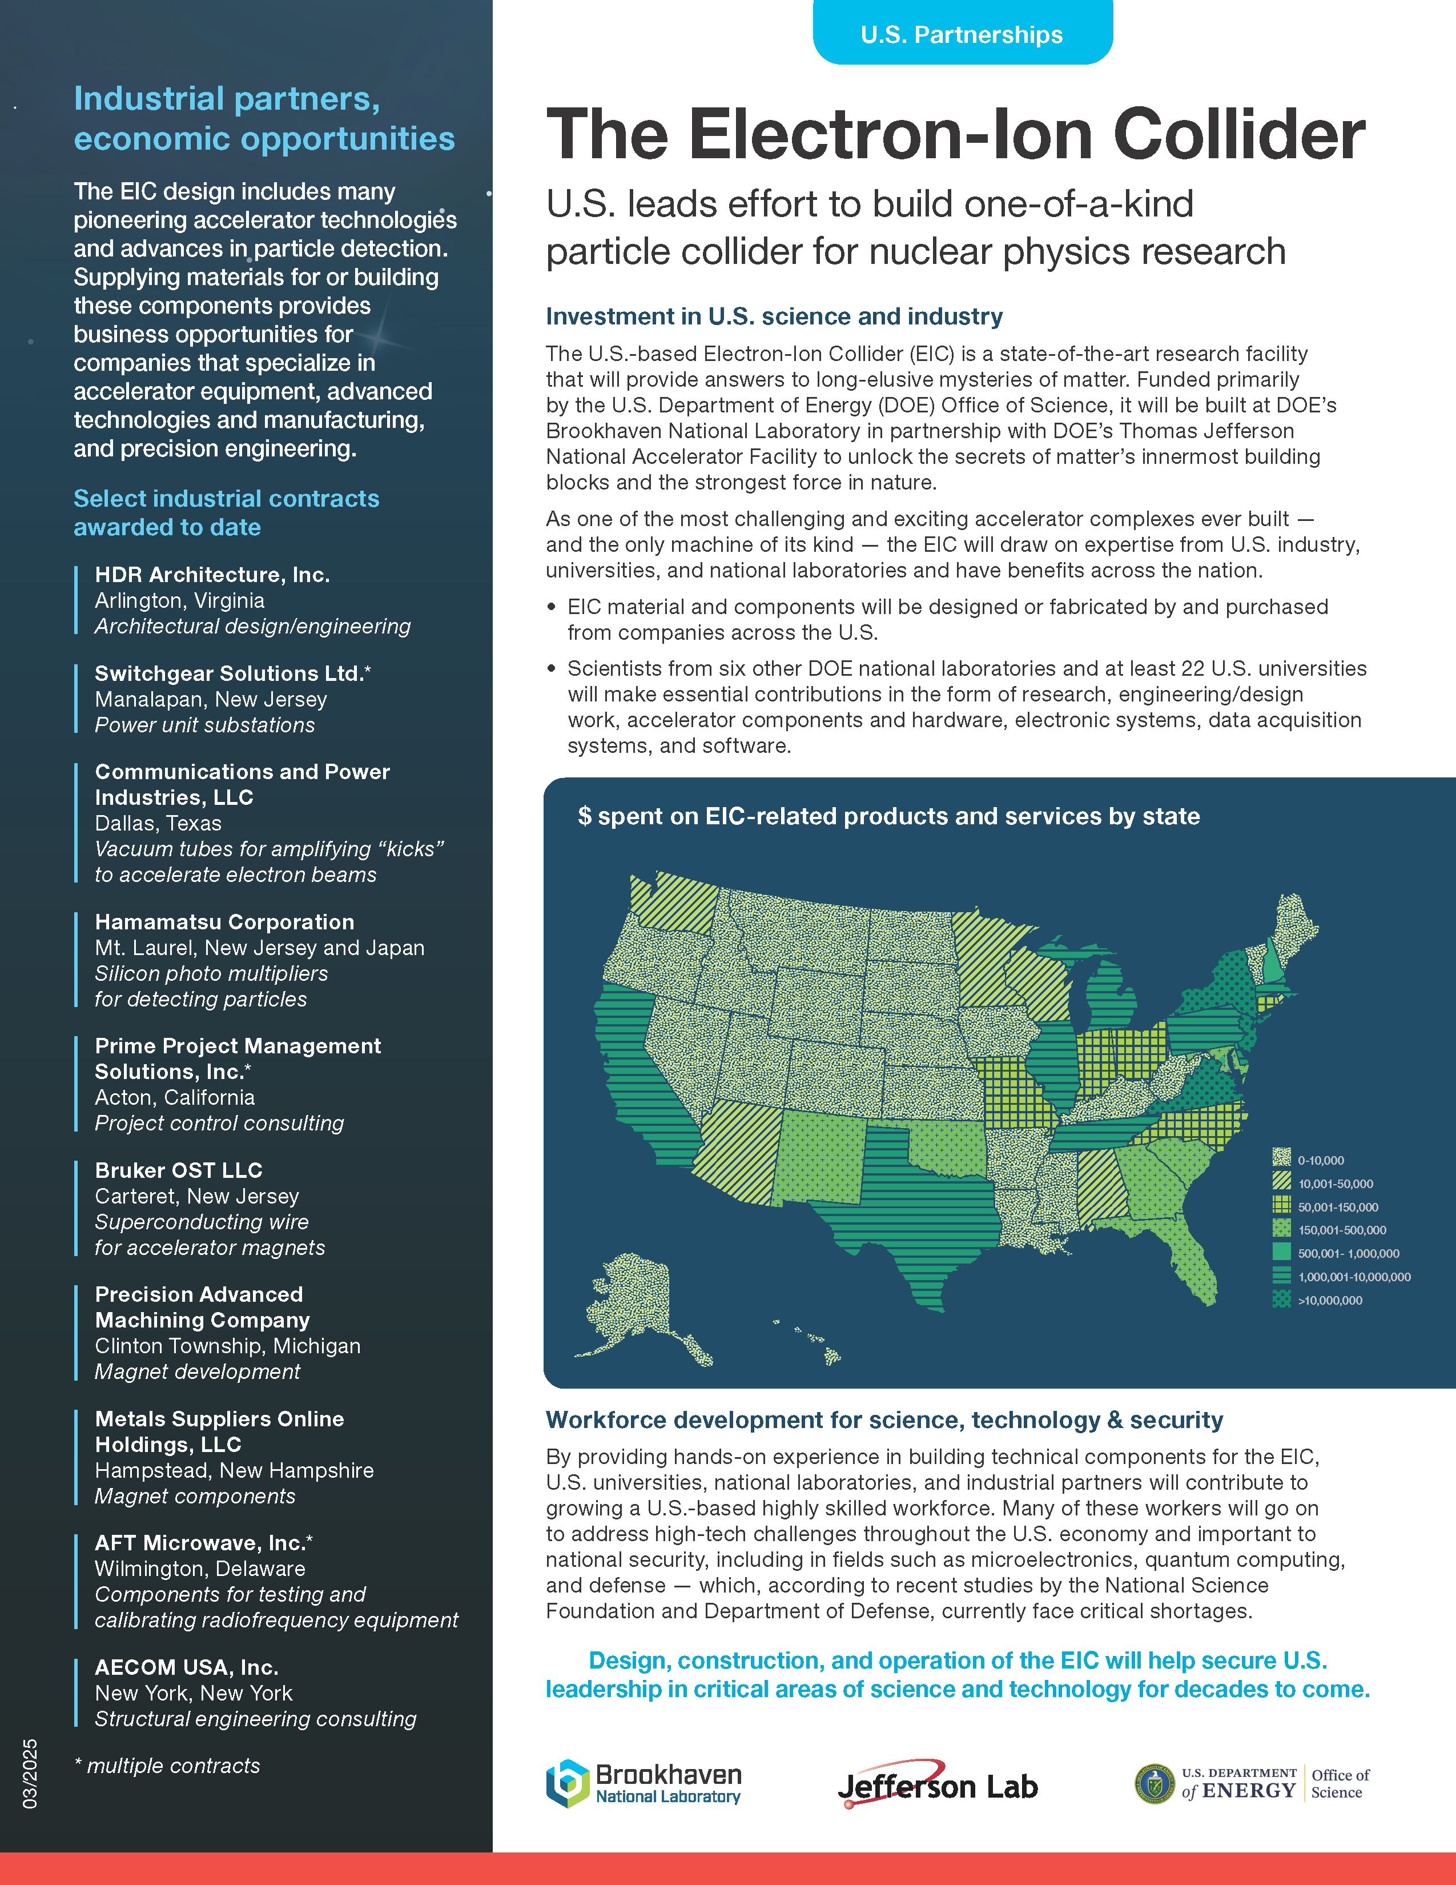
Communicating about the EIC
New material available from EIC project and BNL Public Affairs
https://www.bnl.gov/eic/science.php
Very useful when
discussing EIC/ePIC

Slide 28
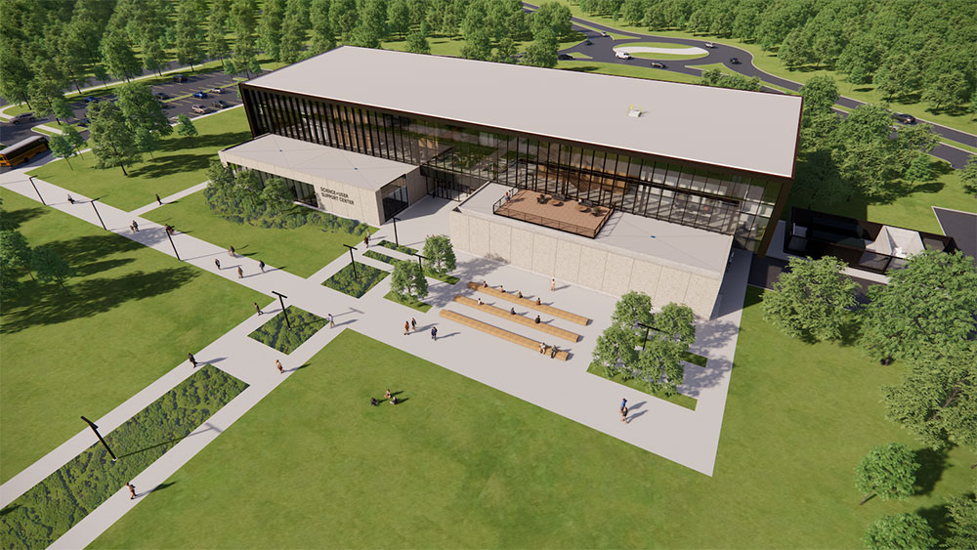
BNL SUSC Now Open!
New Science and User Support Center (SUSC, Bldg. 101) opened on Thursday, May 1.
Staff in Badging, Housing, and the Guest, User & Visitor Center are now working in SUSC.

Slide 29

Parting Messages
CC Meeting end of May / beginning of June
Next General Meeting – May 30th 10:30AM ET
EIC RRB June 5-6th Prague
Despite uncertain times, the best thing we
can do is keep moving ePIC forward so
we can demonstrate our readiness for
construction start!

Slide 30


Slide 31
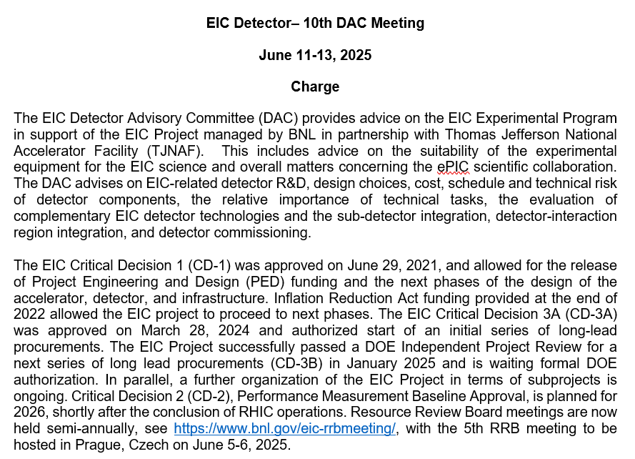
10th DAC Meeting Charge

Slide 32
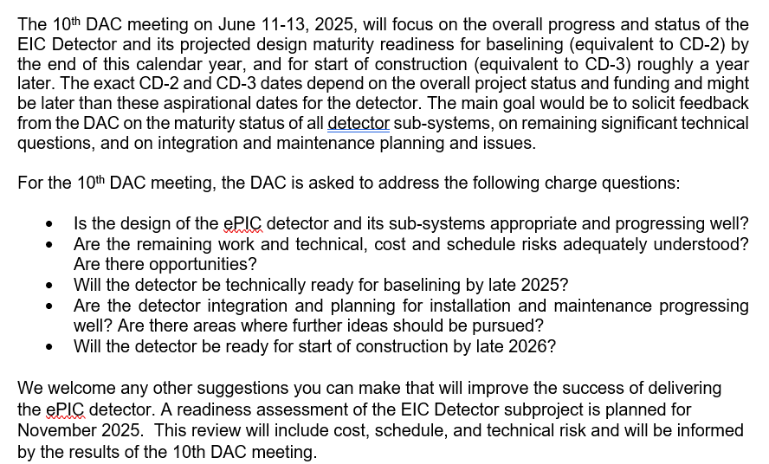
10th DAC Meeting Charge

Slide 33
Detector Reviews planned for 2025 (all Reviews for 2024 completed)
Preliminary Design Reviews (60% design maturity equivalent, called PDR, PDR2 or PDR3, pending the subsystem)
  PDR: MPGD Tracking Detectors (6.10.03.02) – Summer/Fall 2025 – Note: FDR only after completion of first engineering test articles
  PDR2: Silicon Tracking Detectors (6.10.03.01) – Fall 2025 – TBD, pending early results of ITS3 ER2
  PDR2: Cherenkov-based Particle Identification Detectors (6.10.04; pfRICH, hpDIRC, dRICH) – April 1-2, 2025
  PDR2: AC-LGAD-based Particle Identification Detectors (6.10.04; BTOF, FTOF, common systems) – Fall 2025
  PDR3: Barrel EM Cal (6.10.05.02) – ~August 2025
  PDR2: Backward HCAL (6.10.06.01) – ~September 2025
  PDR: Magnet Cryogenics and infrastructure (6.10.07) – September/October 2025
  PDR3: Electronics/DAQ-computing (6.10.08. 6.10.09.01) – Late August 2025 – this does not include slow controls
  PDR: DAQ-Slow Controls (6.10.09.02) – November/December 2025 – Later to ensure integration DAQ in the collider common platform
  PDR: Integration, Infrastructure and Installation (6.10.10) – September/October – everything outside GST, includes cradle, HCAL, etc.
  PDR: Integration, Infrastructure and Installation (6.10.10) – November/December 2025 – everything inside GST
  PDR3: IR Integration and Auxiliary Detectors (6.10.11) – November/December 2025 – includes 6.10.14 lumi detector
  PDR2: Polarimetry (6.10.014) – September/October 2025 → January/February 2025
Final Design Reviews (FDR):
  FDR: Final Design Review of the BABAR DIRC Bar Refurbishment for the High Performance DIRC Particle Identification Detector – April 1, 2025
  FDR: Backward & Forward EM Calorimetry, Barrel & Forward HCAL (6.10.05.01; 6.10.05.03; 6.10.06.02; 6.10.06.03) – ~July 2025
Project Reviews:
  DOE OPA CD-3B Review – January 7-9, 2025
  “Red Team” Review (acts as Director’s Review for DOE OPA Focused Status Review) – May 20-21, 2025
  DOE OPA Focused Status Review – August 5-7, 2025
Other Meetings:
  Detector R&D Day hosted by ePIC and EIC Project – April 16-17, 2025
  DAC Meeting – Comprehensive look to design status and readiness for CD-2. June 11-13, 2025.
  5th RRB Meeting: June 5-6, 2025 – Prague, Czech
  EIC International Computing Organization (EICO) – April 2–4, 2025 @BNL
  Technical interchange meeting with EIC Computing and Software Advisory Committee (ECSAC) – May 12, 2025 - https://indico.bnl.gov/event/27425/
  6th RRB Meeting: November 4-5, 2025 - BNL

Slide 34
Past 2025 Reviews/Meetings and Upcoming Meetings
Past:
DOE/OPA CD-3B and Status Review – January 7-9, 2025
Jan 2025 ePIC Collaboration Meeting – January 20-24, 2025
Magnet In-Kind Follow-Up w/ INFN and CEA – January 31
EIC, RIKEN, U-Tokyo Collaboration Meeting – February 3
PDR2: Cherenkov-based Particle Identification Detectors (6.10.04; pfRICH, hpDIRC, dRICH) – April 1-2
  Includes FDR of the BABAR DIRC Bar Refurbishment for the High Performance DIRC Particle Identification Detector
EIC International Computing Organization (EICO) meeting – April 2-4 @ BNL
ePIC/EIC Project Detector R&D Day – April 16-17 (two half days, from 10 am to 1 pm)
  Indico link: https://indico.bnl.gov/event/27200/
Upcoming:
Technical interchange meeting with EIC Computing and Software Advisory Committee (ECSAC) – May 12 (remote) - https://indico.bnl.gov/event/27425/
“Red Team” Review (acts as Director’s Review for OPA Focused Status Review) – May 20-21 @ BNL
5th Resource Review Board meeting – June 5-6 in Prague, Czech – see https://www.bnl.gov/eic-rrbmeeting/
10th Detector Advisory Committee meeting – June 11-13 (remote) - https://indico.bnl.gov/event/26584/
MC4EIC workshop – July 9–11 @ Jefferson Lab – https://indico.jlab.org/event/930/
Joint EIC User Group and ePIC Collaboration Meeting – July 14-18 @ Jefferson Lab
DOE OPA Focused Status Review – August 5-7 @ BNL

Slide 35
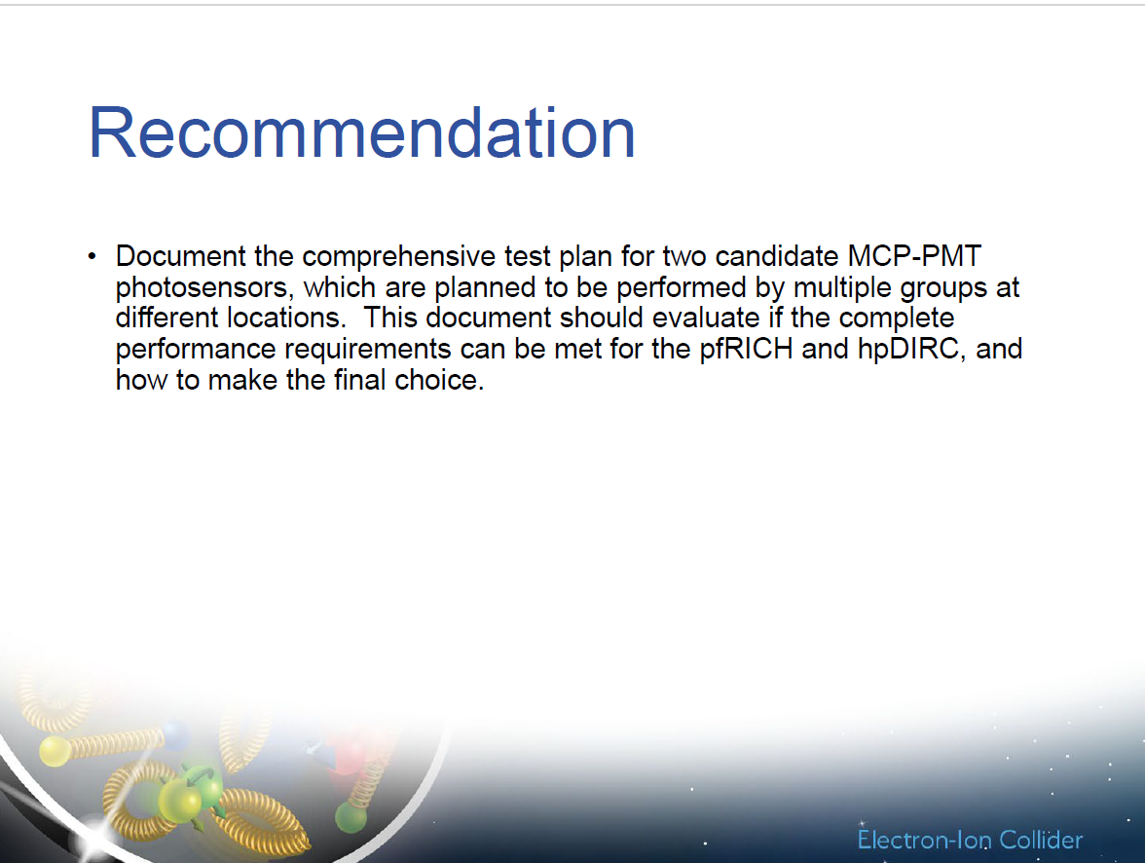
PDR of the Cherenkov-based PID detectors (pfRICH, dRICH, hpDIRC)
PDR:
All charge questions answered with yes
Many excellent comments
One recommendation

Slide 36
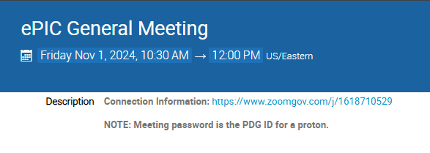
New Zoom Link
The Zoom link for the General Meeting now requires a password
We decided to do this after a TIC meeting was Zoom-bombed
  All our Indico pages are public, so this offers another hurdle for a would-be
  bomber (not a guarantee)
    Old link had password embedded to allow one-click access
  Hopefully this is not
  overly cumbersome for
  our collaborators

Slide 37
ePIC Resources
Public Website - https://www.bnl.gov/eic/epic.php
Mailing Lists – https://lists.bnl.gov/mailman/listinfo
Indico Agenda - https://indico.bnl.gov/category/402/
  ePIC Software and Computing: https://indico.bnl.gov/category/435/
Wiki - https://wiki.bnl.gov/EPIC
ePIC Software Training:
  Landing Page: https://eic.github.io/documentation/landingpage.html
  Tutorials: https://eic.github.io/documentation/tutorials.html
Mattermost: https://chat.epic-eic.org
ePIC Zenodo Community: https://zenodo.org/communities/epic

Slide 38


EICUG Membership
The EICUG is a vital organization to promote the interests of the EIC community!
  Without the EICUG we would never have gotten far enough to form ePIC!
Please register your institution!
Check with your EICUG IB representative to get registered as a member
https://www.eicug.org/content/join.html

