Slide 1
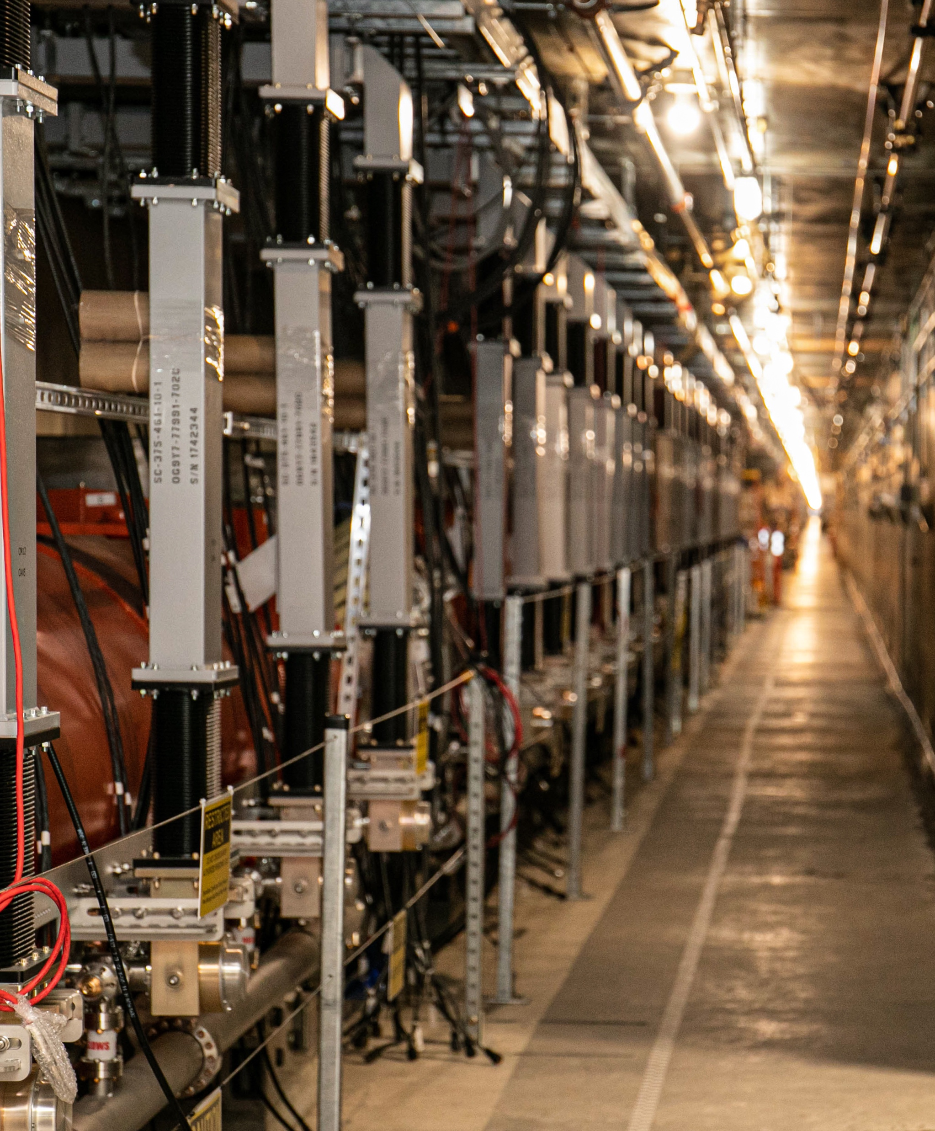
LCLS-II SRF commissioning and early operational experience
Sebastian Aderhold, SC Linac Physics Department Head
December 5, 2024

Slide 2
Outline
Facility Overview
Cryogenic system & Cooldown
SRF commissioning
Operational experience
Outlook & Summary

Slide 3
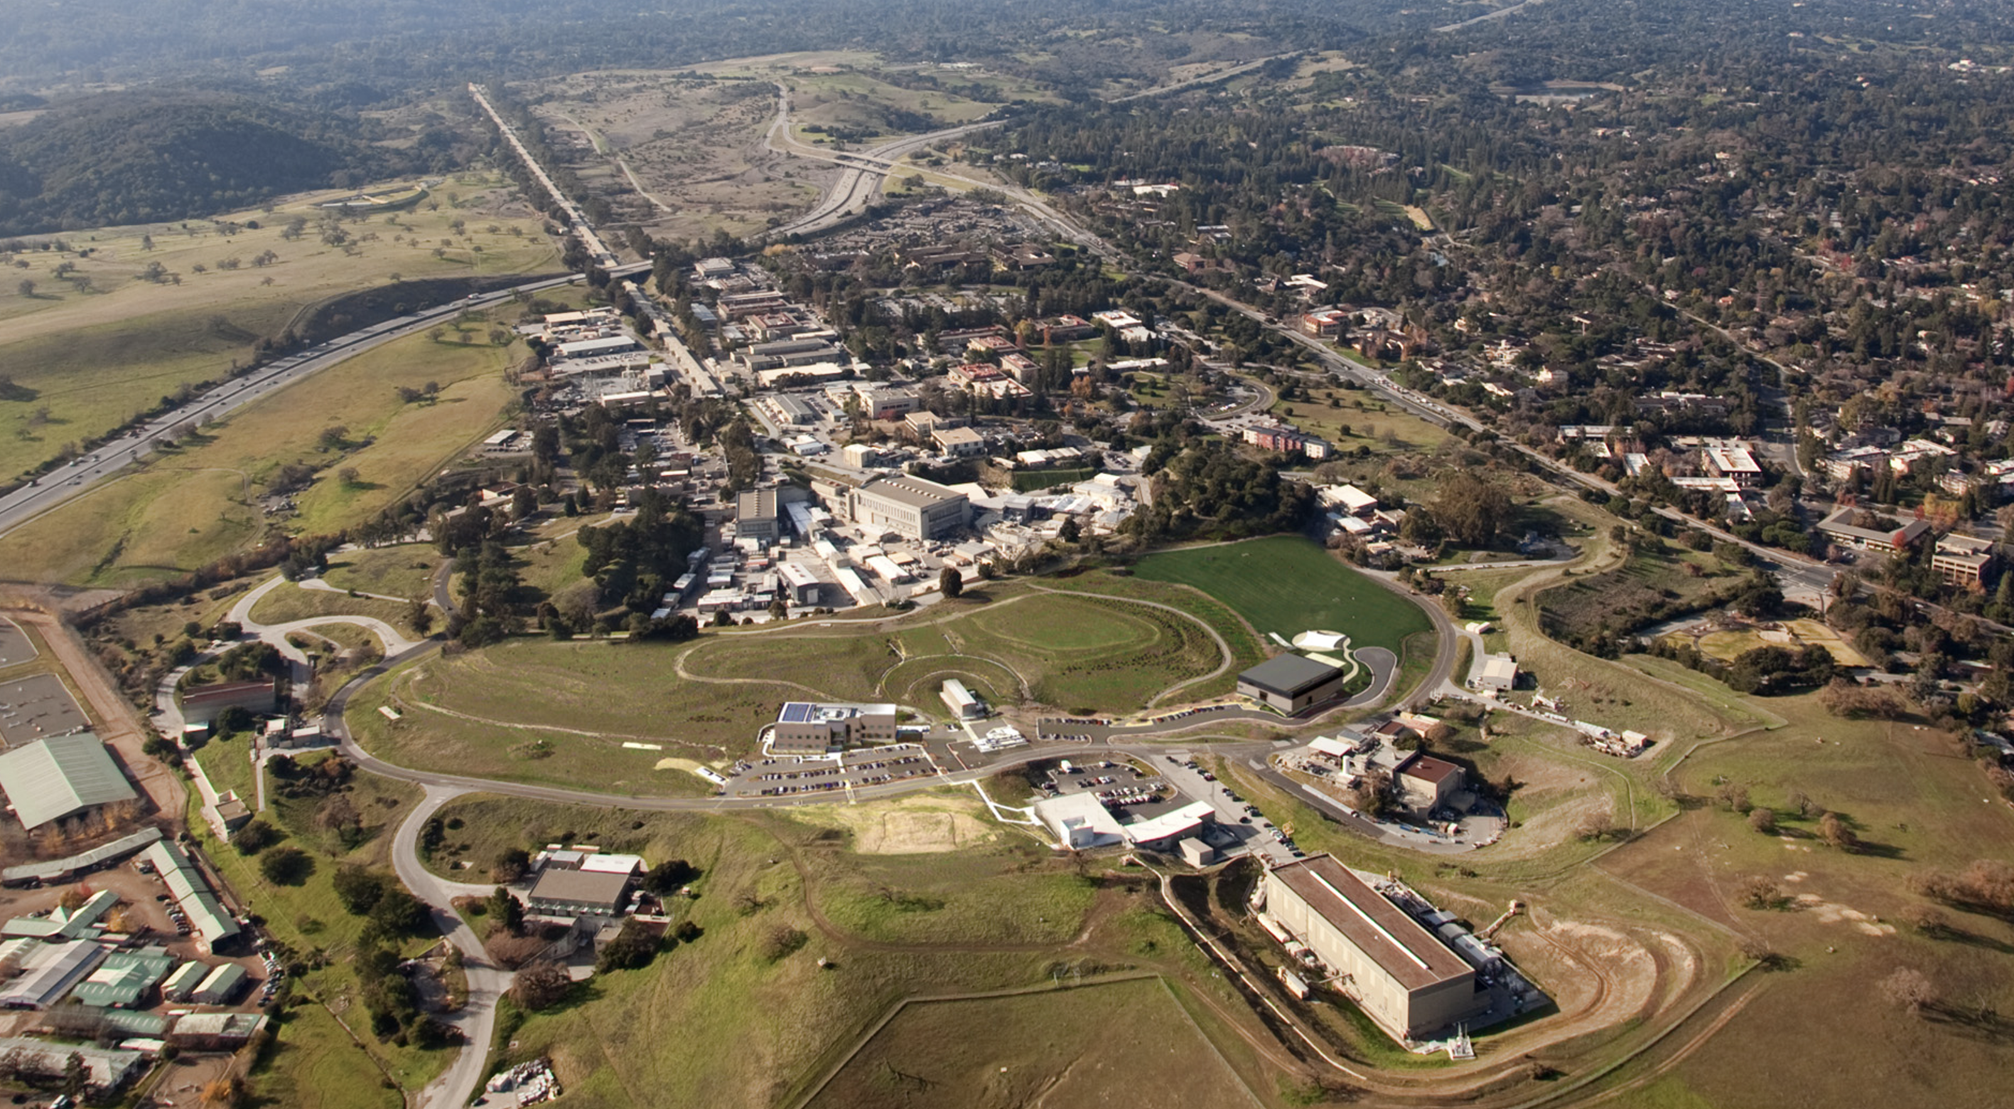







Remove SLAC Linac from Sectors 0-10
New Cryoplant
LCLS-II design features:
CW VHF gun
CW SRF linac
Support MHz-rate
Two undulator lines
Pulsed magnetic kicker
Long (2km) bypass line
Machine protection and beam loss control
New Injector and
New Superconducting Linac
Existing Bypass Line
New Transport Line
LCLS-II
Two New Undulators
And X-Ray Transport
Reconfigure Near Experiment Hall

Slide 4
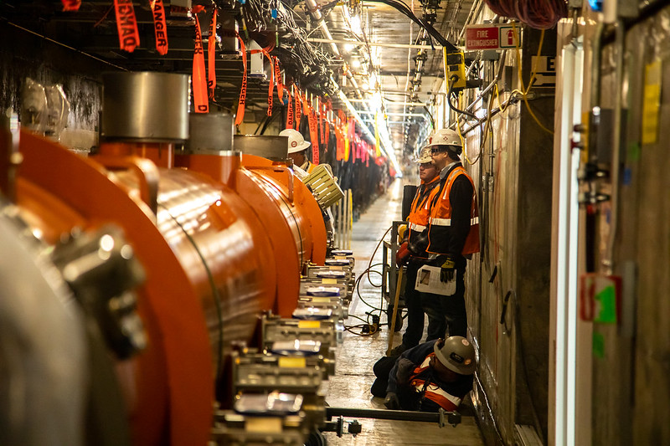
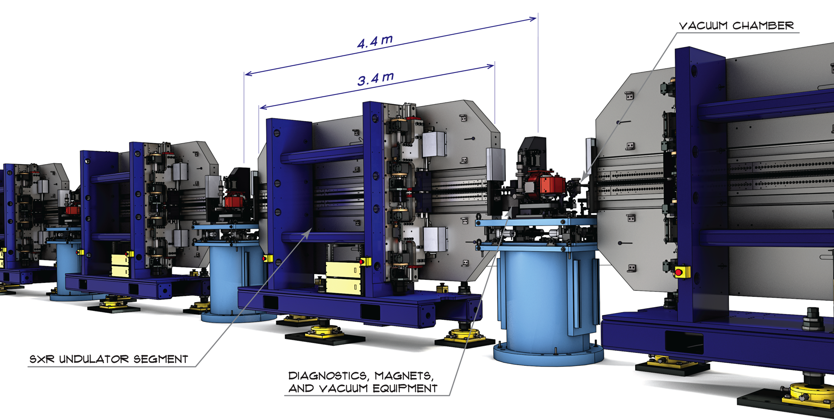
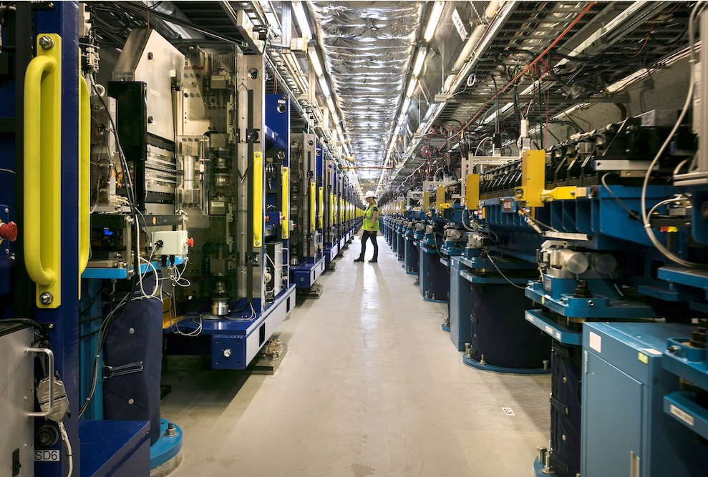
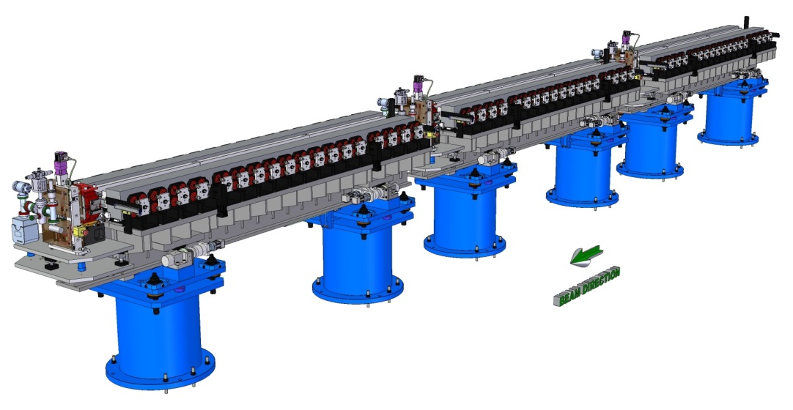
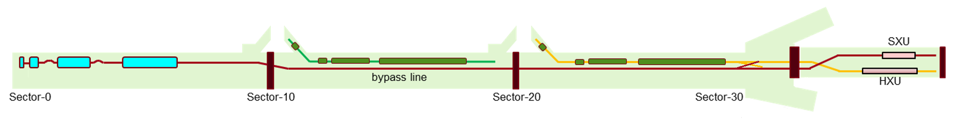
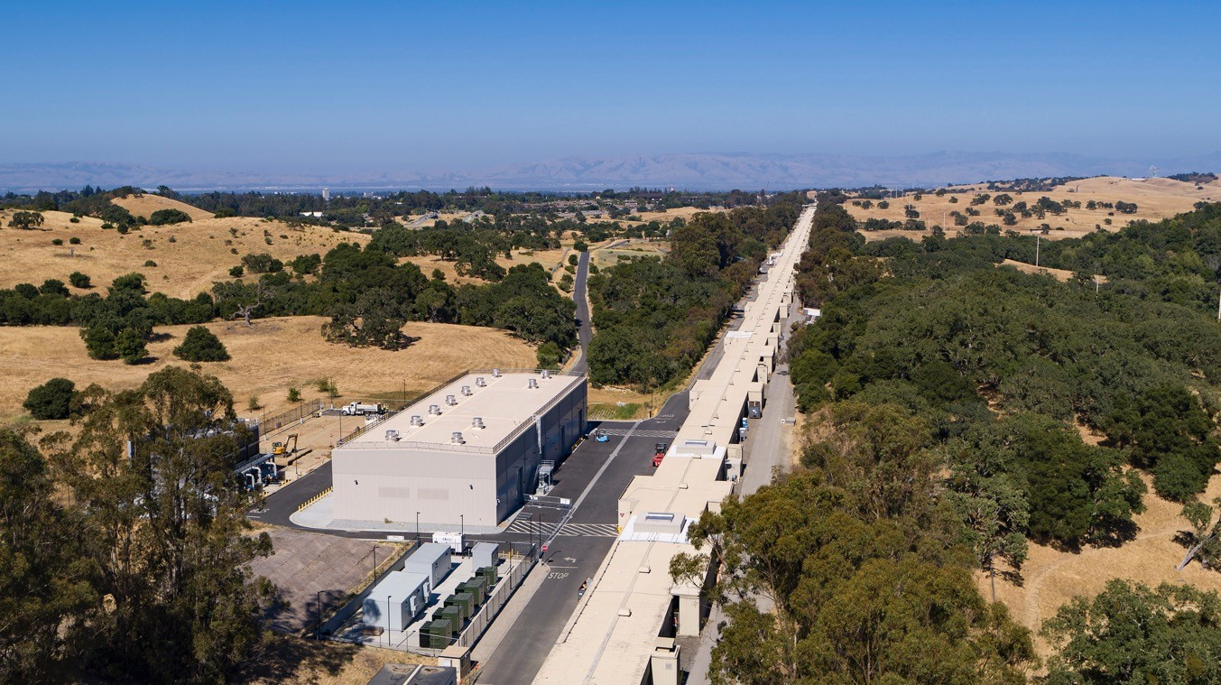
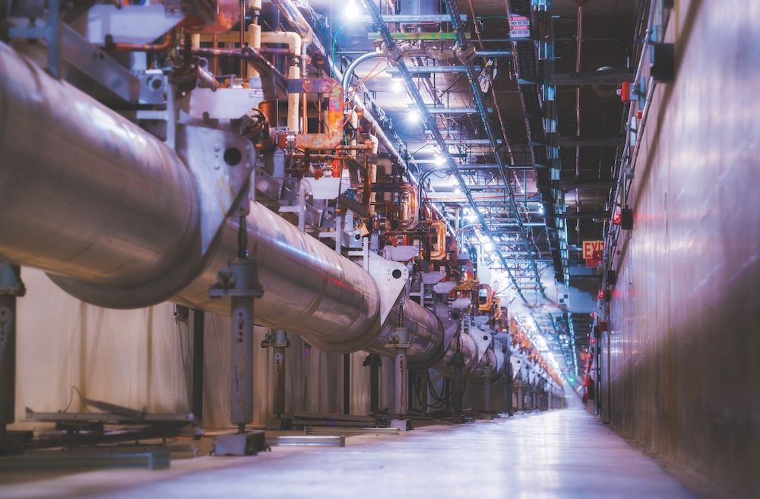
LCLS FEL complex based on normal and superconducting Accelerators
Superconducting Linac
4 GeV, High
rep-rate, CW RF
Soft and Hard X-ray
Variable Gap
Undulators (VGUs)
Future 8 GeV extension
(LCLS-II-HE)
3 km
Linac gallery and new cryoplant viewed from Sector 0
Normal Conducting Linac
3.5-17 GeV,
120 Hz Pulsed RF

Slide 5

LCLS-II Key Performance Parameters - KPPs
Performance Measure | Threshold (5 kW beam) | Objective (120 kW beam) | Measurements
Variable gap undulators | 2 (soft and hard x‑ray) | 2 (soft and hard x‑ray)
Superconducting linac-based FEL system
Superconducting linac electron beam energy | 3.5 GeV | ≥ 4 GeV | Spectrometer bend (magnet strength, screen)
Electron bunch repetition rate | 93 kHz | 929 kHz | BPM’s, laser rate
Superconducting linac charge per bunch | 0.02 nC | 0.1 nC | Toroid, Faraday cup
Photon beam energy range | 250–3,800 eV | 200–5,000 eV | Absorption edges, spectrometer
High repetition rate capable end stations | ≥ 1 | ≥ 2 | N/A
FEL photon quantity (10⁻³ BW) per bunch | 5x10⁸ (10x spontaneous) @2,500 eV | > 10¹¹ @ 3,800 eV | Gas energy monitor, GMD, Spectrometer
Normal conducting linac-based system
Normal conducting linac electron beam energy | 13.6 GeV | 15 GeV | Spectrometer bend (magnet strength, screen)
Electron bunch repetition rate | 120 Hz | 120 Hz | BPM’s, laser rate
Normal conducting linac charge per bunch | 0.1 nC | 0.25 nC | Toroid, Faraday cup
Photon beam energy range | 1–15 keV | 1–25k eV | Absorption edges, spectrometer
Low repetition rate capable end stations | ≥ 2 | ≥ 3 | N/A
FEL photon quantity (10⁻³ BWª) per bunch | 10¹⁰ (lasing @ 15 keV) | > 10¹² @ 15 keV | Gas energy monitor, GMD, Spectrometer

Slide 6
Outline
Facility Overview
Cryogenic system & Cooldown
SRF commissioning
Operational experience
Outlook & Summary

Slide 7
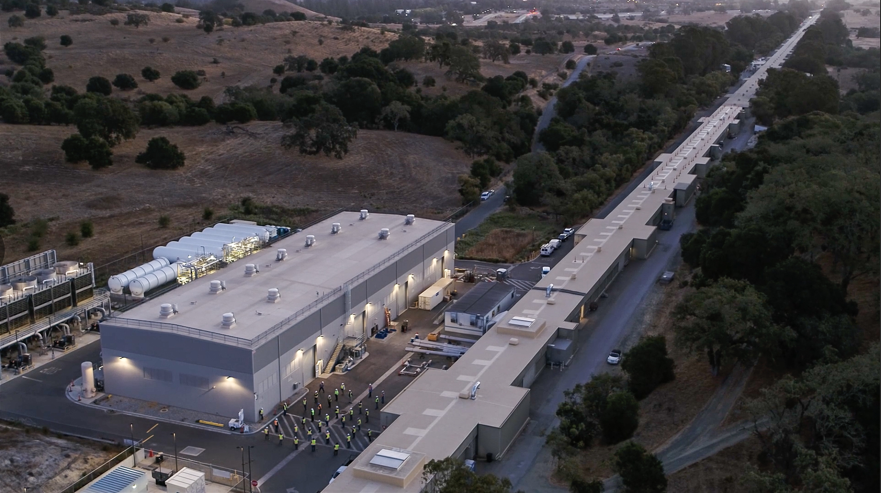
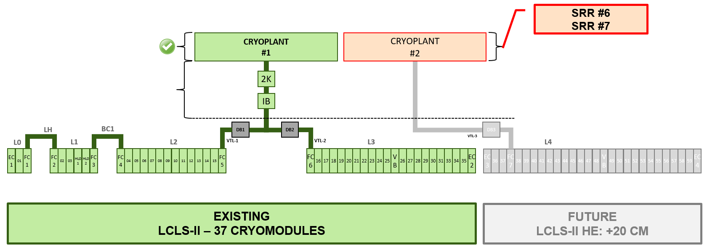
Plan to fully commission and operate LCLS-II with 1 of 2 installed cryoplants

Slide 8
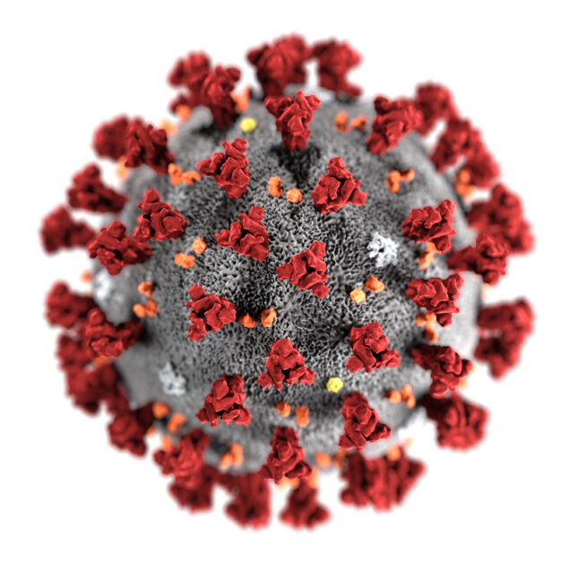
Cryoplant Commissioning Process
~ 30 Months
UTILITIES
Electricity
Control Network
Water
Air
Nitrogen
Helium
AUXILIARIES
Recovery compressor
Gas Analyzer
Purifier
COMPRESSORS
4K Cold Box
LINAC Ready
LINAC @ 4 K
Cool Down
LINAC @ 2 K
2 K Pump Down
Aug. 15th 2019
Dec. 15th 2019
Mar. 15th 2020
Jan. 15th 2021
Oct. 15th 2021
Jan. 1st 2022
Mar. 30th 2022
May 15th 2022
4 mths
3 mths
10 mths
7 mths
2.5 mths
3 mths
1.5 mths

Slide 9
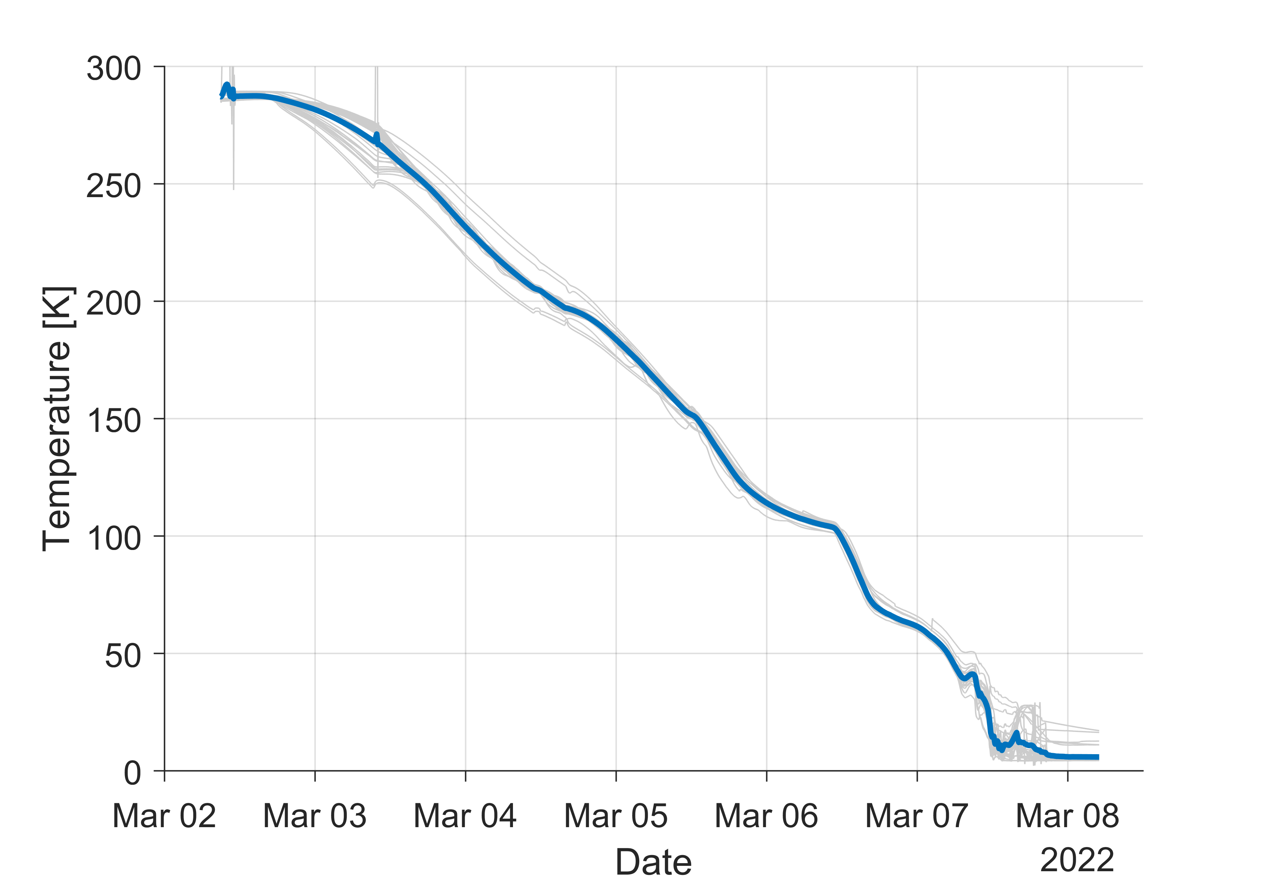
Cool Down & Pump Down to 2 K
Cavity Temperatures During Cool Down
Cool down of the entire linac was completed in ~5 days!
A rate of 2-3 K/hour was maintained over that duration
Cool down was near-fully automated by the cryogenic controls system
After multiple attempts, stable operation at 2 K was achieved only 11 days later
2-3 K/hr

Slide 10
Outline
Facility Overview
Cryogenic system & Cooldown
SRF commissioning
Operational experience
Outlook & Summary

Slide 11
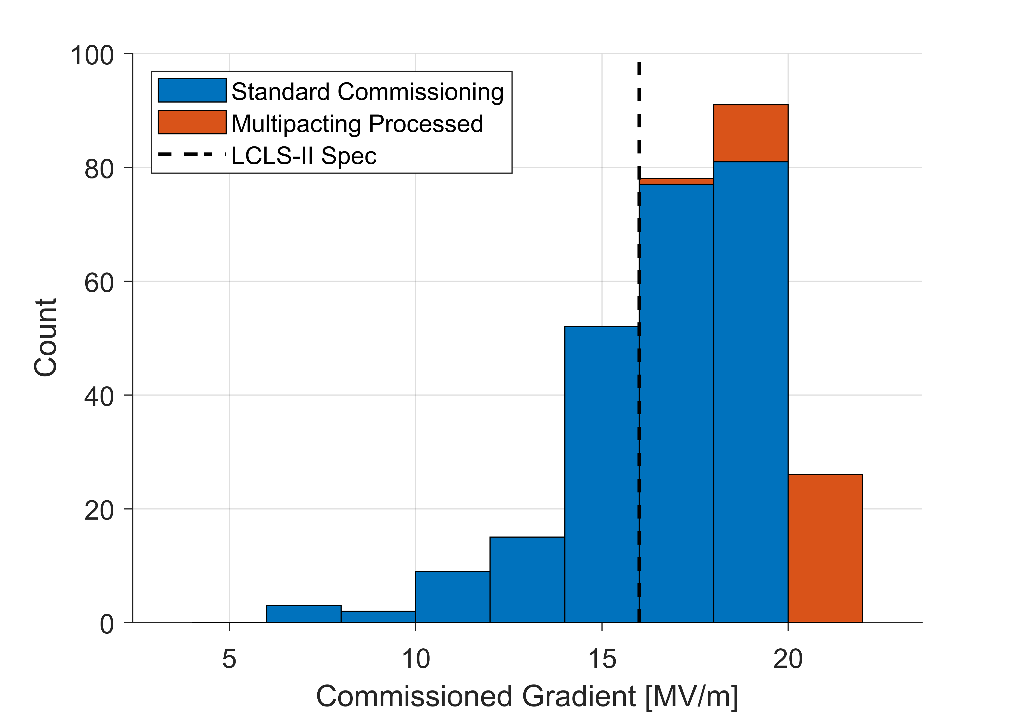
SRF Commissioning
SRF commissioning was very successful
97% of all cavities fully operational (planned for 94%)
Total commissioned (summed individual cavity) voltage exceeded design by >20% and reached 4.8GV
No significant change in field emission observed with respect to cryomodule acceptance tests at partner labs
Gradient Performance

Slide 12
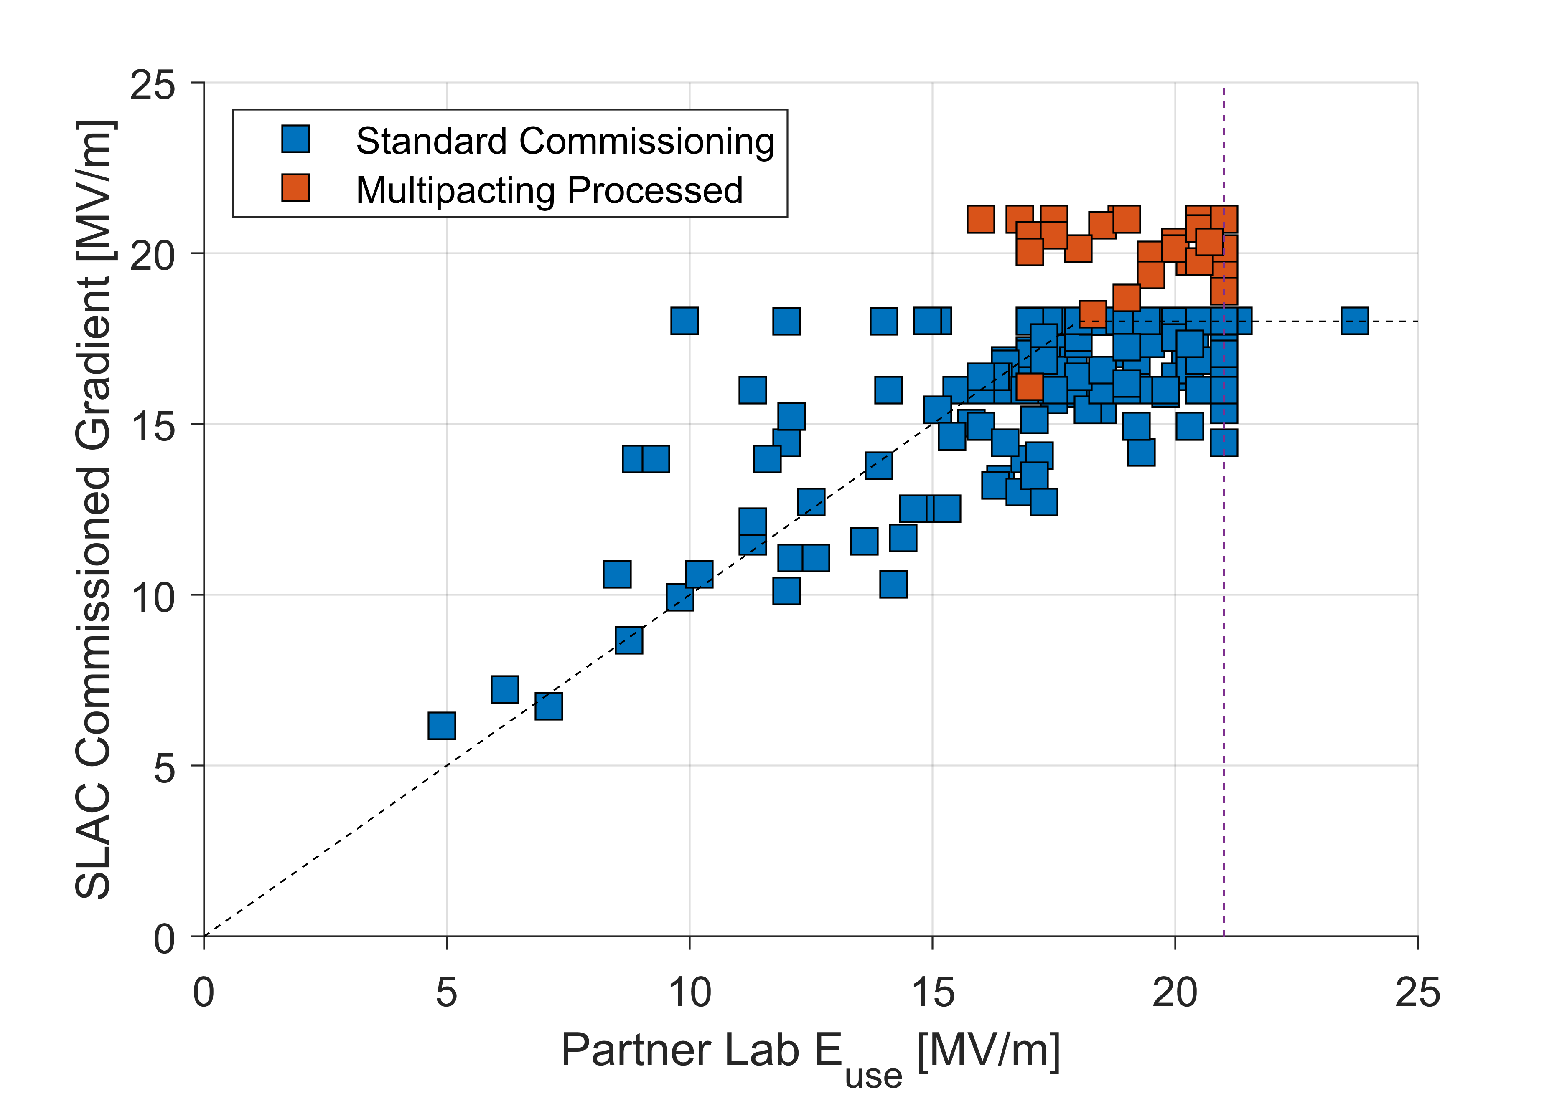
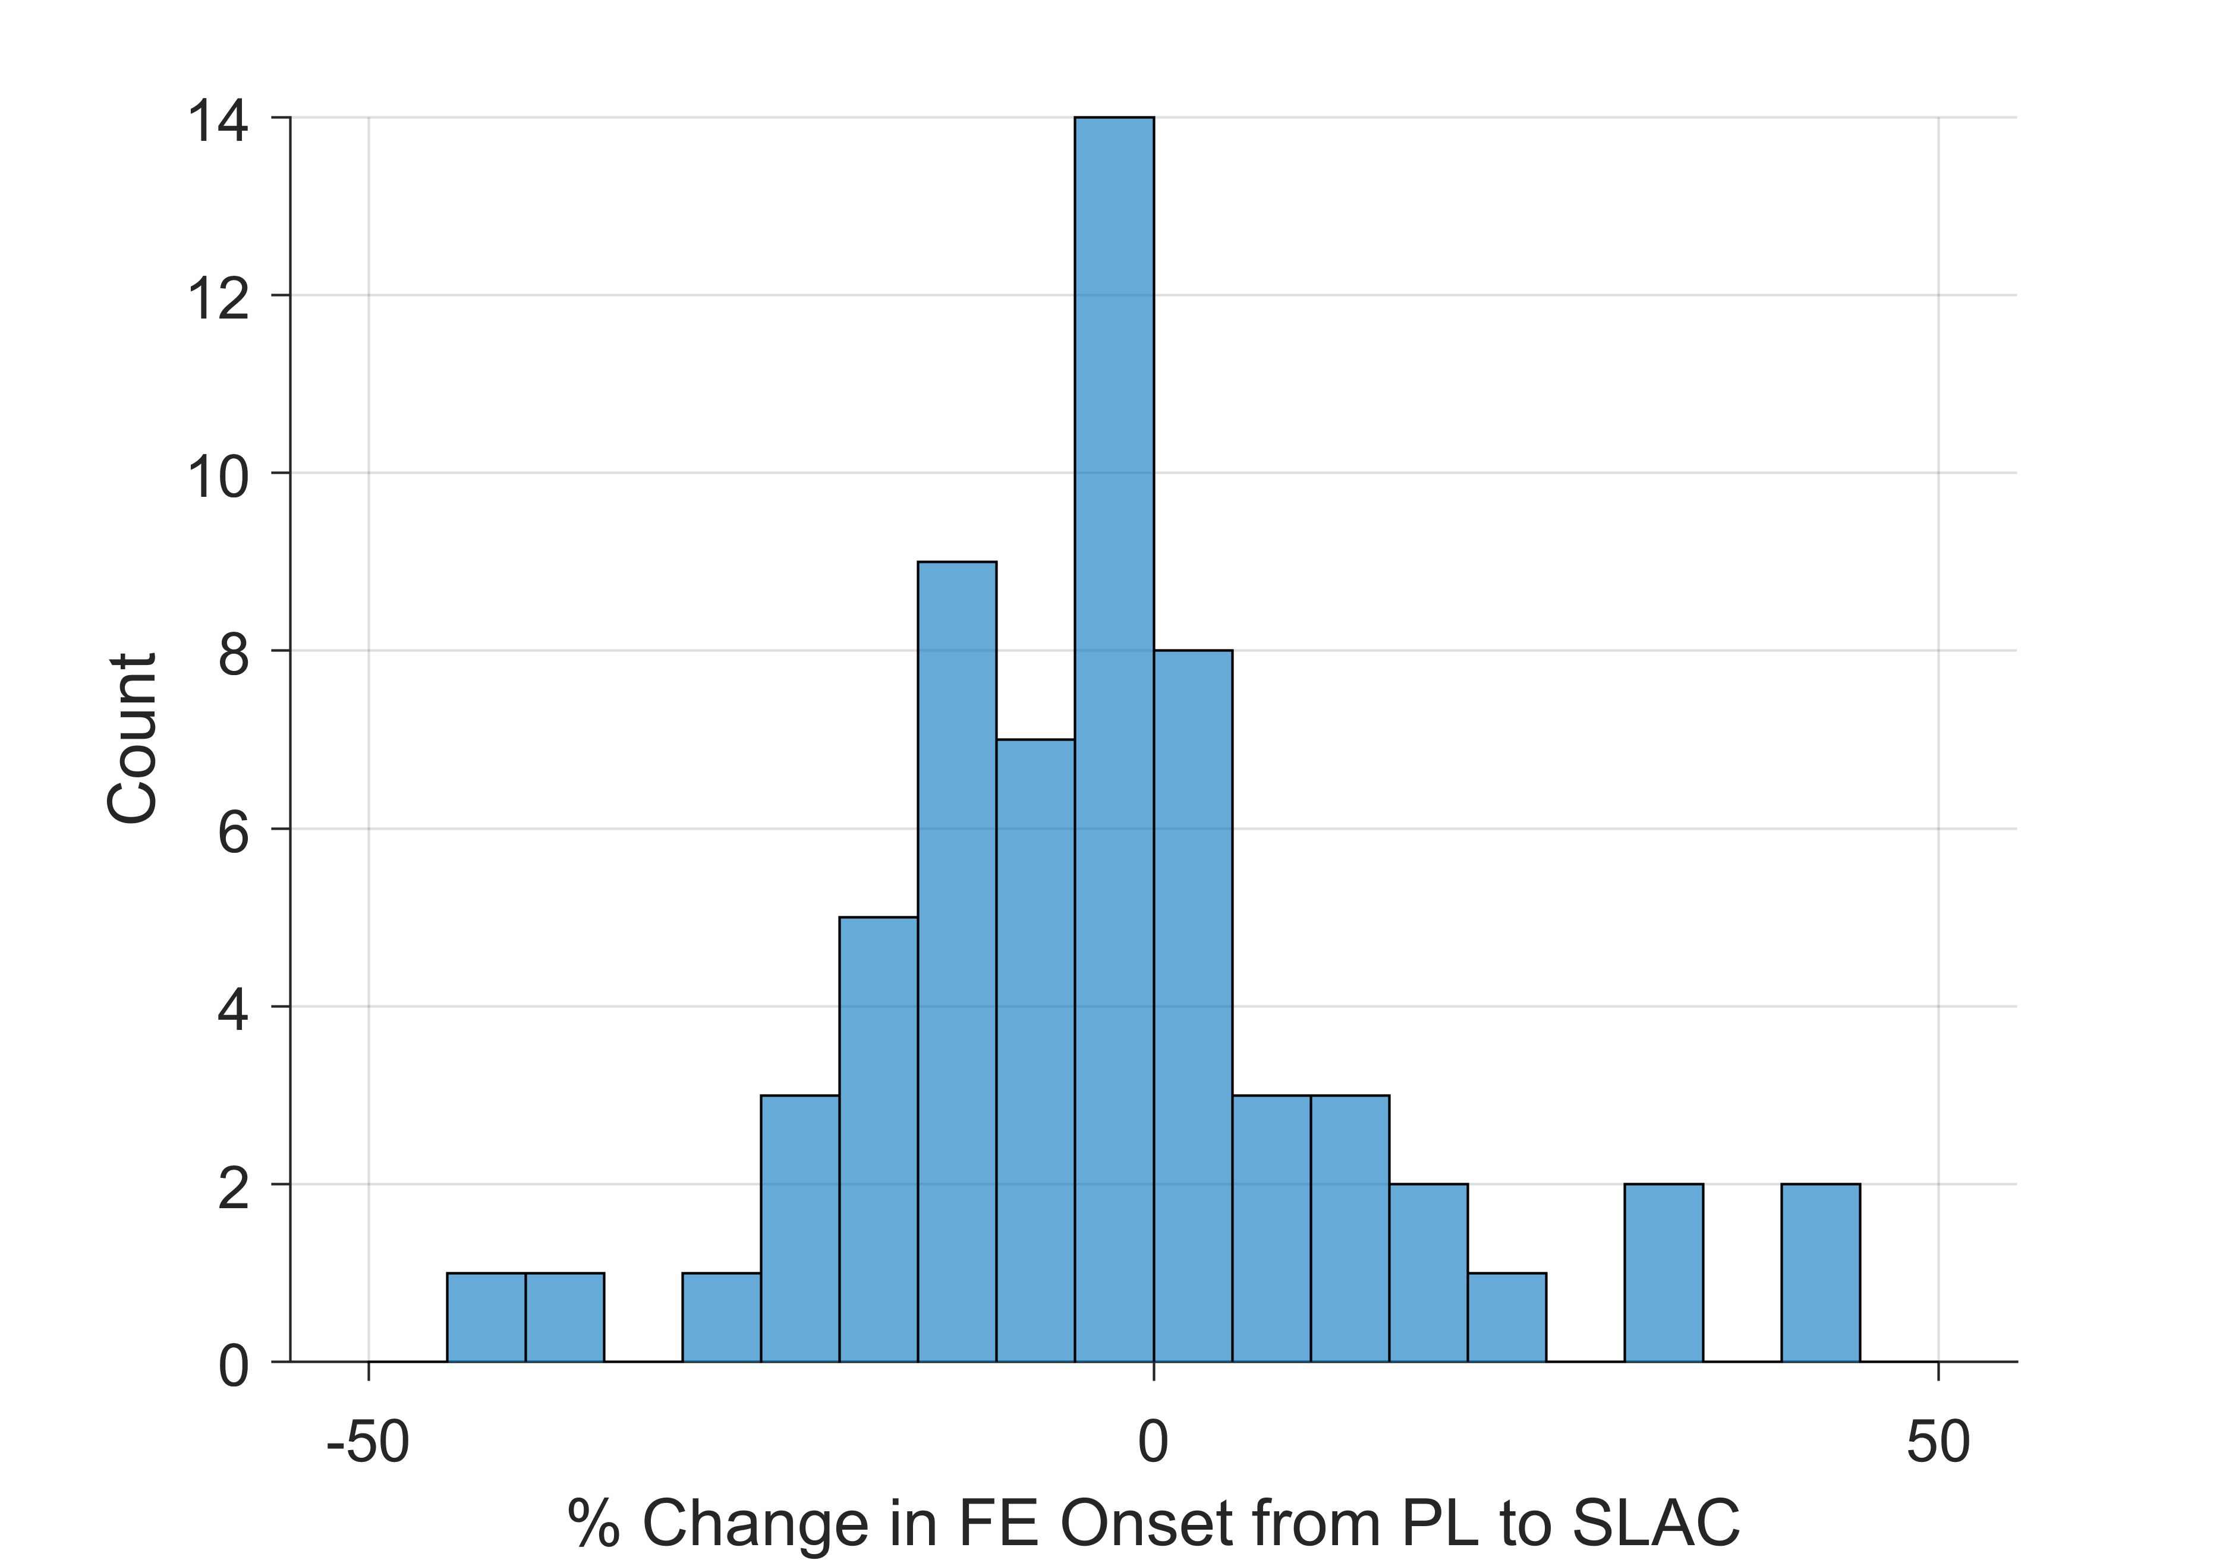

Gradient Performance
Comparison with Acceptance Test
Gradient performance is in line with CM acceptance test measurements at FNAL and Jlab
No observable change in field emission onsets or magnitude from installation
Multipacting processing resulted in ~3 MV/m gain in stable gradient
Change in FE Onset
$$\overline{Δ}=\left(−1±18\right)\%$$
Admin limits:
18 MV/m in commissioning
21 MV/m in acceptance test

Slide 13
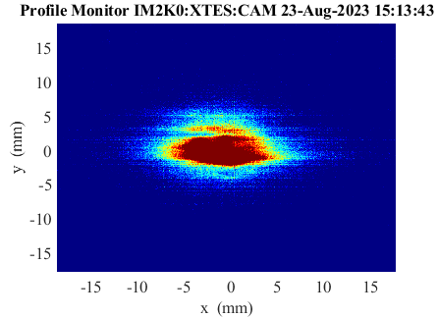
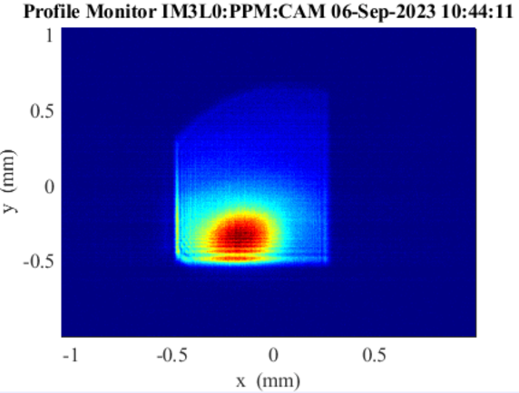
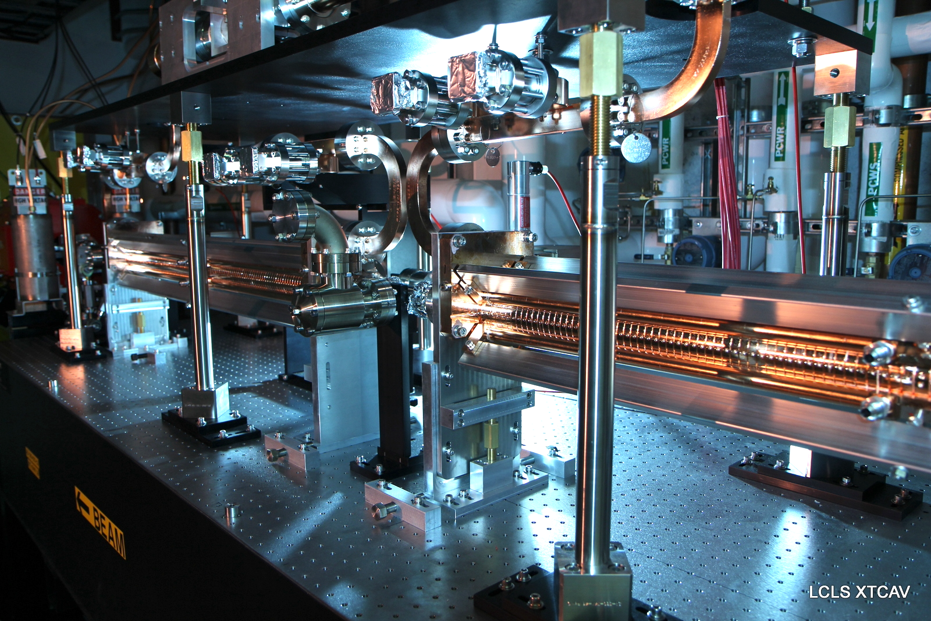
Undulator and FEL commissioning
SXR undulator
HXR undulator
Beam-based alignment with Cu-linac beam;
E-beam transverse and longitudinal optimization;
Beam loss control; Undulator tapering;
GMD, spectrometer, XTCAV measurement.
XTCAV and XTCAVB to support commissioning
First lasing with SC-linac beam, SXR line, 8/23/2023; HXR line, 9/6/2023

Slide 14
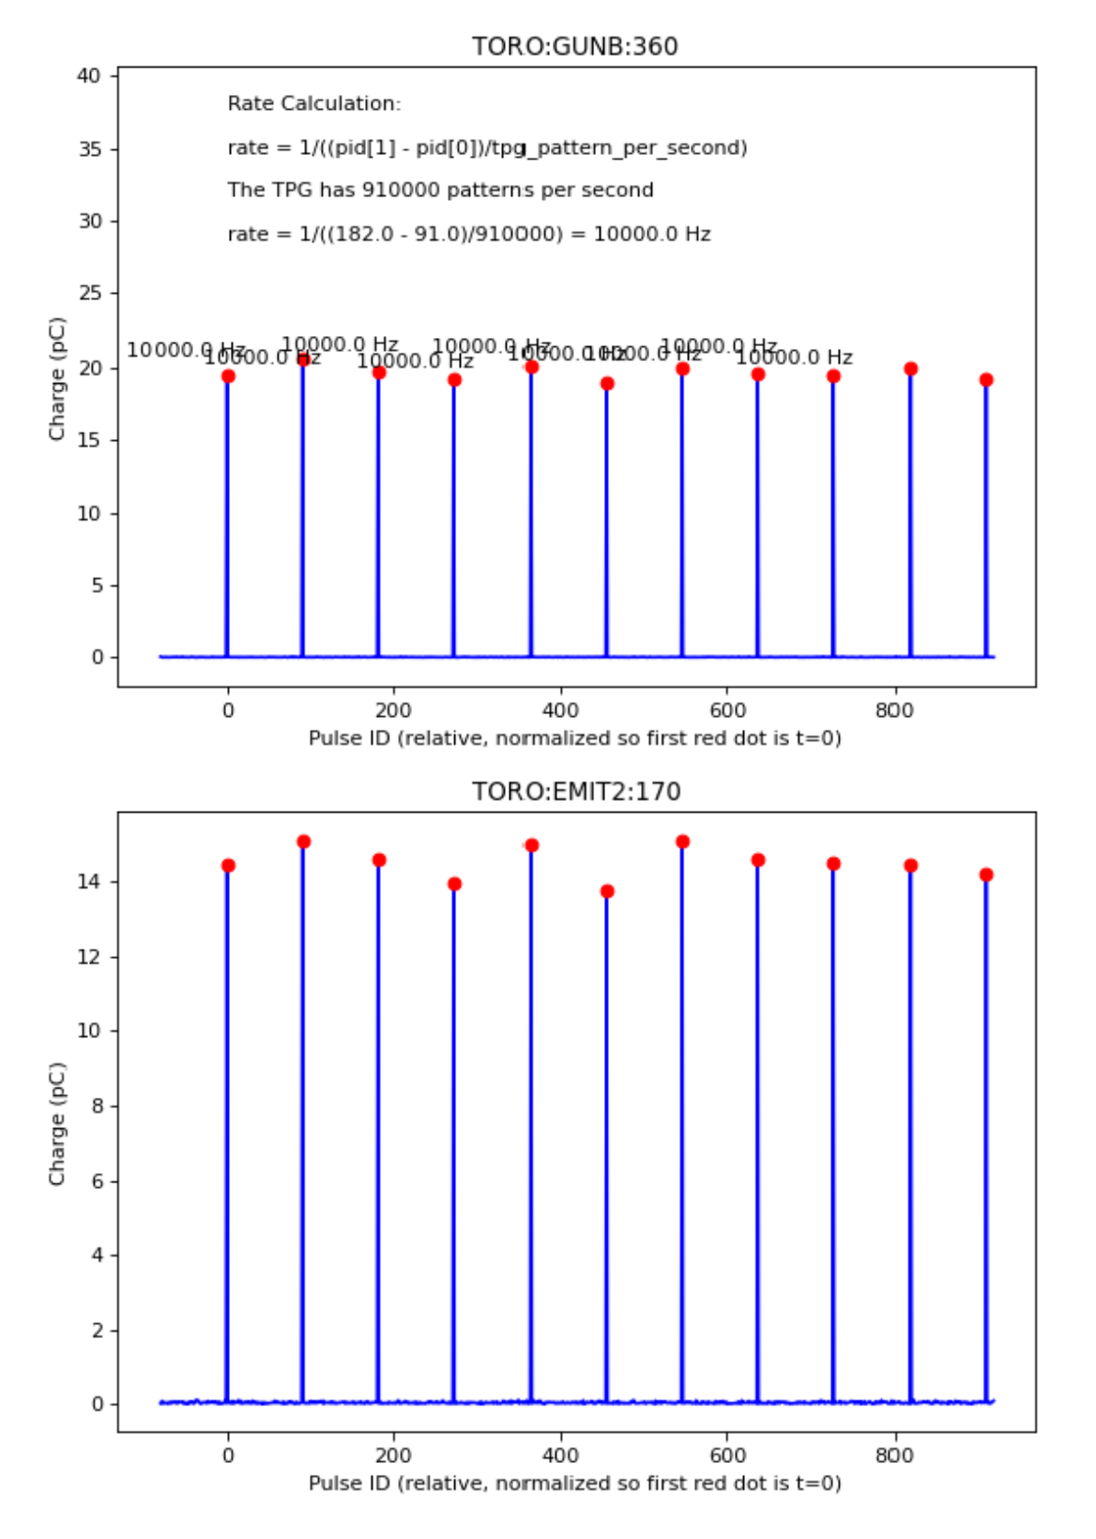
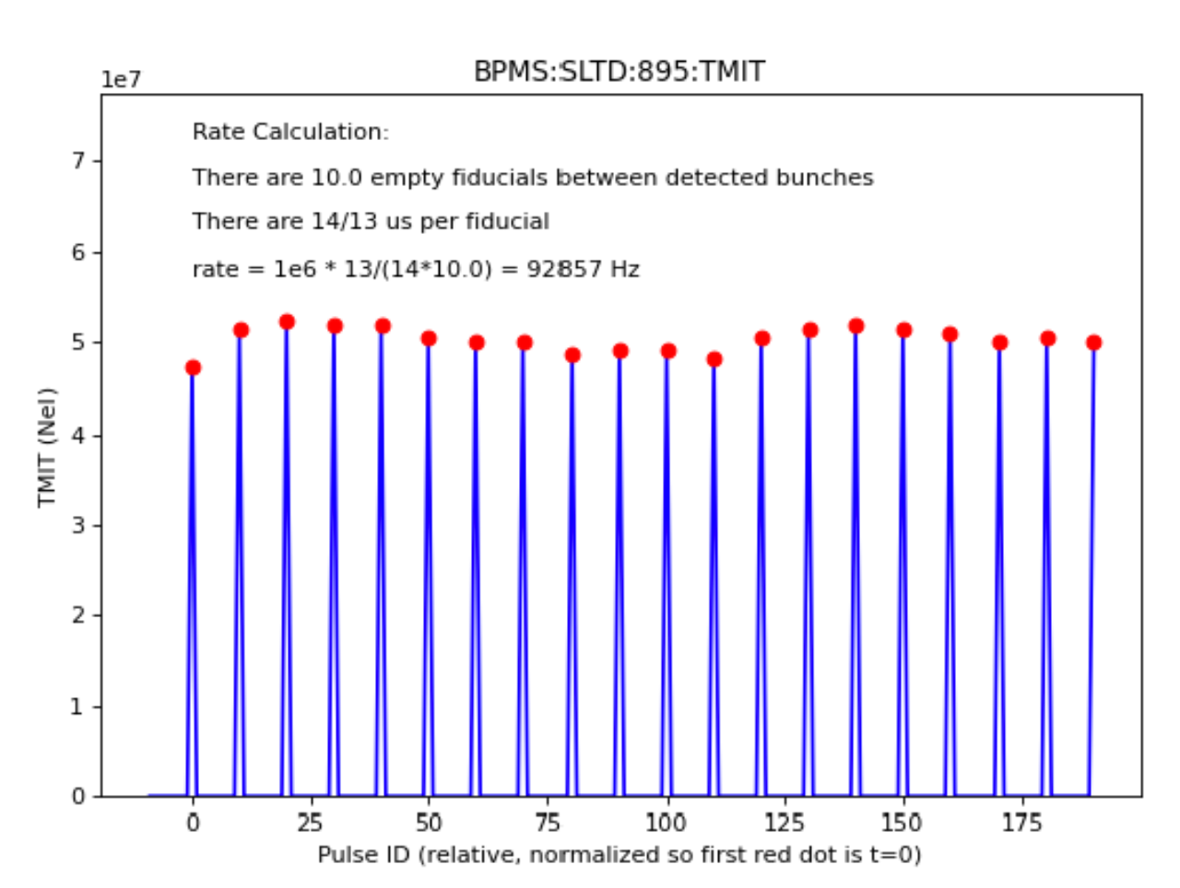
Beam Repetition Rate
Achieved 10 kHz beam rate on 12/9/2022.
Achieved 93 kHz (6/7/2023)
→ Project Threshold Milestone
Initial science program operates at 8.25 kHz.
While ramping up the beam rate:
Diagnostic devices response
Feedback system response
Machine protection system
Beam loss monitor display
Beam dump and cooling water temperature response
Verify actual beam rate with Toroid or BPM BSA data
10kHz
93kHz

Slide 15
Outline
Facility Overview
Cryogenic system & Cooldown
SRF commissioning
Operational experience
Outlook & Summary

Slide 16
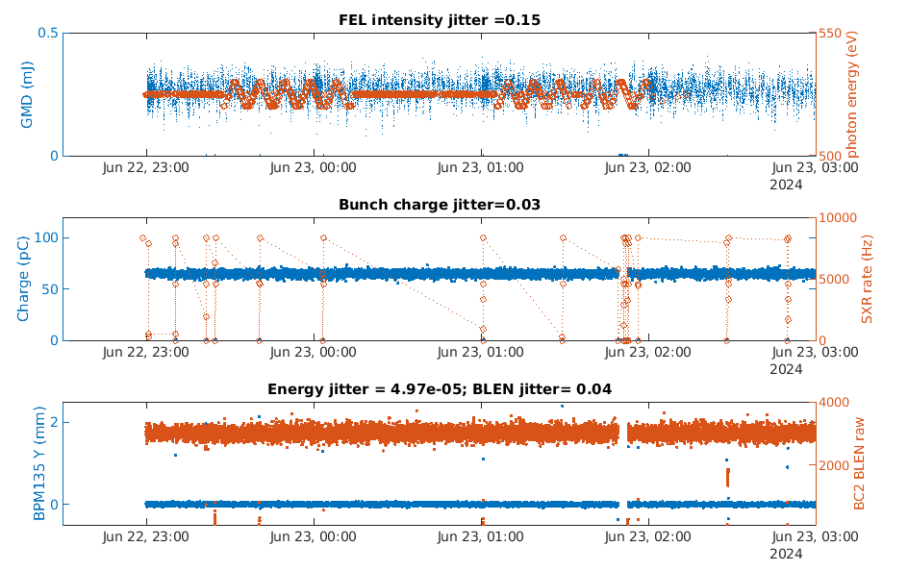
Beam Stability
6/23/2024
65pC, 8kHz, 530eV: operation data in 4 hours
Design jitter specs (rms):
charge jitter: 1.5%,
energy jitter: 1e-4,
peak current jitter: 4%,
arrival time jitter: 20 fs.
With the 3rd cathode

Slide 17
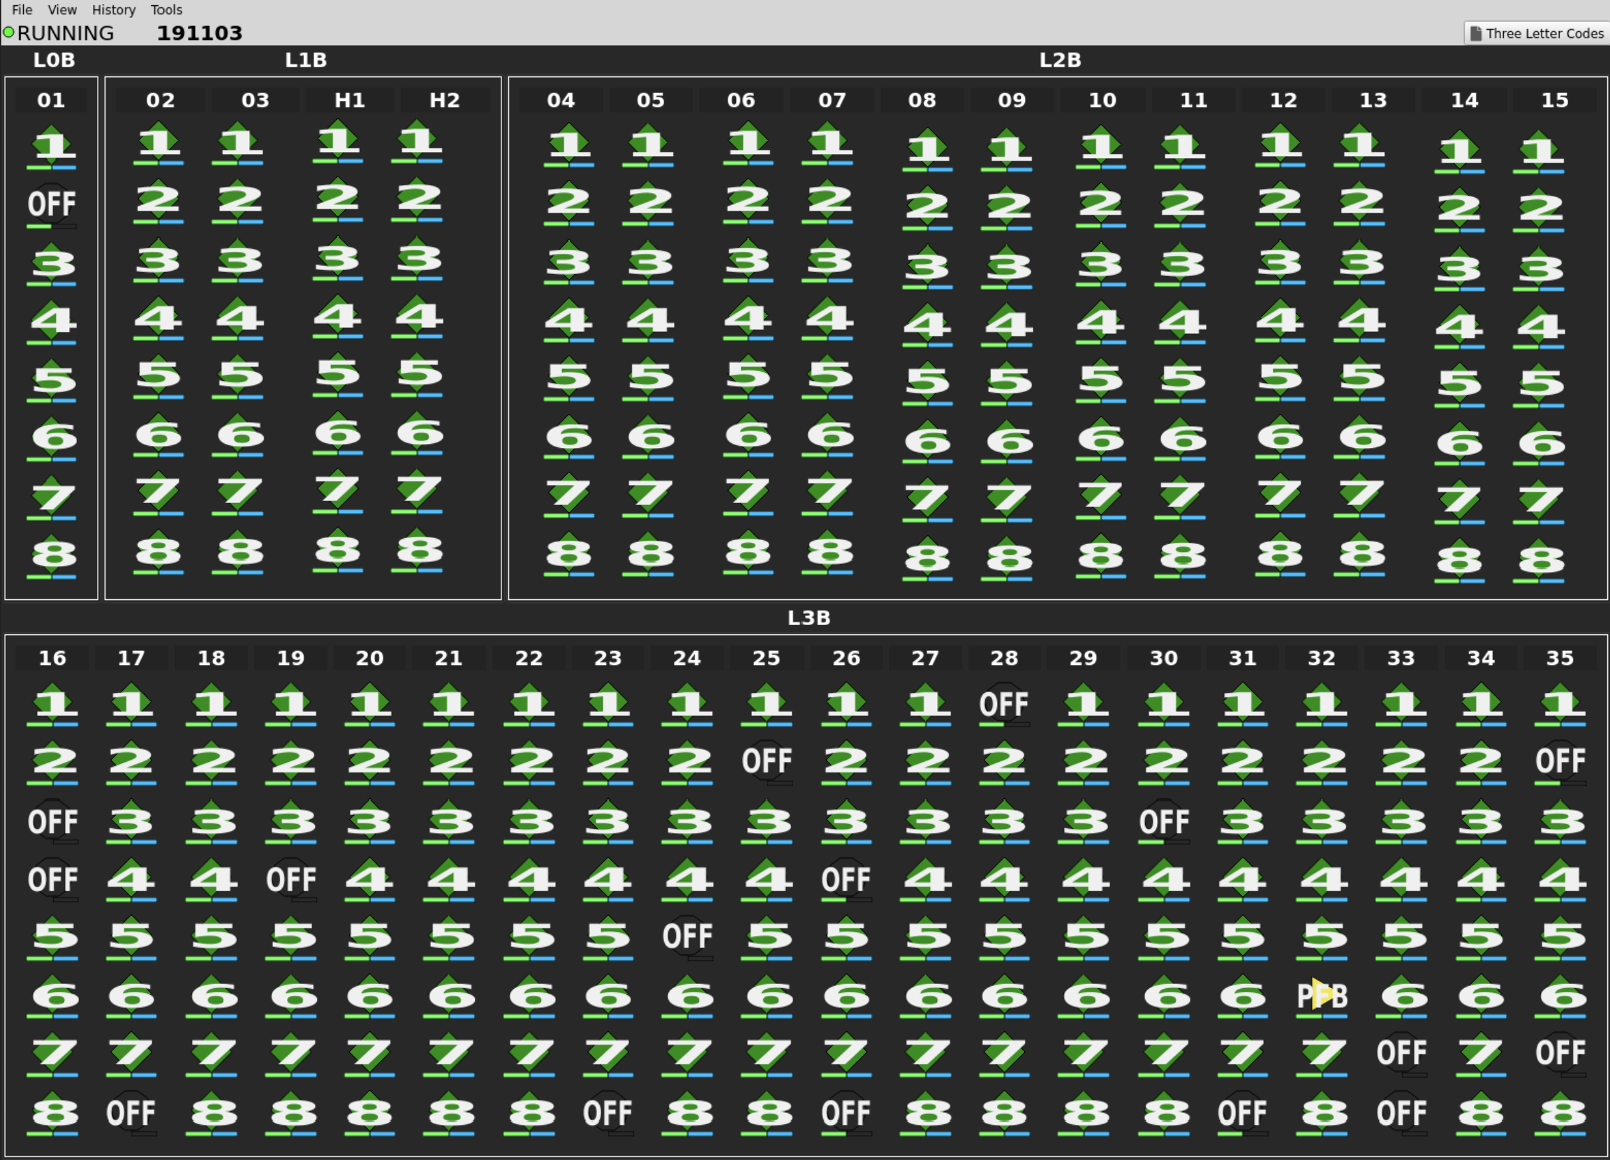
Cavity availability
After initial commissioning only 3% of cavities non-operational (problems inside the CM that need room temperature warm-up)
No additional cavities with problems inside cryomodule since then
All new problems related to LLRF system, cables/connections or SSAs
Individual Solid State Amplifiers allow to take single cavities with intermittent problems offline for maintenance
Generally enough amplitude overhead to compensate for cavities being repaired while the linac is running or during maintenance periods

Slide 18
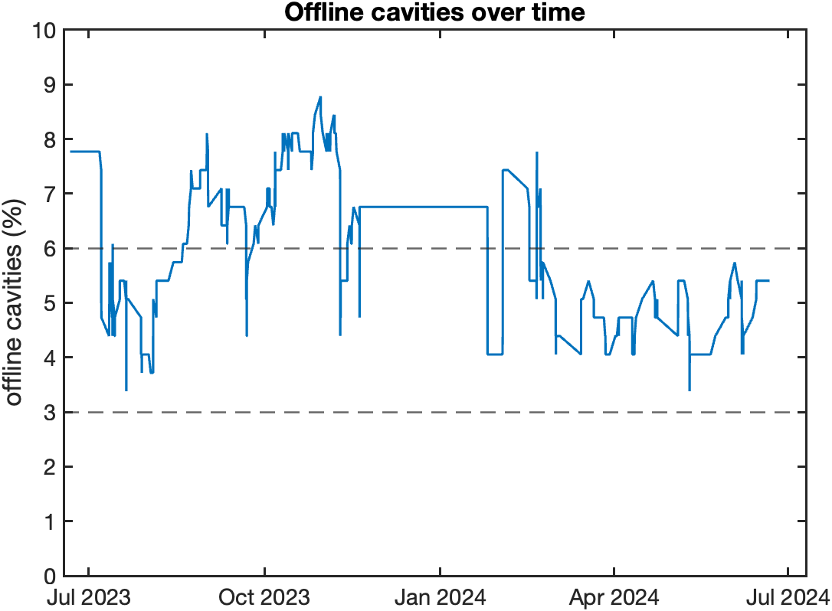
Offline cavities over time
During operation cavities with problems are taken offline to be fixed later.
Repair during maintenance periods or parasitically (if possible)
9 cavities (3%) offline due to long term issues
power coupler: 2x
Tuner (stepper/piezo/limit switch): 7x
Will require linac warm-up
Remaining cavities mostly RF-system related

Slide 19
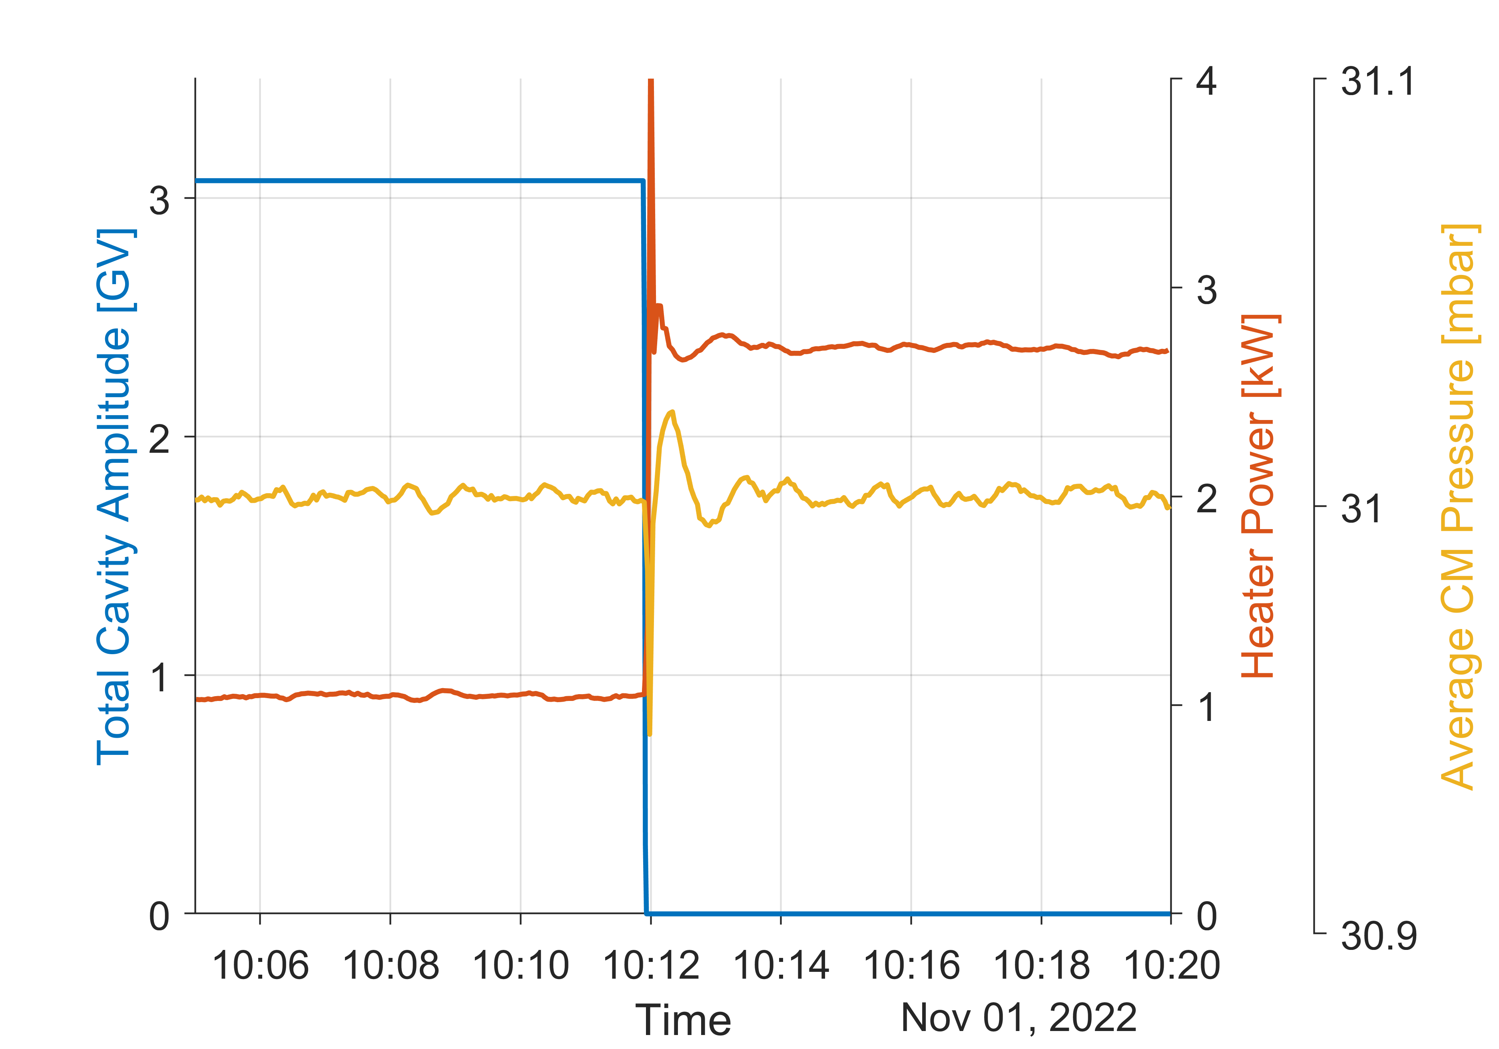
Cryogenic system is very robust
Electric heaters on underside of cavity helium vessels to compensate for change in RF heatload
Control loop regulates linac helium pressure by adjusting electric heaters to keep return pressure to cold compressors stable
Even in cases of sudden loss of all RF heat [e.g. shut-off by Personal Protection System (PPS)] feedback keeps cold compressors stable and recovers pressure within minutes

Slide 20
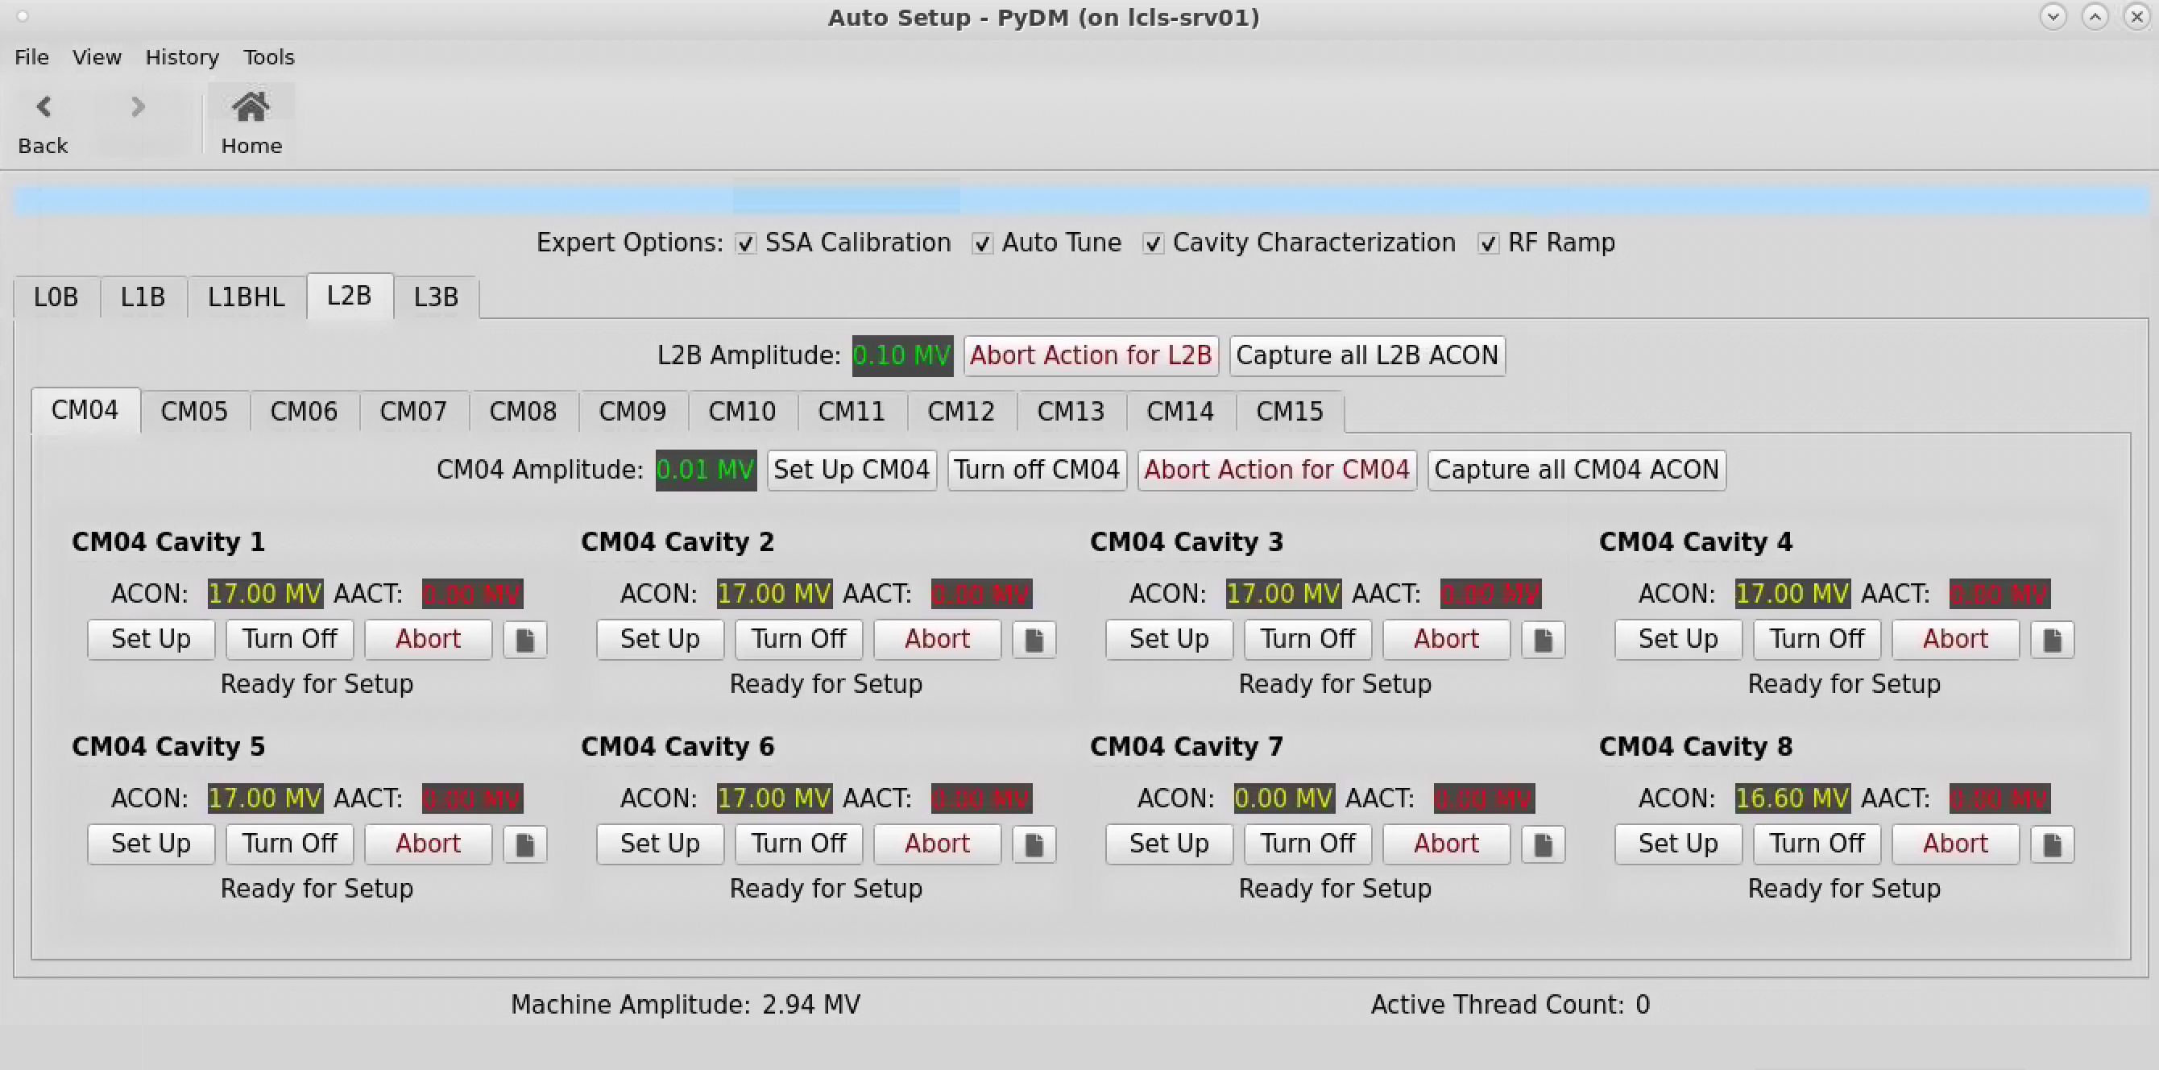
Software development and automation
Auto Setup GUI
Push-button tool for initial set-up or to address cavities that have become unstable
Building heavily on software framework developed for and since initial linac commissioning
Simplified interface on top of expert screens for ease of operator use
Automated sequence of steps, some level of error handling and checking if values are within set boundaries
Start of the whole linac (e.g. after maintenance days) CM by CM within 30min - 1h, depending on number of parallel instances
Recent infrastructure improvement cut down to less than 5min, true single button

Slide 21
Microphonics
Overall microphonics levels are very good
94% of cavities within specification of +/-10Hz
Only two cavities are currently amplitude limited due to microphonics
Biggest source of excessive microphonics are cooldown valve leaks
More details by R. Porter at SRF2023: MOPMB081

Slide 22
L3 insulating vacuum
Upstream linac section
L3 string is separated into section upstream and downstream of insulating vacuum break
L3 upstream string exhibits higher than expected static heatload and increased insulating vacuum pressure
Suspect leak from helium process pipe into insulating vacuum space
Partially mitigated by doubled pump capacity
 | EXPECTED CM STATIC | OBSERVED CM STATIC (Initial) | OBSERVED CM STATIC (with Additional Pump)
LO-L2 | 9 W / CM → 150 W | 9 W / CM → 150 W | 9 W / CM → 150 W
L3-UPSTREAM | 9 W / CM → 90 W | 47 W / CM → 470 W | 17 W / CM → 170 W
L3-DOWNSTREAM | 9 W / CM → 90 W | 16 W / CM → 160 W | 16 W / CM → 160 W
TOTAL CM STATIC | 330 W | 800 W | 500 W
Added Pumps

Slide 23
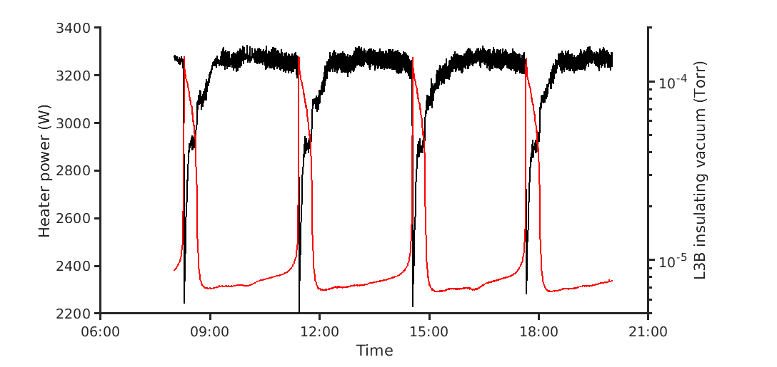
L3 insulating vacuum
Downstream section
L3 downstream string insulating vacuum pressure has oscillating behavior
Oscillation period is dependent on whether RF is on (~1.5h) or off (~3h)
Global heater feedback reacts in response to change in static heatload
Suspect leak in cooldown line of one of the later CMs (~CM33-34)
Most notable consequence is HOM couplers on some cavities to start (over-) heating
Decreased cavity amplitudes slightly to accommodate

Slide 24
New Field Emission in CM01
CM01 has specific cavity amplitude requirements for optimal injector performance and linac beam quality
Cryomodule with high max amplitudes and without field emission was chosen for this location
For best emittance preservation cavity 1 runs at low amplitude (6.5MV) and cavity 2 is chosen to be off
Prompted by unexplained high signals on beam loss monitors in injector moved radiation monitors next to CM01 and re-characterized field emission
Found field emission in cavities 2, 3, 4, 5
No specific events in beamline vacuum that would explain particle migration or gas bursts

Slide 25
CM01: Path forward
Will keep monitoring field emission levels in CM01 on a regular basis
Started re-characterization campaign for all other CMs (moving one set of sensors every maintenance period)
Assessing impact on injector performance
Just at the lower edge of required energy for laser heater operation while keeping cavities below 50mR/hr when turning on cavity 2
Seems feasible as long as FE does not get worse
Looking for mechanisms that would explain pattern with highest radiation in the middle of the CM
Long term solutions (both would need room temperature warm-up and significant work):
Replace cryomodule with spare
Perform in-situ plasma processing

Slide 26
Change in cavity amplitude limits due to Field Emission (FE)
Total cavities in linac | 296
Cavities re-characterized for FE | 192 (65%)
Cavities with change in FE characteristics | 15 (5%)
Number of affected CMs | 9 (out of 23 re-characterized)
Cavities where the change impacts operational setpoint | 8 (3%)
Total amplitude lost over whole linac: 47.4 MV

Slide 27
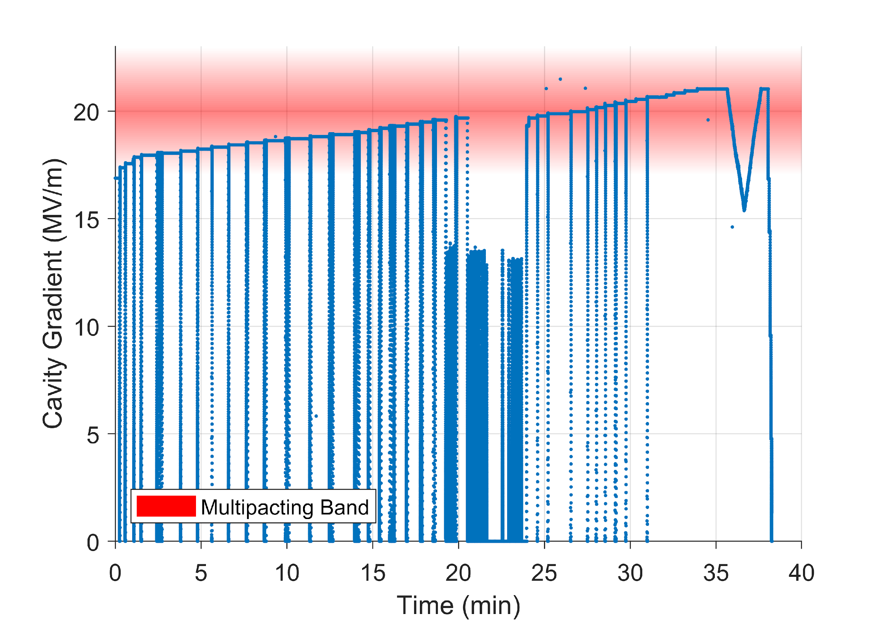
Multipacting processing
Repeated cavity quenches at increasing gradients
“scrubbing” the inner cavity surface
Redistribution of adsorbed gases, lowering the secondary electron emission yield
Typically accompanied by a short x-ray burst
Persistent effect until next room temperature cycle of the linac
Goal:
Gain more available amplitude towards 4GeV (and eventually 4.3GeV) operation of the SC linac

Slide 28
Timeline and process
Completed 8 dedicated shifts over the last two weeks
Working on two cryomodules in parallel, one cavity at a time
47 cavities in 7 cryomodules in L3B were processed
~2-3h per cavity
Initial estimate was 4h
Start at 16.6MV ramping amplitude up to 21.8MV in small steps
When reaching 21.8MV, or other maximum amplitude below that, run for ~30min
Majority of cavities reached 21.8MV
Some “hard quenches” at lower gradients

Slide 29
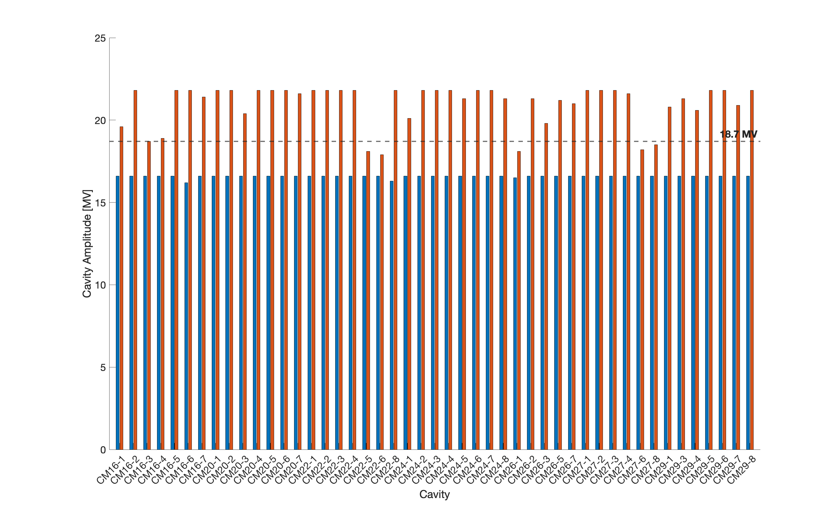
MP processing gains
209.1MV total gain
When considering up to 21.8MV max amplitude
96.8MV total gain
When considering up to 18.7MV max amplitude
Taking into account operational constraints (RF overhead, stability,…)

Slide 30
Outline
Facility Overview
Cryogenic system & Cooldown
SRF commissioning
Operational experience
Outlook & Summary

Slide 31
Ramp-up Plan for 500 kHz FEL Operation – 120 kW Limit
Current beam power limit is 5 kW (safety system limitation)
Ramp – up to full performance is governed by safety system functionality, RP surveys, beam loss minimization.
Process to achieve KPP’s will take 2-3 (+) years and will be integrated into user program.
Repetition Rate and Bunch charge can be traded to maintain a specific beam power.
2-3 (++) years to objective KPPs
Ramp-up is governed by beam power considerations, management of beam losses.

Slide 32
Summary
LCLS-II SRF commissioning has been a successfully completed and threshold key performance parameters have been met
Early operations of SRF systems are going well (beam stability, microphonics, cavity availability) with some issues (new field emission in CM01, insulating vacuum in L3 string)
Next year will be spent delivering beam to users in parallel to further beam performance improvement and beam power ramp up
Getting ready of LCLS-II-HE installation

