Slide 1
Cryomodule Installation Overview
SC Linac Installation Workshop
Dominique White | Cryomodule Integration Lead | AD
December 4, 2024

Slide 2
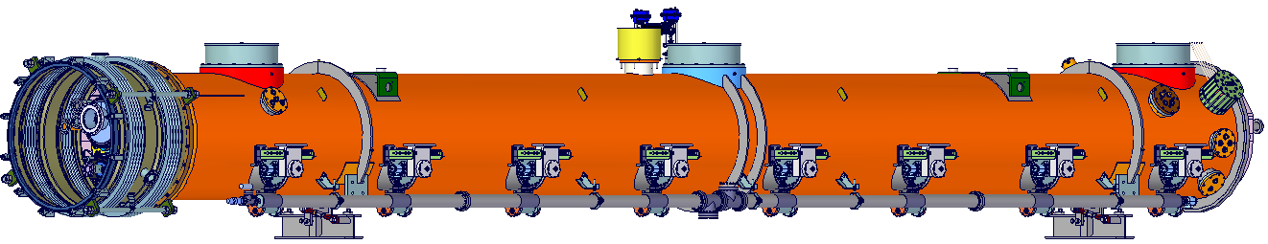
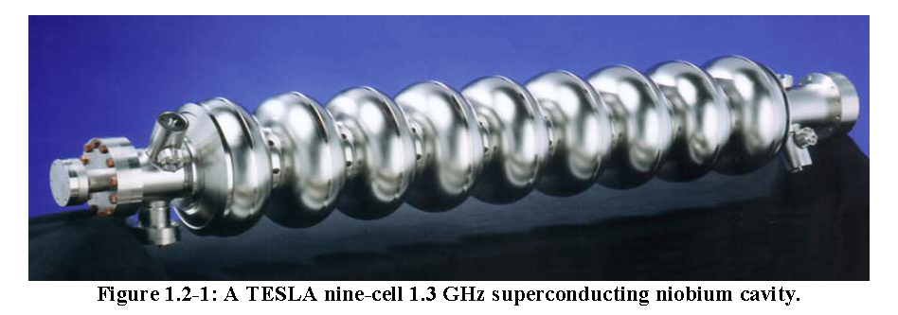
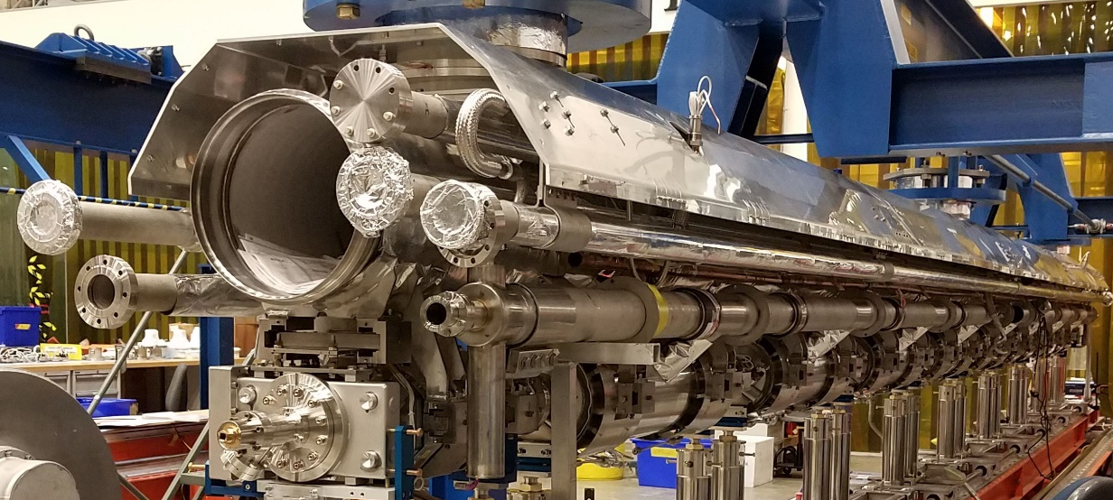
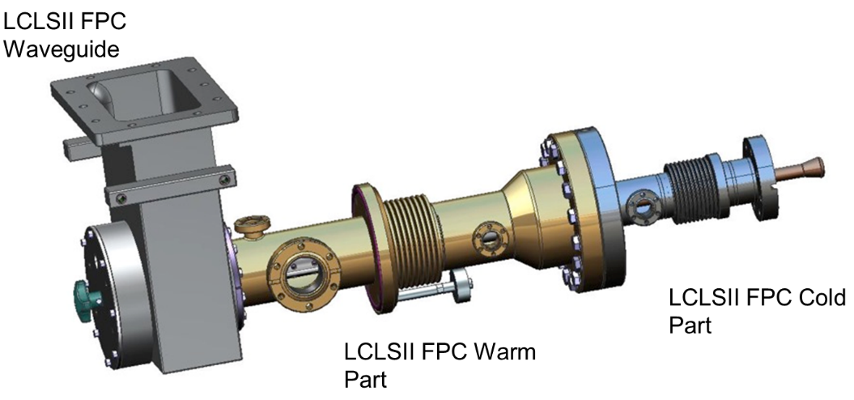
What’s in a Cryomodule?
Beamline Cavities
He Process Pipes
Fundamental Power Couplers
Dec 2024 | Cryomodule Installation | Dominique White
Notes:
And several connection to controls to keep everything going.

Slide 3
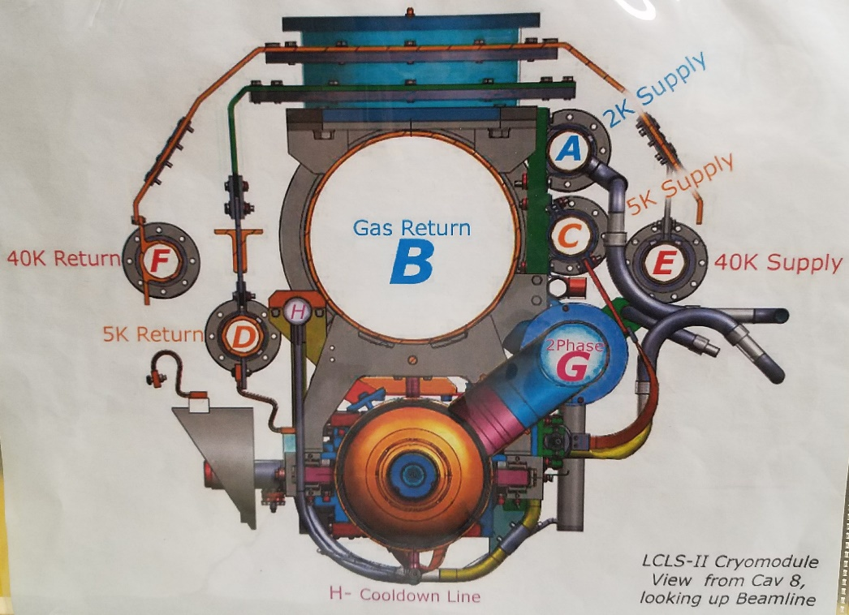
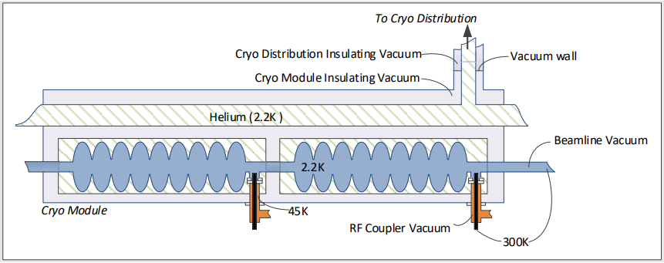
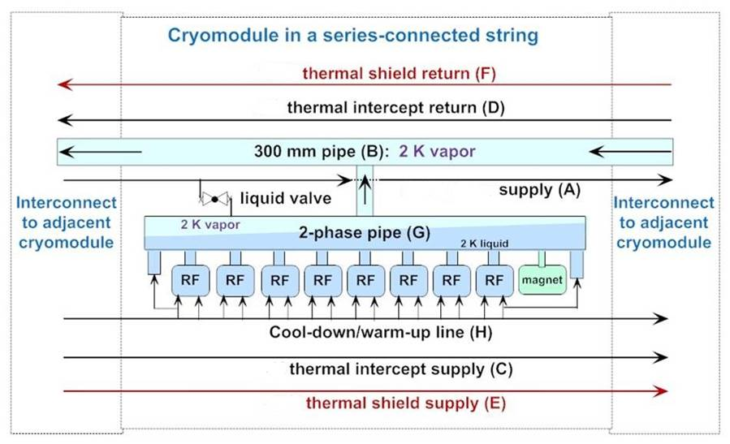
Cryomodules Have Interfaces to Each Other
Vacuum Systems
Helium Process Pipes
Beamline Vacuum
Insulating Vacuum
Dec 2024 | Cryomodule Installation | Dominique White

Slide 4
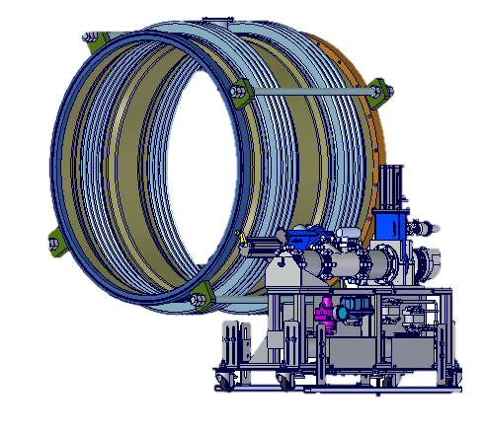
And Interfaces to Other Systems
CDA for Scav Pumps
CDA for Cryo Valves
Magnet Current Leads Port
Iso Vac Gauges and
Scav Pumps
Cryo Valves
Helium for Guard System
Waveguide Interface
He Guard Ports
Coupler Vacuum Manifold, Pump, Gauges
RF Monitoring and Instrumentation Ports
Instrumentation Ports
Controls
RF
Infrastructure/Utilities
Dec 2024 | Cryomodule Installation | Dominique White

Slide 5
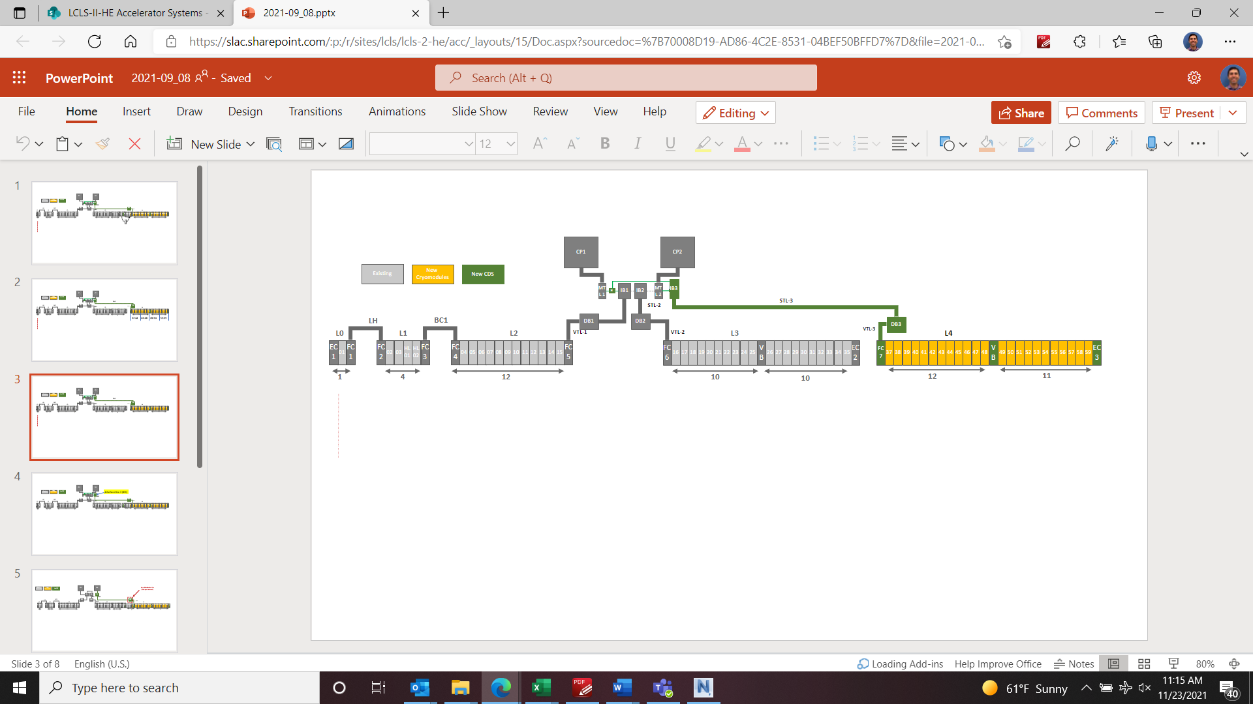
Cryomodules in the Housing
Cryomodules are installed in sections in the housing.
Interface to each other and Cryo Distribution System (CDS) components, resulting in different interconnect configurations. These were standardized as much as possible for HE
Particle Free beamline extends about 20 m on either side of Cryomodules
LCLS-II
LCLS-II HE
Dec 2024 | Cryomodule Installation | Dominique White
Notes:
Going from 4 GeV to 8 GeV
Design Report: Published - LCLS-II-HE Final Design Report.pdf - LCLS-II-HE-Design Reports

Slide 6
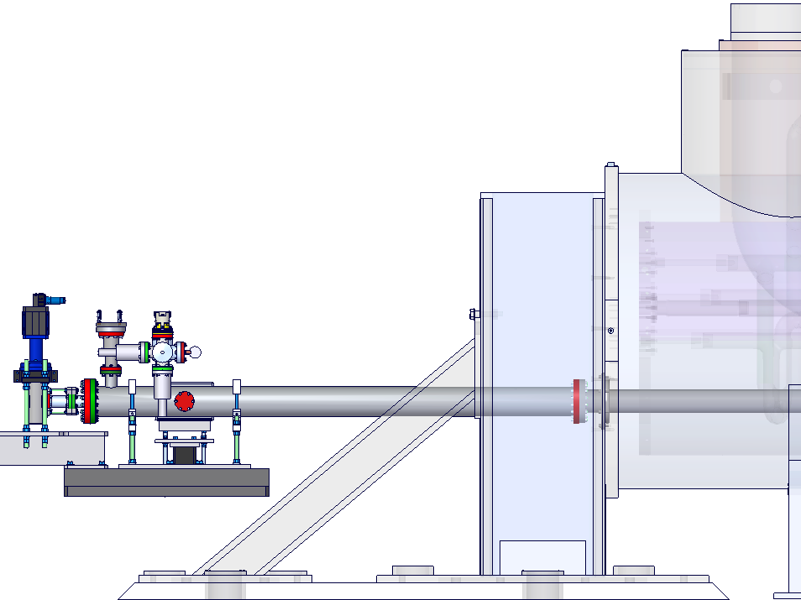
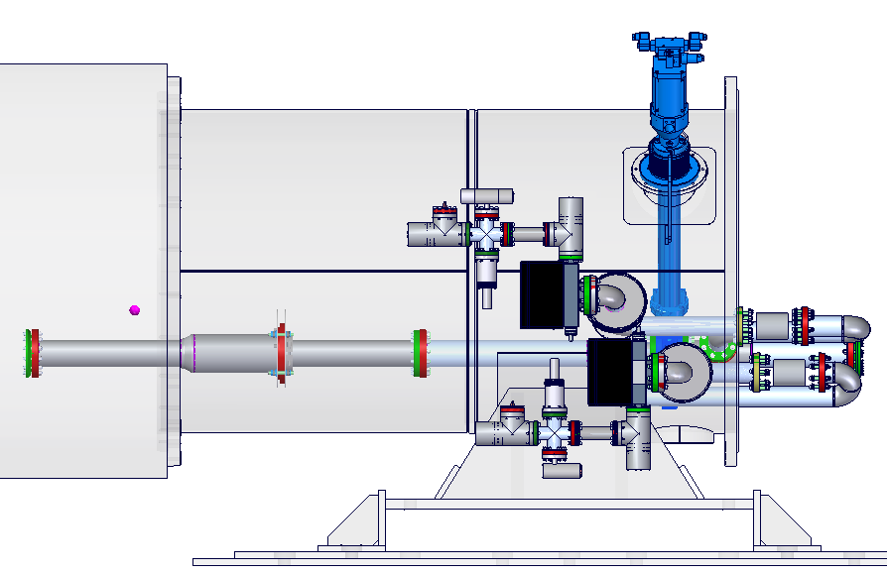
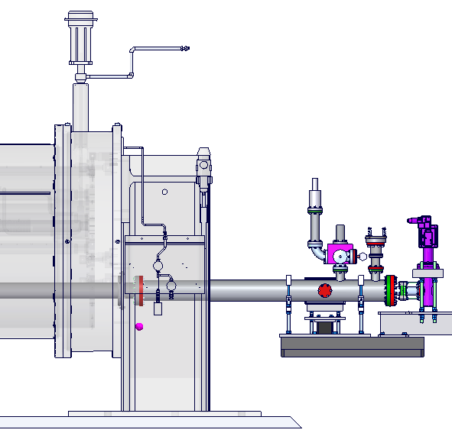
Interface to Cryo Distribution System (CDS) Components
Mechanical interfaces to CDS components have been standardized to match Cryomodule to Cryomodule interconnects.
Beam tube connections to CDS components are created with flanges that make up part of the CM insulating vacuum system.
VBB
Beam Tube
FC-7
EC-3
Valve Ext
Valve Ext
Dec 2024 | Cryomodule Installation | Dominique White

Slide 7

Installation
Notes:
How Cryomodules?

Slide 8
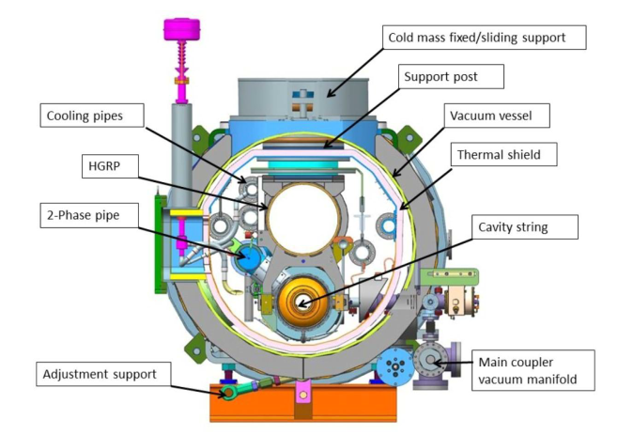
Installation Sequence
6 Major Install Phases
Unloading
Receiving / acceptance testing
Physical install / alignment
Welding cryo pipes
Particle free beamline install
Insulation vacuum / cryo equip.
Dec 2024 | Cryomodule Installation | Dominique White
Notes:
Welding needs to happen first before vacuum connection due to space constraints in interconnect

Slide 9
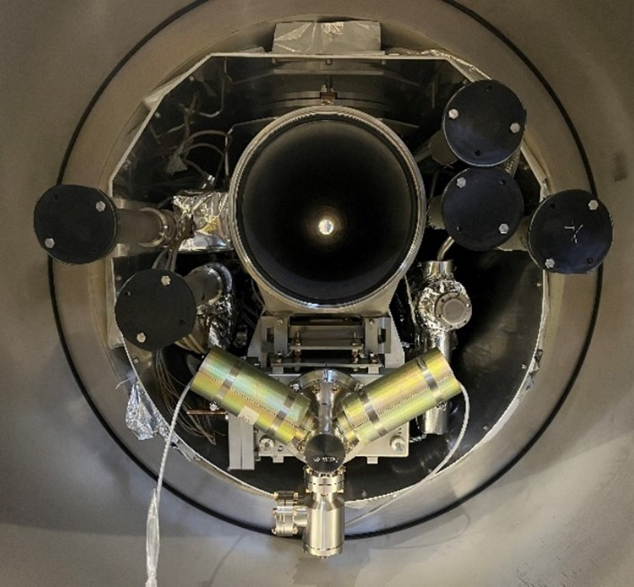
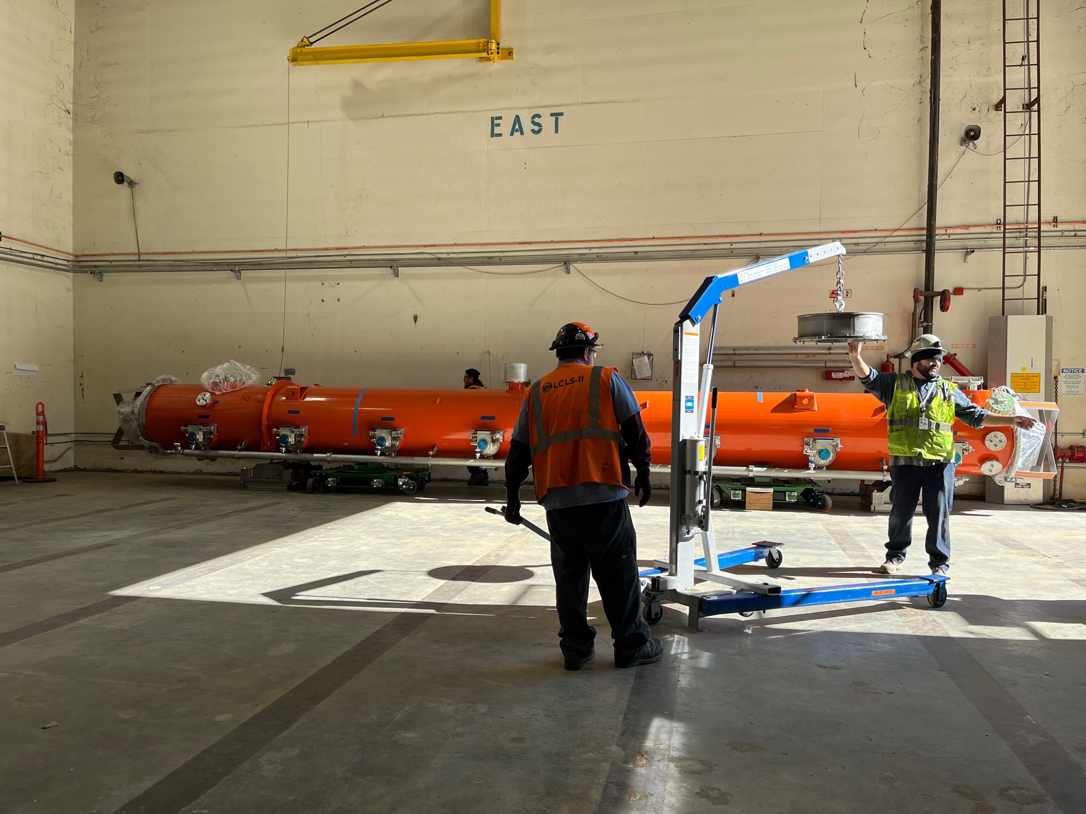
Acceptance Testing- Cryomodule Systems
Acceptance Testing
Acceptance Testing and Installation prep performed at storage location(s) and adit at SLAC
Acceptance Tests upon arrival
Alignment
RF
Instrumentation and Magnet Check-out
Vacuum testing - coupler, insulating, beamline
Mechanical Prep
Mechanical prep - weld prep, heat shields, JT valves
PF work - pump installation and gauge tree removal
M-mount removal
Dec 2024 | Cryomodule Installation | Dominique White

Slide 10
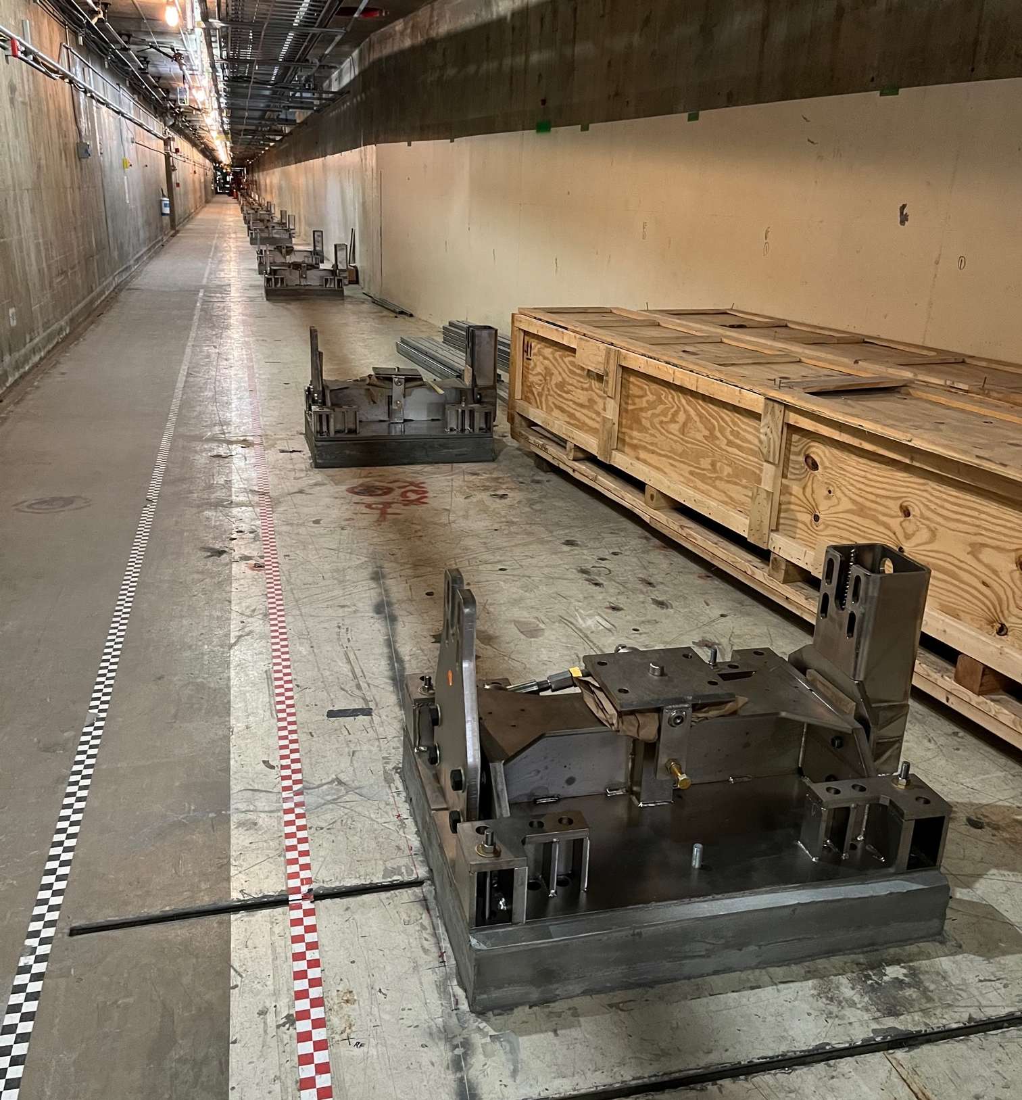
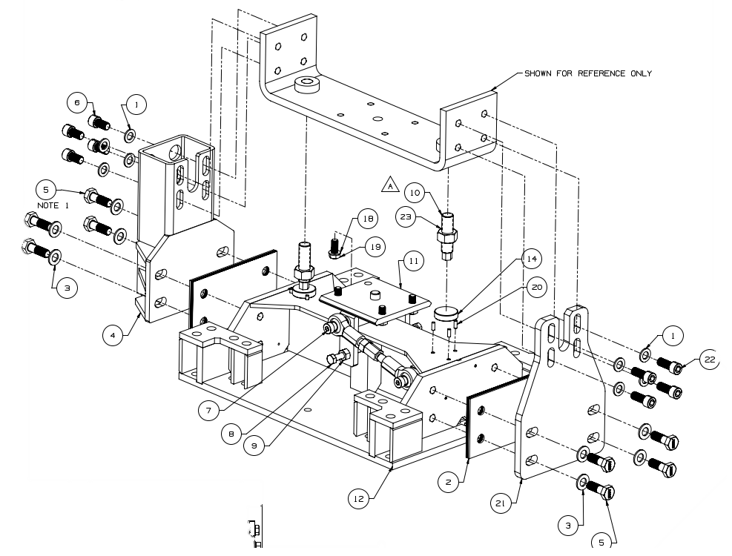
Stand Installation
Stand Install
Cryomodules sit on two stands, fixed and sliding
California has seismic considerations- may be room for optimization
Dec 2024 | Cryomodule Installation | Dominique White

Slide 11
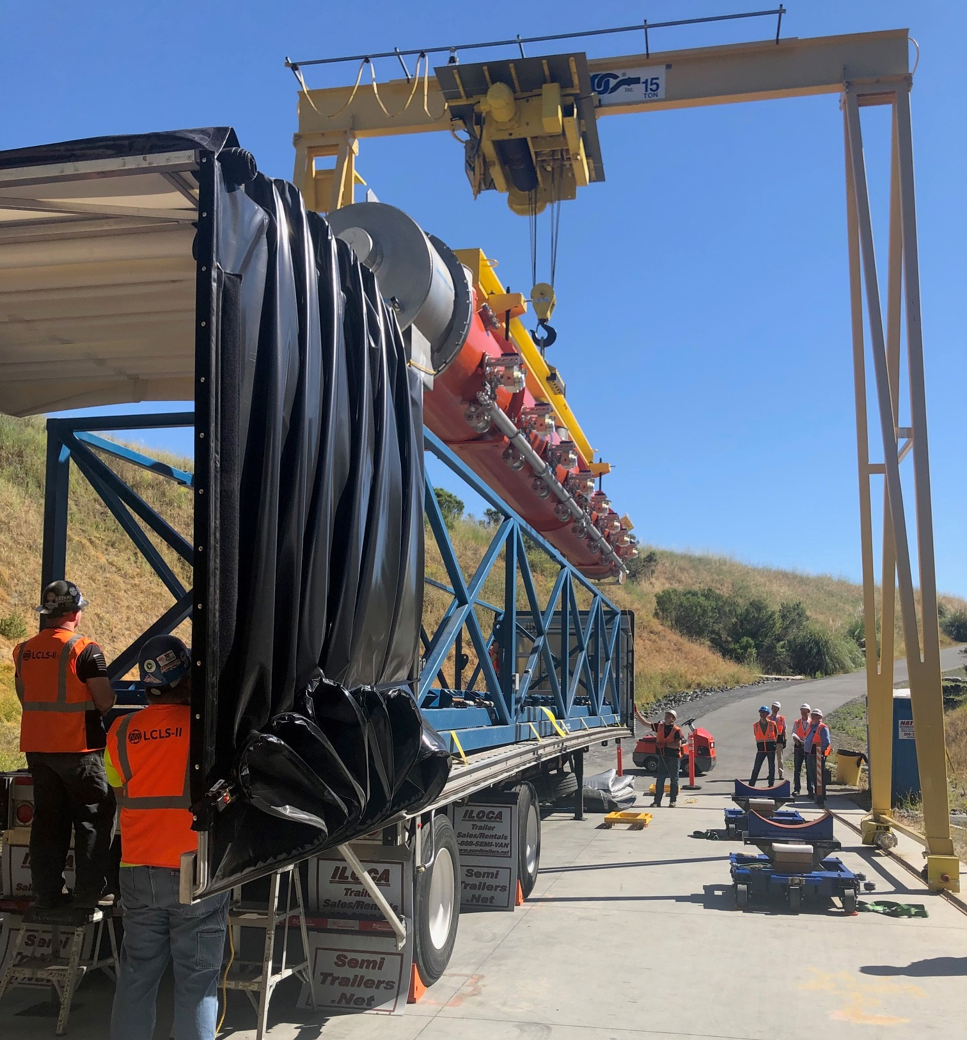
Cryomodule Transport and Unload
Unload
Cryomodules shipped from FNL and JLab in special trailer with springs to avoid damage from shocks.
They are lifted from above with a spreader bar and moved with custom dollies.
Internals are protected with M-mounts, tie downs, and shipping caps. Trips are monitored with slam sticks.
Configuration for moving across site has fewer restraints.
Dec 2024 | Cryomodule Installation | Dominique White

Slide 12
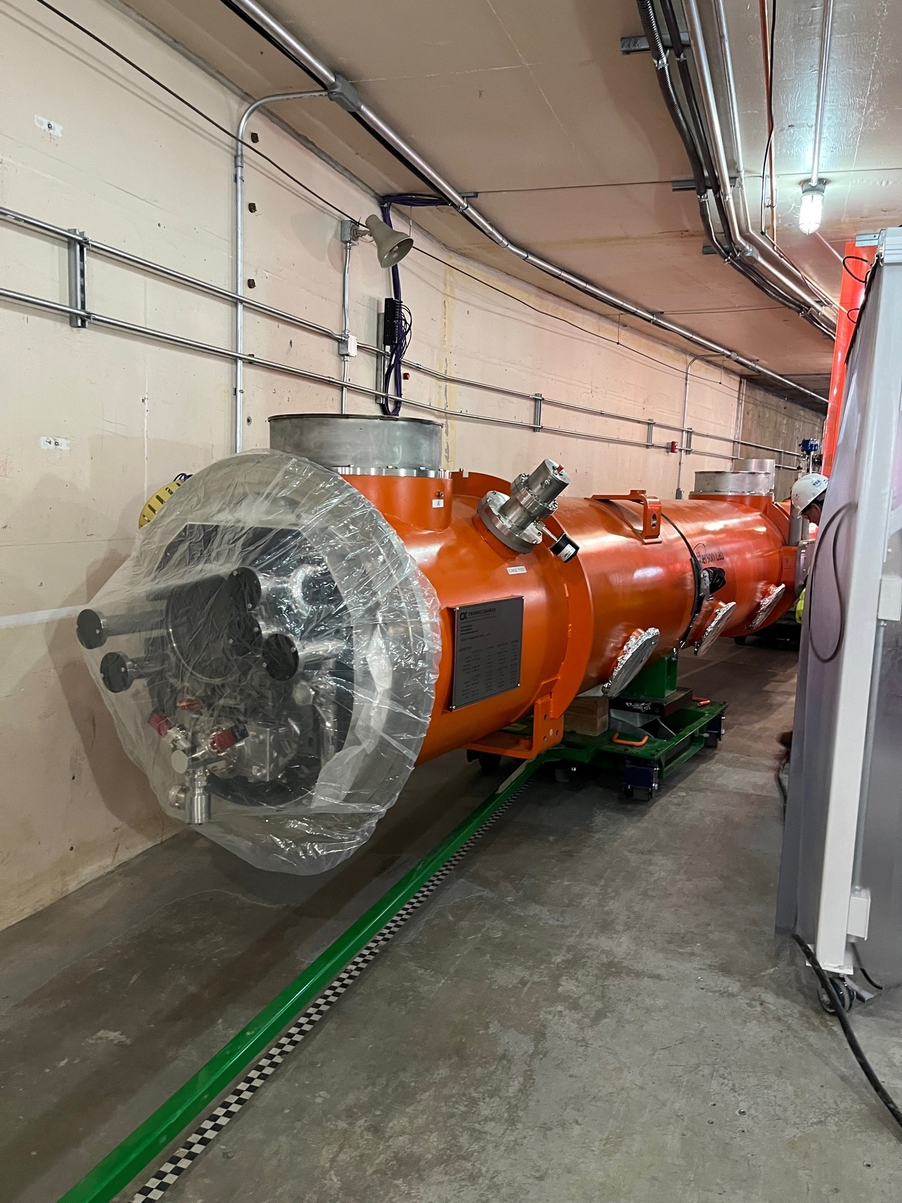
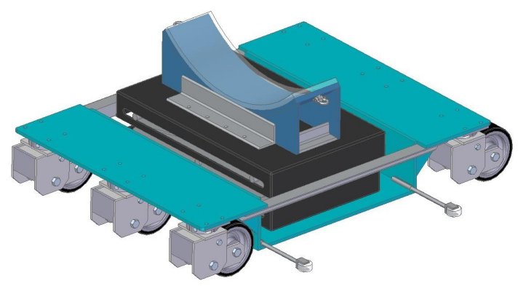
Cryomodule Transport and Unload
Unload
Use two dollies per Cryomodule and tow one Cryomodule at a time by tugger.
Attached with ratchet straps and used with a wooden hard stop on each end.
Use pneumatic jacks for a soft landing and to raise the Cryomodules into place over stands.
Detachable design allows dolly to roll into place under Cryomodule.
Need to be careful with placement. Ratchet straps need to avoid couplers.
Detachable Saddle
Guide wheels
Dec 2024 | Cryomodule Installation | Dominique White

Slide 13
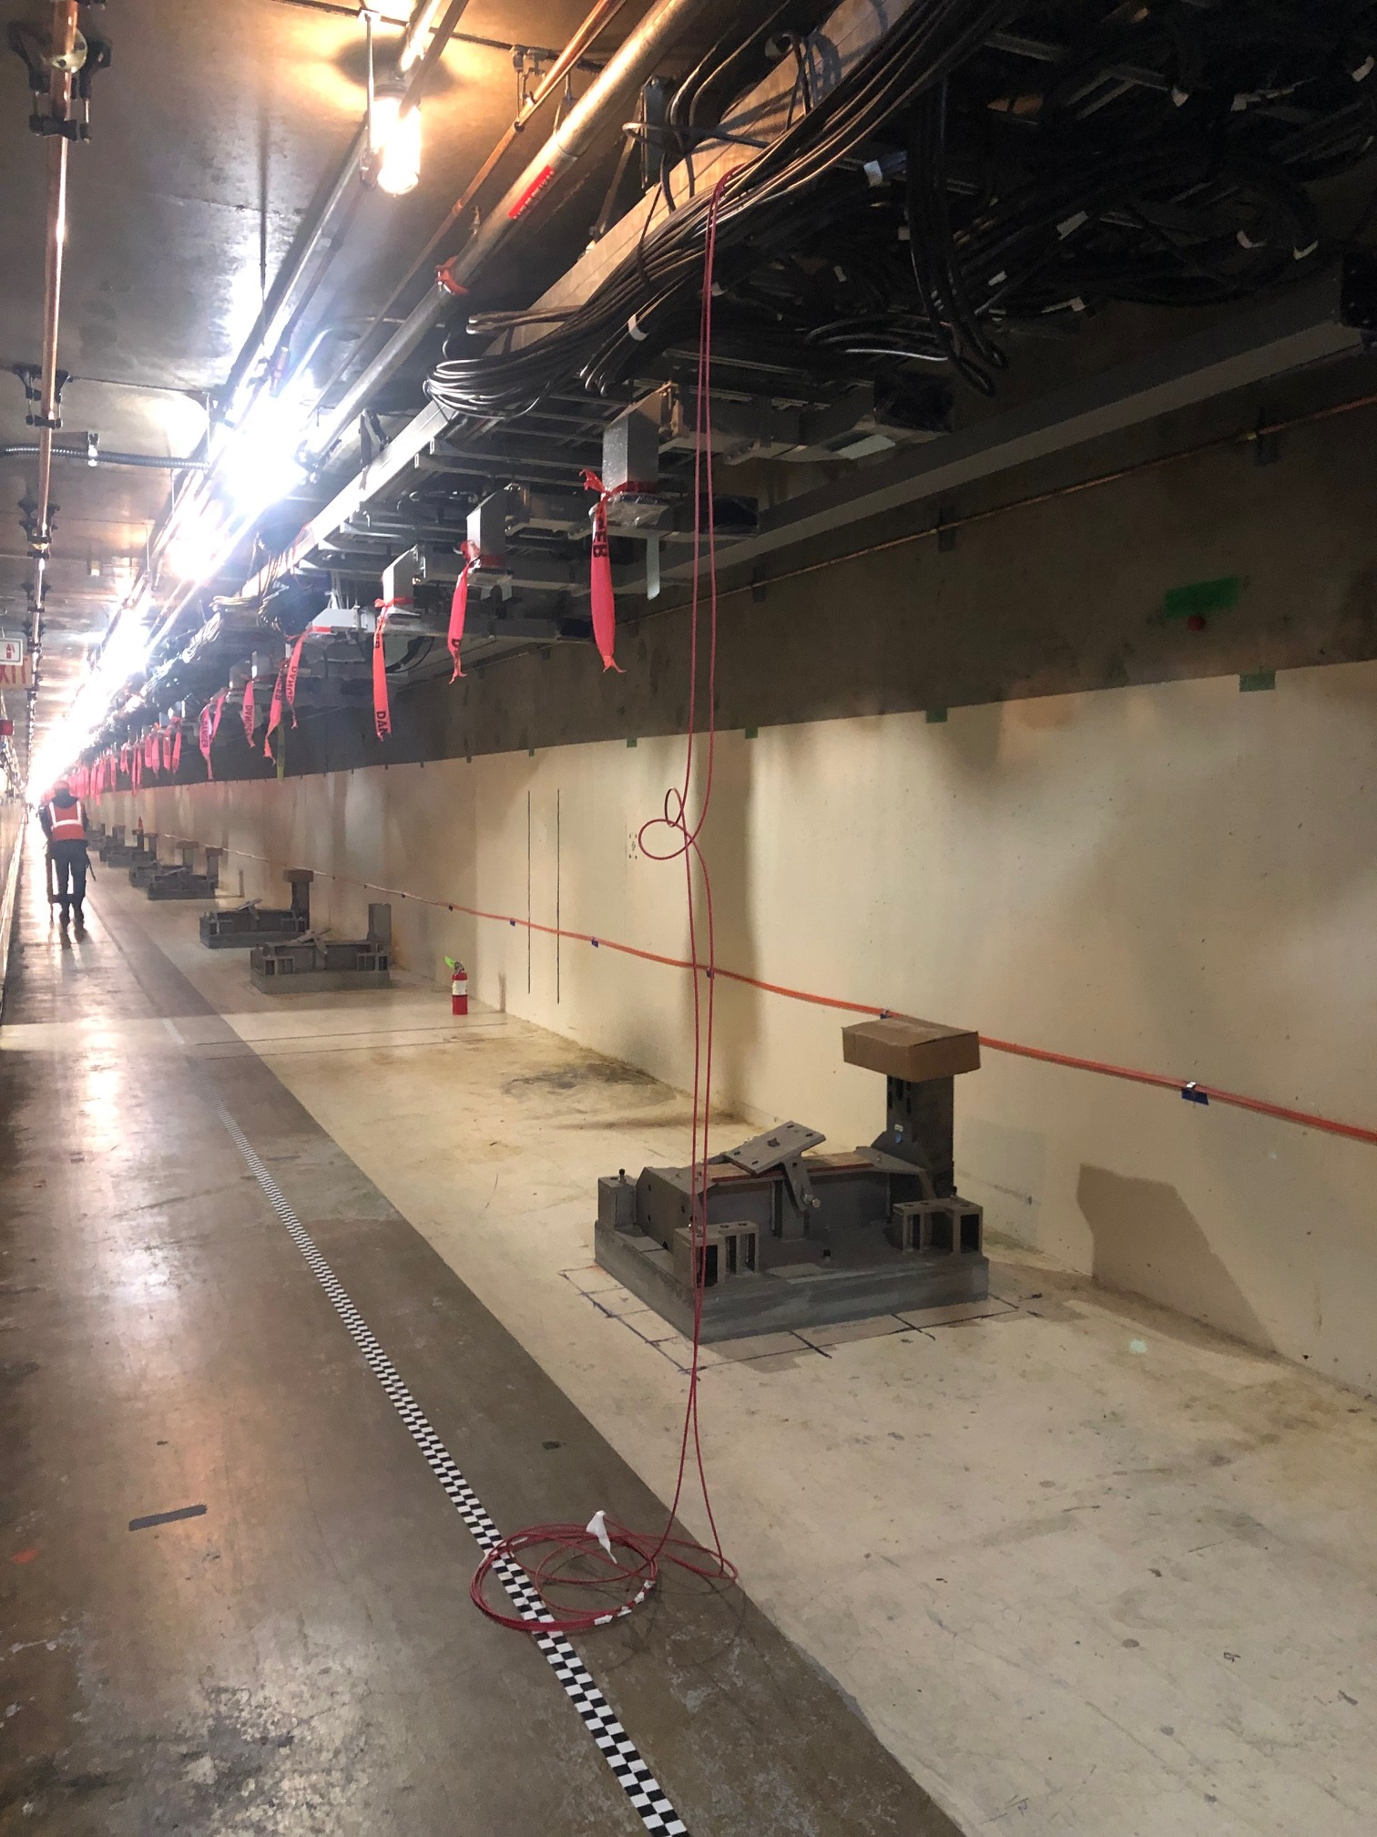
Cryomodule Physical Installation
Physical Install
Align
Some installation is required before we place Cryomodules due to size of housing and risk of working above Cryomodules:
All utilities and infrastructure- He Guard, Compressed Dry Air, etc
Cryomodule stands in place
Cable Plant Work- pulled cables coiled out of the way
Ceiling and penetration waveguide
Dec 2024 | Cryomodule Installation | Dominique White
Notes:
Cable plant- for efficiency we need the bulk of this done, but we can come back and pull cables
CDS can come later

Slide 14
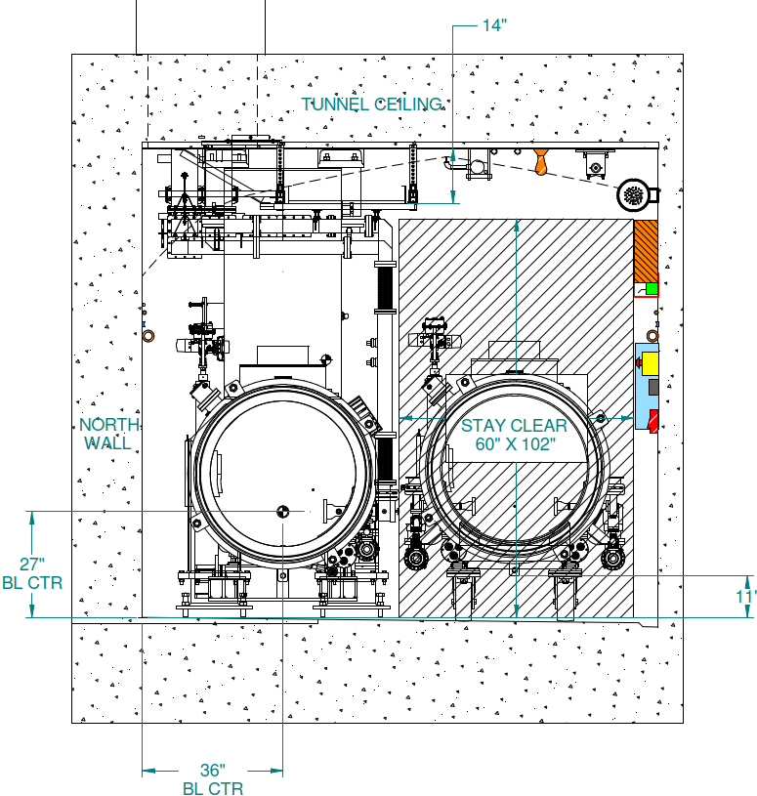
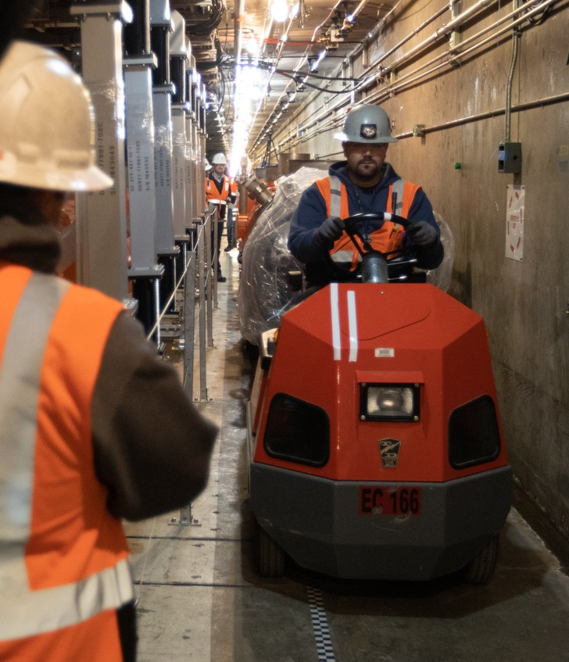
Cryomodule Physical Installation
Physical Install
Align
Cryomodules take up a lot of room
Access to housing and is completely blocked during CM moves to the housing.
Once on stands, the working space of the tunnel is cut in half.
Cryomodules are sensitive to shocks and dust from surrounding work. Once in place, no work can happen above them.
Particle free installation and welding equipment limit access for other groups. Careful coordination with other groups is crucial.
Dec 2024 | Cryomodule Installation | Dominique White

Slide 15
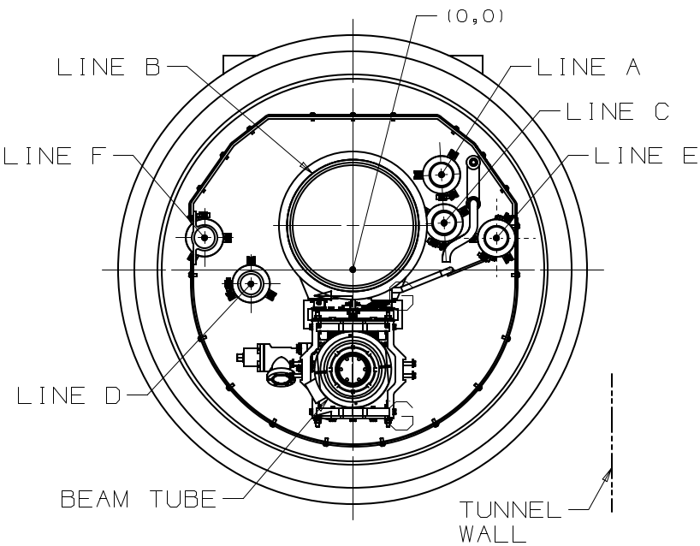
Welding and Leak Check
HGRP Weld & Exam
2” Pipe Weld & Exam
Cryo Pipe Leak Test
He process pipes are welded together with orbital weld machine.
HGRP connected with collar
2” Lines connected with bellows
Must be welded from the inside out
Important to match the metallurgy of cryo pipes at weld interfaces
Sulfur content can affect pathway of weld and programming of orbital welder
Use pipes from same batch of metal where possible
Take care to standardize pipes between CM and CDS components
Dec 2024 | Cryomodule Installation | Dominique White
Notes:
Helium gas return pipe

Slide 16
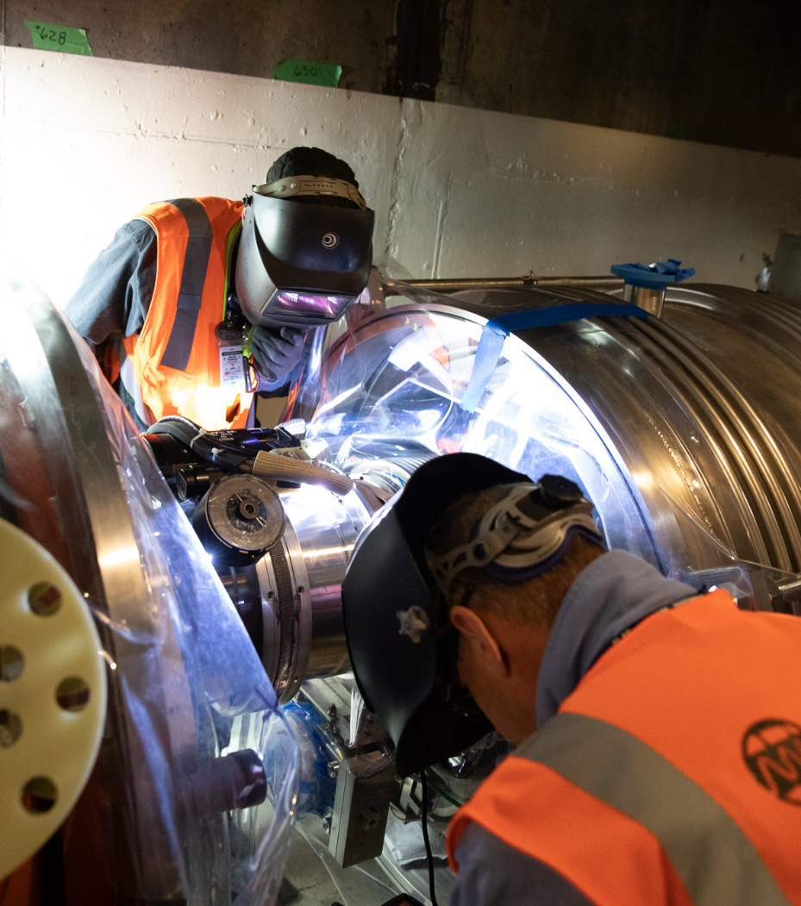
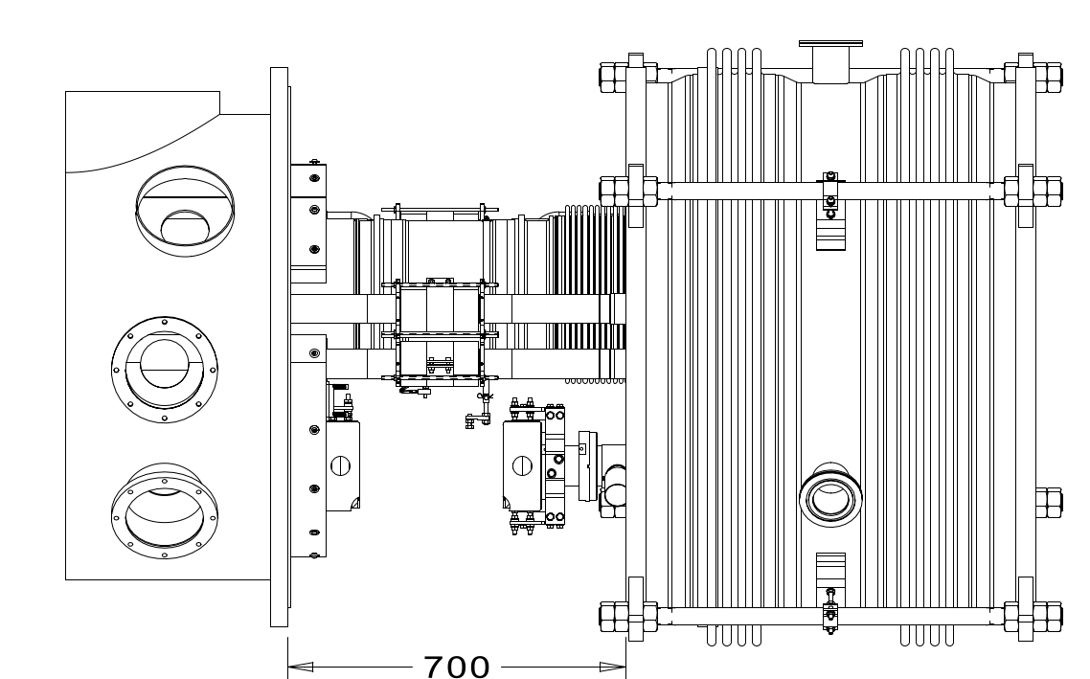
Welding and Leak Check
HGRP Weld & Exam
2” Pipe Weld & Exam
Cryo Pipe Leak Test
Dec 2024 | Cryomodule Installation | Dominique White

Slide 17
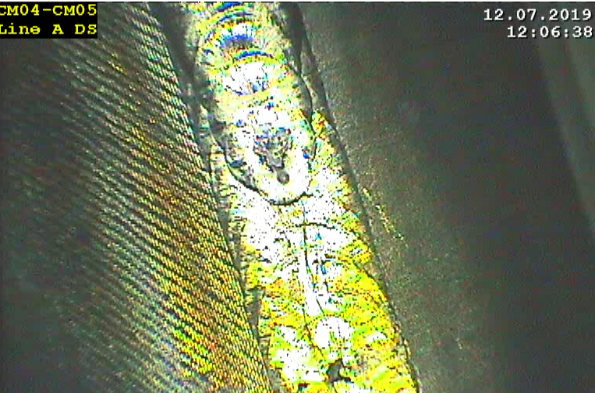
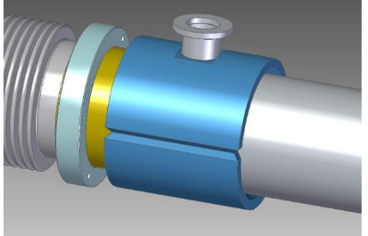
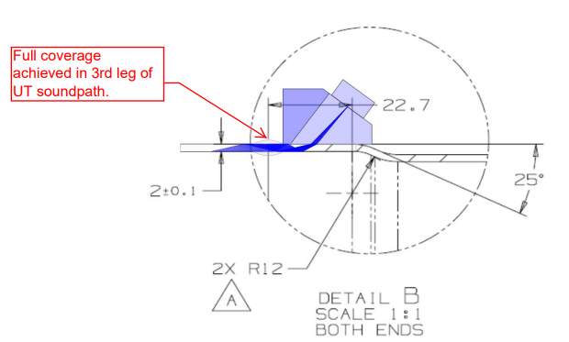
Welding and Leak Check
HGRP Weld & Exam
2” Pipe Weld & Exam
Cryo Pipe Leak Test
Several checks after welds are complete:
Visual examination- external and with borescope
Internal completed with special long borescope
Helium Mass Spectrometry Leak Test
Cryo lines are filled with helium and checked for leaks
Ultrasonic Examination
Outside contractor
Sample % of each welder’s joints
Internal Exam
Ultrasonic Exam
Clamshell
Dec 2024 | Cryomodule Installation | Dominique White
Notes:
Add a full-scale system test to prevent so vac leaks in the future

Slide 18
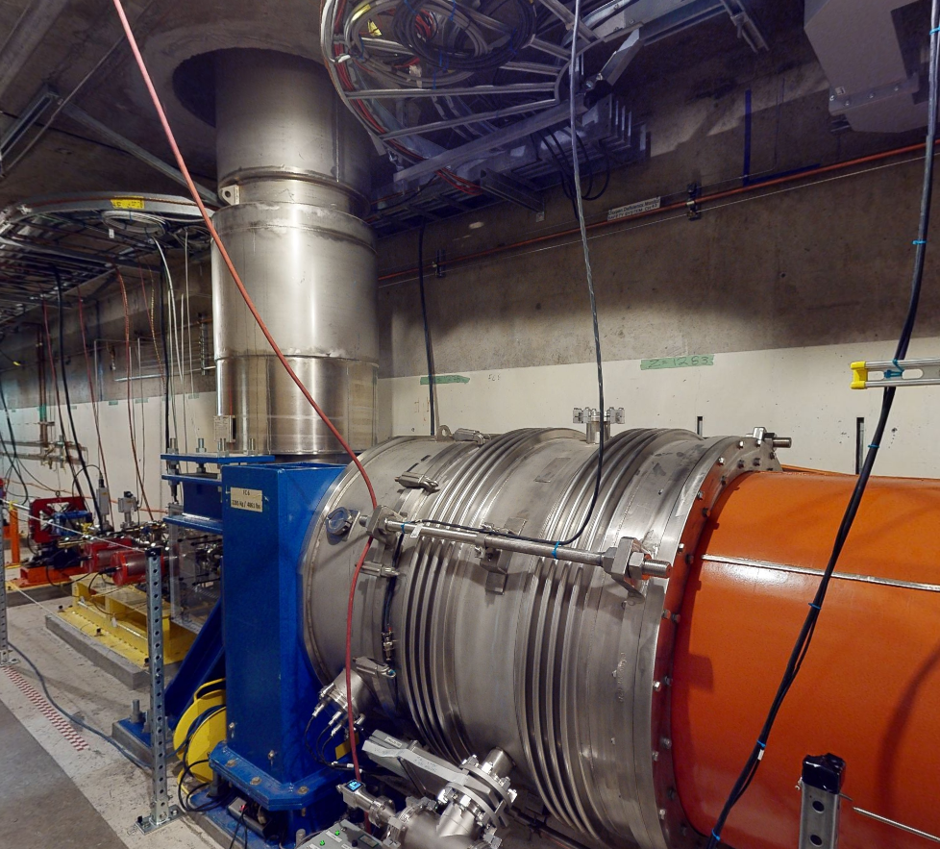
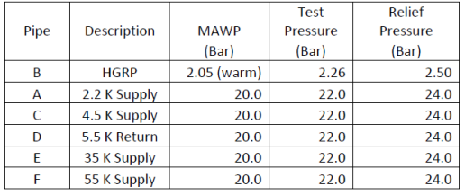
Pressure Test
Pressure Test - Full String
Pressure test of entire string once all welds are completed
Fill all pipes with a mixture of Air and 5% Helium through Vertical Transfer line
Joints are tested with a sniffer probe
Completed over a weekend for reduced access and used SLAC’s LOTO for secure access
Dec 2024 | Cryomodule Installation | Dominique White
Notes:
Pipes filled to 22 Bar

Slide 19
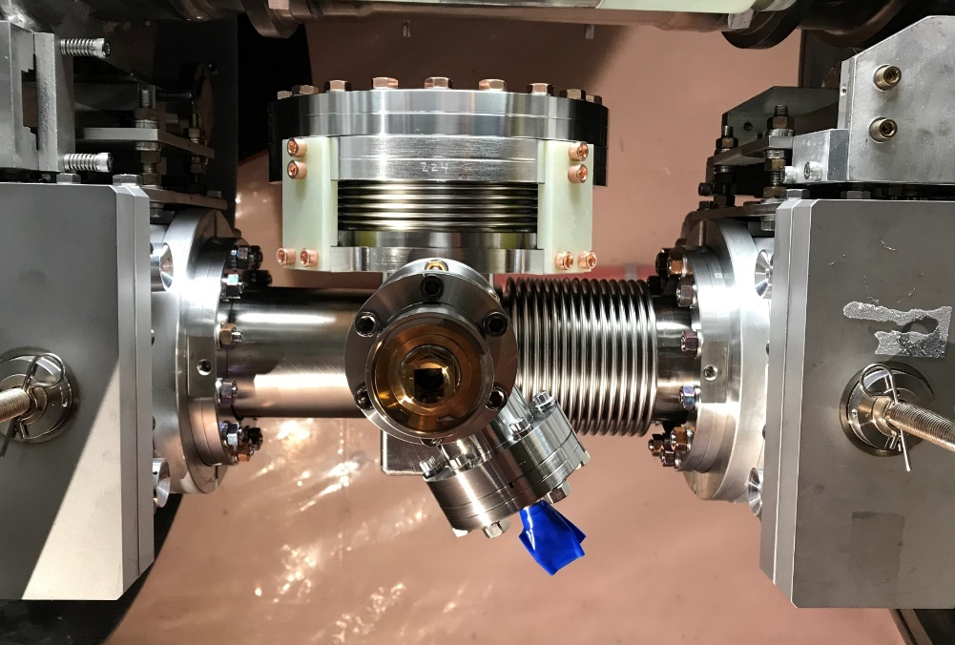
BLA Installation
BLA Install
BLA Pump Down & Leak Test
Particle-free operation to connect CM cavity strings
Install Spools and Beamline Absorbers (BLA) with aluminum gaskets
Spacing is tight and ergonomics are challenging
Cryo pipes on top of the BLA hinder any laminar flow from above
Use custom clean zone and supplemental clean bench for more working space
Dec 2024 | Cryomodule Installation | Dominique White

Slide 20
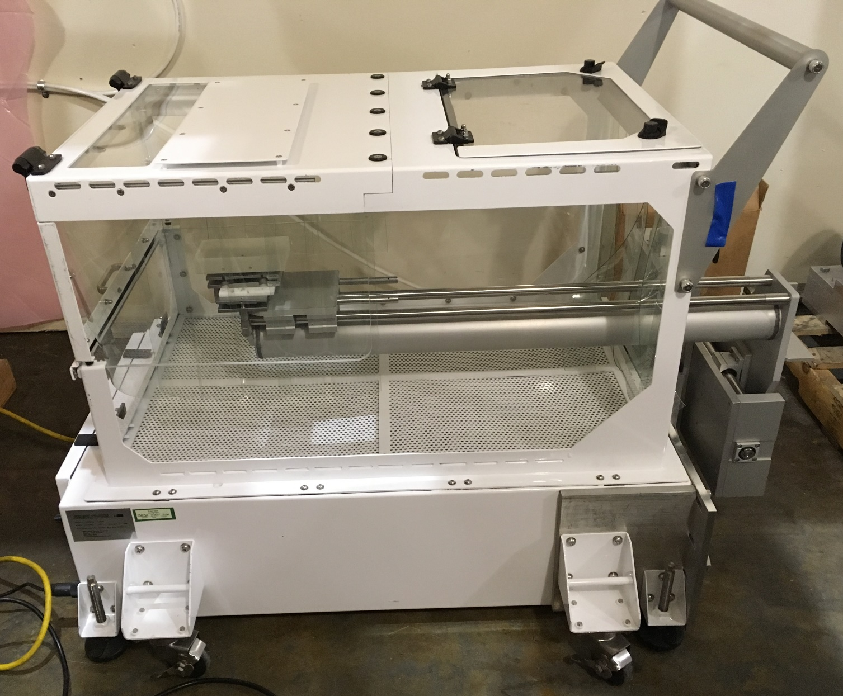
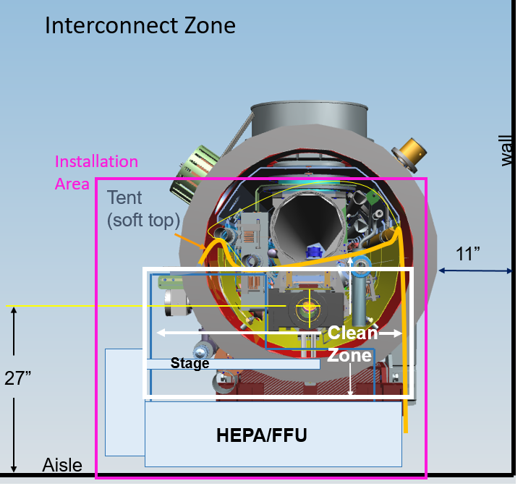
BLA Installation
BLA Install
BLA Pump Down & Leak Test
Protective top for transport
Remove for operation
Top Door
Handle for transport.
Remove for operation.
BLA stage holder
Wall
side
CLEAN ZONE
Fan filter unit (FFU)
Levelling feet
Dec 2024 | Cryomodule Installation | Dominique White

Slide 21
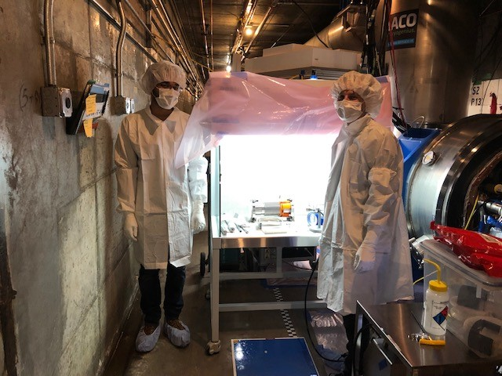
BLA Installation
BLA Install
BLA Pump Down & Leak Test
Particle-free set-up blocks Linac access for other groups/ people
Equipment:
Particle-free pump carts
Interconnect Clean zones for each kind of interconnect (FC-CM and VBB-CM, CM-CM)
Laminar flow benches
Ergonomic Equipment
One CM in interconnect MUST be open to an ion pump with gauge and controller installed to monitor beamline vacuum before BLA installation can take place
Ion pumps at VBB and valve extensions
Can use local controllers to monitor
Dec 2024 | Cryomodule Installation | Dominique White

Slide 22
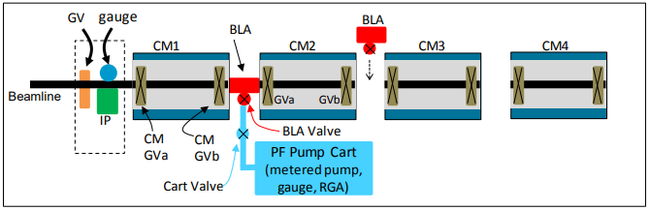
BLA Pump Down and Leak Test
BLA Install
BLA Pump Down & Leak Test
Gauge tree removed before Cryomodules are installed. Cryomodule vacuum is unknown when PF connections are made.
Need to start PF connections at a side of the string with a gauge to monitor beamline during installation
Always open to Cryomodule with unknown vacuum first
Dec 2024 | Cryomodule Installation | Dominique White

Slide 23
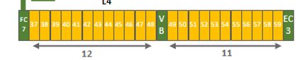
BLA Installation vs Welding
BLA Install
BLA Pump Down & Leak Test
Welding wants to start here
Pump
Pump
Pump
Pump
BLA’s
BLA’s want to start here
Welding needs to happen before vacuum connections
Welding wants to start one interconnect removed from EC and FC for more efficient purge of lines
BLA installation needs to start with ion pump to monitor and maintain beamline vacuum
Pumps are located at FC, EC, and VBB
This conflict is overcome by use of the VBB in the middle of the CM string
Dec 2024 | Cryomodule Installation | Dominique White

Slide 24
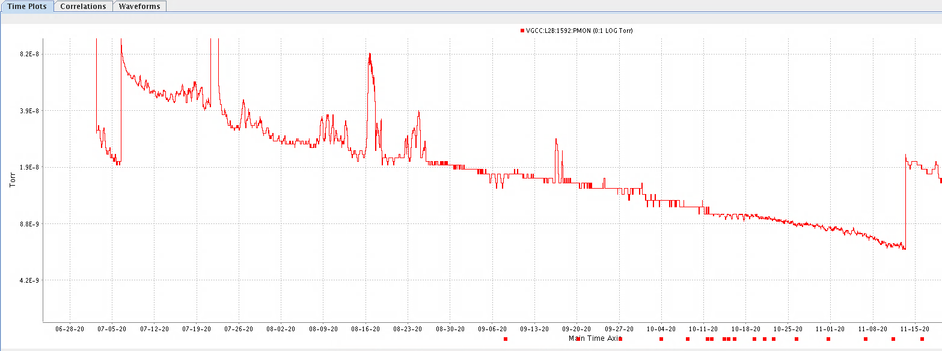
Beamline Pump Down
BLA Install
BLA Pump Down & Leak Test
Beamline needs to be less than 1e-8 Torr on the ends before cool down
Data from LCLS-II suggests this takes about 3 months to achieve for a string of 12 Cryomodules
Dec 2024 | Cryomodule Installation | Dominique White
Notes:
Used to inform outgassing rates and ceramic factor

Slide 25
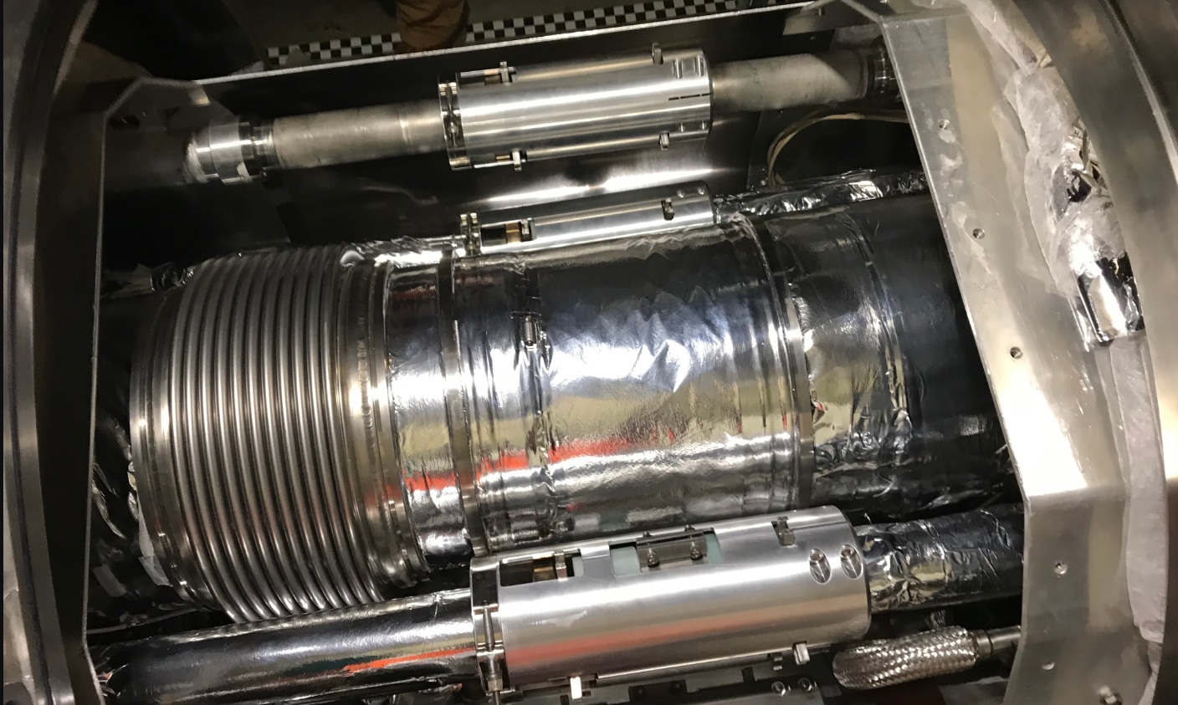
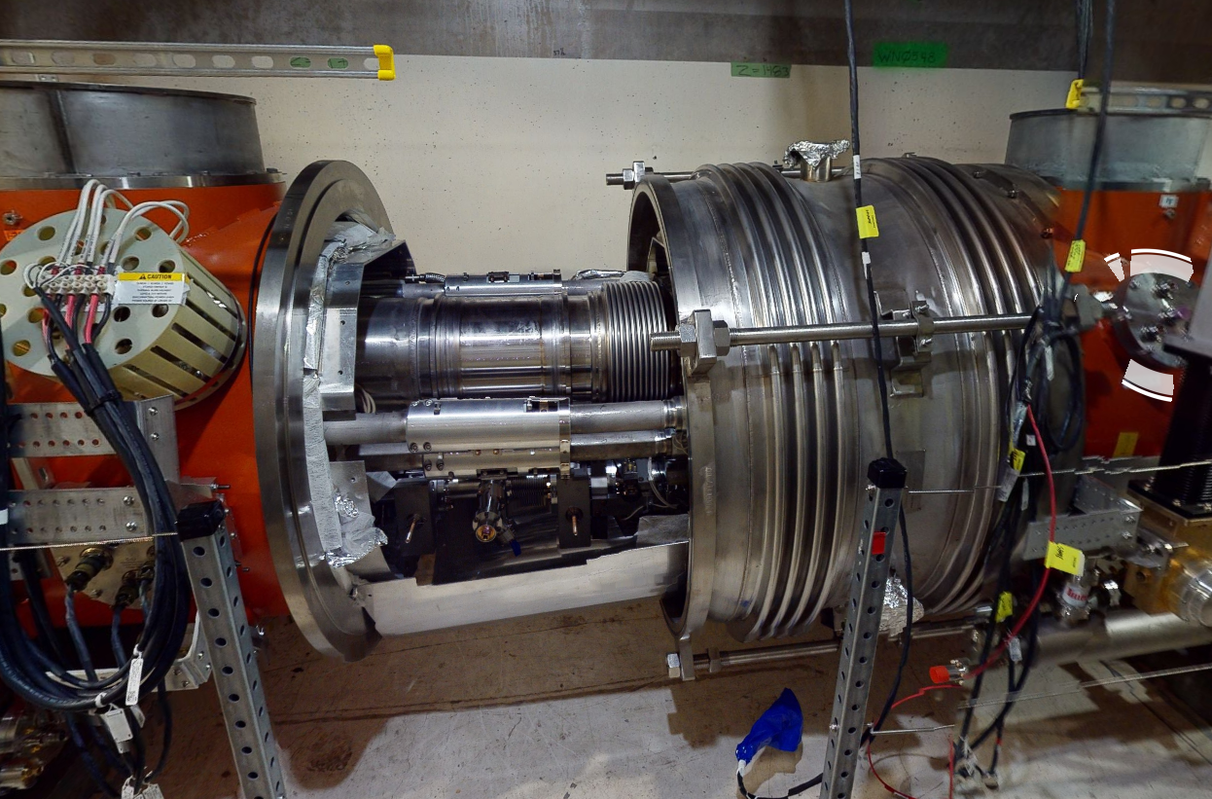
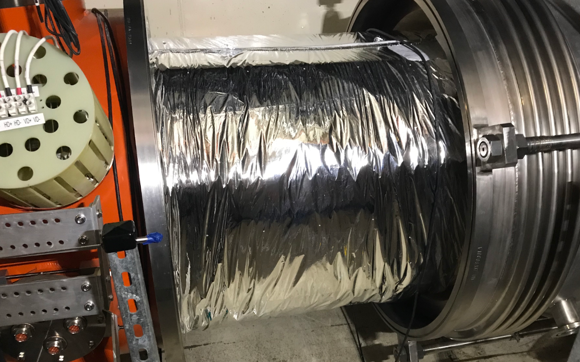
MLI and Interconnect Completion
MLI & Heat Shield Install
Interconnect completion:
Wrap with MLI
Install remaining equipment (heat strap, BLA spring support)
Close up large bellows
Install gauges and gate valves
Take pictures of interconnect before close-up
Dec 2024 | Cryomodule Installation | Dominique White

Slide 26
Cryomodule Insulating Pump Down
Insulation Vac Pump and Leak Test
Insulation Vac Pump and Leak Test
Divided into L4 US and DS at VBB for easier management
Each insulating vacuum space needs to be pumped to 1x10-4 Torr. Expect 2-3 months to reach spec.
Pump and purge each insulating vacuum space three times with nitrogen and check seals of big bellows.
Roughing is completed with MU 600 pump
Use He Scav Pumps (permanent) and aux pumps (temporary) to meet spec
Dec 2024 | Cryomodule Installation | Dominique White

Slide 27
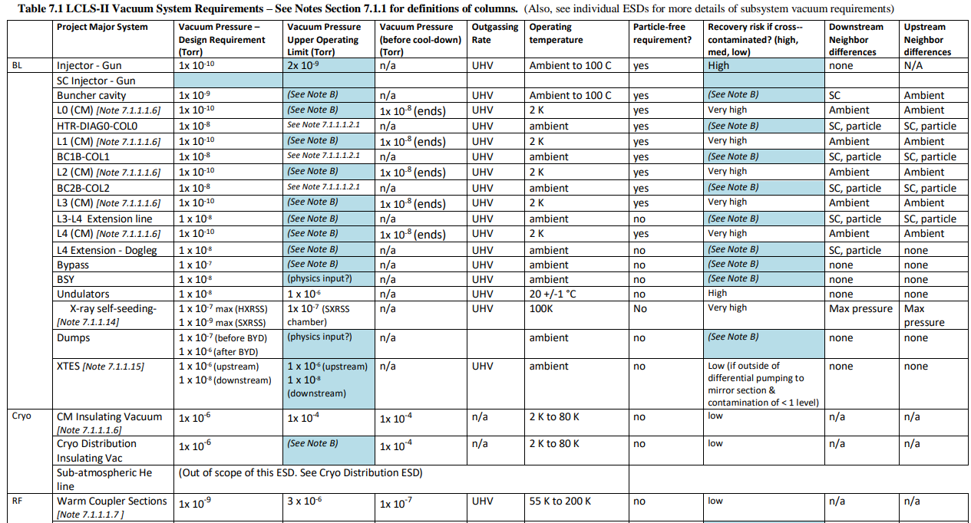
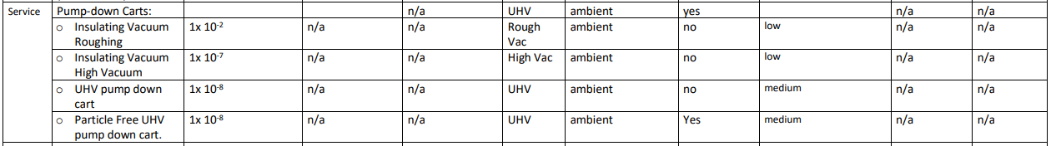
Requirements and Specifications
SLAC-I-020-101-007-00 - Linac & FEL Facility Vacuum Specifications
18 September 2023 | L4 String and Beam Tube FDR | Dominique White
Notes:
AD doc that covers accelerators
Vacuum pressure upper limit mainly pertains to switches

Slide 28
Installation Sequence
6 Major Install Phases
Unloading
Receiving / acceptance testing
Physical install / alignment
Welding cryo pipes
Particle free beamline install
Insulation vacuum / cryo equip.
Dec 2024 | Cryomodule Installation | Dominique White
Notes:
Welding needs to happen first before vacuum connection due to space constraints in interconnect

Slide 29
Questions?
Notes:
How Cryomodules?

Slide 30
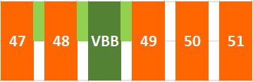
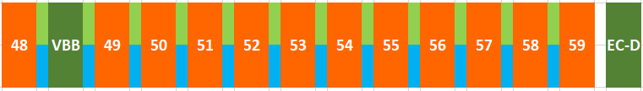
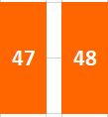

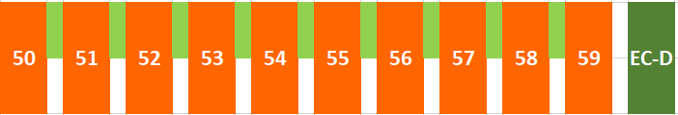
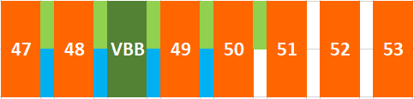
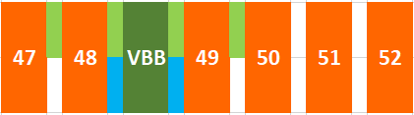
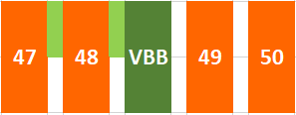

Schedule – CM 47-59
CM Start
Weld Start
BLA Start
First group of CM’s brought in - 47 to 59
Welding and BLA teams follow immediately behind. Welding and vacuum work for the first CM’s can happen while CM’s are being brought downstream. Equipment won’t block CM installation
Particle free work start from the VBB when welding for each interconnect is complete
Nov 2024 | Cryomodule Installation | Dominique White
Notes:
Stacked animated with fade in timing

Slide 31




Schedule – CM 37-47
Last two welds to complete
CM Start
Weld Start
BLA Start
Once 58-59 welding is complete, bring in CM 37-46
Welding starts from 37-38 and works downstream
Once FC-7-CM 37 is complete, BLA work can resume
Pressure test of helium process pipes follows welding
Once BLA and process pipes are complete, interconnects are closed, and insulating vacuum pump down can begin
Other interface connections can be made (RF, Controls, Utilities)
Nov 2024 | Cryomodule Installation | Dominique White
Notes:
Second animation- welding to follow CM’s coming in

Slide 32

Overall Schedule
How does this play out with other groups? To the color block!! and MSP
Nov 2024 | Cryomodule Installation | Dominique White

Slide 33
Bonus: Requirements and Interfaces

Slide 34
Requirements and Specifications
Delete?
Following docs list requirements for L4 Cryomodule String design
All are released
 | Doc Number | Description
Physics Requirements and MAD Deck | LCLSII-HE-1.1-PR-0018 | LCLS-II-HE Linac Requirements
 | LCLSII-HE-1.1-PR-0039 | LCLS-II-HE Parameters
 | LCLSII-HE-1.2-PR-0029 | LCLS-II-HE SCRF 1.3 GHz CM
 | MADdeck | March 2023
Vacuum System Specifications | SLAC-I-020-101-007 | Linac & FEL Facility Vacuum Specifications
 | SLAC-I-020-101-008 | Linac Particle-Free Engineering Specifications
Physical Interface | LCLSII-4.5-IC-0661 | 1.3 GHz Cryomodule Physical Interfaces
Housing RDS | LCLSII-HE-1.6-RD-0290 | HE Linac Housing Sectors 0-10 for infrastructure requirements
**ICD** | LCLSII-HE-1.3-IC-0906 | HE L4 Cryomodule String to Controls, Infrastructure, and CM Systems ICD
Provides all information on interfaces between groups
18 September 2023 | L4 String and Beam Tube FDR | Dominique White

Slide 35

Requirements and Specifications
Delete?
LCLSII-HE-1.1-PR-0018 - LCLS-II-HE Linac Requirements
LCLS-II
LCLS-II HE
18 September 2023 | L4 String and Beam Tube FDR | Dominique White

Slide 36

Requirements and Specifications
Delete?
LCLSII-HE-1.2-PR-0029 - LCLS-II-HE SCRF 1.3 GHz CM
18 September 2023 | L4 String and Beam Tube FDR | Dominique White
Notes:
Recap of 1.3 GHz CM parameters
Drives installation procedures and layout of Cryomodules

Slide 37
Layout and Technical Analysis

Slide 38

Drawings and Schematics
In addition to partner lab drawings, SLAC team has released drawings of CM string and vacuum schematics
Drawing | Description | Status
DSG-000063012 | Vacuum Schematic | Released
DSG-000007866 | L4A Cryomodule String Layout | Final Review
DSG-000007867 | L4B Cryomodule String Layout | Final Review
DSG-000048432 | ASSY, CM, 1.3GHz, HE, LCLS2 | Released
DSG-000056783 | CM Stand Installation Hardware Kit | Released
DSG-000066051 | CM Fixed Sliding Stand | Released
DSG-000066048 | CM Adjustable Sliding Stand | Released
ID-375-240-01 | Helium Scav Pump Installation | Released
18 September 2023 | L4 String and Beam Tube FDR | Dominique White

Slide 39




Drawings and Schematics
18 September 2023 | L4 String and Beam Tube FDR | Dominique White
Notes:
What’s included here- mad deck positions and stands

Slide 40

Vacuum Analysis
LCLSII-HE-1.3-EN-0938 - LCLS-II-HE Vacuum Analysis for L4B
Updated outgassing rates for CM’s, BLA’s, and beam tubes to determine beamline vacuum
Planned pumping is sufficient to meet requirements for cool down
Pressure estimate when warm after 3 months
18 September 2023 | L4 String and Beam Tube FDR | Dominique White

Slide 41
To Delete

Slide 42
Installation Sequence
Stand Install
Acceptance Testing
Unload
Physical Install
Align
HGRP Weld & Exam
2” Pipe Weld & Exam
Cryo Pipe Leak Test
Pressure Test - Full String
BLA Install
BLA Pump Down & Leak Test
MLI & Heat Shield Install
Insulation Vac Pump and Leak Test
1 Day
10 Days
.75 Day
.75 Days
.5 Day
2.5 Days
2.5 Days
2.25 Days
7 Days
1.5 Day
1.5 Day
3 Days
5 Days
6 Major Install Phases
Unloading
Receiving / acceptance testing
Physical install / alignment
Welding cryo pipes
Particle free beamline install
Insulation vacuum / cryo equip.
The time for one CM is ~15.75 days
Duration is how long it will take a group to finish a defined task for one Cryomodule
Pressure test and pump down include multiple Cryomodules at once.
LCLS-II
Nov 2024 | Cryomodule Installation | Dominique White
Notes:
Welding needs to happen first before vacuum connection due to space constraints in interconnect

Slide 43
Installation Procedures
Doc Number | Procedure
LCLSII-HE-1.2-PP-0375 | LCLS-II-HE Cryomodule Rigging and Alignment Procedure
LCLSII-4.5-PP-1602 | 1.3 GHz Cryomodule Cable Restraint Bracket Installation Procedure
LCLSII-4.5-PP-0933 | Cryomodule Stand Installation and Alignment Procedure
LCLSII-4.5-PP-2142 | Installation of Auxiliary Pump for Cryomodule Insulating Vacuum String
LCLSII-4.5-PP-1571 | Cryomodule Beamline Spool Installation Procedure
LCLSII-4.5-PP-0937 | Cryomodule BLA Installation Procedure
LCLSII-4.5-PP-0936 | Cryomodule Weld Examination Procedure
LCLSII-4.5-PP-2114 | LCLS-II Port Guard Helium System Leak Check Procedure
LCLSII-4.5-PP-2107 | LCLS-II Port Guard Helium System Testing Procedure
LCLSII-4.5-PP-0938 | Cryomodule Cryo Equip Installation Procedure
LCLSII-4.5-PP-1820 | Cryomodule Coupler Vacuum Pump Down Procedure
LCLSII-4.5-PP-1314 | Cryomodule Insulation Vacuum Pumping Procedure
LCLSII-4.5-PP-0932 | Cryomodule Anchor Installation Procedure
LCLSII-4.1-PP-2067 | Helium Leak Check of Cryomodule and End Cap Cryo Process Interfaces
LCLSII-4.5-PP-2143 | Cryomodule Insulation Vacuum RGA Testing
LCLSII-4.5-PP-0939 | Cryomodule String Pressure Test Procedure
LCLSII-4.5-PP-1560 | Cryomodule String Pressure Test Search Procedure
LCLSII-4.5-PP-0935 | Cryomodule Welding Procedure
LCLSII-4.5-PP-1871 | Setup And Demagnetization Of LCLS-II Production Cryomodules
LCLSII-4.5-PP-1959 | Setup and Demagnetization of Installed LCLS-II Production Cryomodules
LCLSII-4.5-PP-1964 | Cryomodule Helium Guard Installation Procedure
Nov 2024 | Cryomodule Installation | Dominique White

