Slide 1
Installation Schedule Planning, Integration and Communication
Project Community of Practice Meeting
Pablo Reguero, Project Controls, PMO/LCLS-II-HE
Notes:
Hello everyone, I’m Pablo. I’ll be discussing some of the challenges the LCLS 2 H.E. project has been facing when kl information on the execution/installation plans that different teams on the project develop and maintain. We'll see how we’ve developed and deployed a solution that is now being used across the lab to communicate and evaluate the installation schedule.

Slide 2

Introduction
Pablo Reguero, Project Controls Specialist- PMO
Joined June 2024
Project Management Controls System, PMO
Dedicated to the LCLS-II-HE Project under Jarrod Fitzpatrick (Project Manager)
M.S. in Construction Management from CSU East Bay
B.S. Civil Engineering from the US Coast Guard Academy
Twelve years of working with Federal Contracts and Construction Projects as Civilian and Active Duty
Notes:
Before we go further, I do want to give a briefly introduce myself. I’m Pablo.
I joined SLAC in June 2024 ,not too long ago and I’m part of the PMO Organization.
I’ve been working in Construction and in Project Management for about 12 years.
I have a undergraduate degree from the US Coast Guard Academy and I did my graduate work in CSU East Bay.

Slide 3
Background
Challenges:
Planning installation work
Coordinating between teams
Communicating and reporting consistently
Solutions
Integrated MS Project Online that is Updated Weekly
Tableau Report that Syncs from Data on the MS Project
Notes:
One of the key challenges we’ve encountered is that each team uses diverse methods for documenting and planning at the their own task level., which can and does, make coordination between teams rather complicated. Especially since each group and team will have different ways of executing and in general thinking about their work.
The second issue that we focused on improving is the process of updating reports after data changes. We often create multiple versions of reports to satisfy requirements for different audiences. A slide with deadlines, or work completed. A Timeline VS a Gantt chart etc.
This commonly leads to duplicated efforts and can be inefficient. At the moment this is still very time-consuming because it is iterative, since it’s iterative it is also error-prone.

Slide 4
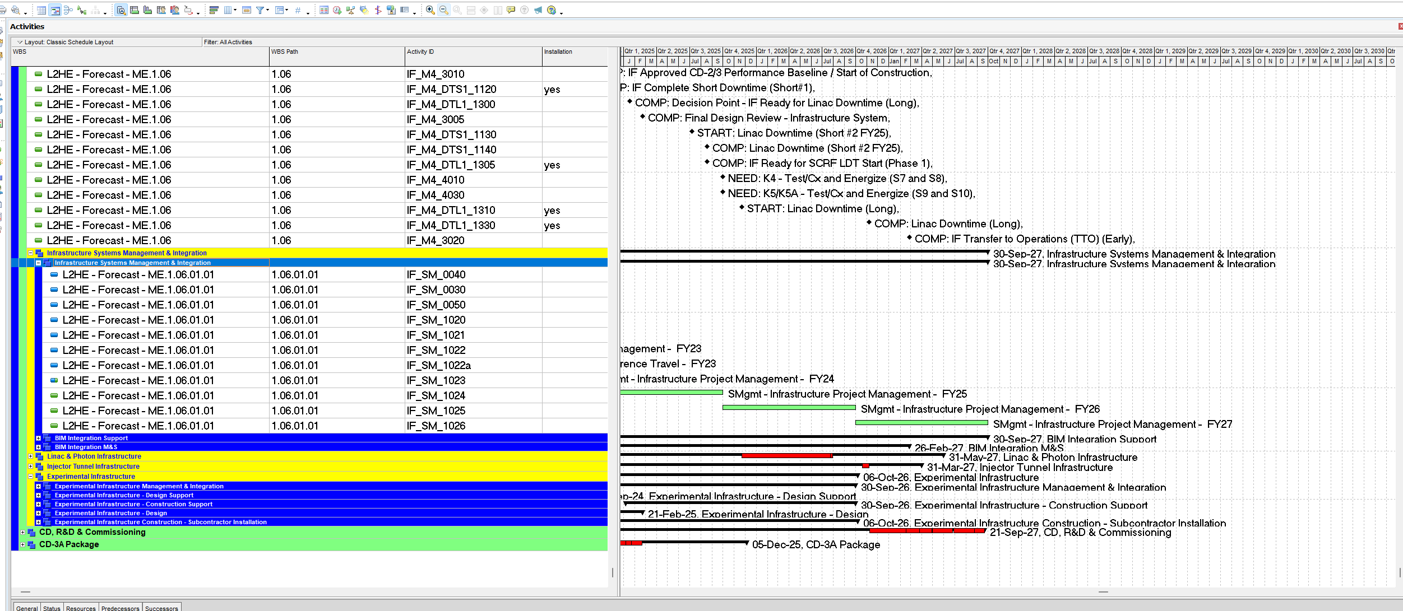

Background/Current Tools
Notes:
We do have, as many of you know, the overall Project Schedule that is used, has the dates we are working towards and held accountable to. This schedule is updated monthly and is the official timeline of the project. Here is a snapshot from that schedule for our project. Now, different teams are responsible for varying sections of the schedule. This schedule provides the big picture of all work including design, contracts/procurement as well as installation and it is updated monthly
When executing and figuring out the plan for their work on site (what we are calling Installation), the teams need a more detailed, “nimble” and more specific way to record their plan. This is the document that will be used with crews and field personnel. It's the plan of what is happening from one day to the next. This day to day cadence changes quickly. Communications between these teams often needs to happen fast especially when task interact heavily from scope to scope.

Slide 5
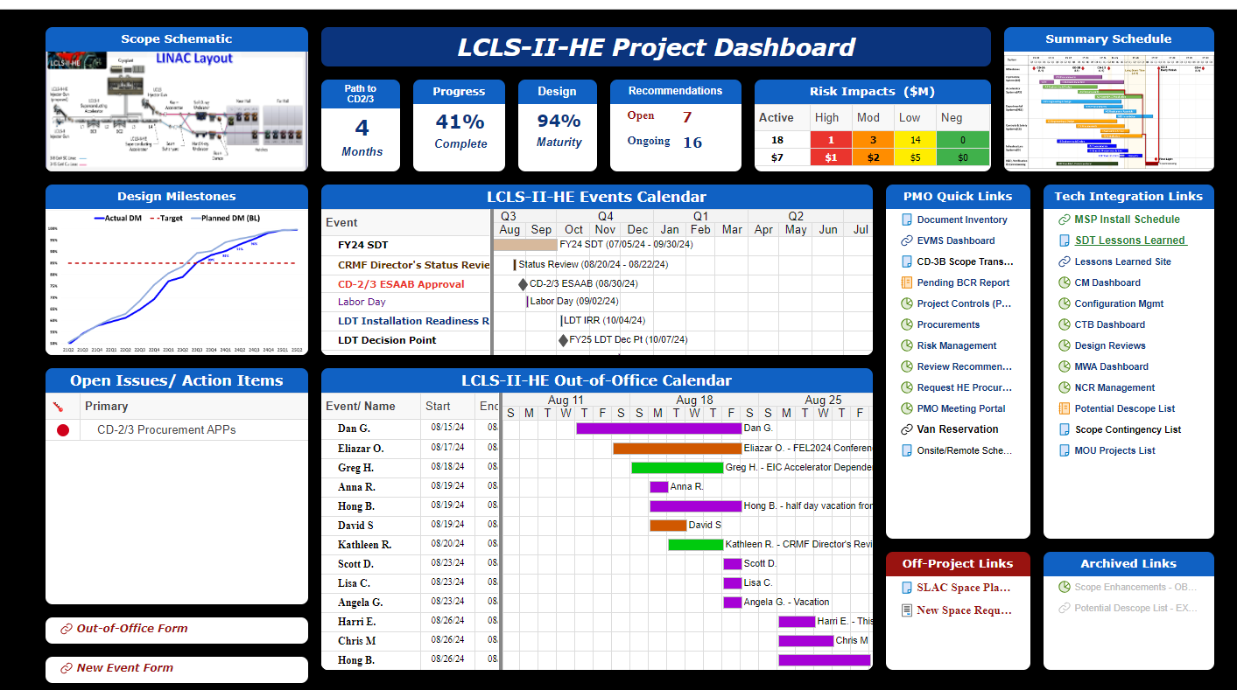
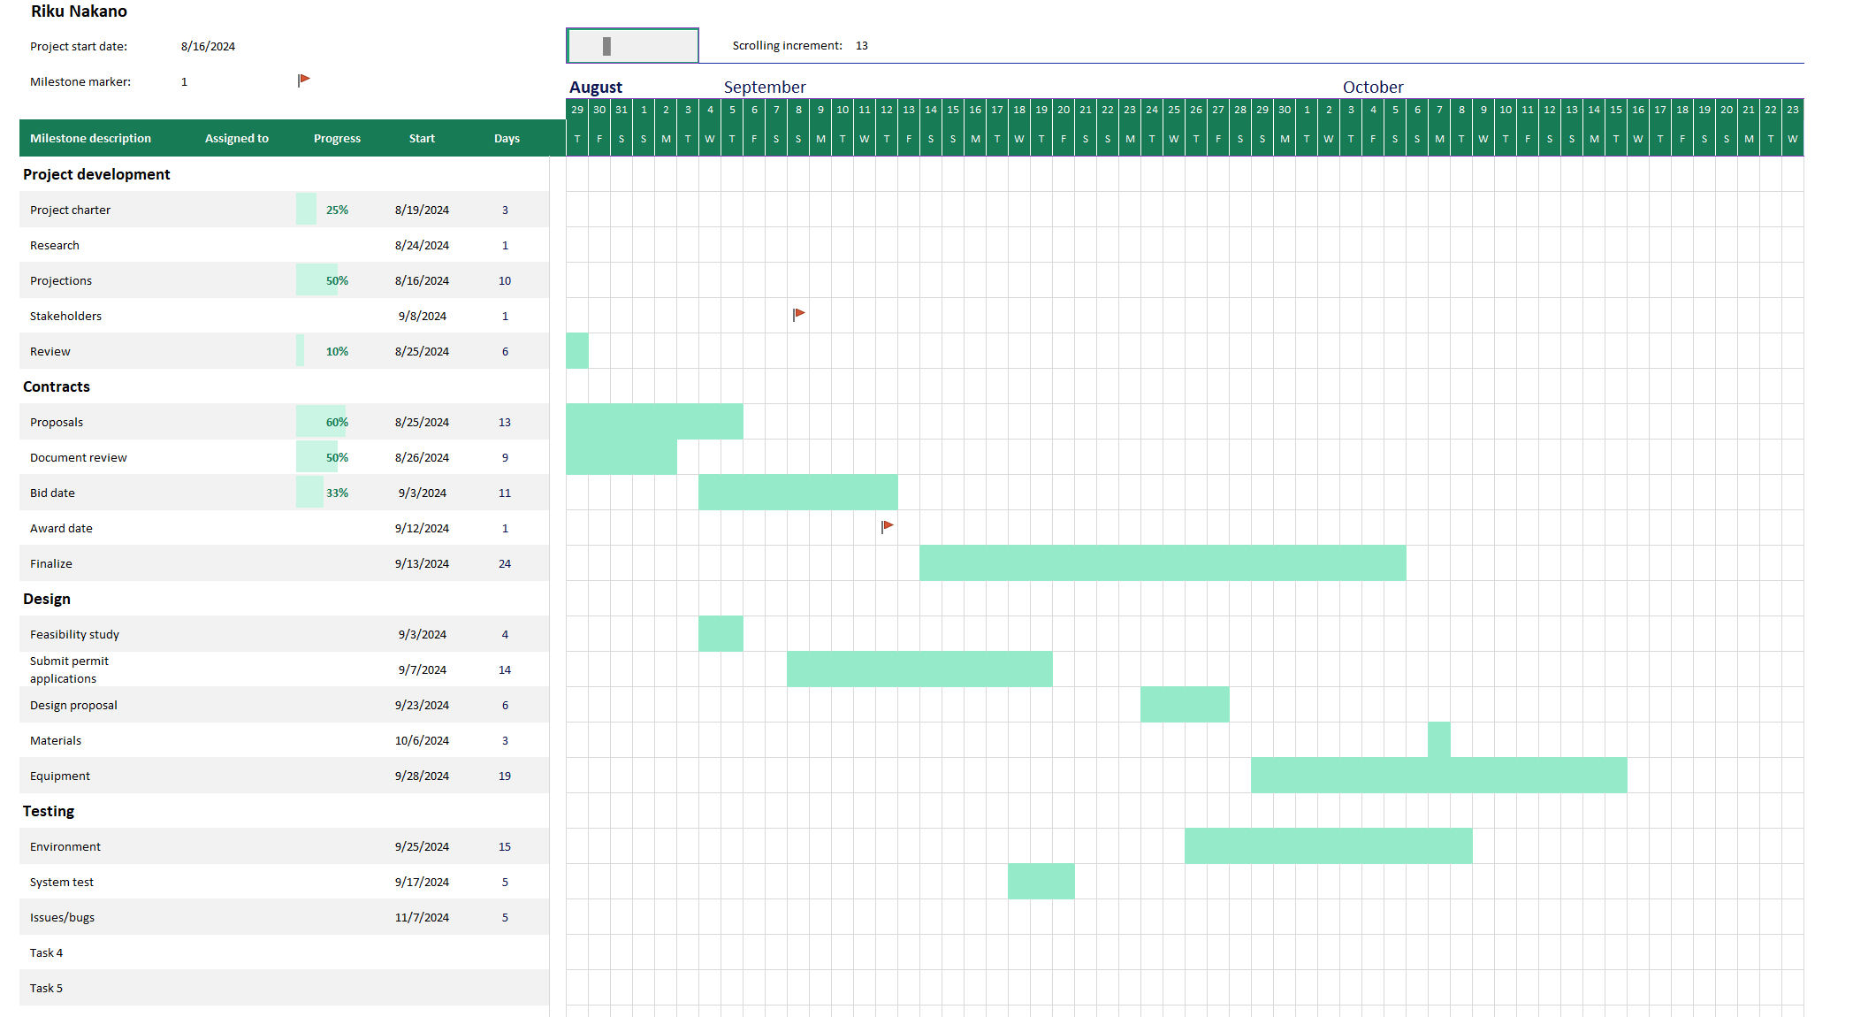


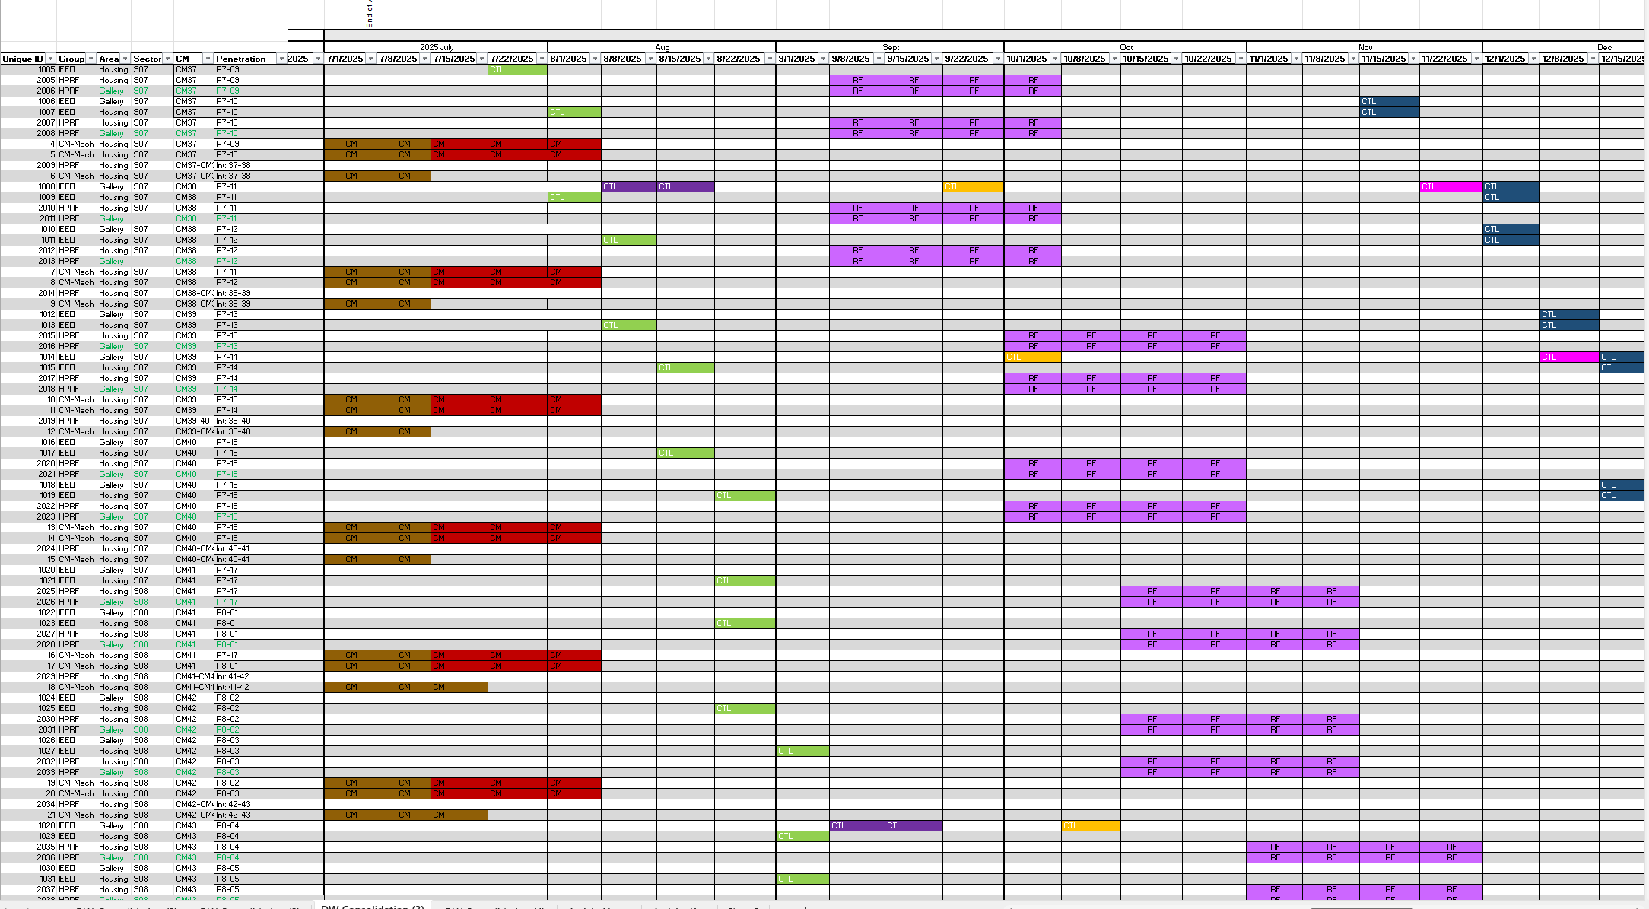
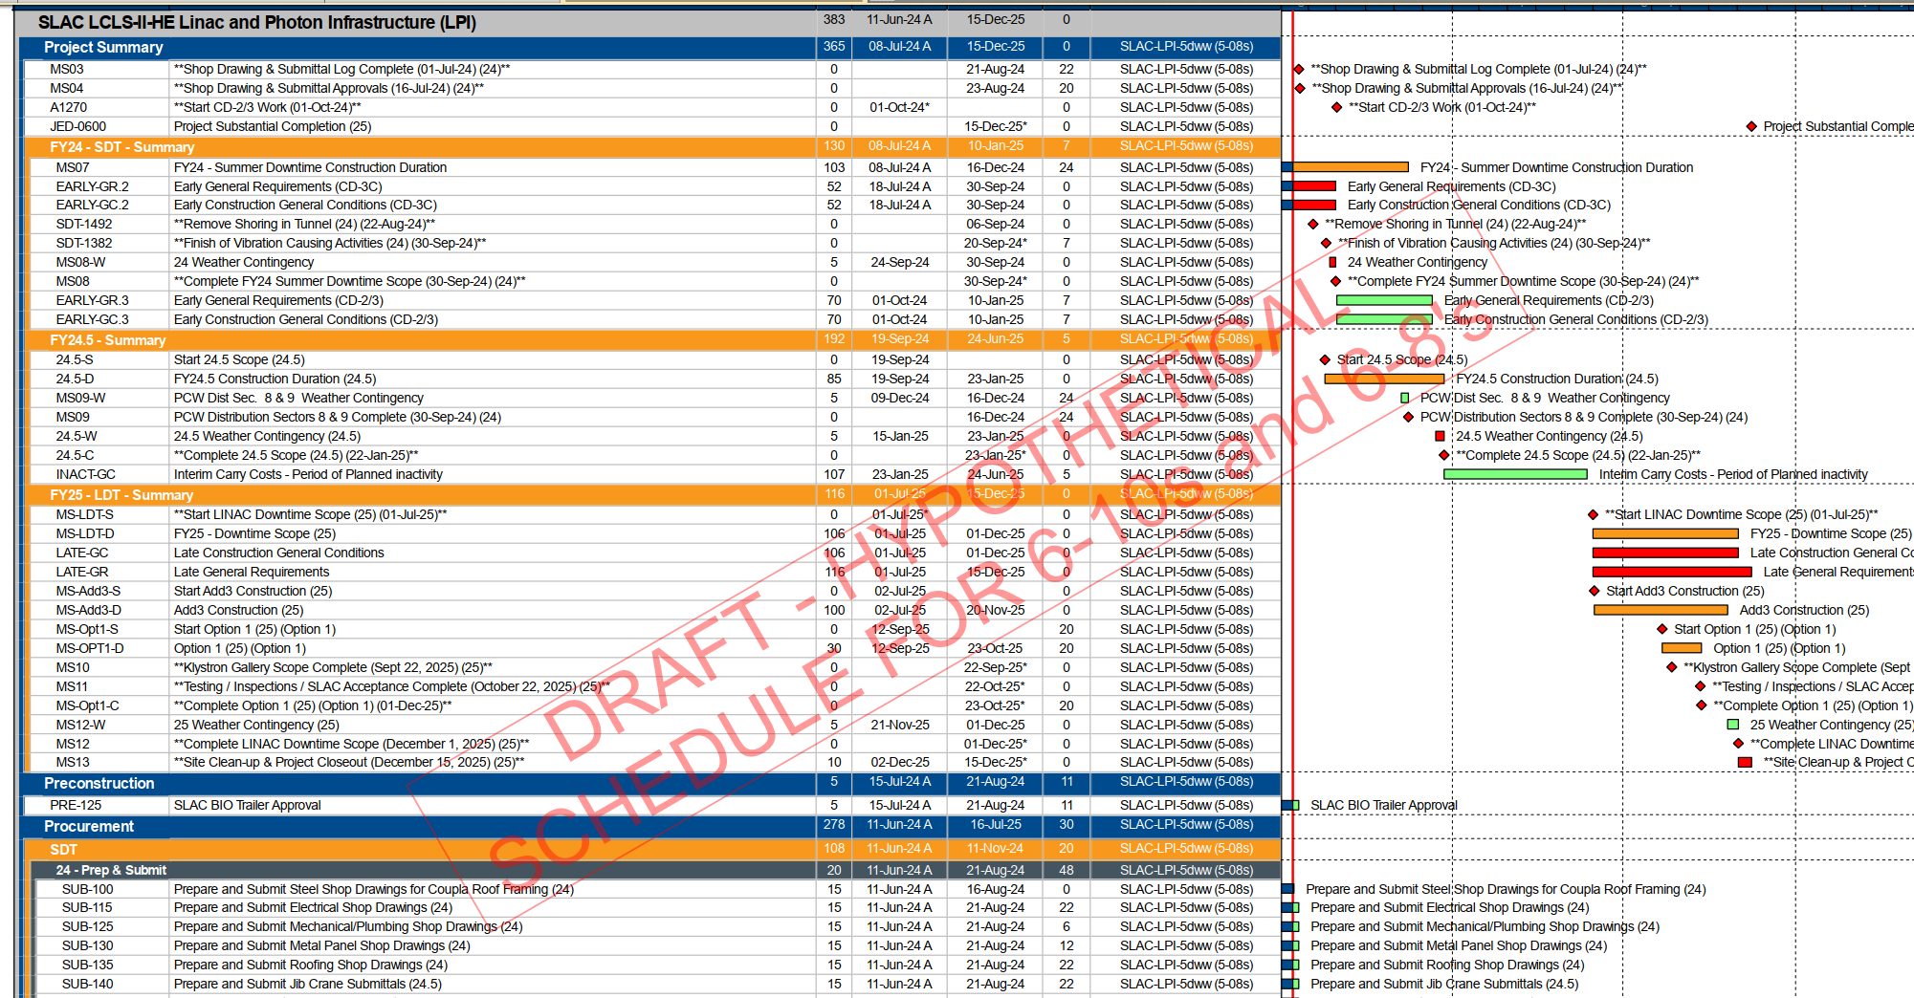

Background/Current Tools
Notes:
That is in fact what different leads do. They create plans using different tools/software. Here are just some of the content that is being used by different team on LCLS-2-HE as well as some contractors. The reality is that all of this information does interact with eachother. And it would be usefull and easier to see it all in one place.

Slide 6
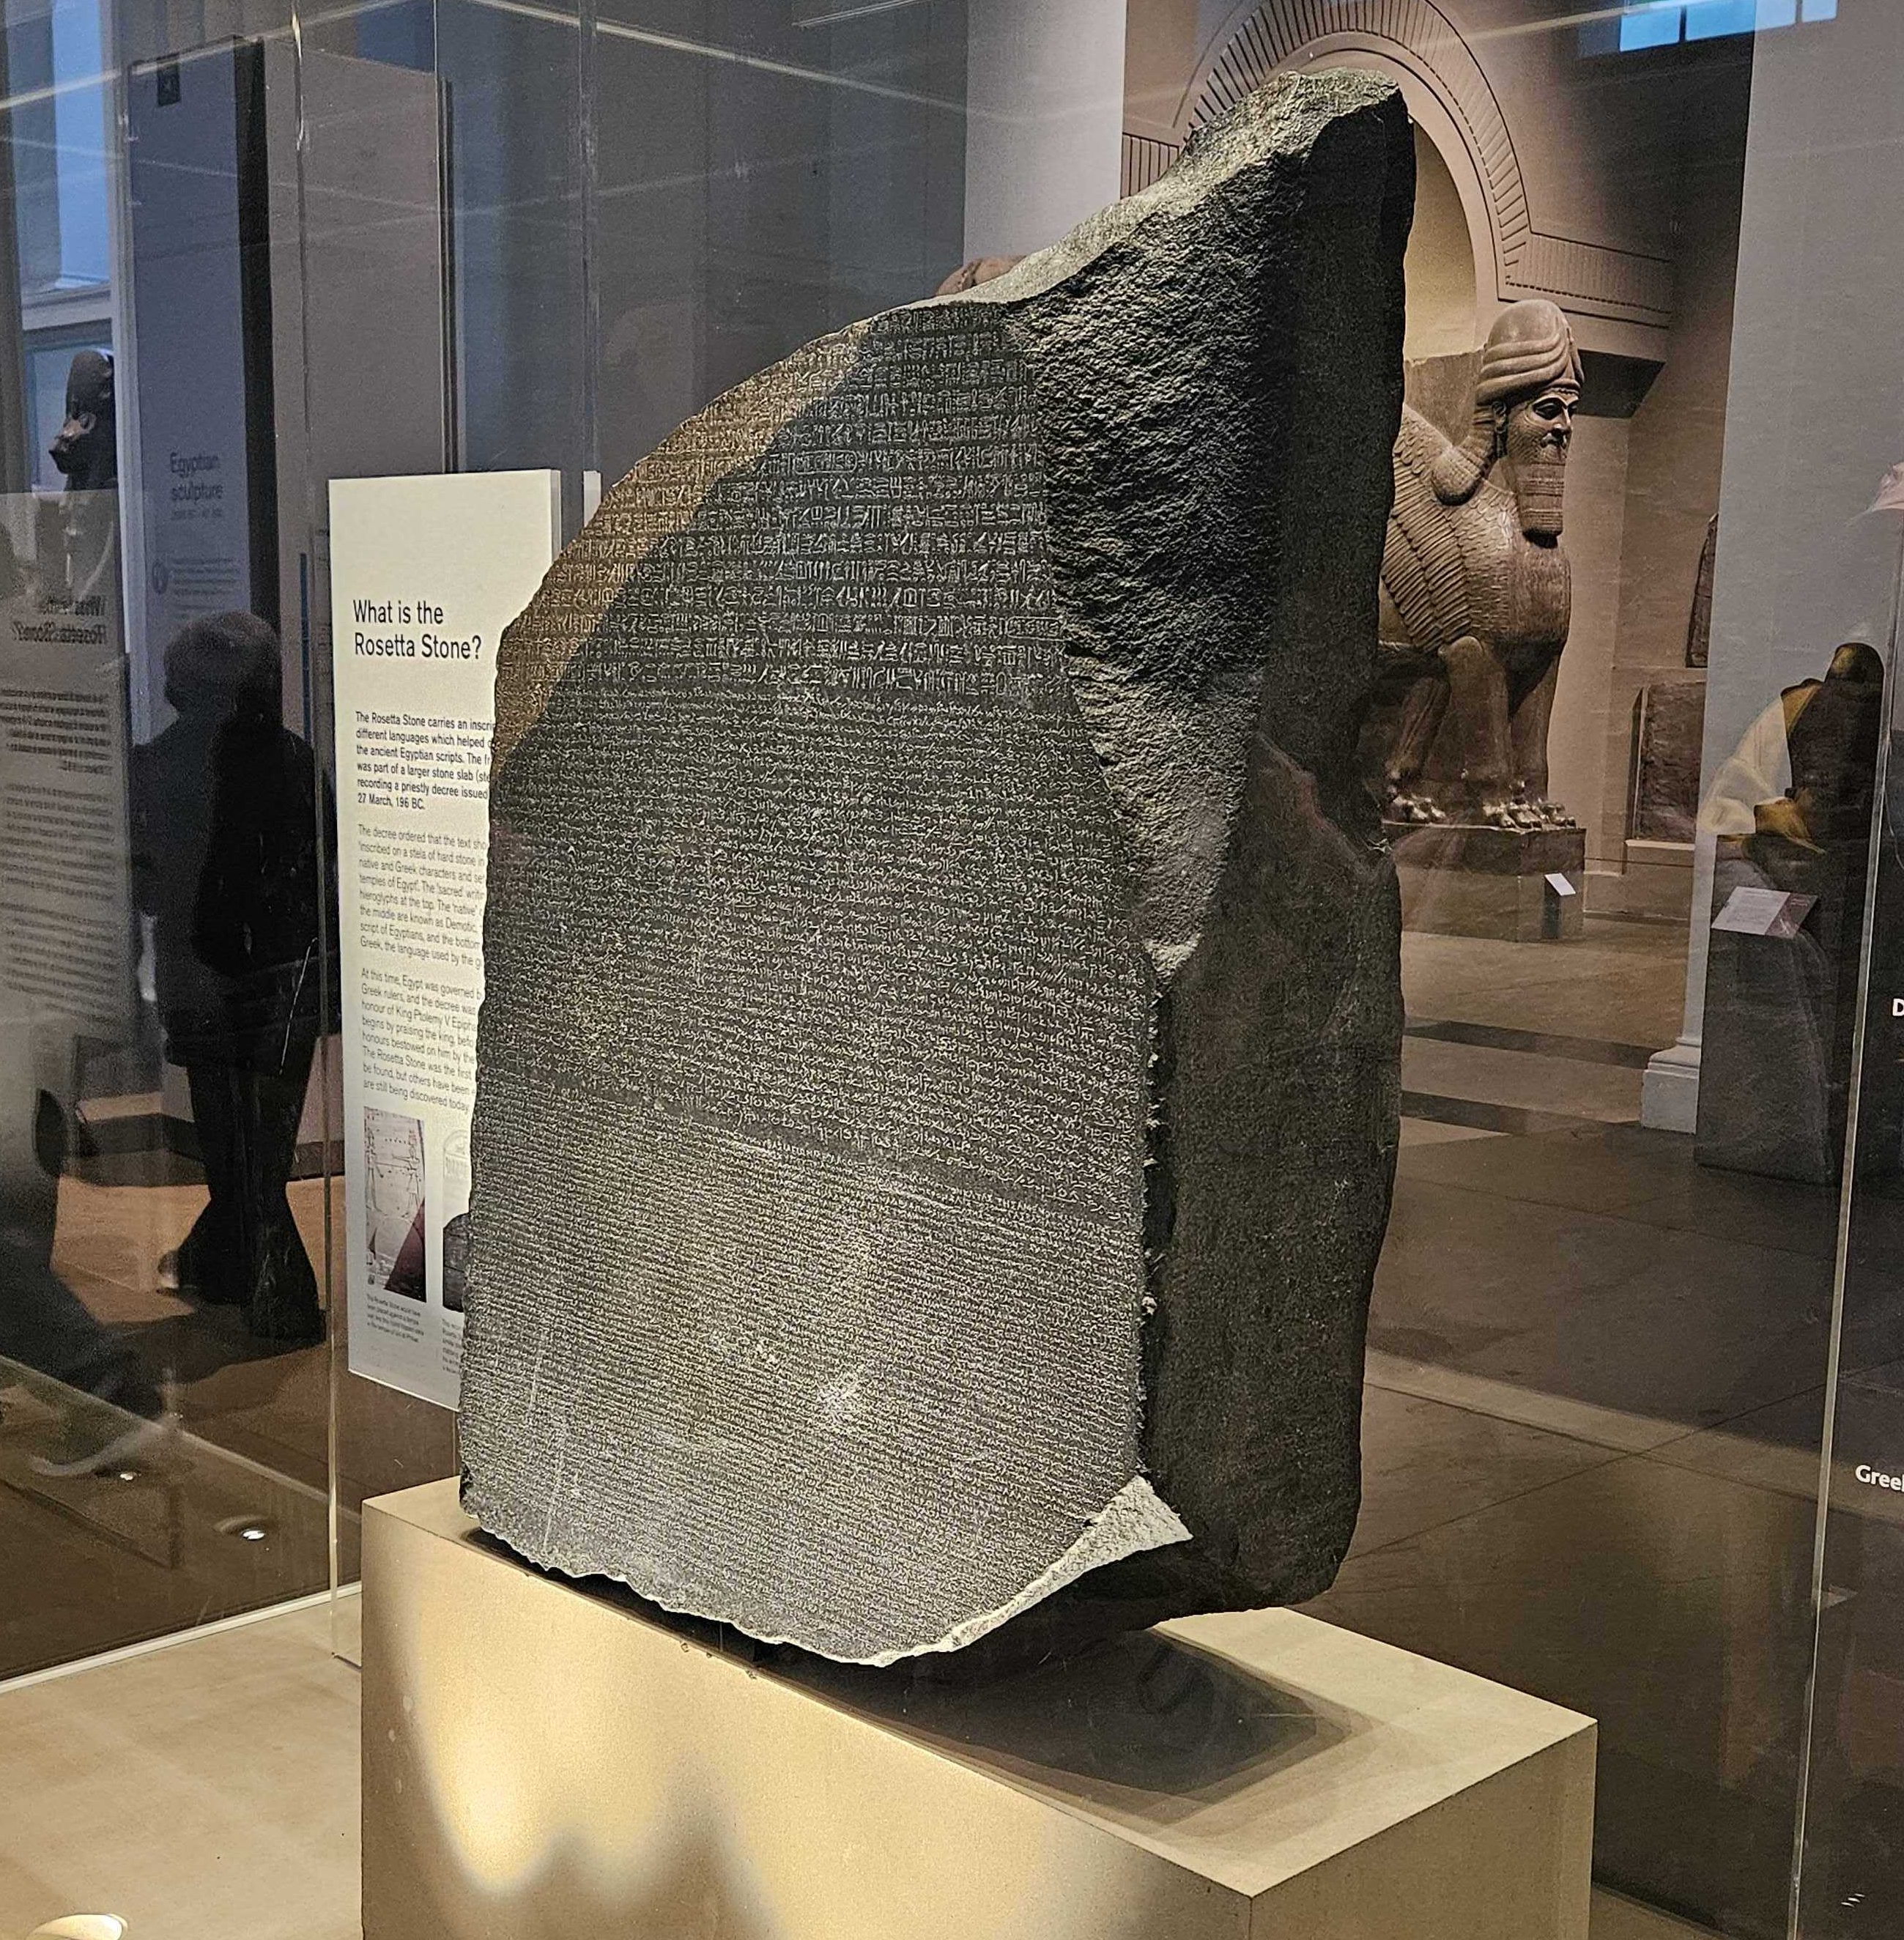
Solution: Need a Common Language
Notes:
Tying these both together. What we need is a "key" or a "common language". The need for a more streamlined, agile, and reliable approach is clear.

Slide 7
Solution: Plan and Deliverable
Single Information Center for Improved Planning
“Translate” the information that installation teams use the same schedule to plan their day-to-day work to better see how it affects and interacts with other teams. MS Project Admin/Controls assists with setting up schedules and system
Develop a simple way to produce communications and Reports on Day-to-Day Schedules and Progress Throughout the Project
Having most of the reports automatically populate based on updated information, standardizes the communications and frees up leaders to focus on other issues/work
Reports can be more detailed without overwhelming viewers by allowing individuals to hone in on information relevant to them
Notes:
The Solution we converged on was to use MS Project Online (also know as the Project Web APP (PWA)) to take all the different plans the teams had and integrate them into one schedule to plan the work on a weekly basis. We then use the information gathered and stored to produce reports on a Tableu dashboard.

Slide 8
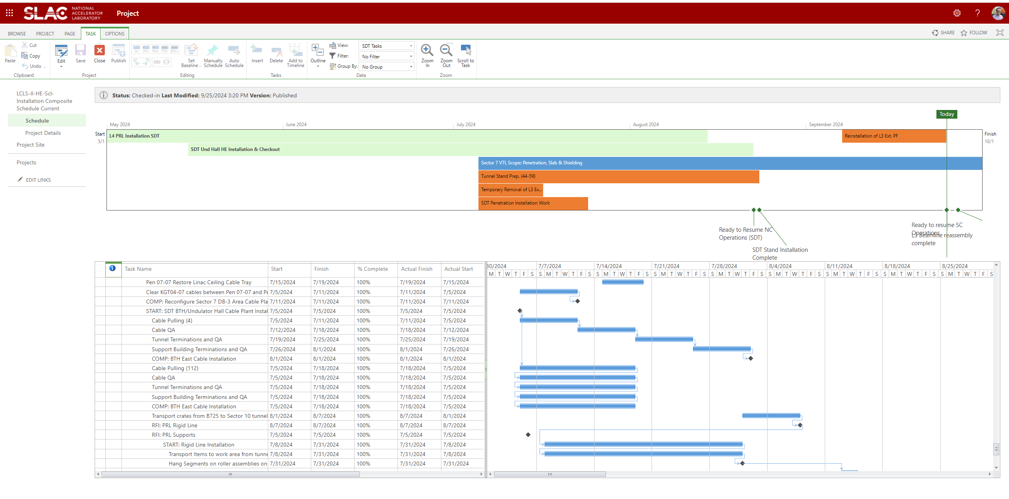
Solution: Results and Improvements
Notes:
This is what the new PWA environment that we made just for the LCLS-2-HE project looks like. The major benefit to this is that it is stored in sharepoint and data from the schedule can be extracted. Additionally teams can create/import their interim schedules here. This seems to meet the requirements we set as the main place to plan the installation work.

Slide 9
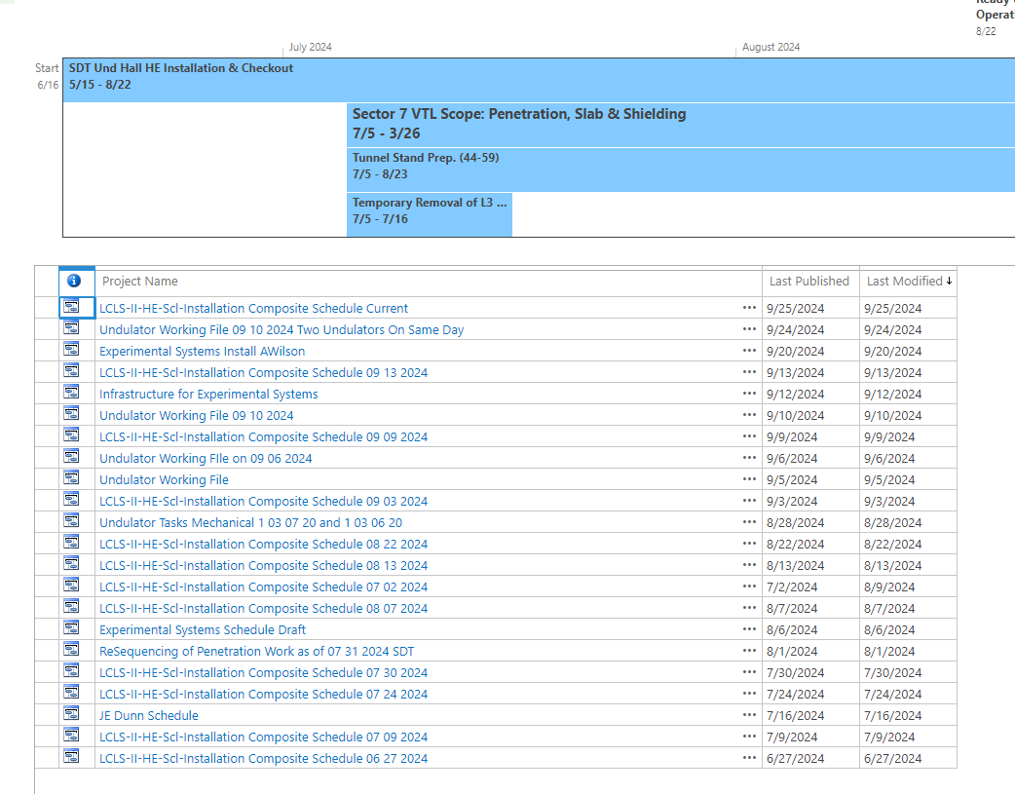
Solution: Results and Improvements
Notes:
This is another screen shot of the PWA environment here it shows all the backup copies of the current schedule that we can use to extract information from as well as individual interim schedules from various teams as well as contractors

Slide 10
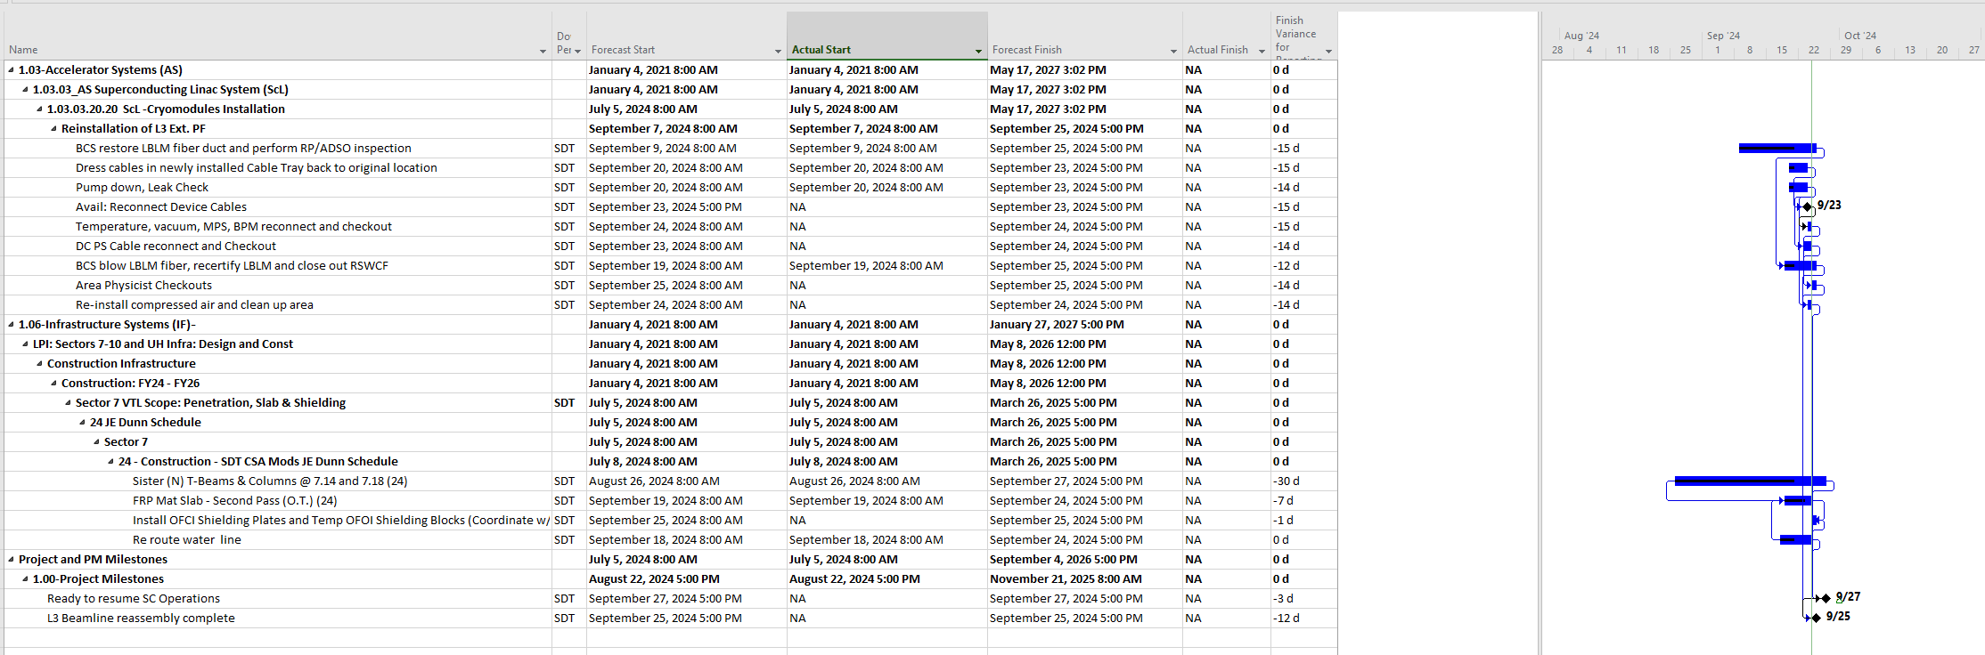
Solution: Results and Improvements
Notes:
Though the schedules are stored and updated in sharepoint. Individuals updating and working on the schedule can still use the desktop application for MS Project as shown in this slide.

Slide 11
Solution: Results and Improvements
Integrated the Various Documents and Planning Schedules using Microsoft Project Online (PWA)
Leveraged existing work on integration schedule
Integration into one installation schedule
Created Key between the planning schedules and the official Project Schedule
Added Enterprise Calendars and PAMM (maintenance) days
Standardized Location and Scope Names (ongoing)
Work with teams about integrating what they are planning with what P6 is showing
Data cleanup formatting it for use in reporting
Built data connection to easily export MS Project Online Data to Tableau
Notes:
This here is a recap of the work done to get to this point.
Meeting with the different teams to garter the documents they had (some were already using a project like this but some were not necessarily doing that)
Integrated the Various Documents and Planning Schedules using Microsoft Project Online (PWA)
Integration into one installation schedule
Tied different scopes to each other with the logic of predecessors and successors. How do different scopes interact with each other
Single Calendar with Holidays and Downtimes
Pam Calendar so only work occurs during pam times
Need to be able to determine how different areas and different teams are affecting immediate work and how they interact
The changes in the schedule and in planning need to occur quickly within a few days
Worked to Created Key between the first level of P6 WBS and the installation nschedule.
Added Enterprise Calendars and PAMM (maintenance) days
Standardized Location and Scope Names
Work with teams about integrating what they are planning with what P6 is showing
Data cleanup formatting it for use in reporting
Built data connection to easily export MS Project Online Data to Tableau

Slide 12
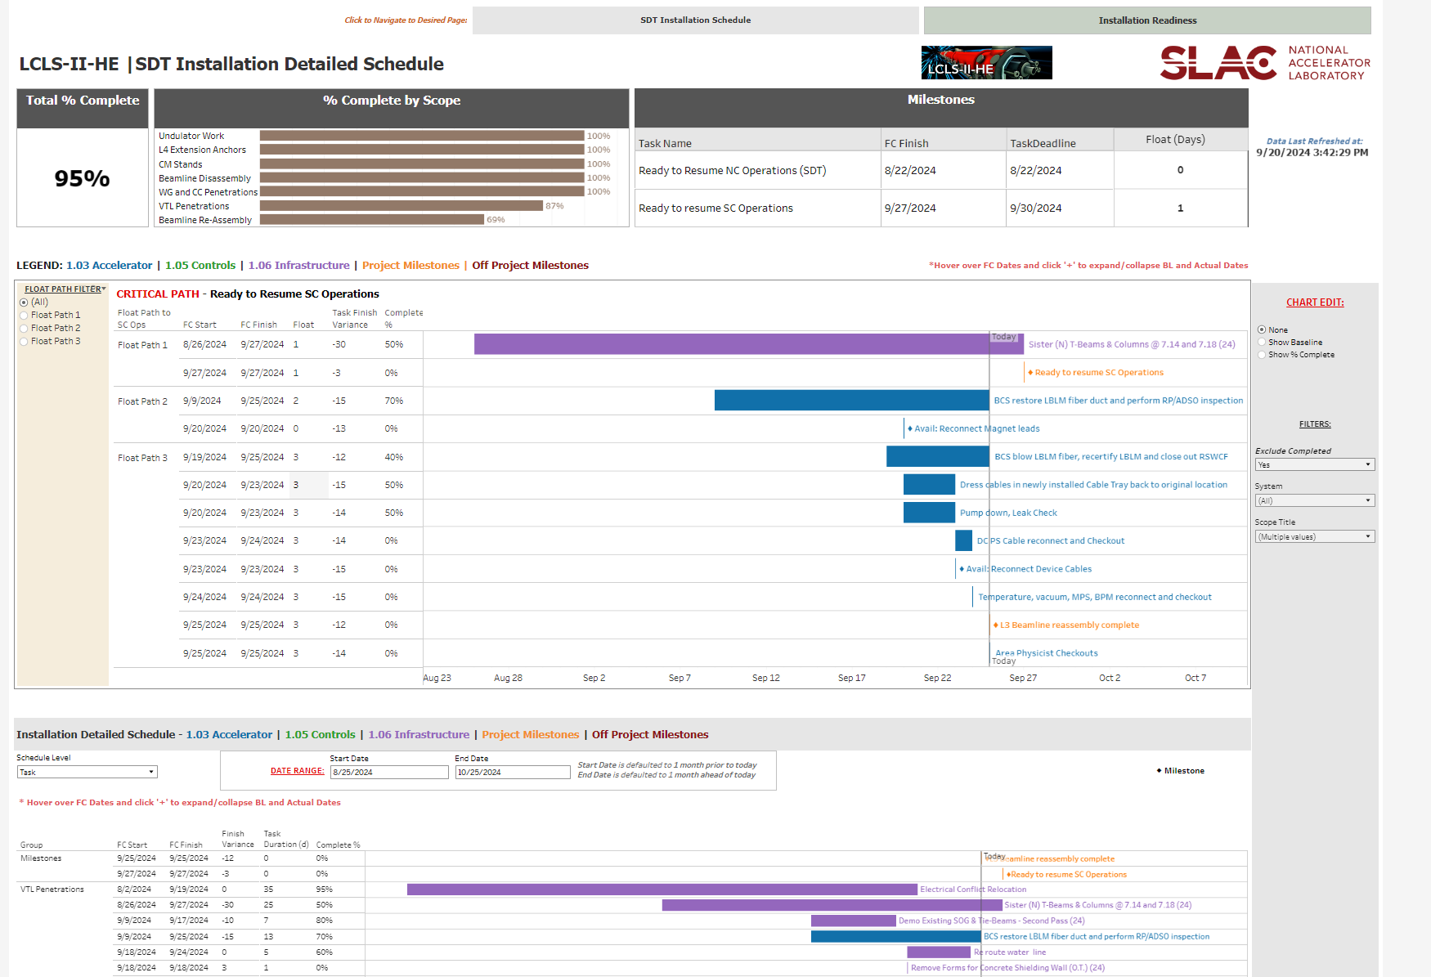
Solution: Results and Improvements
Notes:
This is the second part of the solution that we developed. Vicky really helped out here. She created this live report on Tableau based on the requirements we had. and it runs by extracting data from the PWA MSP schedules. It doesn't require a manual data extraction on a regular basis as it's connected to SharePoint and can be updated very quickly. It can also be modified and improved as a needed.

Slide 13
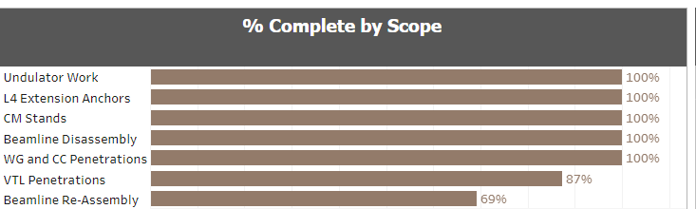
Solution: Results and Improvements
Notes:
This is one of the visuals that appear on the report and was actually shown at the Lab wide all hands this week.

Slide 14
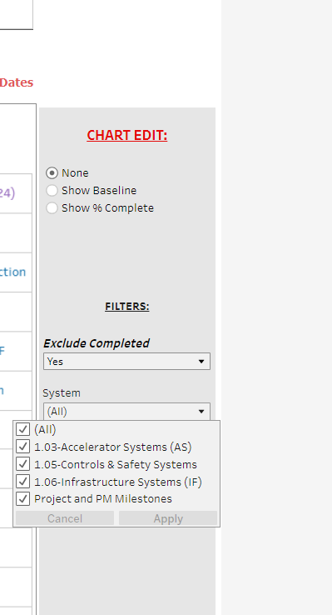
Solutions/Products

Slide 15
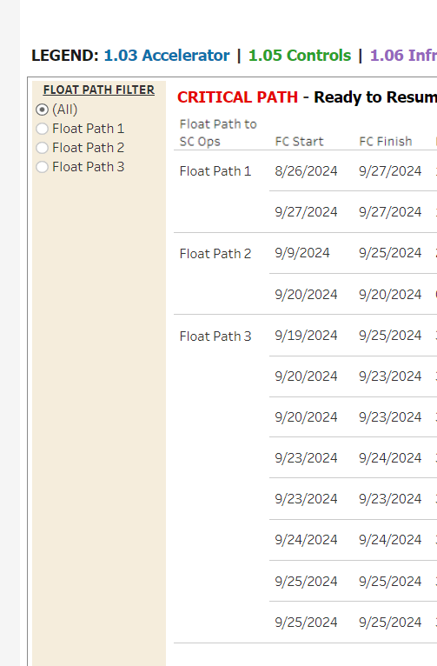
Solutions/Products

Slide 16
Conclusion
Schedule and Reports
Multiple inputs brought into one location
Integrating day to day planning with overall monthly schedule update
Developed Business Intelligence reports to share with wider audience
Using new method at end of the day tailgate meetings and recurring installation planning meetings and have positive reception thus far.
Continuously looking to improve
Already used at leadership levels of SLAC
LCLS-II-HE | SLAC IT Business Intelligence | Vicky Hoang

Slide 17
Questions
?
LCLS-II-HE | SLAC IT Business Intelligence | Vicky Hoang

Slide 18
Questions
LCLS-II-HE | SLAC IT Business Intelligence | Vicky Hoang

