Slide 1
LCLS-II-HE Business Intelligence:
Utilizing BI Tools and Resources to Strengthen Project Management
Project Community of Practice Meeting
Vicky Hoang, Data Analyst, LCLS-II-HE

Slide 2
Introduction
Vicky Hoang, Data Analyst - Business Intelligence
Joined SLAC and LCLS-II-HE in September 2023
B.S in Financial Mathematics & Stats @ UC Santa Barbara (c/o 2018)
6 years experience working in Data Analytics
LCLS-II-HE | SLAC IT Business Intelligence | Vicky Hoang

Slide 3
Project Challenges and BI Solutions
CHALLENGES
SOLUTIONS
Multiple data sources + not centralized
Historical performance visibility
Heavy manual efforts on reporting
Strong analytical thinking + creating digestible data
Tableau integrates data sources and creates a central repository
Database usage allows for efficiently analyzing millions of rows of data
Develop automated reporting, using various BI Tools
Data Analyst have analytical skills to identify trends and draw meaningful insights
Collaboration b/w teams is essential in creating digestible, clean, and accurate data
LCLS-II-HE | SLAC IT Business Intelligence | Vicky Hoang

Slide 4
Earned Value Management (EVMS) – Challenges:
EVMS Month End reports produced manually
Difficulty tracking historical MoM performance
Hard to pin-point problem areas to focus on
Challenge for individual Managers to drill down into their performance
LCLS-II-HE | SLAC IT Business Intelligence | Vicky Hoang

Slide 5
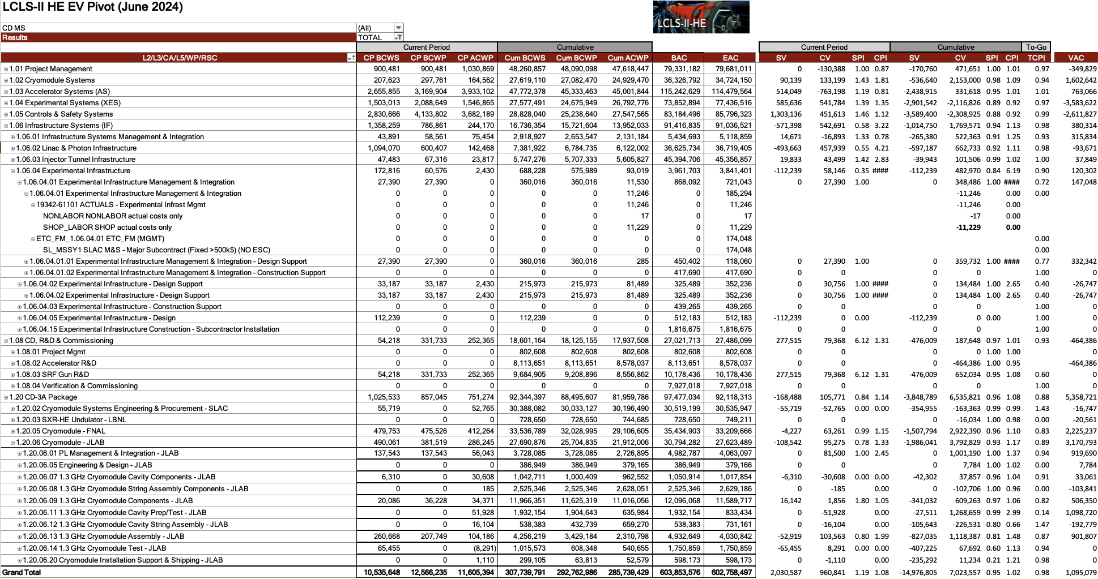
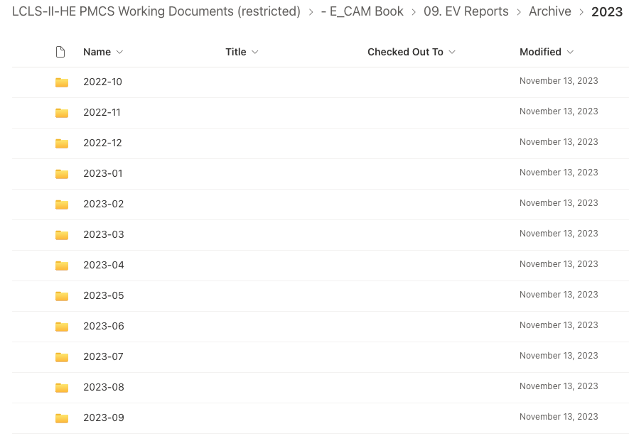
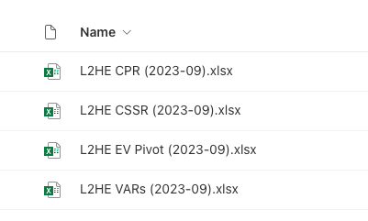
Former EVMS Processes
Text tables require more cognitive load, and limit the ability to spot trends and compelling insights
Multiple reports to keep up with
Individual Month + Year folders containing the same reports
Tabs in 1 workbook
LCLS-II-HE | SLAC IT Business Intelligence | Vicky Hoang

Slide 6
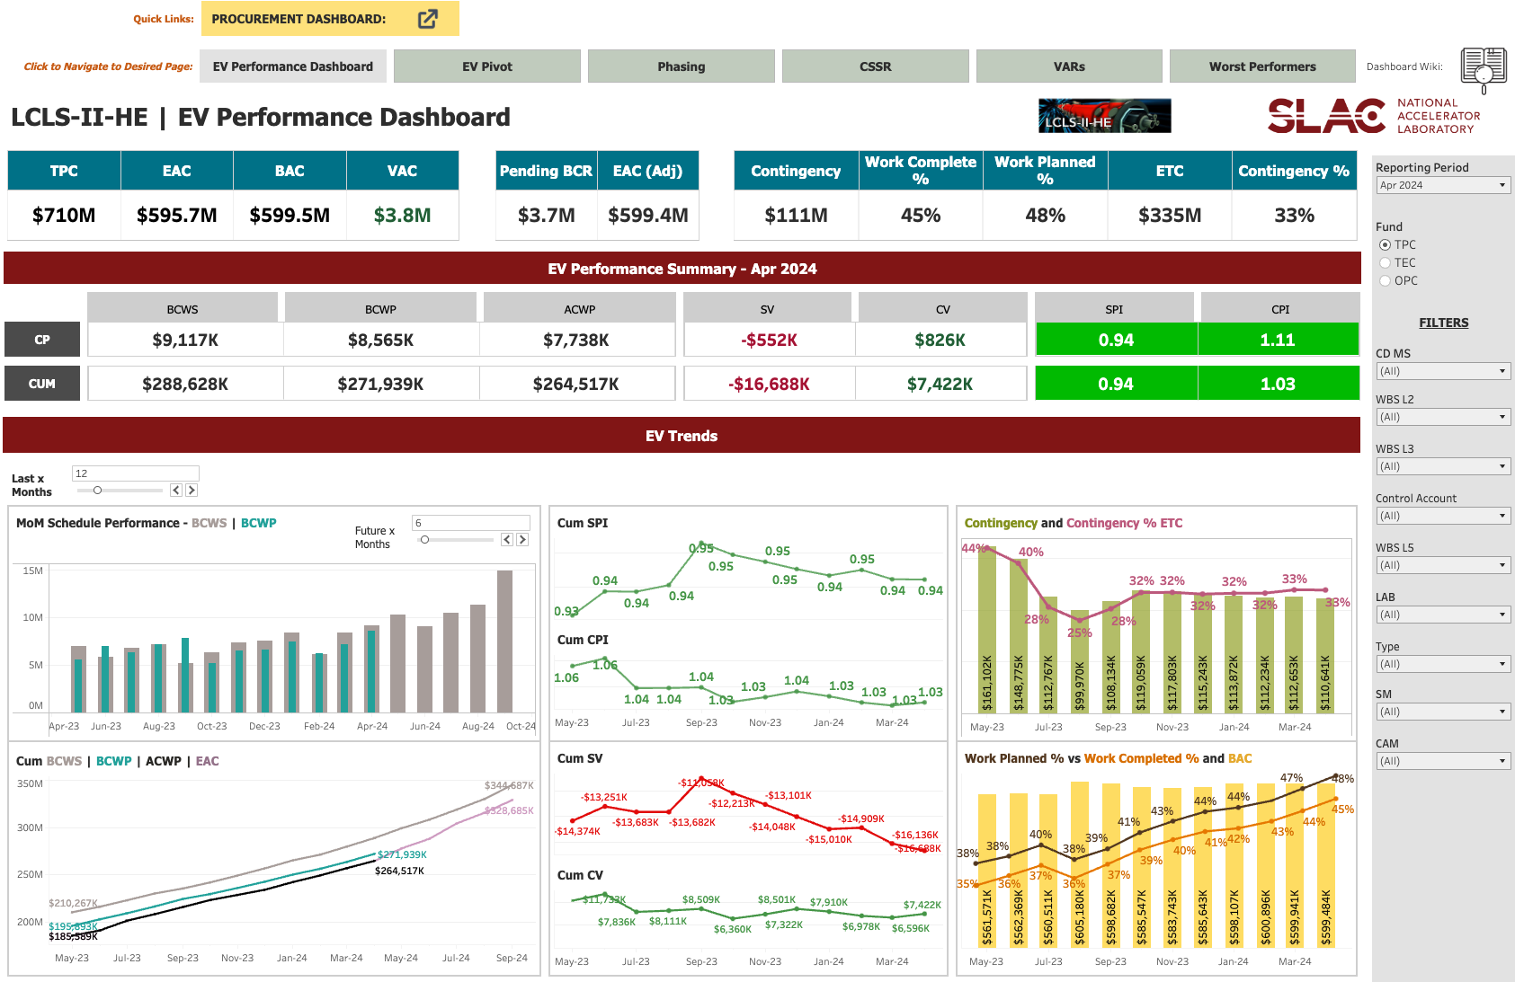
EVMS Dashboard – Solutions:
Provides a holistic summary of current EV performance
LCLS-II-HE | SLAC IT Business Intelligence | Vicky Hoang
Notes:
å-Use of colors and summary trend charts make it easy to digest and interpret data quickly

Slide 7
EVMS Dashboard – Solutions:
Visibility to Historical Performance
Efficient data querying using Tableau & SQL
LCLS-II-HE | SLAC IT Business Intelligence | Vicky Hoang

Slide 8
EVMS Dashboard – Solutions:
Filtering allows Managers to easily drill down
LCLS-II-HE | SLAC IT Business Intelligence | Vicky Hoang

Slide 9
EVMS Dashboard – Solutions:
Reporting is more centralized into one Tableau Workbook
LCLS-II-HE | SLAC IT Business Intelligence | Vicky Hoang

Slide 10
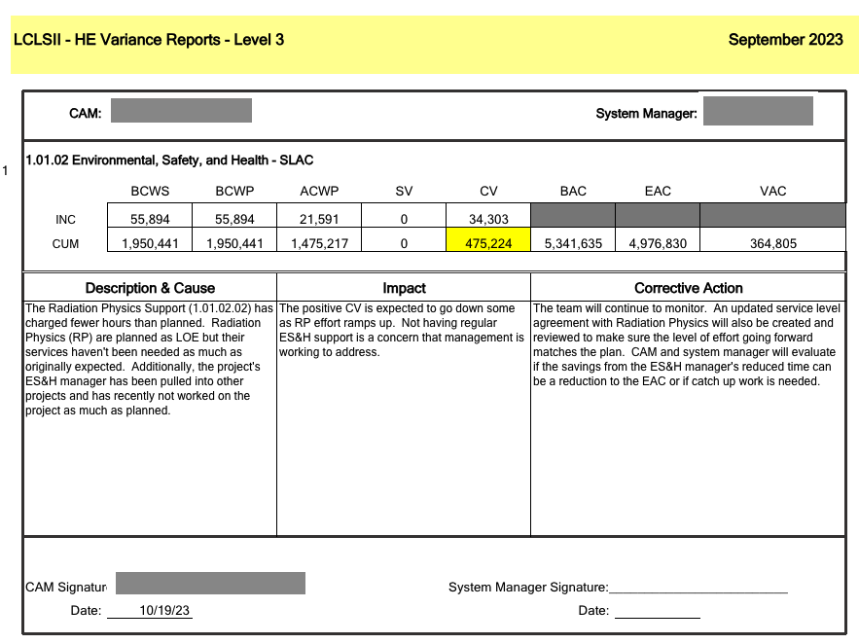
Former EVMS Processes (VARs)
Every month, Project is required to address any significant Variances in schedule or cost performance
Former VAR Process difficult to review
Inability to drill down into KPI data from VAR sheet
(disconnected from actual EV dataset)
Not always user friendly
Shared files - everyone can see edit and filters made
Prone to errors
VARs Example Excel File
LCLS-II-HE | SLAC IT Business Intelligence | Vicky Hoang

Slide 11
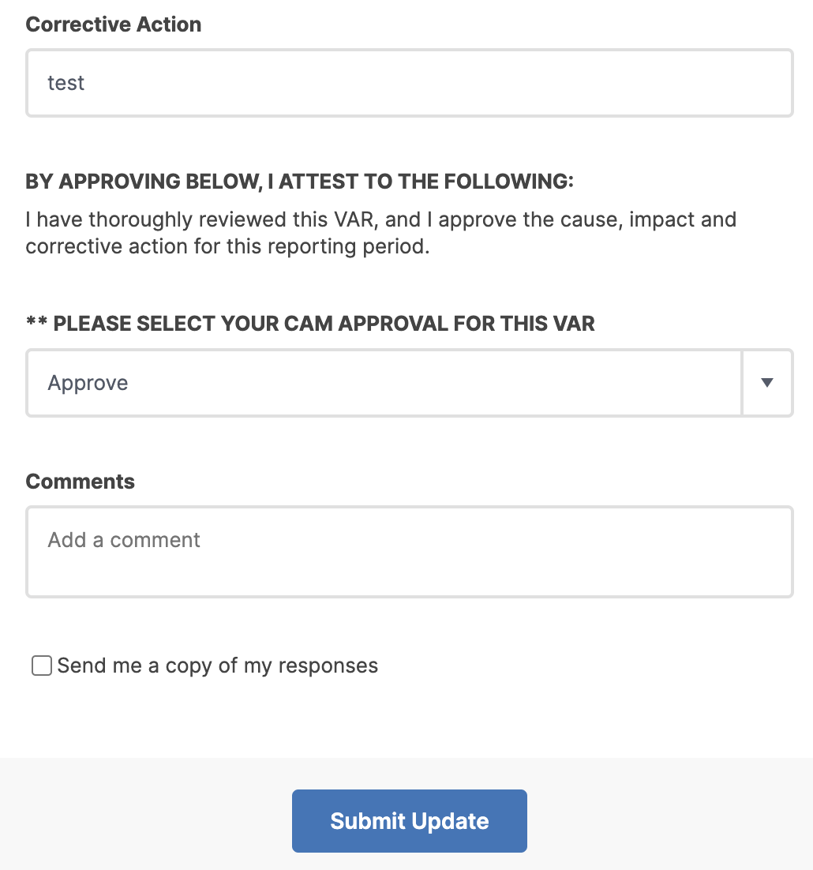
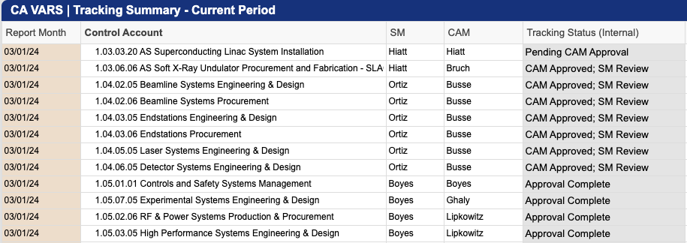
VARs Solution – Utilizing Smartsheet for Approval Tracking
VARs write-ups & approvals moved to Smartsheet
Smartsheet Automation helps track signature routing
Managers get SS email notification forms
Can now track Approval Statuses
LCLS-II-HE | SLAC IT Business Intelligence | Vicky Hoang

Slide 12

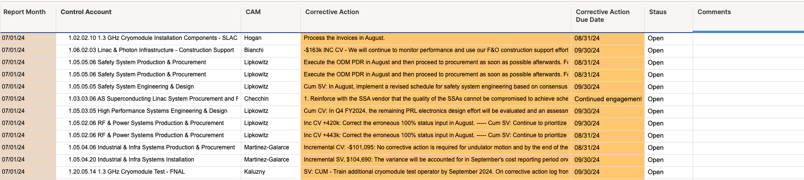
VARs Corrective Action Log: End-to-End solution
Automated VARs Corrective Action Log tracks Manager action items, ensures it will be addressed, and then closed out
VARs Writeups are automatically transferred to a corrective log (if applicable)
- Corrective Actions now trackable and require manager updates
LCLS-II-HE | SLAC IT Business Intelligence | Vicky Hoang

Slide 13
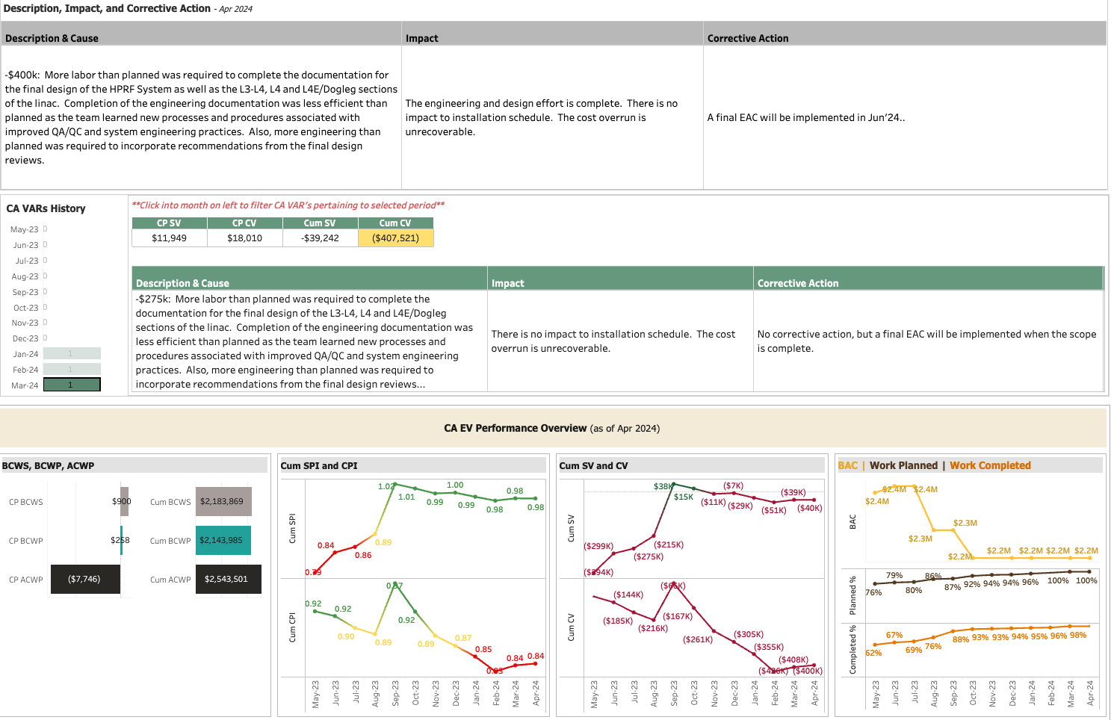
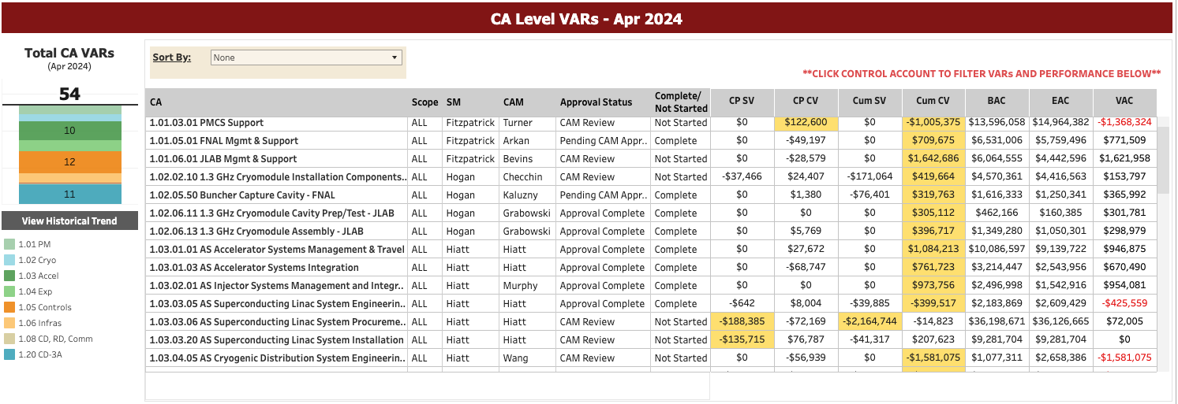
VARs Solution – Tableau Dashboard Integrates w/ Smartsheet
All VARs writeups and KPI data metrics, including historical, now visible in one centralized location in Tableau
VARs Dashboard
Drill-down on write-ups + EV Performance metrics for VAR accounts
LCLS-II-HE | SLAC IT Business Intelligence | Vicky Hoang

Slide 14
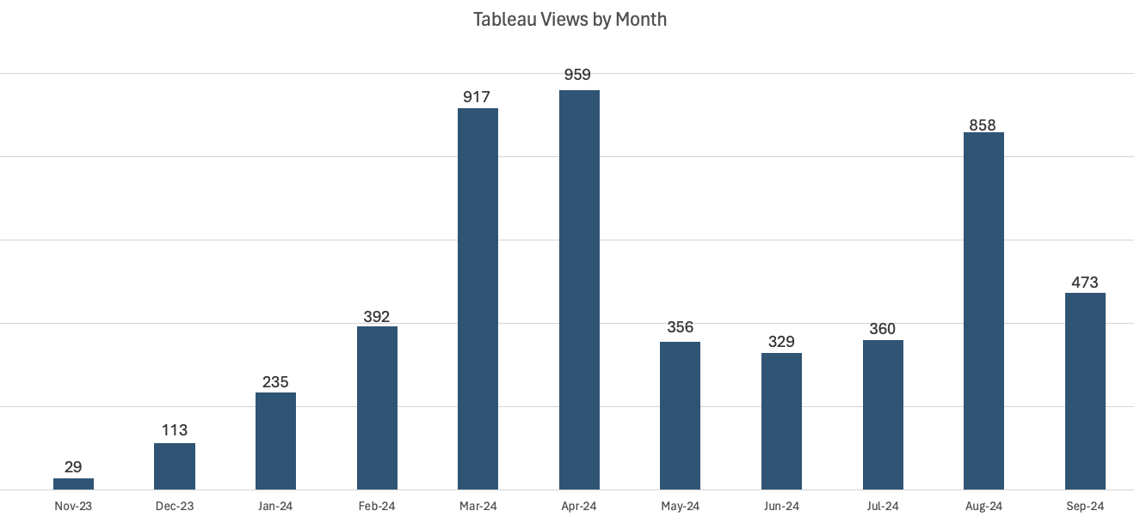
BI User Adoption - Tableau views increased since introduction
Shows overall Project adoption of data products and a data savvy mindset
LCLS-II-HE | SLAC IT Business Intelligence | Vicky Hoang
Notes:
Conduct team Training and walkthroughs
Data savvy mindset allows users to utilize data products to effectively manage performance, focus on problem areas, and make necessary data driven business decisions

Slide 15
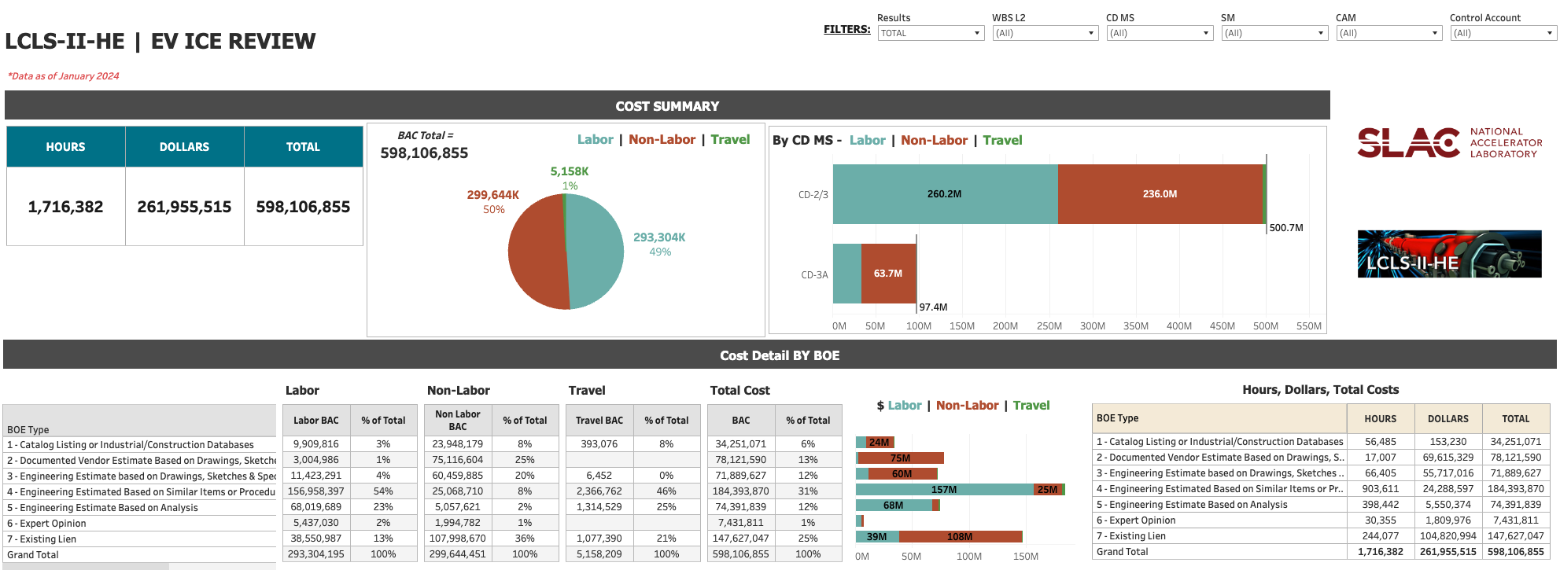
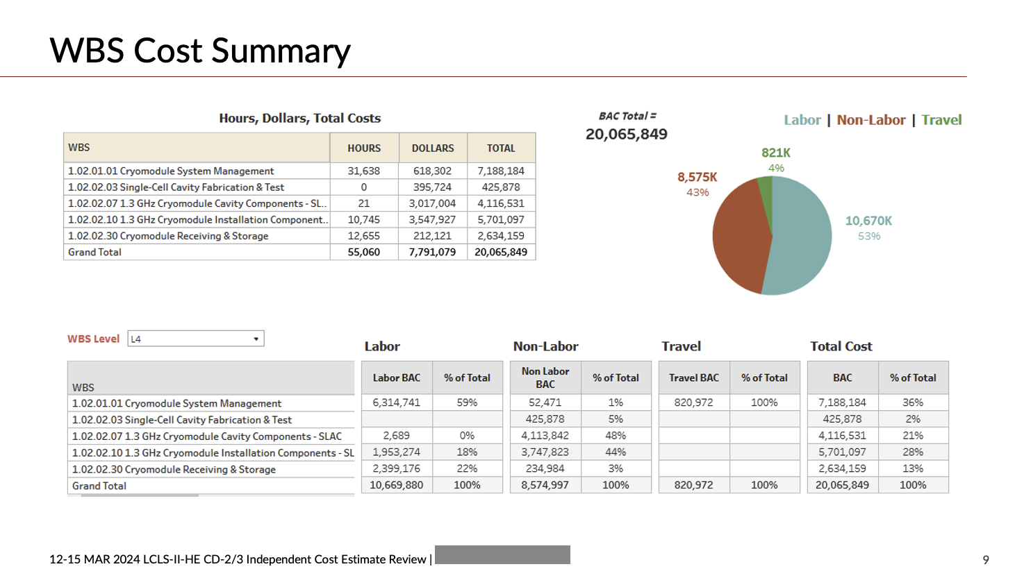
Increased Productivity + Time to Value + Promotes Standardization
Tableau ICE Review Dashboard
Time saved on creating Analytics for PowerPoint slides during reviews
- Enables drill down for individual manager metrics
ICE Review System Manager PPT Slide
- Standardized format across all manager slides
LCLS-II-HE | SLAC IT Business Intelligence | Vicky Hoang

Slide 16
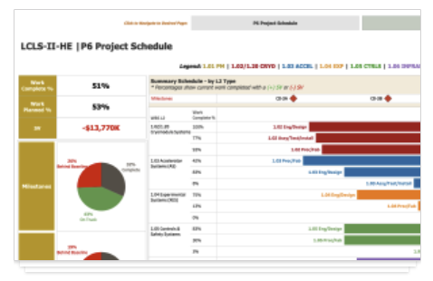
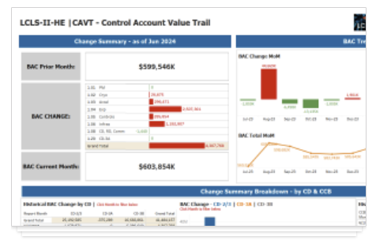
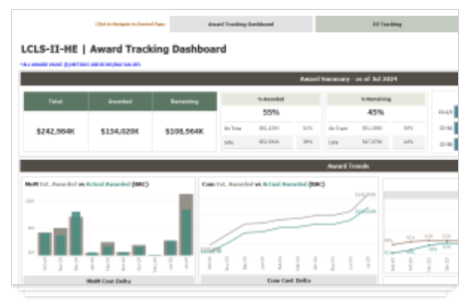
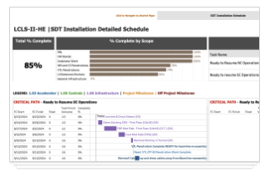
Additional Project Dashboards/Data Products
L2HE P6 Project Schedule
L2HE CAVT
L2HE Procurement
L2HE Installation Schedule
LCLS-II-HE | SLAC IT Business Intelligence | Vicky Hoang

Slide 17
Conclusion: Why Business Intelligence?
Provides valuable insights to help Project team better understand performance, make data-driven decisions, and pin-point problem areas
Automation reduces the amount of time + effort to extract insights from data, allowing leadership to focus on other initiatives
BI Dashboards promote standardized visualizations during Project Reviews, making presentations more consistent, professional, and digestible for the audience
LCLS-II-HE | SLAC IT Business Intelligence | Vicky Hoang

Slide 18
Questions
?
LCLS-II-HE | SLAC IT Business Intelligence | Vicky Hoang

