Slide 1
Introduction to the EIC Electron Injector
Qiong Wu
For a visit @ SLAC
12/6/2024

Slide 2
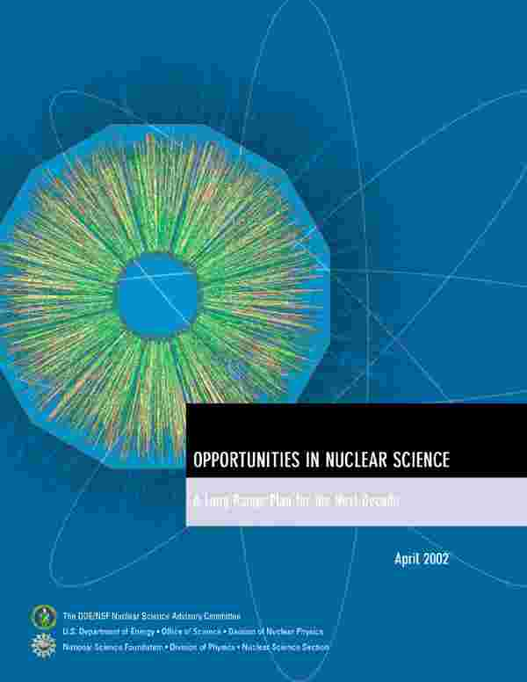
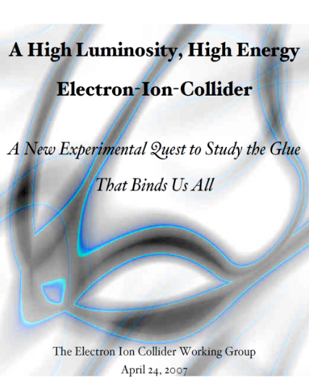


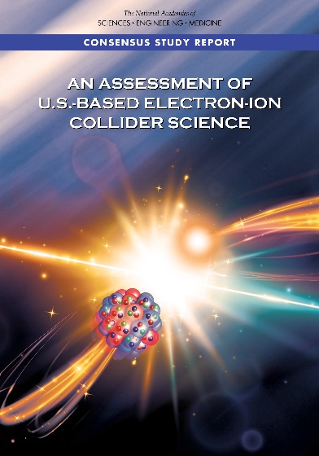

The Scientific Foundation for an EIC was Built Over Two Decades
2002
“a high-energy high-luminosity polarized EIC [is] the highest priority for new facility construction following the completion of FRIB.”
2007
The science questions that an EIC will answer are central to completing an understanding of atoms as well as being integral to the agenda of nuclear physics today.”
2009
2010
Gluons and the Quark Sea at High Energies
2012
2013
High Level Requirements to Accelerator stable since the 2010 INT Program
2015
Science Requirements and Detector Concepts for the EIC – Drives the requirements of EIC detectors
Major Nuclear Physics Facilities for the Next Decade
2018
2021
“…essential accelerator and detector R&D [for EIC] should be given very high priority
in the short term.”
NSAC
2023
We recommend the expeditious completion of the EIC as the highest priority for facility construction.
“We recommend the allocation of resources …to lay the foundation for a polarized Electron-Ion Collider…”
“..a new dedicated facility will be essential for answering some of the most central questions.”
March 14, 2013
“The quantitative study of matter in this new regime [where abundant gluons dominate] requires a new experimental facility: an Electron Ion Collider..”
Electron-Ion Collider..absolutely central to the nuclear science program of the next decade.
arXiv:2103.05419
E. Aschenauer, EICUG 2024
2

Slide 3
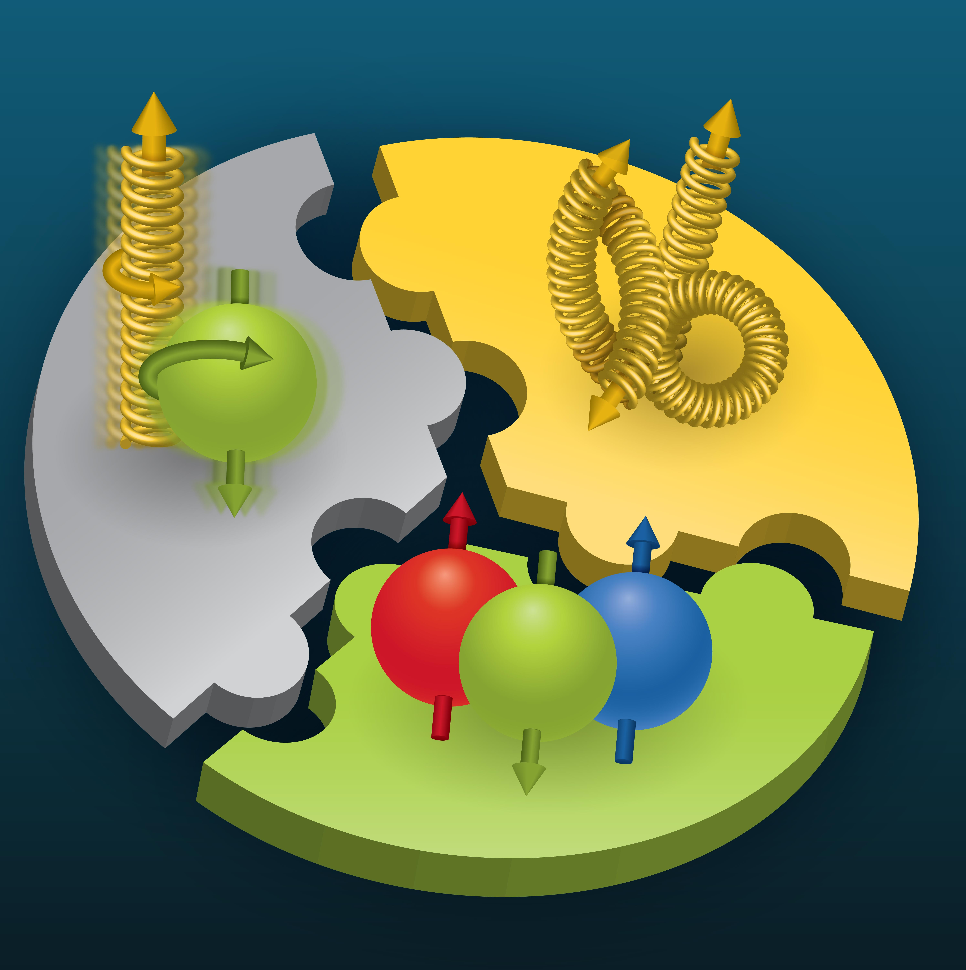

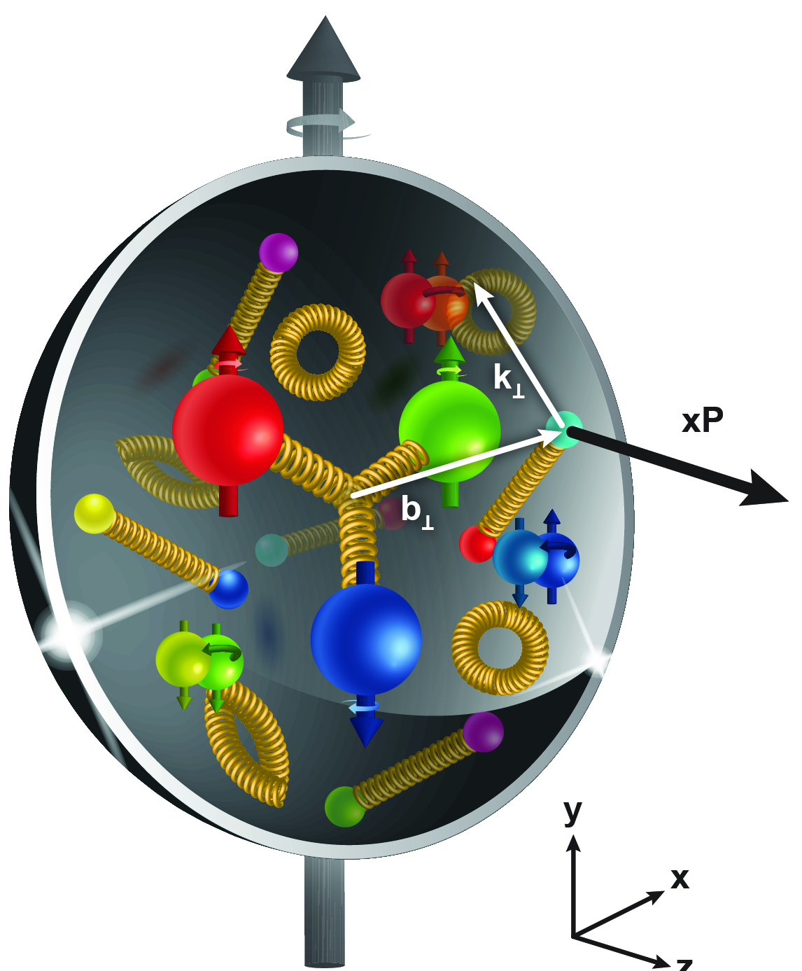
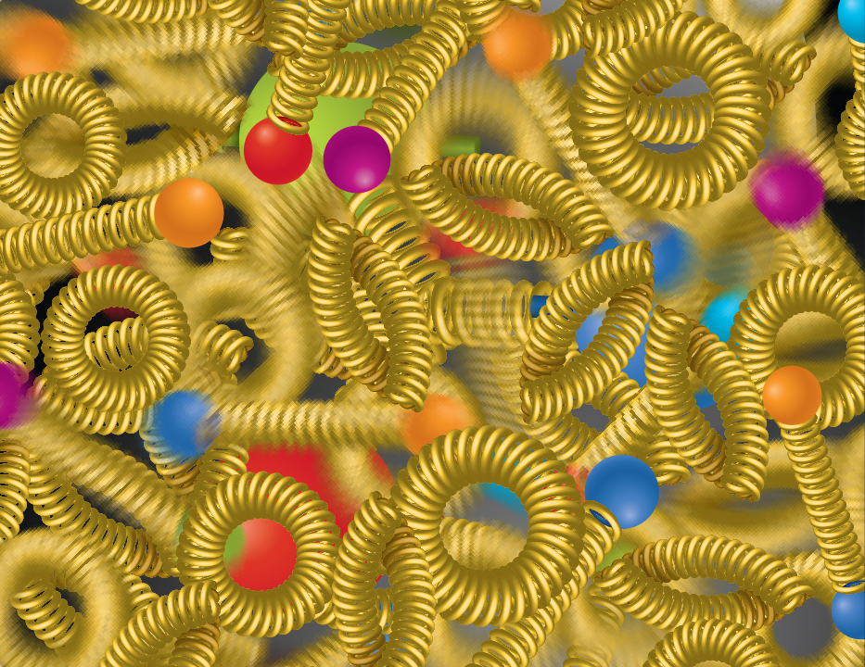
EIC NSAC/NAS Science Pillars
SPIN is one of the fundamental properties of matter.
All elementary particles, but the Higgs carry spin.
Spin cannot be explained by a static picture of the proton
It is the interplay between the intrinsic properties and interactions of quarks and gluons
The EIC will unravel the different contribution from the quarks, gluons and orbital angular momentum.
Does the mass of visible matter emerge from quark-gluon interactions?
Atom: Binding/Mass =
0.00000001
Nucleus: Binding/Mass =
0.01
Proton: Binding/Mass =
100
For the proton the EIC will determine an important term contributing to the proton mass, the so-called “QCD trace anomaly
How are the quarks and gluon distributed in space and momentum inside the nucleon & nuclei?
How do the nucleon properties emerge from them and their interactions?
How can we understand their dynamical origin in QCD?
What is the relation to Confinement
Is the structure of a free and bound nucleon the same?
How do quarks and gluons, interact with a nuclear medium?
How do the confined hadronic states emerge from these quarks and gluons?
How do the quark-gluon interactions create nuclear binding?
How many gluons can fit in a proton?
How does a dense nuclear environment affect the quarks and gluons, their correlations, and their interactions?
What happens to the gluon density in nuclei? Does it saturate at high energy?
?
gluon
splitting
=
gluon
recombination
E. Aschenauer, EICUG 2024
3

Slide 4
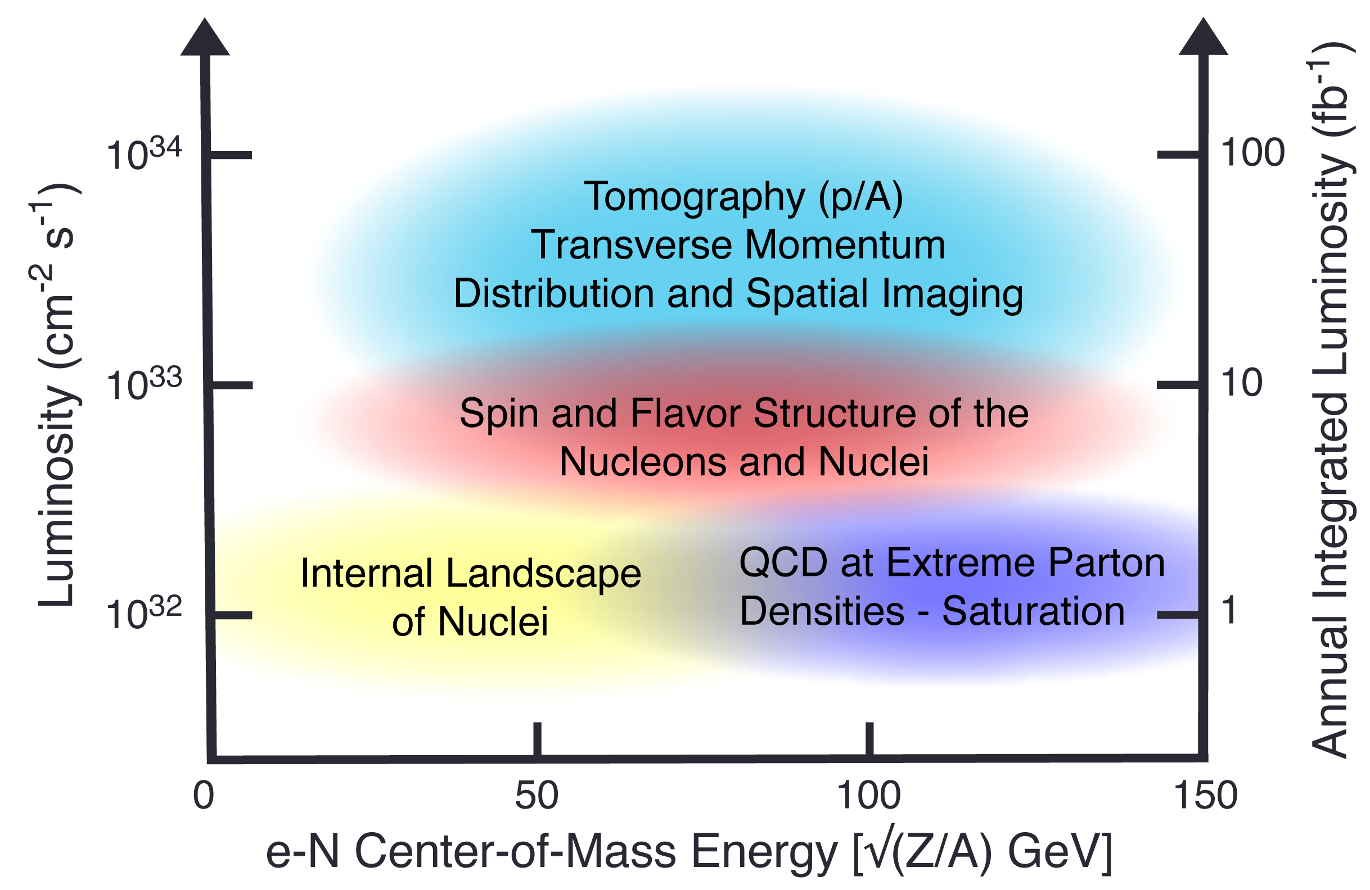
EIC Science Reach
Spin
Mass
3D Imaging
Quarks, Gluons & Nuclei
Dense gluon systems
E. Aschenauer, EICUG 2024
4

Slide 5
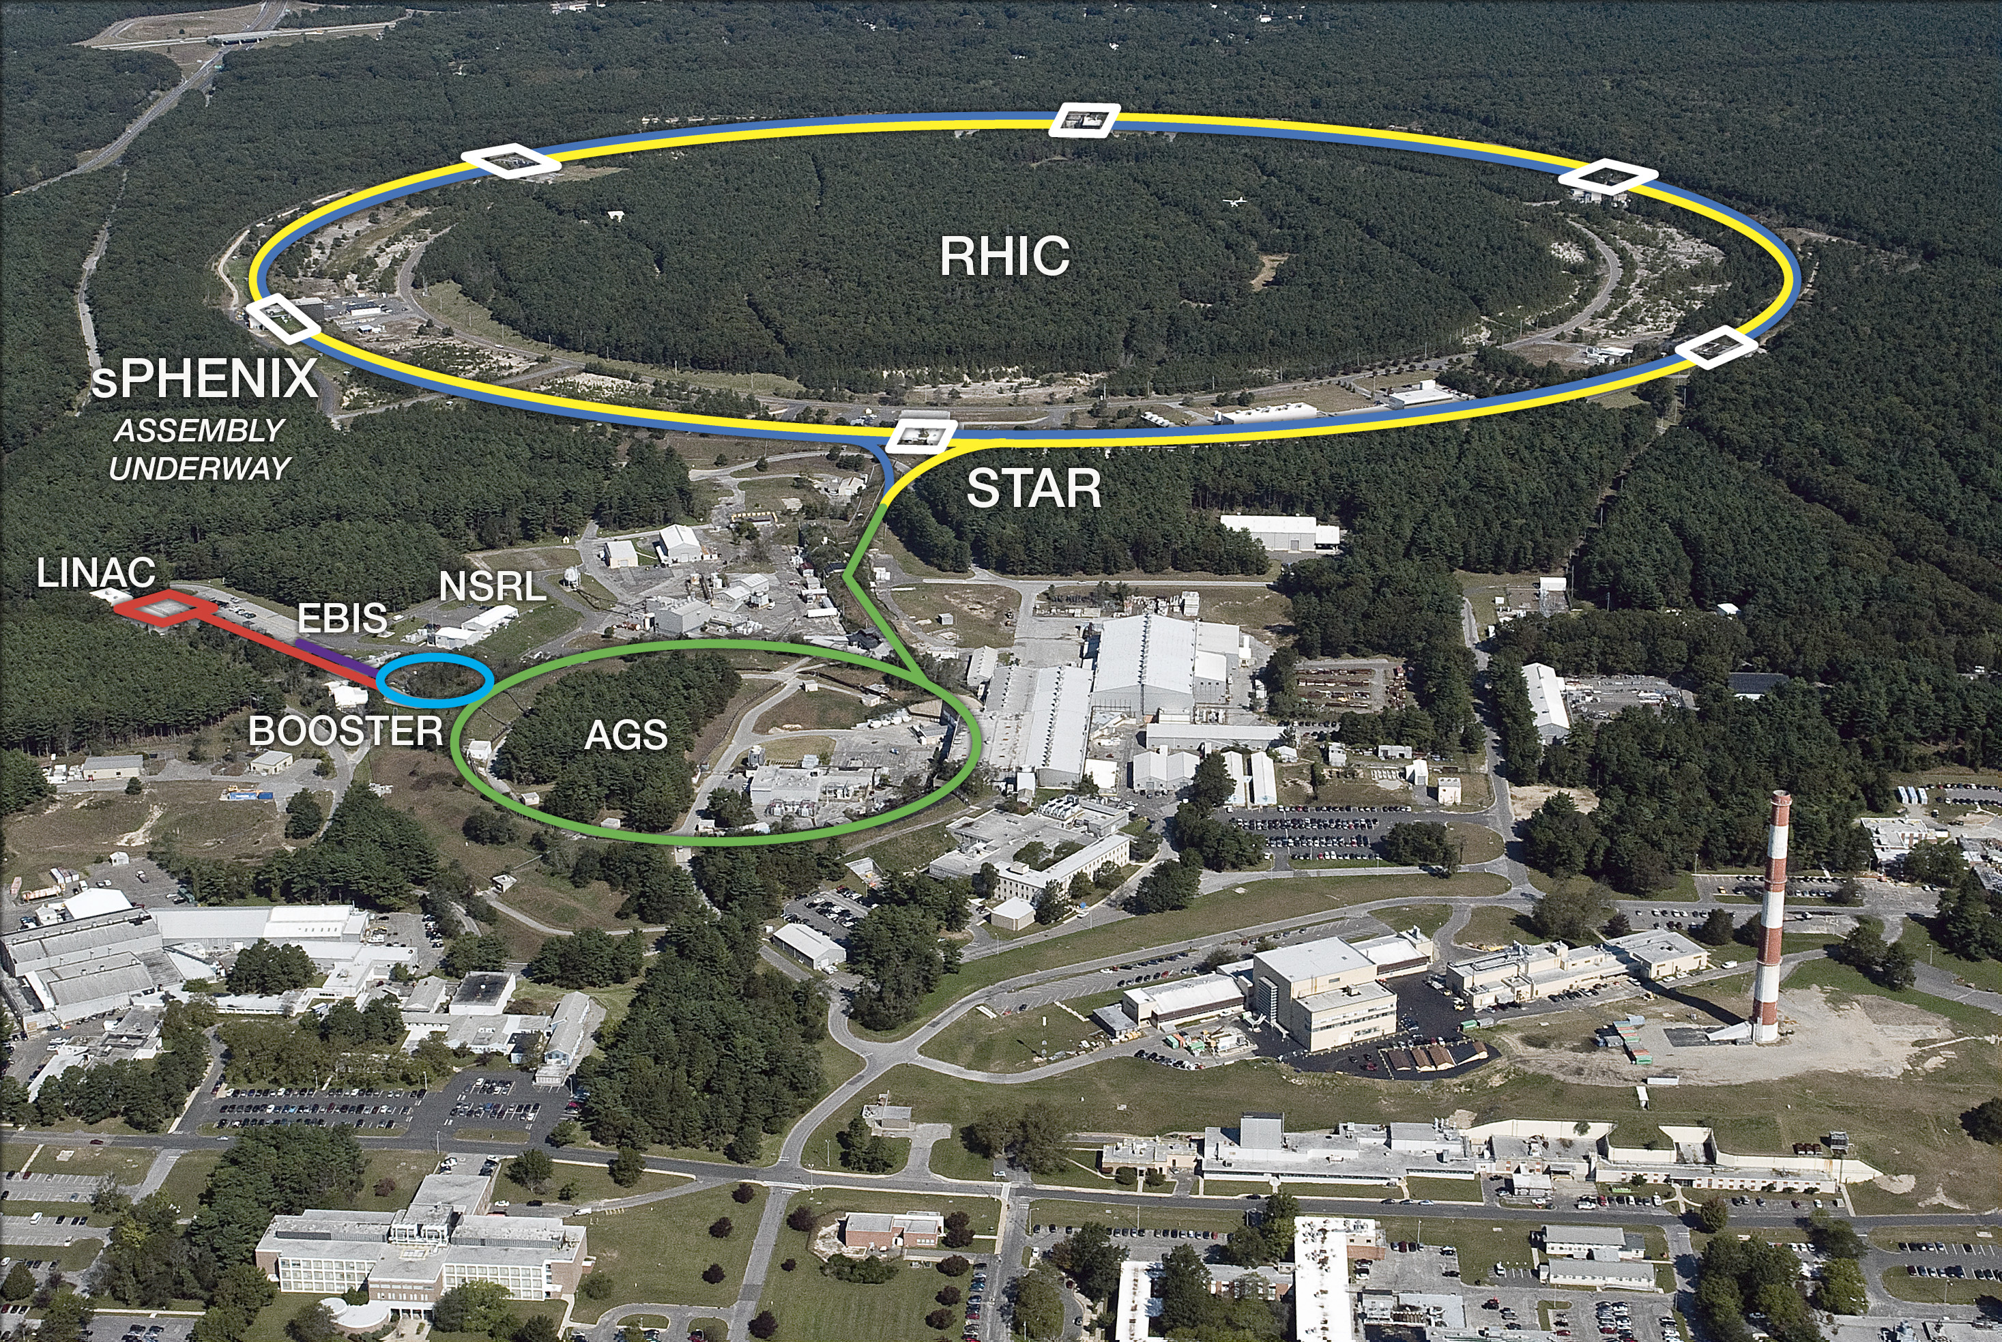
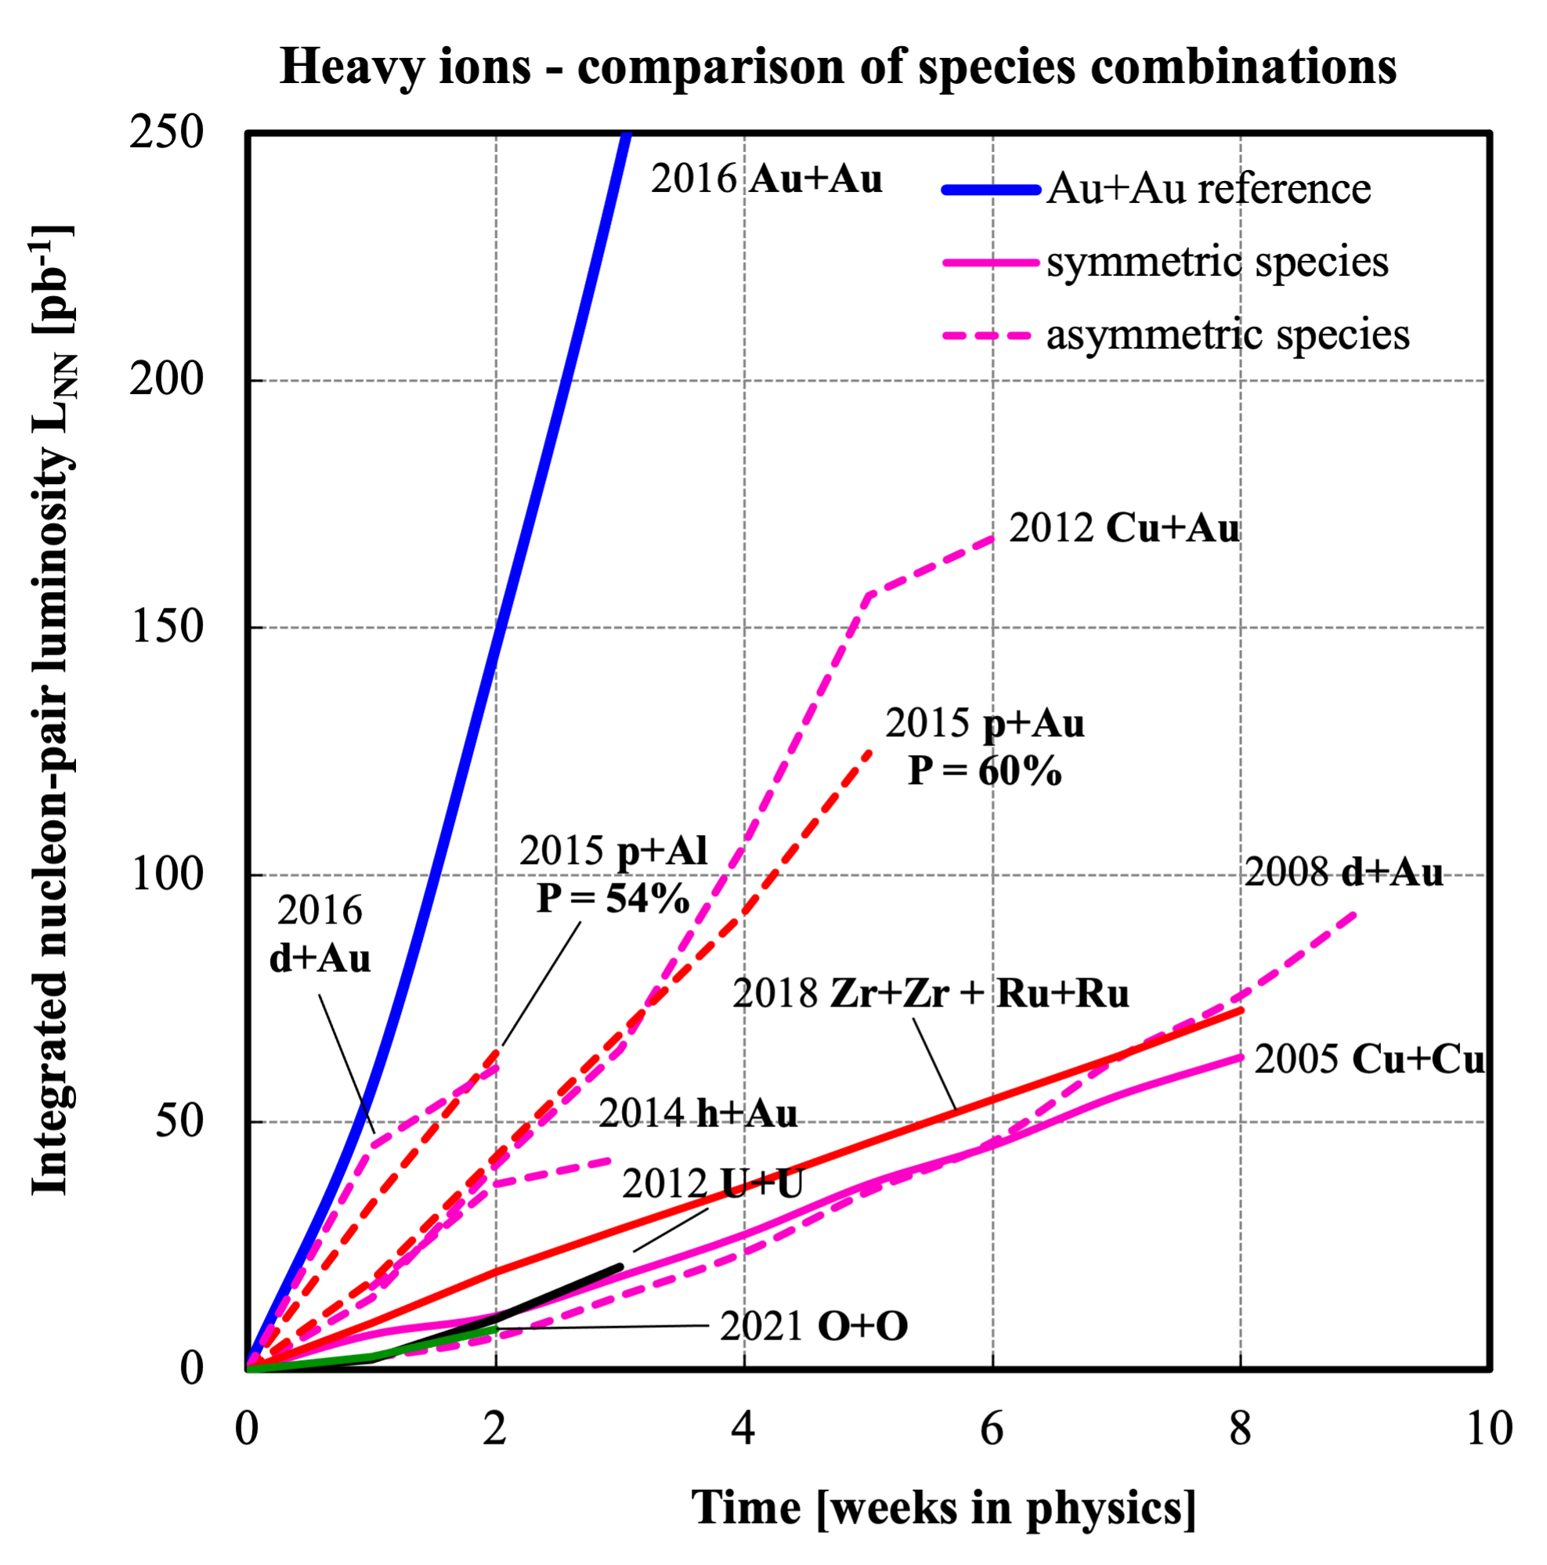
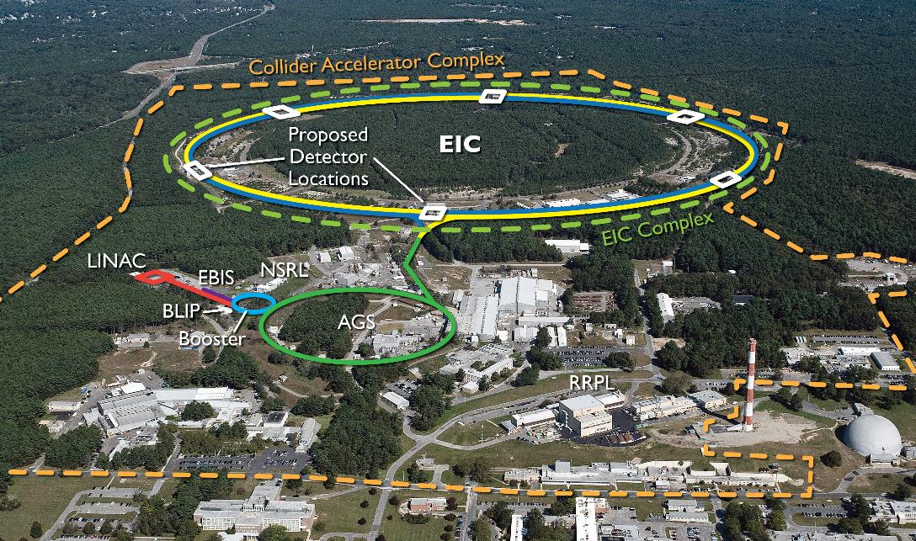
Starting Point
Relativistic Heavy Ion Collider (RHIC)
is the first machine in the world capable of colliding heavy ions.
primarily uses ions of gold but can operate and detect collision with a wide range of ion species from helium to uranium.
is the world's only machine capable of colliding high-energy beams of polarized protons.
We are progressing towards constructing a groundbreaking machine for the international nuclear physics community: the Electron-Ion Collider (EIC)
L. Lari, EICUG 2024

Slide 6
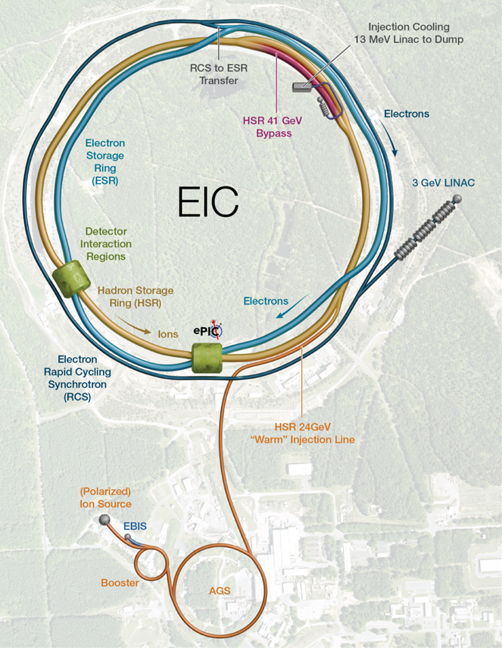


The Electron Ion Collider Platform
Ultimate EIC Performance Parameters:
High Luminosity: L= 10³³ – 10³⁴cm-2sec-1, 10 – 100 fb-1/year
Highly Polarized Beams: 70%
Large Center of Mass Energy Range: Ecm = 20 – 140 GeV
Large Ion Species Range: protons – Uranium
Large Detector Forward Acceptance and Good Background Conditions
Possibility to Implement a Second Interaction Region (IR)
Accelerator Status in a glance:
Polarized ion/proton source
Ion injection and initial acceleration systems – Linac (200 MeV), Booster (1.5 GeV), AGS (25 GeV)
Hadron Storage Ring (40-275 GeV) – HSR
Electron Pre-Injector (3 GeV) – EPI
Electron Rapid Cycling Synchrotron (3 GeV – top energy) – RCS
Electron Storage Ring (5 GeV – 18 GeV) – ESR
High Luminosity Interaction Region(s) – IR
Strong Hadron Cooler System – SHC

Slide 7
Project Planning Update
The focus of EIC project planning efforts is to deliver the DOE approved mission need based on a realistic assessment of technical readiness, cost, schedule, and risk. This continues to be the focus of the EIC project planning efforts.
There are two primary project planning goals/constraints:
Annual EIC project funding requirements should not exceed $300M per year,
Total Project Cost less than $3B, and,
Deliver science within ten years after RHIC shuts down.
The annual funding limitation may require the phased delivery of the accelerator, which is more than 85% of the DOE funded project scope. It is possible to start the science program in less than ten years with electron-ion collisions with the first phase of the accelerator. The second and final phase of the project would complete the scope required to achieve the DOE approved mission need and the two phases will overlap.

Slide 8
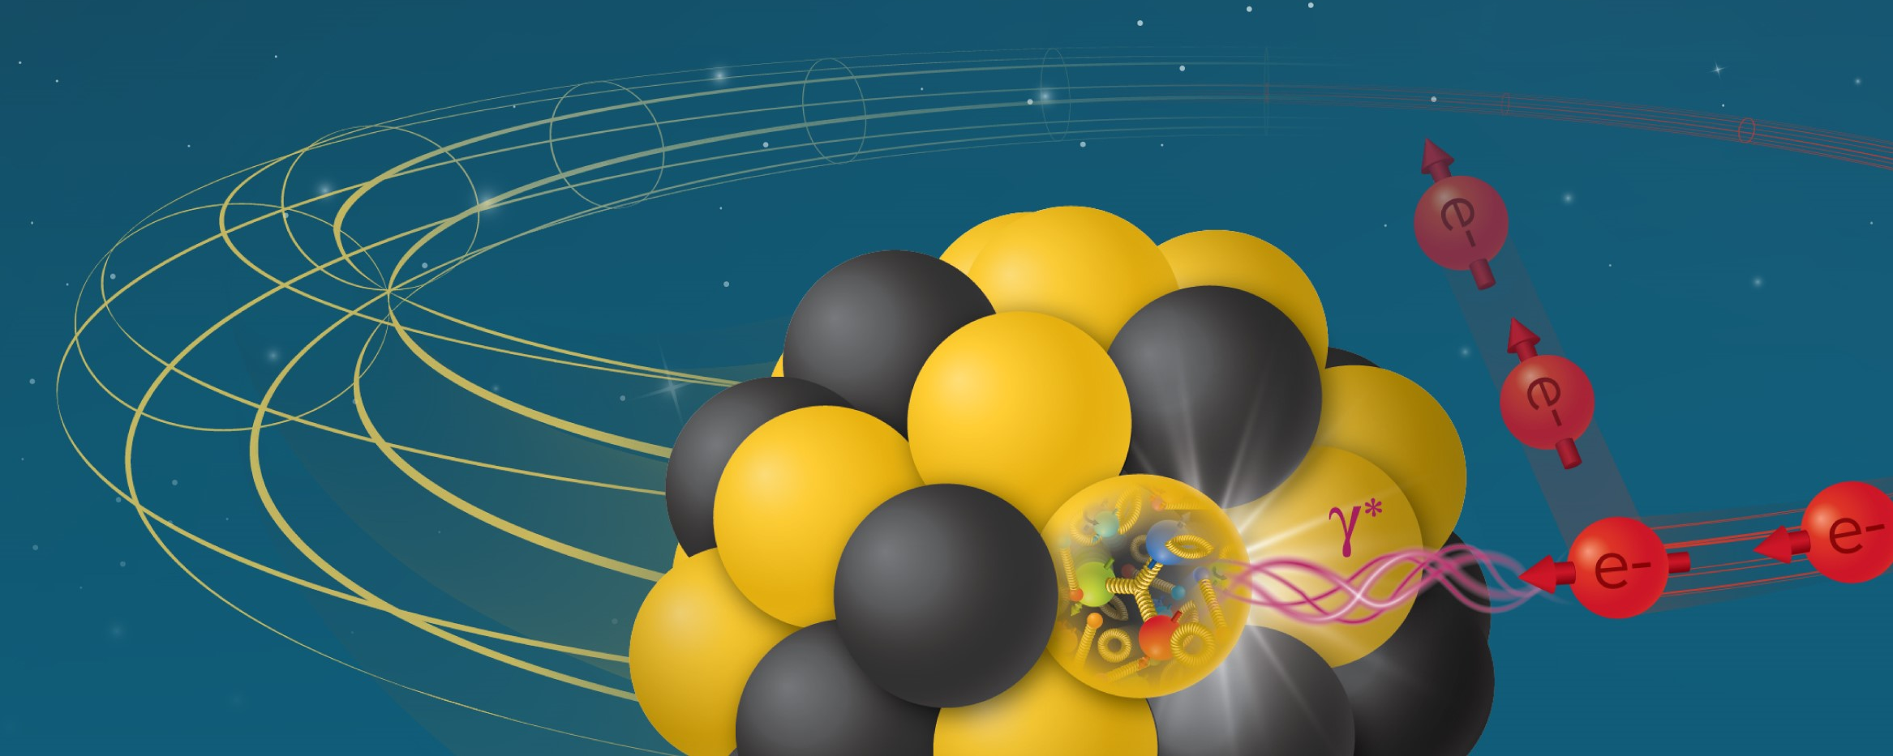

Path to Supporting Science Discoveries
Final Performance Phase: Achieve parameters listed in the Conceptual Design Report
Early Science Phase:
5 GeV or 10 GeV polarized electron | 7 nC per electron bunch | 100 – 250 GeV polarized proton
>100 GeV/u various ion | No Strong Hadron Cooling at full energy | Cooling at injection energy

Slide 9
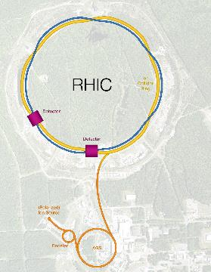
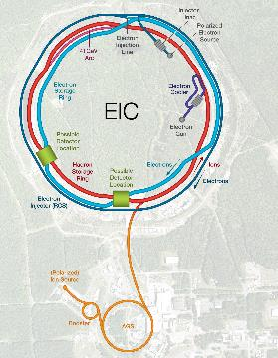
General Challenges in EIC
Hadron Storage Ring (RHIC Rings) 40-275 GeV
Superconducting magnets (existing)
1160 bunches, 1A beam current (3x RHIC)
Bright vertical beam emittance 1.5 nm (“flat beams”)
Cooling at collisions (coherent electron cooling)
Electron Storage Ring 5–18 GeV
High beam current, 2.5 A, 9 MW S.R. power, S.C. RF
Swap-out injection of polarized bunches
Electron rapid cycling synchrotron, 1Hz, 3 -> 18 GeV
Spin transparent due to high quasi-periodicity
SCRF injection linac
High luminosity Interaction Region(s)
Superconducting final focus magnets
25 mrad crossing angle with crab cavities
Spin Rotators (longitudinal spin)
Forward hadron instrumentation

Slide 10
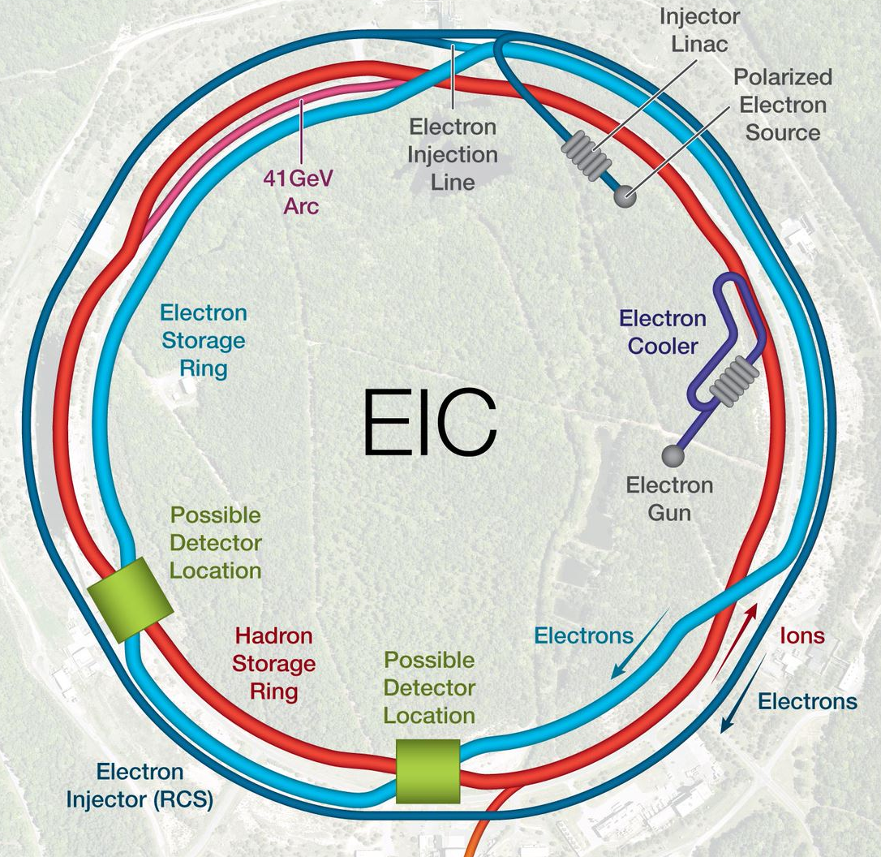
R&D Topic Map
ESR Cavity
Hadron Polarimetry
Electron Fast Kicker
High Power FPC
Polarized Electron Source
RCS Corrector Power Supply
HOM Absorber
HSR Vacuum Upgrade
SHC Component
ESR Arc
Vacuum Chamber
Proton Fast Kicker
IR Design and Magnet Prototyping
Crab Cavity
IR Vacuum Chamber

Slide 11
Current Status of Electron Injection

Slide 12
EIS Performance Goals
Provide bunches with appropriate emittances, charge and polarization at the necessary cycle rate to meet the needs of the ESR and the physics program.
Generate and accelerate polarized electrons to 5, 10 and 18 GeV with 85% polarization
Deliver 28nC bunches at 5 and 10 GeV ( 1 bunch per second)
Need to fill ESR in under 20 min 1160 buckets x 1 sec ~ 19.33 min
Deliver 11nC at 18 GeV
1200 seconds / 290 buckets ~ 4 seconds
Match ESR Emittances

Slide 13
RCS Design
Provide bunches with appropriate emittances, charge and polarization at the necessary cycle rate to meet the needs of the ESR and the physics program.
Accelerate polarized electrons from 3 to 5, 10 and 18 GeV
Maintain 95% polarization transmission
Deliver three 28nC bunches at 5 and 10 GeV every 1.5 sec
Deliver three 11nC at 18 GeV every 1 sec
Design driven by polarization transmission needs
Requires high periodicity and tune
Special Spin Resonance Optimization
Design also guided by need for good off-momentum dynamic aperture to facilitate charge accumulation at injection.
Design needs low average beta and low gammaT to reduce collective effects that would prevent charge accumulation.

Slide 14
Current RCS Lattice with Bypasses
The current design accommodates detector bypasses and RF physical needs by moving dipoles out of the arcs into the IR regions to modify the trajectory around obstructions.
Two connecting arc designs
Detector→ IP6, IP8
RF, Extraction, Injection
IP10→ RF
IP12→ Extraction
IP2
IP4 → Injection
Bypasses damage symmetry of original approach however high polarization transmission is recovered via optimization of quadrupole strength in each arc connecting region → large beta functions ~ 140 m in these regions.
IR12
IR10
IR2
RF, Extraction, Injection Style
By-pass
Detector By-Pass
IR8
IR4
IR6

Slide 15
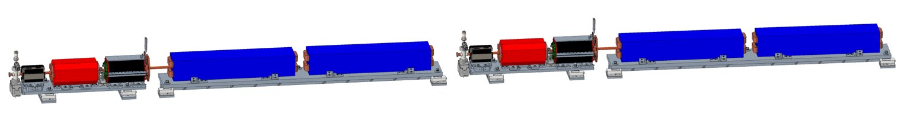
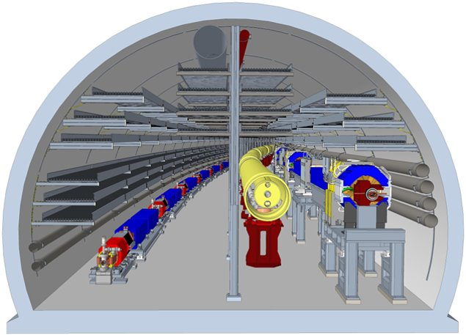
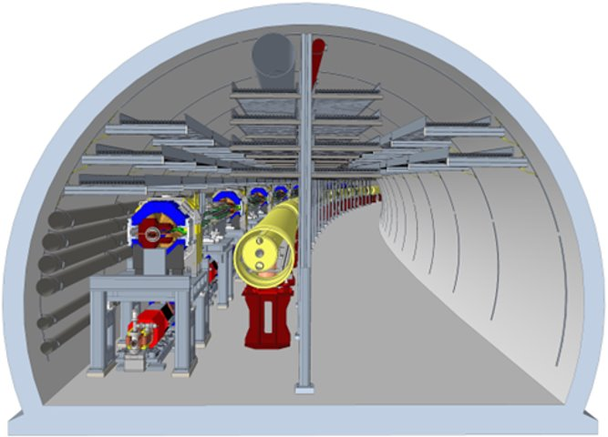
RCS Placement in Tunnel
To access RCS in Sector 1 is challenging and unclear how much we would need to disassemble beamlines. Are planning a review of RCS installation in tunnel.
RCS is 0.36 m from floor
Sector 9
Sector 1

Slide 16
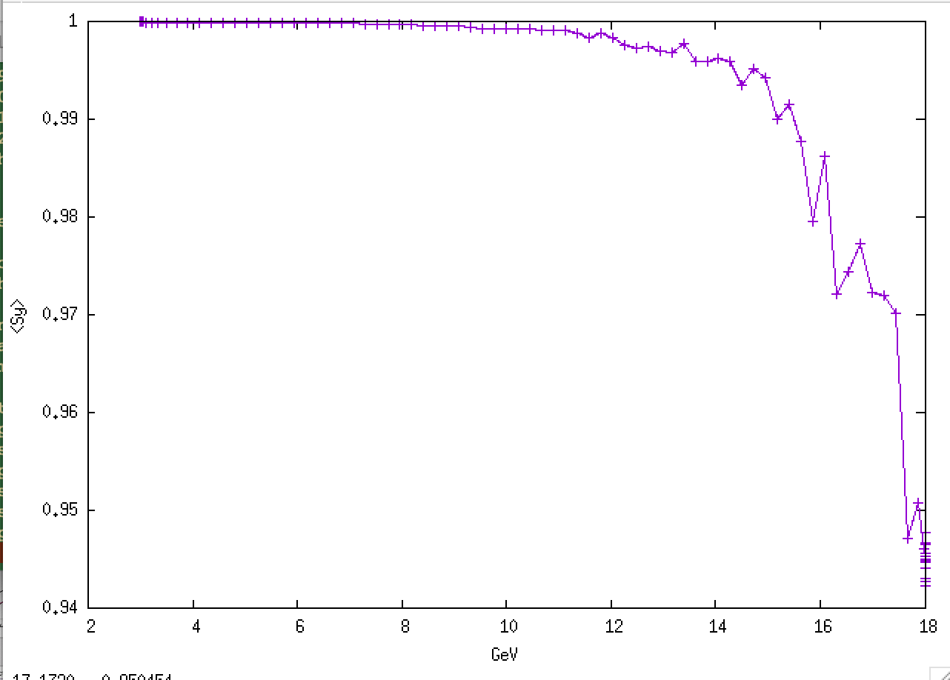
First Spin Tracking Results with New Lattice
Full 6D tracking 1000 particles in BMAD with vertical closed orbit errors of 0.59 mm RMS, including radiation.
Achieved by random misalignment of quads of 2e-5 m with not attempt at correction.
Injected emittance 6.1nm in both planes with 2 mm bunch length and 0.2% dp/p rms.

Slide 17
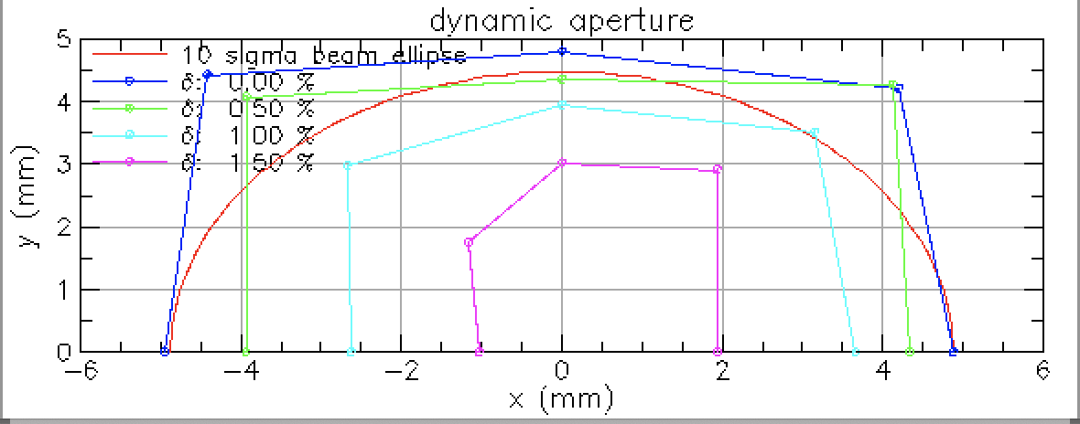
Progress on Dynamic Aperture
Thanks: Will Bergan
With Polarization Transmission recovered we also optimized the sextupoles to recover sufficient off-momentum aperture to accommodate off-momentum injection.
As well at 18 GeV horizontal emittances are large so we need a large enough dynamic aperture to accommodate 27 nm equilibrium emittance.
So far we have > 5 sigma at injection and about 10 sigma at 18 GeV.
Red line is 100 rms emittances
With Physical aperture r=17.8 mm

Slide 18
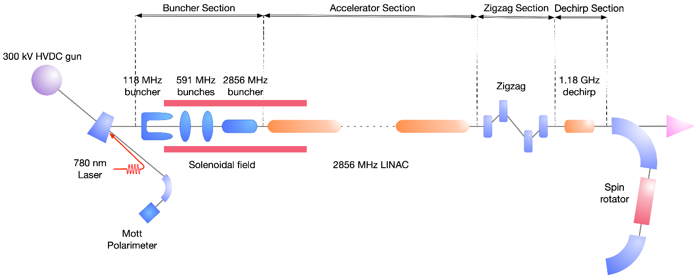
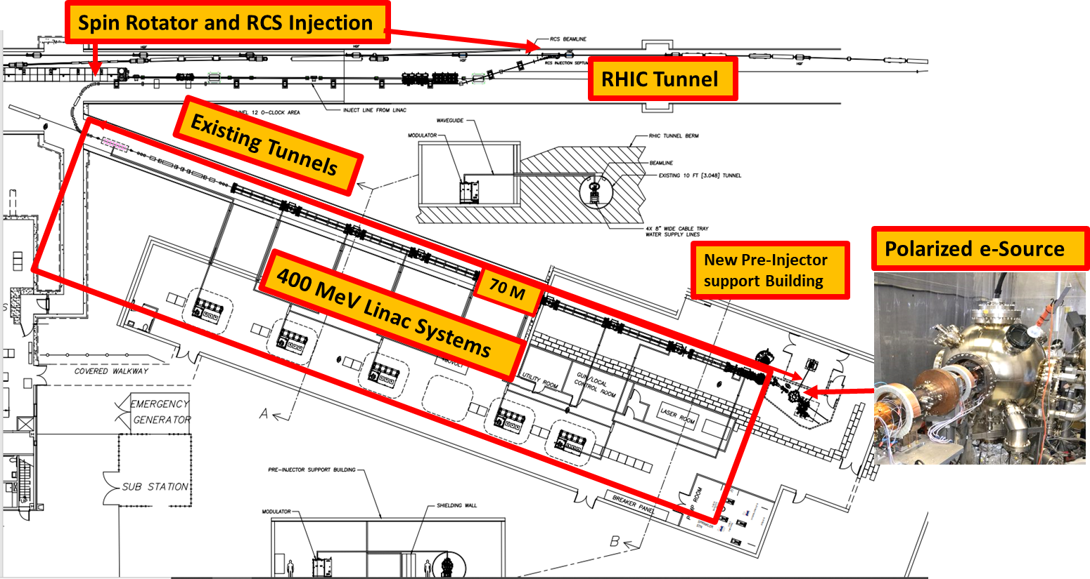
Current Pre-Injector Concept in EIC Baseline
In current project baseline:
Major components of the current electron pre-injector in EIC baseline
Layout of the pre-injector support building at IR12
400 MeV
Pre-injector scope includes electron source to the end of the transfer line into RCS
2.856 GHz 400 MeV normal conducting linac turnkey system
Bunching system before 400 MeV linac
Beam manipulation after 400 MeV linac
Transfer line with superconducting solenoid as spin rotator

Slide 19
From EIC CD-3a Long Lead Procurement Director’s Review Final Report (October 30, 2023) SC1 - Accelerator Design and Beam Dynamics
Comments:
….
RCS design is maturing, however there appears to be several challenges of concern, including low field in the magnets at injection, injection kickers, bunch merging dynamics at 1 GeV, high current effects.
Magnetic shielding will likely be needed for the RCS to help with orbit control. The committee suggests that the mitigation of any remnant magnetic field should receive adequate attention.
…
The RCS magnets at the 400 MeV injection point have very low fields (e.g. ~60 gauss in the dipoles). Several methods to increase these fields have been studied. Additional work is needed to converge on a more feasible solution so that the technical risk can be reduced.
…
Recommendations:
…
Call a topical review focused on the RCS design by the summer of 2024.

Slide 20
Presented in June in the Electron Injector Review (EIR)
CDR baseline
CDR baseline: copper vacuum chamber
400 MeV linac @ 2.8 GHz Normal conducting RF
RCS
ESR
390 keV/turn
at injection with wiggler
New Concept
3 GeV linac @ 1.3 GHz Superconducting RF
bunch injection
Swapout
33 keV/turn without wiggler
at injection
Improvements from baseline
Increased RCS dipole field from 56 G to 400 G to avoid large magnetic field error at below 200 G.
Increased RCS injection energy to avoid beam affected by ambient magnetic field from RHIC tunnel .
Lower linac frequency to open high charge (>10nC) bunch option
Lower eddy current by changing vacuum chamber from copper to stainless steel with copper coating
Change accumulation scheme to avoid large bunch charge single bunch injection
Add spin rotation option at low energy
RF
RF
C ~3800 m
f_{RF} = 591 MHz
New concept: stainless steel vacuum chamber with 30 um copper coating

Slide 21
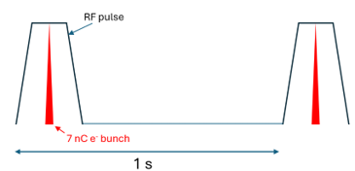
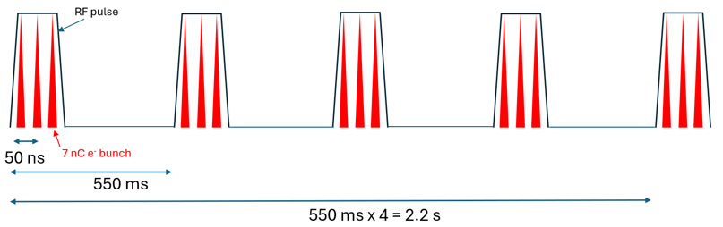
Pre-Injector Goals
Electron for phase I:
Electron for phase II:
7nC / bunch, single bunch
3 GeV polarized e⁻
7nC / bunch, three bunch per train
3 GeV polarized e⁻
 | Unit | Phase I | Phase II | RCS Injection Requirements
RCS injection energy | GeV | 3 | 3 | 2 – 3.5
bunch train repetition rate | Hz | 1 | 4 bunch train every 2.2s | < 10 Hz
# bunch per bunch train |  | 1 | 3 | 1 – 3
charge per bunch | nC | 7.5 | 7.5 | 4 – 14
bunch spacing |  | N/A | 50 ns | Integer multiple of 50 ns (freq. ratio)
rms bunch length | mm | 1 | 1 | 0.8 – 1.9
rms energy spread (σ_p/p) |  | 1.70E-03 | 1.70E-03 | 0.02% < σ_p/p < 0.4% (phase I) 0.1% < σ_p/p < 0.4% (phase II)
rms norm. horizontal emittance (ε_x) | mm-mrad | under study | under study | ˂180 (phase I) or ˂60 (phase II)
rms norm. vertical emittance (ε_y) | mm-mrad | under study | under study | ˂180 (phase I) or ˂60 (phase II)

Slide 22
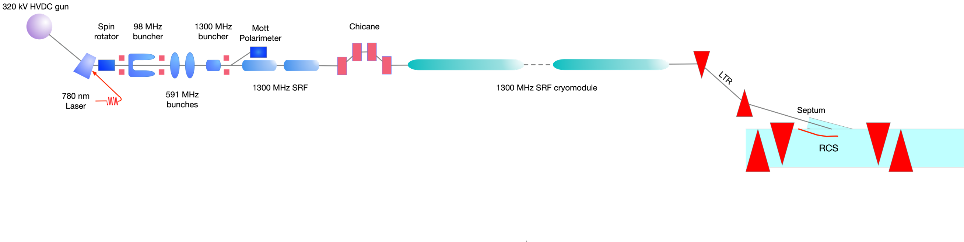
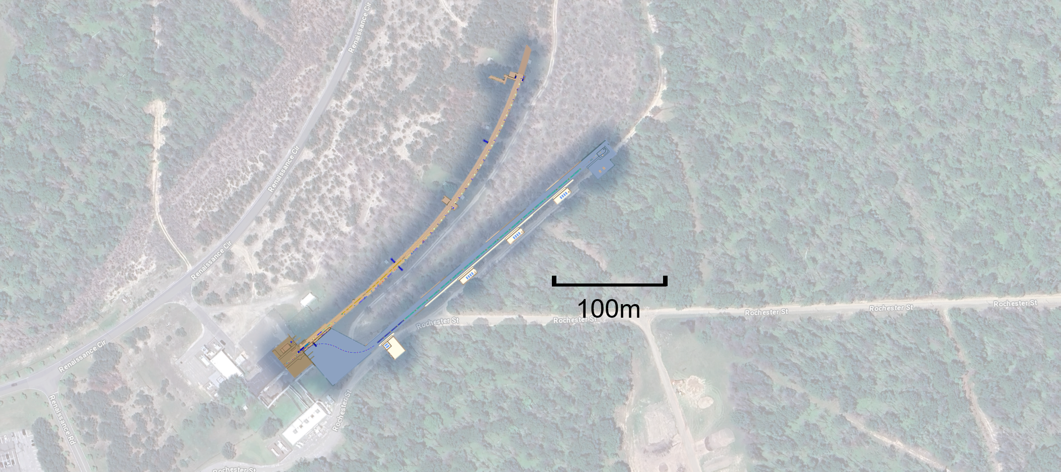
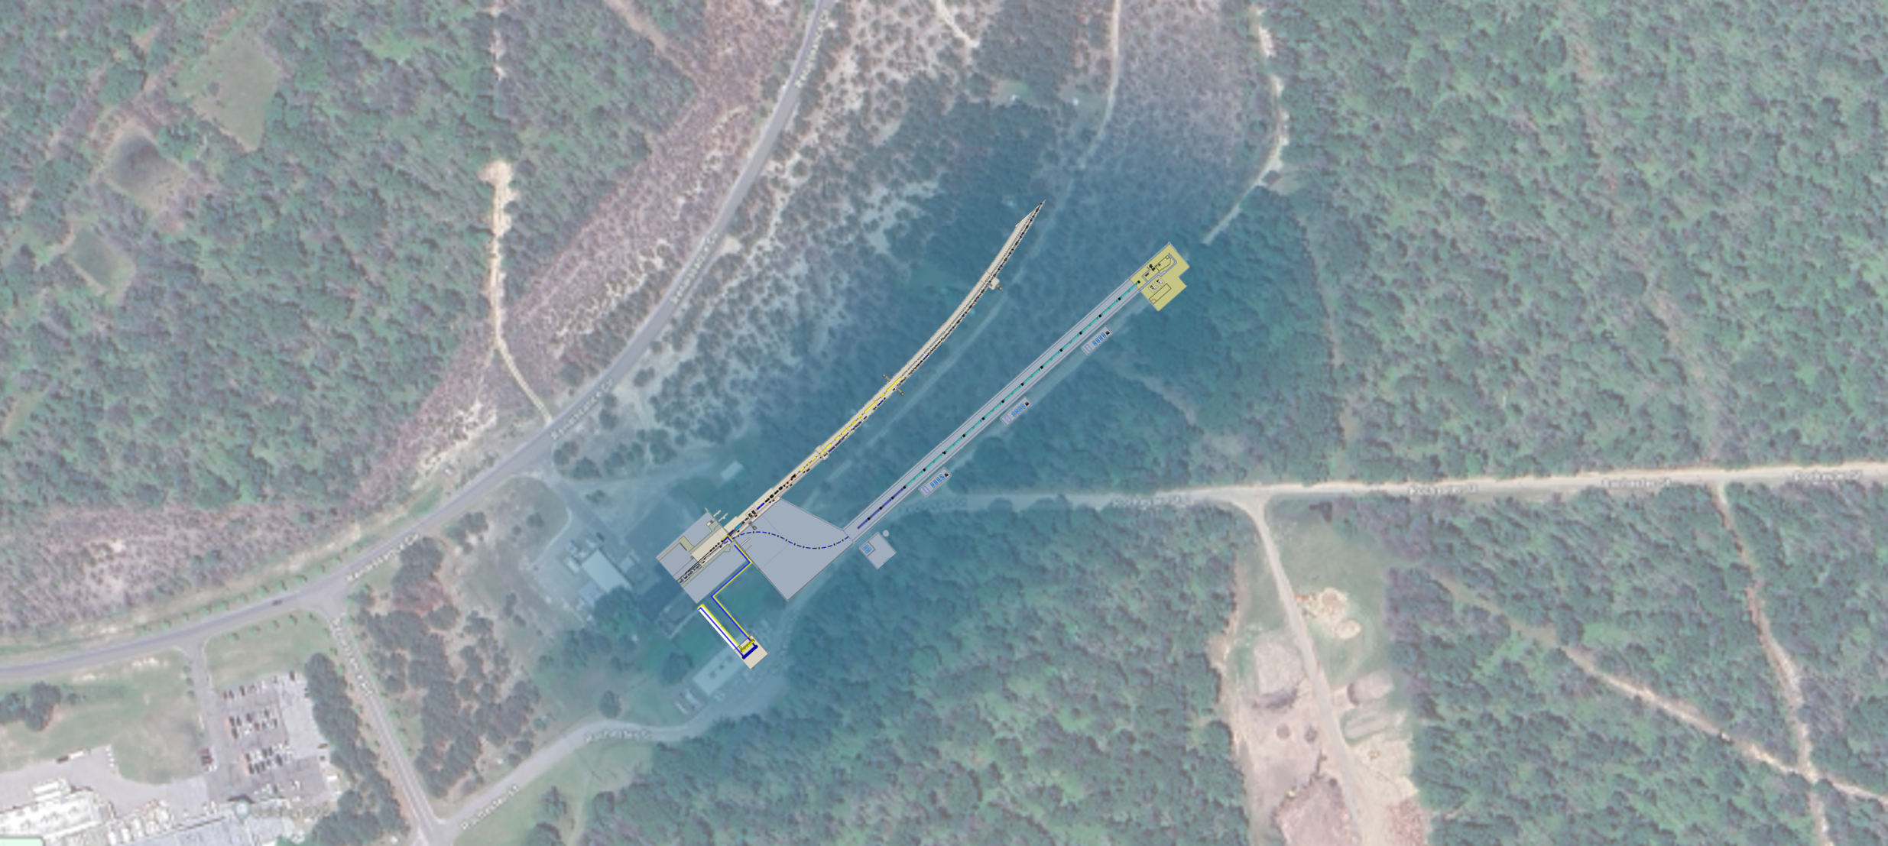

Introduction to new injector
Scope interface
defined at RCS septum entrance
Scope:
From polarized electron gun to end of the Linac to RCS (LTR) transfer line
The Electron Pre-Injector (EPI) delivers polarized electrons from generation to the entrance of the RCS, meeting the physical requirements for early science. With minor modifications, it has the potential to support ultimate accelerator performance as well.
The major components of the EPI are listed in the picture above
IR04
IR04
100m

Slide 23
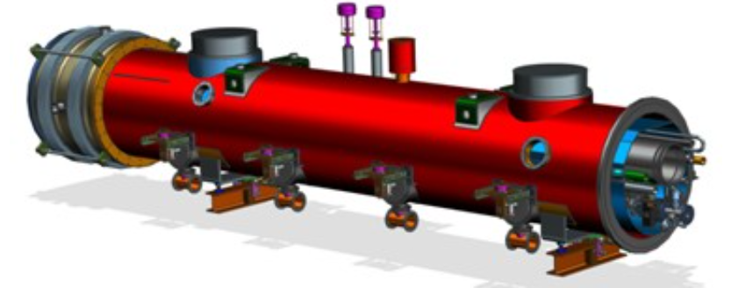
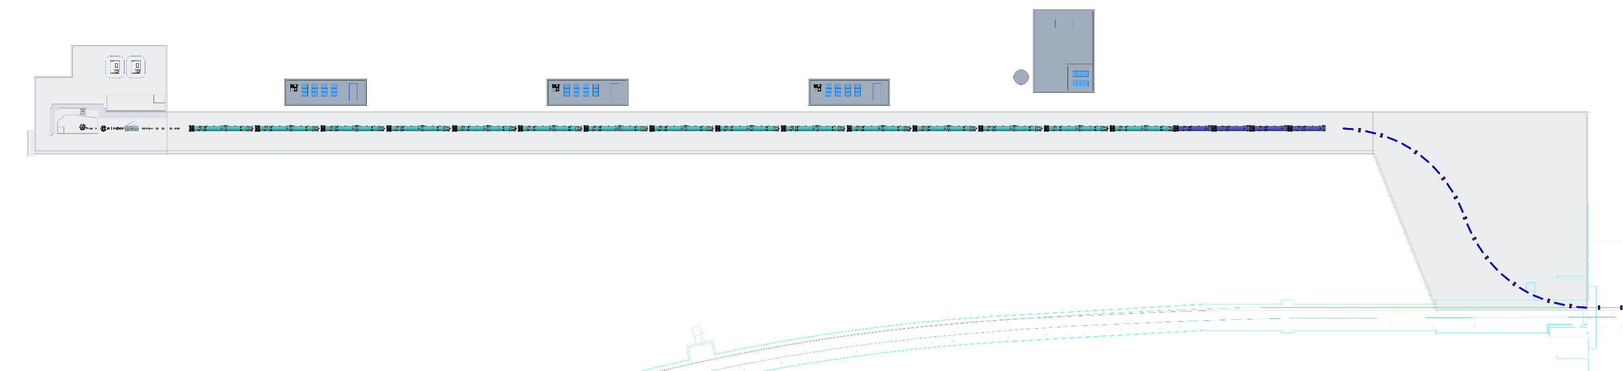
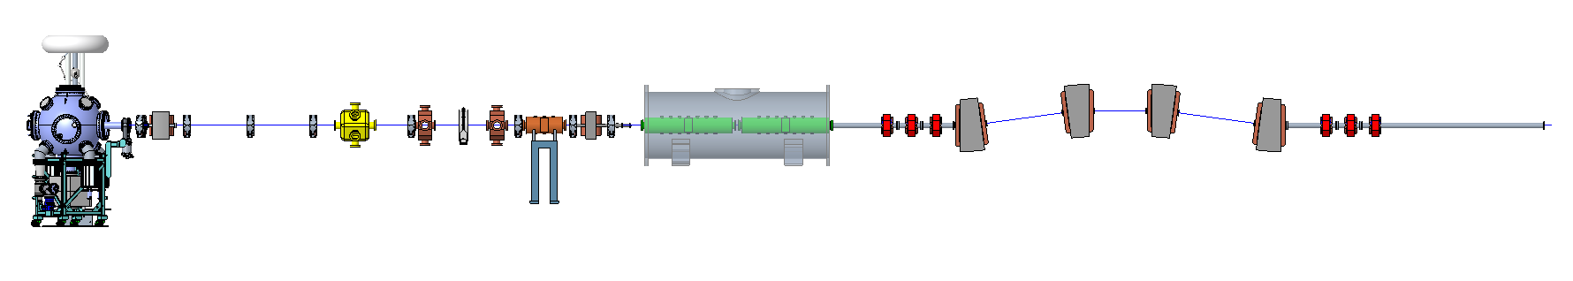
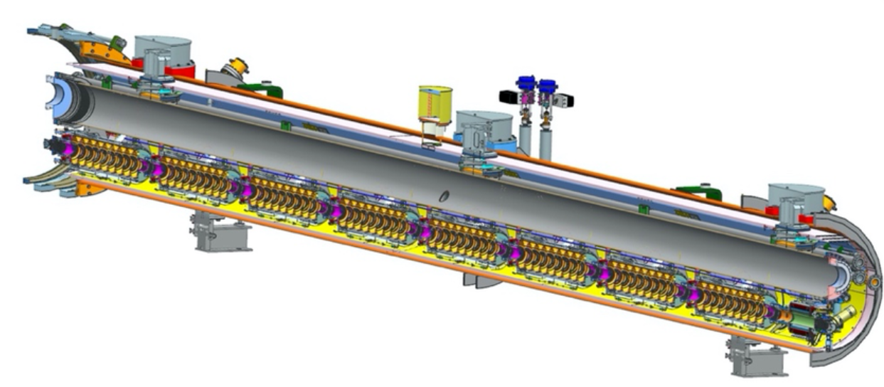
Preliminary layout
The total length of the electron pre-injector is ~250 m from gun to the end of the linac
Space will be reserved for 3rd harmonics SRF cryomodules for phase II.
3.9 GHz cryomodule with
8 cavities (LCLS-II type)
bunching section
1.3 GHz cryomodule with 8 cavities (LCLS-II type)
polarized electron gun

Slide 24
Beam dynamics
Parmela: gun to the end of linac: space charge, wake.
Elegant: start of linac to the transfer line: Longitudinal space charge, CSR, wake.
 | Parmela (end of Linac) | Elegant (end of Linac) | Elegant (end of transfer line with CSR)
RMS bunch length [mm] | 0.86 | 0.954 | 1.9 (LTR decompression)
RMS energy spread | 0.164% | 0.167% | 0.169%
RMS nor. emit x/y [mm-mrad] | 49/31 | 47/34 | 350/33
Bunch charge [nC] | 7.5 | 7.5 | 7.5
red: in working progress

Slide 25
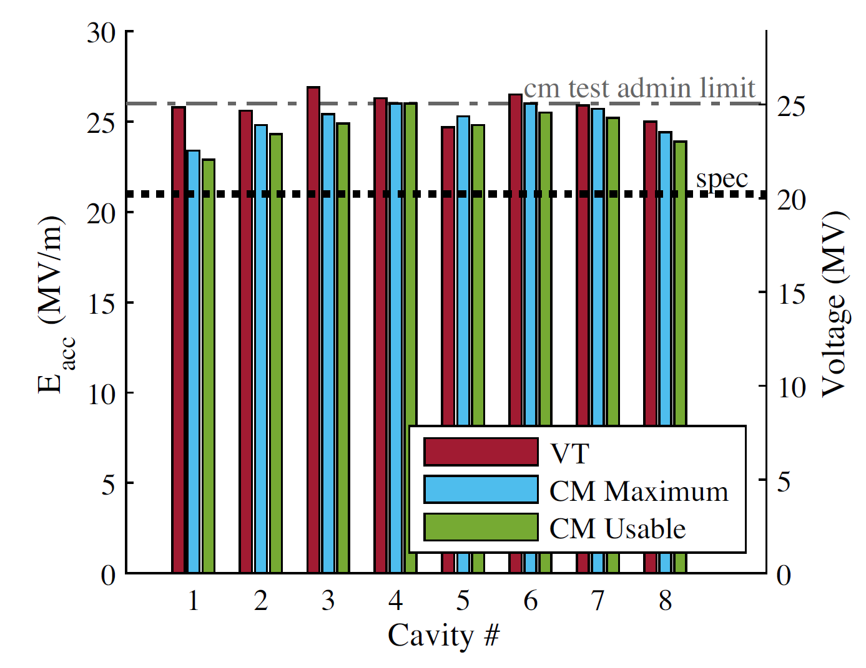
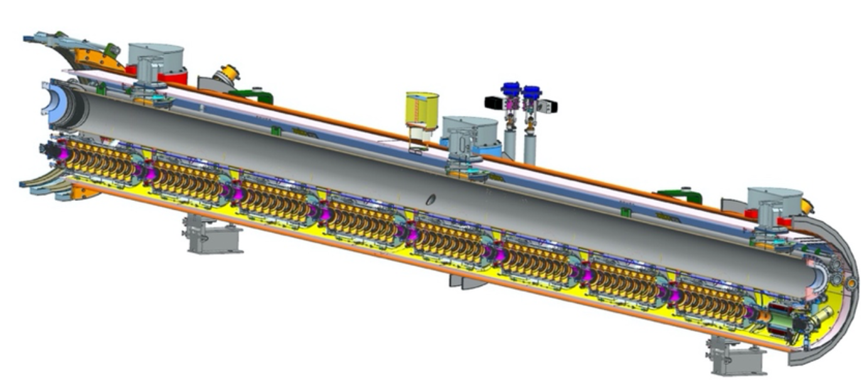
1.3 GHz SRF Linac
Current plan for providing 3 GeV electron beam:
15 LCLS-II or XFEL type cryomodules working at pulsed mode (design for 5 Hz maximum), 8 cavities per cryomodule, with quadrupole, tuner, beam line absorber, BPM, vacuum components etc..
Length: 12 m / cryomodule
Operation gradient: 25 MV/m (driven by expected cavity production yield)
EIC pre-injector
Cross section of LCLS-II-HE cryomodule model
J Kaluzny et al 2022 IOP Conf. Ser.: Mater. Sci. Eng. 1241 012044
S Posen et al 2022 PHYSICAL REVIEW ACCELERATORS AND BEAMS 25, 042001 (2022)

Slide 26
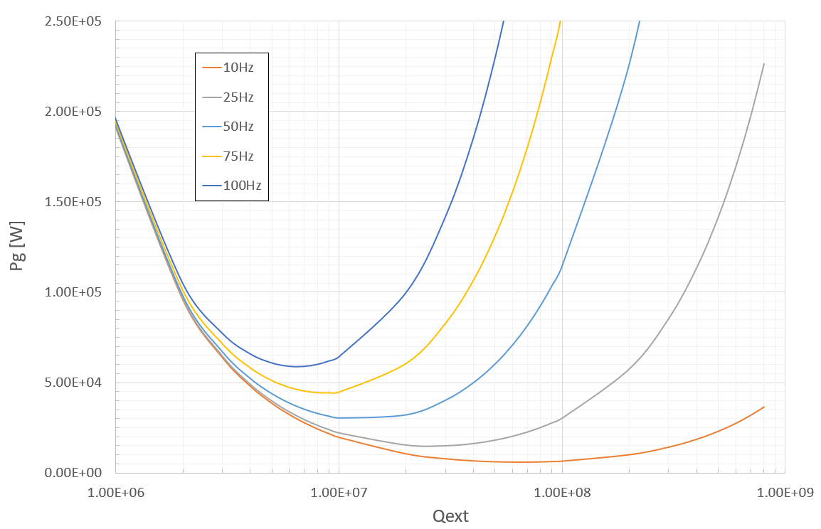
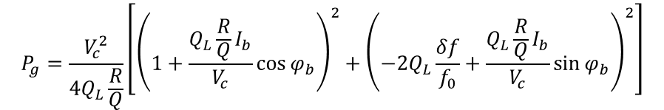
SRF cavity power choice
RF power consideration: 20kW per cavity for 10 Hz microphonics detuning @ pulsed mode
$$P_{g}=\frac{V_{c}^{2}}{4Q_{L}\frac{R}{Q}}\left[{\left(1+\frac{Q_{L}\frac{R}{Q}I_{b}}{V_{c}}\cos{φ_{b}}\right)}^{2}+{\left(−2Q_{L}\frac{δf}{f_{0}}+\frac{Q_{L}\frac{R}{Q}I_{b}}{V_{c}}\sin{φ_{b}}\right)}^{2}\right]$$
The Lorenz Detuning will be challenging to control in pulse mode. However, the system should be stabilized at some mechanical mode with periodic drives.
Increase RF power from minimum necessary is planned, with cost under consideration, for Lorenz Detuning stabilization and mitigation of risk of cavity operation failure.

Slide 27
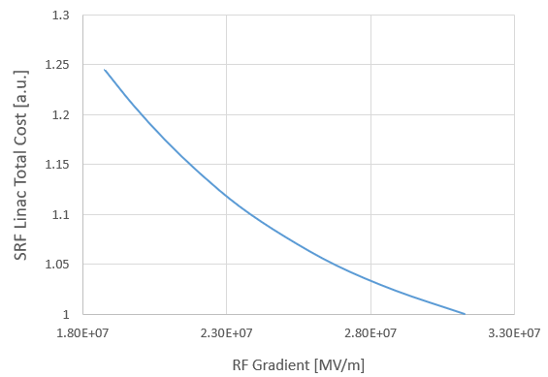
Cost Optimization Study
Tool developed for SRF linac cost optimization.
Estimation includes cost from infrastructure, cryogenics, cryomodule fabrication, RF amplifier, LLRF control.
Preliminary bench marked with cost optimization tool developed by Tom Powers and Peter McIntosh
Results provided guidance to the SRF linac configuration and operation parameters.
In addition to cost, final decision based on operation experience, vendor availability, existing land scape and infrastructure, etc..

Slide 28
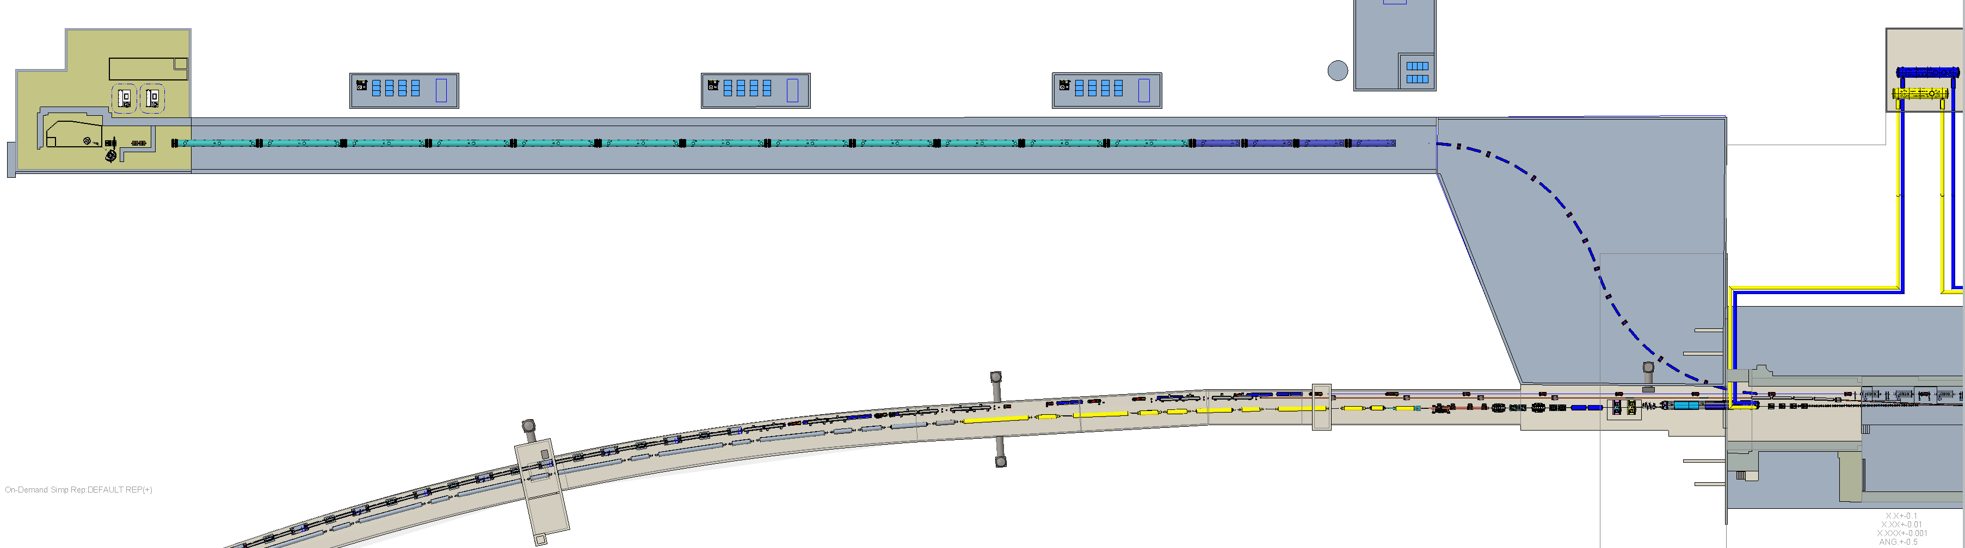
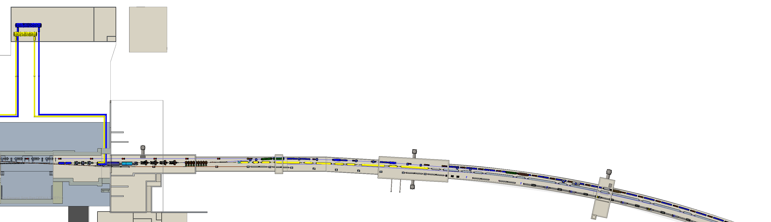
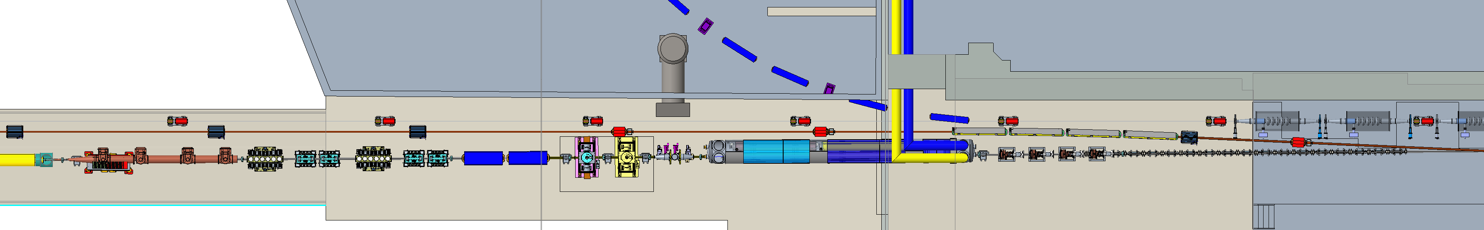
Infrastructure
The pre-injector is currently planned at IR04
Finalizing SOW with infrastructure planning and designing company
Cryogenic distribution line is under active planning
Area of Detail
Area of Detail
IP4
RCS
Injector
Transfer Line
RCS Inject location
RCS SRF Cavities
ESR
Dipoles
HSR
Triplet
4X 49 MHz
HSR Inject Kickers
Off-momentum Detectors
Stochastic Cooling
HJet
3He Jet

Slide 29
Progress in past five months
Defined a clear scope of the Electron Pre-Injector (EPI). Including physical boundary and site of construction.
Defined the major parameters for RCS injection, with phasing in consideration.
Defined major hardware elements. Completed defining hardware requirements based on physics design. Initiated discussion of engineering design.
Completed first beam dynamics simulation from gun to end of the transfer line.
The Linac to RCS (LtR) transfer line design in progress.
Adjusting lattice based on RCS merging study results in progress.
Design of hardware with higher uncertainties in progress (spin rotator and polarimeter).
Preliminary layout generated with current hardware dimensions and accurate RHIC coordinates
High level cost optimization of the 1.3 GHz SRF linac in progress. Considerations of cost from infrastructure, cryogenic capacity, RF power amplifier, LLRF control, cryomodule are all included. Preliminary results under review by individual groups for feedback.
Cost estimation of major components completed with preliminary results.

Slide 30
Summary
The electron pre-injector challenges were thoroughly studied, and solutions were developed with a new concept.
The new design adopts a higher injection energy of 3 GeV and a lower RF frequency of 1.3 GHz, which eliminates the low magnetic field during the RCS injection and allows for high-charge injection.
Lattice design and beam dynamic studies are ongoing, with start-to-end simulations completed. No major issues identified.
The SRF linac power and cost estimations have been completed and benchmarked against existing tools to ensure accuracy.
Reviewing the latest study of new electron injection concept, and comparing the results with similar recent DOE projects
Decision for final electron injection scheme will be made, and detailed schedule will be implemented in P6.

Slide 31
Back Up

Slide 32
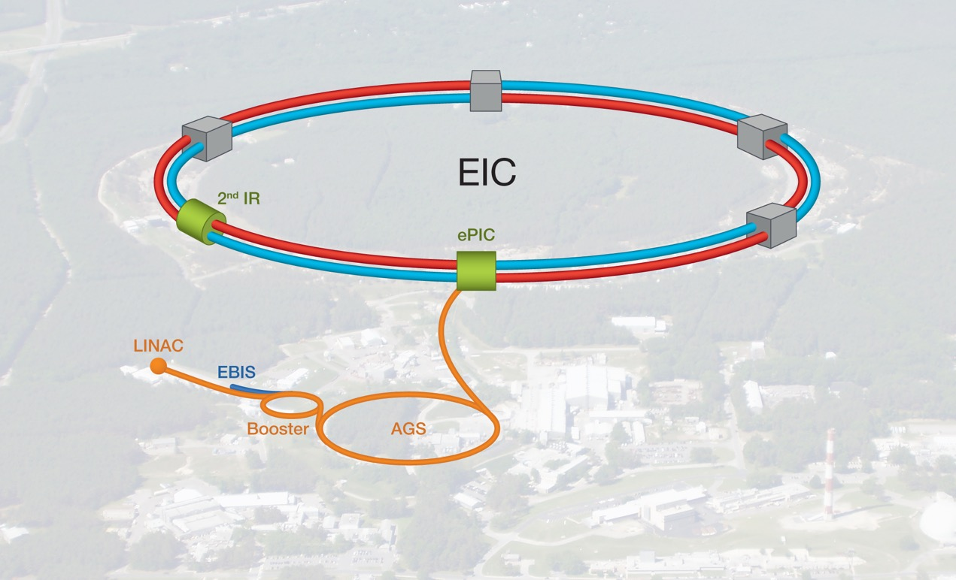
EIC Project Overview
The Electron-Ion Collider (EIC) is a unique high-energy, high-luminosity polarized beam collider that will be one of the most challenging and exciting accelerator complexes ever built.
Only collider in the next decade(s).
Approval (ESAAB) received:
CD-0 in Dec-2019
CD-1 in Jun-2021
CD-3A in Mar-2024
L. Lari, EICUG 2024

Slide 33
Current Project Goals
The EIC Project scope and projected performance continues to meet the science requirements.
The Project is requesting CD-3B Approval.
Target Critical Decision Milestones Approval dates (ESAAB)
Q2FY2025 CD-3B
Q2FY2026 CD-2/3C
Q2FY2027 CD-3
Q1FY2034 CD-4 (early)
Q1FY2036 CD-4
The EIC Project is currently investigating to include subprojects, defined according to the DOE Order 413.3B requirements, to delivery the project in the most cost-effective way.
L. Lari, EICUG 2024

