Slide 1
Polarized gun and preinjector beamline design
Erdong Wang
For a visit @SLAC
12/6/2024

Slide 2
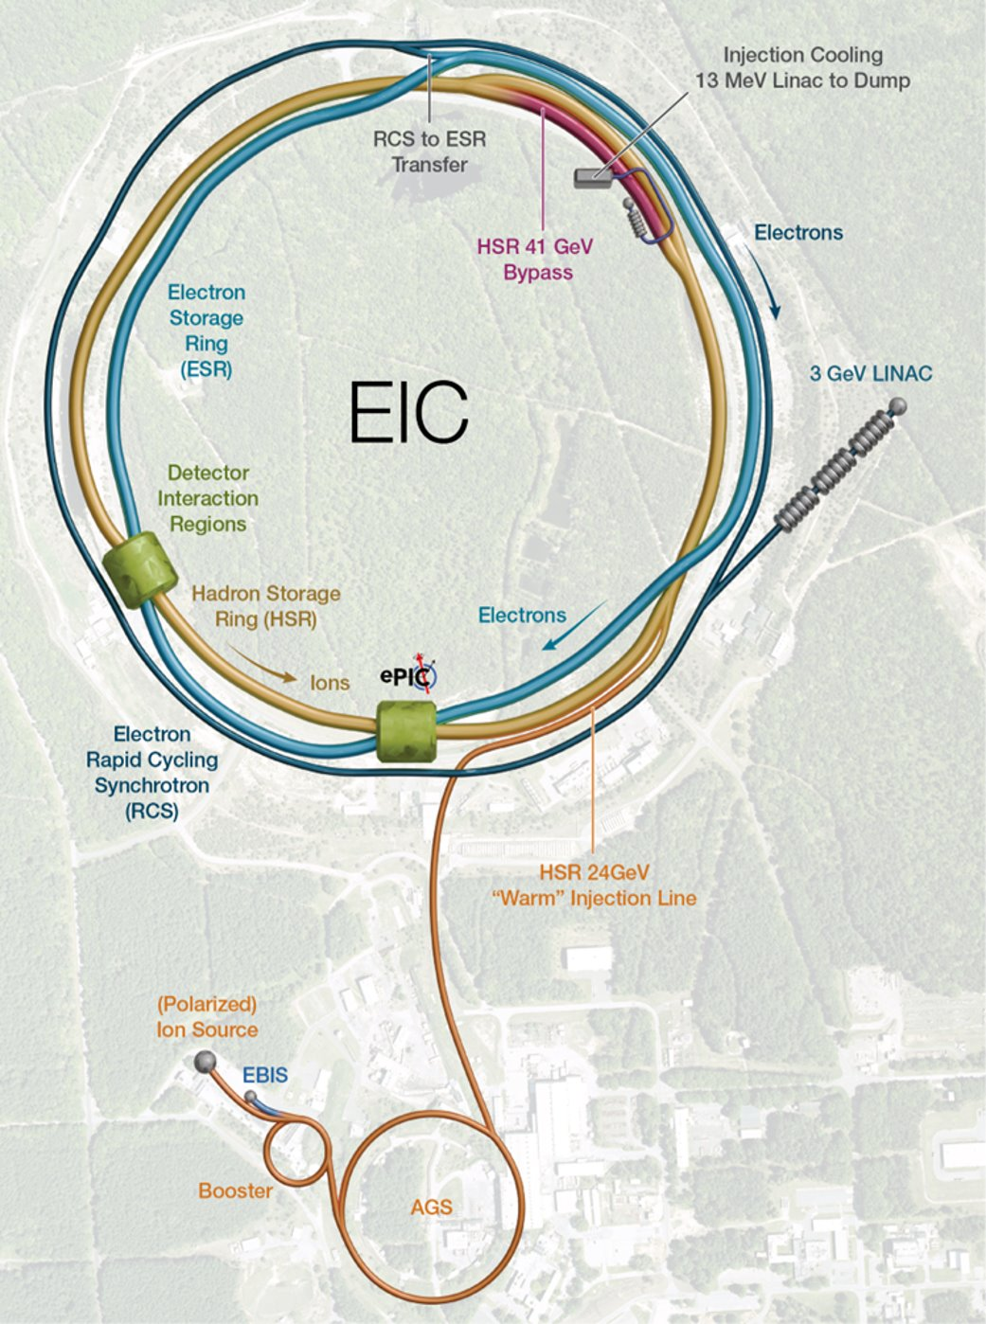
Outline
Preinjector Subsystem Overview
Frontend Design and Beam Dynamics Simulation
Major Subsystems
Polarized Gun
Wien Filter
Bunching Section RF
Mott Polarimetry
Conclusion

Slide 3
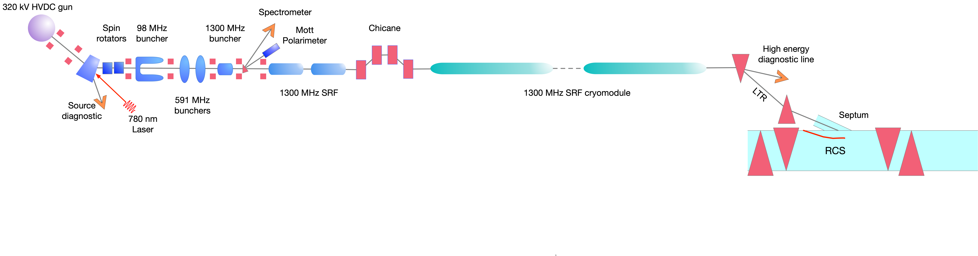
Preinjector Major Subsystems
Frontend
Linac
Transfer line
High intensity pre-injector major components
High intensity polarized electron gun
Spin rotator
Solenoid
Spin measurement
Bunching section

Slide 4
Preinjector beam dynamics

Slide 5
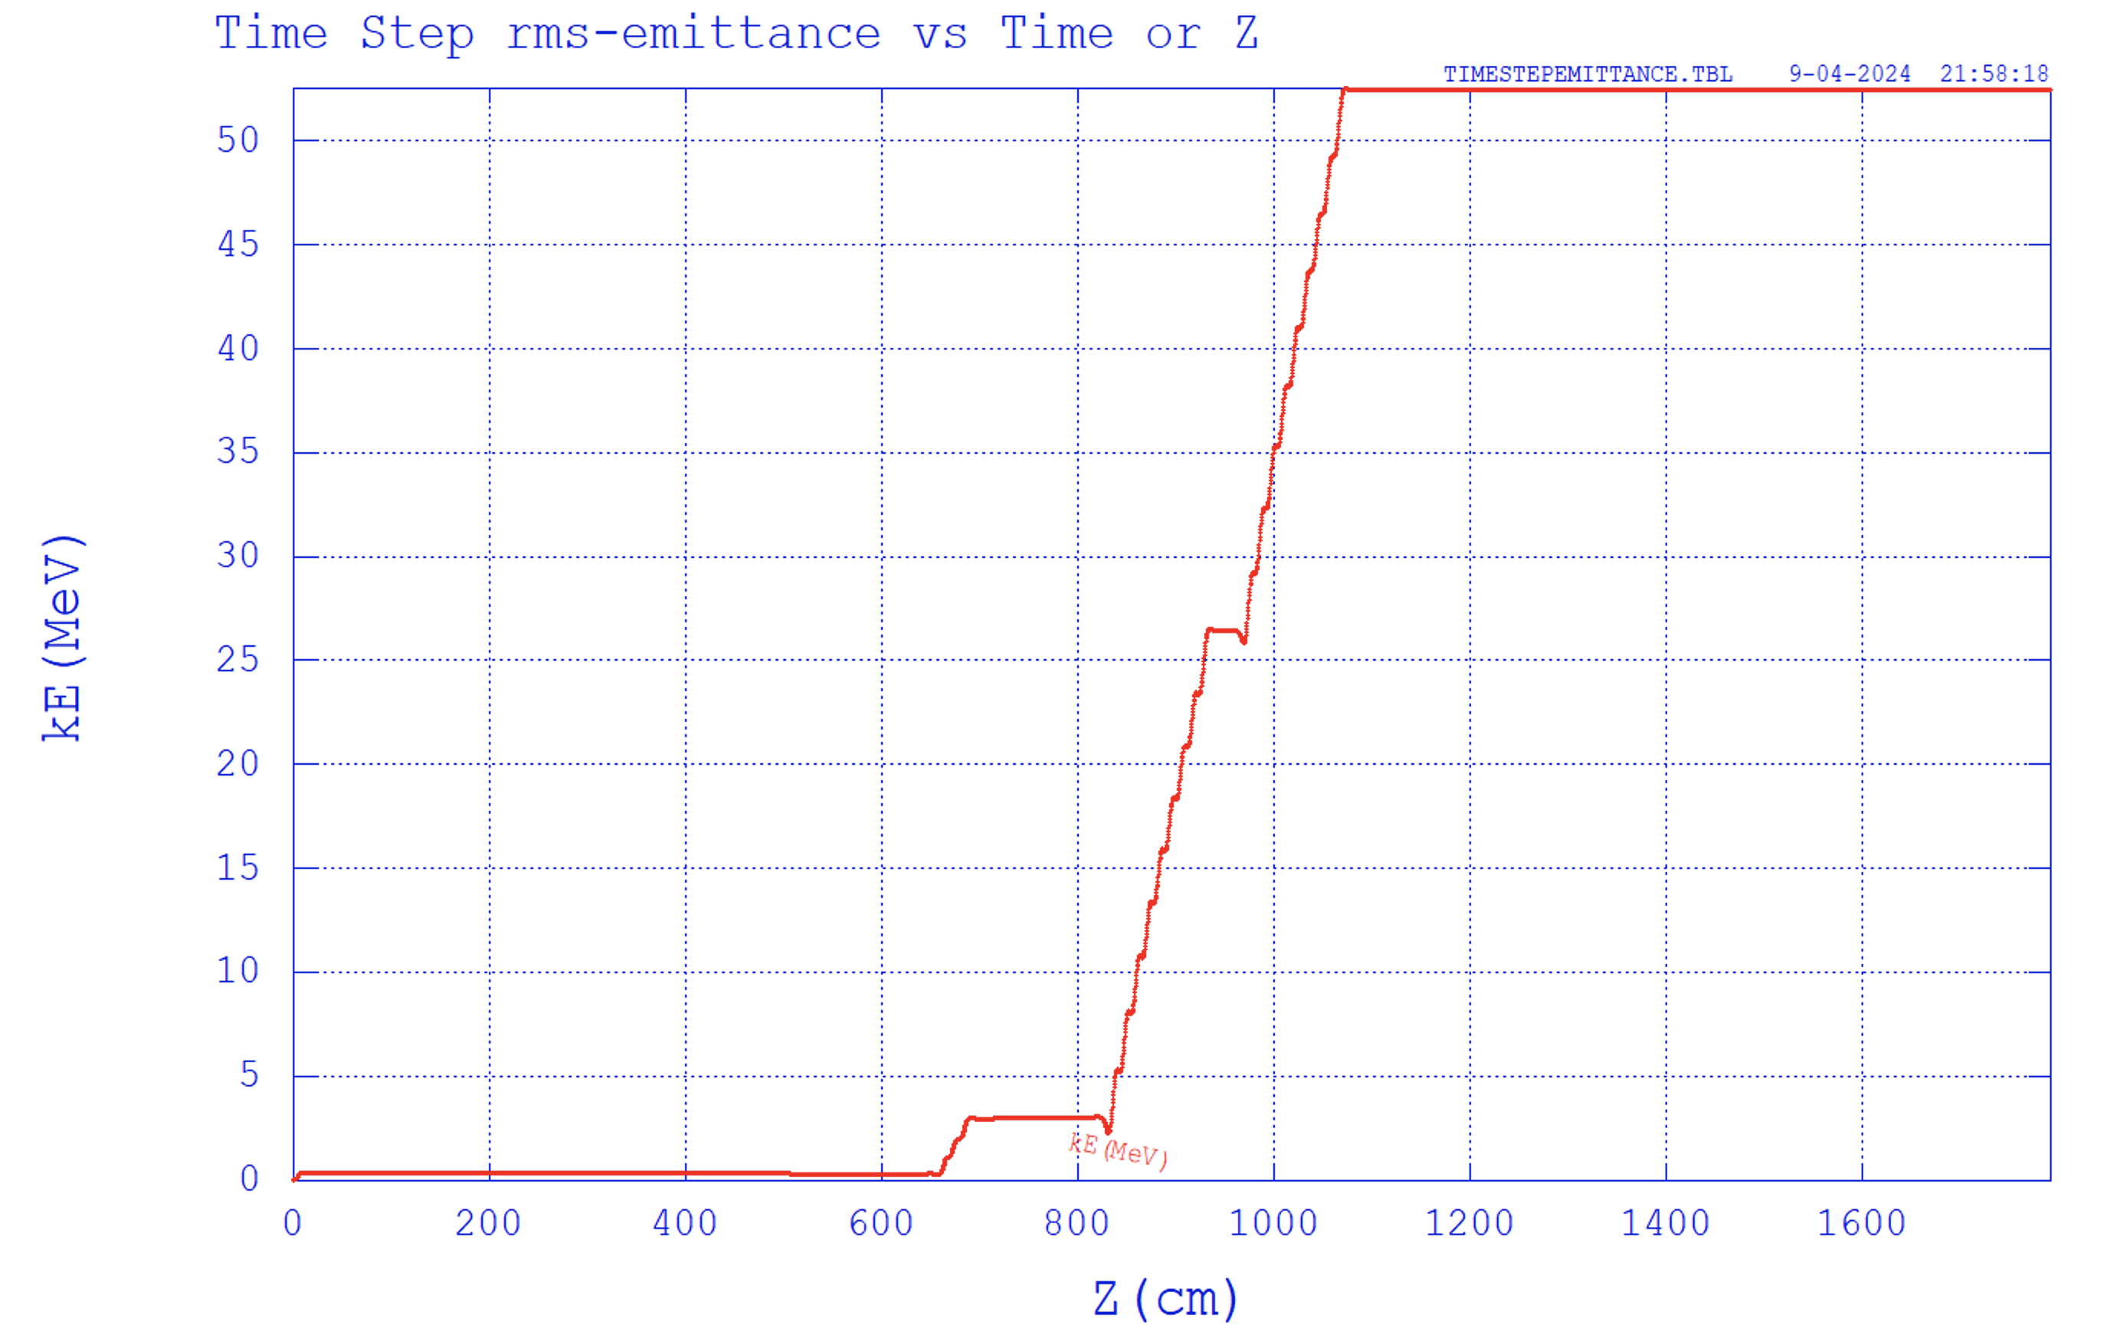
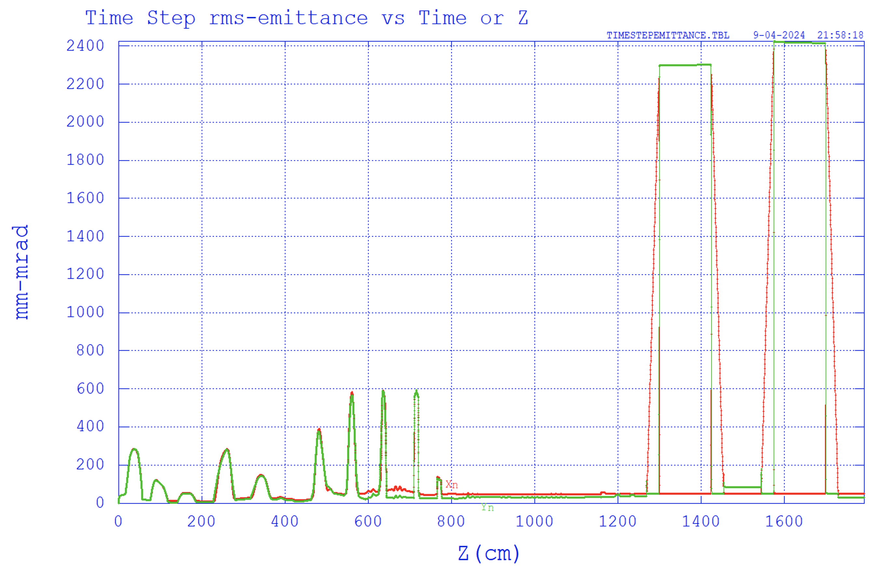
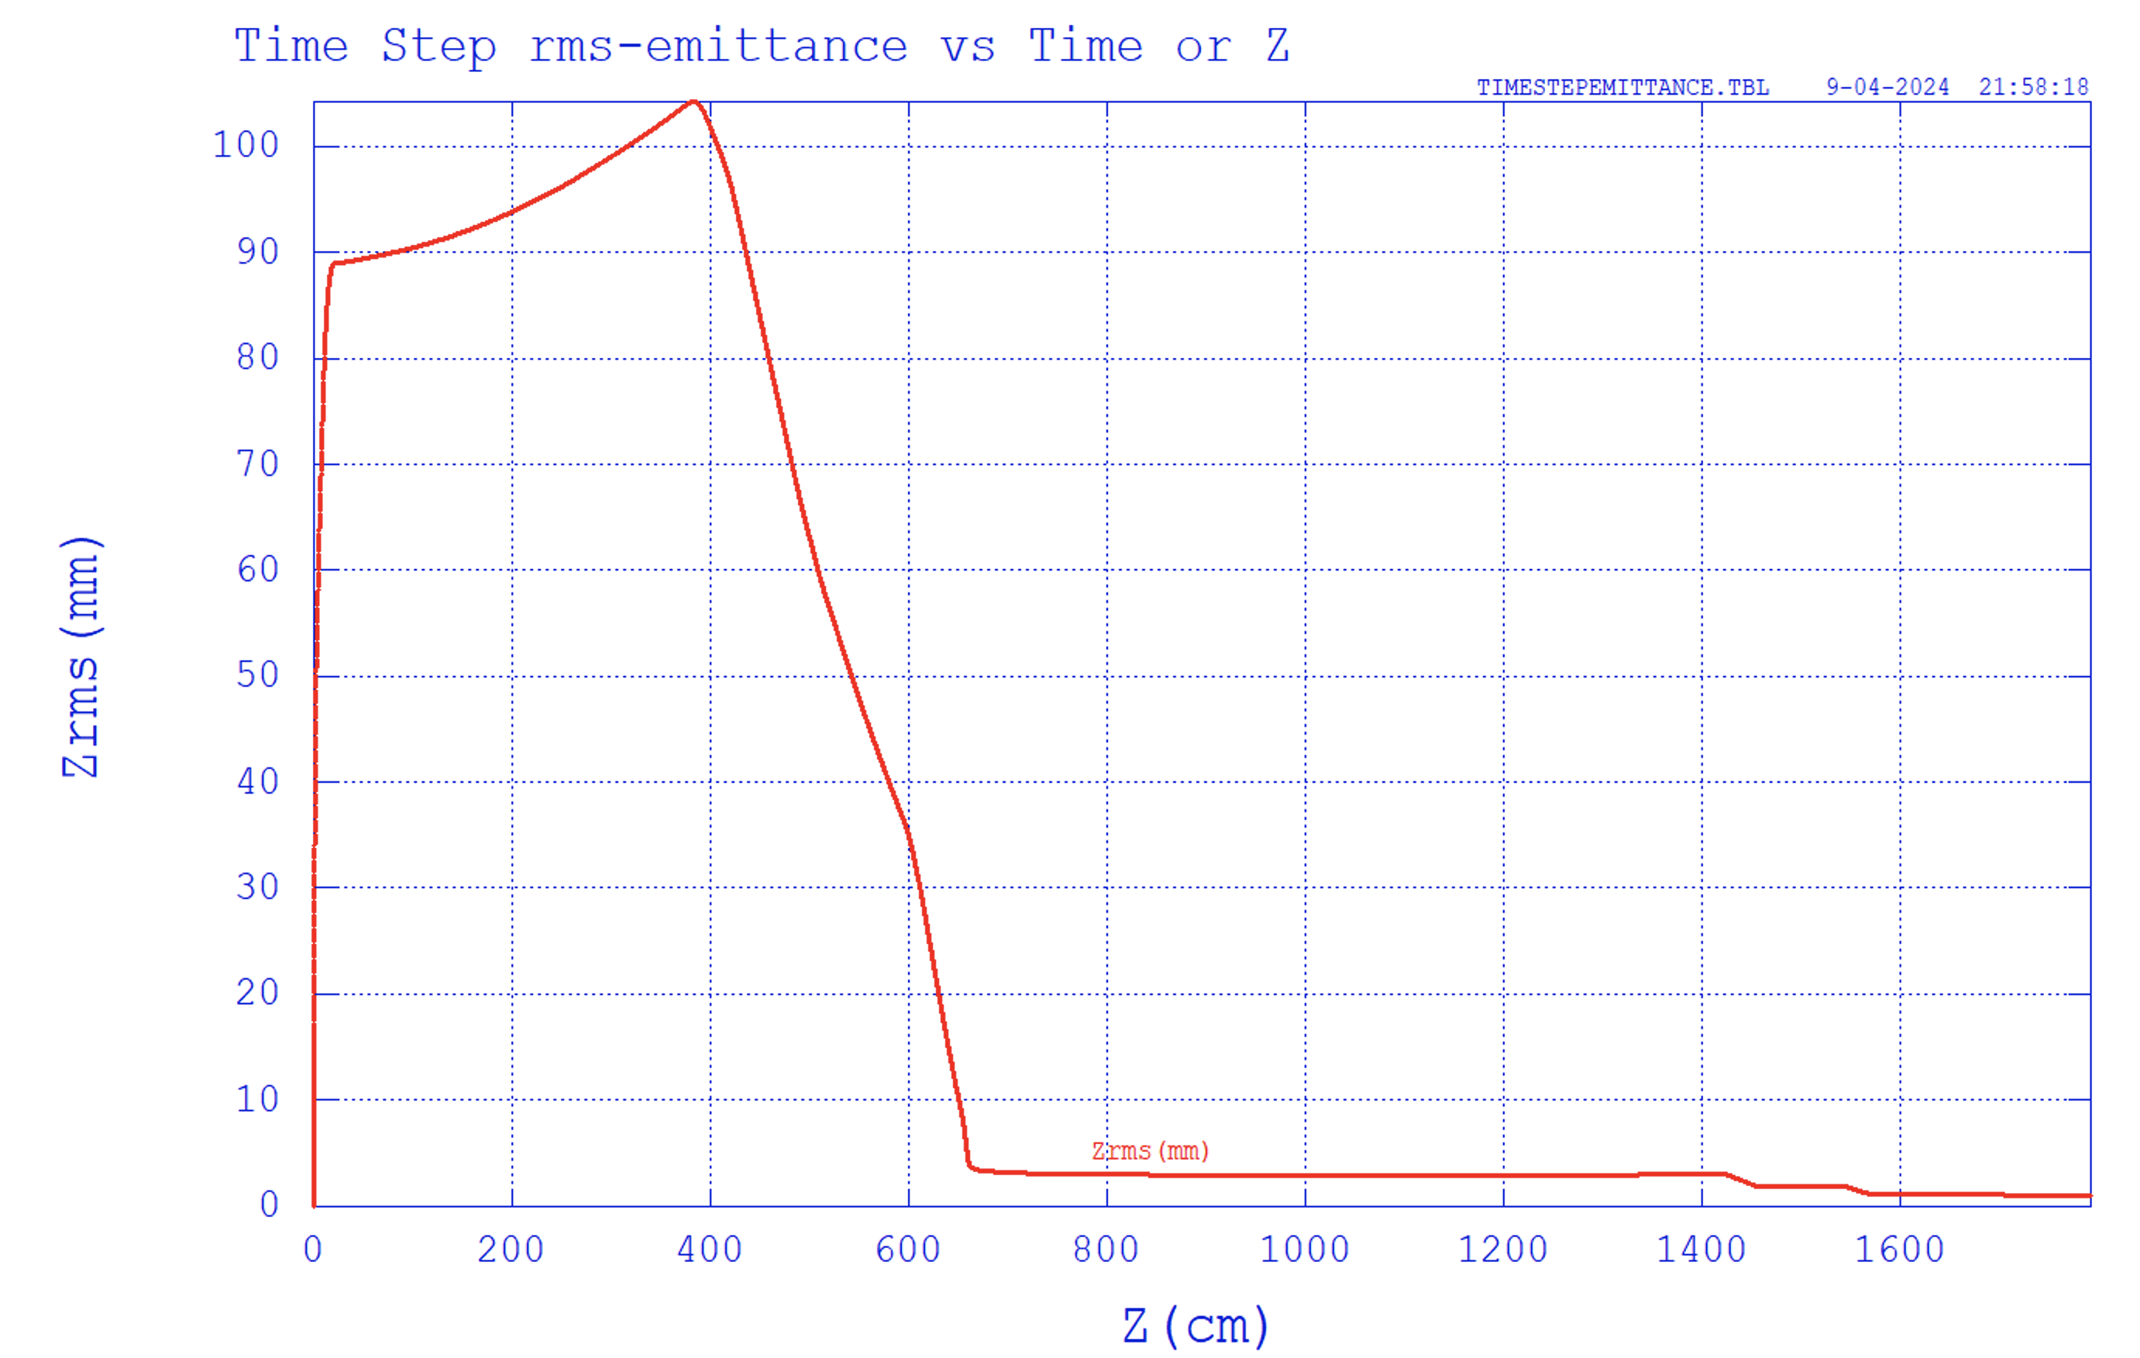
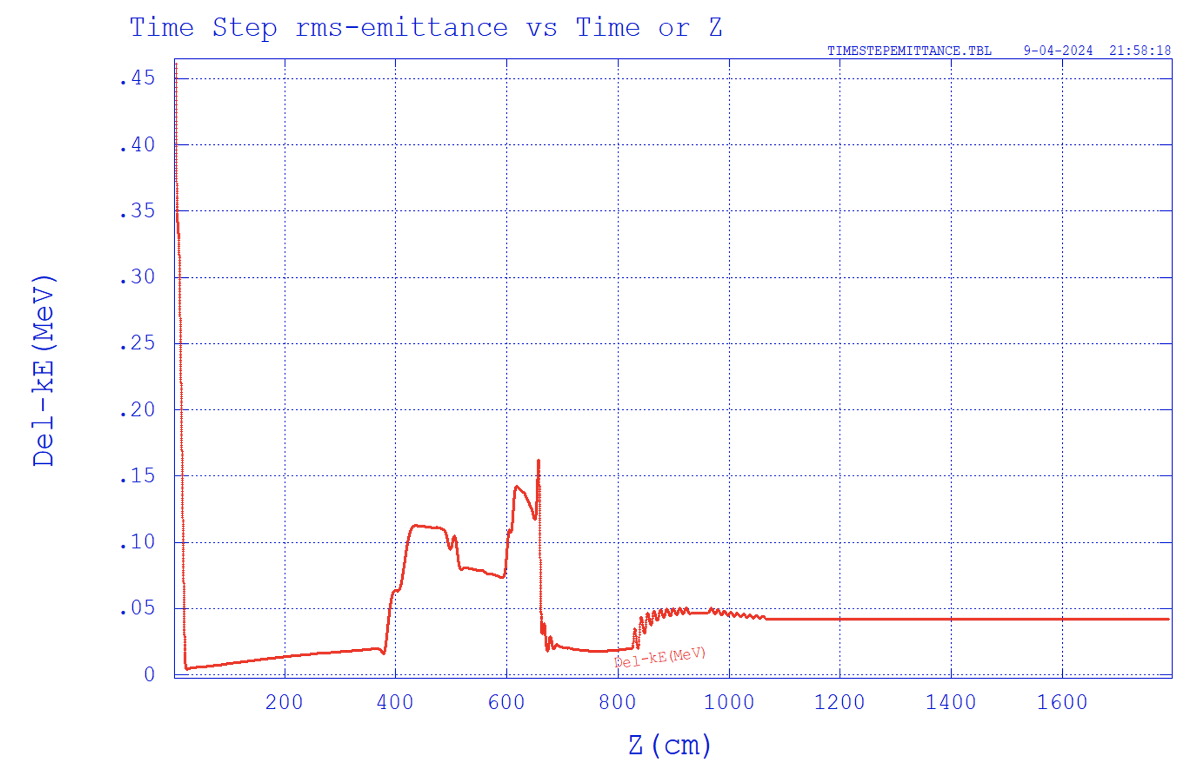
Gun to End of Chicane Tracking with Space Charge
7.5 nC gun to end of linac space charge tracking using Parmela.
Two sections of compression:
Ballistic and chicane.
Chicane CSR is not included in the Parmela simulation. Will includes into GPT simulation.
CSR impact on the energy spread is evaluated to be small.
Two 9 cell SRF cavities to accelerate beam to 55 MeV for chicane compression.
Energy chirped before chicane,
dechirp in the Linac.
RMS normalized emittance
48/30 mm-mrad
energy: 55 MeV
RMS bunch length:
0.87 mm (2.9 ps)
RMS energy spread:
4.2 %, chirped

Slide 6
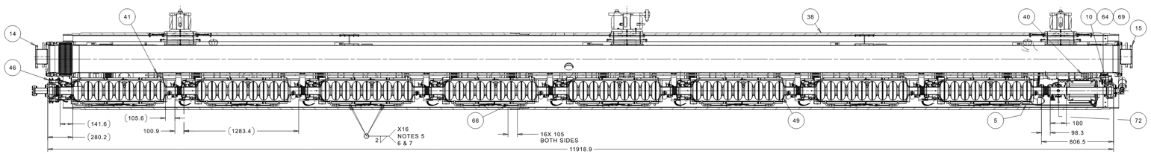
3 GeV Linac Design: Realistic Model
@Todd
Reuse LCLS-II cryomodule model, internal cryomodule layout
SRF linac lattice assembled and modeled
LCLS-II SRF modules including wakefields
15x 1.3 GHz: 25 MeV/cavity, 200 MeV/cryomodule
One superconducting quad/cryomodule
FODO optics matched (no CM quad modifications)
Acceptable strengths, beam sizes
Evolving optimization of transport optics, energy
4x 3.9 GHz RF linearizer slots
also quadruplet to match to LTR transfer line optics
15x 1.3 GHz modules
4x 3.9 GHz
module slots
Transfer Line
200 MeV/cryomodule
Linac
LTR
Consistent with injection aperture
LTR DBA dispersive peaks
6

Slide 7
3 GeV Linac Lattice Design
matching
3.9 GHz placeholder
15x 1.3 GHz (CM1-15) cryomodules
CM1 phase (64°) optimizes end CM1 σ_{p}/p
CM2-15 phases (85°) optimize end linac σ_{p}/p
Gradient (24.04 MV/m, 1.04m cells) set to match exit p=3 GeV/c
FODO optics; interconnects match LCLS-II
Triplet+CM1/2 match injection to linac FODO
Maintain reasonable beam sizes in CM1/2
4x 3.9 GHz (linearizer slots)
Keep wakefields for now (worst case)
4 module quads match linac FODO to LTR DBA
Straight-ahead linac diagnostic line
Not illustrated; in preliminary design
Linac commissioning diagnostics in development
M. Wendt presentation
Linac section
Transfer
Line
LCLS-II-like FODO optics
7

Slide 8
High intensity polarized HVDC gun

Slide 9
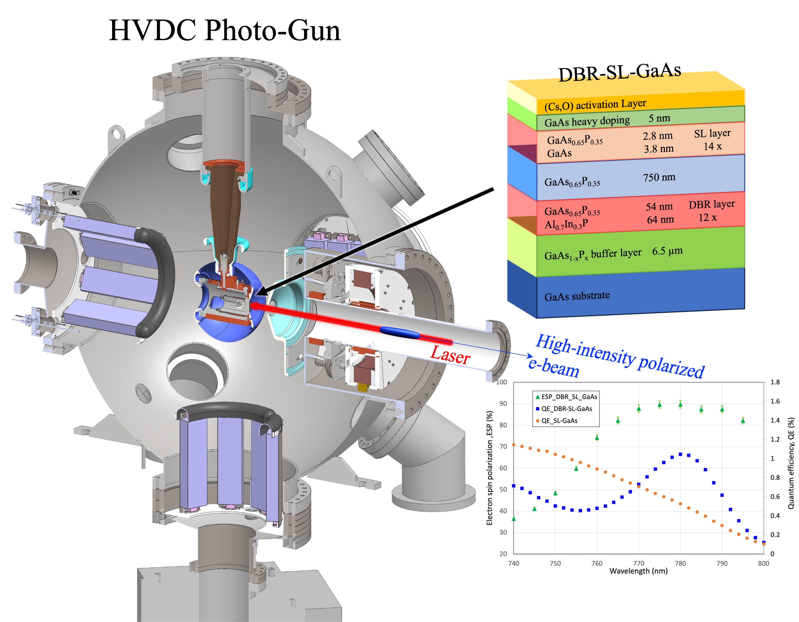

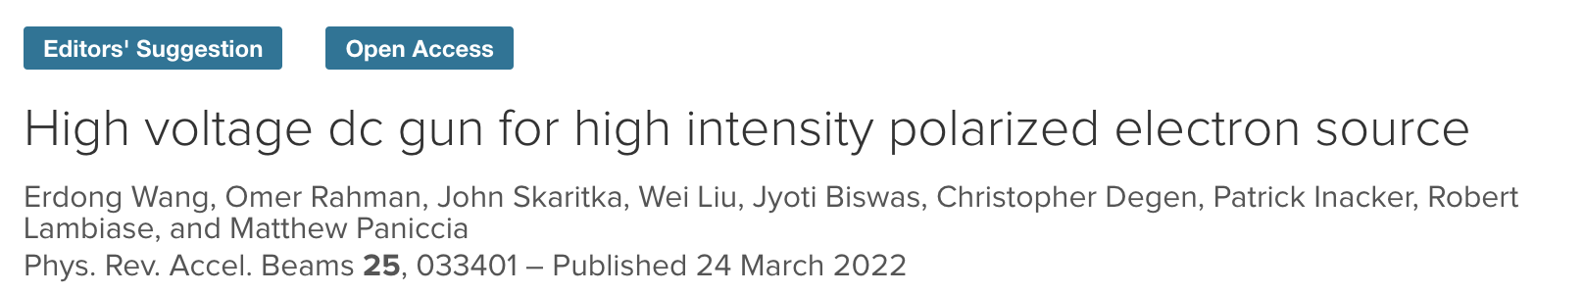
High intensity polarized HVDC gun
High intensity polarized HVDC gun
R&D achievements
Plan

Slide 10
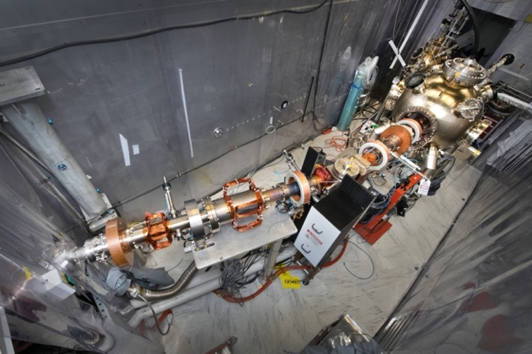
EIC Polarized Electron Source Requirements
 | EIC R&D goal | Achieved in stable operation | R&D delivered
Bunch charge [nC] | 7 | 7.5 (12) | Y
Peak current [A] | 3.8 | 4.8 (No SCL) | Y
Frequency [Hz] | 1 (4 bunches) | 1 (9000 bunches) | Y
Voltage [kV] | 300 | 320 | Y
Average Current | 28 nA | 30 uA | Y
Polarization [%] | > 85% | 88% | Y
EIC polarized gun at Stonybrook Univ.
EIC lifetime requirement in CDR : 24x7x3600x4= 2.4 e6 bunches /week for 2 weeks
EIC requirements(Charge achieved):
phase I : 7 nC
phase II : 4-7 nC, bunch trains

Slide 11
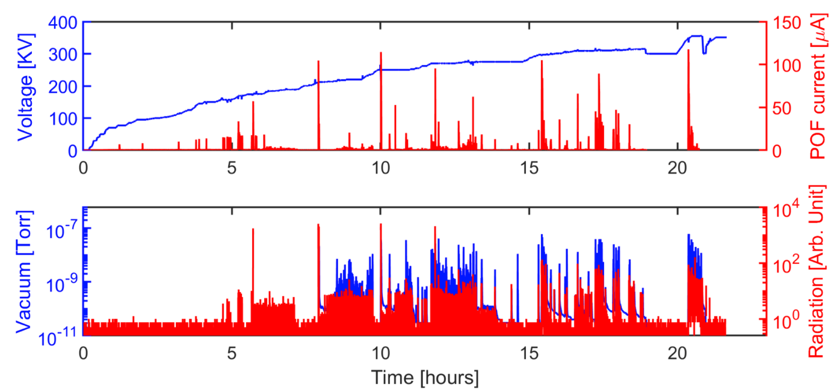
HV Conditioning
352kV
No field emission
Radiation noise level
Vacuum into 10e-12 torr
EIC preinjector gun voltage requirement 300 kV
Gun conditioned up to 352 kV in Dec 2020 (vacuum conditioning, total takes 23 hrs, Cooling is on):
In 2023, we improved the puck clean procedure. The new puck with new SL-GaAs(ODU) sample can achieve 350 kV without any conditioning. We don’t need extra conditioning to use new samples/puck.

Slide 12
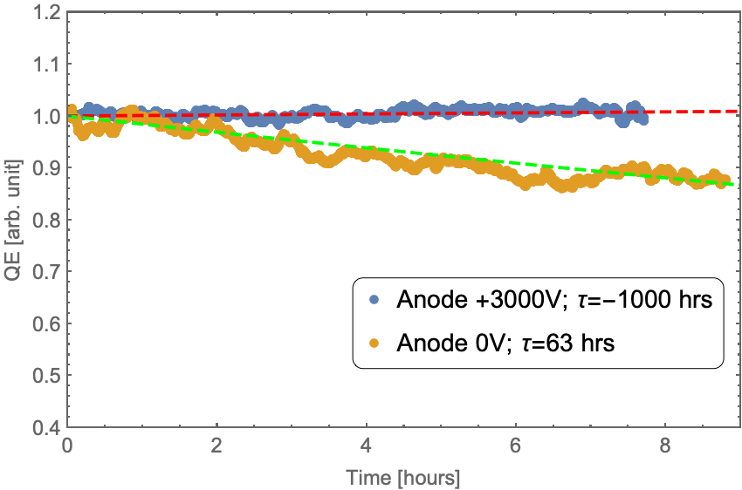
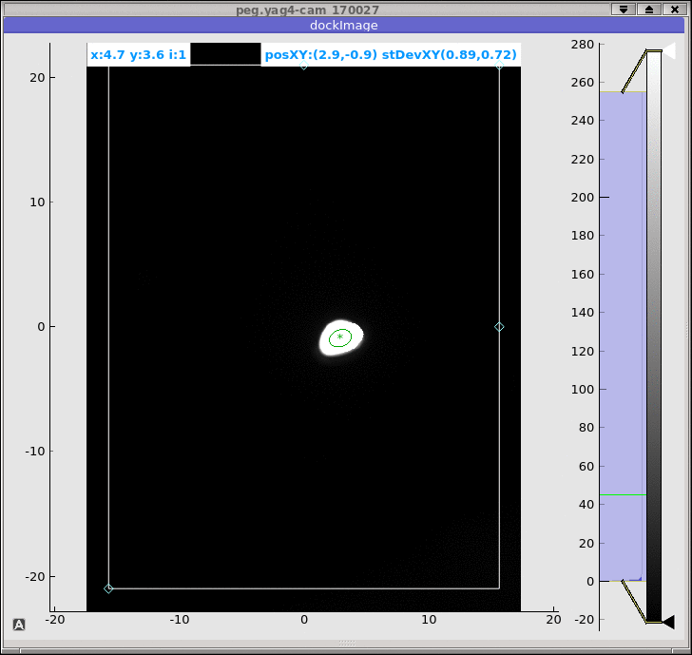
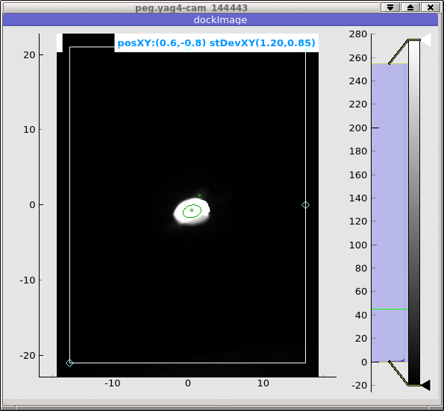
Bunch Charge and Bulk GaAs Lifetime
Space charge limit
starts from 12 nC
6 mm laser spot size
4 mm laser spot size
Bulk GaAs with 785 nm polarized laser; Gun operates at 300 kV. Run up to 67.5 uA.
7.5 nC bunch charge polarized beam, 5000 pulses/s ~37.5 uA;
With anode bias, we didn’t observe QE drop.
Without anode bias, 1/e lifetime is 63 hrs. Dominated by the outgassing from FC.
Using the bulk-GaAs, we can achieve 15 nC (~35% polarization ) without changing the laser and gun settings.
Beam image before the dump
1 nC
8 nC

Slide 13
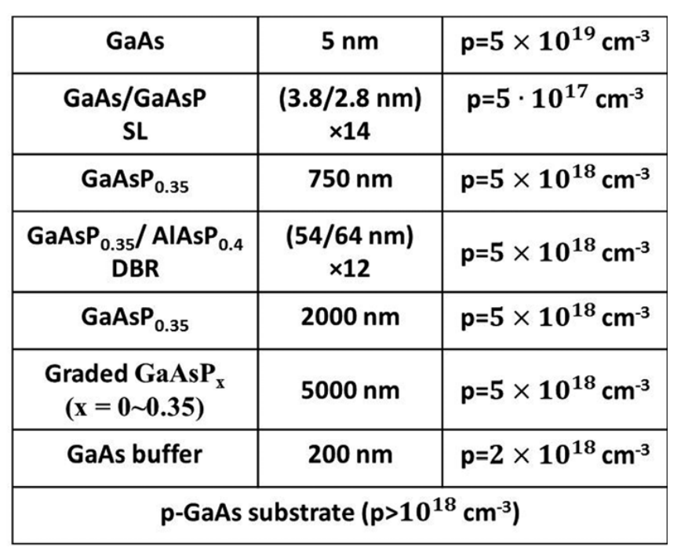
High Polarization Photocathode
ODU/Jlab/BNL: GaAs/GaAsP SL with AlGaAs/GaAsP DBR
Best performance: QE=2.35%, ESP=92%

Slide 14
Generated High Intensity Polarized Electron Bunch
Surface charge limit (SCL)
trapped electrons
Cathode
Vacuum
Surface Charge Limit(SCL) was the main issue towards high bunch charge polarized beam.
In Feb 2023, we extracted 6 nC maximum bunch charge, limited by SCL
In June 2023, we extracted 11.6 nC maximum bunch charge by following improvement:
Optimize surface doping levels of the cathodes
Restudy the surface clean procedure: acid wet clean+450 C heat clean
We developed circular polarized laser with tunable wavelength.
High Polarized (85%-90%)
DBR-SL-GaAs with 785 nm polarized laser;
Maximum bunch charge 11.6 nC (8mm)
Linear range up to 9 nC
Run up to 30 µA.
Charge limited by the surface charge limit

Slide 15
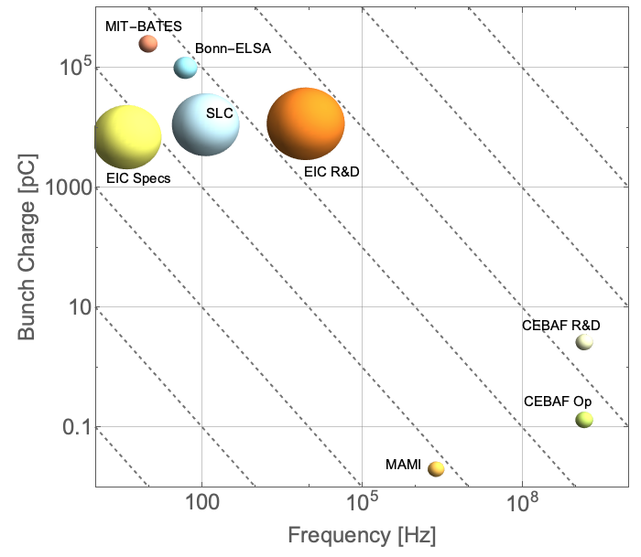
Gun Performance Meets Requirements of EIC
Lifetime was measured at 30 uA average current.
The charge generated from this cathode in a single activation is more than 28 weeks of EIC continuous operation.
This gun holds the record of the highest voltage, and intensity of all the polarized guns.
The polarized gun R&D successfully met all its goals, staying with in the planned schedule and budget.

Slide 16
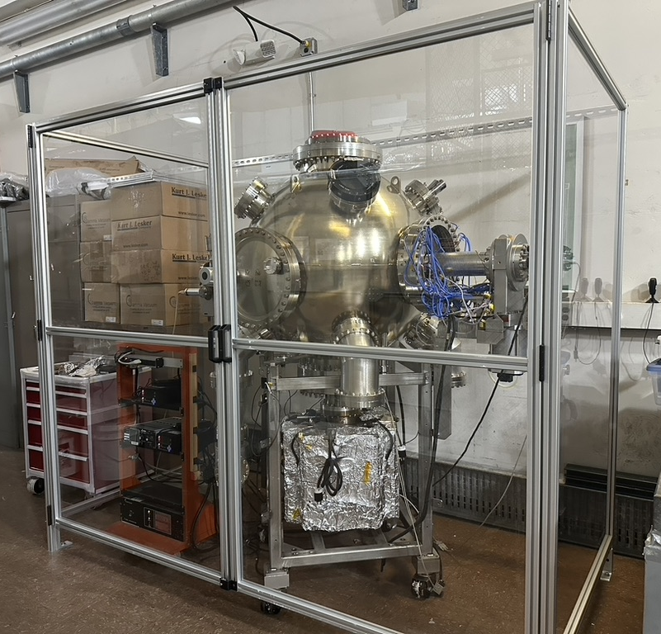
Polarized R&D Gun Towards Operation
The polarized gun is currently disconnected from the test beamline and stored at the SBU gun test lab.
A few upgrades will be carried out after the preinjector source lab is ready at BNL.
Motor drive cathode transferring
New stable laser for low rep rate, and high pulse energy.
Cathode growth system, control system.
Back up high voltage cable and feedthrough
Stable SL-GaAs vendors from the industry.

Slide 17
Wien Filter
In the EIC CDR, we use the dipole-solenoid spin rotator at the end of the linac to rotate the spin. However, the challenges are:
Needs specific energy;
CSR effects;
Not suitable to low energy (<250 MeV) or very high energy like 3GeV.
Wien filter is more suitable for the 3 GeV preinjector

Slide 18
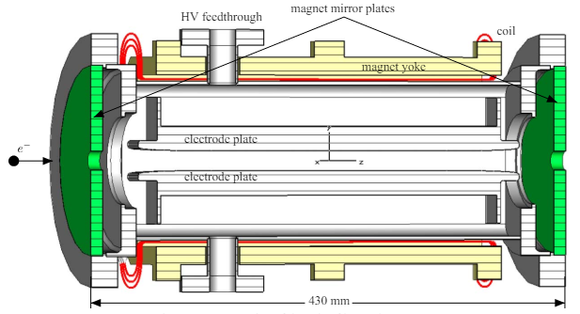
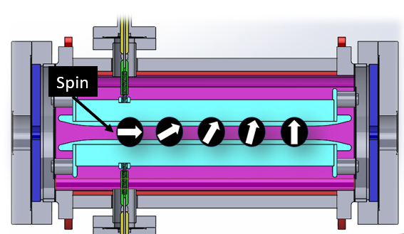
Spin Rotator- Wien Filter
Schematic of the Wien filter for S-DALINAC and CEBAF
Name | Energy [keV] | Bunch charge | Plate length [cm] | Gap [cm] | Ey [MV/m] | Bx [mT] | Feedthrough (each) | Ref.
CEBAF | 130 | 2 pC | 32.28 | 1.5 | 1.6 | 9.1 | 12.4 kV | 1
CEBAF | 200 | 2.7 pC | 32.28 | 1.5 | 2.7 | 13 | 17.5 kV | 2
S-DALINAC | 100 | 4 pC | 38.10 | 2.0 | 0.756 | 4.6 | 12 kV | 3
MAMI | 100 | 0.02pC | 32 | 2.0 | 1.07 | 6.56 | 12.5 kV | 4
EIC* | 320 | 7-14 nC* | 45.92 | 7.0 | 1.44 | 6.080 | 50.5 kV | 5
https://accelconf.web.cern.ch/ipac2021/papers/mopab324.pdf
https://inspirehep.net/files/a7bbe70b5f54adc3b7e7f320651d2dd7
https://accelconf.web.cern.ch/p07/PAPERS/MOPAN013.PDF
https://www.sciencedirect.com/science/article/pii/S0168900206014434
https://www.jacow.org/ipac2024/pdf/MOPC24.pdf

Slide 19
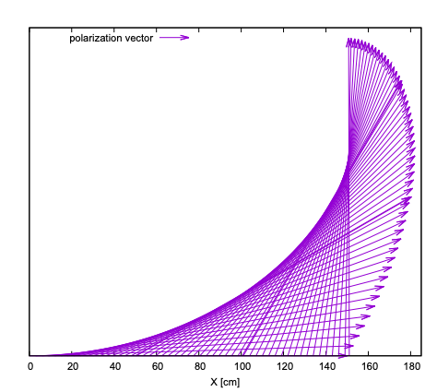
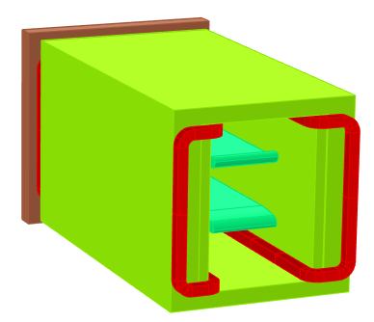
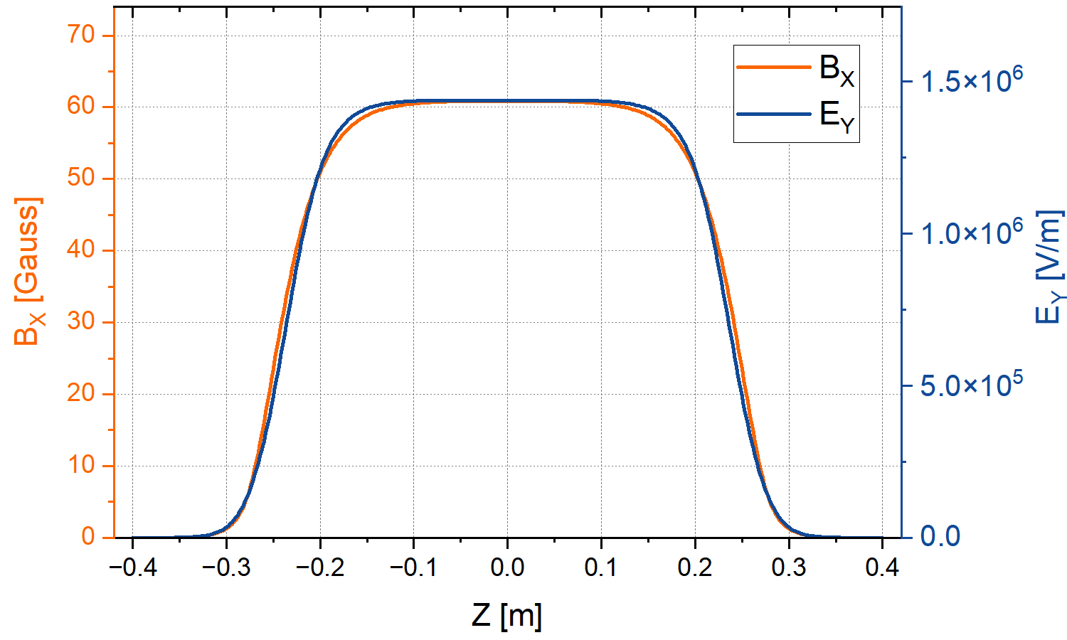





EIC Wien Filter Design
Limited by the high voltage design, higher beam energy needs a longer length. High space charge requires to put the focusing element very close. We determined the Wien filter length about 0.5 meter based on beam dynamics simulation.
$$−\frac{E_{y}}{B_{x}}=v_{z}$$
Our proposed approach:
Two Wien filters, each one rotates spin by 45 deg.
$θ=\frac{eL}{m_{0}cβγ^{2}}B_{x}$;
Engineering demonstration goals and schedule:
Dec 2024-Dec 2025: Develop a Wien filter for engineering demonstration. Apply the voltage, alignment the electrodes, and measure the B field (Approved)
End of 2027 to 2028: Install the Wien filter in the R&D gun beamline for the 5 nC beam test (Not approve yet. If we can have Wien filter beam test, we will learn a lot for the production Wien filter.)
$$E field variations:0.69 \%$$
$$B field variations:0.40 \%$$
Y
$$B=60.88 Gauss$$
$$E=1.44 MV/m$$
X
Z
19

Slide 20
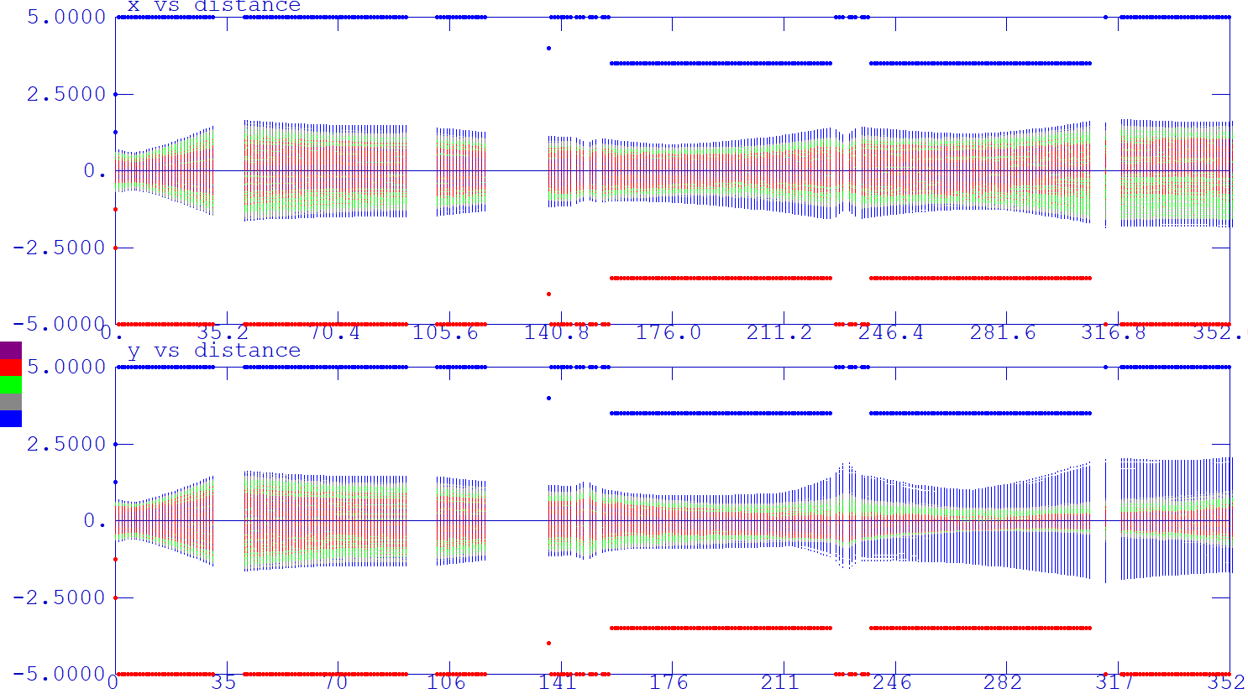
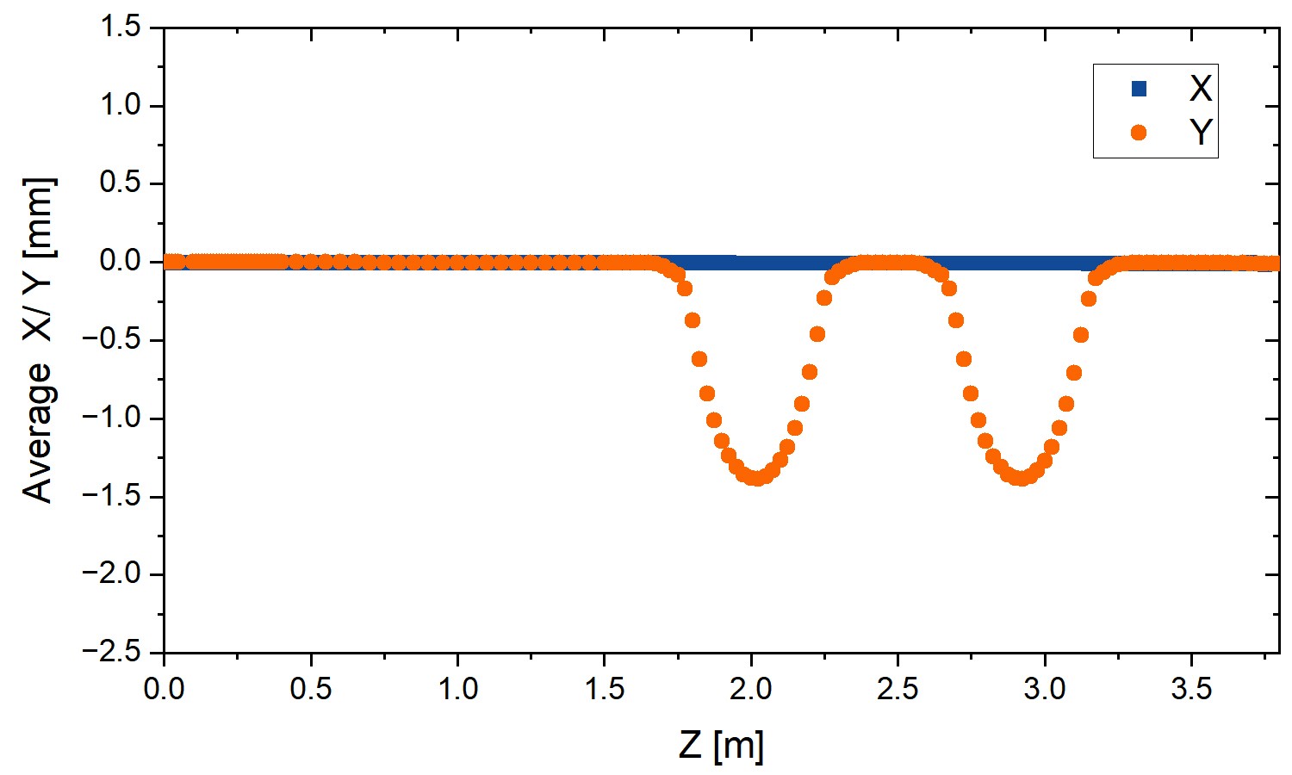

Preliminary Beam Tracking Through the Wien Filter
Wien filter 1
Wien filter 2
Parameter | Value
Bunch charge | 7 nC
Energy | 320 keV
L | 45.92 cm
E_{x} | 1.44 MV/m
B_{y} | 60.88 G
Electrode gap | 7 cm
Feedthrough | 50.5 kV each
$$checked in GPT$$
X
Y
After couple iterations of design improvement, the 7.5 nC bunch charge beam with space charge can go through the Wien filter. Normalized emittance is increased extra 50%.
Given the novel nature of high charge/high voltage Wien filter configuration, building a Wien filter for engineering demonstration is planned.
20

Slide 21

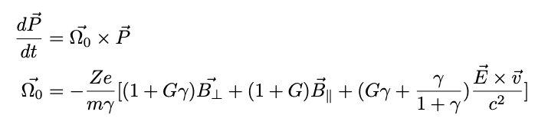



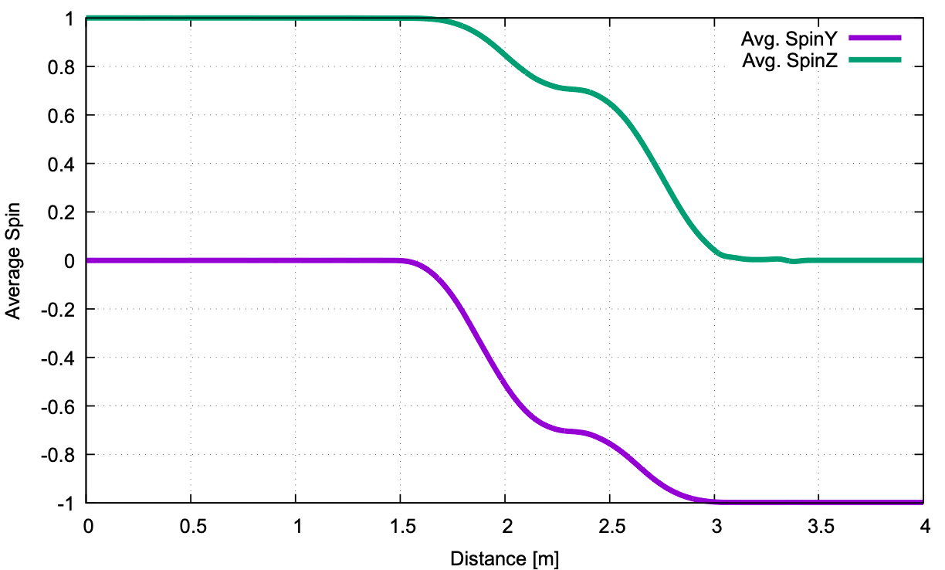
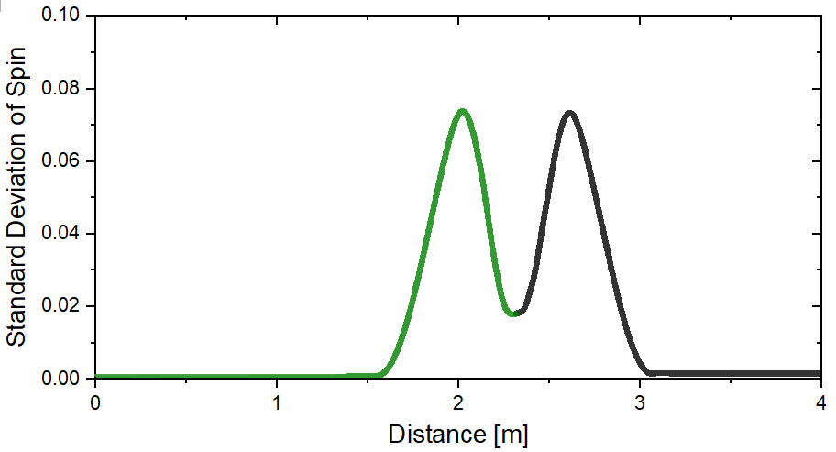
Spin tracking with space charge
Space charge:
E. Wang, Space Charge Effects on Spin Polarization in High-Intensity Preinjector”, BNL-226378-2024-TECH
0
When assume 0 emittance and uniform field distribution, the space charge impacting on the polarization is:
energy spread caused by longitudinal space charge about 4e-4;
Transverse space charge is about 4e-4
Total about 1e-3.
Spin direction from longitudinal(z) to vertical (y)
Spin degradation: GPT
We also did spin tracking with Space charge tracking using GPT.
z:0
y:0.0016
inside the Wien
0

Slide 22
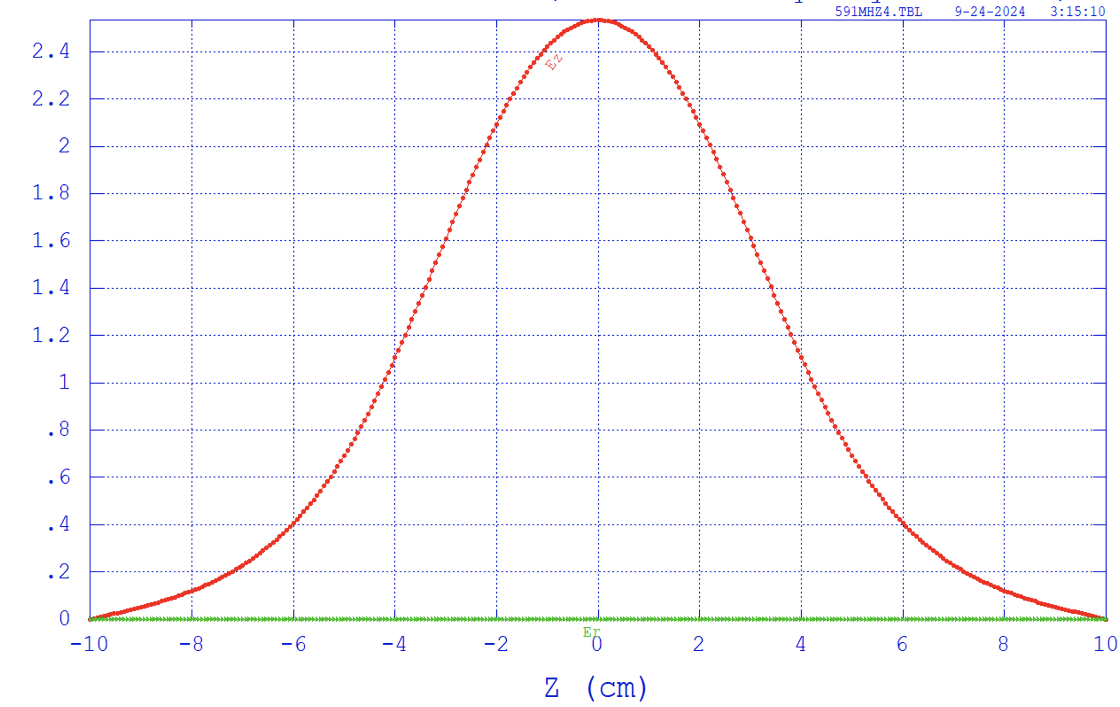
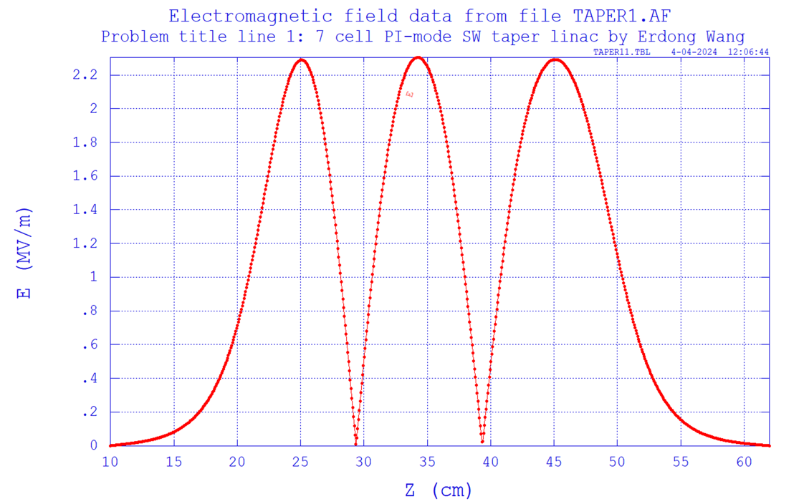
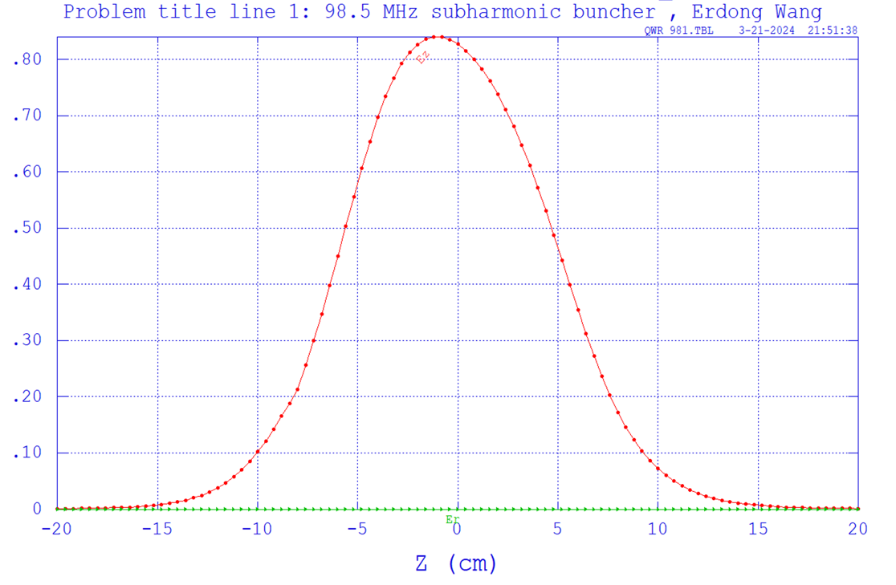
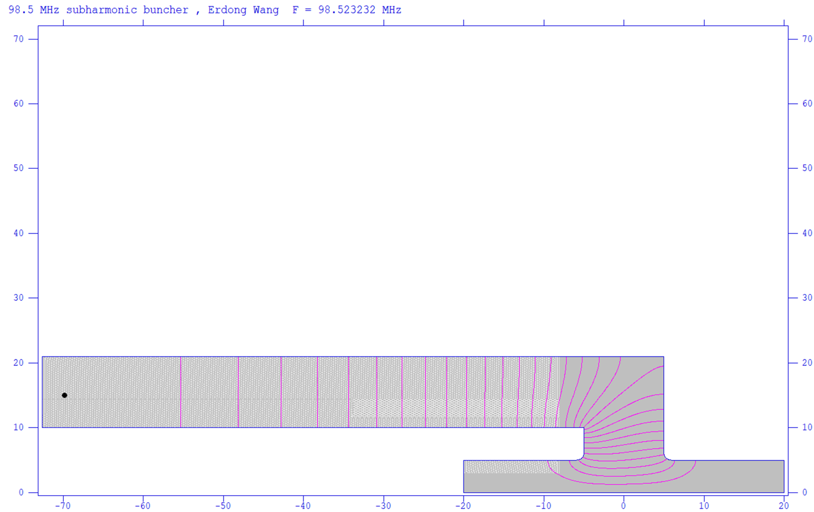
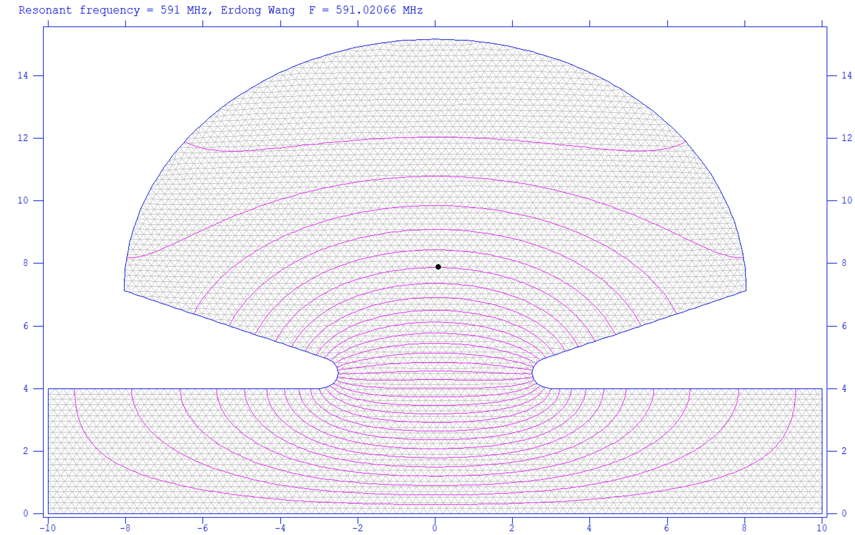
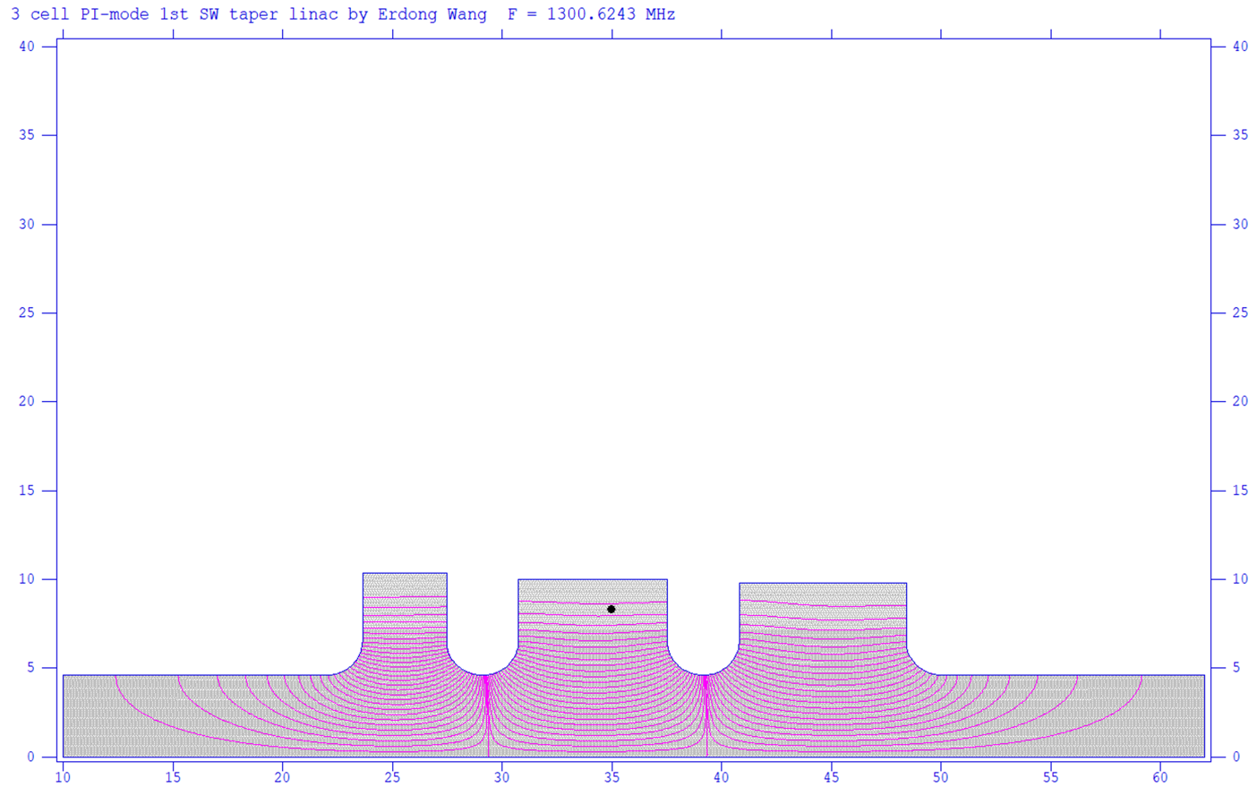
Bunching Section
For the above nC range, DC gun with GaAs shall use a pencil shape bunch
15 nC bunch charge, the initial bunch length ~2.3 ns
7.5 nC bunch charge, the initial bunch length~ 1.3 ns
98.5 MHz buncher - 591 MHz buncher - 1.3 GHz taper buncher
22

Slide 23
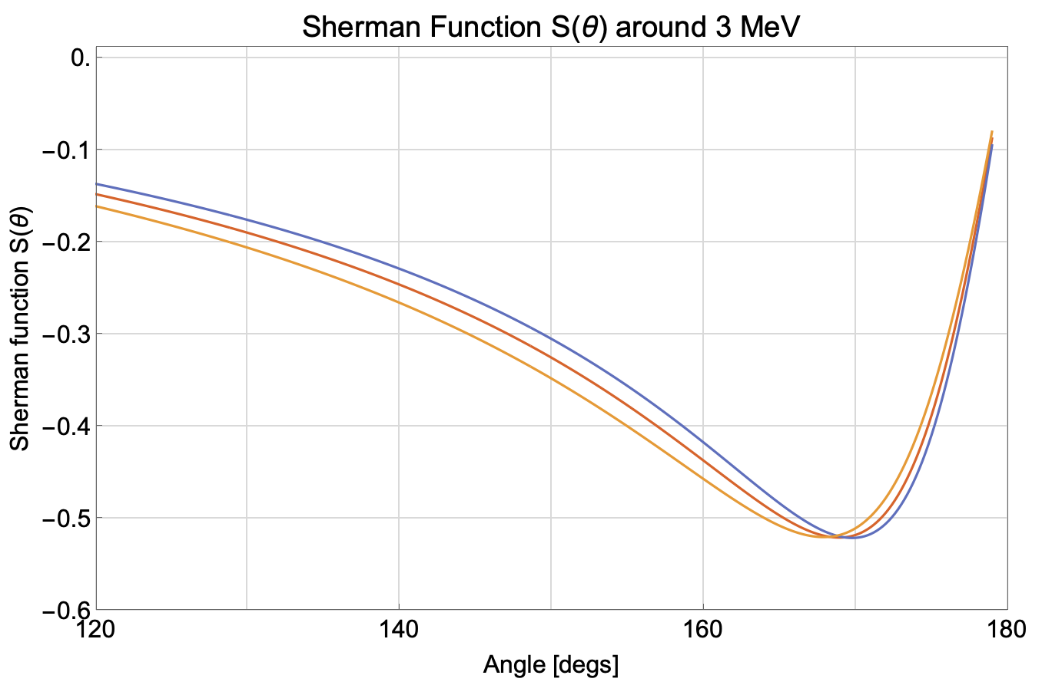
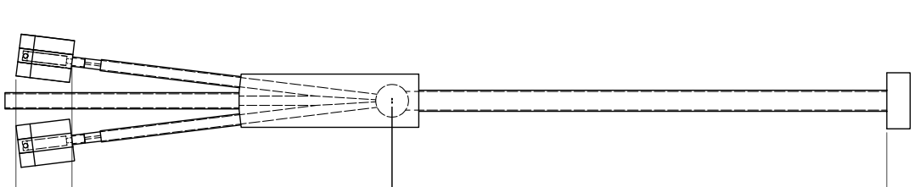
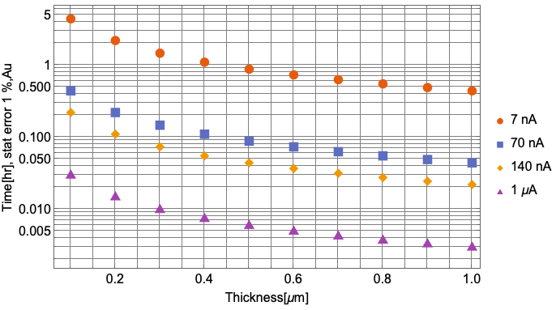
Mott Polarimeter
In the CDR, the Mott was placed after the gun for 300 kV measurement
Since we added Wien filter, the Mott polarimeter is moved to after the buncher at 3 MeV.
11 deg
Sherman function is a measure of the probability of a spin-up/down electron to be scattered, at a specific angle.
169 degrees gives the largest Sherman function amplitude at the designed beam energy.
Target material has been evaluated Th>Au>Ag>Cu
Au → easy to obtain and safe to use
Polarization measurement scheme should be in bunch train mode. Like 2 pulses with 10 Hz. Take less than an hour to get polarization.

Slide 24
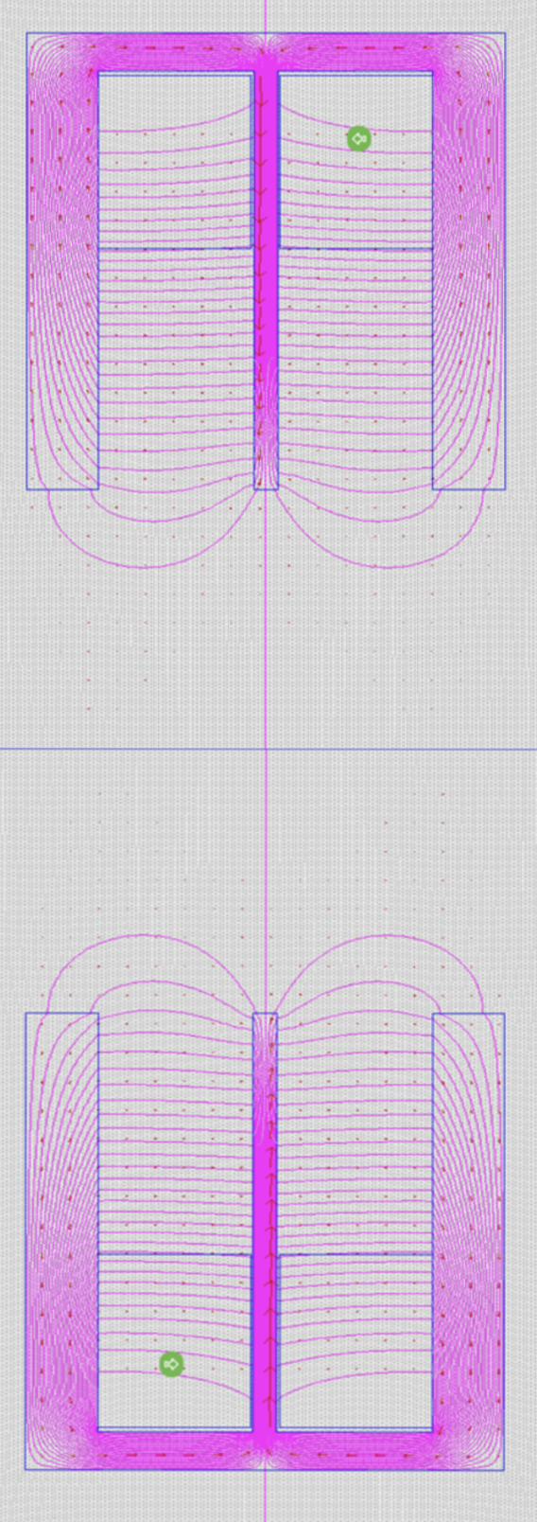
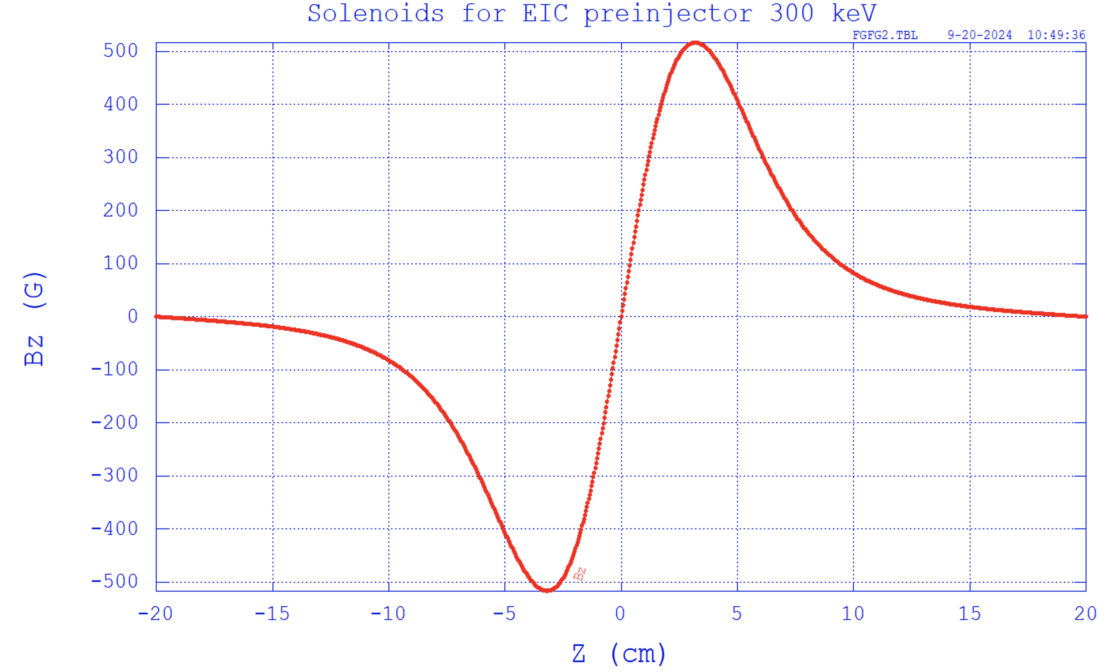
Solenoids
Mott polarimeter
Bz.l=0
Wien filter
Linac
Regular solenoid
Bunchers
Solenoid with clockwise/counter-clockwise winding has been modeled and included into the Parmela simulation.
Full 3D simulation including spin tracking are in progress.
Discussed and got experiences from Jlab injector group on detail design , fabrication and control of the solenoid field.
A regular solenoid is planned to fine-tune the spin direction before the Mott polarimeter.
z

Slide 25
Summary
Preinjector sub-system beamline conceptual design has been completed.
S2E space charge tracking with wake has been completed. Full 3D,s2e space charge simulation with spin tracking is in progress.
Polarized Electron Source
High bunch charge, up to 11.6 nC generate from SL-GaAs photocathode using polarized 780 nm laser.
Gun performance, including operational lifetime, polarization, and bunch charge exceeds EIC requirements.
The polarized gun R&D successfully met all its goals, staying with in the planned schedule and budget.
Wien filter
7nC Wien filter design looks promising. Simulation shows beam can go through without loss but has emittance growth. Space charge impacting on the polarization has been evaluated analytically and simulated.
Engineering demonstration is needed.
Bunching system and two cavities cryomodule
MeV Mott System
Conceptual design has been completed. Discussing with Jlab injection group to develop the detailed design. We have design and operation experience with retarding field Mott system at BNL.
Solenoid
Lesson learned from CEBAF experiences. The conceptual design has been completed. No risk was observed.
25

Slide 26
Thanks !

Slide 27
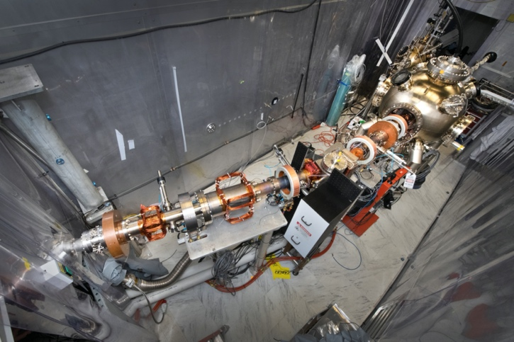
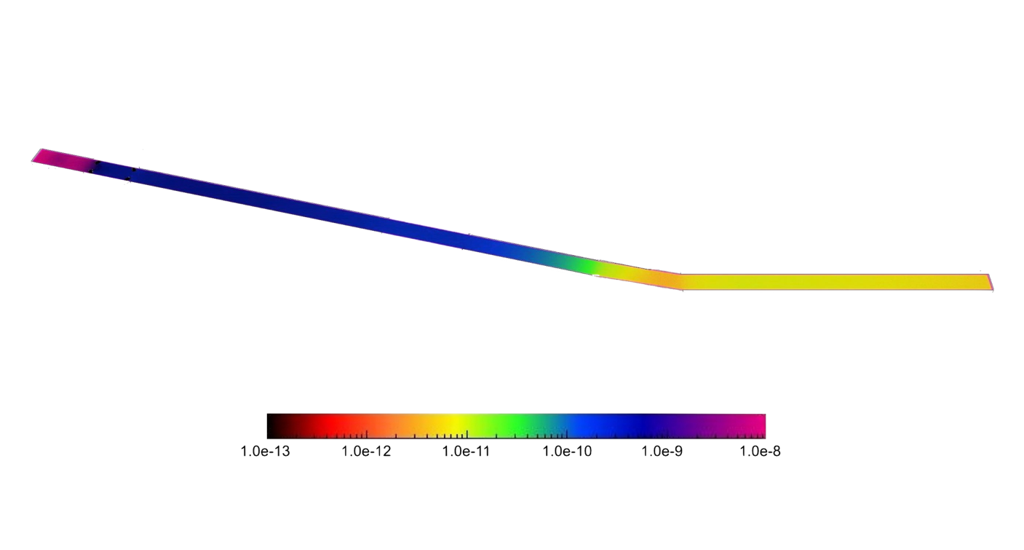
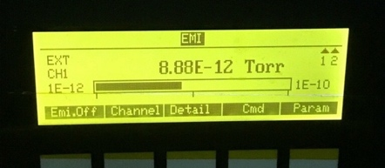
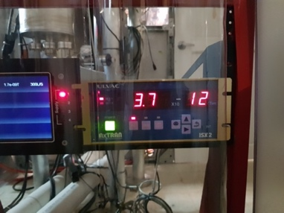
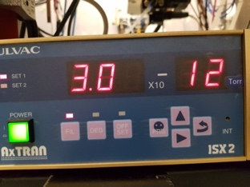
Beam-Line Vacuum in Experiment
Gun Vacuum
3BG gauge
3BG gauge | Gun
Baseline | 5-8 e-12
3uA | Low (c.c)
67.5 uA | 2e-11,Low (c.c)
Beam dump
ULVAC gauge | Beam dump
Baseline | 3-4 e-12
3 uA | 3e-10
67.5 uA | 1e-9
ULVAC gauge | Beam Line
Baseline | 3-4 e-12
3 uA | 5e-12
67.5 uA | 1.5-3 e-11
Beamline

Slide 28
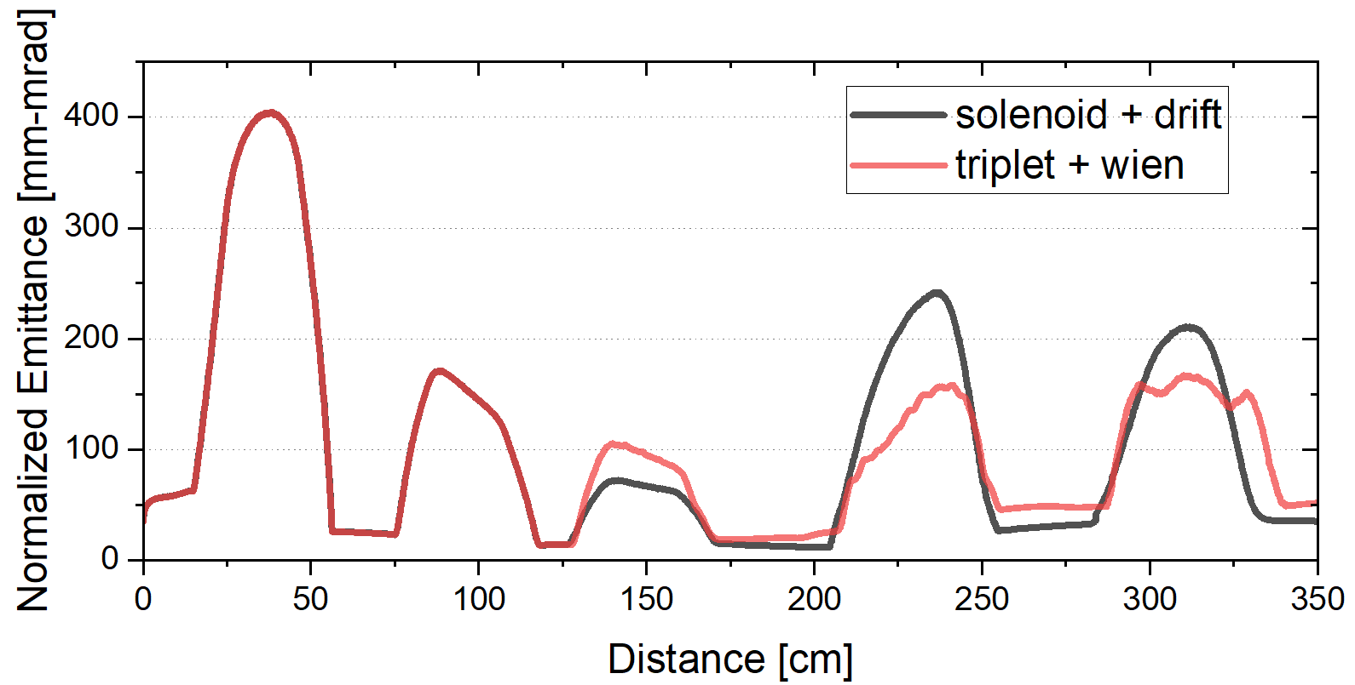
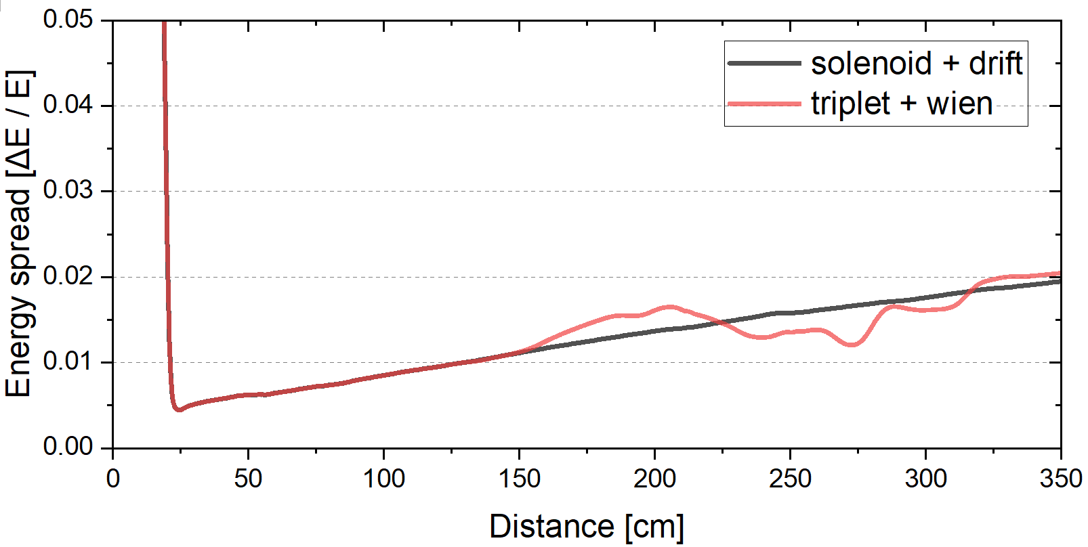
Wien Filter Beam Tracking

Slide 29
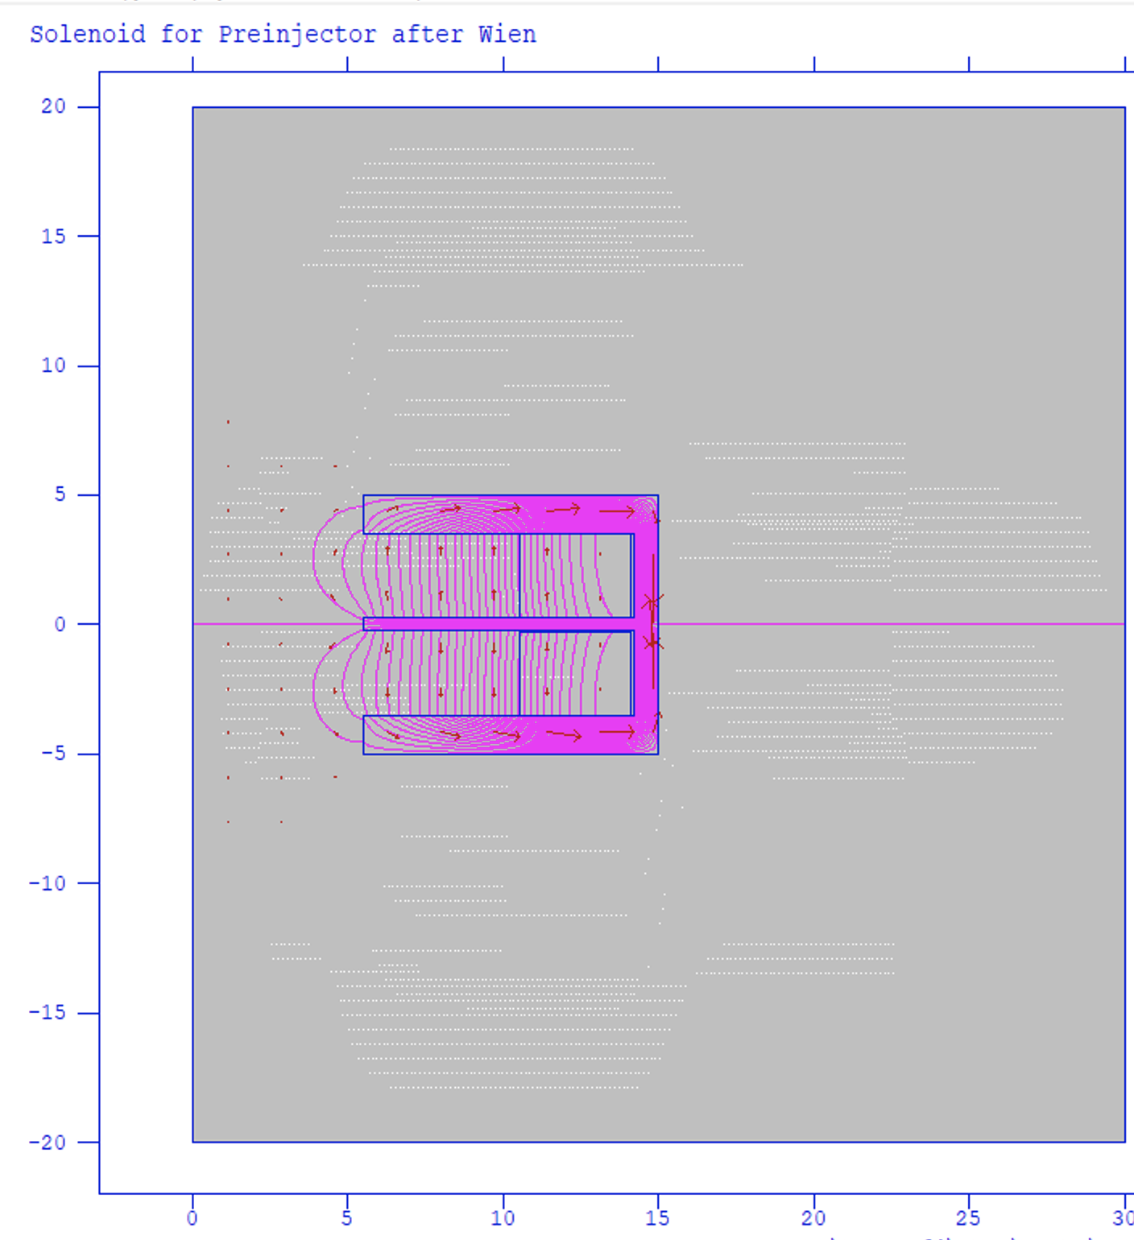
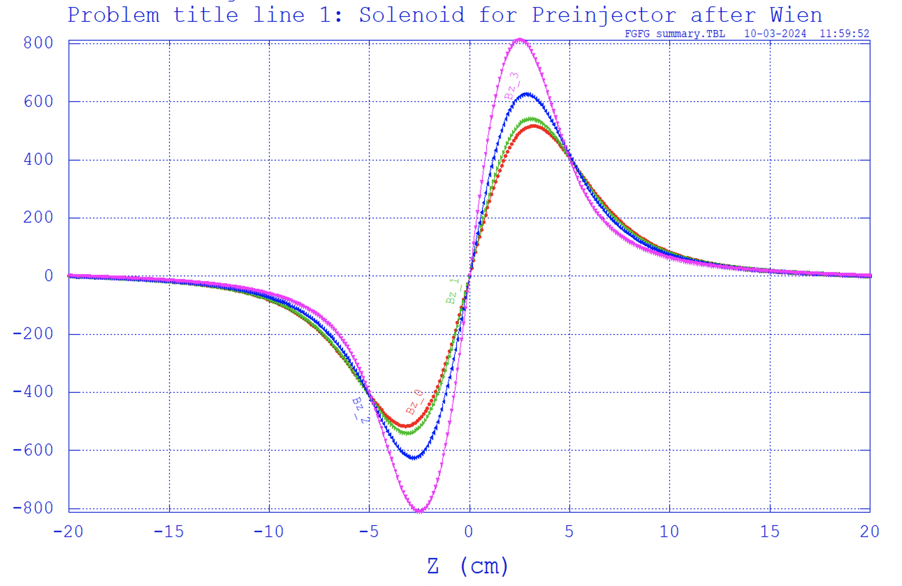
Spin Solenoid Field

Slide 30
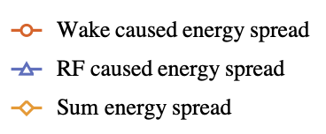
Bunch Length Determination
What is the bunch length we need to achieve energy spread goal (0.2% for stacking)?
The minimum energy spread could be achieved by compressing the bunch to 0.8 mm in rms.
Ballistic compression happened at 300-500 keV is not able to compress to such short bunch due to space charge.
Two stages compression are needed.

Slide 31
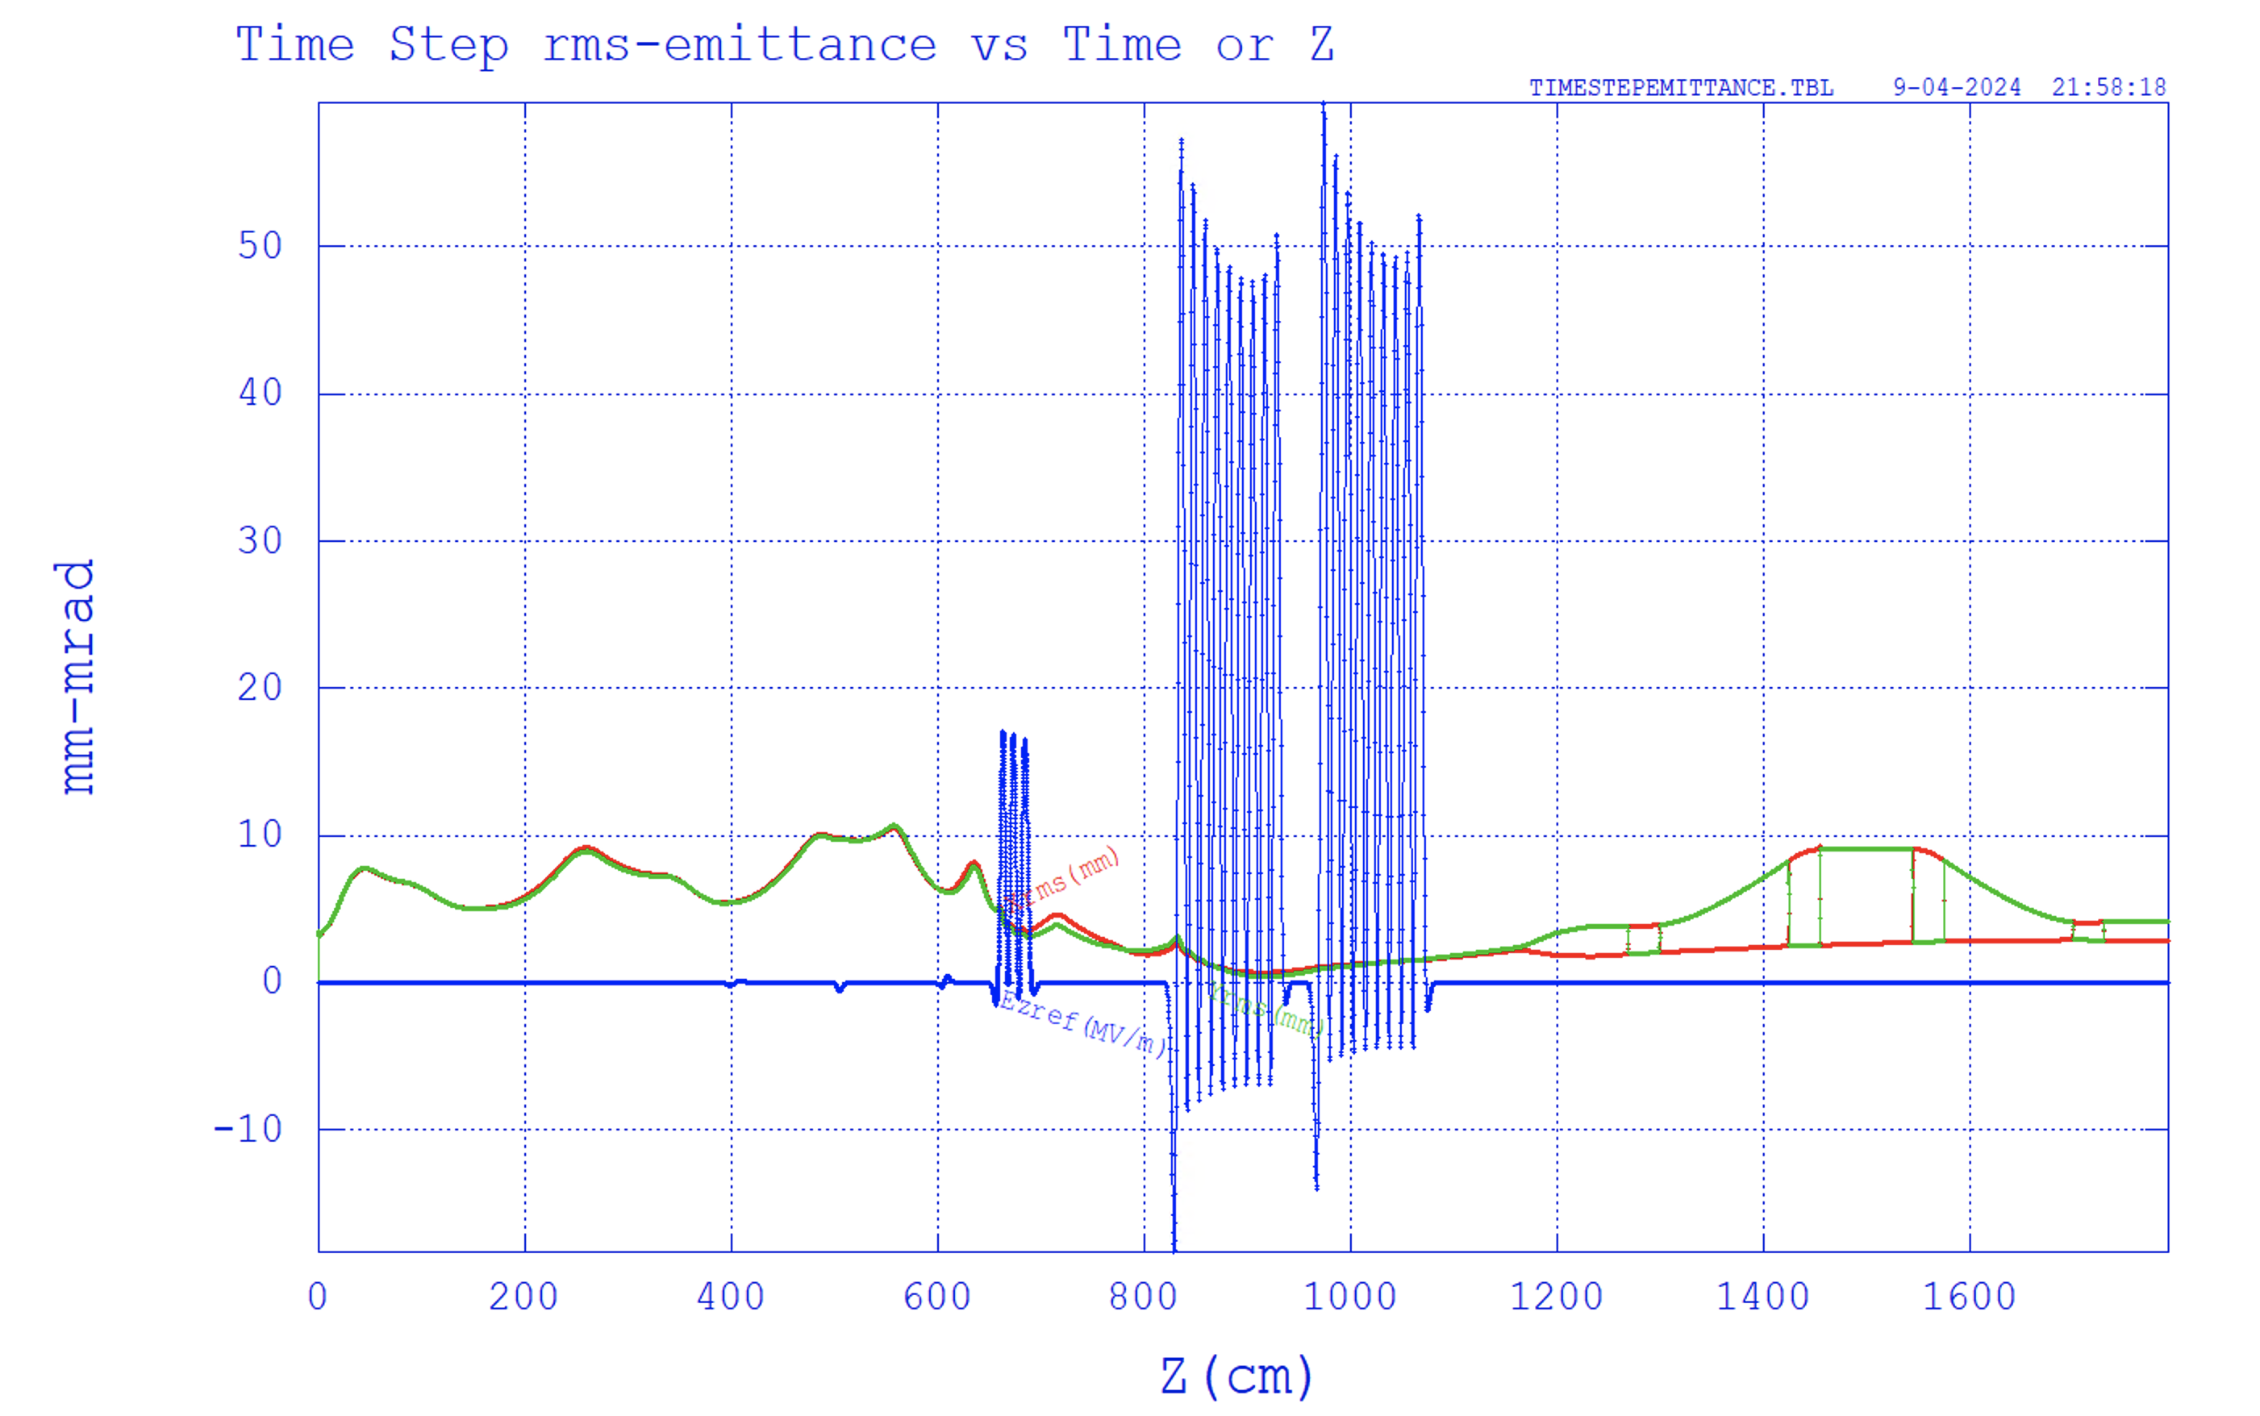
Front end

Slide 32


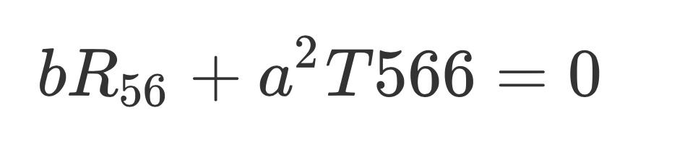







Brief Discuss on Peak Current
peak current about 4000 A
The nonlinearity of chicane (T566 and above) induces distribution changes
if can produce desired correlated energy spread before the chicane, like
We will have a compressed bunch without change initial distribution.
R56=-11 cm
T566=17 cm
With linearizer(3.9 GHz) before the chicane can reduce the peak current to 2500 A. We decided move linearizer to phase II. Leave space available.

