Slide 1
Evaluation of WireCell’s workflow in uBooNE MCC10
Wenqiang Gu, Jay Hyun Jo
Haiwang Yu, Hanyu Wei

Slide 2
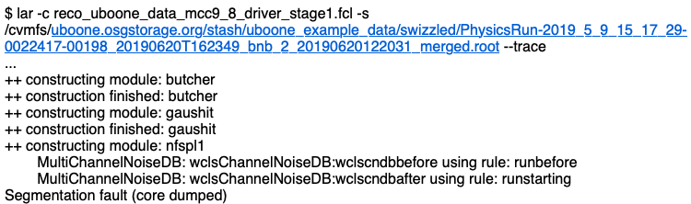
Reports from Herb G. and Matt R.
Three issues for WireCell’s (WCT/WCP) function in MCC10
First, reco stage1: segmentation fault in uboonecode v10_00_04
Second, reco stage2: unified WCP script
Will debug this
This talk

Slide 3
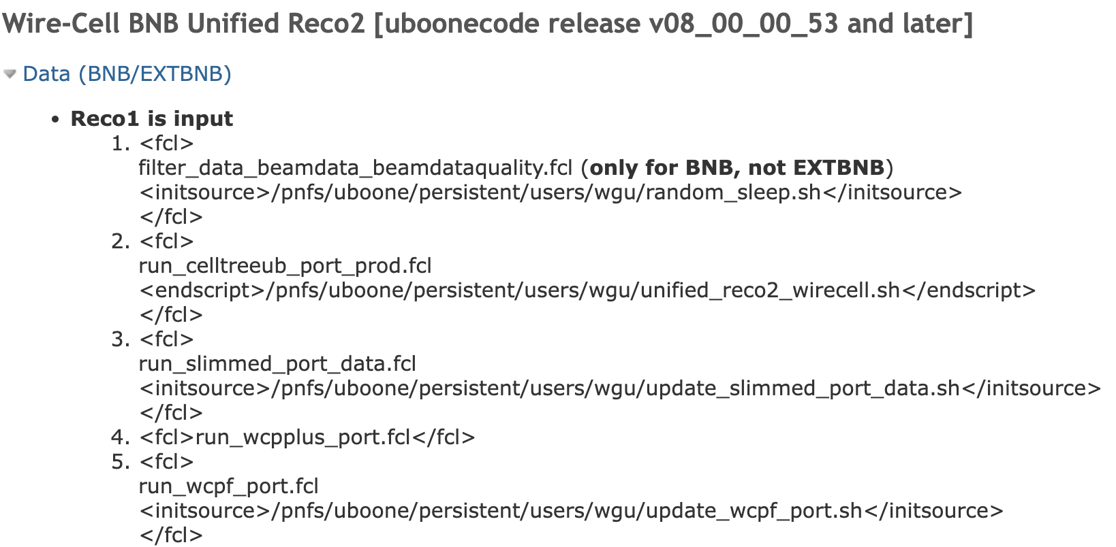
Reco2: from MCC9 to MCC10
WireCell apps run in the endscript (imaging, generic nu pre-selection, pattern recog., etc.)
Improvement required for MCC10:
Move endscript/initscript to uboonecode official release (done, thanks to Herb)
SparseConvNet loaded as a UPS in the script, but need a new version in python3
Segmentation fault from WC apps in the MCC10 env? Need to debug

Slide 4

UPS setup in the endscript
The MCC9 setup in the endscript uses numpy, libtorch and SparseConvNet for python 2
New version of numpy and libtorch are available for python 3 in the MCC10 env (uboonecode v10_00_04)
Need to provide a new version UPS of SparseConvNet
Currently, we have successfully installed it in a virtual env of python 3 (thanks for Brett’s instruction)

Slide 5

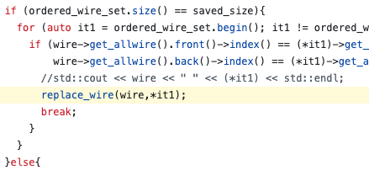

Segmentation fault in the MCC10 env
Segmentation fault from the app wire-cell-imaging-lmem-celltree
Turns out to be an undefined behavior of missing return value of a function (see commit 863248a) although the returned boolean is not used in the main program
…

Slide 6
Todo list for MCC10
Further debug the segmentation fault in reco stage1
Publish a new release of WCP for UPS product
Provide a new UPS product for SparseConvNet in python 3 env

