Slide 1
EIC HRPPD anode tarnish
[progress report]
Alexander Kiselev
pfRICH DSC general weekly meeting, 12/12/2024

Slide 2
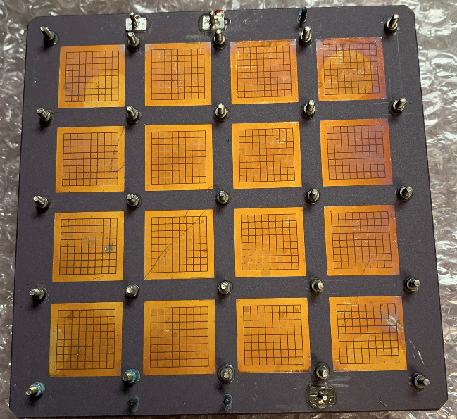
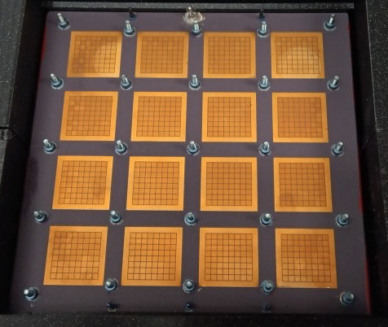
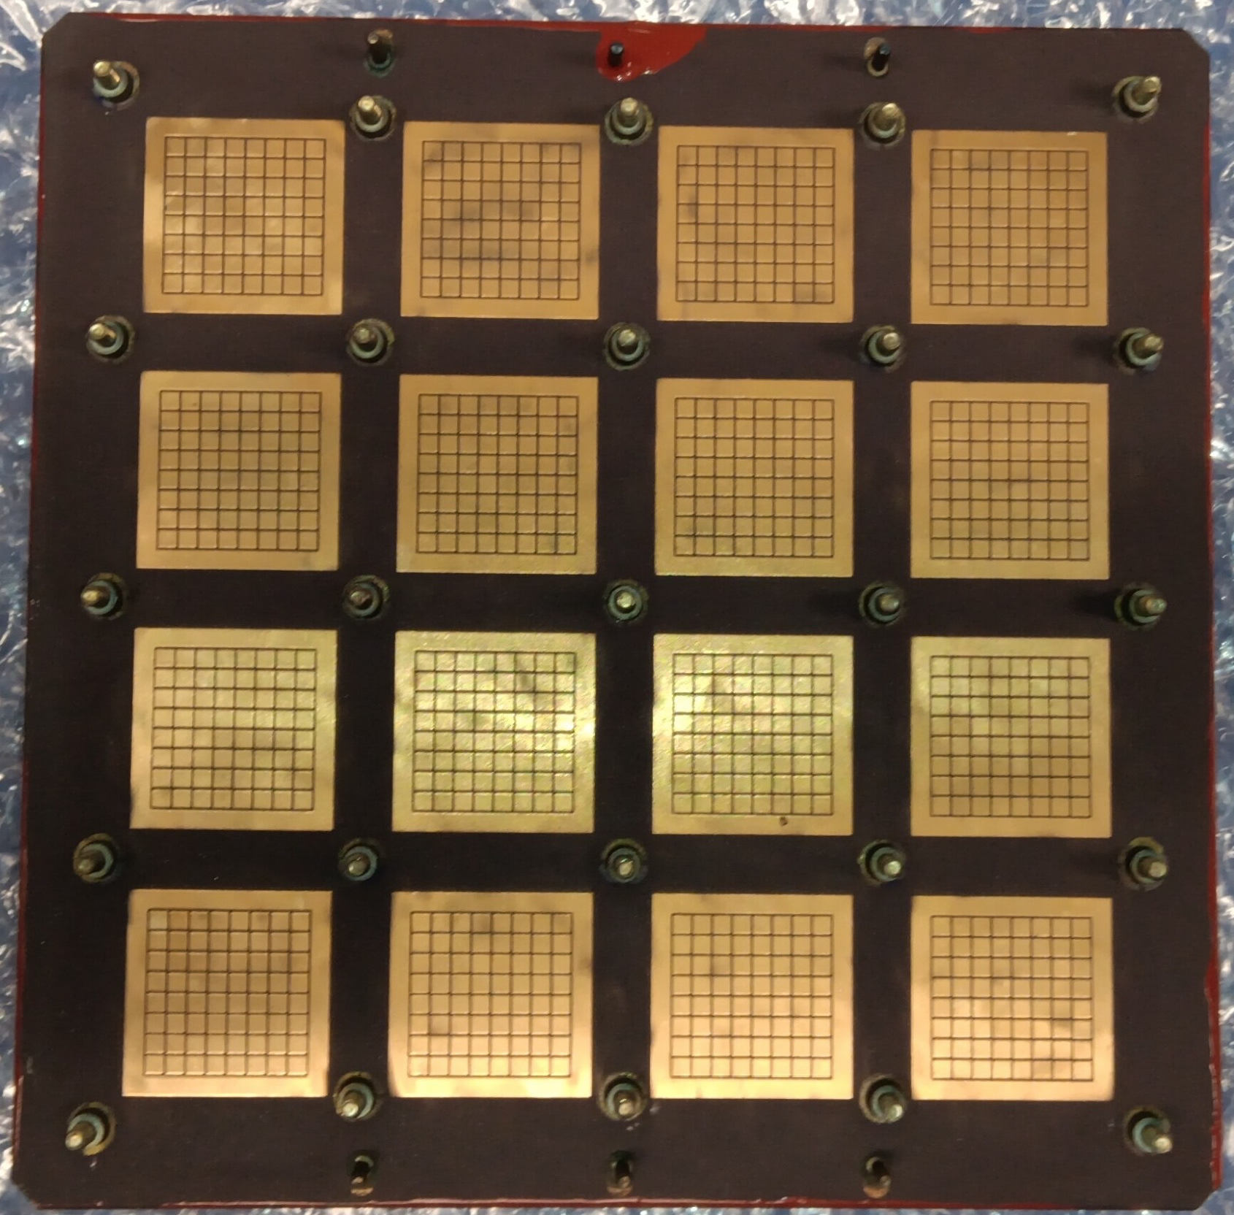
The issue: first three tiles
tarnish was sanded off this one
HRPPD #15
HRPPD #16
HRPPD #17
An apparent tarnish of unknown nature is seen on all Kyocera HRPPD anodes
It is not visible after a ~750 C brazing cycle in vacuum needed to attach HV springs, …
… but a pattern of support structure used in this iteration is clearly seen after fritting in air
It becomes apparent only after fritting of side walls in air at about 550 C

Slide 3
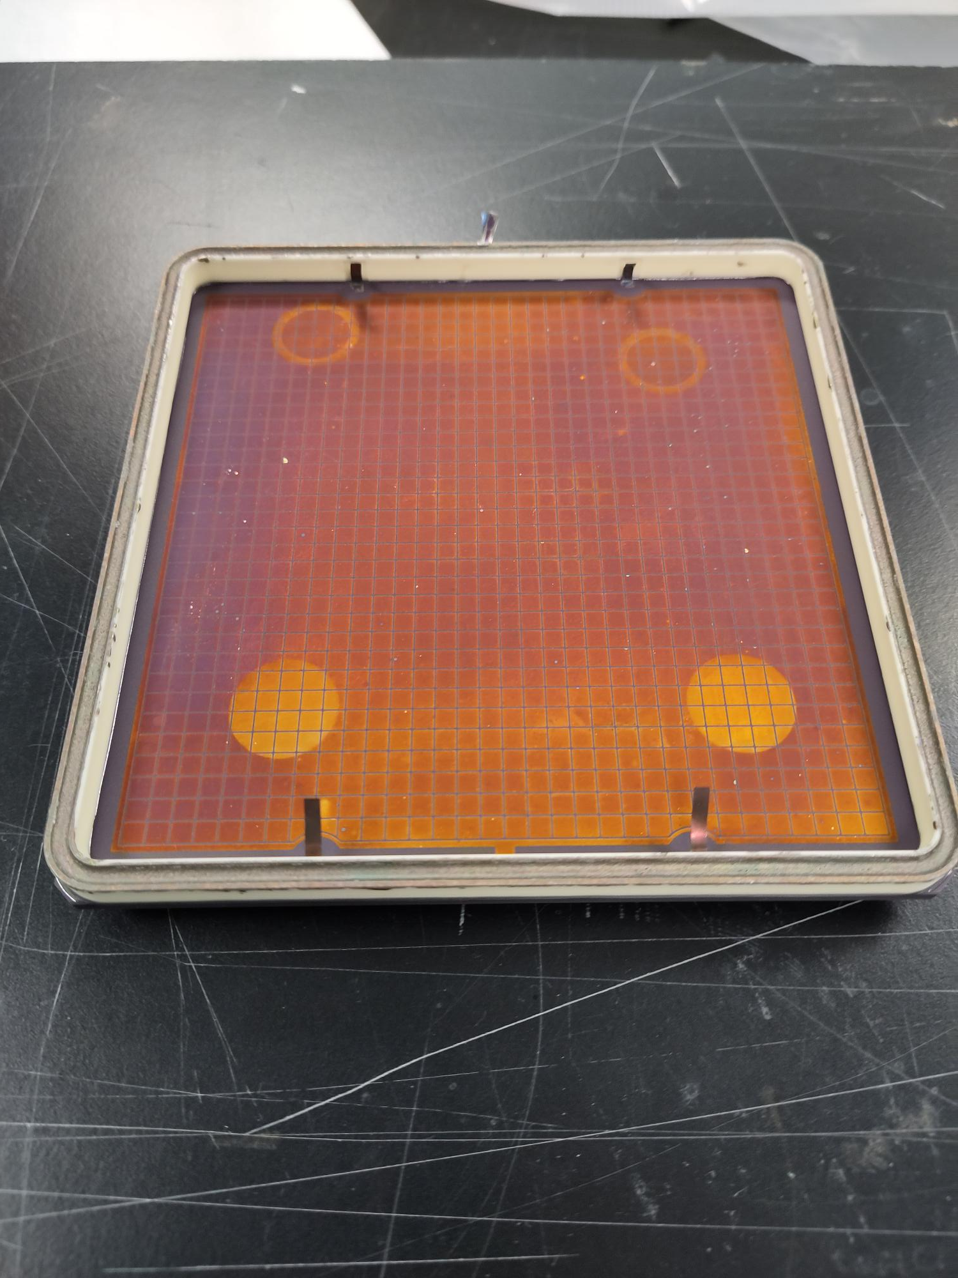
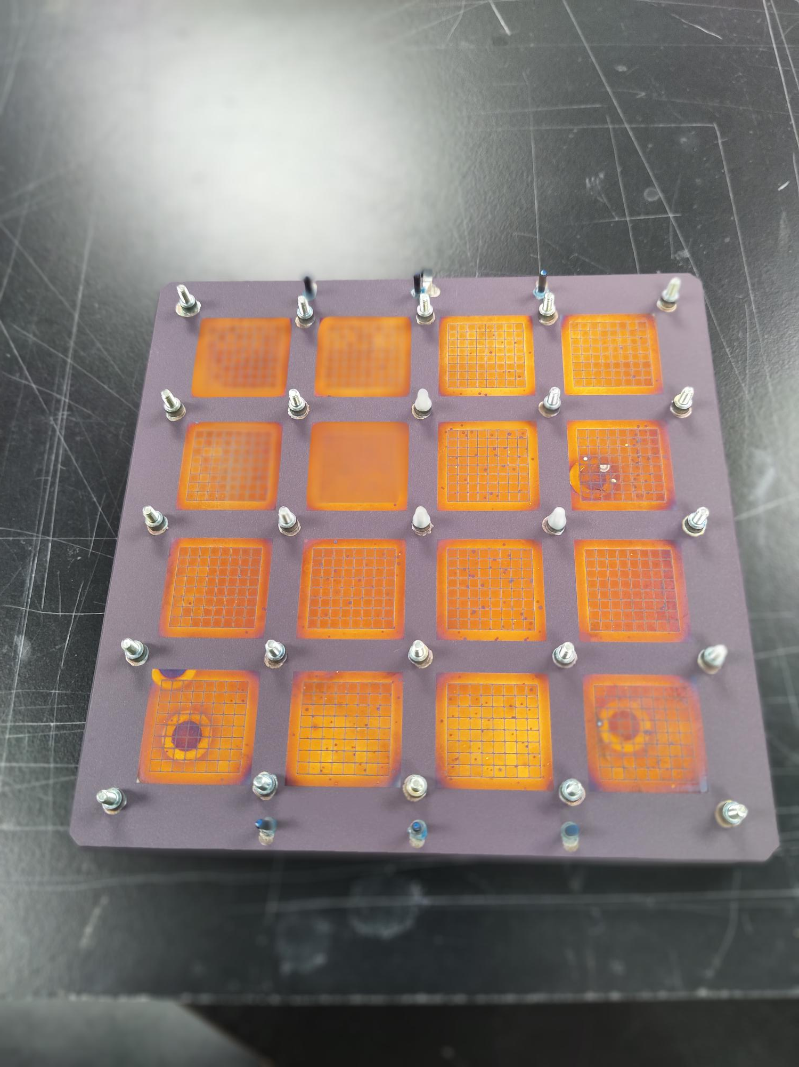
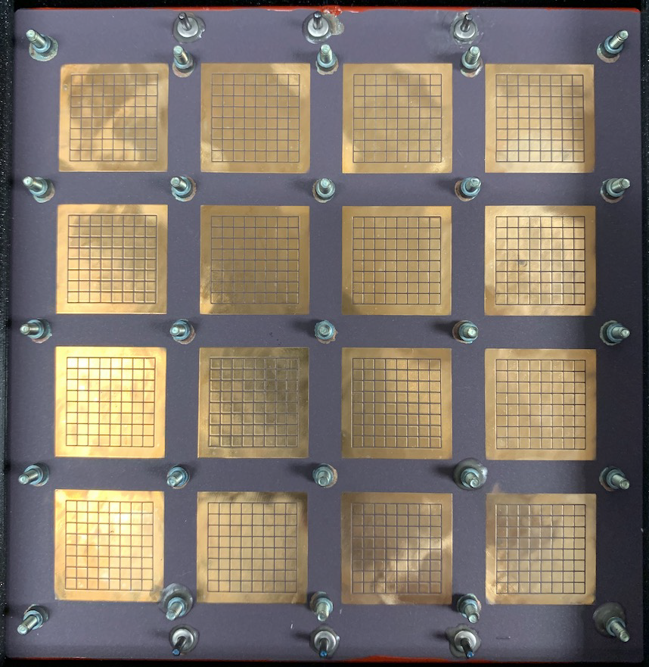
The issue: HRPPD #18
Anode: vacuum side
Anode: air side
Air side after sanding
This was an extreme case (first HRPPD produced in vacuum tank #2)
Could have been exposed to a higher temperature
Sanding tarnish off a ~1 μm thick gold layer may not be the best idea
Leaving it on the outer side may cause further oxidation during HRPPD use

Slide 4
Center for Functional Nanomaterials (CFN) @ BNL
A five-minute walk from Physics building 510
Plenty of amazing top-notch equipment
Including electron microscopes with an X-ray analysis capability
It is a user facility (free of charge for local BNL users)
Proposal -> review -> time allocation

Slide 5
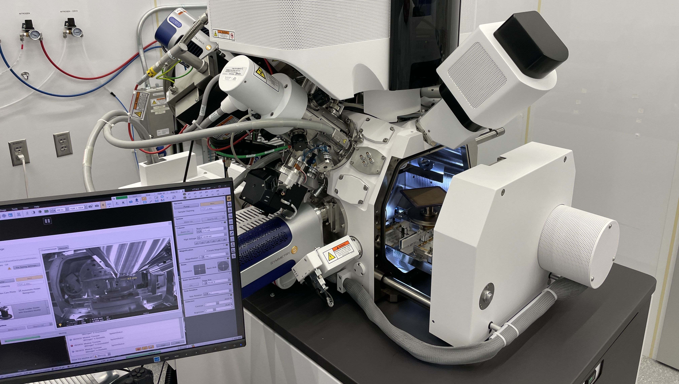
Our case
A so-called rapid access proposal "Measuring chemical composition of tarnish on HRPPD HTCC anode surface” submitted on 9/23/2024
Delays due to the SEM/FIB equipment malfunction
First half a day session on 11/26/2024

Slide 6
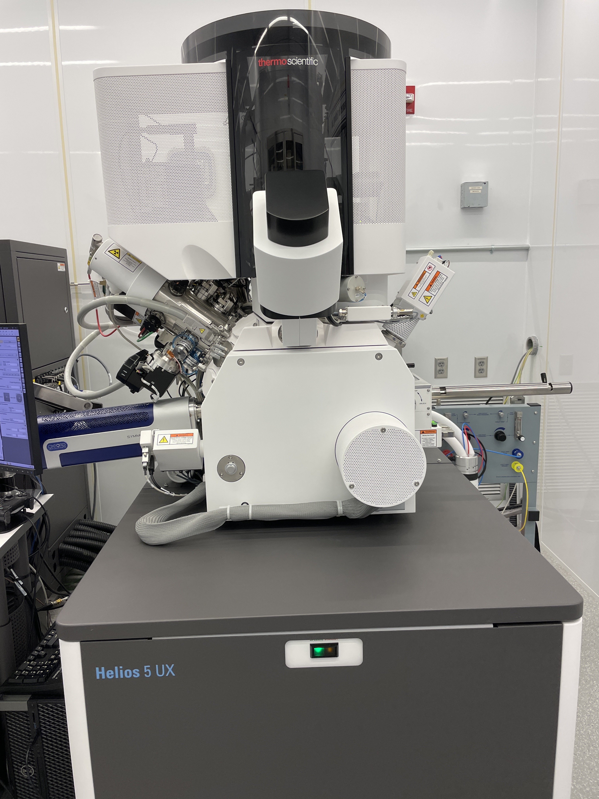
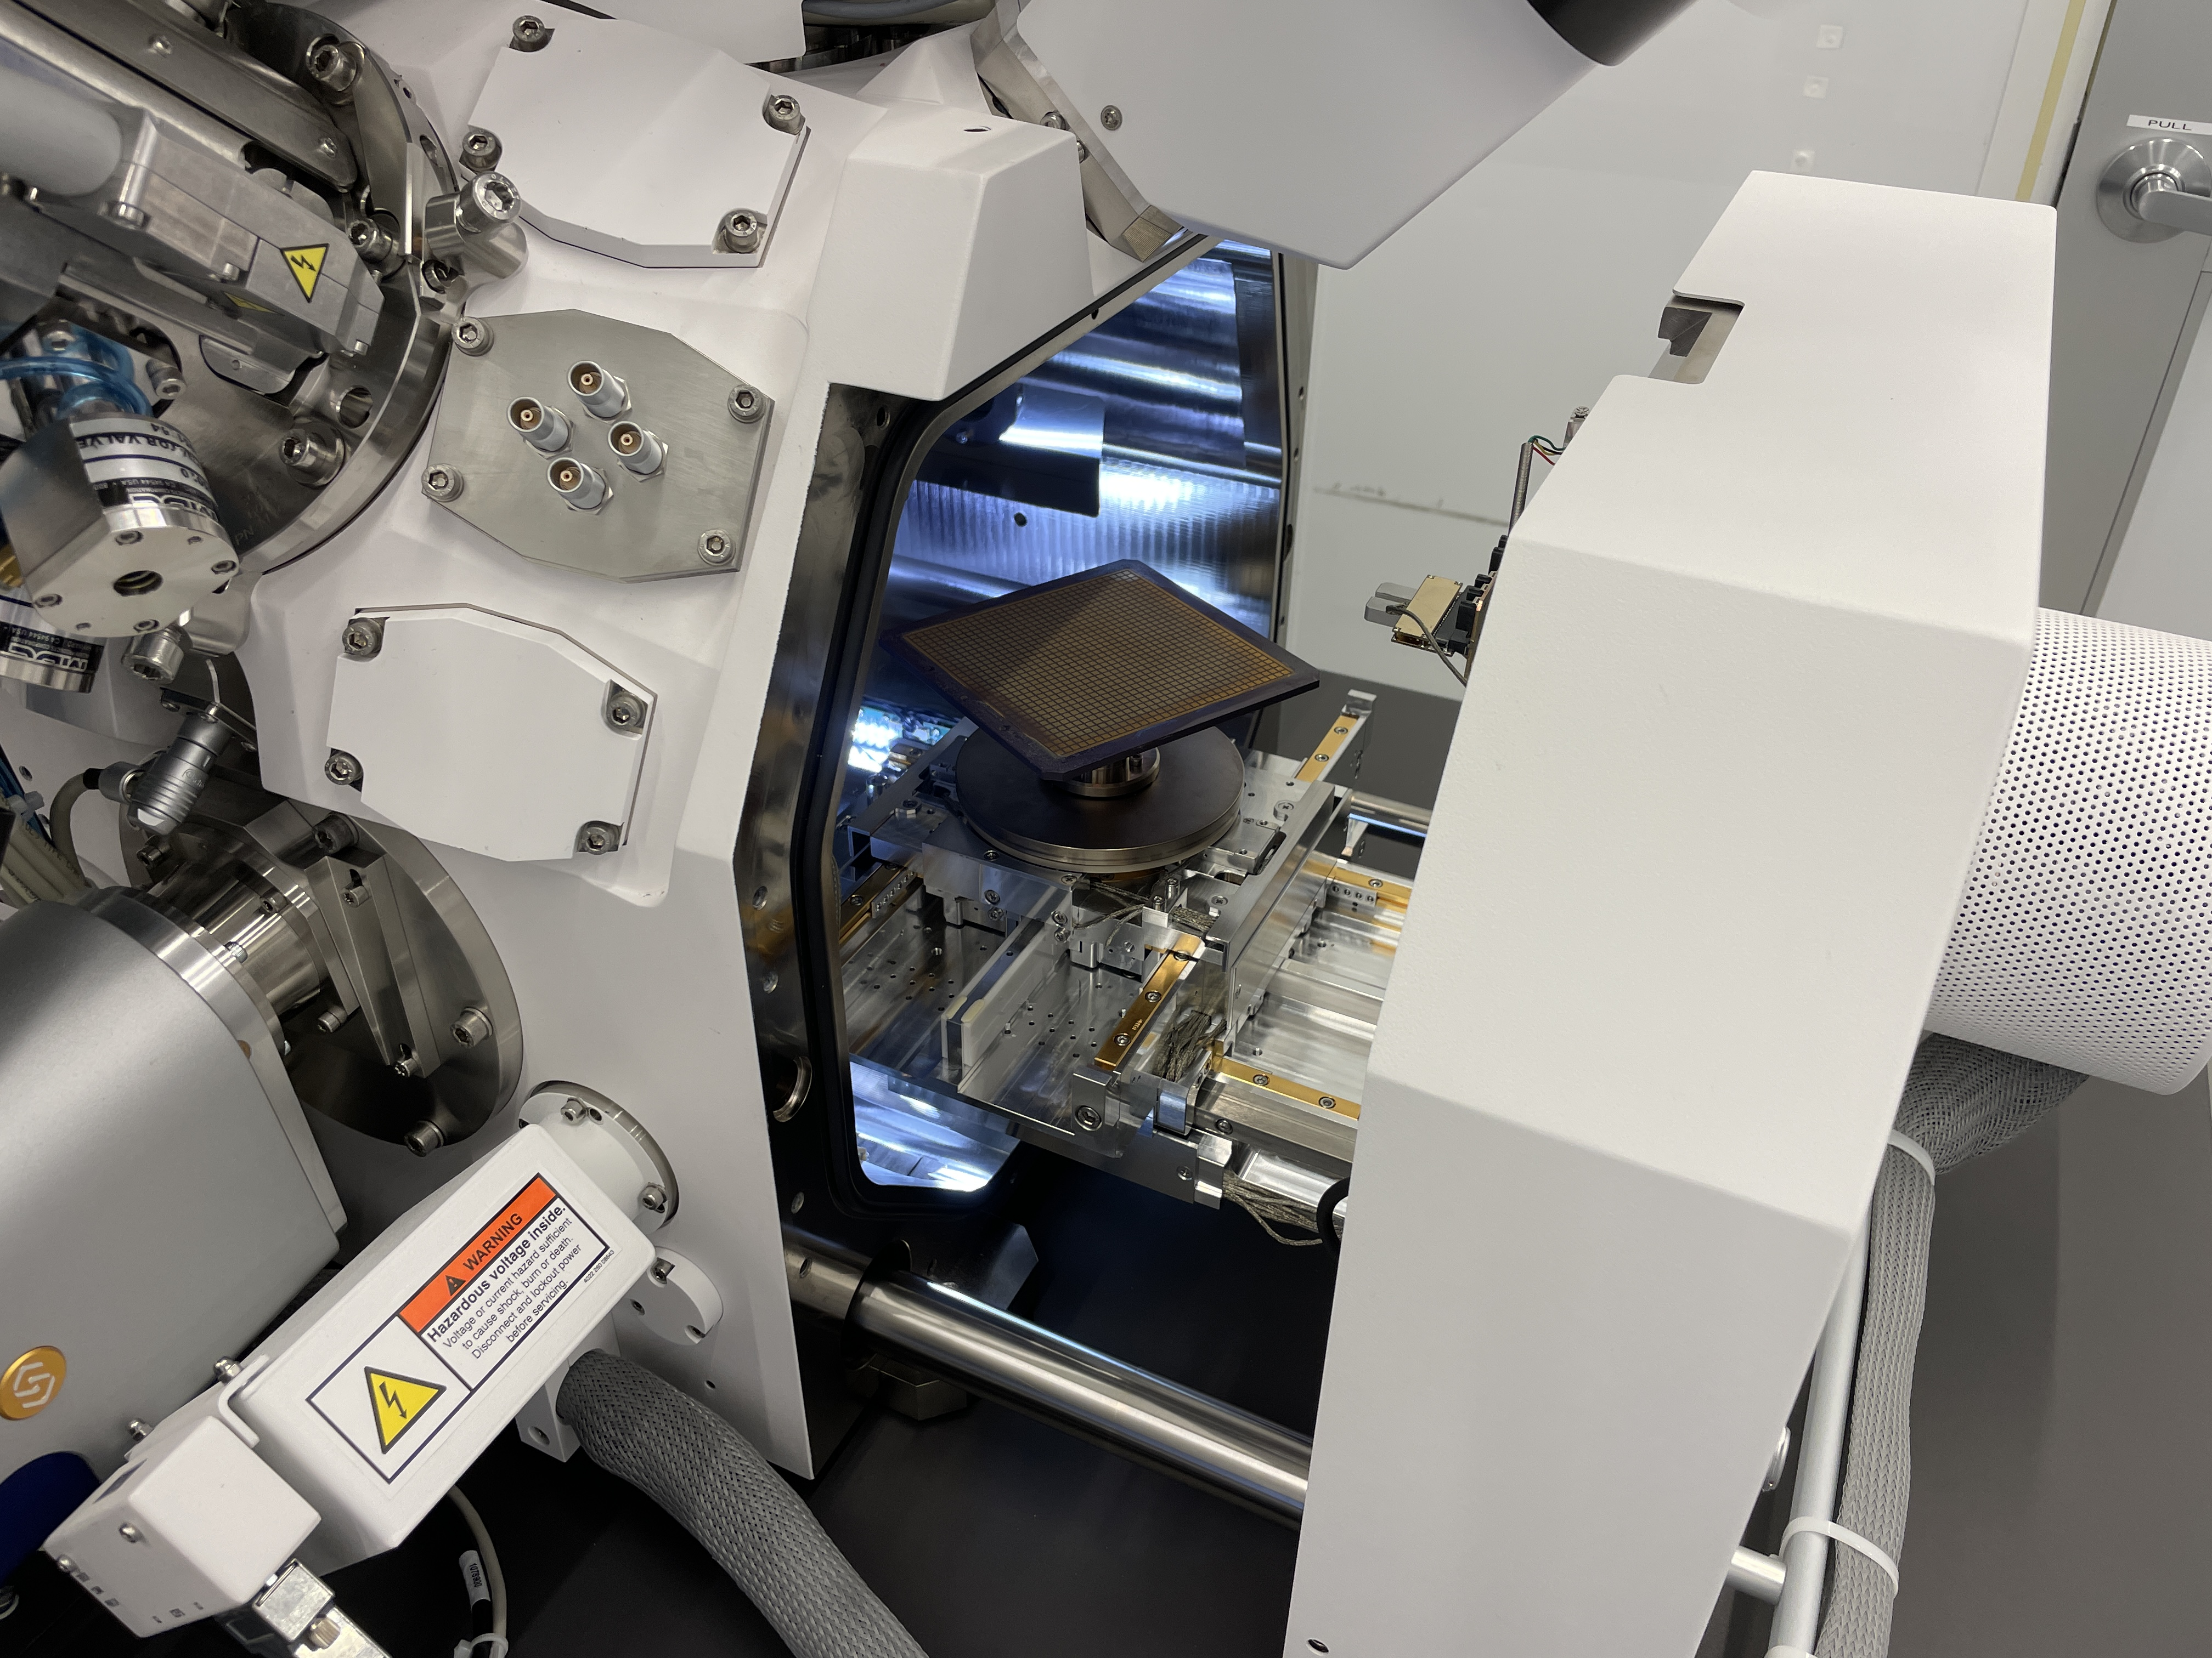
Equipment used in this first study
Thermo Fisher Scientific “Helios G5 Dual Beam SEM/FIB Microscope”

Slide 7
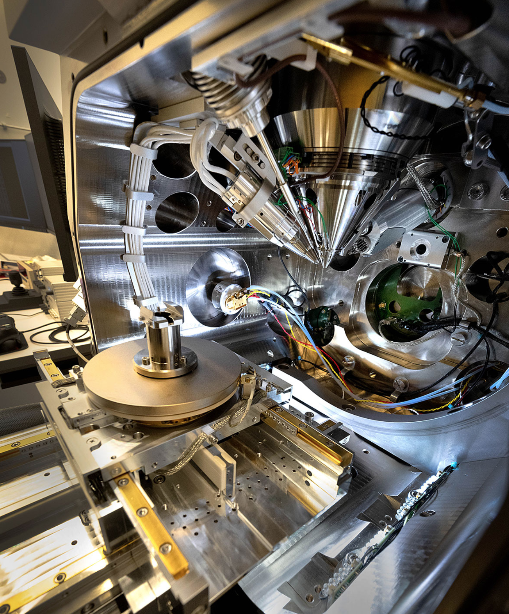
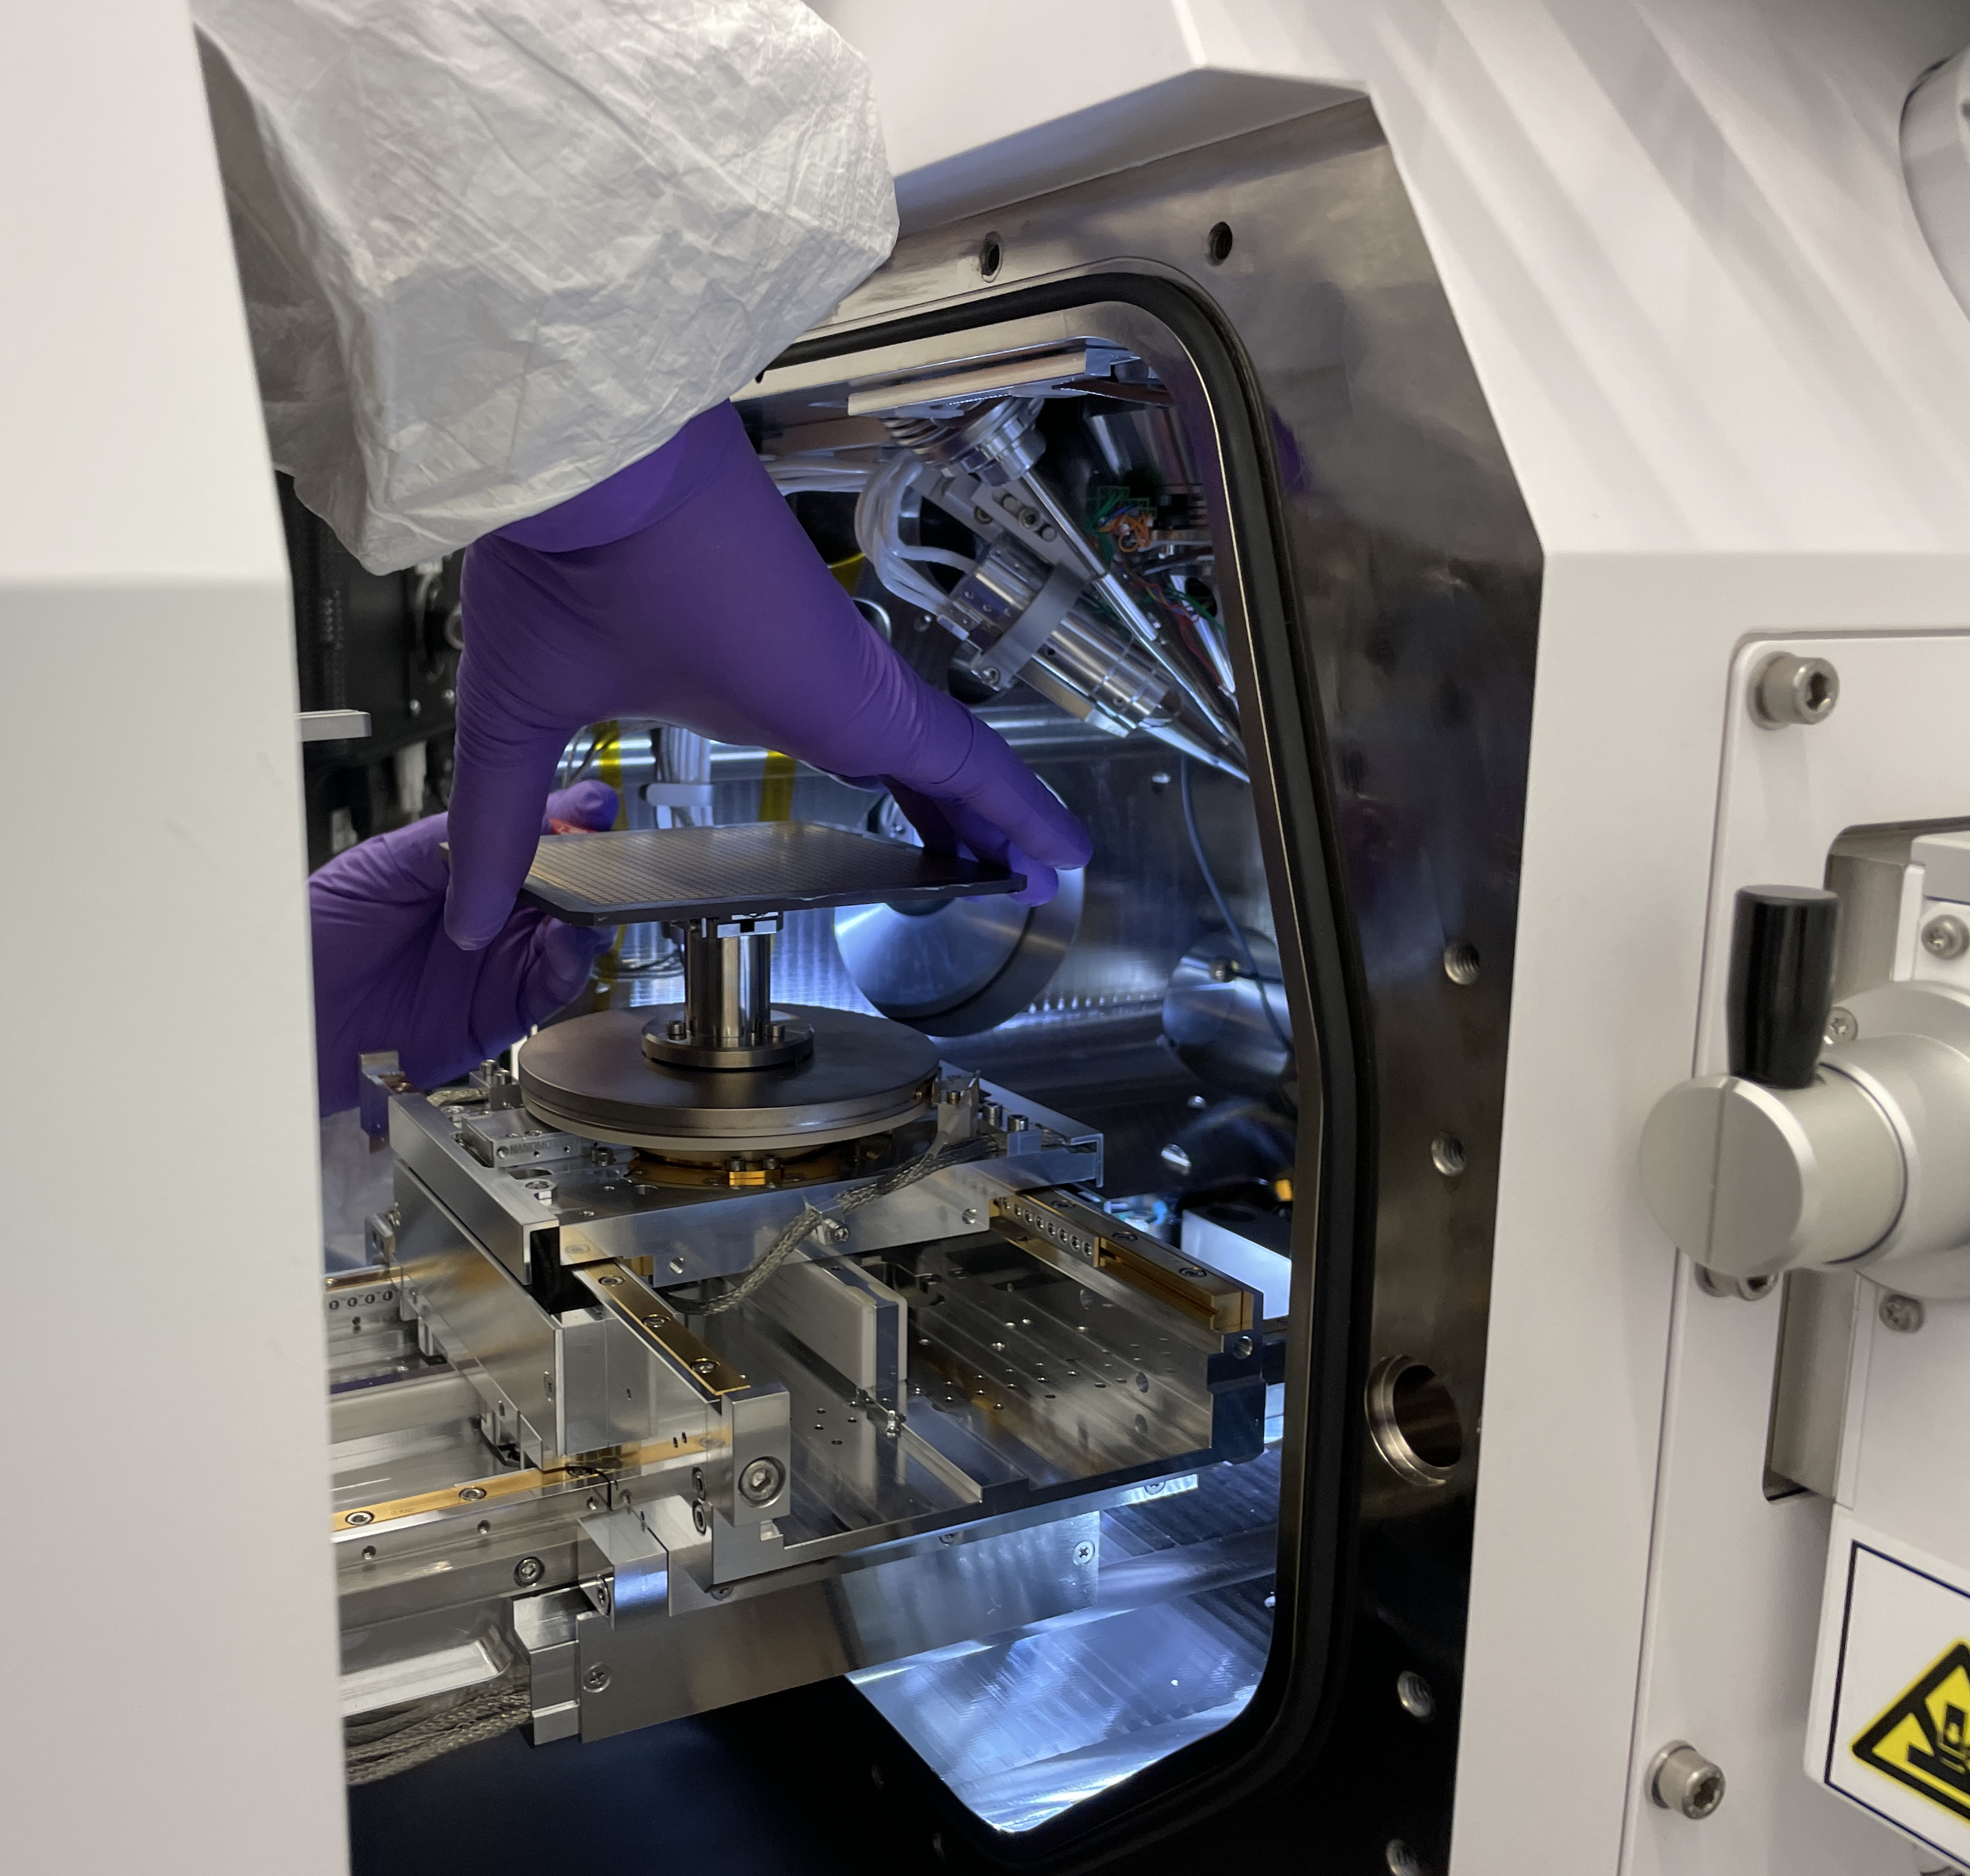
Equipment used in this first study
Picture from official BNL CFN site
Inside view of the sample chamber
Kyocera anode mounted on a turntable

Slide 8
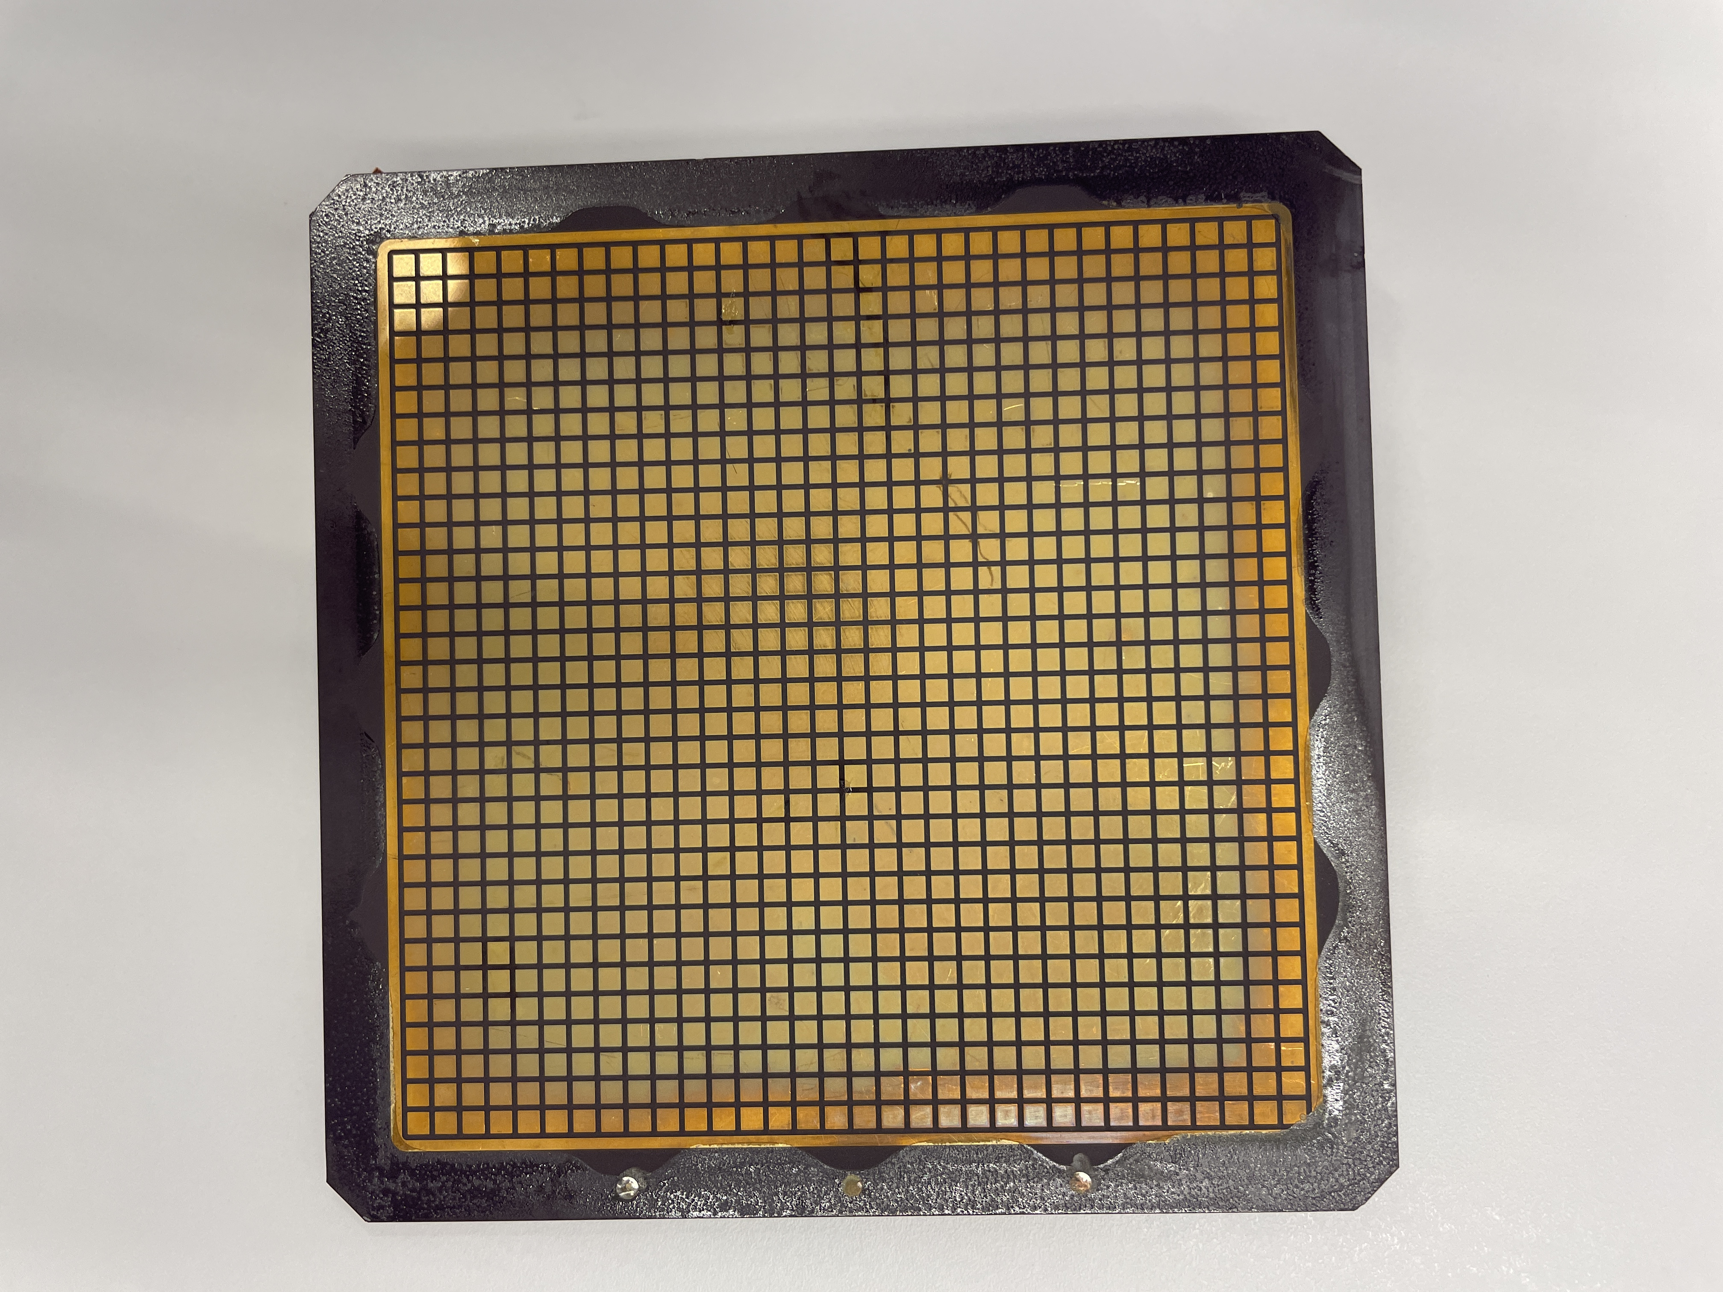
Sample
sanded area
tarnished area
One of the old (2020) Kyocera anodes
Spot under study

Slide 9
First results [SEM & X-ray analysis]
Sanded area
Filled histogram: tarnished area
Picture coming from vendor software
Normalization mismatch: either dead time or absorption in the tarnish layer

Slide 10
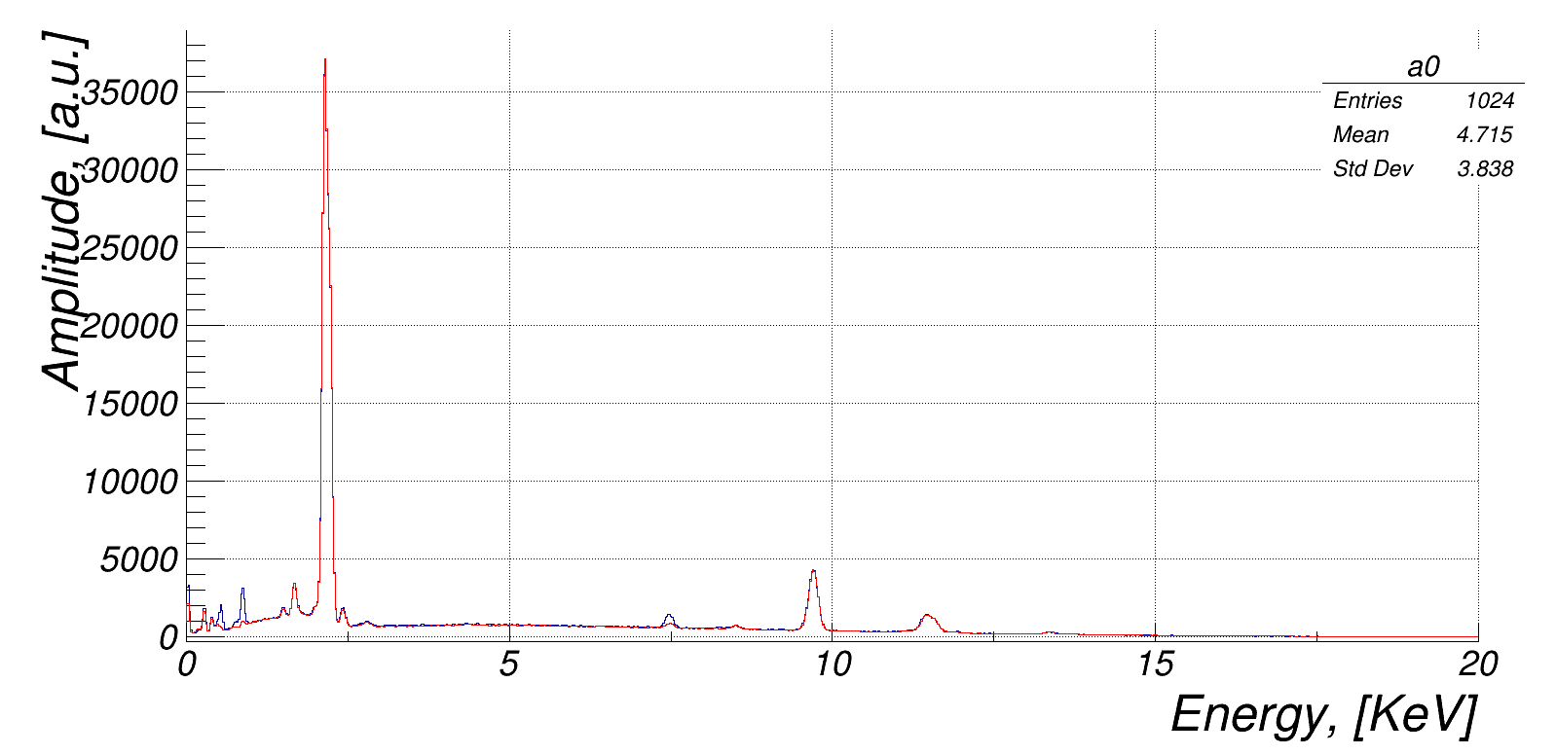
Custom analysis: overlay of two spectra
Spectra normalized by hand using Au peak and smooth “background” as a reference
Everything is the same in both cases, but Ni and O stick out

Slide 11
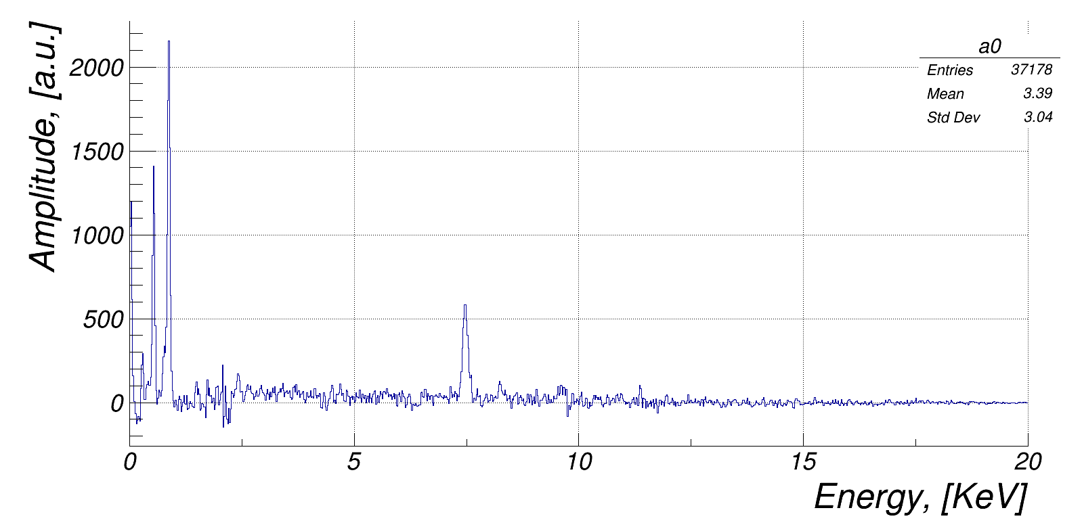
Custom analysis: difference of two spectra
Ni K-edge line @ 8.339 KeV
Full scale up to 20 KeV

Slide 12
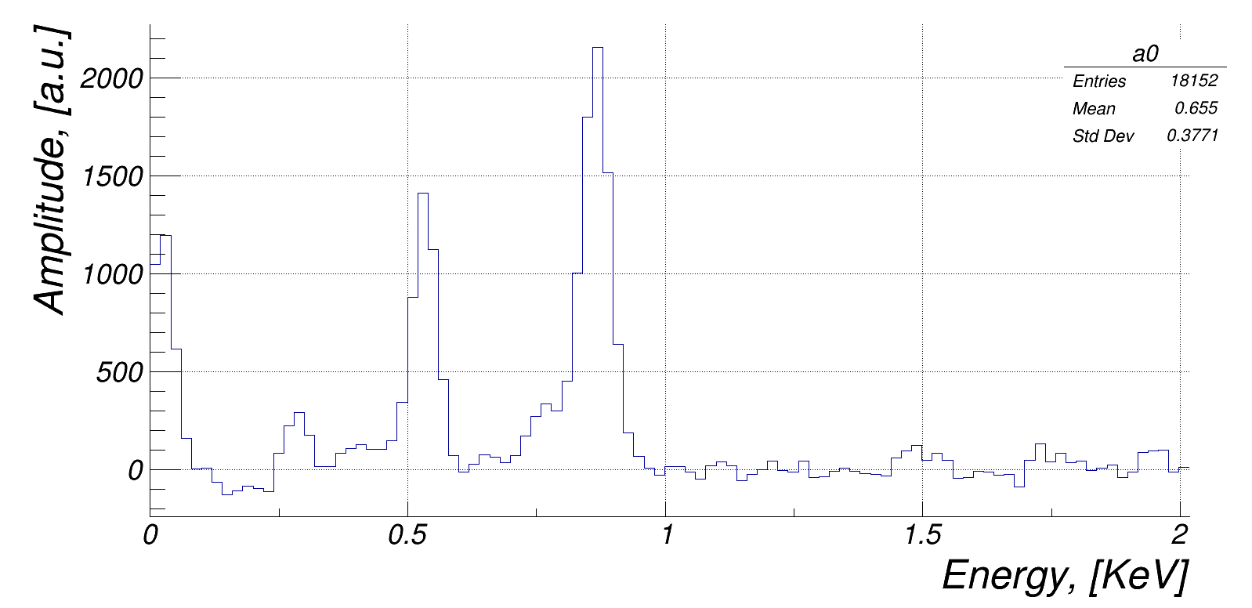
Custom analysis: difference of two spectra
O K-edge line @ 530 eV
Ni L-edge lines (853 eV & 870 eV)
Low energy fraction

Slide 13
Summary & Outlook
Looks like a NiO present on the surface (and nothing else?)
Ideally would like to check Ni:O proportion
Sure Ni is present in the system (right beneath a thin gold plating layer)
Whether Ni diffuses through gold plating during brazing cycle or “evaporates” off the exposed areas (and then pollutes the anode surface) is still a question
Ni diffusion through gold grains is a well-known effect, though …
… we know that obscuring / covering a fraction of pad area suppresses tarnish
There is a strong Ni signature at the very edge of gold-plated pads in the data
Have data measured between the pads; Ni presence there may give a good hint

Slide 14
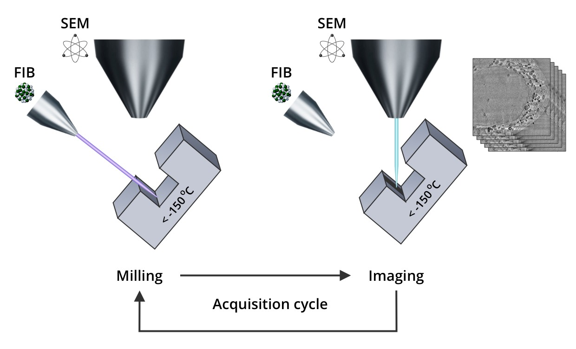
Summary & Outlook
Yet need to get access to a 2D map measurement data (next Monday)
Depth scan can be performed in January if needed using FIB functionality
Try to remove NiO by either a citric acid or ammonia in the meantime?
Consider removing Ni layer after the brazing cycle prematurely in the future (any acid would do)?
An illustration of FIB/SEM principle (ignore -150 C note)
Volunteers to take this activity over?

