Slide 1
Stave End Support Update
Adam Huddart
18/12/24

Slide 2
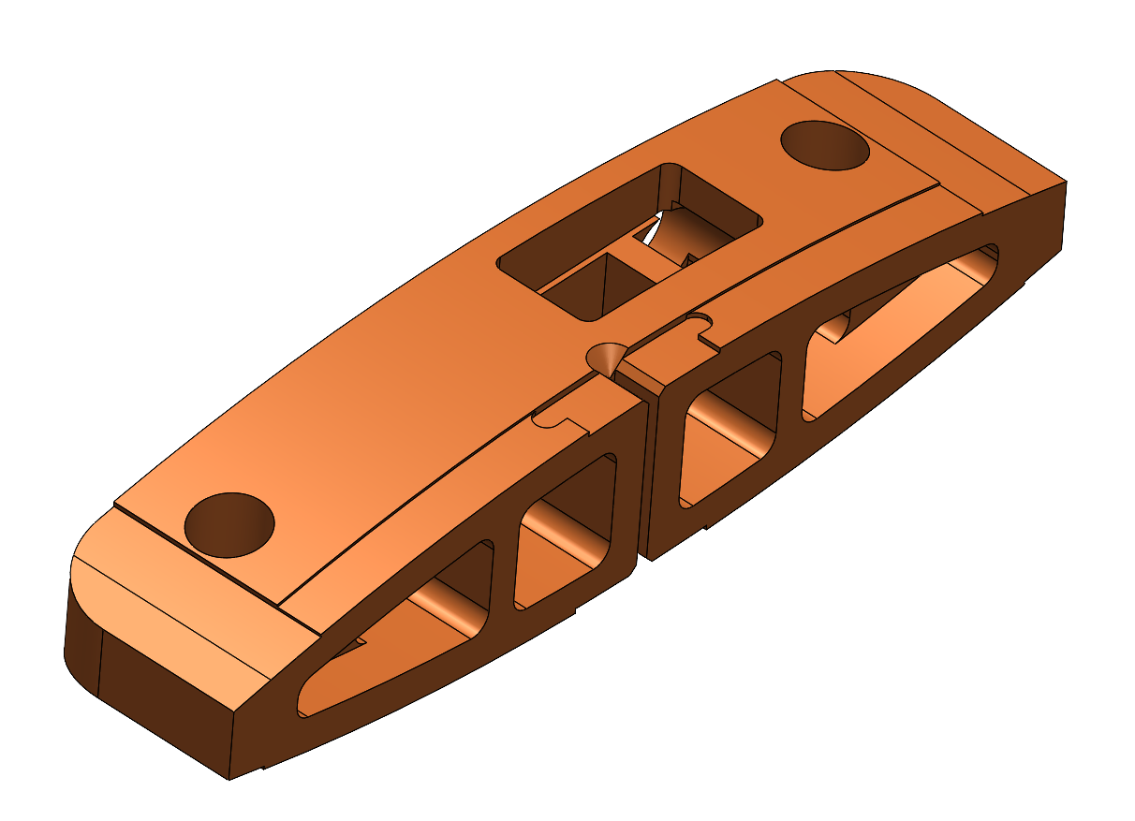
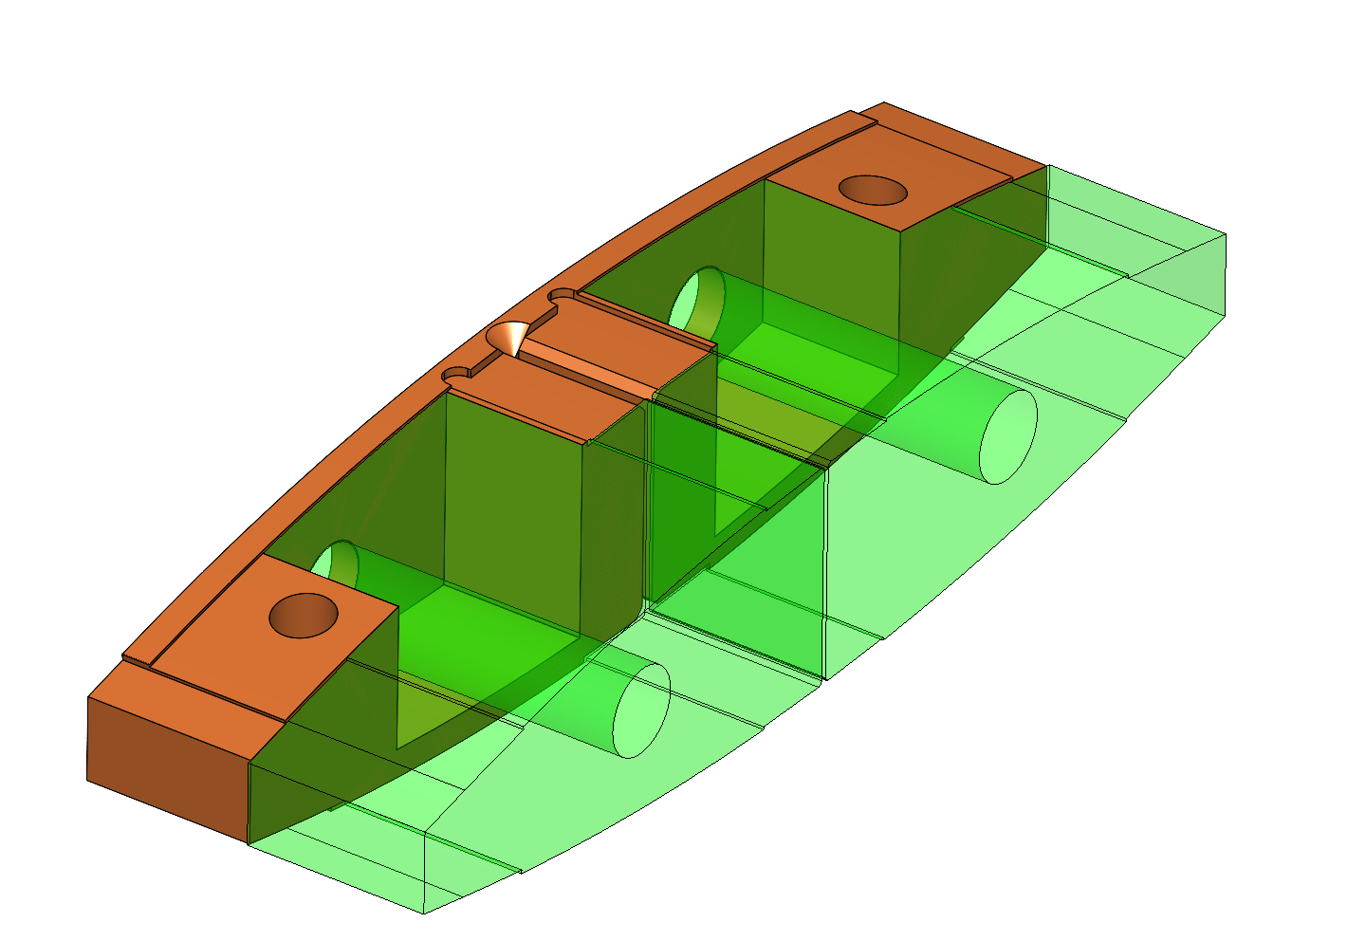
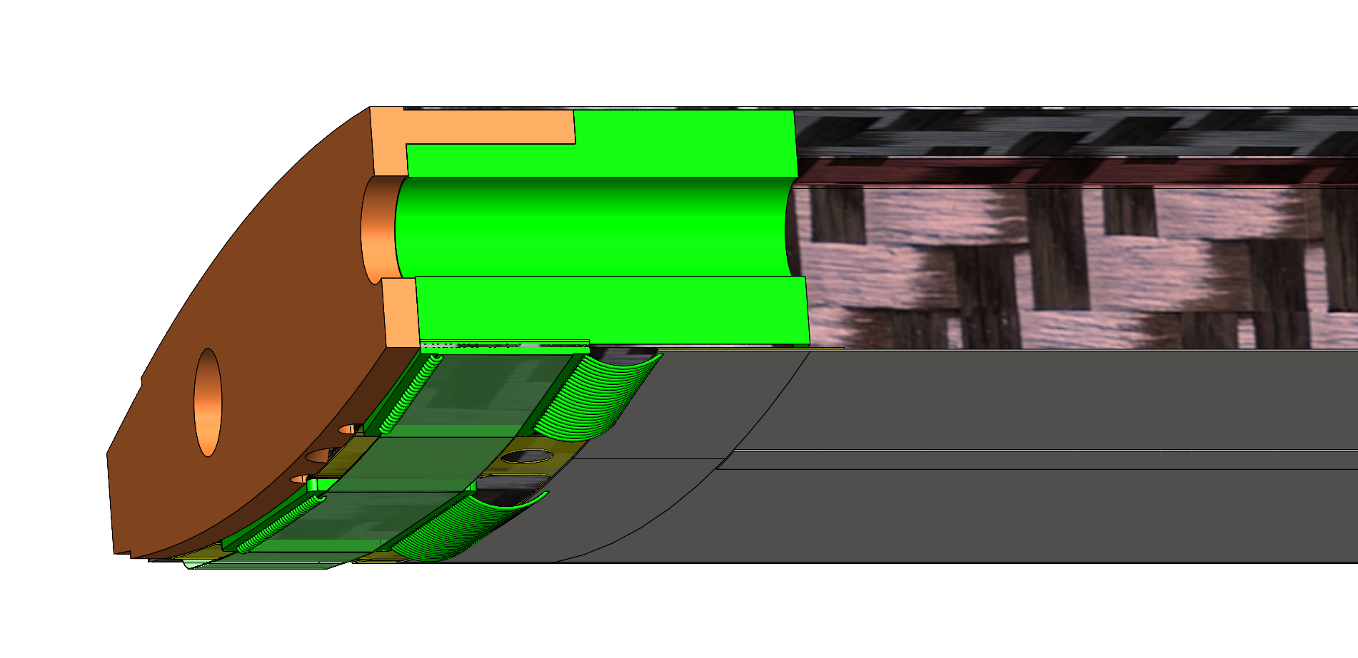
Introduction
Presented a revised ends support design at Birmingham
Reduced the length beyond the first stave module to the stave end by integrating the K9 foam into the Ultem/Plastic End support
6.5 mm length reduction per side
This design works for narrow Ancillary ASIC (modelled as 10 mm)
What if ASIC was wider (currently looks like it’ll be 15 mm or more)?
Old Design
New Design

Slide 3
Revised Design
Support cones need to be sided
Left side module is on bottom side of the stave structure
Cone interface must be on top surface
Right side module is on the top side
Cone support must be on the bottom surface or end face
Coolant
ASIC
LAS
Exhaust
Stave Structure
Fasteners
ASIC
LAS
Alternate mounting point

Slide 4
Revised Design – Wider ASIC
With wider ASIC there’s no room for through holes in stave
ASIC cooling above bolt boles will be compromised
If high power output components can be localised over the foam backed regions this may not be an issue
Otherwise, we could invert end modules
Coolant
ASIC
LAS
Exhaust
Stave Structure
Fasteners
ASIC
LAS

Slide 5
Inverting Modules
LEC of the modules closest to the stave end would now face the centre of the stave.
Pros
ASIC no longer interferes with stave support
Moves ASIC & LEC away from stave end
Optimise FPC lengths
Stave length can be further reduced
Cons
Introduced left and right handed modules (need to check this is true)
Internal tooling more challenging/increased number of parts

Slide 6
Inverted End Module
End support can move in by approx. 6mm
Additional Tooling

Slide 7
Open Questions
ASIC dimensions?
SLDO is primary power output components occupies 7x 0.5 mm in Stephanie’s models?
Is there a benefit to reducing L4 and L3 length any further
Is the answer different if we move to 5 RSU on L3?
Outlet flow from K9 foam blocks tends to have a large thermal gradient which stabilises over module length
Not sure what temperature profile will look like with K9 blocks close together.

