Slide 1
ANSYS 3D Structural Analyses of the sPHENIX Magnet at Full Current John Cozzolino November 23, 2016

Slide 2
ANSYS 3D Structural Analysis of sPHENIX Magnet
Lorentz forces in the coil and magnetic forces in the iron are calculated using ANSYS Maxwell 3D.
The current is 4596 A. Corresponding current densities are 25x10⁶ A/m² in the central coils and 42x10⁶ A/m² in the outer coils.
1.39 T central field, 2.56 T peak field.
These forces are directly mapped to a static structural FE model that includes the aluminum cryostat and its support hardware.
Most steel fasteners are accounted for on the side wall only. They have each been preloaded to 24,000 lbf.
Gravity is included.
Most interfaces between large iron panels are set to frictionless contact.
Symmetry about the central vertical plane is assumed.
Components inside the cryostat are not modeled in detail.
However, the coil is held in its correct position and its forces are transmitted to the cryostat end plates and to the support jacks.
The twelve cryostat support jacks have been accurately modeled.
Stresses and deflections including those in the cryostat support region are observed.

Slide 3
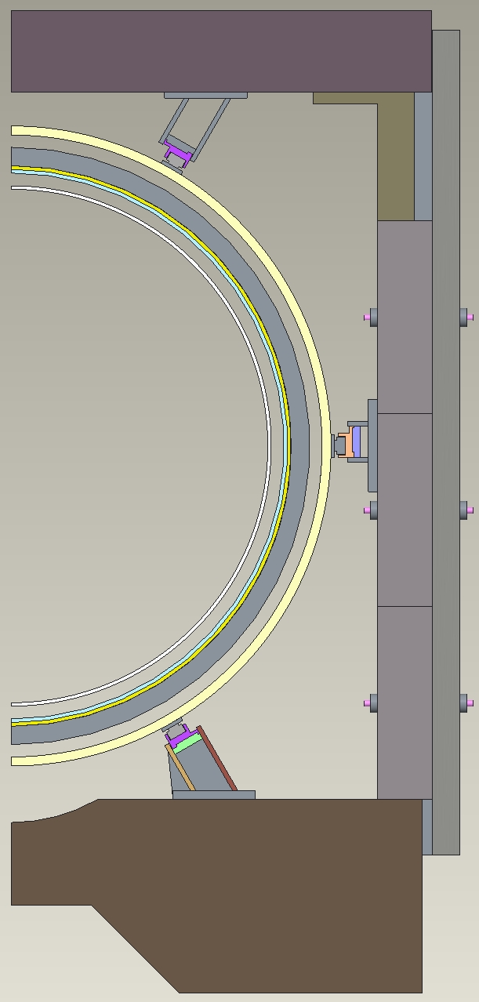
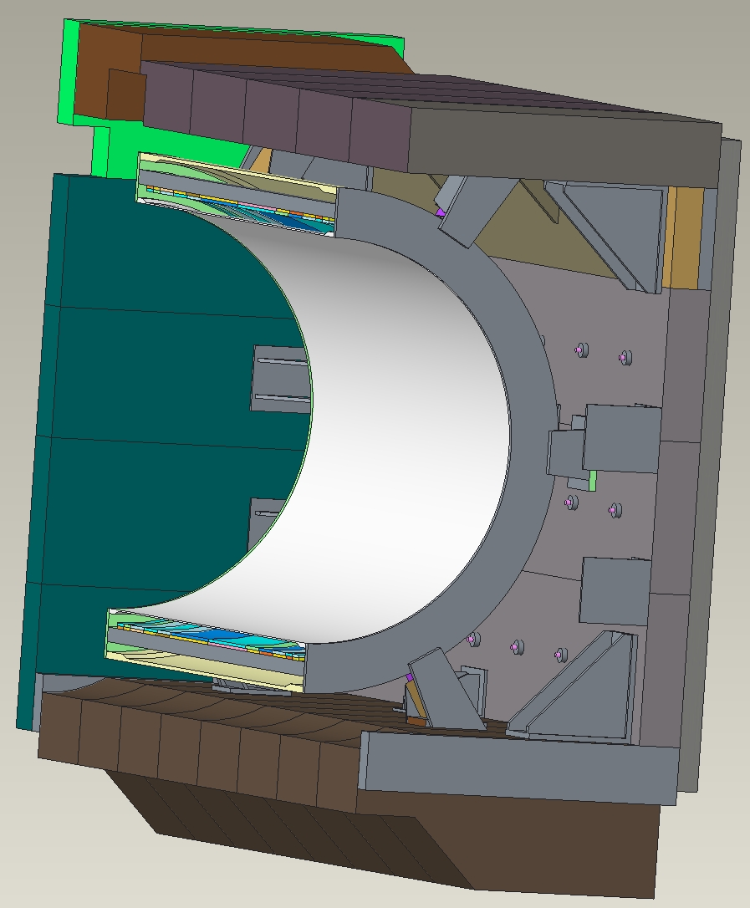
Cross-Section showing Cryostat with Braces and Supports
Inward deflection of the side supports against the cryostat is of particular interest.

Slide 4
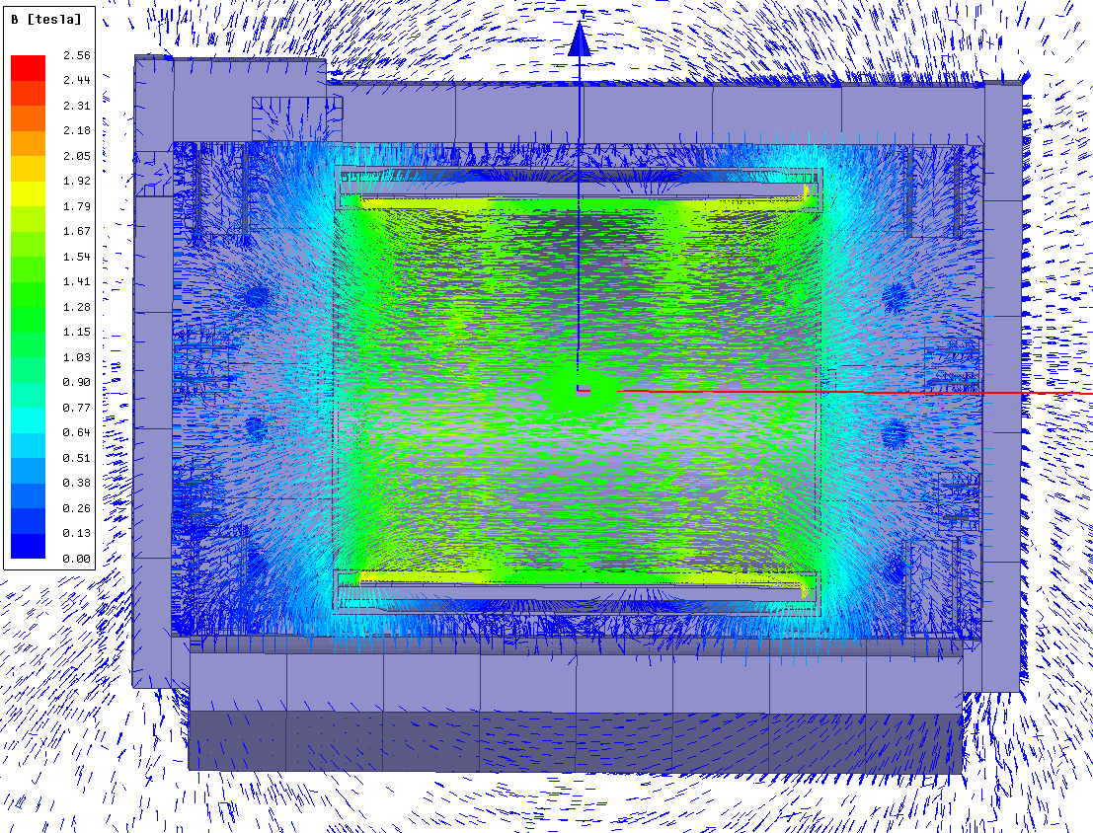
Magnetic Flux Vector Plot @ 4596 A

Slide 5
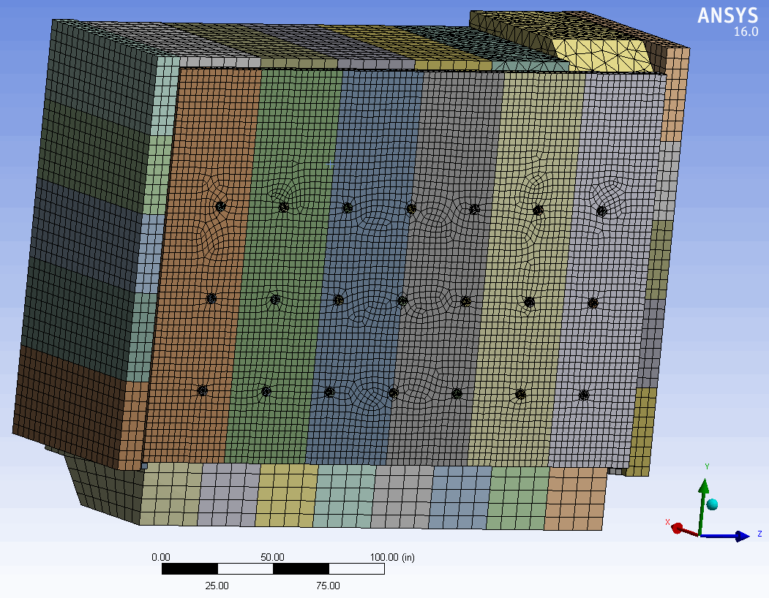
Static Structural FE Mesh

Slide 6
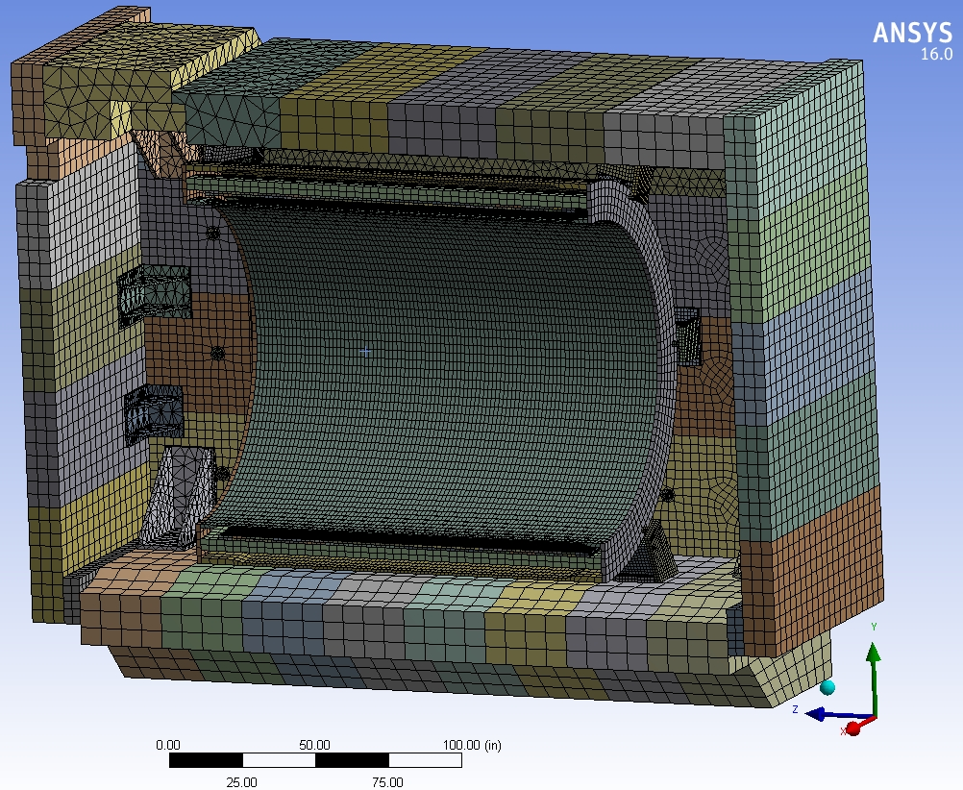
Static Structural FE Mesh

Slide 7
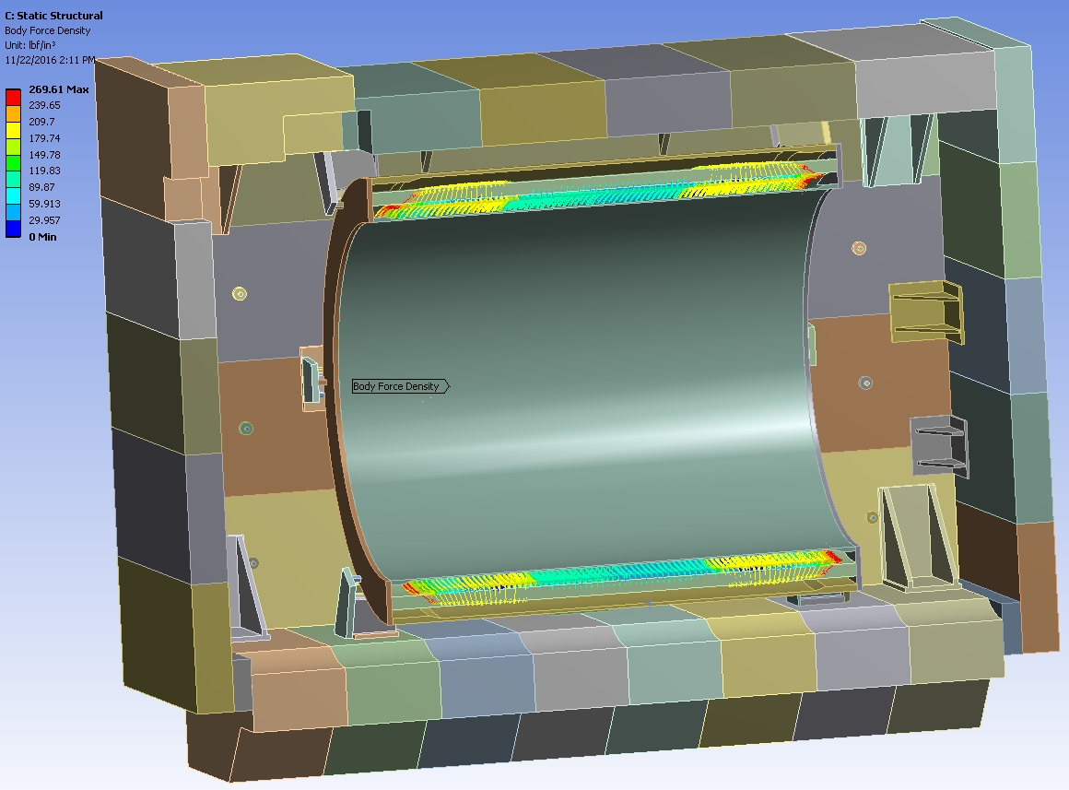
Lorentz Force Density in Coil (lbf/in³) at 4596 A

Slide 8
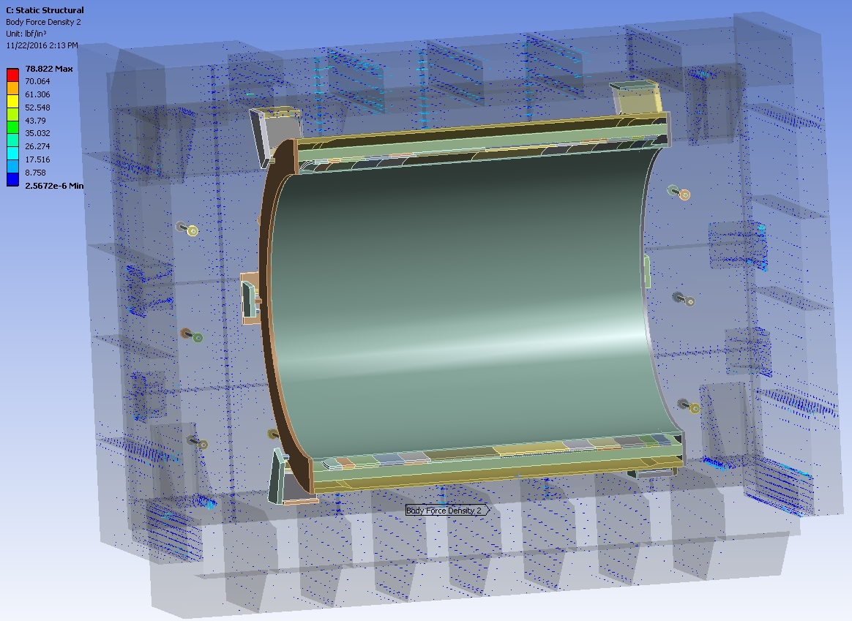
Magnetic Body Force Density in Iron (lbf/in³) at 4596 A

Slide 9
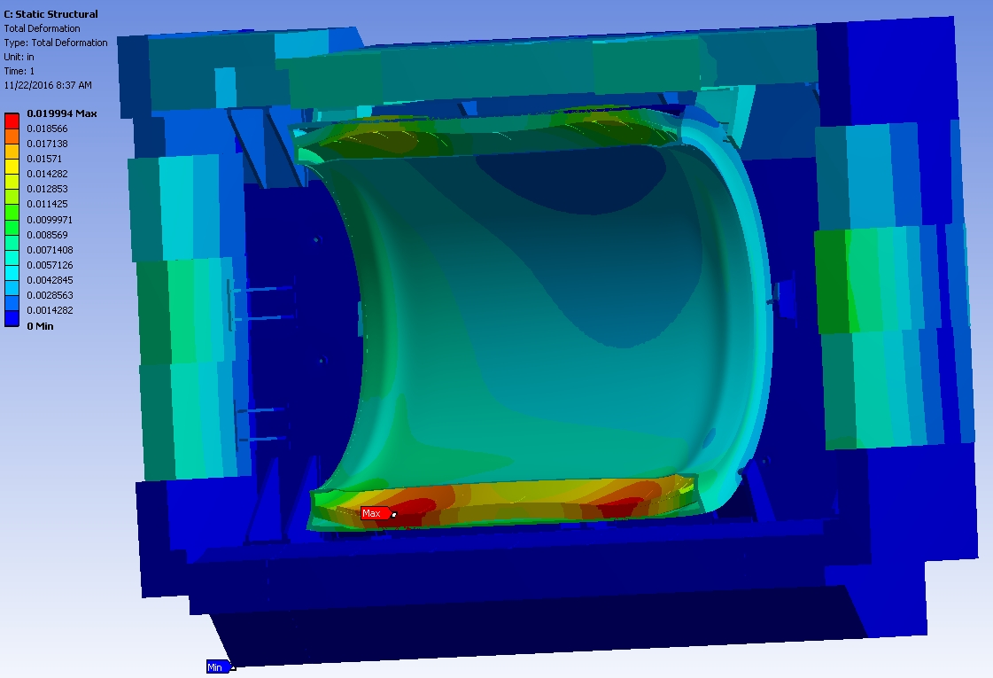
Total Deflection (in.) @ 4596 A

Slide 10
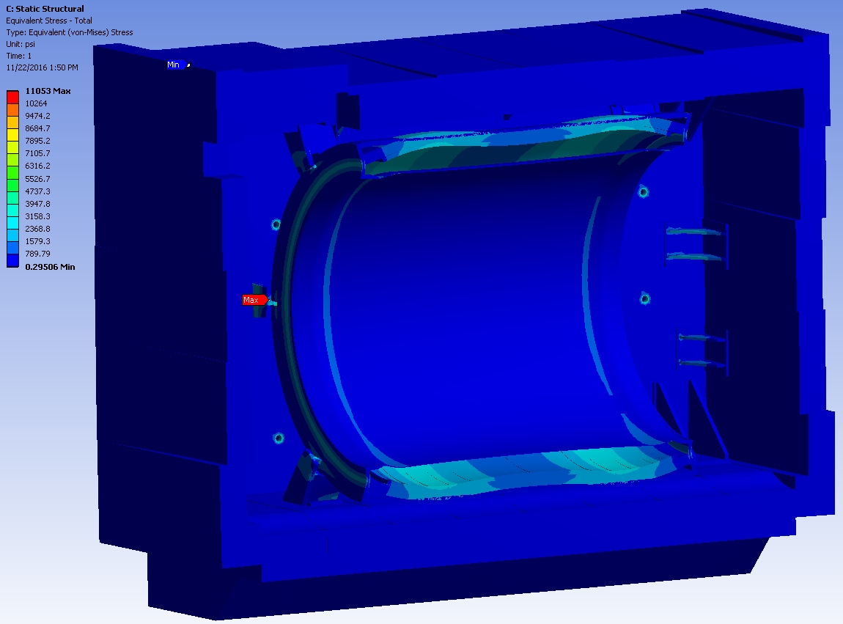
Equivalent Stress (excluding fasteners) - psi @ 4596 A

Slide 11
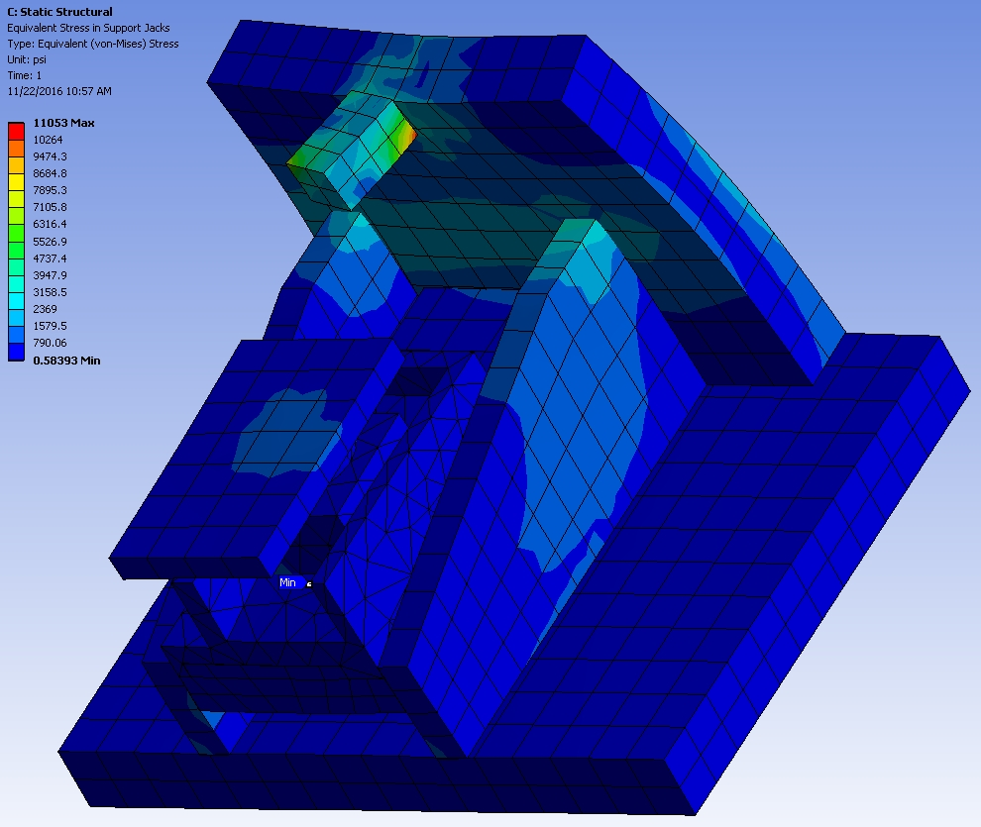
Stress in Side Support Jack (psi) @ 4596 A

Slide 12
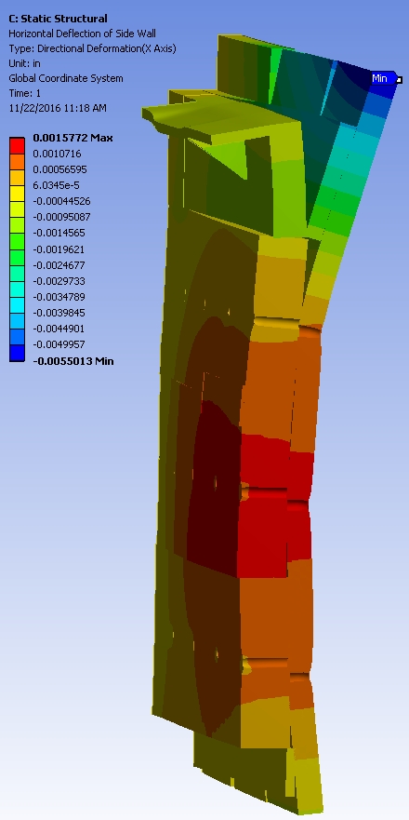
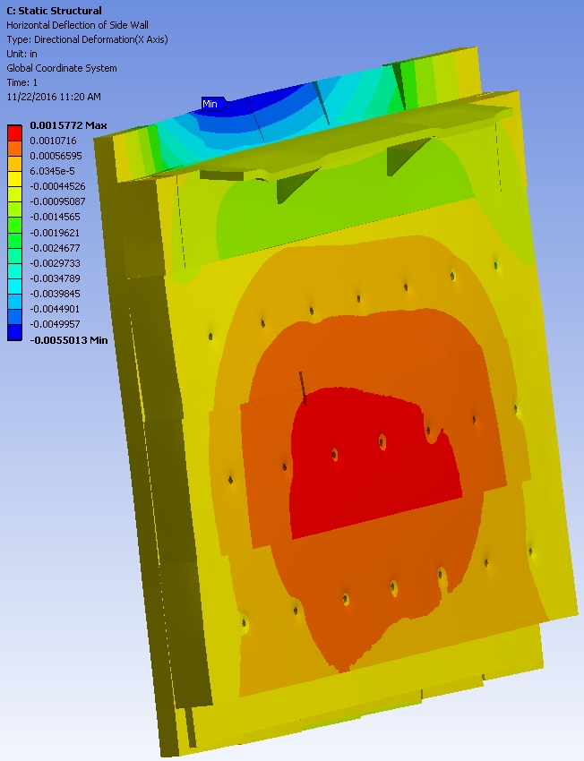
Side Wall Horizontal Deflection (in.) @ 4596 A

Slide 13
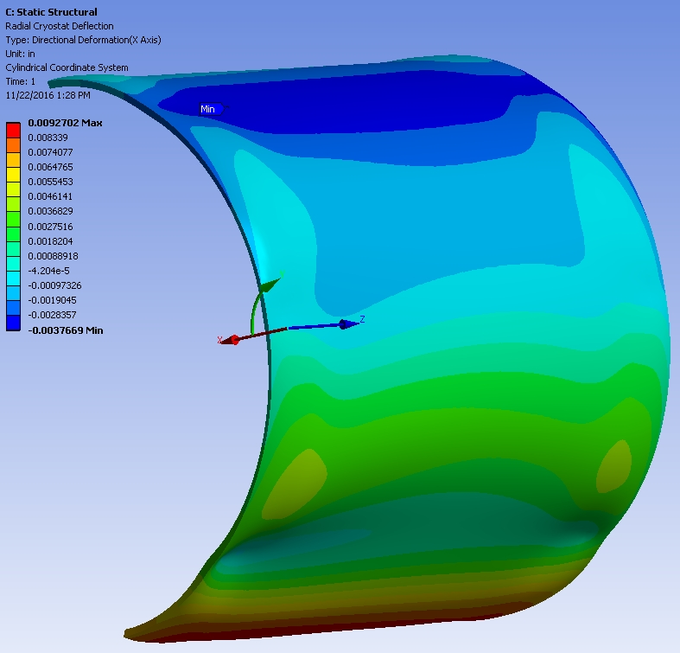
Radial Deflection of Outer Cryostat Wall (in.) @ 4596 A

Slide 14
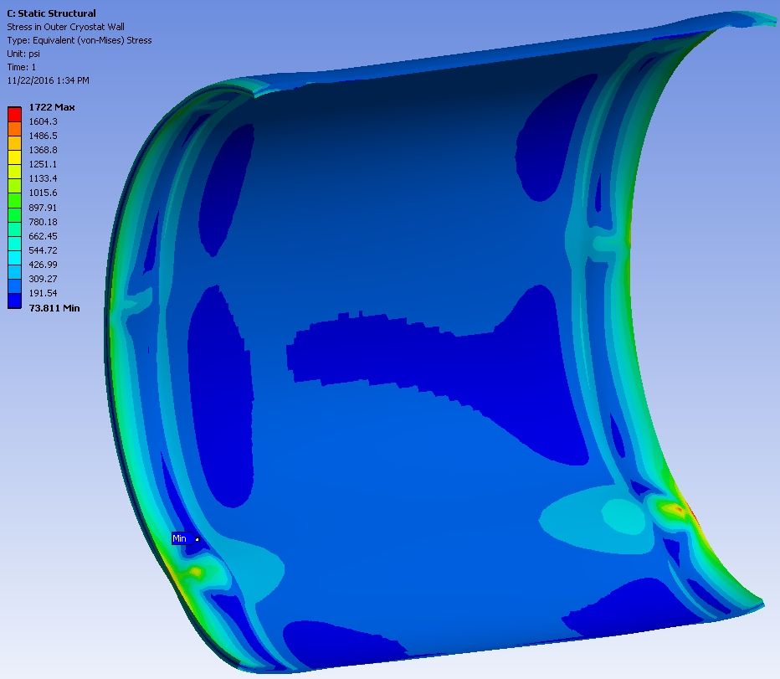
Stress in Outer Cryostat Wall (psi) @ 4596 A

Slide 15
Conclusions
Stresses and deflections appear to be quite manageable.

