Slide 1
Change in magnetic fields after flattening the roof of the High-Field Test return yoke ?
J. Hock (2016-11-18) : The reason for the change is that the original thicker steel planned to be used for the roof was found (after re-analyzing) to be contaminated with Co-60 and therefore cannot be sent out to Streck to be machined.
Kin YIP
Nov. 23, 2016
Notes:
Just a title slides

Slide 2
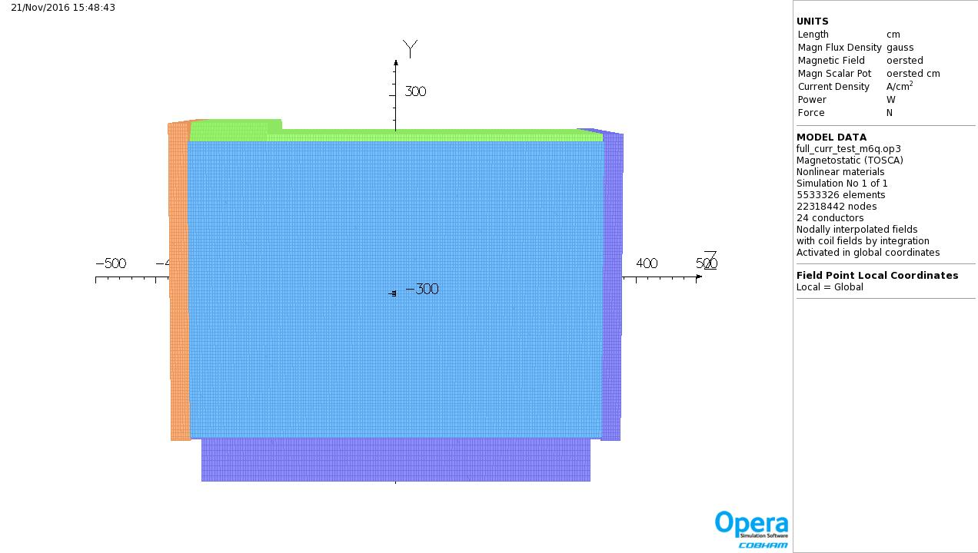
Original

Slide 3
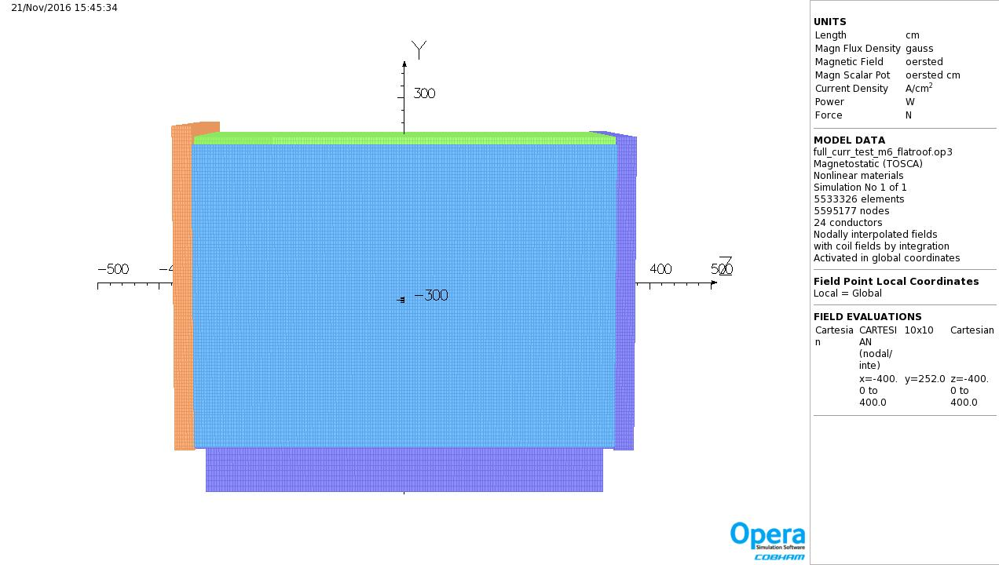
N. Tsoupas helped make the change (in W. Meng’s preprocessor model) by changing the material in the relevant parts from “steel” to “air”.
Flattened

Slide 4
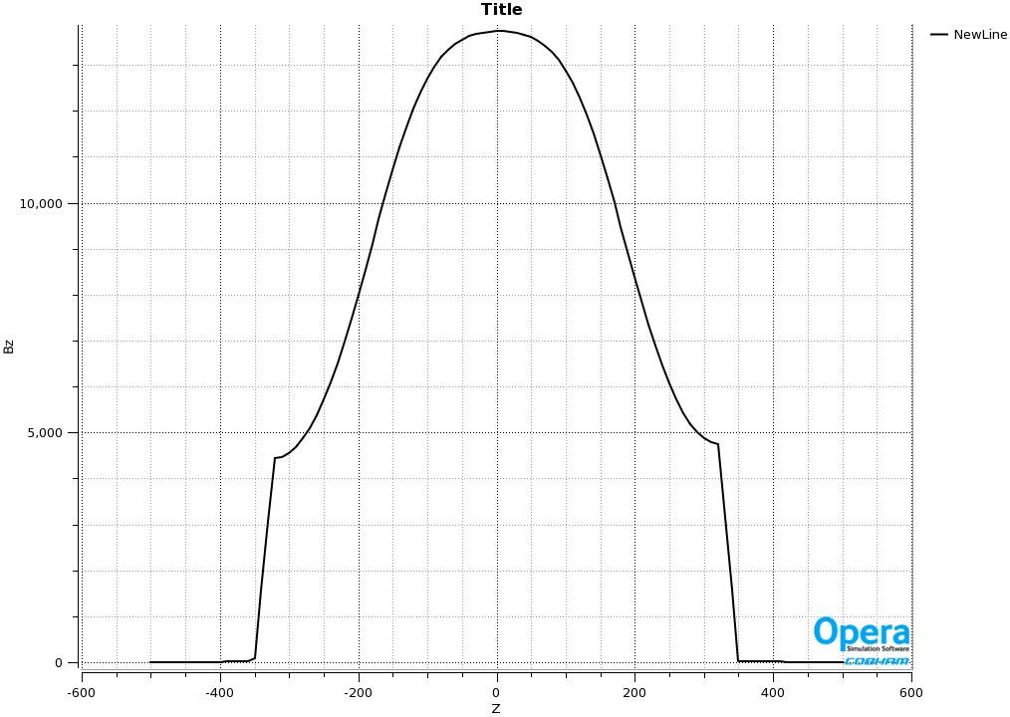

Any Major Change ?
Central Field (B_{z}) after flattening
  B_{z}(0,0,0) = 13734.4 G ⇒ 13734.2 G
Gauss
original
Gauss
flattened

Slide 5
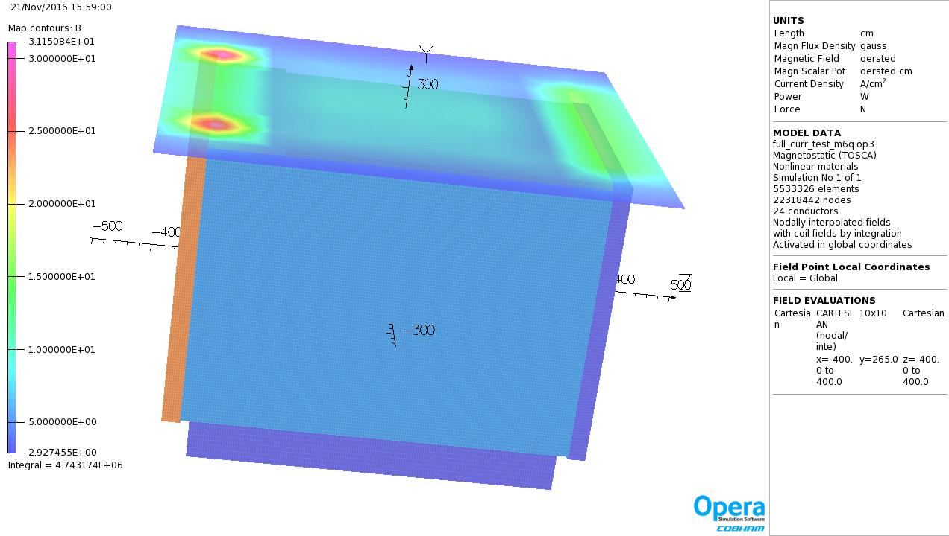
Original

Slide 6
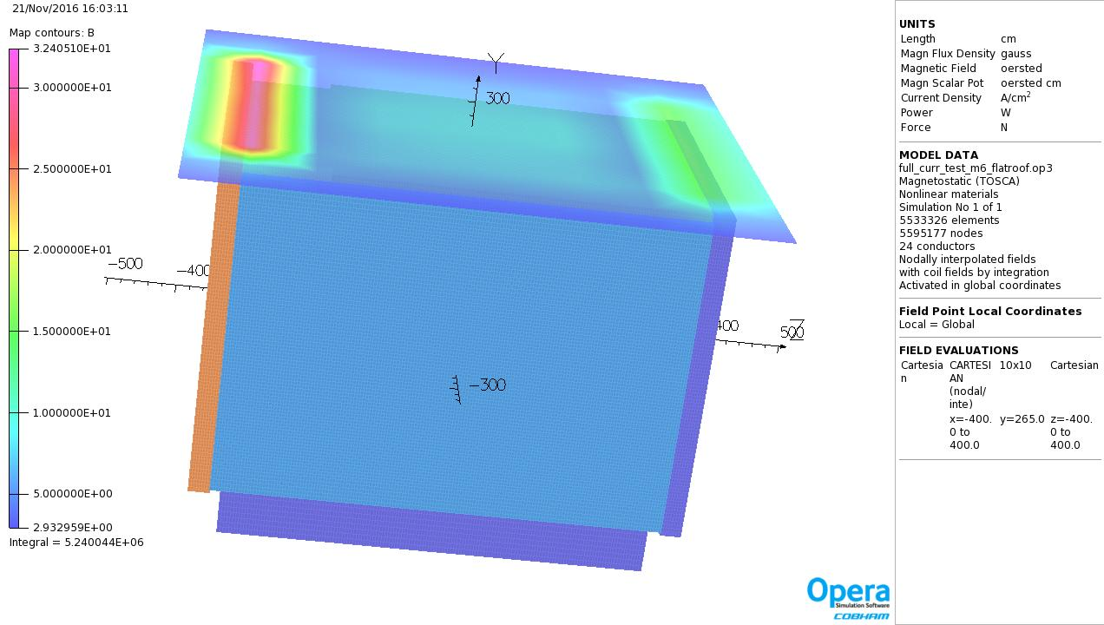
Flattened

Slide 7
Brett Parker confirmed (Nov. 22, 2016) …
Hello,
I confirm Kin's results. The change in central field is negligible (well within the error of having a different mesh) and the change in external field is less than 2 gauss.
While I am also using Opera3D, my model uses a different, more detailed, geometry that I got from John Cozzolino a while ago and can be considered an independent calculation.
I am trying to get several things done before the holiday time (after which I leave for a CERN visit) so I won't attend the meeting this week, but Kin can report these results. – Brett

