Slide 1
pfRICH Laser System PED Update Fiber Bend Radius Measurements
Bob Azmoun (BNL), Bill Li (MSU)
12/19/2024

Slide 2
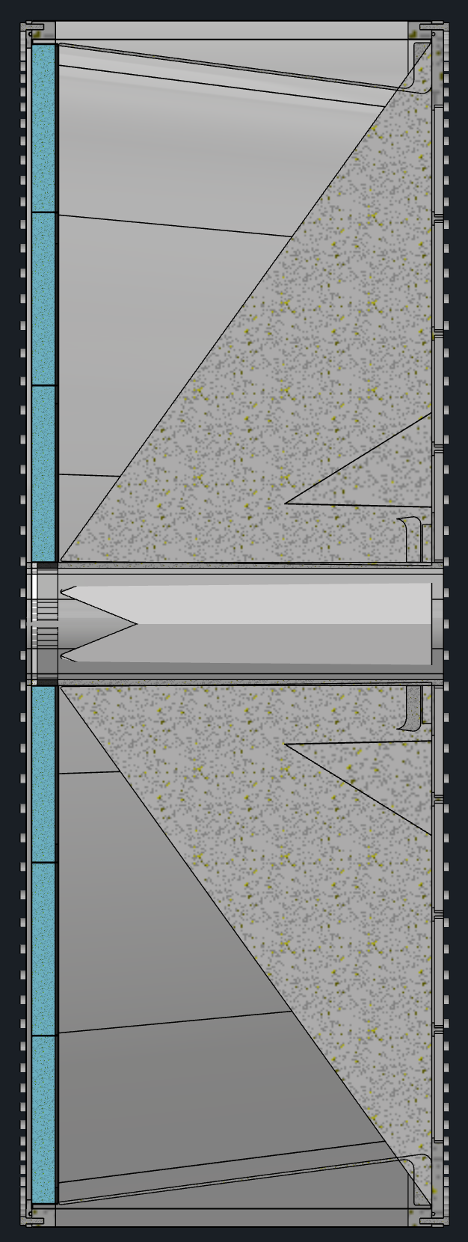
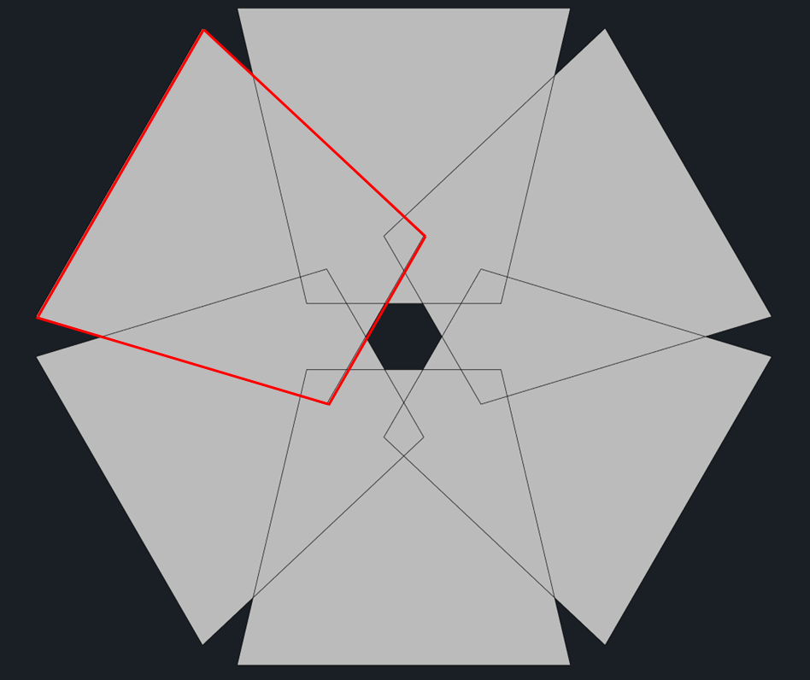
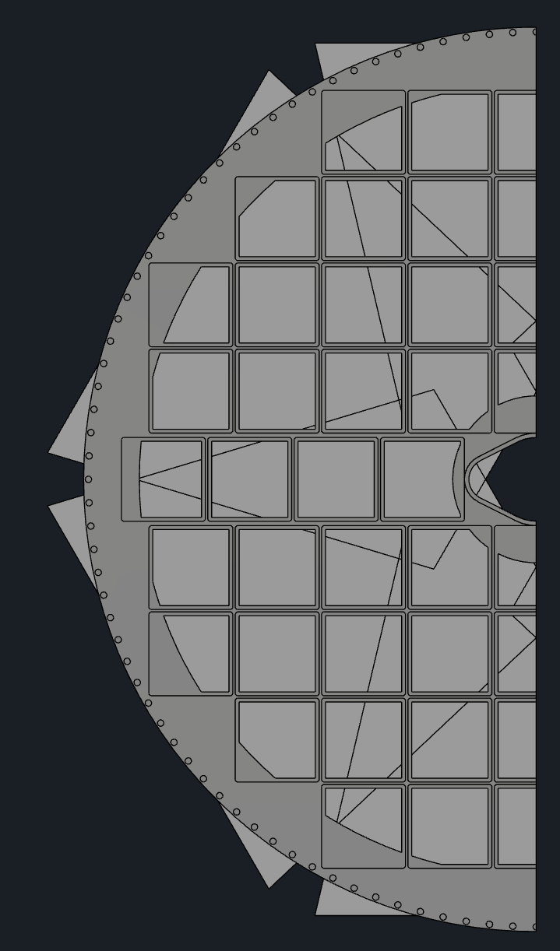
RECAP: Method of Light Delivery
Outer mirror
Array of 6 fibers may be used for direct illumination of HRPPDs + array 6 fibers may be used to reflect light off of the mirrors
Light profiles from 6 fibers for direct illumination
HRPPD coverage
Here 1 of 6 fibers directly illuminates a HRPPD from gap between inner mirror and aerogel
*Tilt angle of fiber is critical to minimize reflections from mirror; can also use baffle to better shape light profile
Inner mirror
The light path from a given fiber to a HRPPD pixel defines the photon flight length
A radially divergent profile is a good match for the annular shape of the HRPPD sense plane
Aerogel
HRPPD
Light profile from a single fiber on the HRPPD sense plane
*Overlapping profiles can be separated in time using different length fibers
pfRICH Vessel
6 fibers for direct HRPPD illumination + 6 fibers for the mirror illumination should suffice to illuminate all HRPPD pixels

Slide 3
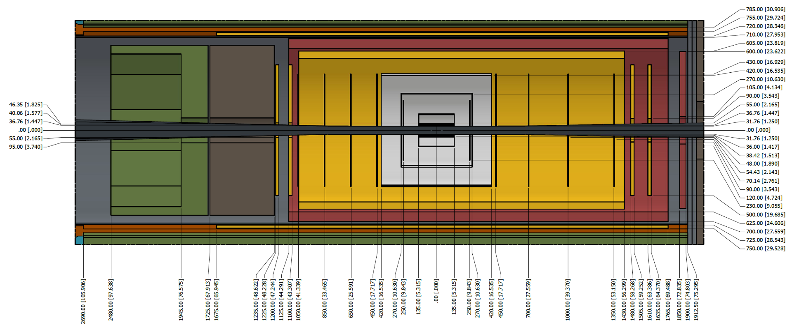
pfRICH Envelope
Some options for introducing fibers into pfRICH vessel, but all are tight
Several cm gap for services
(Incl. in brown envelope)
10mm gap
Several cm gap
pfFRICH

Slide 4
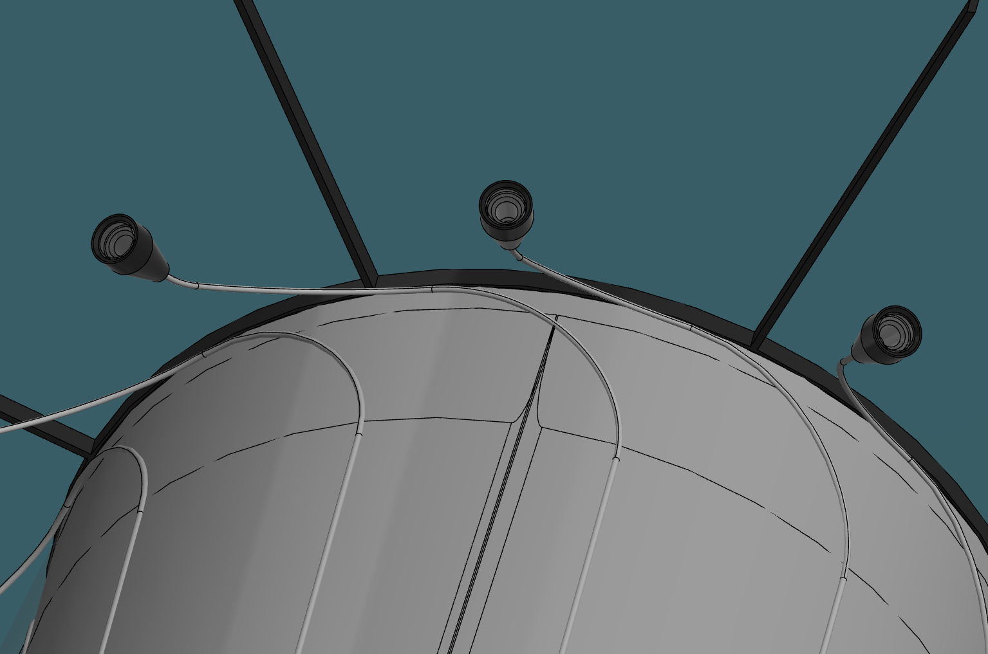
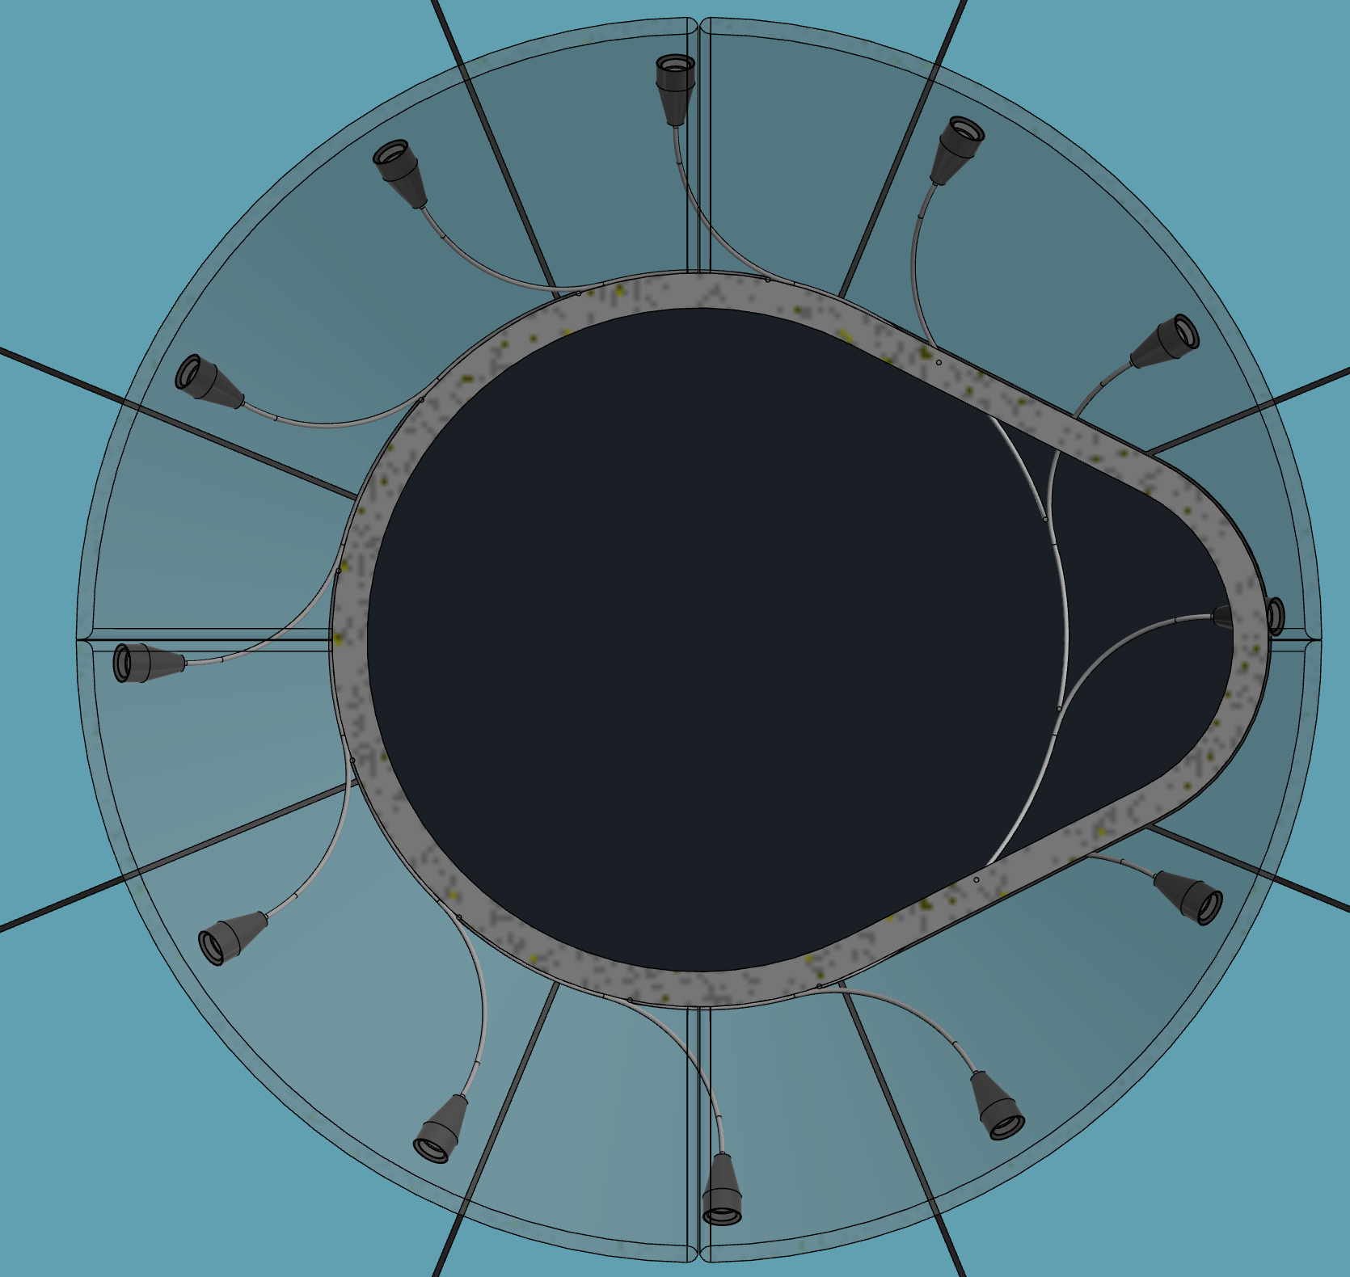
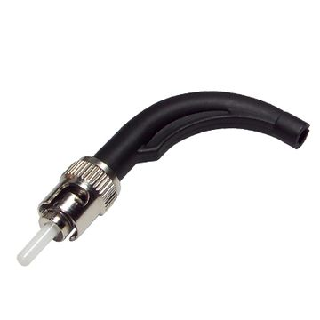
Options for routing internal fibers
Arrange fibers into a circular array of “source points” (6 “direct fibers” + 6 “mirror fibers” in odd/even pattern) facing the HRPPD sense plane
Here use 30mm fiber bend radius; utilize compound bending angles
Fibers emanate from inner mirror on aerogel side (may require making notches in mirror for clearance)
Fixture for diffuser on fiber tip (custom 3D printed piece)
Inner Mirror
Aerogel
HRPPDs
Introduce fibers from HRPPD side
Rigid jacket for holding fiber at fixed angle

Slide 5
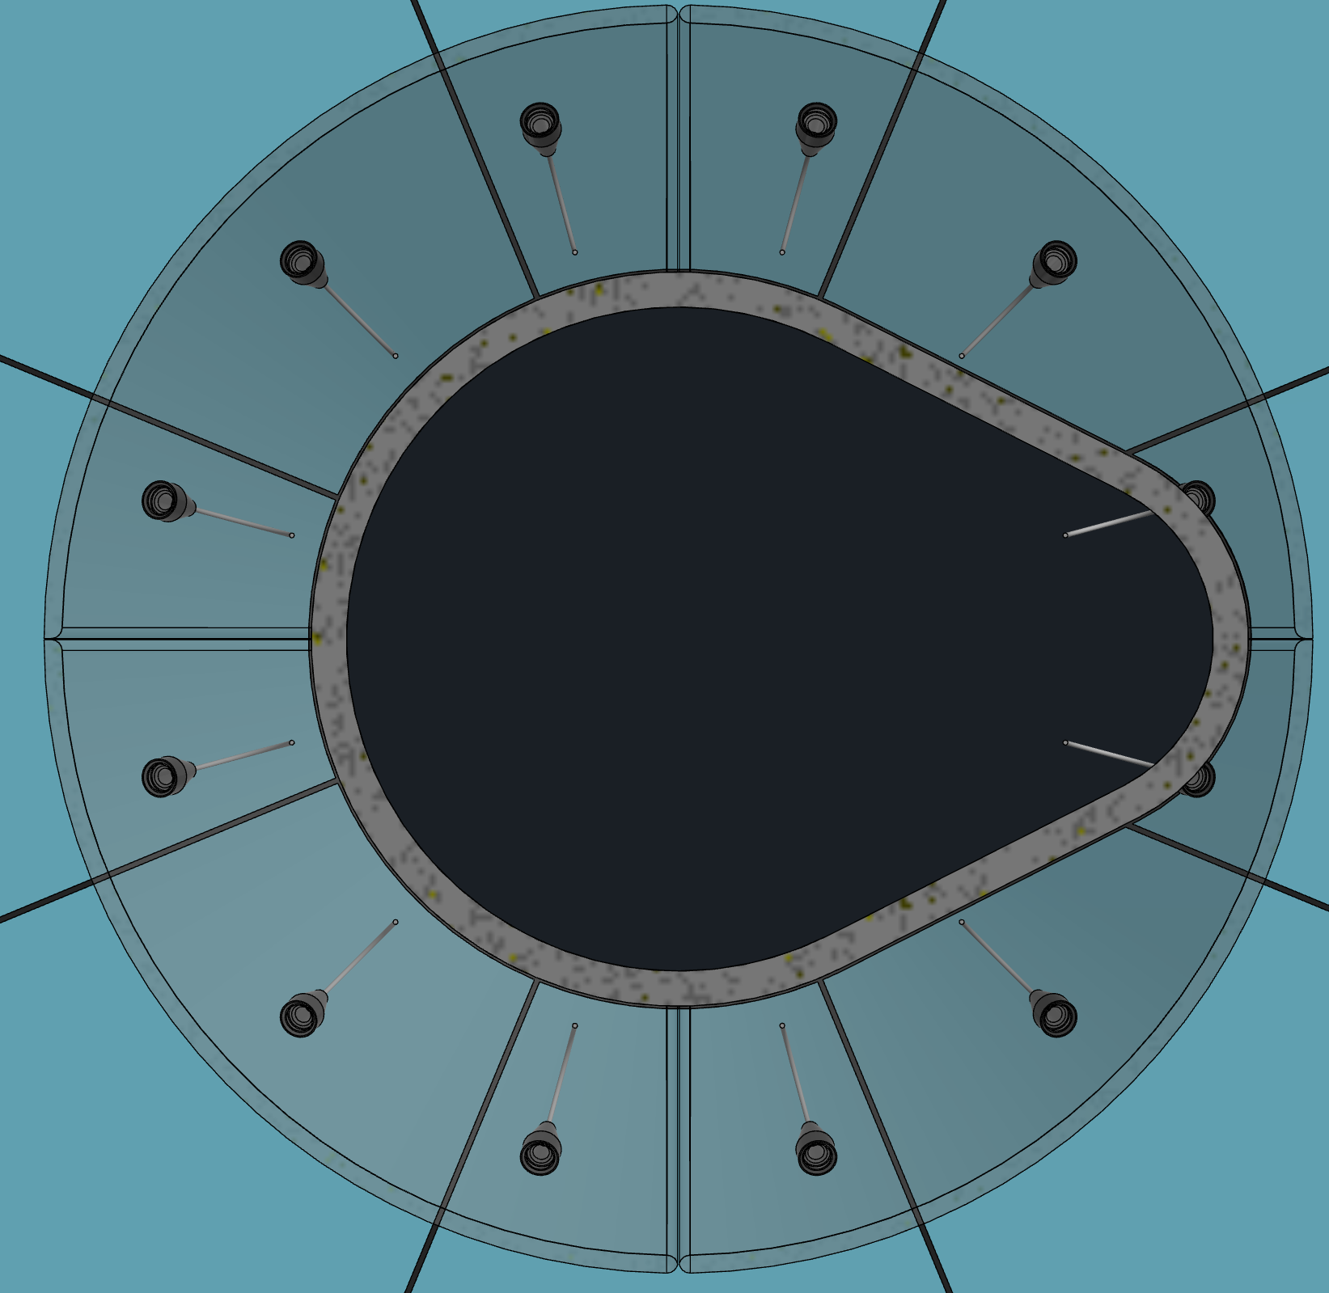
Another option for routing internal fibers
10mm fiber bend radius; no compound angles used (simple design)
(requires using Thorlabs S405-XP fiber)
Fibers emanate from inner mirror rim on aerogel side
may require making notches in mirror for clearance
If compound angle bends are used, may be able to avoid notching mirror, or at least place notches in convenient location at rim
Other options must also be checked, including introducing fibers from rim of outer mirror
Introduce fibers from HRPPD side

Slide 6
Possible paths for introducing the internal fibers into the pfRICH vesslel
Outer Mirror
Outer Mirror
HRPPD Side
Aerogel Side
HRPPD Side
Aerogel Side
Inner Mirror
Inner Mirror
We are working on a design for each of these options…

Slide 7
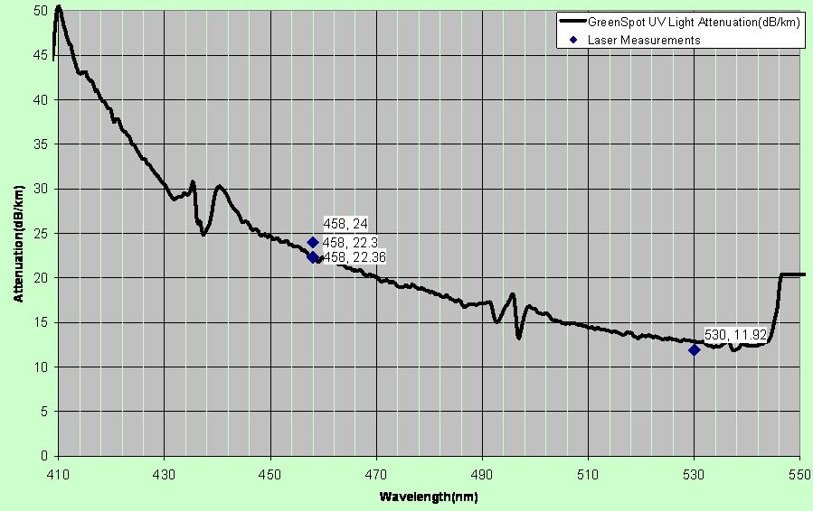
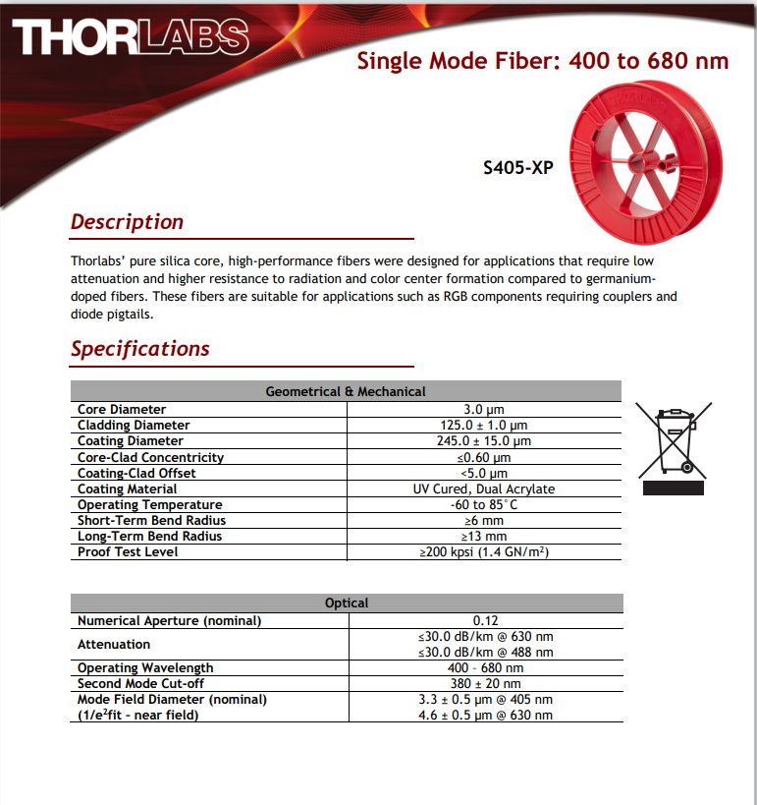
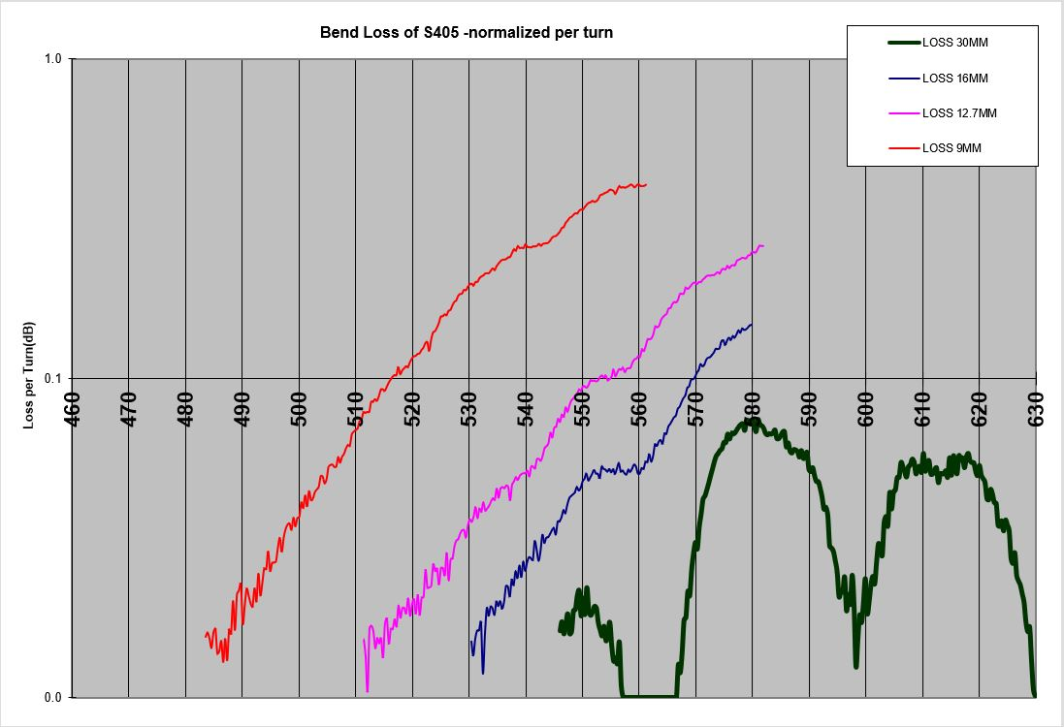
Fiber Specs
Single mode fiber preserves timing characteristics of laser pulse (ie, no modal dispersion)
This SM fiber model was chosen mainly for its small min. bending radius (for routing purposes)
Fiber Attenuation ~50dB/km @405nm
Thorlabs
Room to explore whether lower bend radius is possible (<10mm)
405nm
Thorlabs

Slide 8
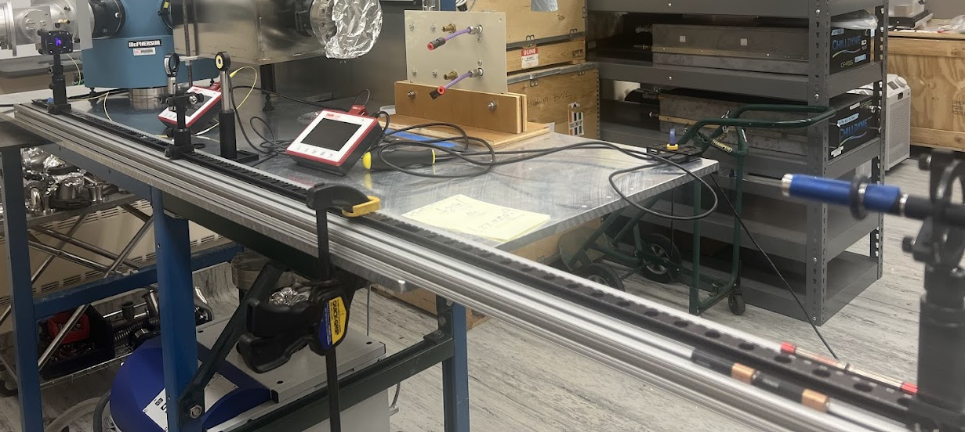
Setup to Measure min. Bend Radius
Reference PD Sensor
Fiber PD Sensor
5-axis Kinematic mount for light coupling into fiber
Laser source
(405nm laser pointer)
Optical track
(long lever arm matches focal length of laser pointer for good light coupling into single mode fiber (3um aperture))

Slide 9
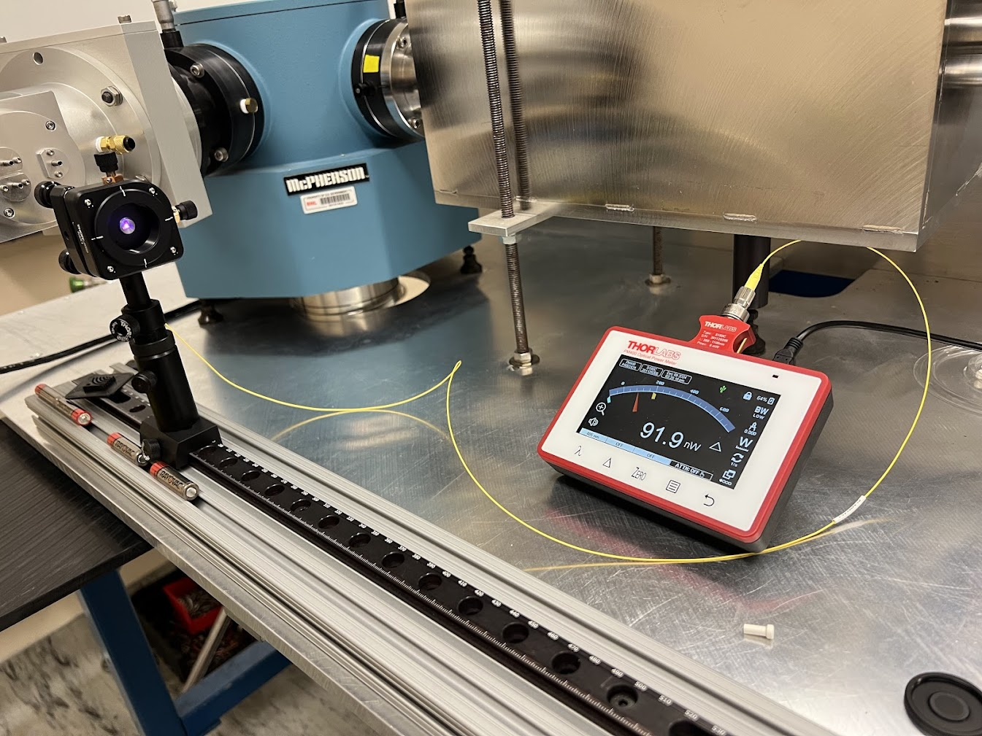
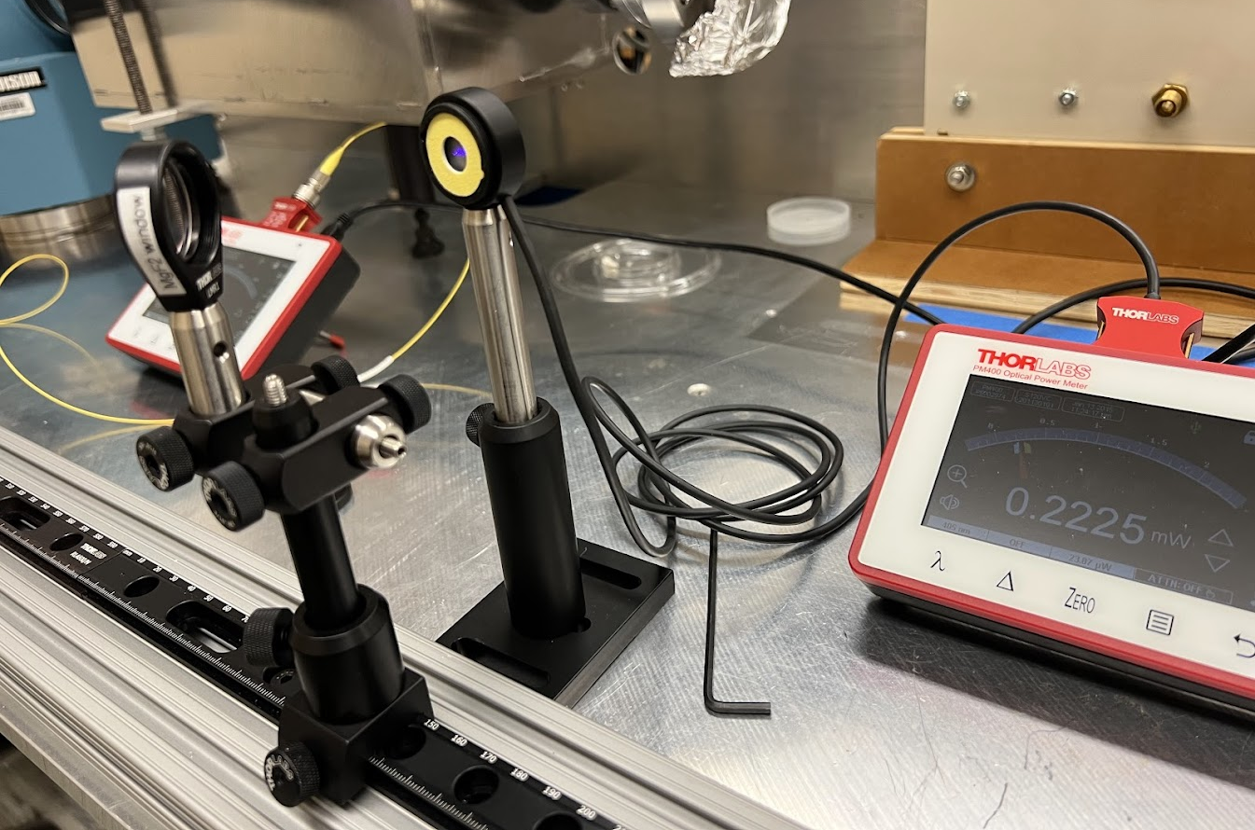
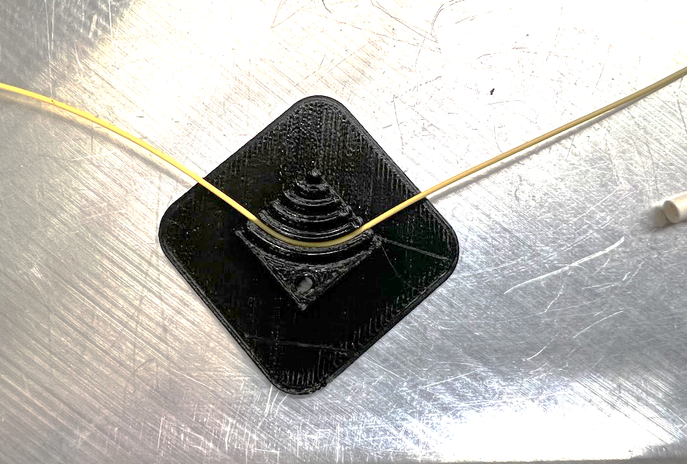
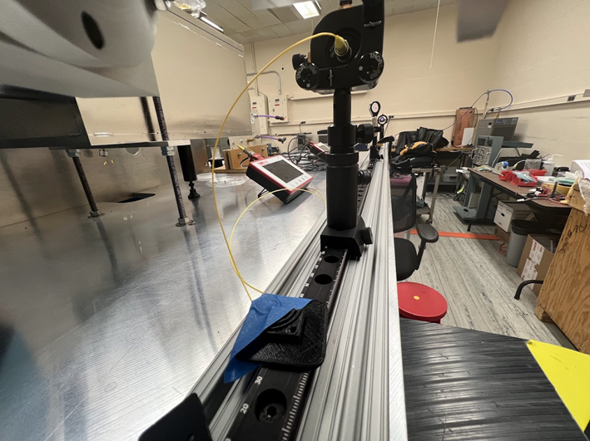
Setup continued…
Fiber routed from coupler to PD sensor
Beam Pick-off measured by Ref. sensor
Fiber mounted in bending jig
Bending jig: 15, 12.5, 10, 7.5, 5, and 2.5mm radius

Slide 10
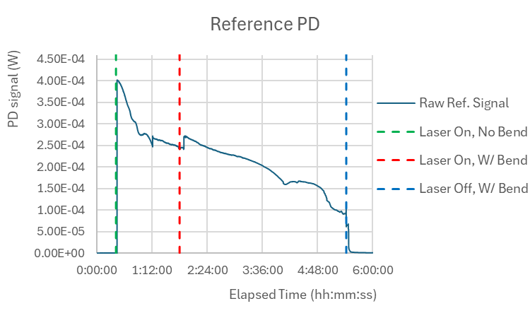
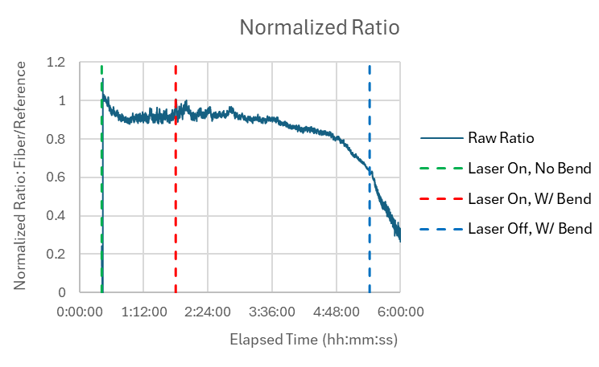
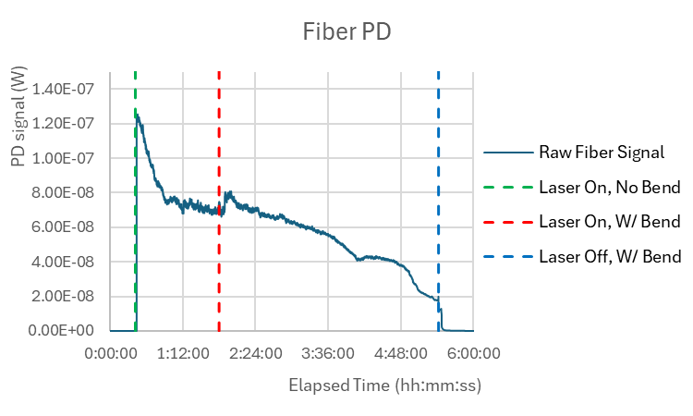
Results: Bend=5mm
Since each measurement depends on the coupling efficiency achieved on that day, one cannot compare absolute light intensity values from one day to the next – each measurement run can only be normalized to itself
Beam intensity decays due to laser pointer battery life
Ideally, expected the ratio to be and remain at unity
Immediately one can see that the systematics play a larger than desired, judging by the ~10% variation in the ratio before any bend is put in place
The ratio seems to drop more rapidly after 4:48:00 (low beam intensity)
The results for larger bend radii tell more or less the same story…

Slide 11
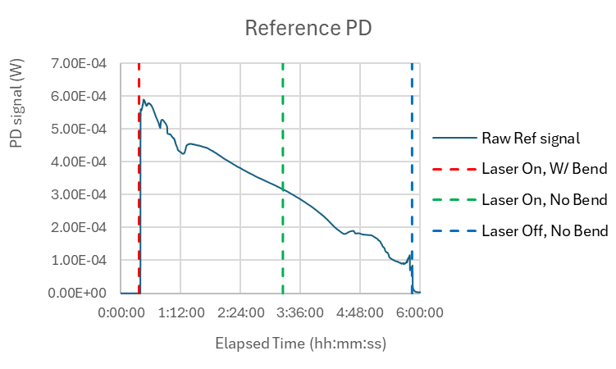
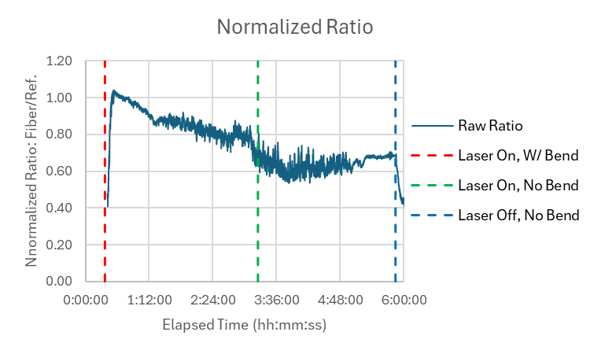
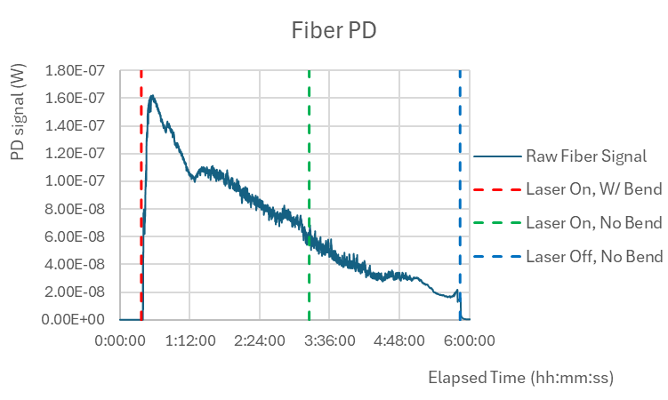
Results Bend=6mm (Long Term – 5 days)
The downward trend seems to continue once the measurement resumes after 5 days with the bend still in place (no measurements from days 2-4)
Interestingly the ratio seems to flatten out after the bend is removed
It’s tempting to conclude that a 5mm radius incurs substantial losses
However, 2 points contradict this:
A limited “control” measurement with no bend exhibits similar trends and fluctuations (must be repeated)
After stressing the fiber throughout the series of measurements, I’m still able to couple the same amount of light in
Hypothesis: as the battery life decays, the beam profile also changes and degrades the coupling efficiency, which in turn reduces the light throughput from the fiber

Slide 12
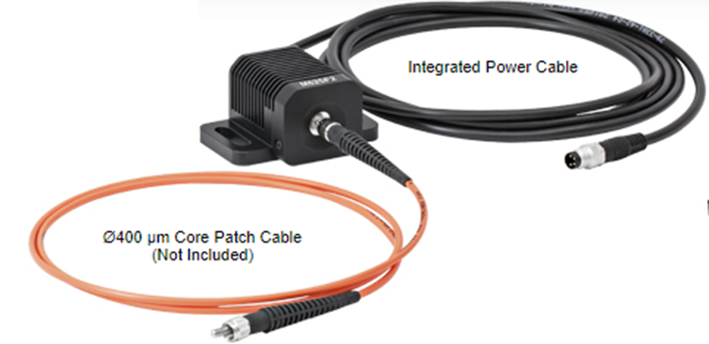
New setup to avoid variations in coupling efficiency
Fiber coupled LED source (405nm, 24mW)
Fiber under test (S405-XP)
(with bend)
Fiber
Attenuator
Fiber-Splitter
LED
Source
Fiber PD sensor
Any setup where the coupling efficiency is not captured by the reference PD is liable to incur the fluctuations observed
This new setup should eliminate most systematics
It should be relatively straight forward to decouple differences in fiber/sensor response using calibration runs
As part of our PED funds, Bill is willing and able to spend (immediately) ~$1K to nail down this important parameter for the design of the laser system
Fiber control sample (S405-XP)
(No bend)

