Slide 1
Advancing Silicon Carbide Technology for Radiation-Hardened and Low-Damage Applications
FY2026 NPP LDRD Type B Pre-Proposal
Principal Investigator(s) – Thomas Kubley, Gabrielle D’Amen, Stefania Stucci
Date: 1/8/2025

Slide 2
FY2026 NPP LDRD Type B Pre-Proposal
Proposal title: Advancing Silicon Carbide Technology for Radiation-Hardened and Low-Damage Applications
Primary Investigator: Thomas Kubley
Other Investigators: Stefania Stucci(co-PI), Gabriele D’Amen, Dannie Steski
Indicate if this is a cross-directorate proposal: Yes ___ No_X__
Proposal Term: From: Oct-10-2025 To: Sept-30-2027

Slide 3
FY2026 NPP LDRD Type B Pre-Proposal
Advancing Silicon Carbide Technology for Radiation-Hardened and Low-Damage Applications
Silicon Carbide (SiC) has emerged as a critical material for high-radiation and high-power applications due to its exceptional radiation hardness, electronic efficiency, and potential for widespread deployment in advanced technologies. This project unifies efforts to enhance SiC technology through innovative ion implantation techniques, comprehensive characterization, and irradiation studies, followed by post-irradiation analysis.
Program: Collider Accelerator and High Energy Physics.
Return on Investment: High Energy Physics, Strengthen BNL position in SiC development.
Broader impact on the activities at the laboratory: Develop an advanced fabrication technique for LGAD SiC sensors that remove cooling requirements and improves timing for HEP detector sensors.
Total planned funding per year in FY26 and FY27:
FY26: $250k FY27: $250k

Slide 4
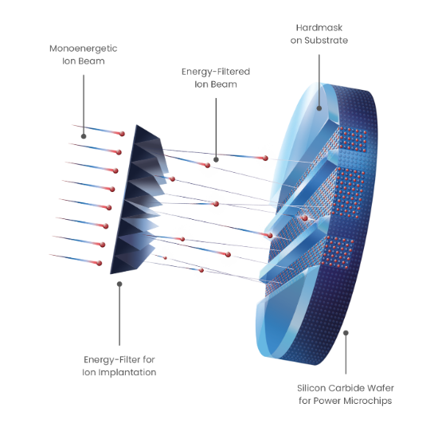
Experimental Concept
Conventional implants focus all ions and energy at a singular depth, resulting in significant damage to the implanted area.
A pyramid-shaped filter ensures uniform ion distribution from the surface to the desired depth within the wafer.
With this filter, the SiC bonds have sufficient time to recover before the arrival of the next ion.

Slide 5
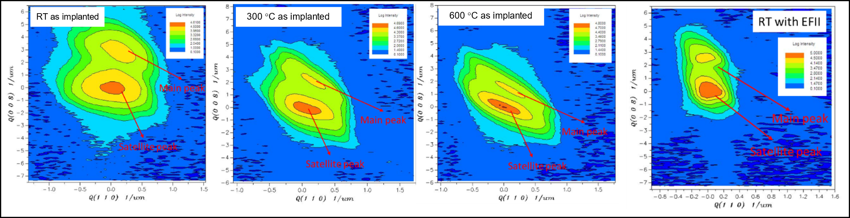
Expected Results, Motivation, and Implications for Accelerator Physics
Expected Results:
Verify minimal damage to lattice structure for deep implants into SiC.
Determine the viability of using SiC for detectors in accelerator physics.
Provide visibility to the Tandem User Facility for future Implantations.
Motivation and Implications:
Replace Si LGAD sensors for SiC LGAD sensors:
  Wider band gap, thermal conductivity, and higher displacement energy.
  Reduction in cooling requirements and better time resolution.
0008 Reciprocal space maps of wafers as-implanted with multi-step implantation at RT, 300 °C, 600 °C and single-step implantation with EFII at RT.*
*Z.Y, Chen, et al. "Analysis of Lattice Damage in 4H-SiC Epiwafers Implanted with High Energy Al Ions with Silicon Energy-Filter for Ion Implantation." Scientific Books of Abstracts 8 (2024): 650-651.

Slide 6
Experimental Plan and Resources
Tandem Implant (Kubley)
Characterization (Stucci)
Characterization (Stucci)
NSRL Damage (D’Amen)
Personnel:
Thomas Kubley: Implantation and simulations
Stefania Stucci: Characterization
Gabrielle D’Amen: Damage creation
Resources:
Beam Time for NSRL and Tandem
Characterization cost

Slide 7
Summary
Confirm an effective method for deep ion implantation into SiC wafers.
Provide structure to create SiC LGADs.
Showcase how BNL’s Tandem energy range and intensity are perfectly suited for advanced research in SiC deep implants.
Increase user base at the Tandem.

