Slide 1
Developing a Charged-Particle Nuclear Reaction Evaluation in ENDF
FY2026 NPP LDRD Type B Pre-Proposal
Emanuel V. Chimanski (NE) & Jonathan Morrell (IP)
January 8, 2024

Slide 2
FY2026 NPP LDRD Type B Pre-Proposal
Proposal title: Developing a Charged-Particle Nuclear Reaction Evaluation in ENDF
Primary Investigator: Emanuel V. Chimanski
Other Investigators: Jonathan Morrell
Indicate if this is a cross-directorate proposal: Yes
If yes, identify other directorates/organizations: Nuclear Energy/NST
Proposal Term: 2 years From: Oct. 2026 To: Sept. 2028

Slide 3
FY2026 NPP LDRD Type B Pre-Proposal
Proposal title and brief abstract: Developing a Charged-Particle Nuclear Reaction Evaluation in ENDF
We propose developing a curated charged-particle reaction library that incorporates modern quantum-mechanical pre-equilibrium models, which are the dominant reaction component at BLIP’s operation energy scale and play a critical role in numerous other applications. Hosting both the NNDC and BLIP, BNL provides a unique environment for developing reaction models and a high-fidelity charged-particle reaction library. First, we can develop, test and refine these models with extensive benchmarking and validation experiments at BLIP, and we can then distribute the results to a global audience via the NNDC.
Program: DOE NP, DOE IP, NASA
Return on Investment: This will reduce the need for costly experiments at BLIP to optimize isotope production. Could lead to future funding from NASA NSRL as they rely upon similar reaction mechanisms for modeling astronaut dose.
Broader impact on the activities at the laboratory: Establish BNL as global leader in charged particle nuclear reaction data.
Total planned funding per year in FY26 and FY27: $250k for JM, EM, experiment in second year and PD support

Slide 4
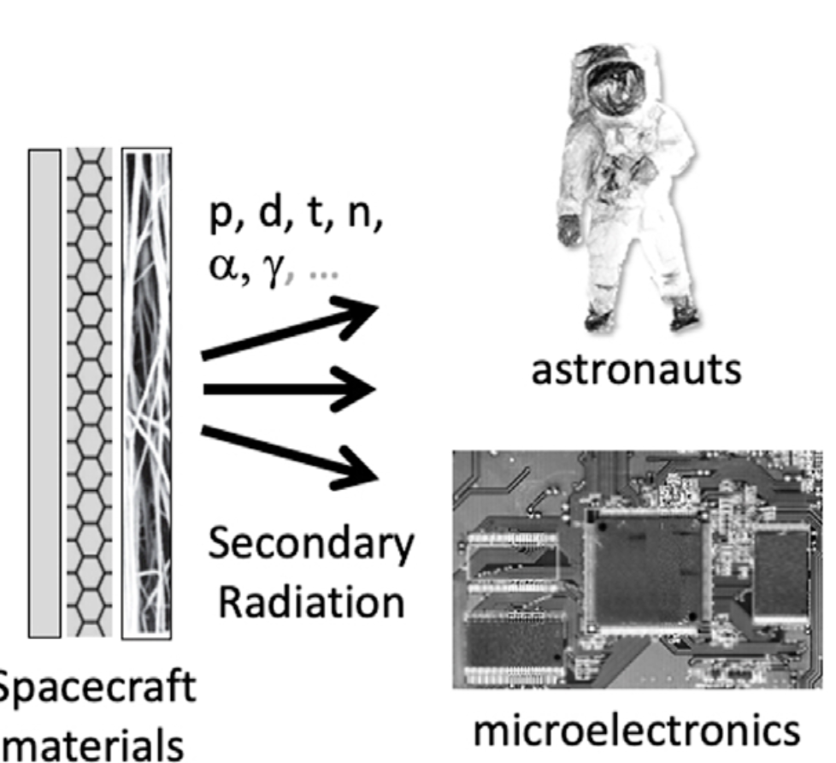
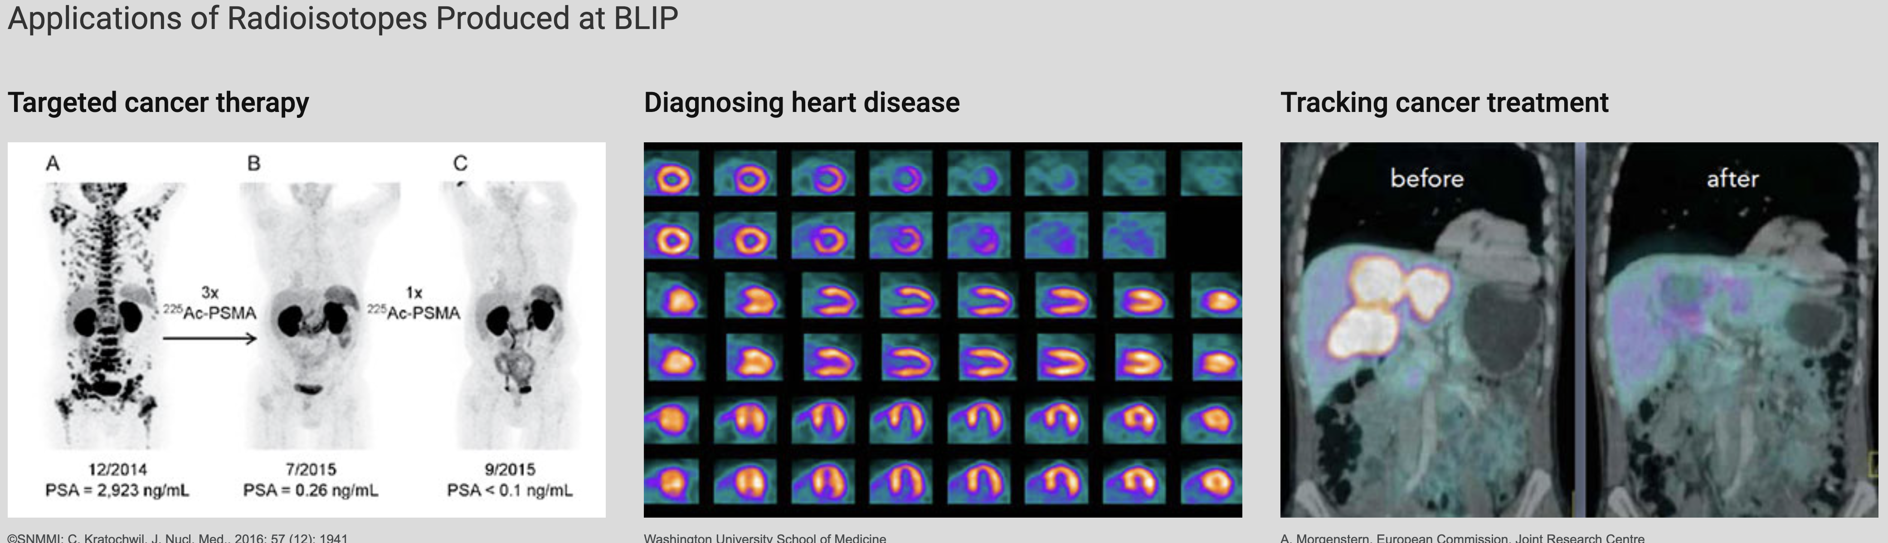
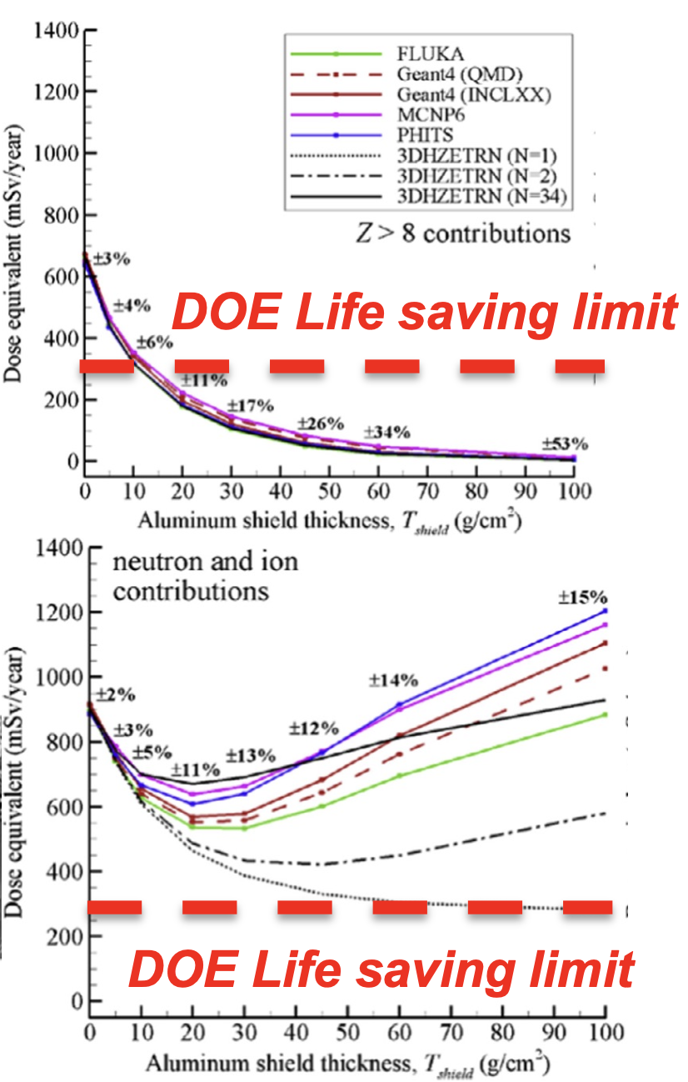
Motivation
Customers: Isotope Production, NASA: shielding and activation applications
BLIP: isotope production: energies up to 200 MeV - No evaluated library, particularly for all product isotopes (impurities important) - Expensive measurements - Classical Pre-equilibrium models
BLIP: fission and radiation damage studies – similar modeling needs
Goal: Implement quantum mechanical pre-equilibrium model, incorporate evaluations into ENDF
We can fix what is wrong in the models and create a capability that will support BLIP and other IP sites

Slide 5
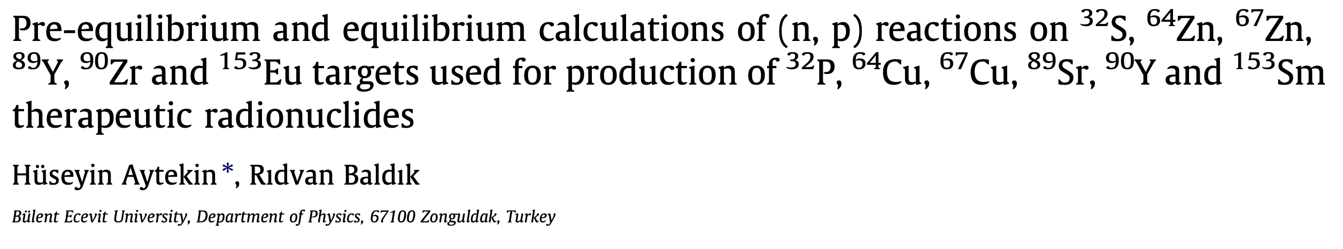
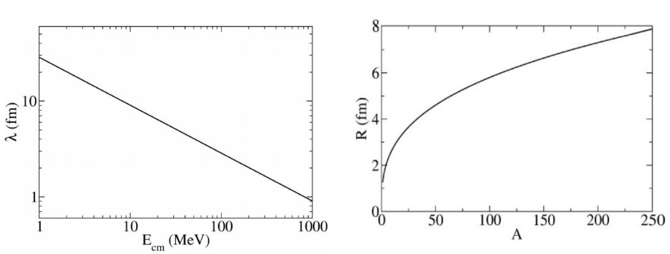
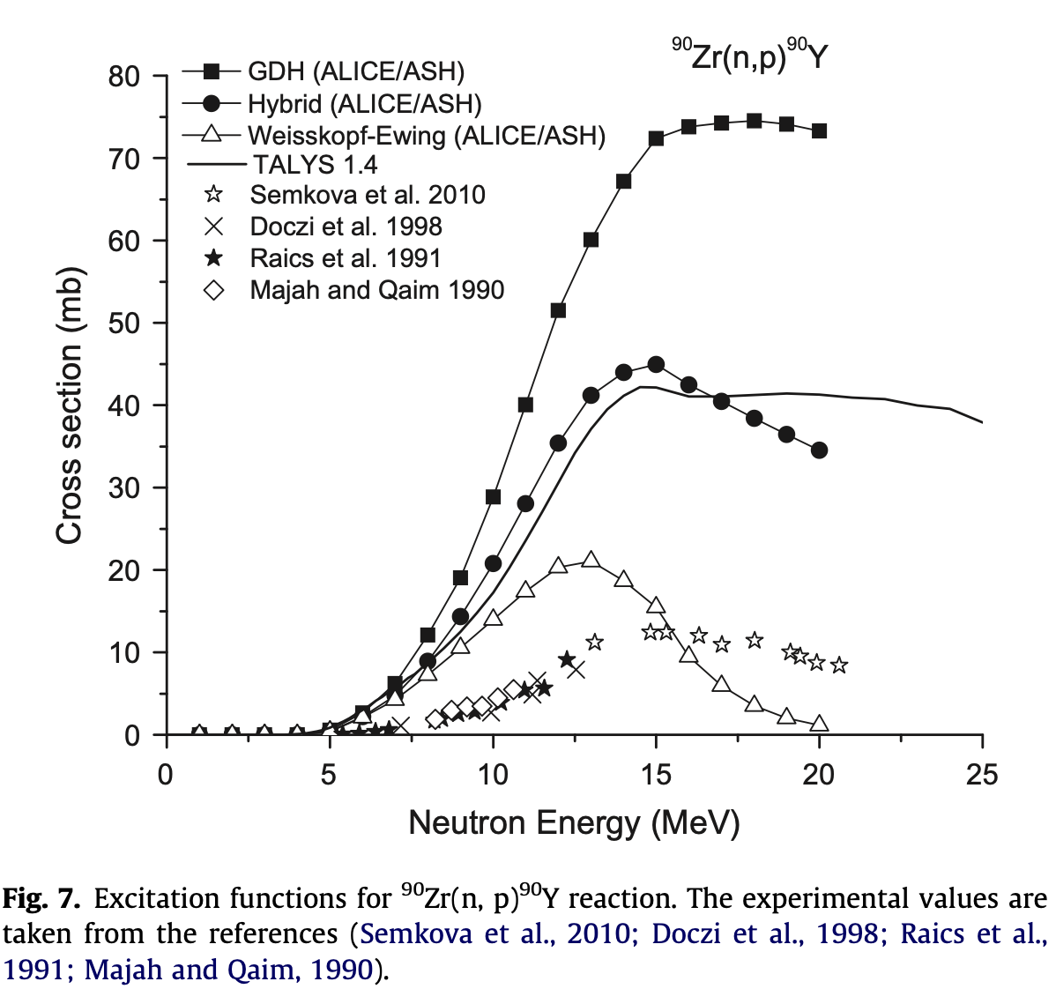
Develop model capability to support charge particle induced reaction libraries
These reactions are not classical!
Classical Models
Same models for p induced reactions
Data
Incident nucleons interact with nuclei rather than with individual nucleons. Diffractive effects at the nuclear surface are still expected at >200 MeV .
Poor angular distribution ( backward angles)
No nuclear structure is taken into account explicitly
No Angular momentum excitation distribution
We can fix what is wrong in the models and create a capability that will support BLIP
Develop (or extend current) theory cap for producing charge particle libraries: -> replace classical theory models with QM
Quantum-mechanical modeling will overcome these deficiencies

Slide 6
Plan
Joint 2-year project: IP (Jonathan Morrell) and NNDC (Emanuel Chimanski) - Establish capability with: ¹³⁴₅₈Ce production from ¹³⁹₅₇La (reduce impurity ¹³⁹Ce)
PE theory extension, ENDF formatting scripts, Gitlab project
Benchmark and Validation with FLUKA transport code - New experiments in second year
With the capability in place one can evaluate other isotopes
Deliverable: Charged particle library, in ENDF, validated with BLIP data
Evaluation and data incorporation procedure
Quantum-mechanical models
Hosting of data on NNDC website
Exit plan - > Space Exploration interested in charge particle libraries for damage, dose and activation studies
Possible problems: Proprietary data/validations
Affordable and strategically valuable: -> supporting multiple areas over the long term -> save $ with better cross-section predictions

Slide 7
Summary Slide
NNDC and IP/BLIP collaboration creates an opportunity to establish BNL as a global leader in charged-particle nuclear reaction evaluations
New data valuable for accelerator isotope production, and NASA radiation shielding
Project will focus on developing quantum-mechanical pre-equilibrium physics models and fitting to experimental data (from BLIP)
2x early career award opportunities
Potential for costs savings to Isotope Production, and future funding from DOE IP and NASA

