Slide 1
Development of new techniques to measure high-energy nuclear reaction data at NASA Space Radiation Laboratory
FY2026 NPP LDRD Type B Pre-Proposal
Trevor Olsen (NSRL, CAD)
Shuya Ota (NNDC, EBNN)
8 January 2025

Slide 2
FY2026 NPP LDRD Type B Pre-Proposal
Proposal title:
Development of new techniques to measure high-energy nuclear reaction data at NSRL
Primary Investigator(s): Trevor Olsen, Shuya Ota
Other Investigators:
Indicate if this is a cross-directorate proposal: Yes
If yes, identify other directorates/organizations: NNDC (EBNN directorate)
Proposal Term: 2 years From: 1 Oct. 2025 To: 1 Aug. 2027

Slide 3
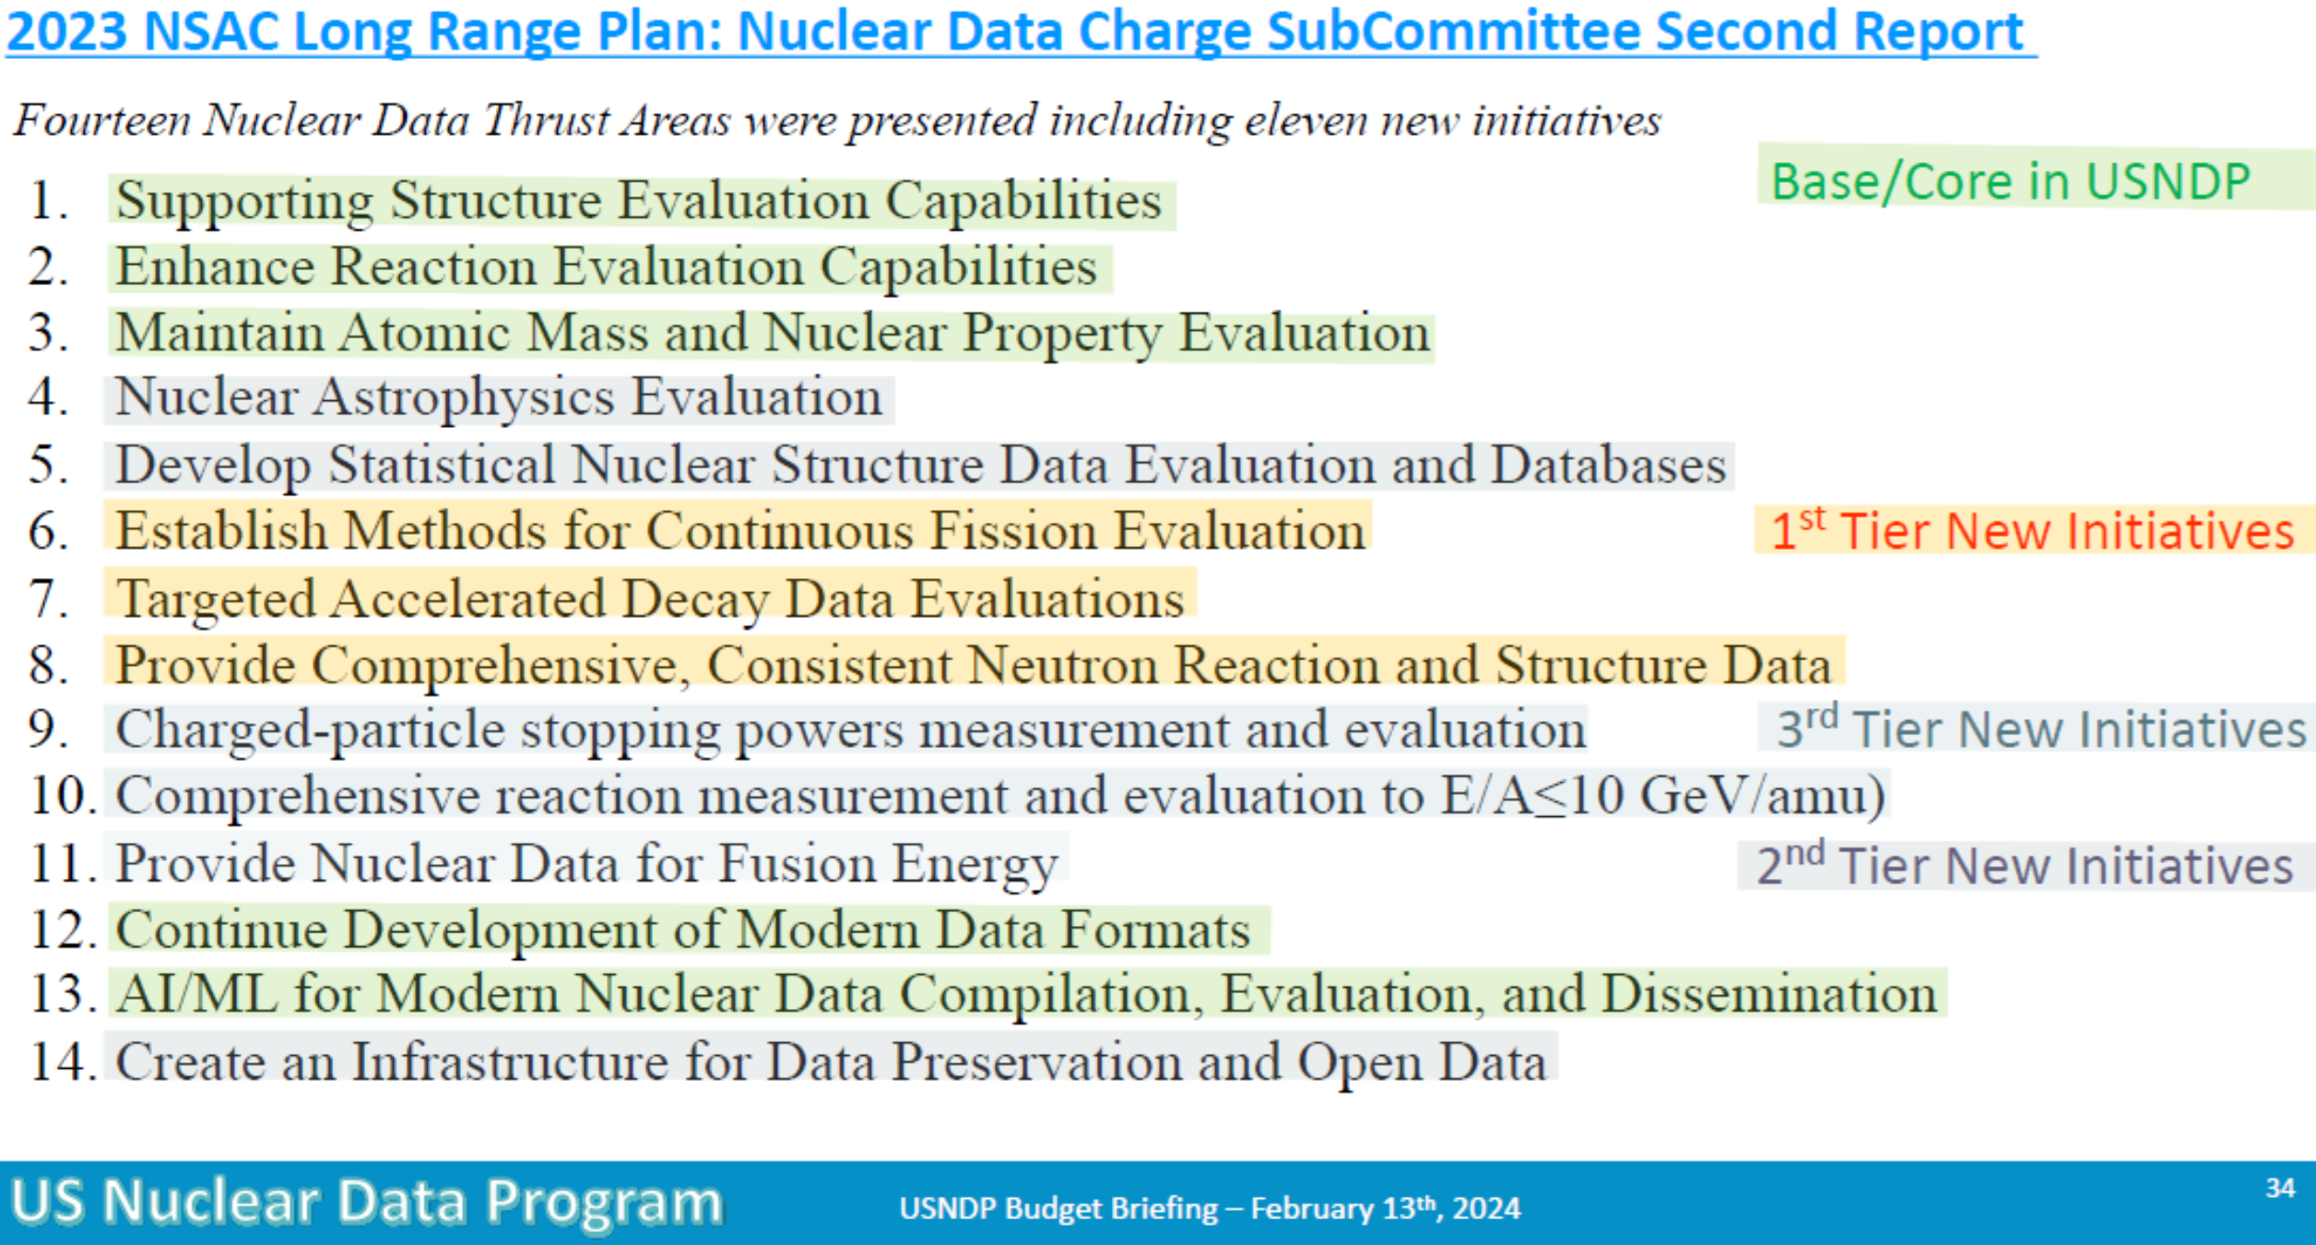
FY2026 NPP LDRD Type B Pre-Proposal
Proposal title and brief abstract: Development of new techniques to measure high-energy nuclear reaction data at NSRL
The NASA Space Radiation Laboratory (NSRL) hosts user experiments for two distinct sectors; NASA Radiobiology and space industry microelectronics testing. Both user bases heavily rely on high-energy nuclear data for radiation transport simulations such as MCNP and Geant4. However, a severe lack of nuclear data are often highlighted by researchers in those sectors.
This project will measure select reaction cross sections for high-energy (1 GeV/nucleon) proton and helium induced spallation reactions at NSRL. Cross-sections can be determined by measuring prompt γ-rays emitted from the produced nuclei decays immediately after a reaction, using high-purity Germanium (HPGe) detectors and light ion fragments will be detector using scintillators. Additionally, we will develop a new “micro-pulsed” slow extraction technique using the recently-installed air-core quadrupole (ACQ) in the AGS booster. The ACQ enables rapid tune manipulation of stored beam, pushing small fractions out of stability (and therefore out to the beamline) in a controlled, deliberate manner. At the conclusion of this project, we will present cross-section data, report on the target room environment, necessary shielding characteristics, and evaluate the quality of the micro-pulsed beam for these experiments.
Program(s): NP, ARDAP(?)
Return on Investment:
The DoE NP program has regular funding opportunities for nuclear data needs outlined in wanda. Work done in this study creates opportunities for additional experiments at NSRL through those grants.
Broader impact on the activities at the laboratory:
Within group: NSRL gains a controlled, micro-pulsed beam technique and related controls tools. This ability could expand the user community to nuclear data measurements. Existing microelectronics tester at NSRL could also benefit from this development with increased accuracy in partial spill flux determination (number of events observed in a fractional spill).
Within lab: High energy nuclear data cross sections are used widely across the lab. Increased inter-directorate collaboration.
Total planned funding per year in FY26 and FY27: Year 1 $180k (labor & procurement), Year 2 $250k (labor & beam time), Total: $430k
Notes:
Could also been seen as Accelerator R&D effort.
Wanda: Workshop for Applied Nuclear Data Activities

Slide 4
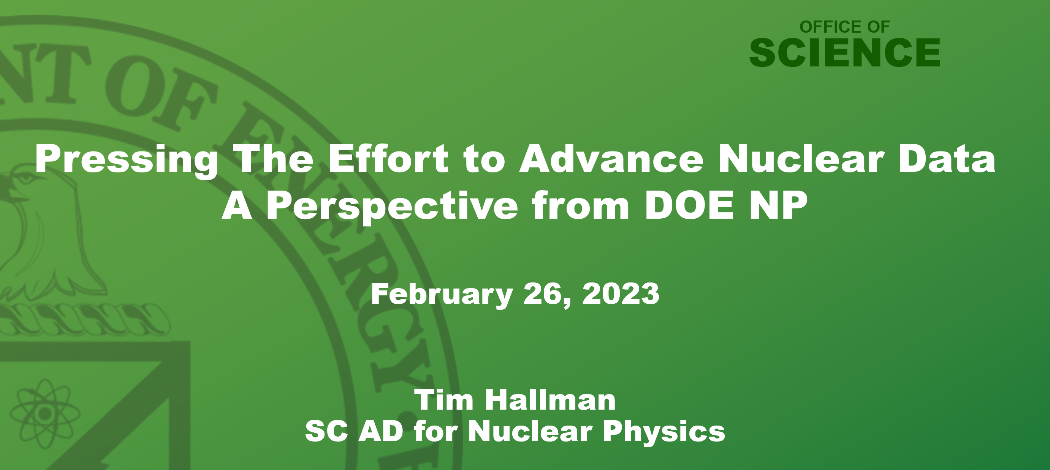

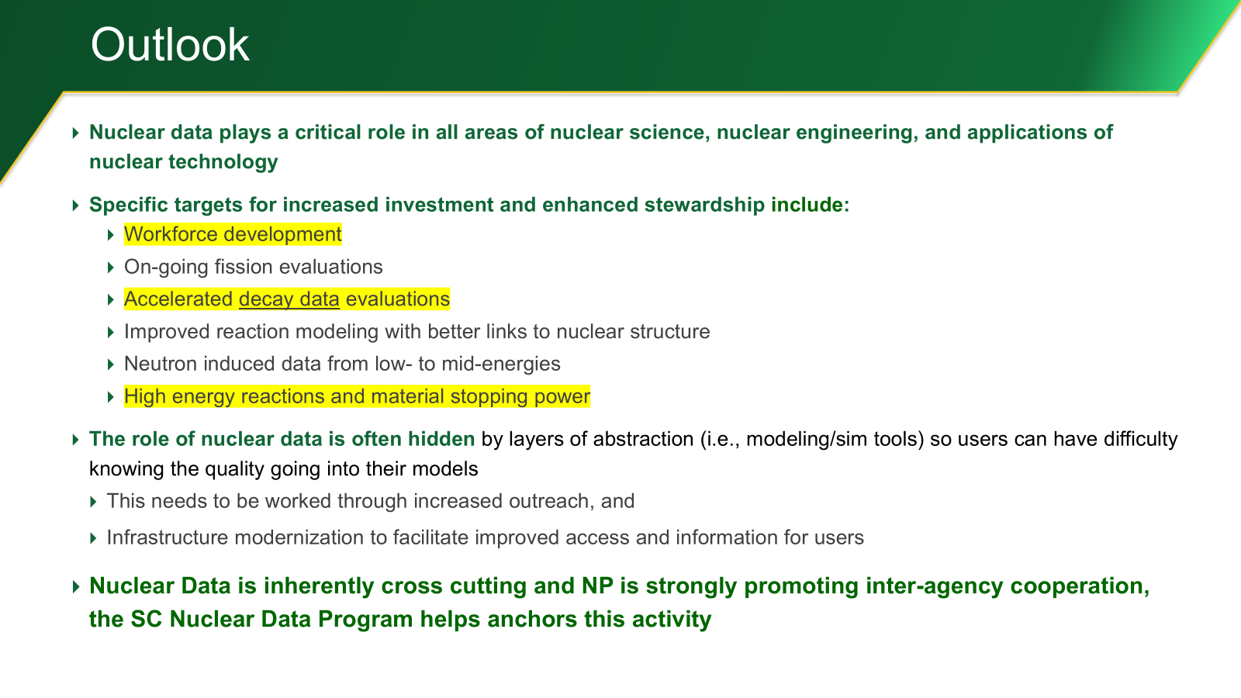
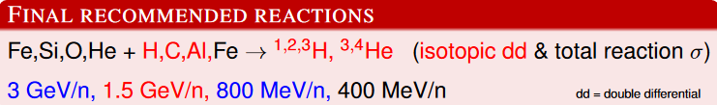
Proposal Motivation…
Recent NP outreach to NASA led to needs in space exploration in human spaceflight, electronics protection, and planetary exploration
Human Spaceflight requires high energy data due to galactic cosmic rays hitting spacecraft → dose to astronauts
Electronics Protection requires data on advanced electronics materials (GaAs)
Planetary Exploration requires data on a variety of elements that could be found on the Moon, Mars, and beyond
Aligns With Administration Priority on return to the moon and on to Mars
The need for nuclear data of this type is specifically called for by DoE/Tim Hallman at the 2024 Workshop for Applied Nuclear Data Activities.
As few beamlines are capable of reaching these experimental conditions. As a domestic heavy ion beam line, NSRL is an excellent choice to support these experiments and this LDRD enables it

Slide 5
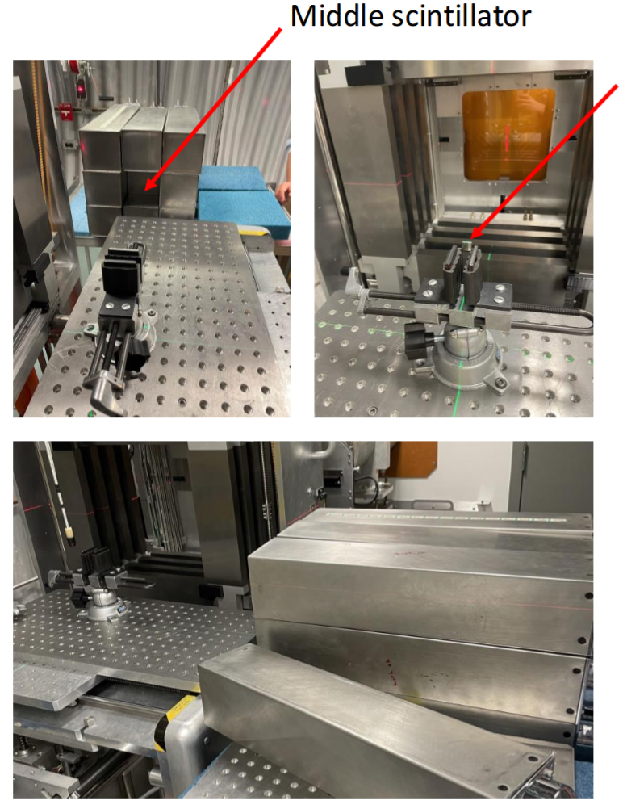
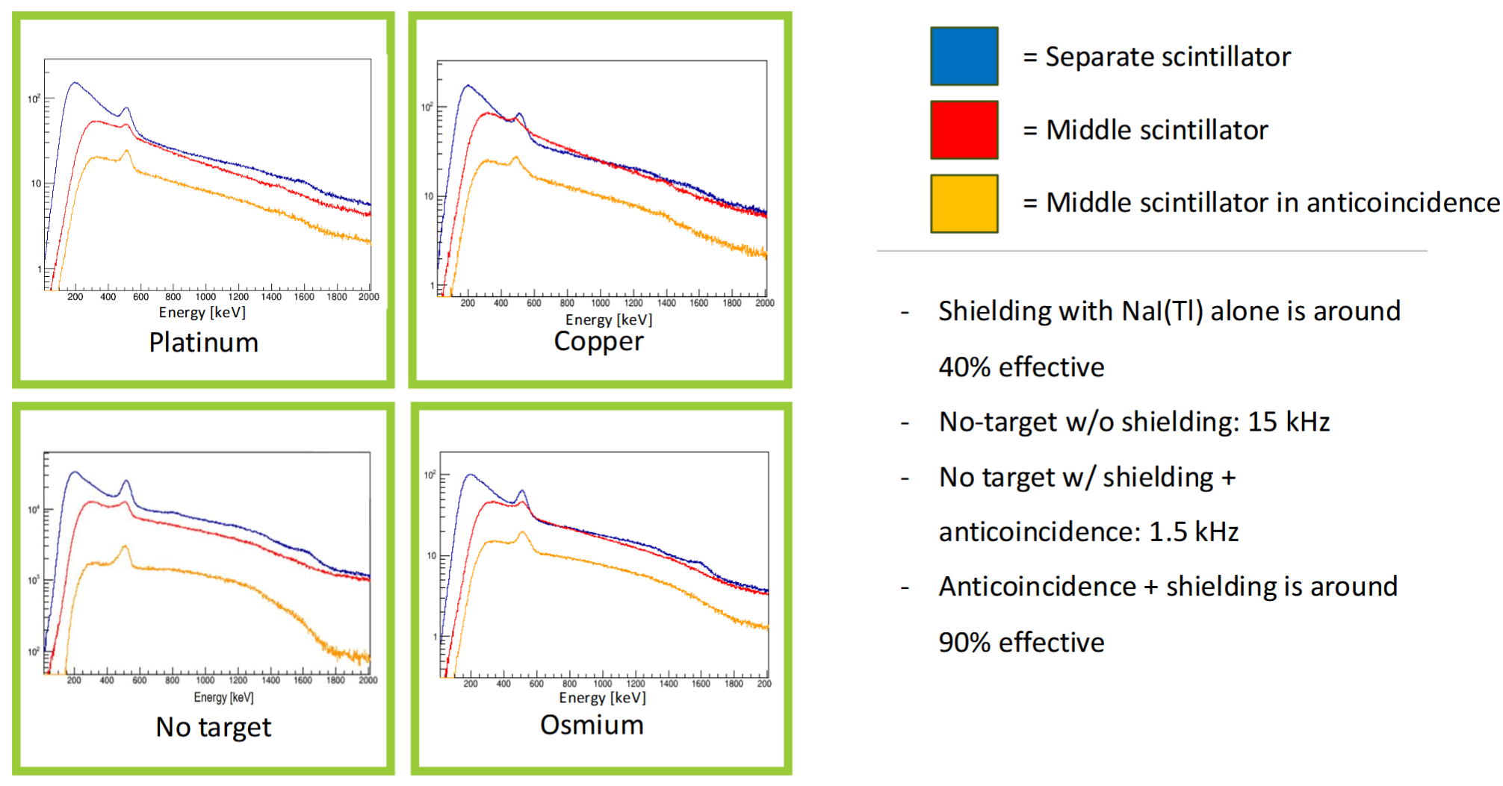
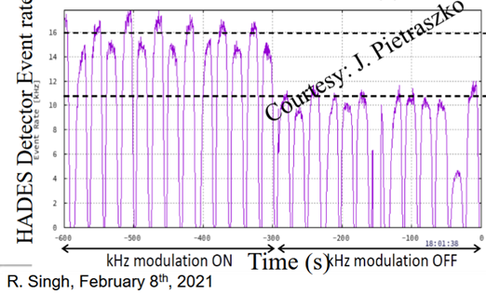
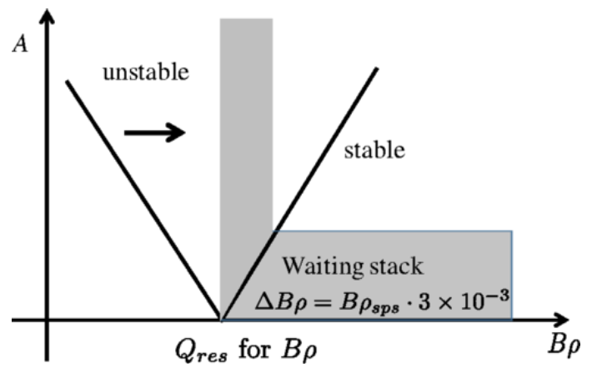
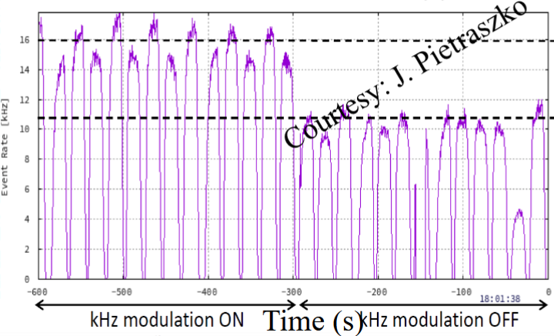
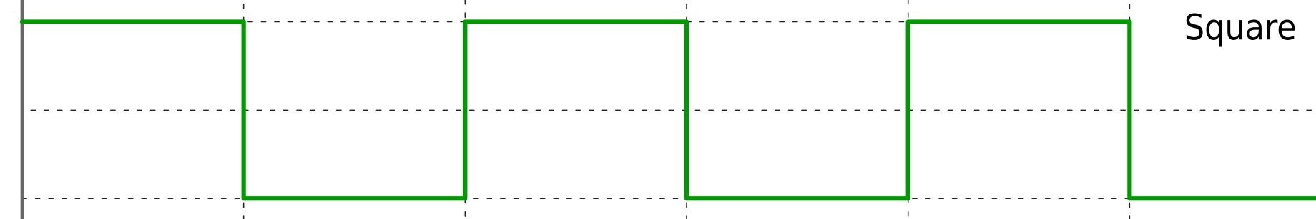
Overview
Nuclear data needs are constantly growing, especially in an energy regime relevant to space applications where very few measurements exist. New measurements to address those needs are lacking.
Part of the issue is accessibility to an accelerator capable of performing these studies.
NSRL is underutilized for nuclear data measurements.
Target
Approach
An NNDC experiment at NSRL on Oct. 25 briefly measured the NSRL target room background with beam on, observing count rate. → Safe for HPGe… if shielded appropriately (borated poly and W)
HPGe prompt gamma measurements of Pb thin target reaction products. → Aims to reduce uncertainty on single isotope x-secs
Measure light ion production (H, He) double diff. x-sec for thick target Si and Fe. → Targets light ion fragment production…
of high interest for DoE and NASA
MHz scale micro-pulse beams of cyclotrons work well for HPGe detector dead times and ToF analysis.
→ Apply “square-wave” modulation to ACQ
“feed forward” correction function
Oct. 25 NNDC Experiment @ NSRL
spill
beam
↑ + ↓ =
Controlled Detector Event Rate
AC Quad ΔQ
R. Singh (GSI), Feb. 8th 2021
Notes:
This experiment was done using large NaI(Tl) detectors, pictured right
The two distinct measurements will plan to use a forward position on the beam line for HPGe prompt measurements while farther down the beam line will measure light ion fragments
Current slow extraction scheme uses 1/3 integer resonance on debunched beam. We would likely be using bunched beam in this scenario with.
Would need to investigate tune quad ramp during extraction, sextupole strength, bunch amplitude spread, chromaticity

Slide 6
Anticipated Project Timeline
Leveraging ongoing efforts at the NSRL/CAD…
2022-2024, booster/NSRL slow extraction simulation model (BMAD)
During Fy25, CAD controls and operations will begin commissioning the AC quad
Fy25 Q4, tune AC quad function for spill smoothing in normal NSRL spill
FY 2026
FY 2027
Develop AC quadrupole pulsed beam structure
NSRL beam time
“Test beam”
NSRL beam time
Data analysis, reporting, publication
Procure targets, shielding, & detectors
“Deliverables”
At the conclusion of this proposal… produced cross-section data, new beam delivery technique for NSRL, and report on the necessary experimental setup recommended for future experiments.

Slide 7
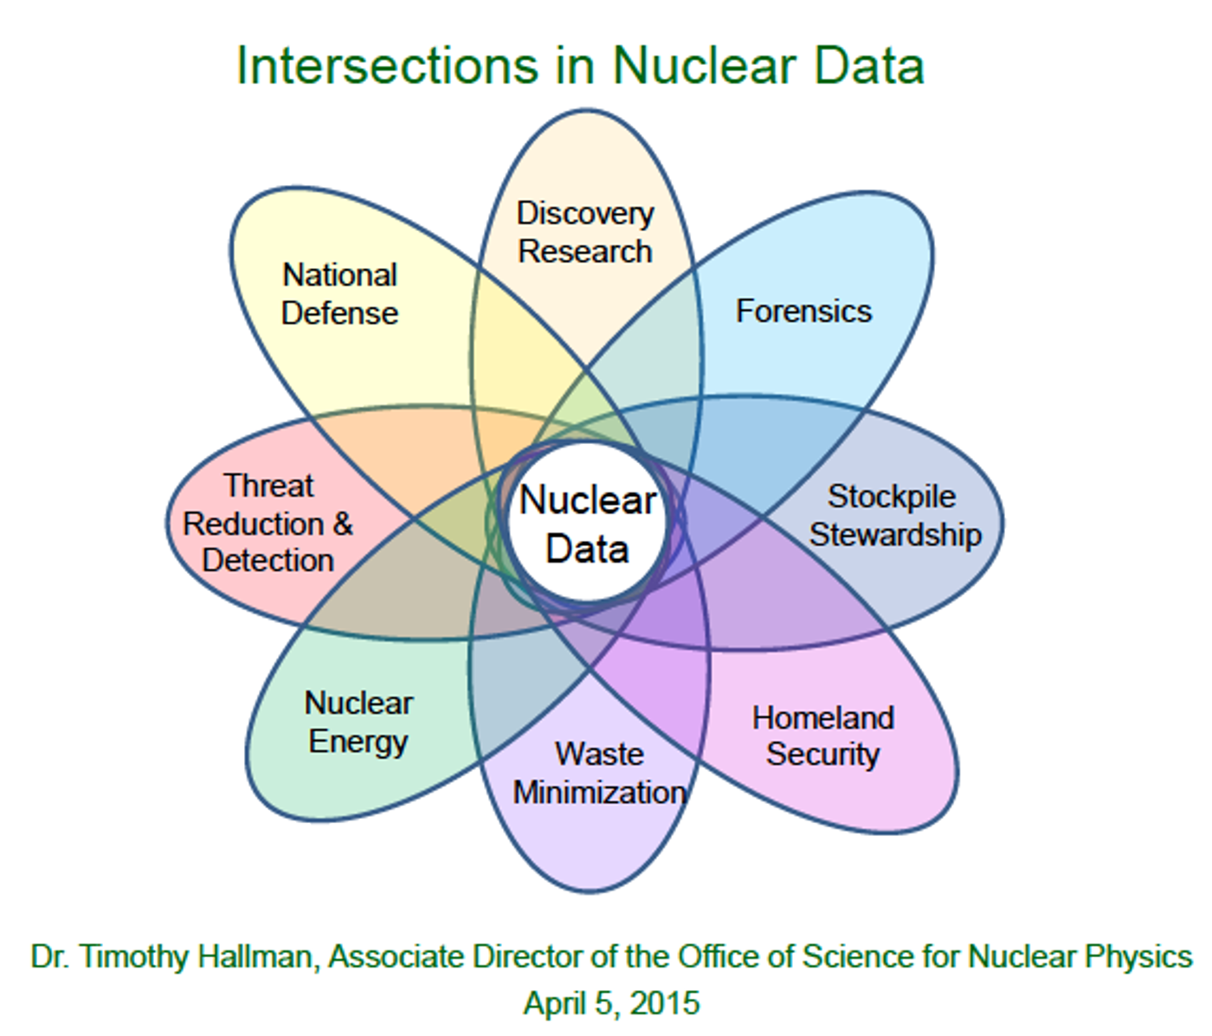
Proposal Summary
Oct. 25 NNDC Prompt Gamma Measurement @ NSRL
BNL is home to a versatile high energy, heavy ion beam line at NSRL and a team of expert nuclear data experimenters at the NNDC.
But NSRL is not designed for nuclear data experiments. This presents both unique challenges and possibilities to perform valuable measurements in the future…
Develop novel micro-pulsed spill technique
Characterize “beam on” target room environment for in-situ HPGe measurements
Measure double diff. light ion fragments (identified as highly needed by DoE and NASA) and prompt gamma reaction products
Integrate cross-section data into appropriate databases if possible
If successful, this proposal intends to add new techniques and capabilities to an existing beam line to enable new opportunities for this emerging programmatic need in support of large, administrative goals.

Slide 8
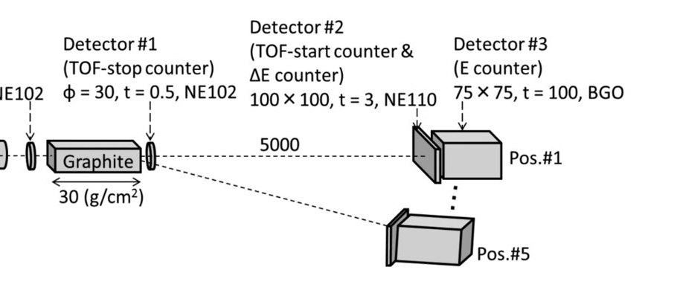
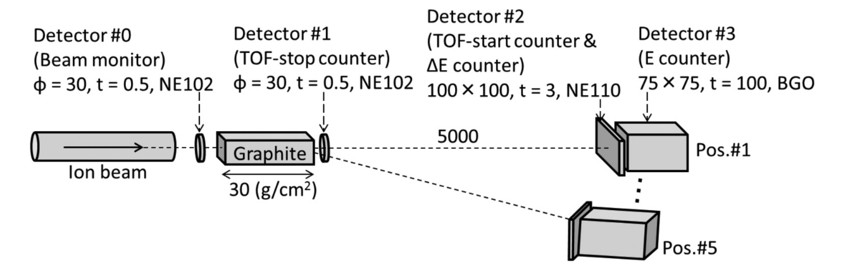


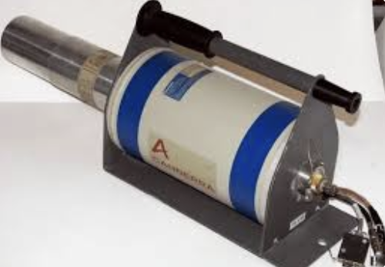











Backup Slide:
Example experimental setup
(simultaneous measurement scheme)
Thin target
Thick target
HPGe & Shielding

Slide 9
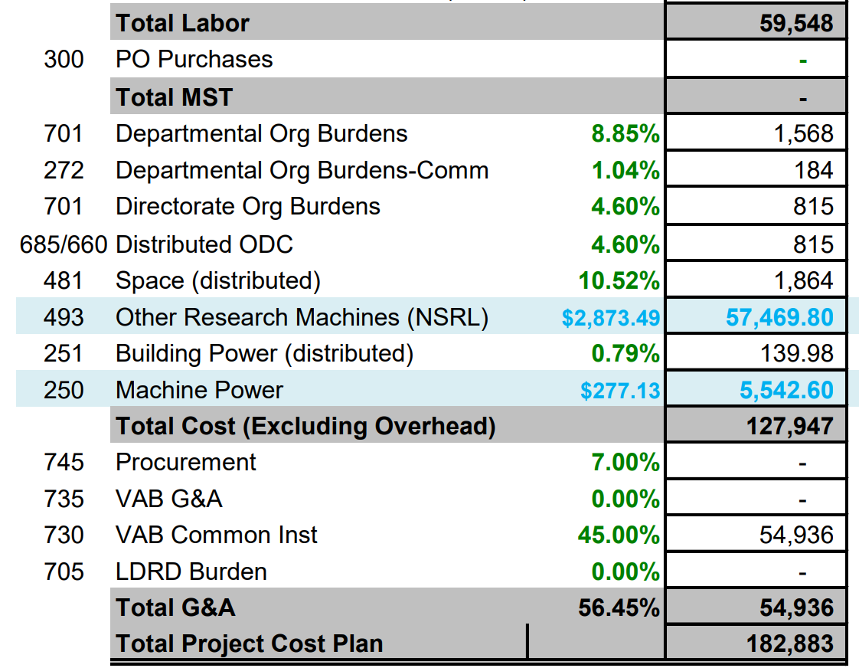
Backup Slide:
Example budget breakdown
1 year Estimate with overhead for:
2 x 0.15 FTE
20 hours of beam time at current rate
Will need to add procurement to this after getting quotes

Slide 10
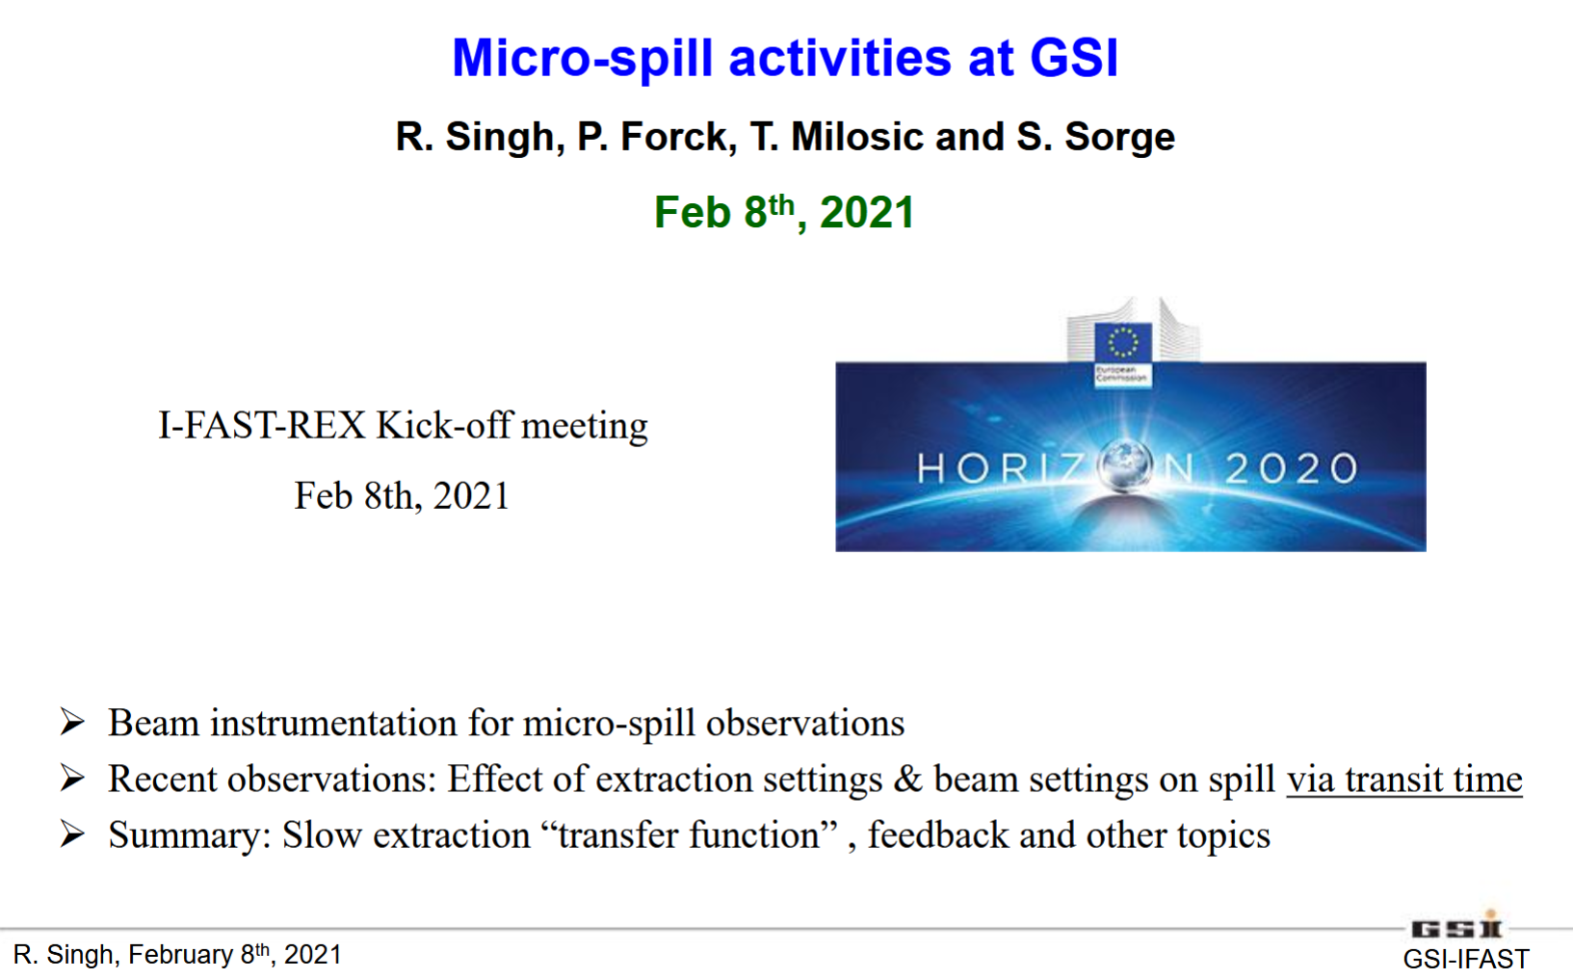
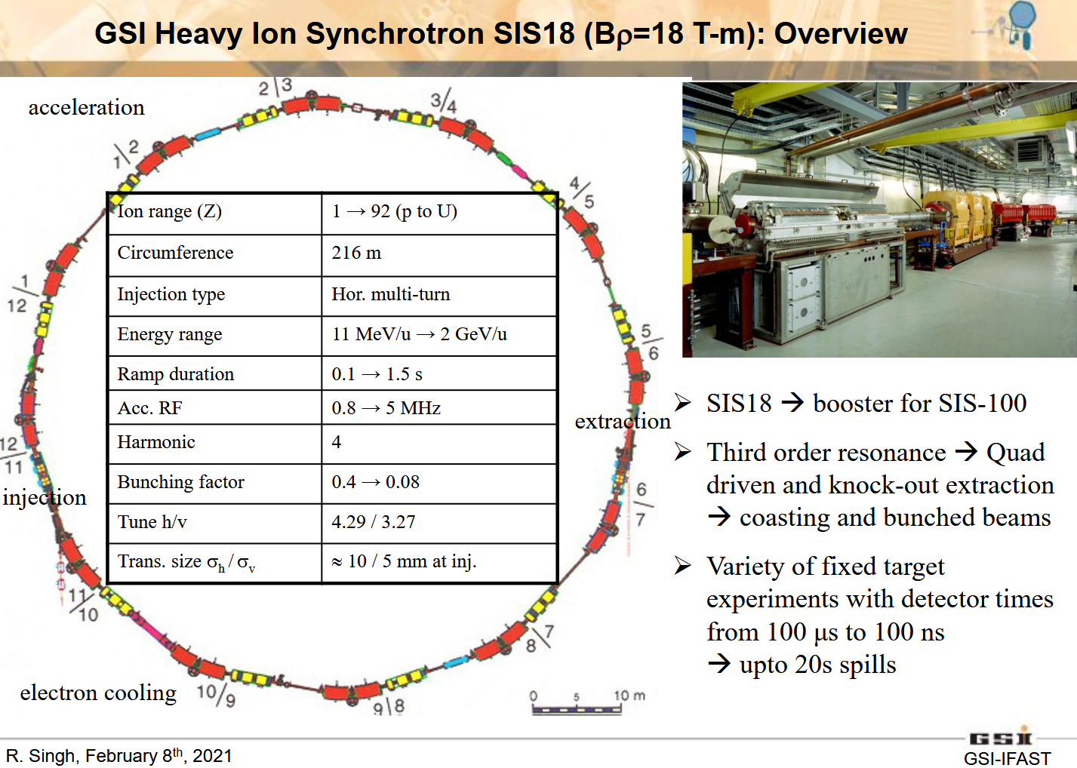
Backup Slide:
Pulsed beam “Proof of concept”
This method of spill manipulation has been used at GSI SIS18, similar machine to AGS booster for NSRL
Idea formulated after discussions with Kevin Brown (CAD controls) w.r.t. spill ripple control via AC quad
May benefit from newly developed r-line slow extraction BMAD model

