Slide 1
Proof of Principle for Permanent Magnet Gantry
FY2026 NPP LDRD Type B Pre-Proposal
Dejan Trbojevic
January 6th, 2025

Slide 2
FY2026 NPP LDRD Type B Pre-Proposal
Proposal title: Proof of Principle of the Permanent Magnet Gantry
Primary Investigator: Dejan Trbojevic
Other Investigators: Stephen Brooks, George Mahler, Nicholaos Tsoupas, Michael Anerella, Ruy Samuel
Indicate if this is a cross-directorate proposal: Yes _X__ No___
If yes, identify other directorates/organizations: The Accelerator Science & Technology (AST) Department, Magnet Division
Proposal Term: From: Oct. 1/2025 To: Sept. 30/2027

Slide 3
FY2026 NPP LDRD Type B Pre-Proposal
Proof of Principle for Permanent Magnet Gantry
Abstract: A strong collaboration with the Radiation Oncology of the Stony Brook University Hospital (SBUH) Cancer Center resulted in a seed grant for FLASH proton therapy proposal by Chairman professor Samuel Ruy and Dejan Trbojevic approved by the Dean and by NPP directorate. The further part of the SBUH proposal is to to build the Proton FLASH Therapy Facility (PFTF) in collaboration with BNL. The facility includes first (1) the Permanent magnet Fast Cycling Synchrotron (FCS), the (2) Transport beam lines and the (3) Permanent Magnet Proton Gantry. The FCS proof of principle had received the LDRD support from the BNL and a successful execution will be before Oct 2025. The $40M funding for the facility is to be established by the SBU. The injector for the synchrotron is ~ $1.5M cyclotron. The proposed LDRD we would build a proof of principle of the Permanent Magnet Proton Gantry producing the asynchronous part of the gantry.
Program: NPP/CAD with the Accelerator Science & Technology (AST) Department, Magnet Division
Return on Investment: With two proof of principles: one for the synchrotron and the other for the permanent proton gantry (if this LDRD is approved) we would have a clear path towards the full facility funding.
Total planned funding per year in FY26 and FY27 $250,000, with a total of $500,000.

Slide 4
FY2026 NPP LDRD Type B Pre-Proposal
INTRODUCTION
FLASH and proton radiation cancer therapy: existing seed grant
A success of the LDRD will improve further funding for the whole SBUH facility
Advantages of the Fixed proton therapy gantry
2. THE NEW ACCELERATOR PHYSICS CONCEPT – Fixed field large energy acceptance
Background – limitation of all existing gantries for FLASH therapy
Experiences from CBETA project
Fixed Field Gantry in Range 70 MeV< E_{k} <250 MeV or -28% < δp/p < 28%
Simulation of the orbit corrections for different energies
3. LDRD 2025-2027 GOALS and ACHIVEMENTS
Permanent Magnet Design, Building and Measuring Magnetic Field
Part of the Permanent Gantry Assembly
Measurements of the Proton Beam Propagation at NSRL
Technology transfer expected returns

Slide 5
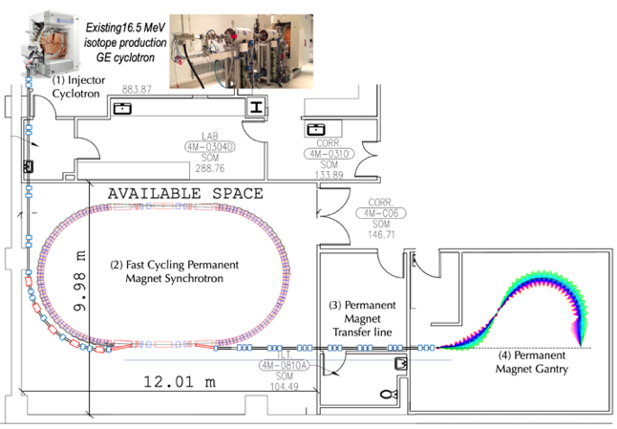
Description of the LDRD
A purpose of the proposed new LDRD is to build a proof of principle of the permanent magnet gantry by building a part of the gantry and run the proton beams at the NSRL facility beam line through it in energy range between 70-250 MeV. The Permanent Magnet Gantry is the third part of the future facility as shown on the right side of the figure 1. A purpose of the previously approved 24-010 LDRD Project 26823 AD/NPP is to show a proof of principle for the fast-cycling synchrotron shown in the Fig.1.
Fig. 1: Stony Brook University Hospital Proton Therapy Facility.

Slide 6
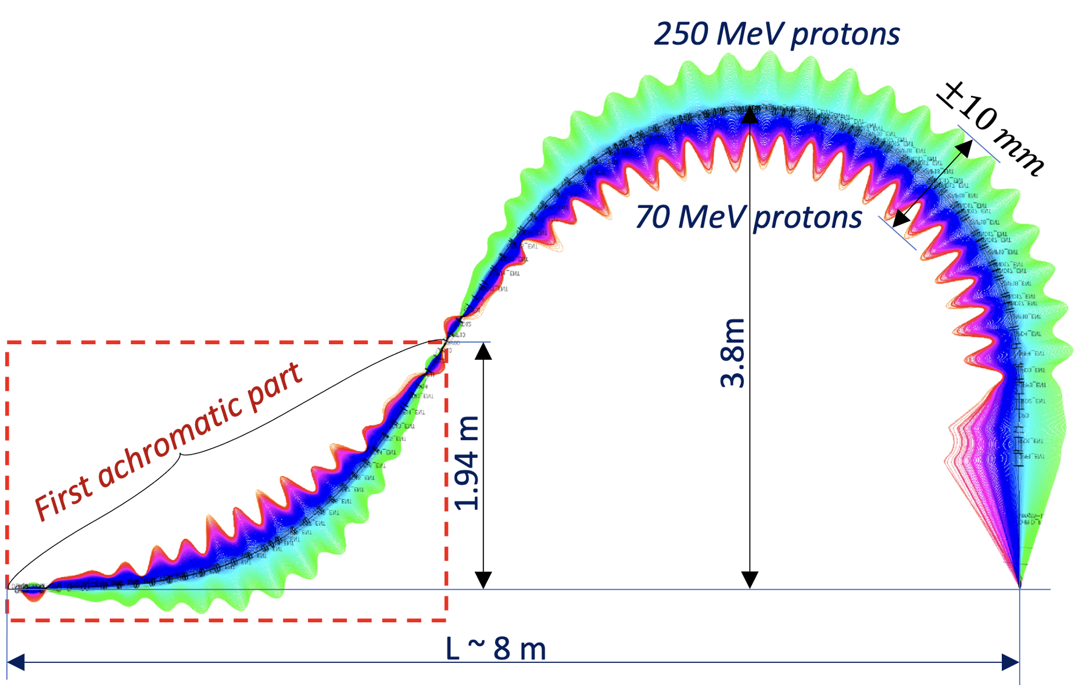
Description of the LDRD
Magnified orbits of the full Permanent proton Gantry are described in Fig. 1. The gantry transports protons with an extraordinary proton energy range between 70 -250 MeV with the fixed magnetic field produced by the combined function permanent magnets. This already established technology developed in BNL by the previous CBETA project and with BSA ownership [1] is will be transferred to the SBU for the purpose of building the FLASH cancer therapy facility for treating patients.
We have already received permanent magnet material to build two combined function magnets. We would need to order additional Nd₂Fe₁₄B wedges measured them and assemble them at the BNL magnets facility. Details of the proposed assembly are shown in Fig. 3.
B
A. The first achromatic part of the gantry as shown in Fig. 3 and Fig. 4 accepts protons within the kinetic energy range of 70-250 MeV. The 70 MeV proton orbit is within the “upper” part of the vacuum pipe or towards the center of the bending radius.
B. The second FFA-LG opposite bending arc B has two goals: to accept protons with 65-250 MeV energy range, the same way as the first part A and to direct
A
C
Figure 2: Proton Therapy gantry
the beam to the beginning of the part A and beginning of the part A and between the two parts A and B for the purpose of vacuum pipe connections and support. The second goal of the FFA-LG arc B not only transports all energies but also provides proton beam focusing to the patient with achromatic properties.
C. The orbits of all energies are merged at the patient in the third part of the gantry labeled as C. At this part of the gantry between the last magnet and the patient is the place for the fast transverse scanning system and the nozzle.
[1] D. Trbojevic, “Gantry for medical particle therapy”, US Patent 8,173,981 https://patents.google.com/patent/US8173981

Slide 7
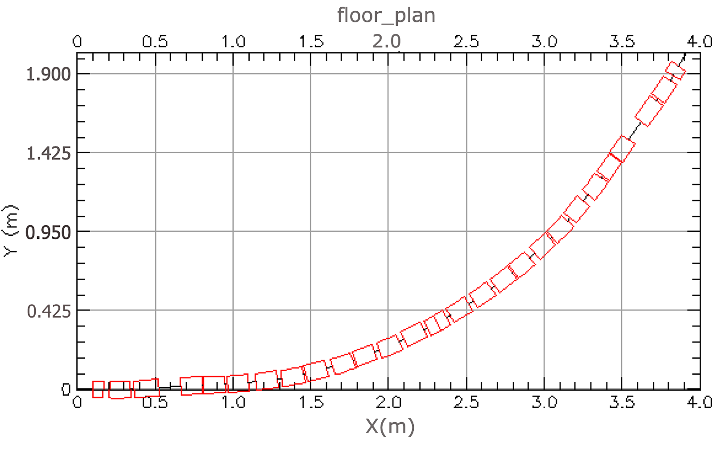
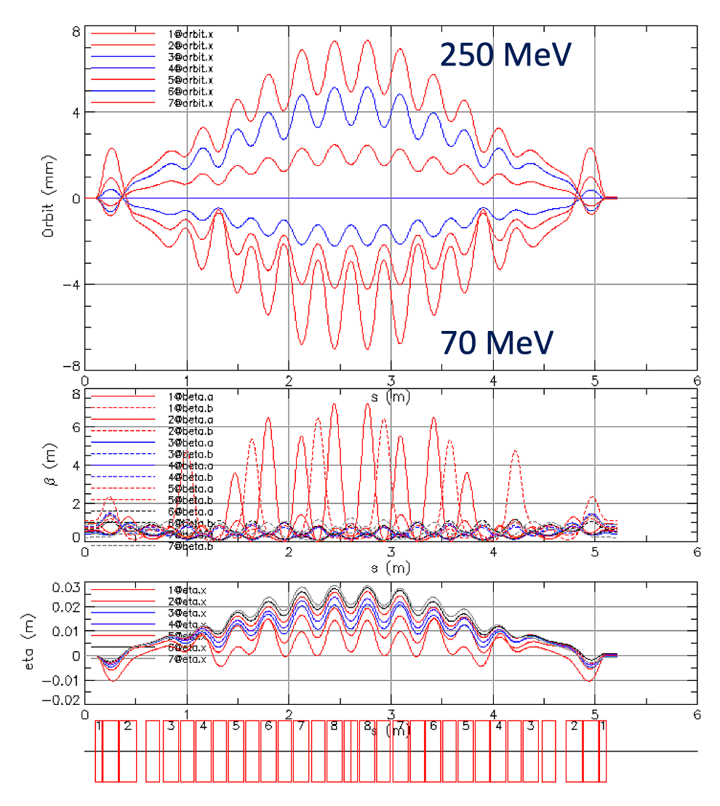
Part A of the Permanent Magnet Gantry to be built as a proof of principle
A
Figure 3 and 4: The layout of the achromatic part of the gantry. First achromatic part-A of the gantry. Top-are the proton orbits of different energies being bent upward, middle-betatron functions: starting with #1 with energy 70 MeV and finishing with #7 with energy 250 MeV. Full lines are showing the β_{x} while the intersected lines present the β_{y}. The third lower part are dispersion functions with the upper function showing the dispersion for 70 MeV protons, while the lowest (orange) curve shows dispersion of protons with 250 MeV.

Slide 8
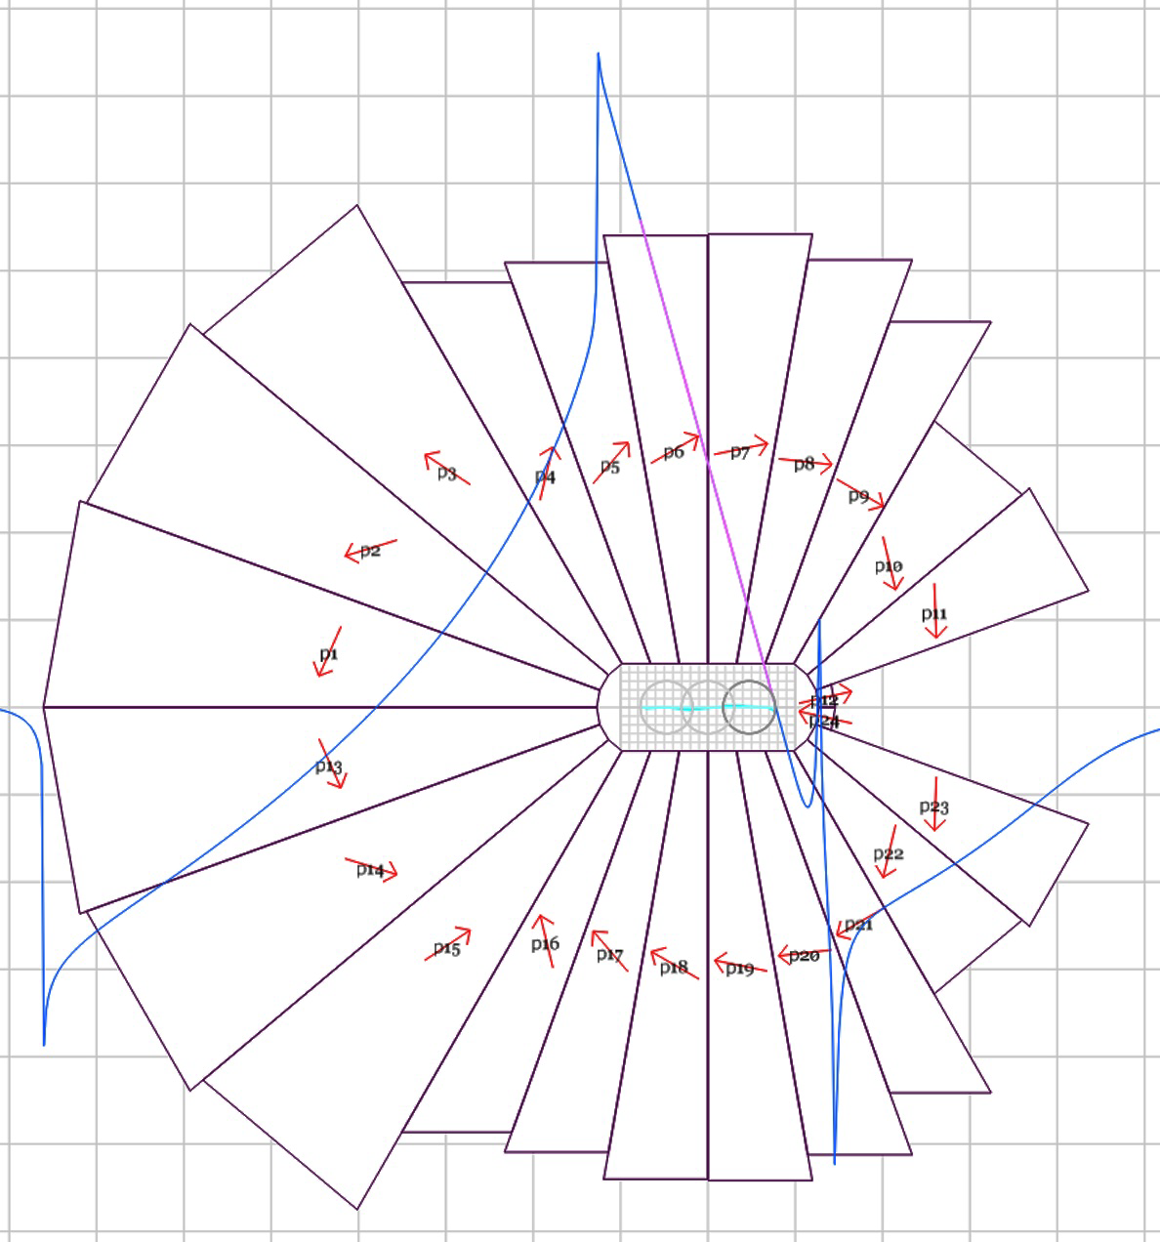
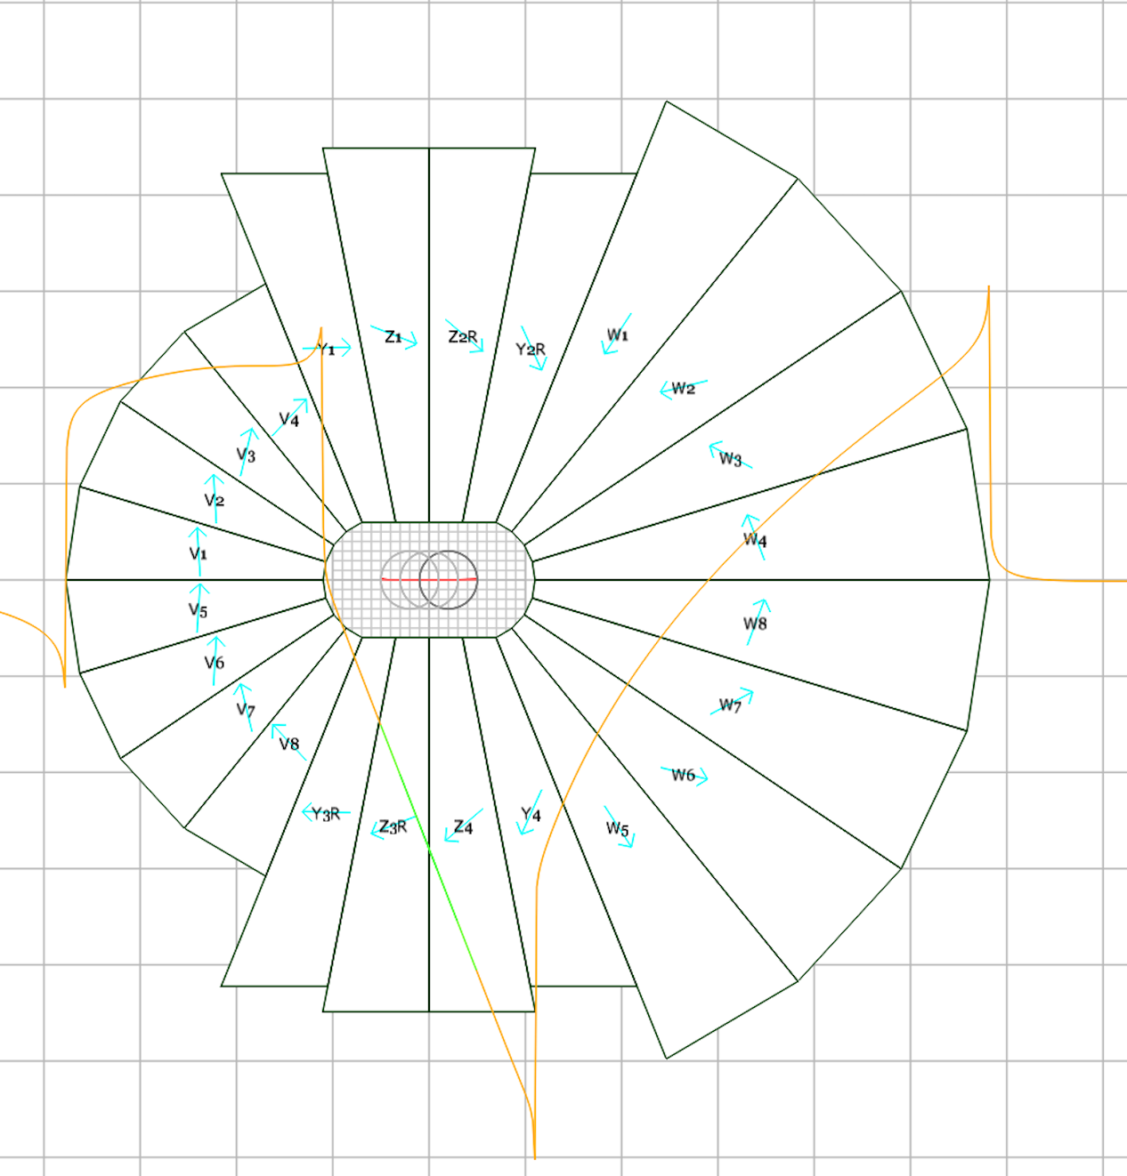
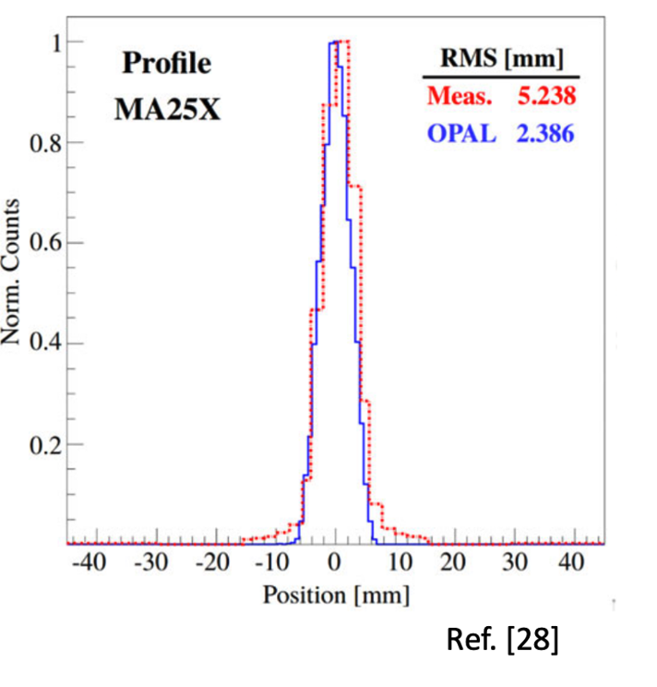
Proof of principle Permanent Magnet Gantry
There are multiple constraints to be fulfilled in the permanent magnet design; a) The curvature of the gantry needs to be as small as possible to reduce the gantry size; b) The aperture size of the gantry magnets needs to allow not only predicted oscillations of the beam but also the relatively large beam size especially in the Cyclotron based proton therapy facilities as they need to use the degrader to get smaller energy proton beams, and c) The maximum of the magnetic field inside of the magnet needs to be within the limits of demagnetization. Recent OVAL permanent magnet designs are shown in Fig. 8.
G_{F}= -146.2 T/m
B_{F}= 0.445 T
G_{F}= 159.98 T/m
B_{F}= 1.1367 T
11.54 cm
10 cm
12 cm
9.6 cm
Figures 5, 6, and 7: Two oval combined function defocusing (left) and focusing magnet (right) designs of the highest magnetic fields, with beam sizes at both proton kinetic energies of 70 (right side) and 250 MeV (left sides) with the ‘PROSCAN’ measured beam profile (right) after the degrader and collimators.
We already have Nd₂Fe₁₄B wedges for two focusing magnets ready to be assembled.

Slide 9
Summary Slide
The goal of the LDRD is to transfer the existing technology developed at BNL to the proton and FLASH cancer radiation therapy facility at the Radiation Oncology Department of the Stony Brook University Hospital.
The LDRD results will be used as a proof of principle for the concept of permanent magnet gantry towards obtaining full funding.
This is a proof of principle for a novel type of gantry the only one in the world to cover 70-250 MeV protons with the fixed magnetic field.
The present collaboration with SBU includes the FLASH therapy experiments on mice at the BNL TANDEM accelerator with the 28.5MeV proton beam.
When the whole proton therapy facility is built the FLASH radiation therapy could be explored. The FLASH radiation requirement within 100ms is fulfilled due the fixed magnetic field. This is significant advantage to any other existing radiation therapy facilities.

