Slide 1
RHIC Run 25 Outlook
Michiko Minty
Associate Chair for Accelerators and Applications
Accelerator Division Head
2025 APEX Workshop
January 22, 2025

Slide 2
Outline
Long-Range Plans for Nuclear Physics at BNL
Mission Status
Completing the RHIC Nuclear Physics Science Missions in FY25/26
Summary and Outlook
M. Minty - APEX Workshop, 22 January 2025

Slide 3
Long-Range Plans for Nuclear Physics at BNL

Slide 4
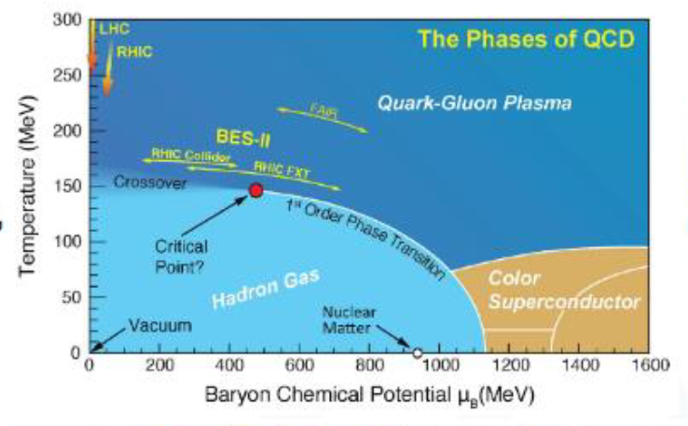
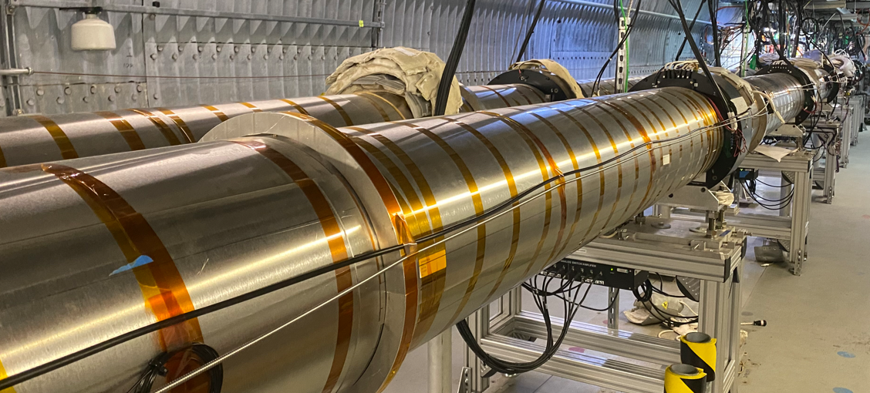
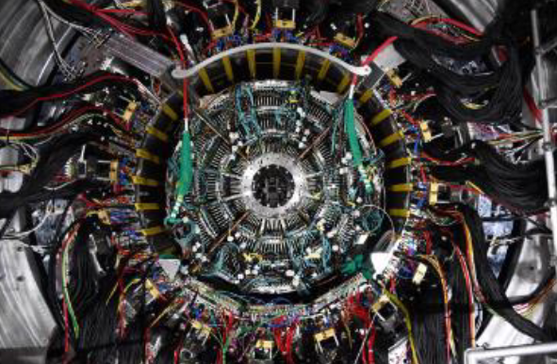
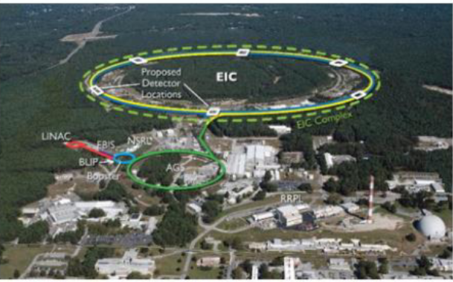
Long Range Plans for Nuclear Science
2015 LRP
✓
Recommendation #1: The highest priority in this 2015 plan: to capitalize on the investments made;
states the two central goals of measurements planned at RHIC:
1) probe the inner workings of QGP by resolving its properties at shorter and shorter length scales…
2) map the phase diagram of QCD …
✓
Recommendation #3: “… a high-energy high-luminosity polarized EIC as the highest priority for new
facility construction …”
✓✓
LEReC
sPHENIX
RHIC and the EIC
construction and installation com-pleted, commissioning in Run-23
BNL selected as host site, CD-3A review in Nov 2023
STAR Beam Energy Scan with LEReC completed
2023 LRP
Recommendation #1: … continued effective operation of national user
facilities …. and completing the RHIC science program…
culminating in 2025
Recommendation #3: Expeditious completion of the EIC as the highest
priority for facility construction
in progress with 2025 APEX experiments to inform accelerator design and / or demonstrate challenging operating parameters
M. Minty - APEX Workshop, 22 January 2025

Slide 5
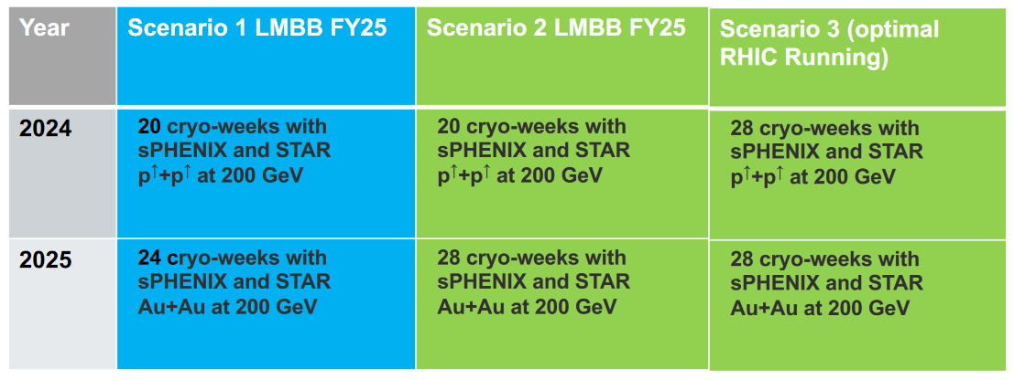
RHIC Run Scenarios FY24 – FY25 (from LMBB FY25)
FY24 priority: p↑+p↑ FY25 priority: Au+Au
NP Program Advisory Committee report (Sep 2023)
The top priority for Run24 is completing the commissioning of sPHENIX and collecting the high statistics pp dataset that is the necessary reference for all the sPHENIX hard probes Au+Au measurement to come in Run25 and that will at the same time allow STAR to make landmark polarized proton measurements using its new forward instrumentation.
The top priority in Run25 is collecting the marquee, high statistics, Au+Au data set that is the raison d’etre for sPHENIX, essential for completion of the RHIC science mission, and that will also allow STAR to complete its scientific program.
✓
✓
M. Minty - APEX Workshop, 22 January 2025

Slide 6
Mission Status

Slide 7
Recent RHIC schedule
Run-22 (p↑+p↑, √s_{NN} ~500 GeV) through 4/18/22
sPHENIX installation and preparation for Run-23
2022
Jan | Feb | Mar | Apr | May | Jun | Jul | Aug | Sep | Oct | Nov | Dec
sPHENIX magnet mapping
Run-23 (Au+Au, √s_{NN}=200 GeV ) 5/1/23 - 8/4/23 (early end)
RHIC repairs, preparation and sPHENIX upgrades for Run-24
sPHENIX installation completed
2023
Jan | Feb | Mar | Apr | May | Jun | Jul | Aug | Sep | Oct | Nov | Dec
CAD prep completed
CAD support for sPHENIX
sPHENIX upgrades completed
Run-24 ( p↑+p↑, √s_{NN} ~200 GeV ) 4/15/24 - 10/1/24
Preparation for Run-25
2024
Jan | Feb | Mar | Apr | May | Jun | Jul | Aug | Sep | Oct | Nov | Dec
CAD repairs and prep completed
Run-24 ( Au+Au, √s_{NN}=200 GeV )
10/1/24 - 10/21/24
Issue (“auto-recovery events” in sPHENIX MVTX detector) discovered when running Au+Au at end of RHIC Run-24. RHIC Run-25 will include time to establish suitable operating conditions (after which time APEX sessions will be scheduled).
M. Minty - APEX Workshop, 22 January 2025

Slide 8
RHIC Availability
C. Naylor
Au+Au
100 GeV
p↑+p↑, Au+Au
100 GeV
74.4% FY23
80.4% FY24
85.2% 10-year average
RHIC Availability [%]
Time [Fiscal Year]
Availability = beam time / scheduled beam time
Availability goals: 82.5% (< FY20) , 85% (FY21-FY22), 82.5% (FY23), 80.0% (FY24)
RHIC Run FY24: 80.4%
Average over last 10 years: 85.2%
Accelerator availability is coveted and closely monitored by the DOE.
One hour “back-to-physics” is charged to APEX for restoring operating conditions following each APEX session.
M. Minty - APEX Workshop, 22 January 2025

Slide 9
Completing the RHIC Nuclear Physics Missions in FY25/26

Slide 10
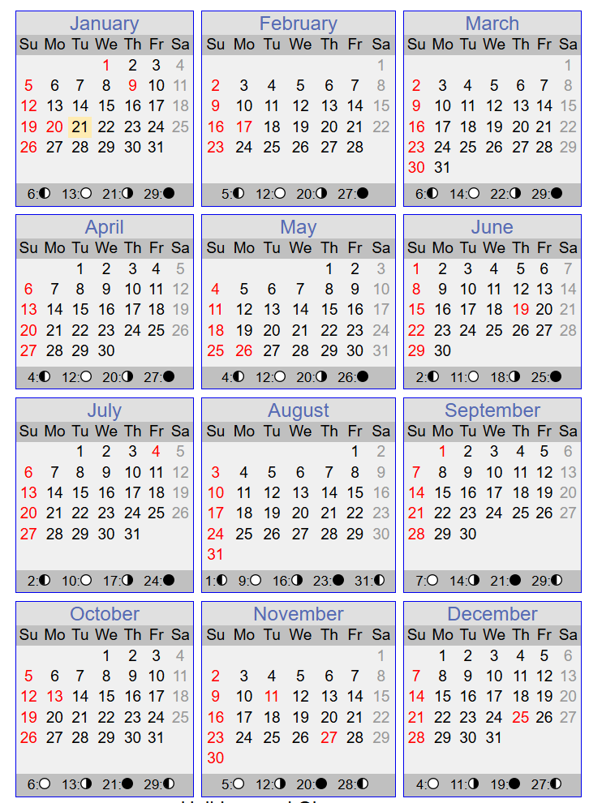
RHIC Run-25 and Run-26 Scenarios
excerpts from Abhay Deshpande (1/21/25):
Planning assumptions are:
For Run-25 we have 20 weeks (22-2 weeks)
For Run-26 in the Q1 of FY26, we assume 12 weeks
Total of 32 weeks.
Of course, we still don’t know the actual FY25 budget, nor do we know the President’s budget to plan the FY26 more concretely. All this could change once we have the budget numbers. Currently the Continuing Resolution is on until March 14, 2025.
Run Plan for Calendar Year 2025:
Start the RHIC Operations at 4k on March 24, 2025.
Online PAC meeting early June 2025
We will end 1st part of the Run on June 30, 2025 (14 weeks)
No beam from July 1 – August 18, 2025, 2nd part of the run from August 19 - December 22, 2025 (18 weeks)
We will start with Au-Au operation which was given the highest priority by the PAC with the aim of acquiring 7 nb-1 of data.
We will consult with PAC in early June – when we have a good idea of how we are doing (machine and detectors) towards that goal, to request advice on what other collision-combination aims could be achieved during this year’s RHIC operation.
Long final RHIC run *could* (TBD) accommodate lengthy list of APEX beamtime requests.
M. Minty - APEX Workshop, 22 January 2025

Slide 11
Summary and Outlook

Slide 12
Summary and Outlook
Long-Range Plans for Nuclear Physics at BNL
2015 LRP – successfully completed
2023 LRP – underway with EIC construction to start in 2026 following multi-decadal operation of RHIC
Completing the RHIC Nuclear Physics Missions in 2025
Highest priority is Au+Au at 200 GeV c.o.m. energy
Program Advisory Committee to convene (~June, 2025) to advise on physics priorities taking into account
progress with sPHENIX auto-recovery event mitigation measures
Planning basis assumes 2025 RHIC operations from 24 Mar – 30 Jun, 19 Aug – 22 Dec with schedule
contingent on approved operating budget
APEX experiments must be well-planned and well-executed
to optimally use available beam time
(potentially) to justify beam time usage competing with RHIC physics priorities
M. Minty - APEX Workshop, 22 January 2025

