Slide 1
RUN25 EXPERIMENTS & PRIORITIES
Haixin Huang
2025 RHIC APEX Workshop
Snyder Seminar Room, Building 911, BNL
January 22, 2024

Slide 2
RHIC APEX Program
Accelerator Physics EXperiment (APEX) program is about beam experiments related to Accelerator Physics.
APEX experiments are performed at Relativistic Heavy Ion Collider RHIC), Collider-Accelerator Department, BNL
The goals of APEX program are:
- Improve current RHIC machine performance
- Support near-future machine upgrade
- General academic research, such as inter-lab collaborations

Slide 3
APEX Steering Committer & Coordinator
APEX program is supervised by the C-AD APEX Steering Committee.
- Chair: Haixin Huang
- Members: Michael Blaskiewicz (EIC), Alexei Fedotov
Yun Luo (EIC), Michiko Minty
- Ex-Officio: W. Fischer (CAD chair), Abhay Deshpande(ALD)
APEX Steering Committee will review, grade, and prioritize APEX proposals and guide the routine operation of APEX program.
APEX Coordinator: Yun Luo
Role of APEX Coordinator: to coordinate APEX routine work, such collecting proposals, planning APEX schedules, running APEX bi-weekly meetings, etc.

Slide 4
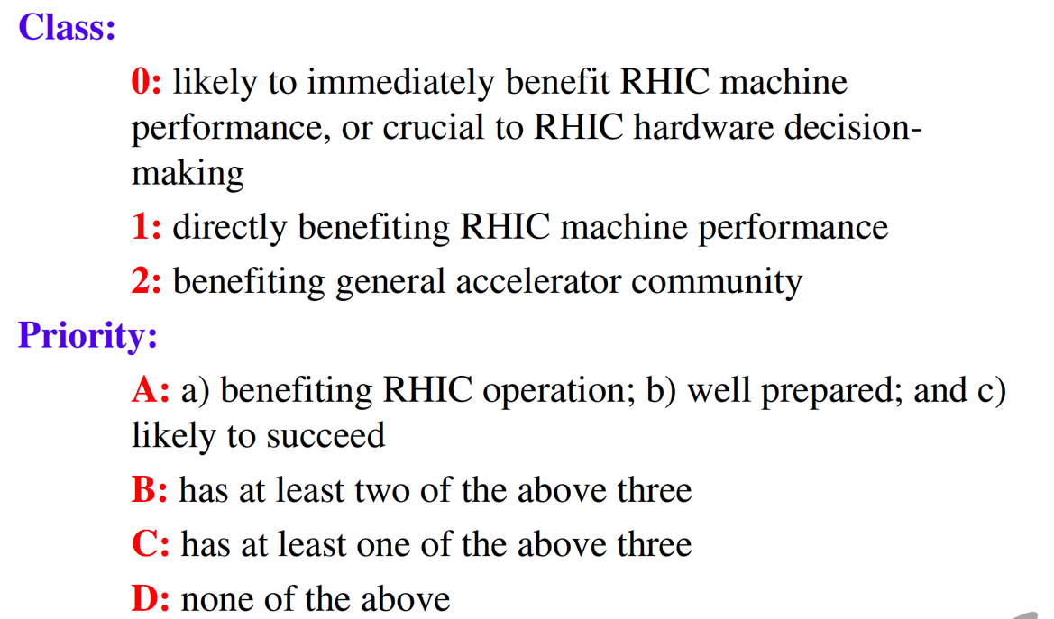
APEX Proposal Gradings
RHIC should be replaced by RHIC and EIC design and operation
EIC design is more critical than EIC operation
➔ Must do
➔ Recommended
➔ Considered for inclusion
➔ Declined

Slide 5
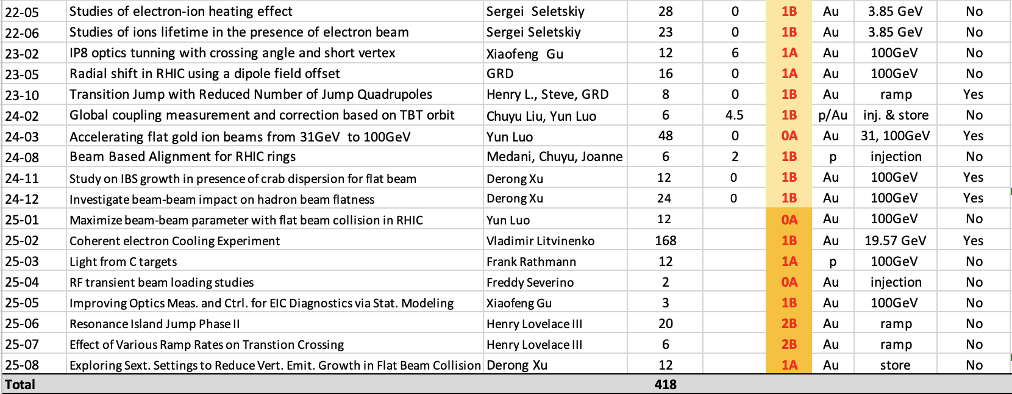
Current proposals
183 hours for proposals carried over from run24. Total of 235 hours for new proposals. Total hours of 418 hours.
Five still need ramp development.

Slide 6
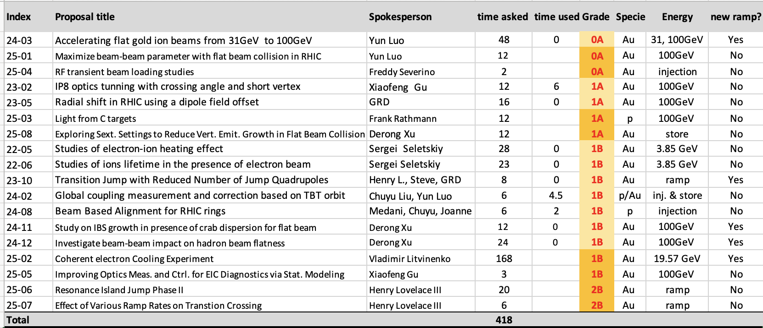
Current proposals in the order of Grades
114 hours for proposals with 0A and 1A. Total of 278 hours for proposals with 1B grade and 26 hours with 2B.

Slide 7
Total Beam Time Requested for Run 25
Total beam time requested: 418 hours
with proton beams: 12 hours, 2.9%
with gold ion beams: 406 hours, 97.1%
Total of 114 hours for proposals with 0A and 1A. Total of 278 hours for proposals with 1B grade and 26 hours with 2B.
32 cryo weeks-> 28 weeks physics -> 14 APEX sessions.
14sessions X 15hours X 0.9(efficiency)=189hours.
We are short of 200+ hours of APEX time.
If the special request of bulk APEX session (2 weeks in the end) is approved, there will be additional ~300hours. Then we can run all APEX listed.
A question to EIC people: what consequence will it be, if we could not run all these APEX?

Slide 8
Planning and Preparation of APEXs
This is the last calendar year for RHIC operation. It is critical to carry out EIC-critical APEX in the last RHIC run.
The priorities of experiments are set by the rating.
To ensure the efficient use of APEX time, readiness is the key to stream out the planned APEX.
Although we had a skeleton weekly schedule for APEX last year, we still faced the same old issue: many APEX were not ready in the early part of run24.
We will layout the overall APEX schedule for FY25 before run starts, with some fine tuning several weeks ahead of actual APEX to give enough time for preparation.
An MCR OC will be assigned to each APEX to make sure no neglected issue.
The readiness of each APEX is still in the hands of the spokesperson.
How can we improve the APEX schedule and preparation?

Slide 9
Summary
APEX program played an important role to RHIC operation improvements and upgrades in the past.
APEX program in run25 plays a crucial role to the EIC design and its future operation.
In the last run of RHIC, our goal is to make a good use of available APEX beam time to answer critical questions related to the EIC design.
The APEX readiness early in run25 is critical to fulfill our goal to carry out these APEX efficiently during the assigned time.

