Slide 1
Further Radial Offset Orbit Studies
G. Robert-Demolaize, A. Drees, H. Lovelace III, S. Peggs
APEX Workshop
01/22/2025

Slide 2
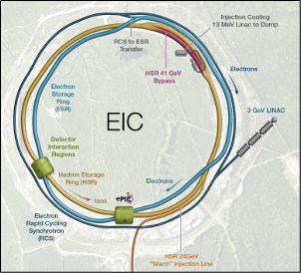
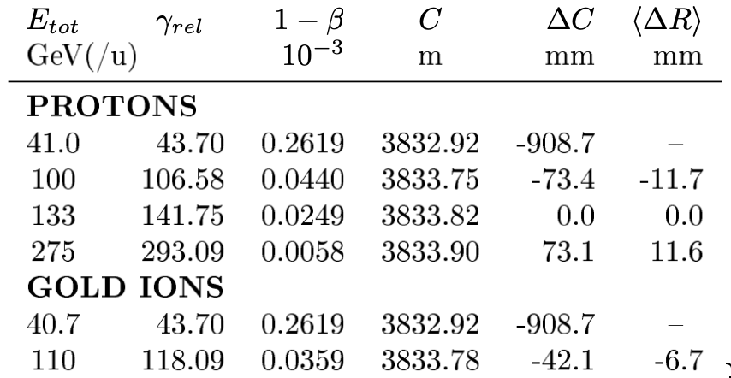
Introduction – the EIC configuration
The Electron-Ion Collider (EIC) features two storage rings aiming to deliver collisions over a wide range of center of mass energies $\sqrt{s_{e−h}}=20−140$ GeV.
Collision synchronicity over a broad range of hadron energies requires that the hadron ring circumference be adjusted by as much as ±73.2 mm.
(largest circumference changes at 41 GeV handled by using a shorter arc)

Slide 3
Designing a large radial shift – what can be tested
Define the relative magnetic field change δB applied to the dipoles:
A well-matched closed orbit would then be radially displaced proportionally to the dispersion D_{x}:
With all RHIC bending magnets receiving the same δB, ΔR translates to a circumference change ΔC:
where C₀ is the design RHIC circumference and 𝛾_{T} the transition gamma of the lattice being shifted.
Combining RHIC typical lattice settings to the required ΔC values for the HSR, one gets a range of δB = ±1%.

Slide 4
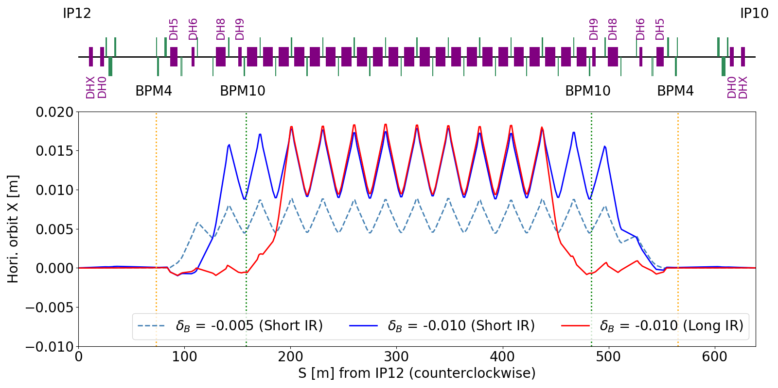
Designing a large radial shift – two possible configurations
Two main lattice options were used to launch and capture matched radial shifts across the RHIC arcs:
Short IR: the radial shift is constrained to have (x, x’) = (0, 0) at BPM4 at both ends of every arc;
Long IR: the radial shift is constrained to have (x, x’) = (0, 0) at BPM4 and BPM10 in every arc.

Slide 5
Comprehensive tests at high energy – w/ 100 GeV/u Au ions (1/4)
Key parameters for tests with 2021 RHIC lattice for 100 GeV/u Au ions:
Four configurations tested: Short/Long IR, δB = ±1%. Short IR configurations prepared with MAD-X, Long IR with Bmad.
Dedicated radial shift ramps were prepared to move all magnets from their on-axis high energy setpoints to their radially-shifted setpoints, while simultaneously adjusting the RF frequency. Tune and coupling feedback systems were used once again to minimize the probability of losing the circulating beam to resonances, and to maximize the time spent at flattop.

Slide 6
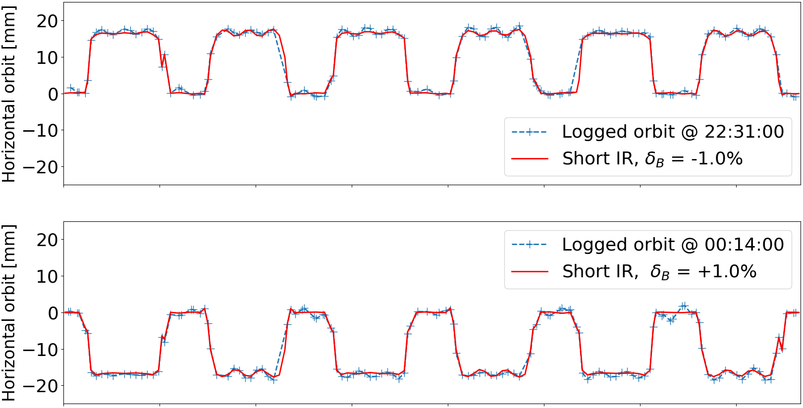
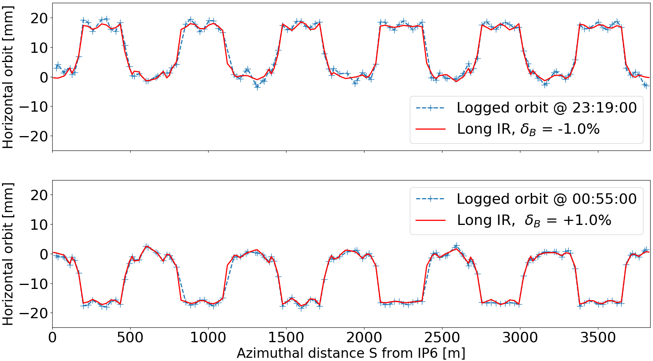
Comprehensive tests at high energy – w/ 100 GeV/u Au ions (2/4)
Comparison predicted vs. measured beam orbits:
Excellent agreement with predictions!
For moderately squeezed RHIC IRs (β* = 5.0 m) at 100 GeV/u, models managed to rematch linear optics without exceeding neither quadrupole nor corrector PS limits.
First demonstration of RHIC’s ability to store high energy beam with very large orbit offsets in the arcs!

Slide 7
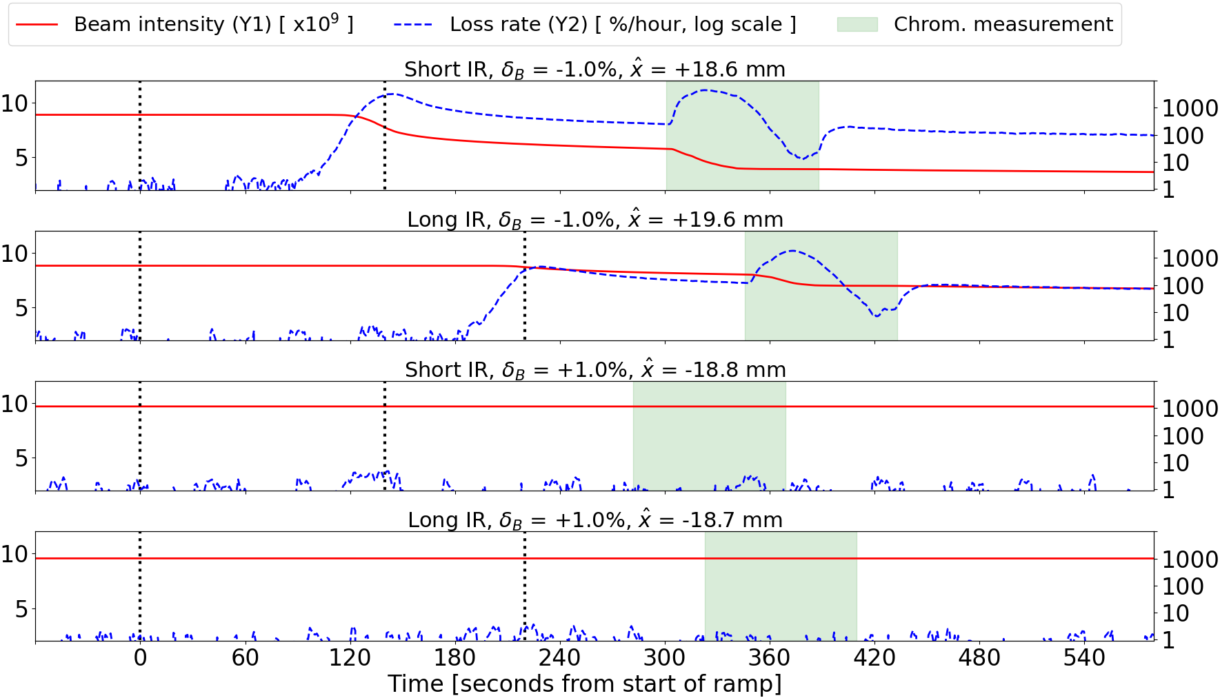
Comprehensive tests at high energy – w/ 100 GeV/u Au ions (3/4)
Note: all beam losses were localized on the RHIC collimators; no other aperture issues were detected.
Overview of beam losses during each of the four configuration tests:
δB = -1%
large losses (> 3000%/h)
large Q’_{x,y} discrepancies
δB = +1%
minimal losses (< 5%/h)
small Q’_{x,y} discrepancies

Slide 8
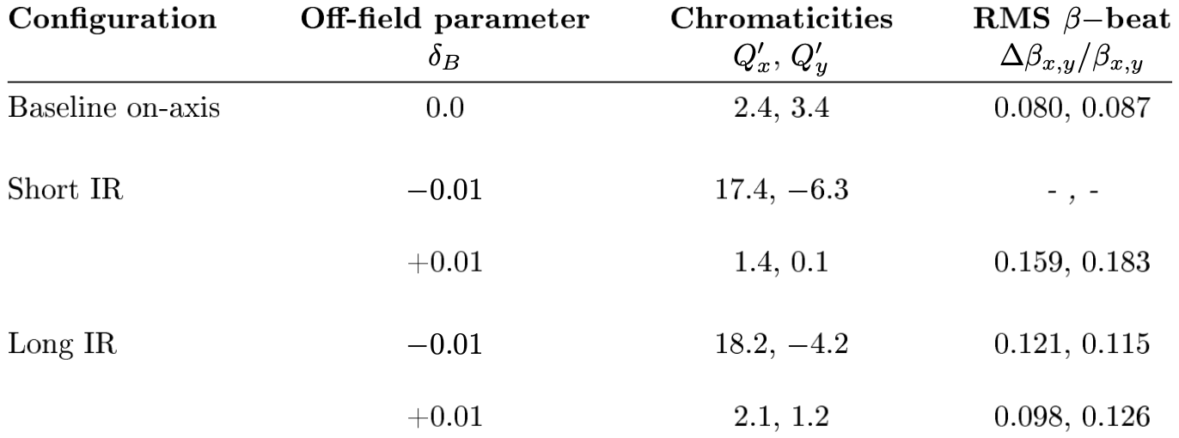
Comprehensive tests at high energy – w/ 100 GeV/u Au ions (4/4)
Measured chromaticities and linear optic functions:
In both Short and Long IR configuration, δB > 0 leads to smaller chromaticity deviations compared to δB < 0.
Measured increases in rms beta-beat in each case are not enough to explain this difference in behavior.
How do high order field errors in arc dipoles (above sext. order, already in model) impact chromaticity at large orbit offsets?

Slide 9
Comprehensive tests at high energy – defining the dipole field B_{y}
RHIC design documentation defines the measured magnetic field of an arc dipole as:
where $B\left(R_{\text{ref}}\right)$ is the field of a given dipole at the reference radius $R_{\text{ref}}$, and $b_{n}$ and $a_{n}$ are the measured multipole coefficients of nth order for that dipole.
Discounting the skew terms and using a simpler notation for the normal coefficients, the expansion of the previous definition up to decapole order reads:
The RHIC online and offline models already include$b_{2}$coefficients to account for tune feed-down from arc dipole offsets during installation => one must similarly account for the effect of octupole and decapole terms on chromaticity.
The chromaticity feed-down from $b_{3}$applies linearly with $x$, and $b_{4}$applies quadratically with $x^{2}$
this plausibly explains the asymmetry between the two RS directions: a positive radial offset results in a cumulative effect from $b_{3}$and $b_{4}$, while a negative offset benefits from some compensation from $b_{4}$over the effect of $b_{3};$
similar observations reported from LEP in 1995 and with the LHC in 2023.

Slide 10
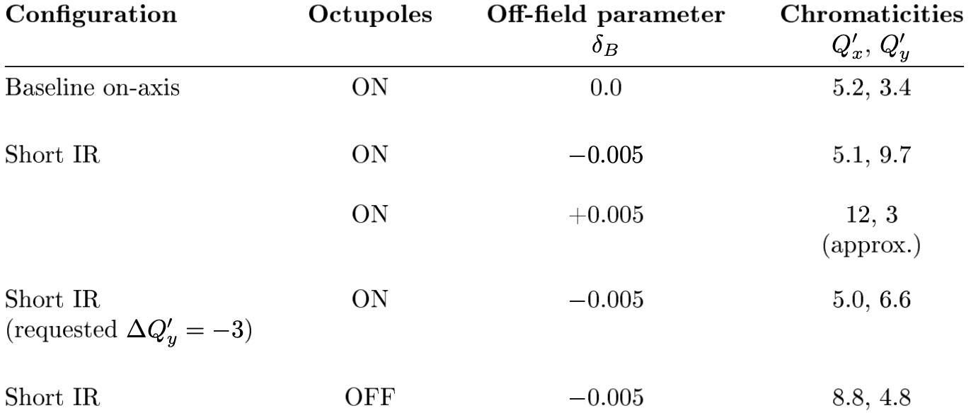
Comprehensive tests at high energy – chromaticity control in ‘22
Chromaticity measurements during the 2022 APEX sessions with polarized protons at 255 GeV:
(1) Off-axis measurement: with smaller peak excursions than in 2021, the largest Q’_{x,y} changes are in the 6-7 units range, with much less impact on the beam dynamics as well (lower loss rates on every attempt).
(2) Test of the RHIC chromaticity knob: when requesting a vertical chromaticity change of -3 units, the measured change was within 0.1 unit of the target => chromaticity differences between prediction/measurement are not due to misunderstanding the sextupole magnet responses.
(3) Contribution from octupoles: with octupole magnets turned off, we measured ΔQ’_{x,y} = (+3.8, -1.8) when MAD-X predicts (+4.2, -2.0)
=> validates the predictive power of the RHIC modeling tools even at large excursions
=> highlights the significant impact on chromaticity from octupole fields at large orbit offsets
Note: polarized protons physics stores require the octupole magnets to be powered, to stabilize beam dynamics at top energy.
(1)
(2)
(3)

Slide 11
Conclusions
Large radial shifts are required in the EIC Hadron Storage Ring, in order to adjust its circumference and ensure synchronous collisions with electrons in their storage ring. Such large radial excursions were successfully designed and commissioned in RHIC in 2021 and 2022, reaching peak excursions of ± 20 mm in some cases, with both heavy ions and polarized protons at high energy. The successes that were achieved provided a solid proof-of-principle demonstration of future HSR operability.
HSR insertion region features and constraints (both geometric and optical) are different from RHIC, therefore HSR lattice design has challenges that go beyond the scope of the proof-of-principle techniques so far demonstrated in RHIC. The question of additional power supplies needs (dipole shunt, IR quadrupoles, orbit correctors) still needs to be investigated with the HSR lattice.
The designed and measured closed orbits in each configuration were in excellent agreement. Significant unexpected discrepancies between measured and predicted chromaticities were observed when large radial shifts were present. The octupole strengths tests in 2022 indicate that the available measurements of high order field errors (mainly $b_{3}$ and $b_{4}$ coefficients) in the arc dipoles must be included into the models to more accurately predict changes in tunes and chromaticities at large orbit excursions. This will be tested during this year’s APEX program.
There is strong motivation to carry over much of the RHIC power supply and wiring schemes to the HSR. There is also a strong motivation to test hybrid radial shift solutions in 2025 where both Short and Long configurations are combined in different IRs, including the experimental (i.e. squeezed) ones. This will lead to a better understanding of the available range of circumference changes for the HSR, impacting the range of possible c.o.m. energies.
Needed for 2025: database update, new lattices, new ramp files => requires development time…

Slide 12
BACKUP SLIDES

Slide 13
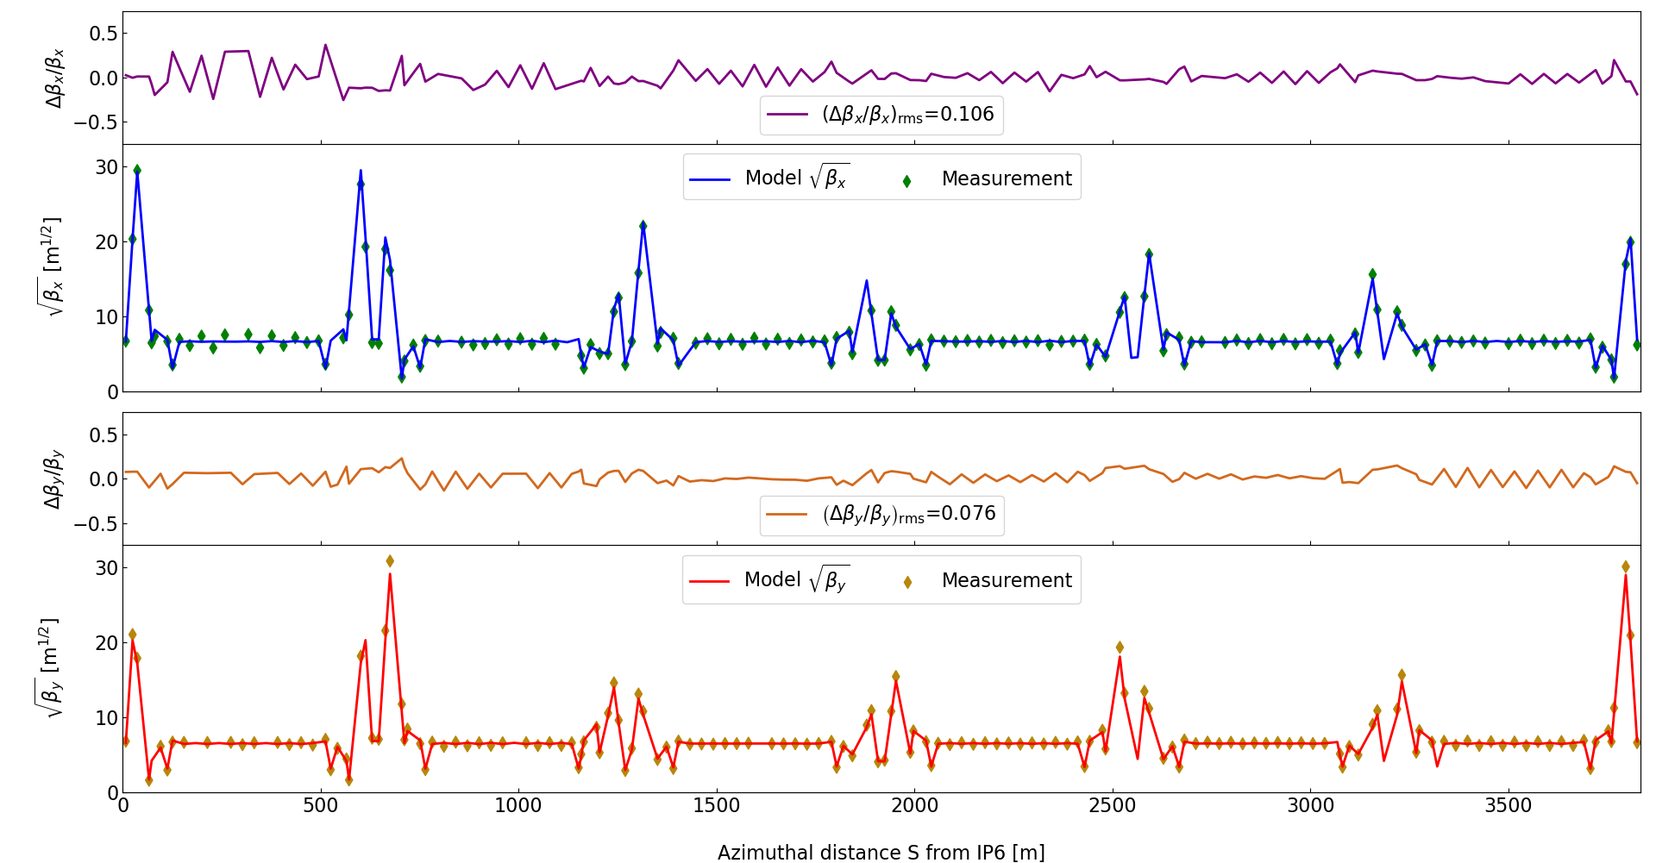
Baseline RHIC linear optics design
Design and measured linear optics functions of the Yellow RHIC ring in the horizontal (top) and vertical (bottom) plane for the baseline configuration of the 2022 beam studies with 255 GeV polarized protons.

Slide 14
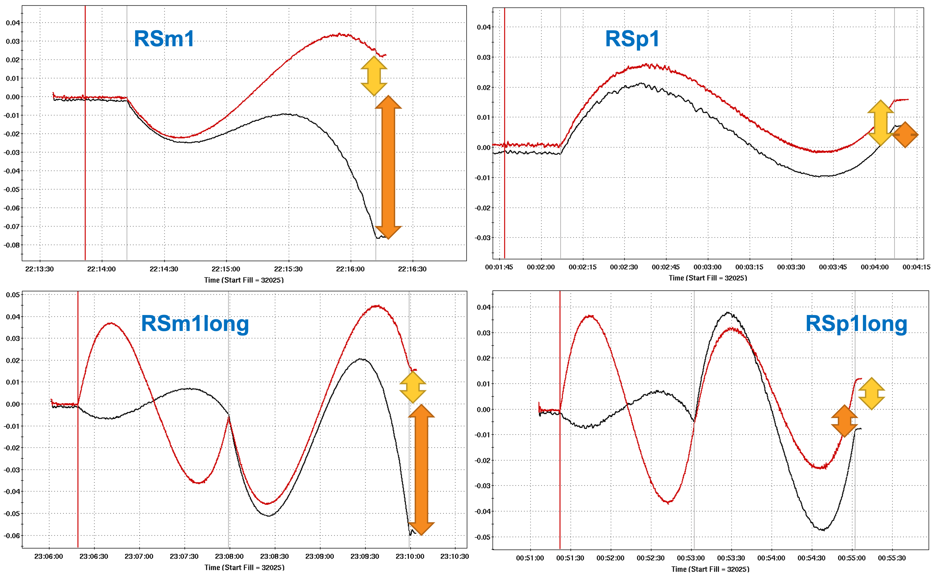
2021 APEX w/ 100 GeV/u Au ions
Comparing feedback efforts with 100 GeV/u Au ions:

Slide 15
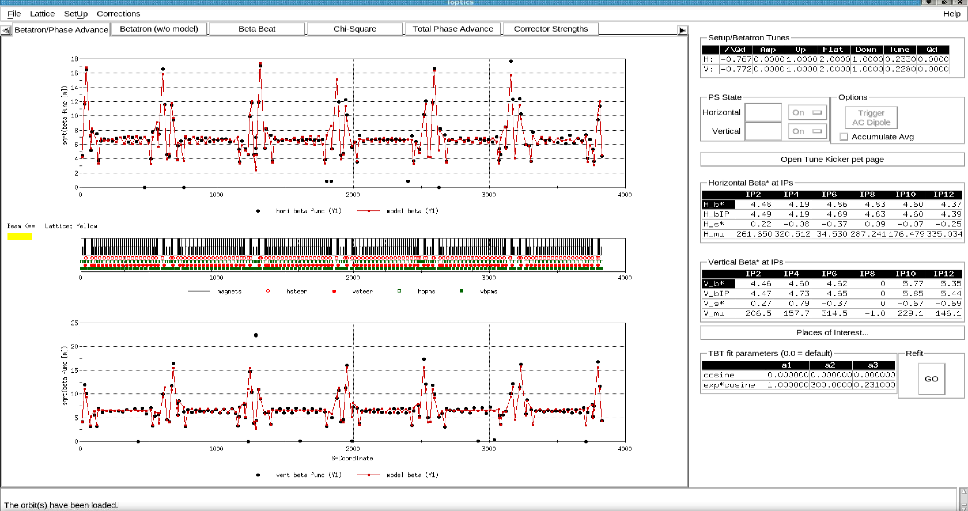
2021 APEX w/ 100 GeV/u Au ions
Linear optics functions measured at store with the full +1% excursion (low chromaticities) – Short IR
RSp1

Slide 16
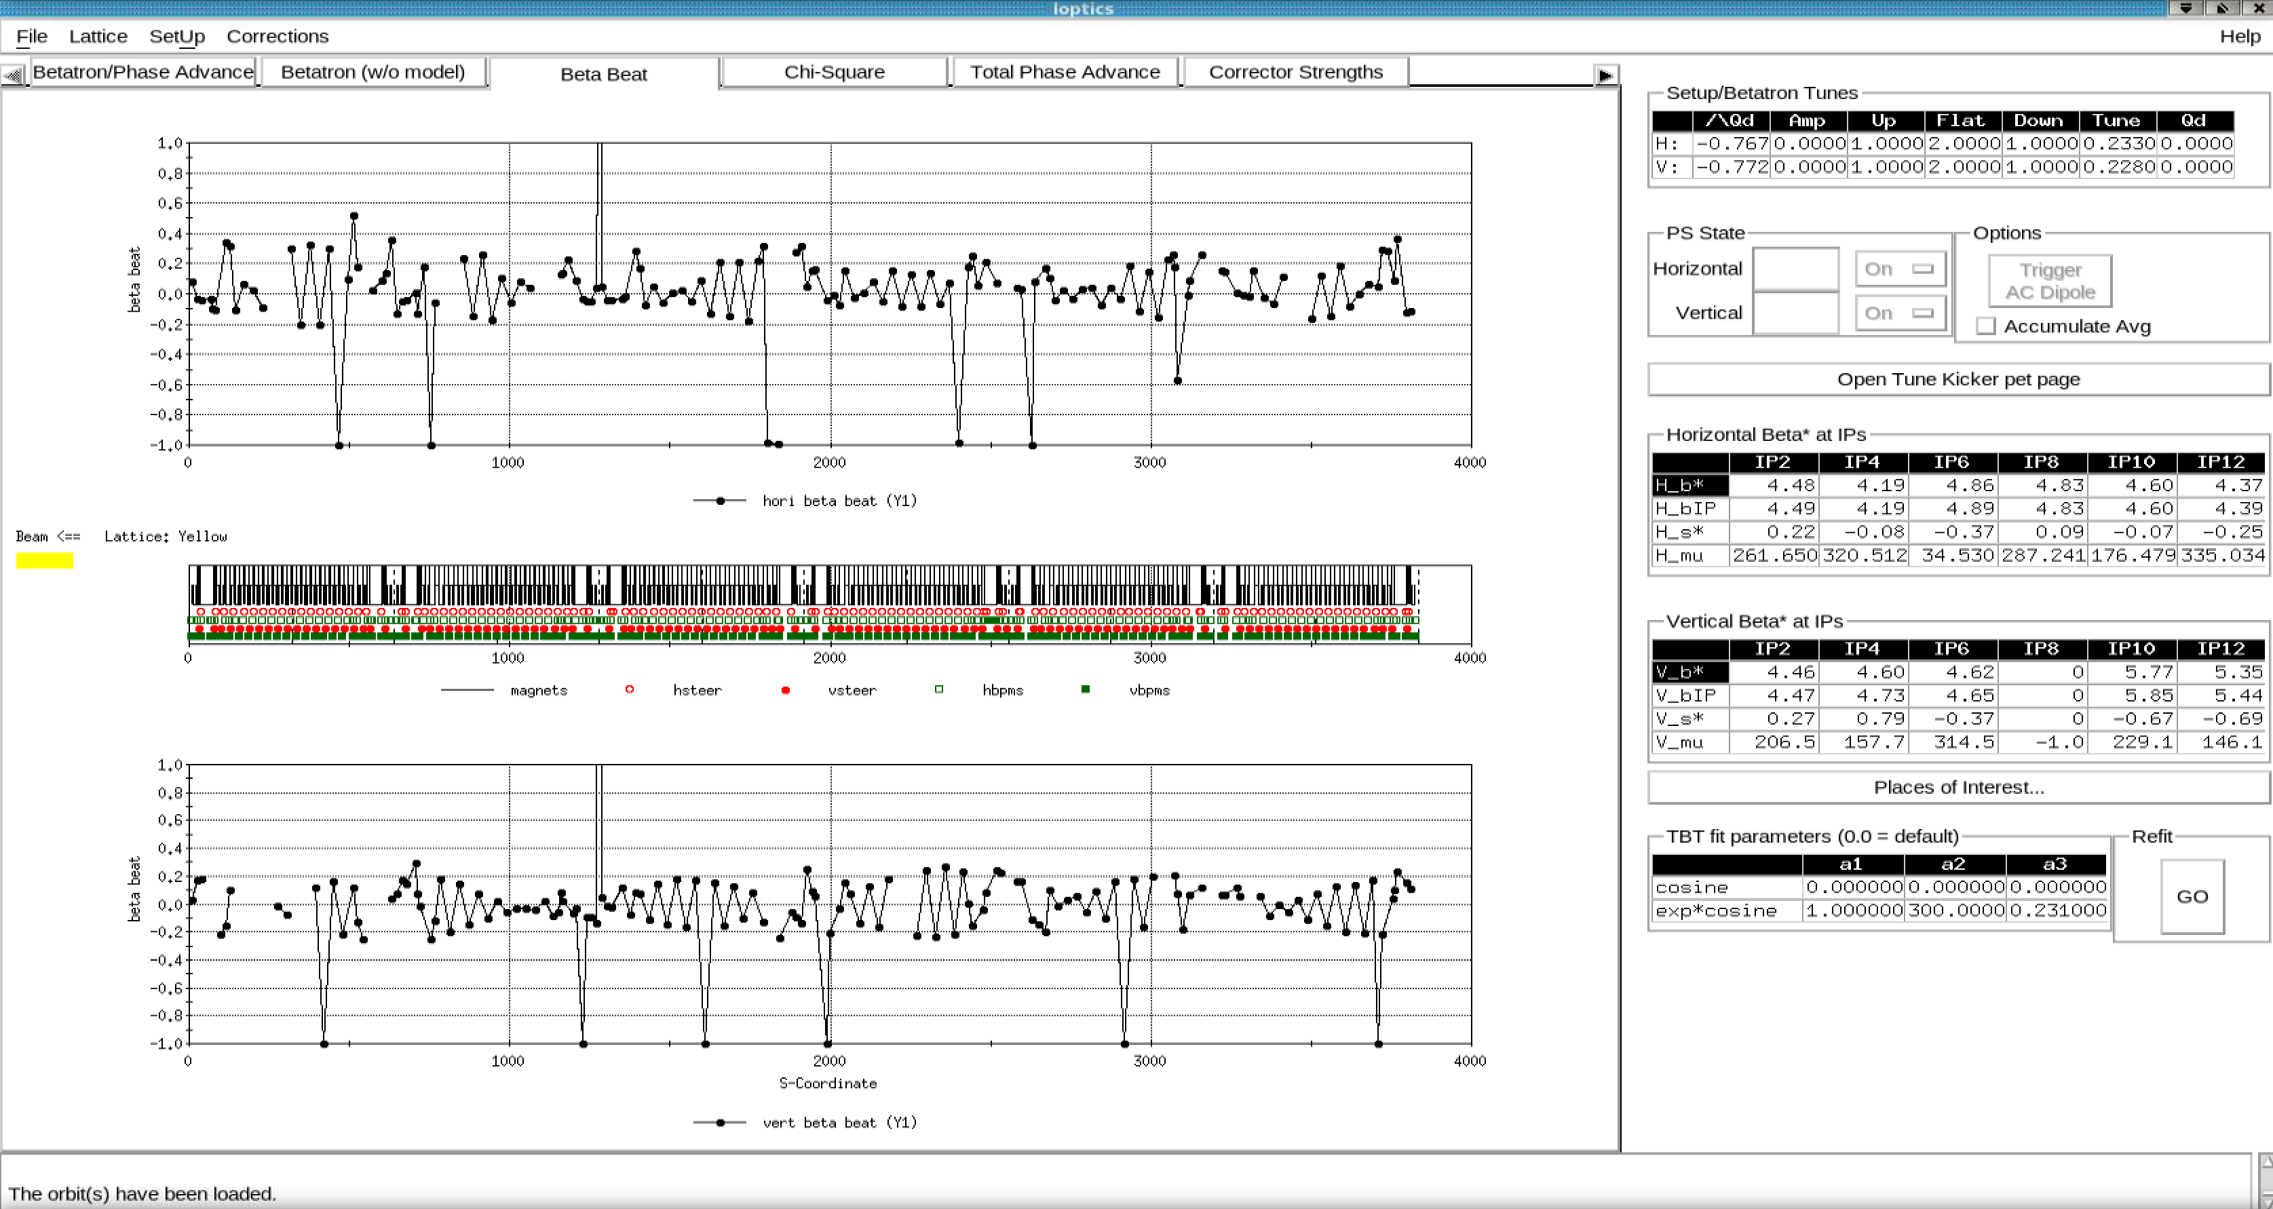
2021 APEX w/ 100 GeV/u Au ions
Linear optics functions measured at store with the full +1% excursion (low chromaticities) – Short IR
RSp1

Slide 17
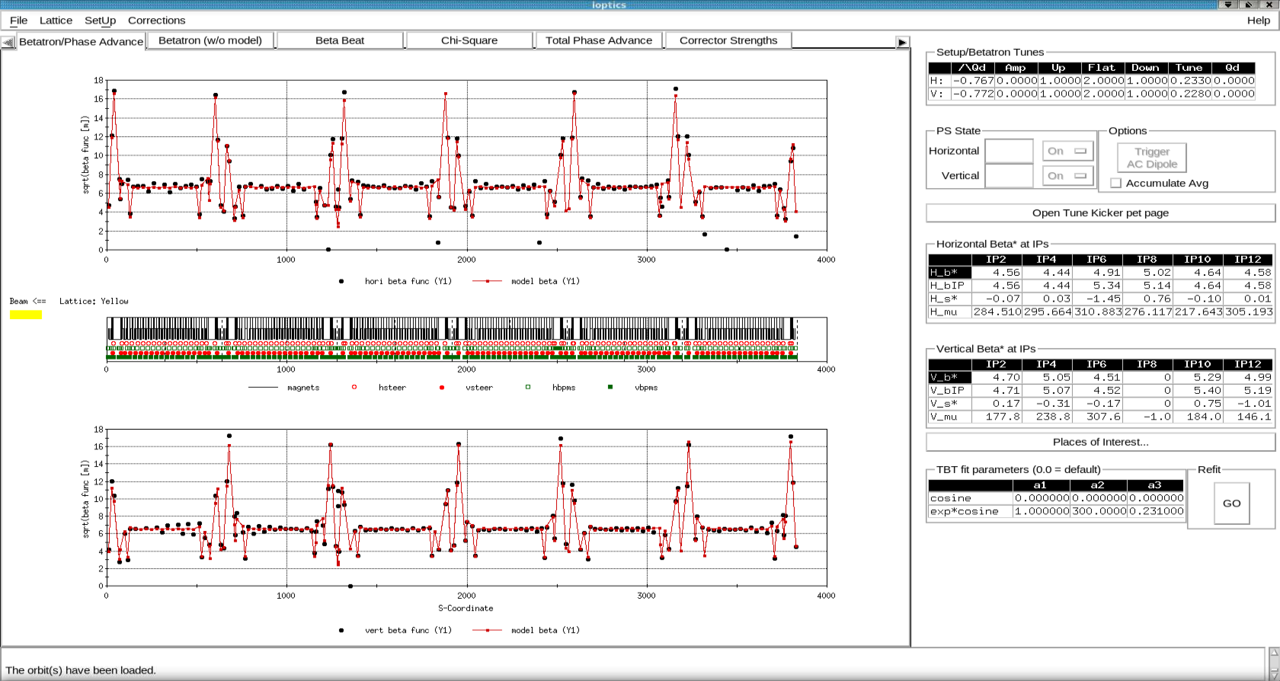
2021 APEX w/ 100 GeV/u Au ions
Linear optics functions measured at store with the full +1% excursion (low chromaticities) – Long IR
RSp1long

Slide 18
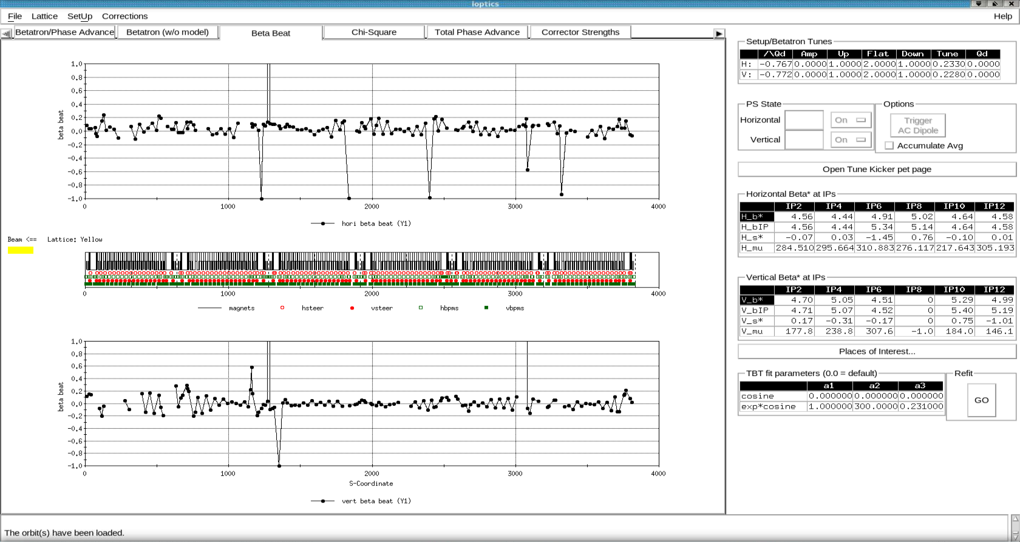
2021 APEX w/ 100 GeV/u Au ions
Linear optics functions measured at store with the full +1% excursion (low chromaticities) – Long IR
RSp1long

Slide 19
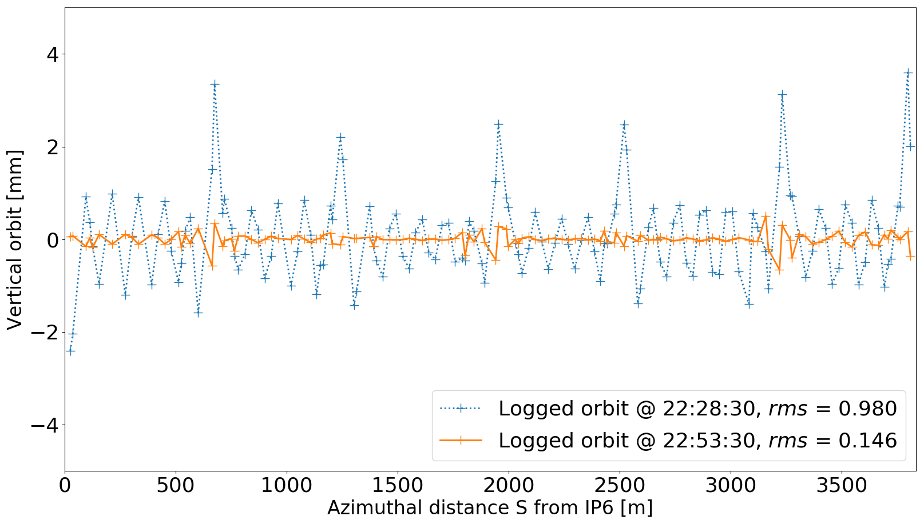
2022 APEX w/ 255 GeV pp
Since RHIC feedbacks cannot correct radially shifted lattices, we used a more “traditional” method with the SVD algorithm inside of MAD-X applied to one of the logged vertical orbits for δB = -0.5%.

Slide 20
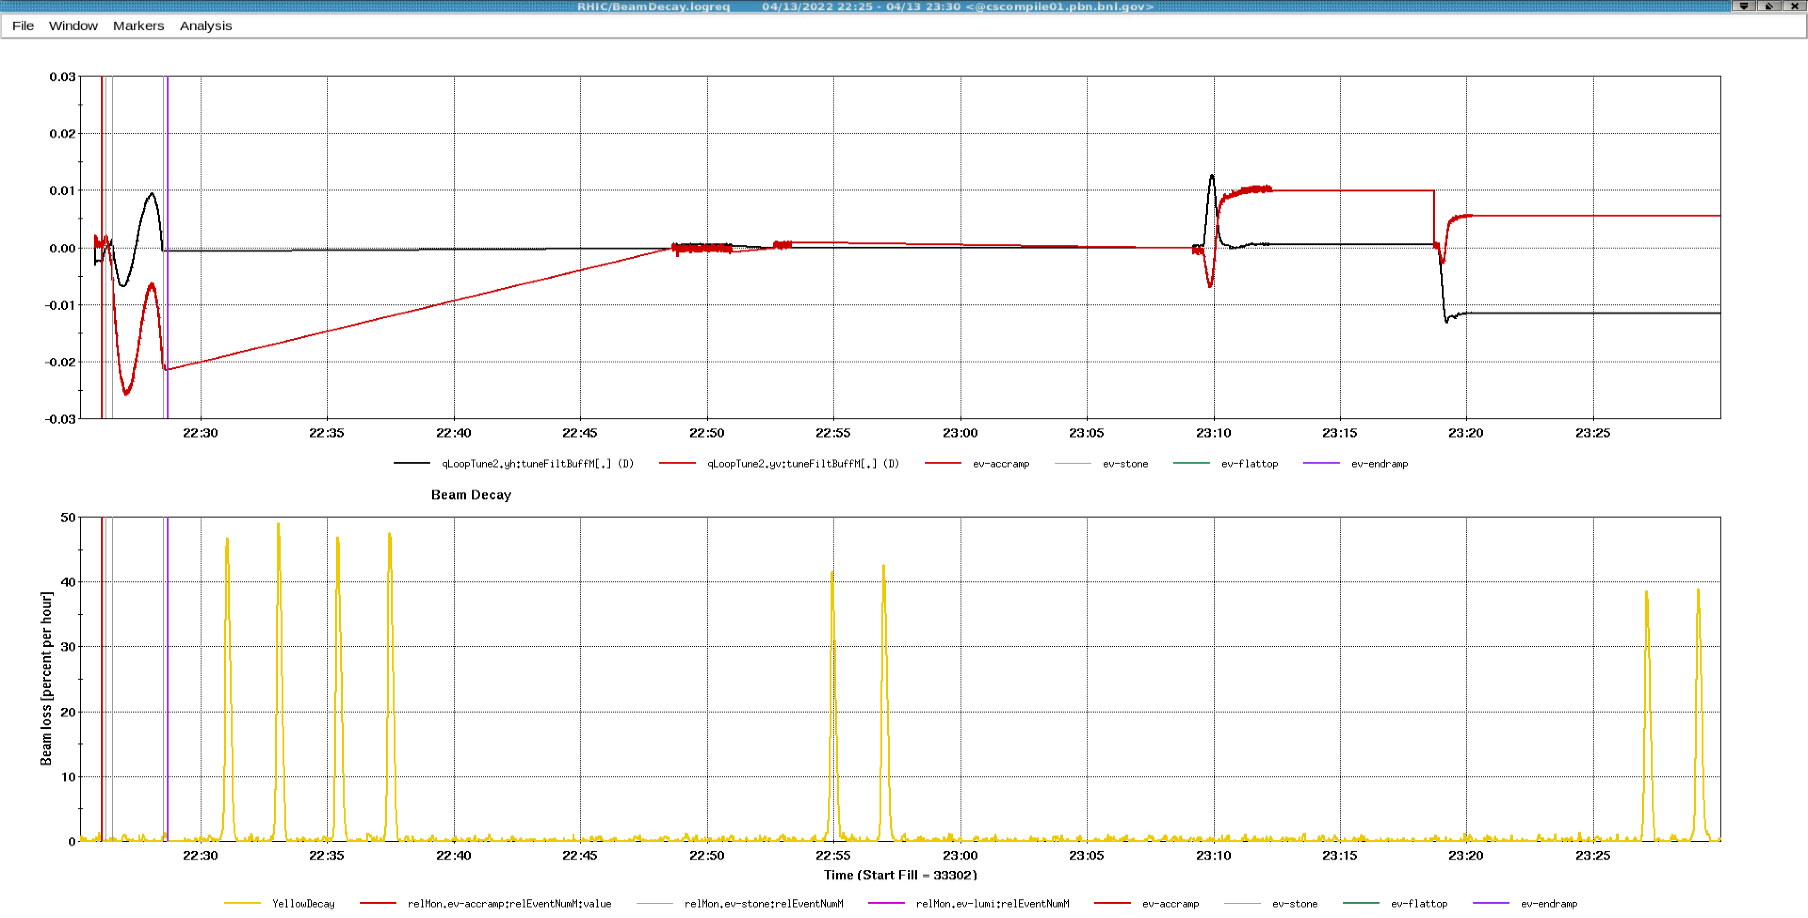
2022 APEX w/ 255 GeV pp
Since RHIC feedbacks cannot correct radially shifted lattices, we used a more “traditional” method with the SVD algorithm inside of MAD-X applied to one of the logged vertical orbits for δB = -0.5%.
In addition to correcting the orbit, two more items were tested: (1) the RHIC Chromaticity control knob, from the on-axis online model; (2) the effect of zero’ing the octupoles on the chromaticity at large excursions. For these tests, as well as for the vertical orbit correction, the tune/coupling feedback was turned ON to keep the tunes constant:
Vert. orbit correction
Chrom change
Octupoles at zero
Octupole fields in magnets would explain chromaticity behavior!

