Slide 1
23-02 Machine Learning Experiments at RHIC
X. Gu, G. Robert-Demolaize, Brendan Lepore, Y. Hao, Will Fung
24-02 ML-based Global and Local Coupling Measurement/Correction Chuyu, Xiaofeng Gu
25-05 Improving Optics Measurement and Control for EIC Diagnostics via Statistical Modeling
William Fung, Yue Hao, Xiaofeng Gu

Slide 2
Machine Learning Experiments at RHIC
(IP8 optics tunning with crossing angle and short vertex)
X. Gu, G. Robert-Demolaize, Brendan Lepore
Y. Hao, Will Fung
Jan 22, 2025

Slide 3
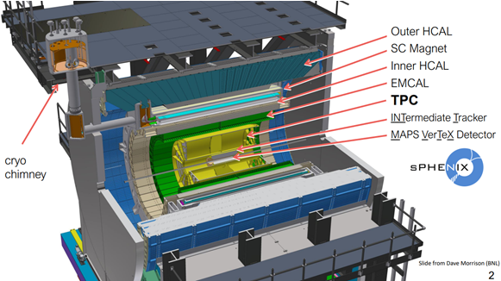
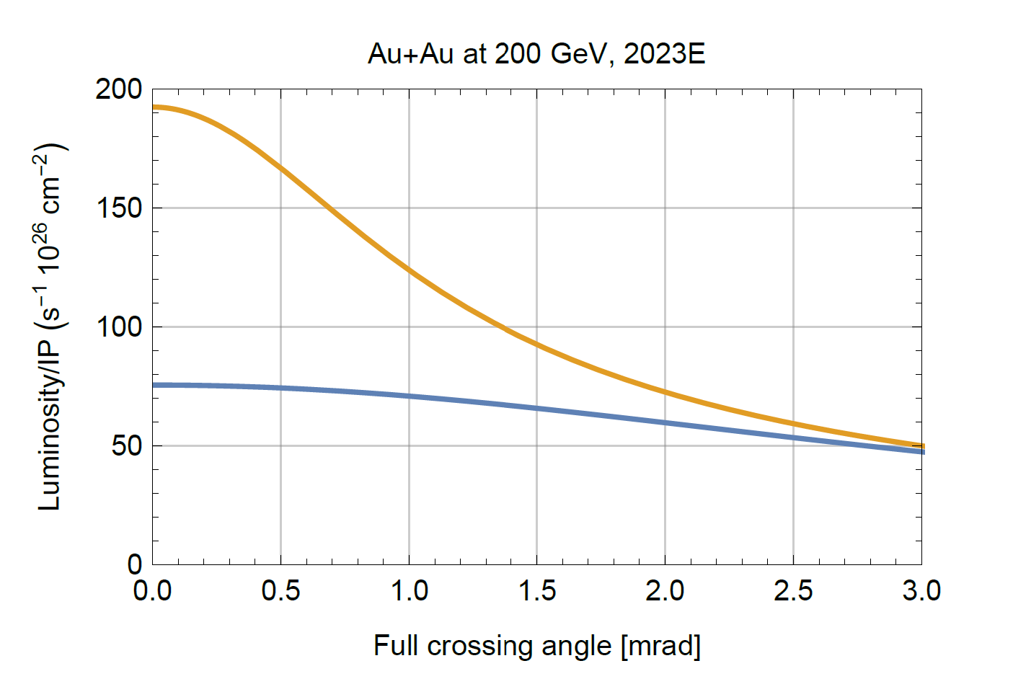
sPHENIX Luminosity Optimization
New detector sPHENIX is being commissioned in 2023.
Physics study needs higher luminosity.
VTX (+/-10 cm)
Crossing angle (2mrad)
S/N - Background
Luminosity depends on:
Global Parameters:
Orbit (Dipole)
Tune (Quadrupole),
Chromaticity (Sextuple)
Octupole
RF cavity
Local (IR8) Parameters:
Beta*
S* (more sensitive than head on)
Bunch length
ALL
VTX
Courtesy of W. Fischer

Slide 4
Optimization Diagram
s* 2023
Quad knobs 2023
Generate by MADX
Quad knobs
GPTune
Luminosity
GPTune 2023
Luminosity

Slide 5
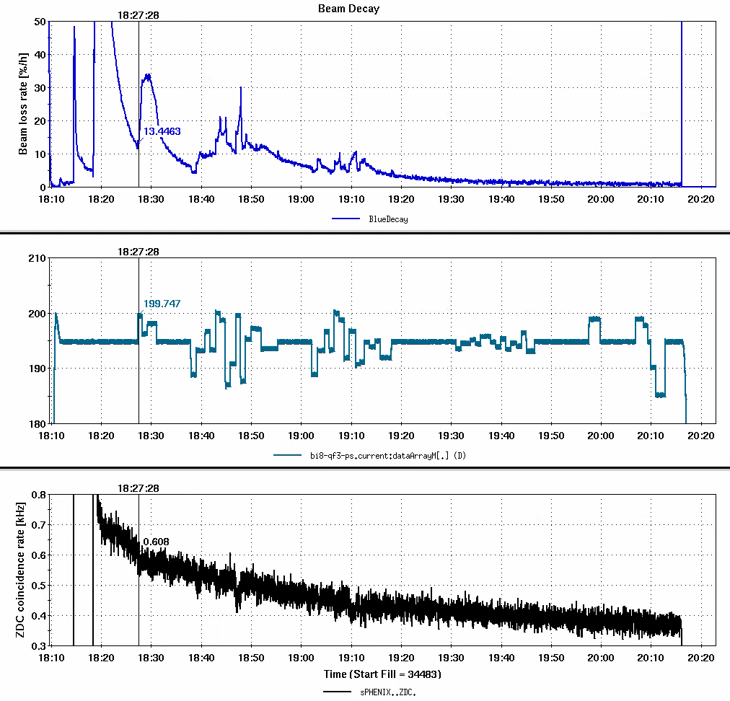
The First sPhenix ZDC GPTune Optimization 05/16/2024
S*: +/-0.5 m without decay compensation
S*: +/-0.5 m; +/-0.1 m.
S*(x plane): 0.74-0.76m; 0.8m->0.4m->0m->-0.4m->-0.8m.
S* > 0.8 m, MADX didn’t find solutions.
Blue Beam Loss
+/-0.5 m
+/-0.5 m
+/-0.1 m
0.74-0.76m
Beam loss is acceptable.
ZDC rate was changed. Didn’t see any visible improvement with ± 10% pp noise.
With +/- 0.8m, it is expected 17% change for ZDC rate.
GPTune works with std ±10% (pp) noisy signals ±15%!
GPTune Signal
0.8 to -0.8m
sPhenix ZDC rate

Slide 6
Reasons and Plan for Luminosity Optimization
S* control:
Base line: s*x = 1.19m, s*y = 0.67m
Move s*x -> -0.5 m: s*x = 1.14m, s*y = 0.01
Move s*x -> 0.5 m: s*x = 0.74m, s*y = 0.35
S* Measurement: lattice and real machine
Magnet hysteresis: Same current can have different field (up or down ramp)
Too large beam size: the emittance was 3~4 higher than nominal.
Optimal S* already: is very closed to its optimal and don’t need to do anything!
More than 20 times luminosity now.
S* measurement to confirm
Using Power supplies instead of S*
Control Power supplies only ramp to one direction
Improve Emittance: Done
Explore other control parameters?
Optimize Luminosity vs Reduce background?
sPHENIX detector or MVTX signal were OFF.
Orbit Tune feedback
Global Parameters:
Orbit (Dipole)
Tune (Quadrupole),
Chromaticity (Sextuple)
Octupole
Local (IR8) Parameters:
Beta* (beam size)
S* (longitudinal beam waist)
Transverse offset
Other Parameters:
RF Voltage
Collimator Position

Slide 7
Improved Optics Control and Measurement
See Will Fung’s Talk.

Slide 8
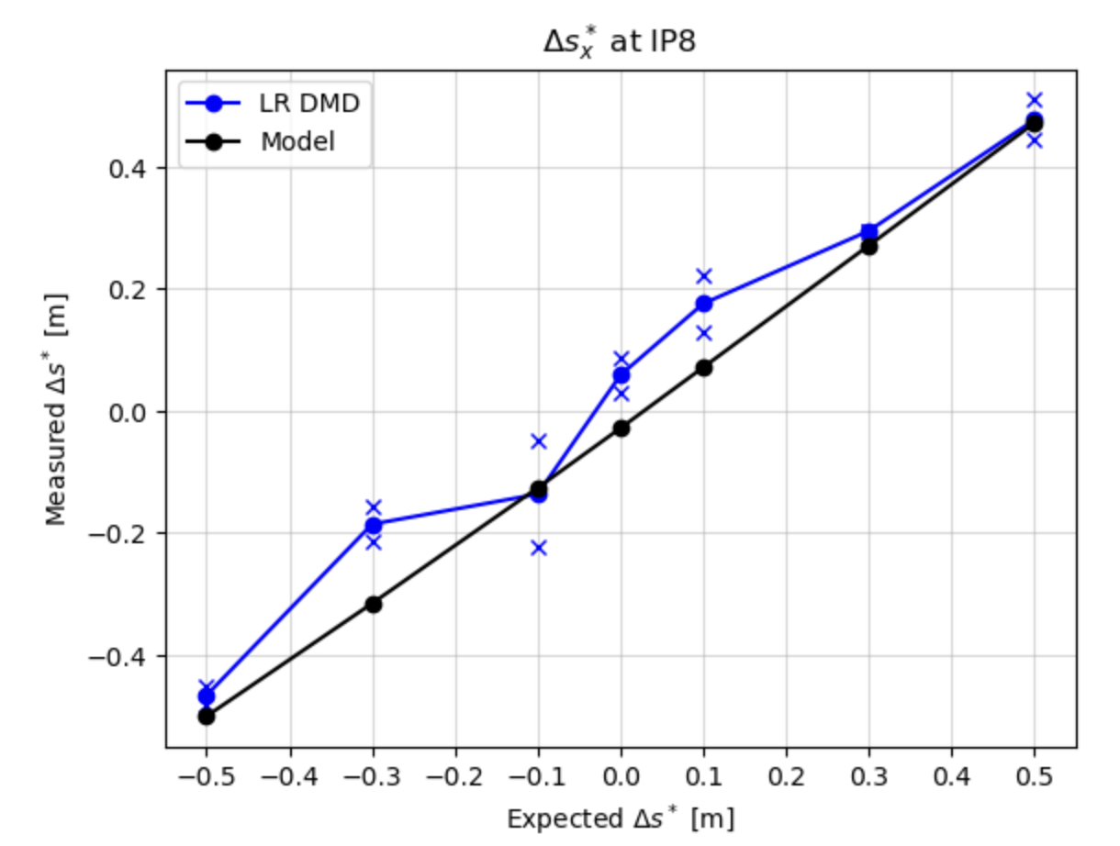
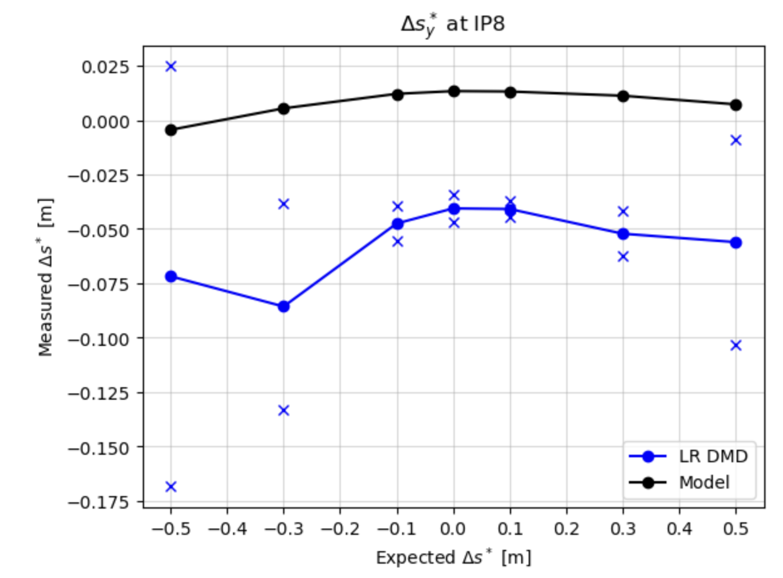
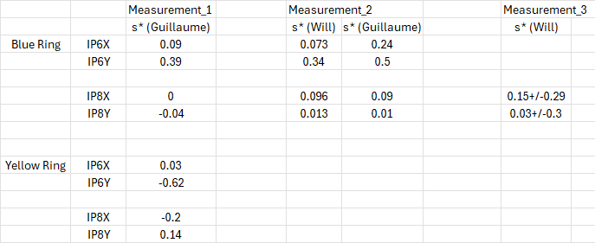
Improved Optics Control and Measurement
Able to show on average that Δs*_{x} increases while Δs*_{y} is fairly constant (red vs black)
During the EIC director's review (Oct. 2024), it was asked what the effect on the EIC luminosity would be if the location of minimum beta for the electron and/or hadron beam was longitudinally offset from the IP.
With our APEX result, we have provided the RHIC s* star measurement with 0 offset.

Slide 9
Summary and Plan
Summary:
Closed the GPTune optimization loop with sPHENIX ZDC detector
Demonstrated consistent control in changing Δs*x between [-.5, .5]m with minimum variation in Δs*y, be able to fit and retrieve s* and beta* with better uncertainty.
Plan:
Test the GPTune optimization loop with sPHENIX vertex detector
Maybe end of run APEX.
Any/current species/lattice nominal collision (28 bunces) at IP8 with cross angle.

Slide 10
ML-based Global and Local Coupling Measurement/Correction
Chuyu, Xiaofeng Gu
Jan 22, 2025

Slide 11
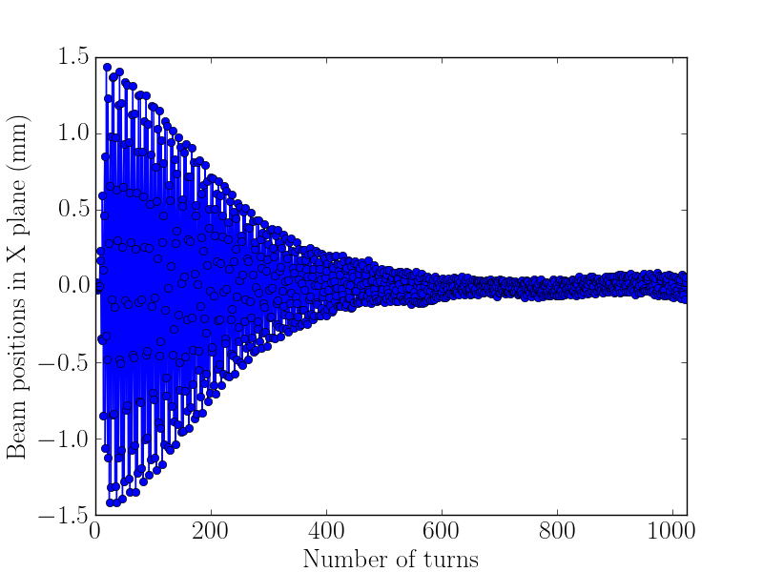
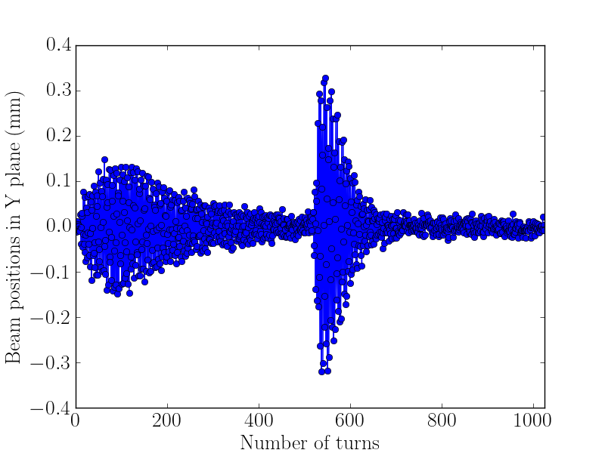
Motivation
Local coupling around the RHIC rings has been observed even with global coupling being compensated by coupling feedback
The observed local coupling is intermittent, excluding ARTUS kicks and BPMs as the source.
Therefore, one would/could make local coupling compensation based on BPM turn-by-turn data.
X coupling
Y coupling

Slide 12
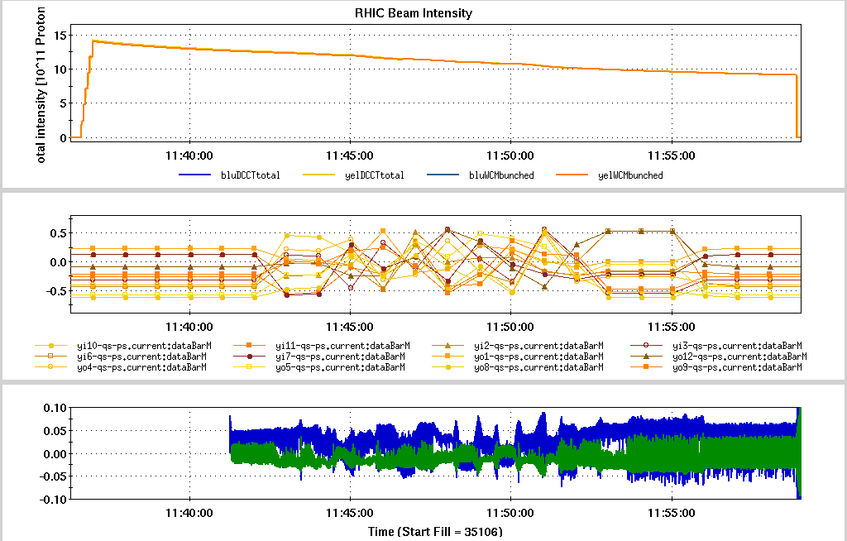
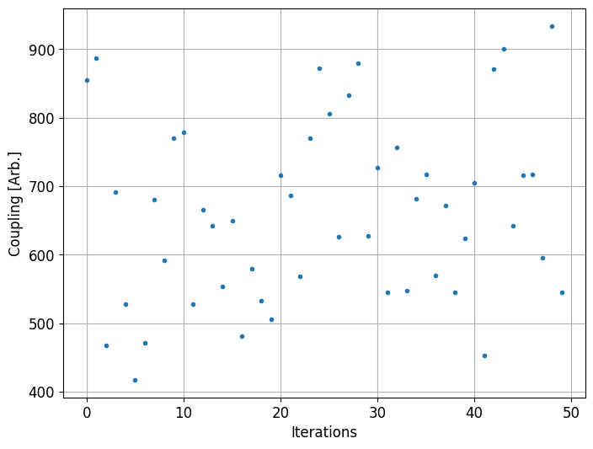
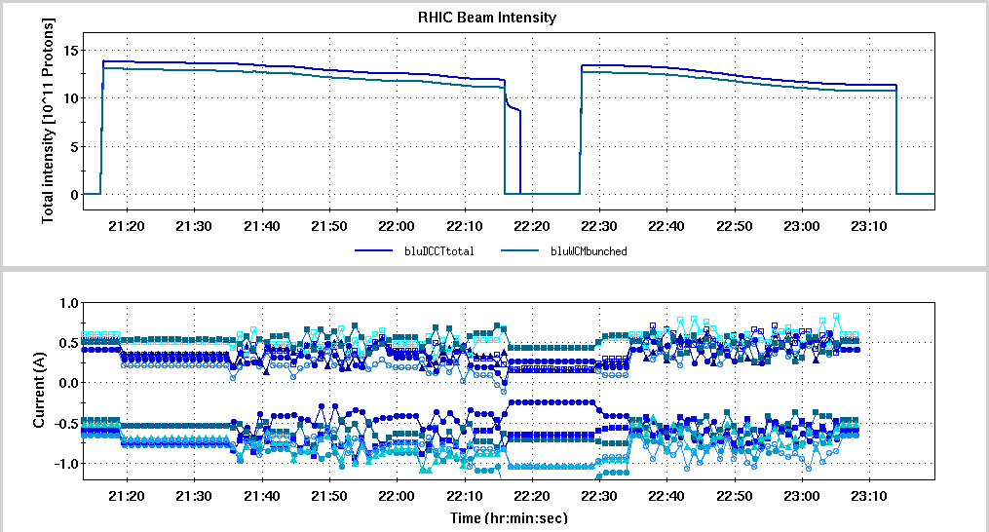
Result
Current tuning range:
I_0 +/- 0.6 A
Objective:
minimize global coupling
Current tuning range:
I_0 +/- 0.2 A
Objective:
minimize local coupling

Slide 13
The Plan Forward
Run the ML script for 100 or more iterations, to see the declining trend of the coupling.
Add global coupling to the objective and rerun the ML script
Add the IR skew quads to the variables
Compare configurations: globally corrected, locally corrected, both corrected, with and without IR skew quads...
Correct coupling at store with optimized ML script

Slide 14
Improving Optics Measurement and Control for EIC Diagnostics via Statistical Modeling
William Fung, Yue Hao, Xiaofeng Gu
Jan 22, 2025

Slide 15
Motivation and Goal
Motivation: EIC requires high precision in optics
Beta functions, dispersion, crab dispersion functions, etc.
Quantifying the uncertainties in these optics will help highlight limitations imposed by current instrumentation
Goal: Enhance understanding of relation between BPM measurement errors and optics uncertainty
Build a statistical model that will help measure this relationship
Improve control over optics
Provide foundational understanding for the precision requirement of EIC Diagnostics

Slide 16
Method
Utilize results from last run to aid in development of statistical models
Development of ORMs to move magnets in an accurate manner
Preprocessing to measure TBT data accurately and consistently
Resulting model will aid in understanding of relation
Can also be used to modify dispersion around RF cavity (Derong’s proposal)
Fit linear 6-by-6 model using turn-by-turn BPM data, incorporating both crab and momentum dispersion
Measure the IBS lifetime

Slide 17
Improved Optics Control and Measurement

Slide 18
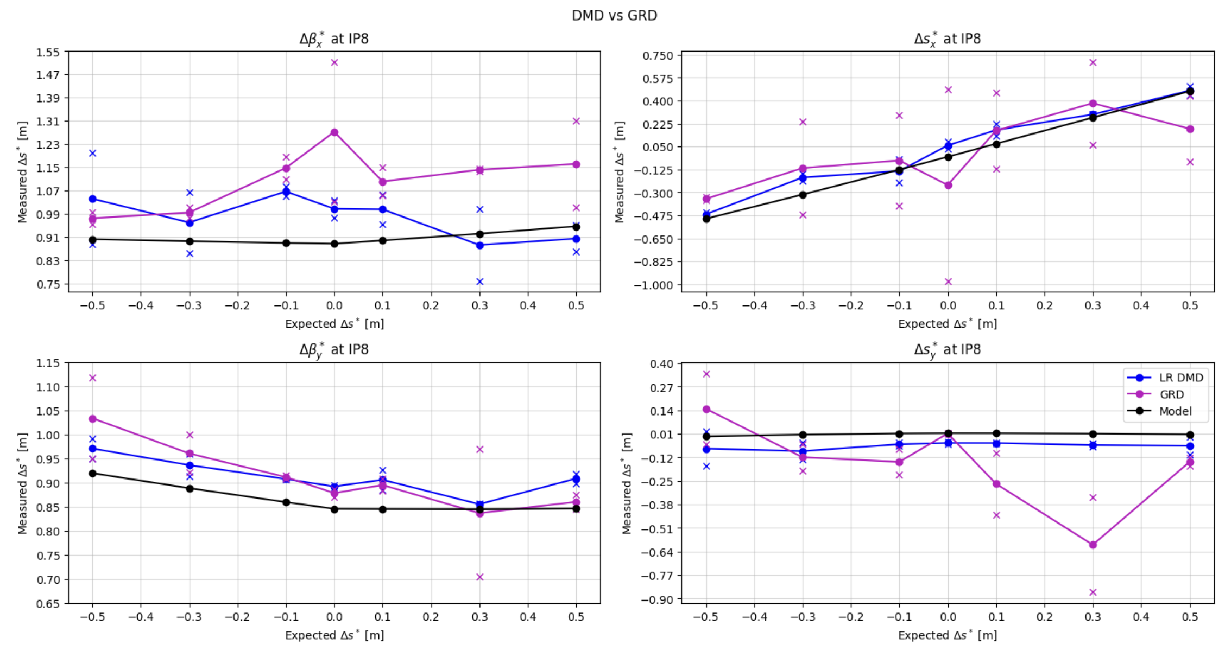
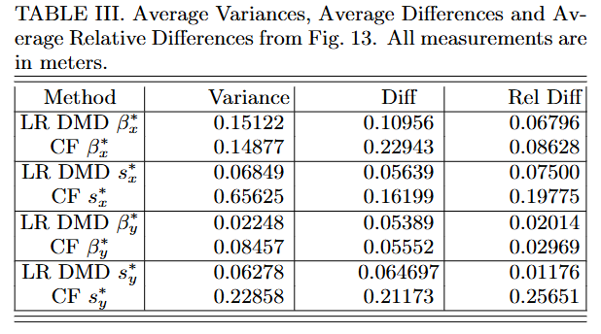
Improved Optics Control and Measurement
Δs*_{x} = 0:
Change IP8 s*_{x} while everything else stays constant
Δs*_{x} = .5:
12 Datasets: move Δs*_{x=} [-.5, -.3, -.1, 0, .1, .3, .5] m
Only s*_{x} IP8 should change while other optics stay constant
Demonstrate accurate movement of magnets as well as improved consistency of optics measurements

Slide 19
Summary and Plan
Summary:
Demonstrated accurate measurements of s* as well as improved consistency of optics measurements with LR DMD method.
The optics measurement and control could be used for EIC which has smaller beam size.
Plan:
Test the effects of BPM noise on the optics measurement via shifting the bpm timing.
Any/current species/lattice blue/yellow ring without collision (6 bunces).
One or two sessions (2 hours/session) or combine with Derong’s proposal.

