Slide 1
Beam Instability Experiments
Alexei Blednykh
L2 System Manager
WBS 6.12 Pre-Operations
APEX Workshop 2025
January 22, 2025

Slide 2
Outline
Longitudinal Space Charge
Particle Tracking Simulations at Injection Energy, 23.8 GeV
Haissinski Equilibrium
APEX on Longitudinal Instabilities in RHIC
Summary

Slide 3
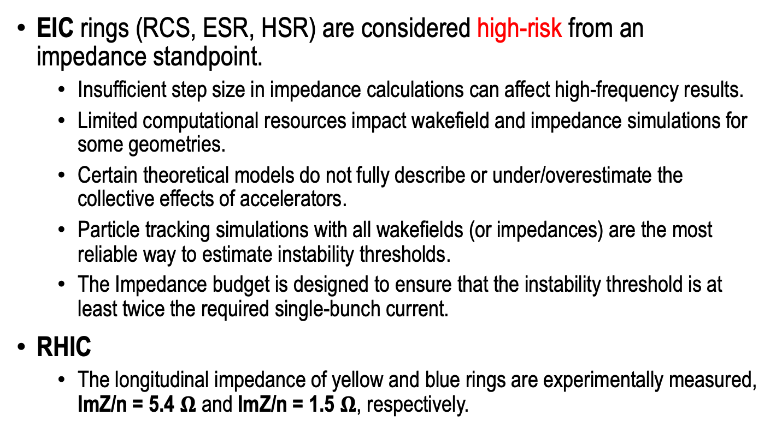
APEX and EIC
EIC rings (RCS, ESR, HSR) are considered high-risk from an impedance standpoint.
  Insufficient step size in impedance calculations can affect high-frequency results.
  Limited computational resources impact wakefield and impedance simulations for some geometries.
  Certain theoretical models do not fully describe or under/overestimate the collective effects of accelerators.
  Particle tracking simulations with all wakefields (or impedances) are the most reliable way to estimate instability thresholds.
  The Impedance budget is designed to ensure that the instability threshold is at least twice the required single-bunch current.
RHIC
  The longitudinal impedance of yellow and blue rings are experimentally measured, ImZ/n = 5.4 $Ω$ and ImZ/n = 1.5 $Ω$, respectively.

Slide 4
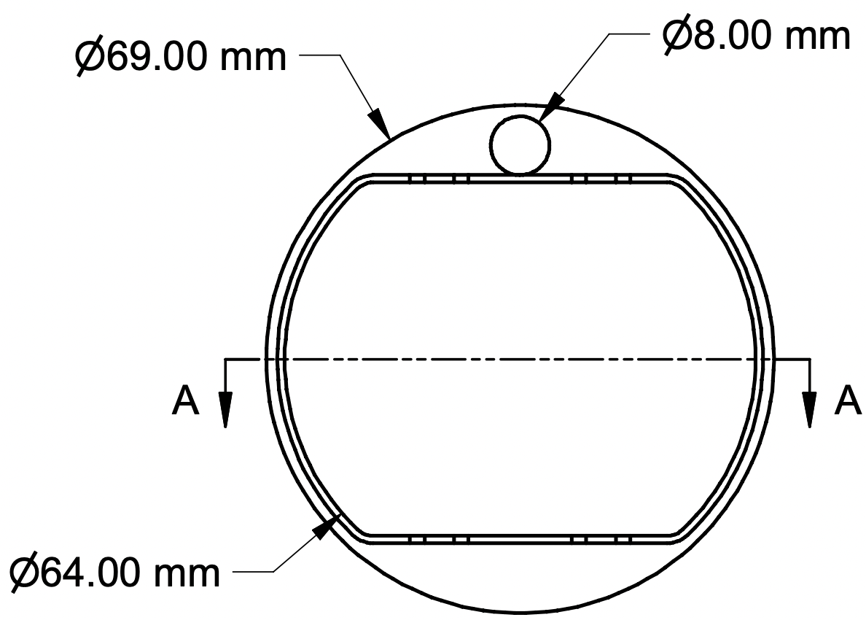
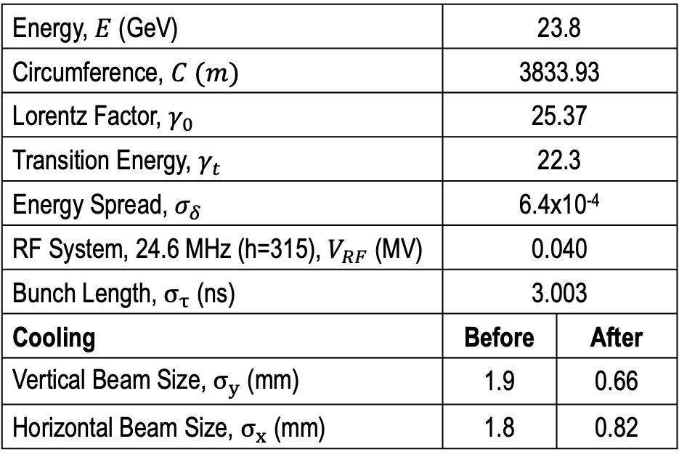
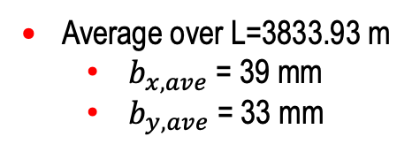
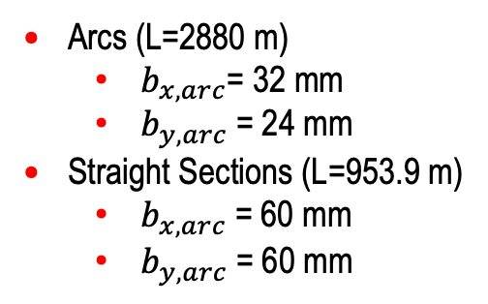
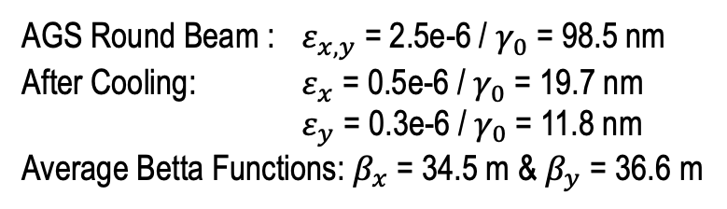
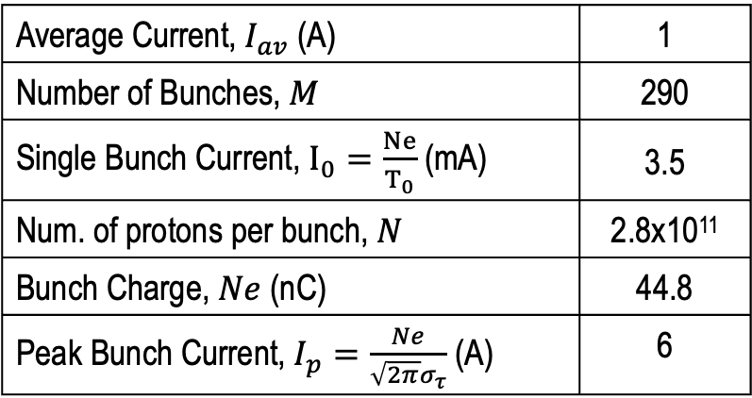
HSR Beam Parameters At Injection Energy
Energy, $E$ (GeV) | 23.8
Circumference, $C (m)$ | 3833.93
Lorentz Factor, $γ_{0}$ | 25.37
Transition Energy, $γ_{t}$ | 22.3
Energy Spread, $σ_{δ}$ | 6.4x10⁻⁴
RF System, 24.6 MHz (h=315), $V_{RF}$ (MV) | 0.040
Bunch Length, $σ_{τ}$ (ns) | 3.003
Cooling | Before | After
Vertical Beam Size, $σ_{y}$ (mm) | 1.9 | 0.66
Horizontal Beam Size, $σ_{x}$ (mm) | 1.8 | 0.82
Average Current, $I_{av}$ (A) | 1
Number of Bunches, $M$ | 290
Single Bunch Current, $I_{0}=\frac{Ne}{T_{0}}$ (mA) | 3.5
Num. of protons per bunch, $N$ | 2.8x10¹¹
Bunch Charge, $Ne$ (nC) | 44.8
Peak Bunch Current, $I_{p}=\frac{Ne}{\sqrt{2π}σ_{τ}}$ (A) | 6
Arcs (L=2880 m)
  $b_{x,arc}$= 32 mm
  $b_{y,arc}$= 24 mm
Straight Sections (L=953.9 m)
  $b_{x,arc}$= 60 mm
  $b_{y,arc}$= 60 mm
Arcs
24 mm
AGS Round Beam : $ε_{x,y}$ = 2.5e-6 / $γ_{0}$= 98.5 nm
After Cooling: $ε_{x}$ = 0.5e-6 / $γ_{0}$= 19.7 nm
$ε_{y}$ = 0.3e-6 / $γ_{0}$= 11.8 nm
Average Betta Functions: $β_{x}$ = 34.5 m & $β_{y}$ = 36.6 m
Average over L=3833.93 m
  $b_{x,ave}$= 39 mm
  $b_{y,ave}$= 33 mm

Slide 5
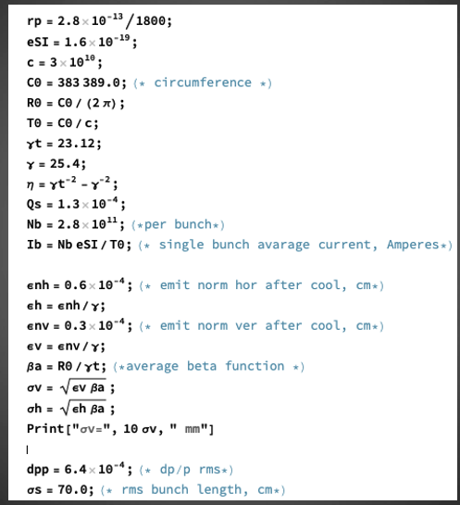
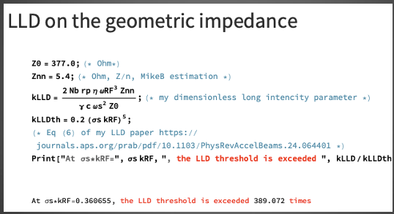

Beam Stability At Injection Energy 23.8 GeV
Theory predicts that the beam is longitudinally unstable at 23.8 GeV energy for the space charge impedance of ImZ/n=2.5 $Ω$ and geometric impedance of ImZ/n= 5.4 $Ω$ (A. Burov – Longitudinal Loss of Landau Damping).

Slide 6
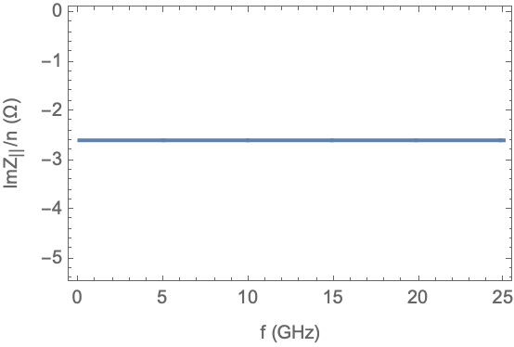
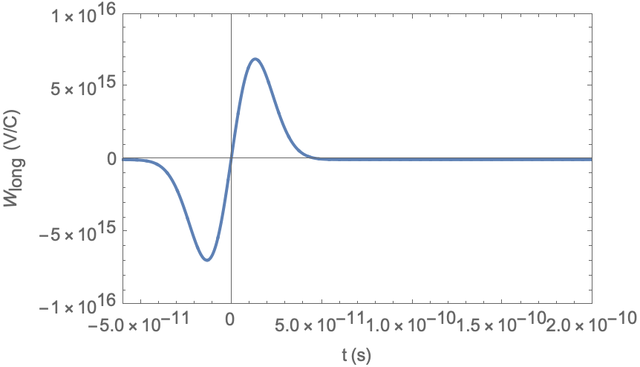

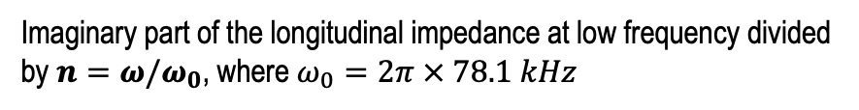

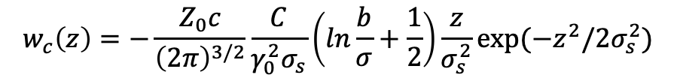
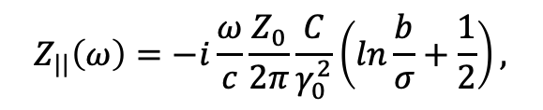
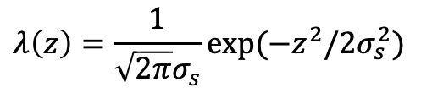


Long. Space Charge Impedance And Wakefield
Longitudinal Space Charge Impedance¹
$Z_{||}\left(ω\right)=i\frac{Sω}{c^{2}}$, where $S=\frac{2C}{γ_{0}^{2}}\left(ln\frac{b}{σ}+\frac{1}{2}\right)$
$$Z_{||}\left(ω\right)=−i\frac{ω}{c}\frac{Z_{0}}{2π}\frac{C}{γ_{0}^{2}}\left(ln\frac{b}{σ}+\frac{1}{2}\right),$$
where b and $σ$ are the radius of the vacuum chamber and beam, C is the ring circumference, $γ_{0}$ is the Lorentz factor and $Z_{0}$ is the impedance of free space
Longitudinal Space Charge Wakefield^{1,2}
Imaginary part of the longitudinal impedance at low frequency divided by $n=ω/ω_{0}$, where $ω_{0}=2π × 78.1 kHz$
$w\left(z\right)=Sδ′(z)$ – point particle
$w_{c}\left(z\right)=Sλ′(z)$ – pseudo-Green’s function
$$λ\left(z\right)=\frac{1}{\sqrt{2π}σ_{s}}exp⁡(−z^{2}/2σ_{s}^{2})$$
Panageotis Baxevanis
$$w_{c}\left(z\right)=−\frac{Z_{0}c}{{\left(2π\right)}^{3/2}}\frac{C}{γ_{0}^{2}σ_{s}}\left(ln\frac{b}{σ}+\frac{1}{2}\right)\frac{z}{σ_{s}^{2}}exp(−z^{2}/2σ_{s}^{2})$$
Longitudinal space charge wakefield for a 4mm bunch length
[1] A. Chao’s Book
[2] P. Baxevanis, EIC Tech Note, Draft

Slide 7
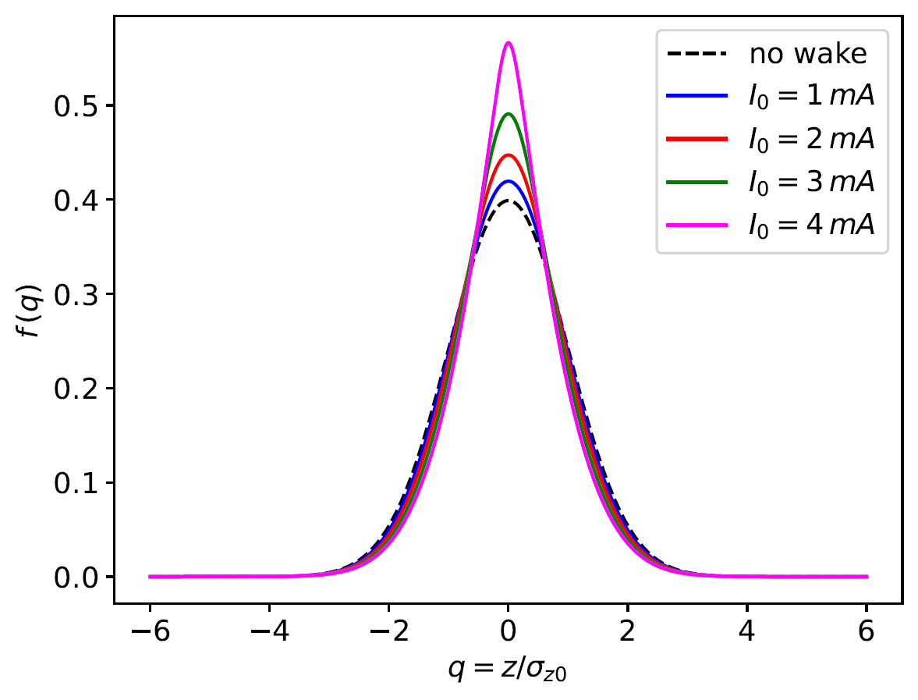


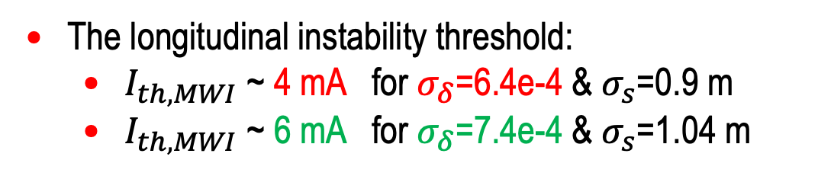
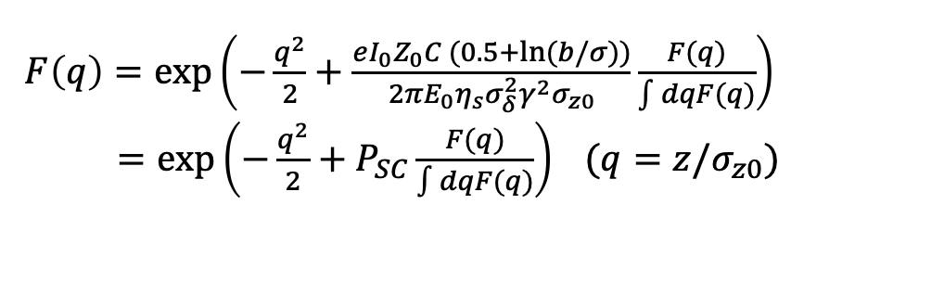
Haissinski Solution For Longitudinal SC Wake
Haissinski solution with longitudinal space charge¹:
An equilibrium solution exists as long as
$P_{SC}≤P_{SC,max}≈1.55$
$σ_{δ}$=6.4e-4
$F\left(q\right)=exp\left(−\frac{q^{2}}{2}+\frac{eI_{0}Z_{0}C (0.5+ln⁡(b/σ))}{2πE_{0}η_{s}σ_{δ}^{2}γ^{2}σ_{z0}}\frac{F(q)}{\int{dqF(q)}}\right)$
$=exp\left(−\frac{q^{2}}{2}+P_{SC}\frac{F(q)}{\int{dqF(q)}}\right) (q=z/σ_{z0}⁡)$
The longitudinal instability threshold:
  $I_{th,MWI}$ ~ 4 mA for $σ_{δ}$=6.4e-4 & $σ_{s}$=0.9 m
  $I_{th,MWI}$ ~ 6 mA for $σ_{δ}$=7.4e-4 & $σ_{s}$=1.04 m
The longitudinal space charge leads to bunch shortening.
Ryan Lindberg, Panageotis Baxevanis
[1] R. Lindberg, APS Tech Note, Draft

Slide 8
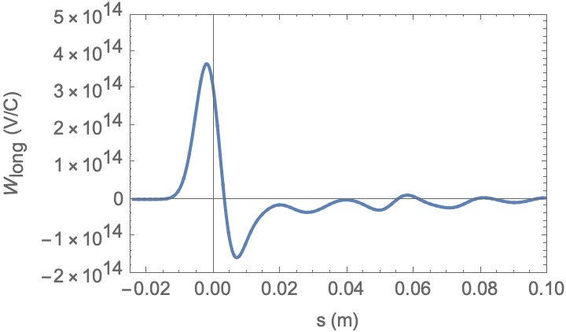
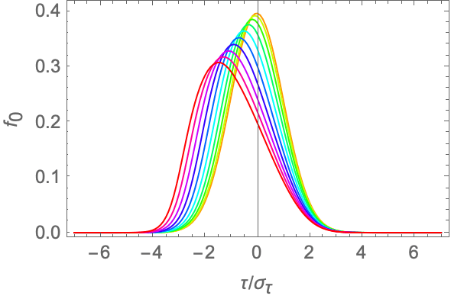
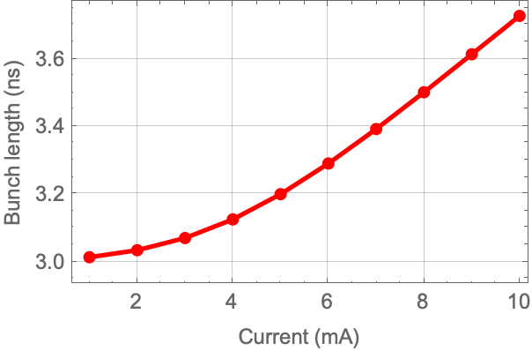
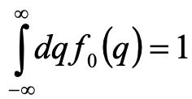
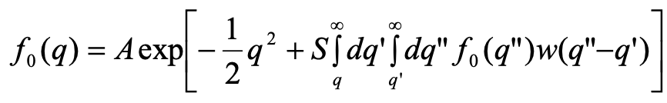
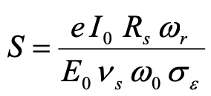
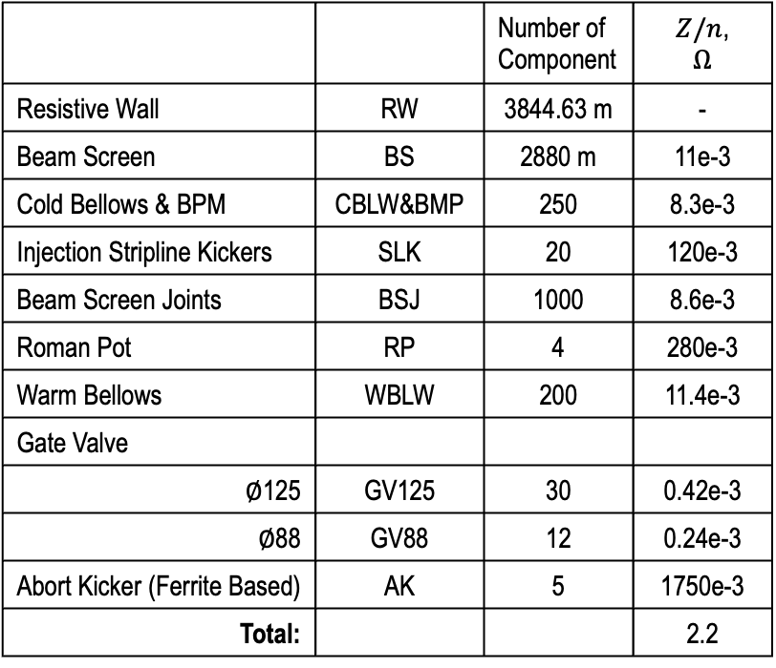
Haissinski Solution For Geom. & RW Wakefields
Total Longitudinal Geom. & RW Wakefield
 |  | Number of Component | $Z/n$, $$Ω$$
Resistive Wall | RW | 3844.63 m | -
Beam Screen | BS | 2880 m | 11e-3
Cold Bellows & BPM | CBLW&BMP | 250 | 8.3e-3
Injection Stripline Kickers | SLK | 20 | 120e-3
Beam Screen Joints | BSJ | 1000 | 8.6e-3
Roman Pot | RP | 4 | 280e-3
Warm Bellows | WBLW | 200 | 11.4e-3
Gate Valve
$∅$125 | GV125 | 30 | 0.42e-3
$∅$88 | GV88 | 12 | 0.24e-3
Abort Kicker (Ferrite Based) | AK | 5 | 1750e-3
Total: |  |  | 2.2
1mA
10mA
The geometric & RW wakefields lead to bunch lengthening.

Slide 9
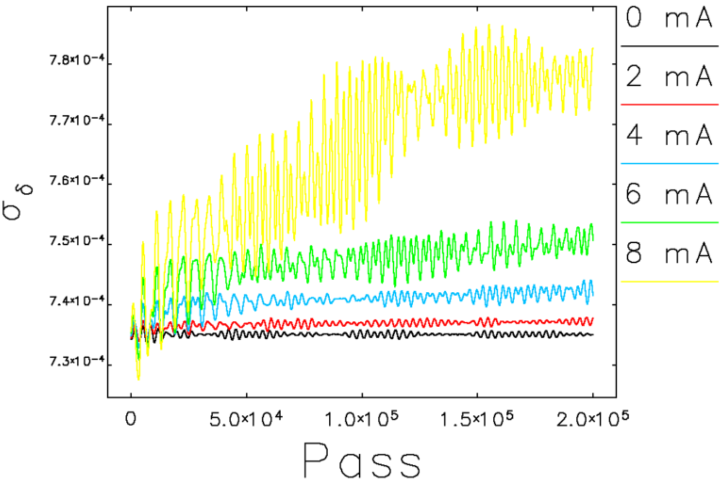
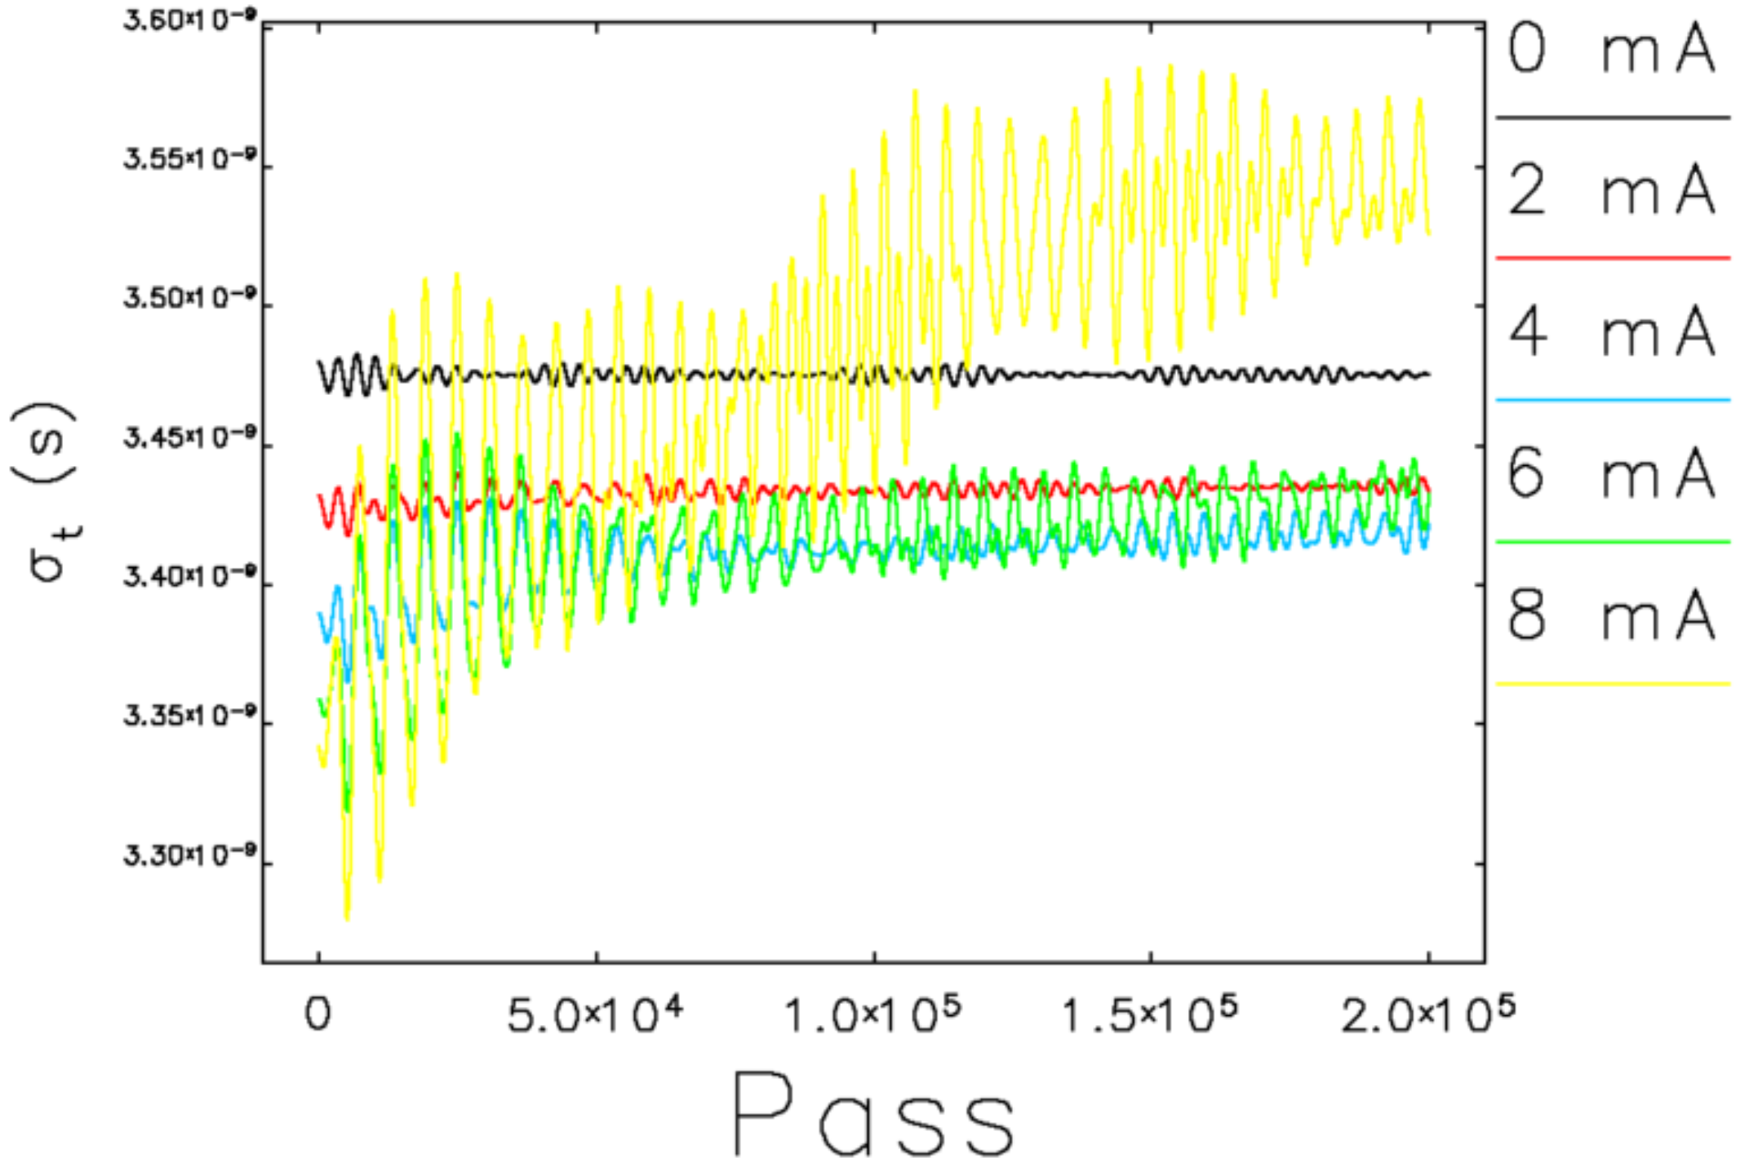
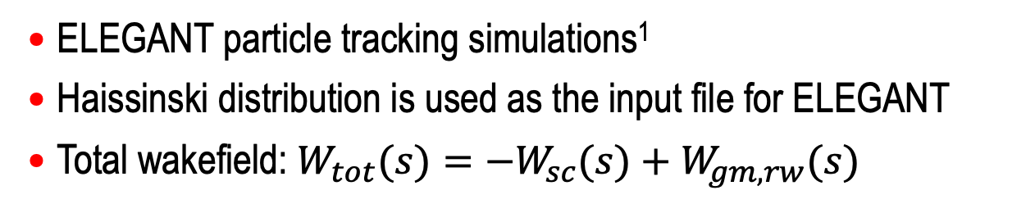

Particle Tracking And Instability Threshold
ELEGANT particle tracking simulations¹
Haissinski distribution is used as the input file for ELEGANT
Total wakefield: $W_{tot}(s)=−W_{sc}(s)+W_{gm,rw}(s)$
ELEGANT
$σ_{δ}$=7.4e-4
The MWI threshold is ~7 mA
[1] M. Borland, “ELEGANT: A Flexible SDDS-Compliant Code for Accelerator Simulation”, ANL, Argonne, IL, USA, Rep. ANL/APS LS-287, Aug. 2000
Ryan Lindberg

Slide 10
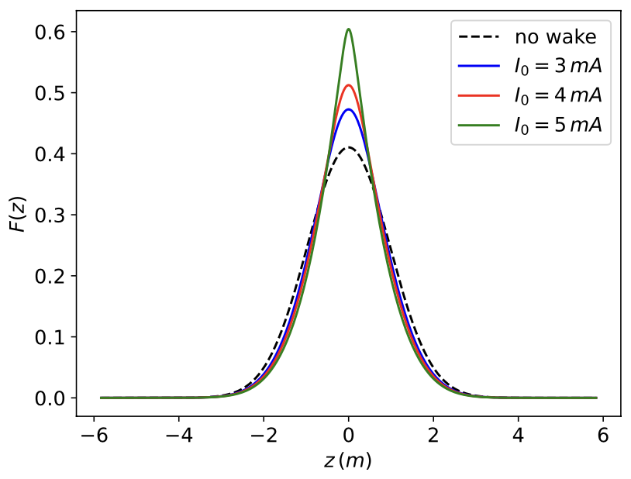
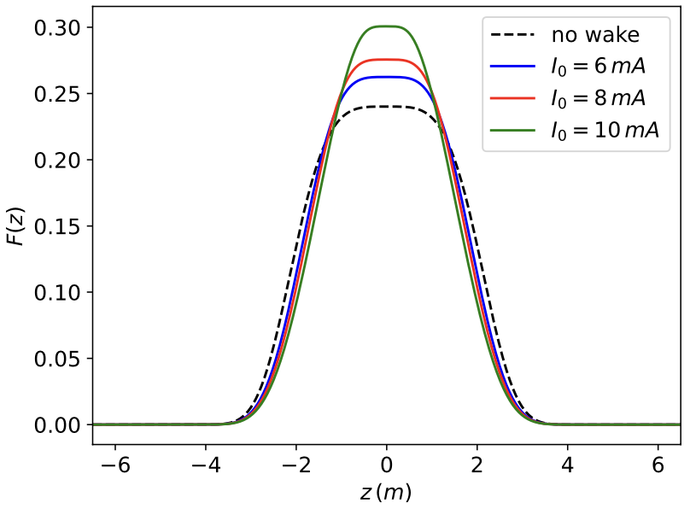
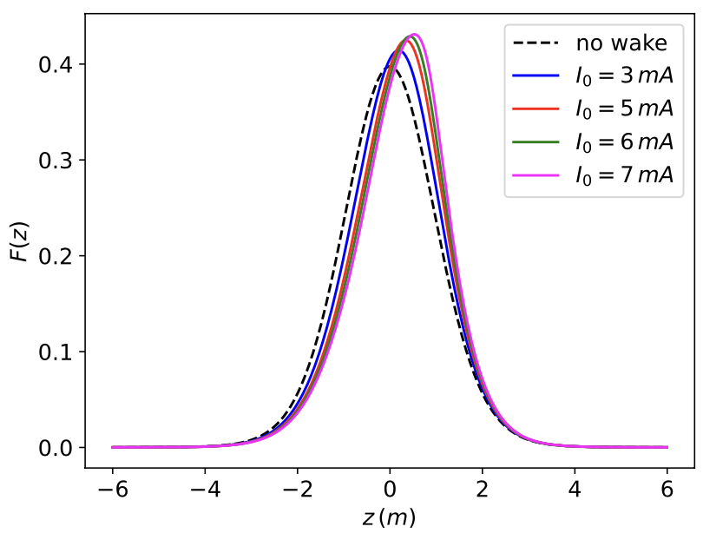
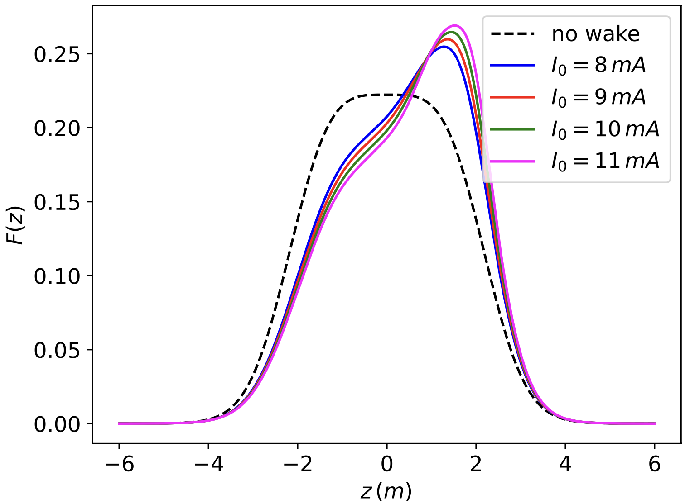
Double RF System (2nd Harmonic)
24 MHz RF System
Double RF System
Space Charge (SC) Impedance: The Haissinski equilibrium exists at 5 mA and at twice that value with the 2nd harmonic cavity.
Geom. + SC Impedance: A factor of 1.5 increase in single-bunch current at which the Haissinski equilibrium exists with the 2nd Harmonic cavity¹.
Working on the transverse space charge wake and its effect on beam dynamics.
See talk by A. Fedotov –
Low-Energy Electron Cooling Experiments
[1] P. Baxevanis and A. Blednykh, BNL-226418-2024-TECH
Ryan Lindberg & Panageotis Baxevanis

Slide 11
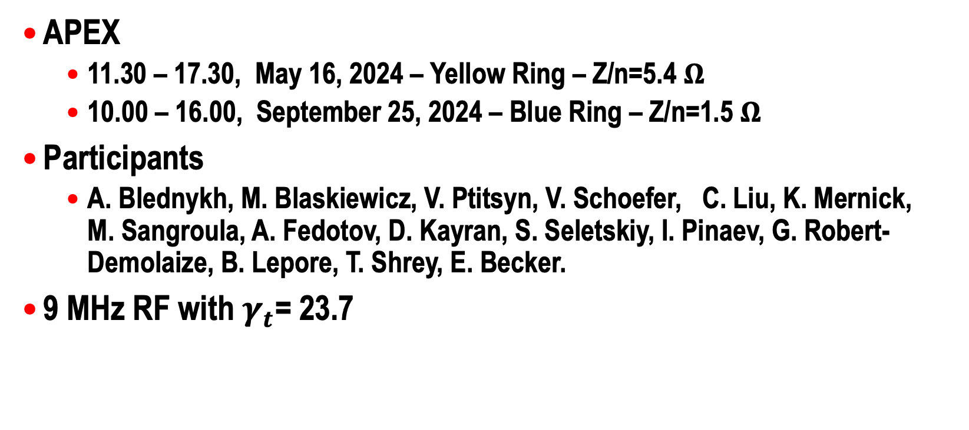
APEX On Longitudinal Instabilities in RHIC
APEX
  11.30 – 17.30, May 16, 2024 – Yellow Ring – Z/n=5.4 $Ω$
  10.00 – 16.00, September 25, 2024 – Blue Ring – Z/n=1.5 $Ω$
Participants
  A. Blednykh, M. Blaskiewicz, V. Ptitsyn, V. Schoefer, C. Liu, K. Mernick, M. Sangroula, A. Fedotov, D. Kayran, S. Seletskiy, I. Pinaev, G. Robert-Demolaize, B. Lepore, T. Shrey, E. Becker.
9 MHz RF with $γ_{t}$= 23.7

Slide 12
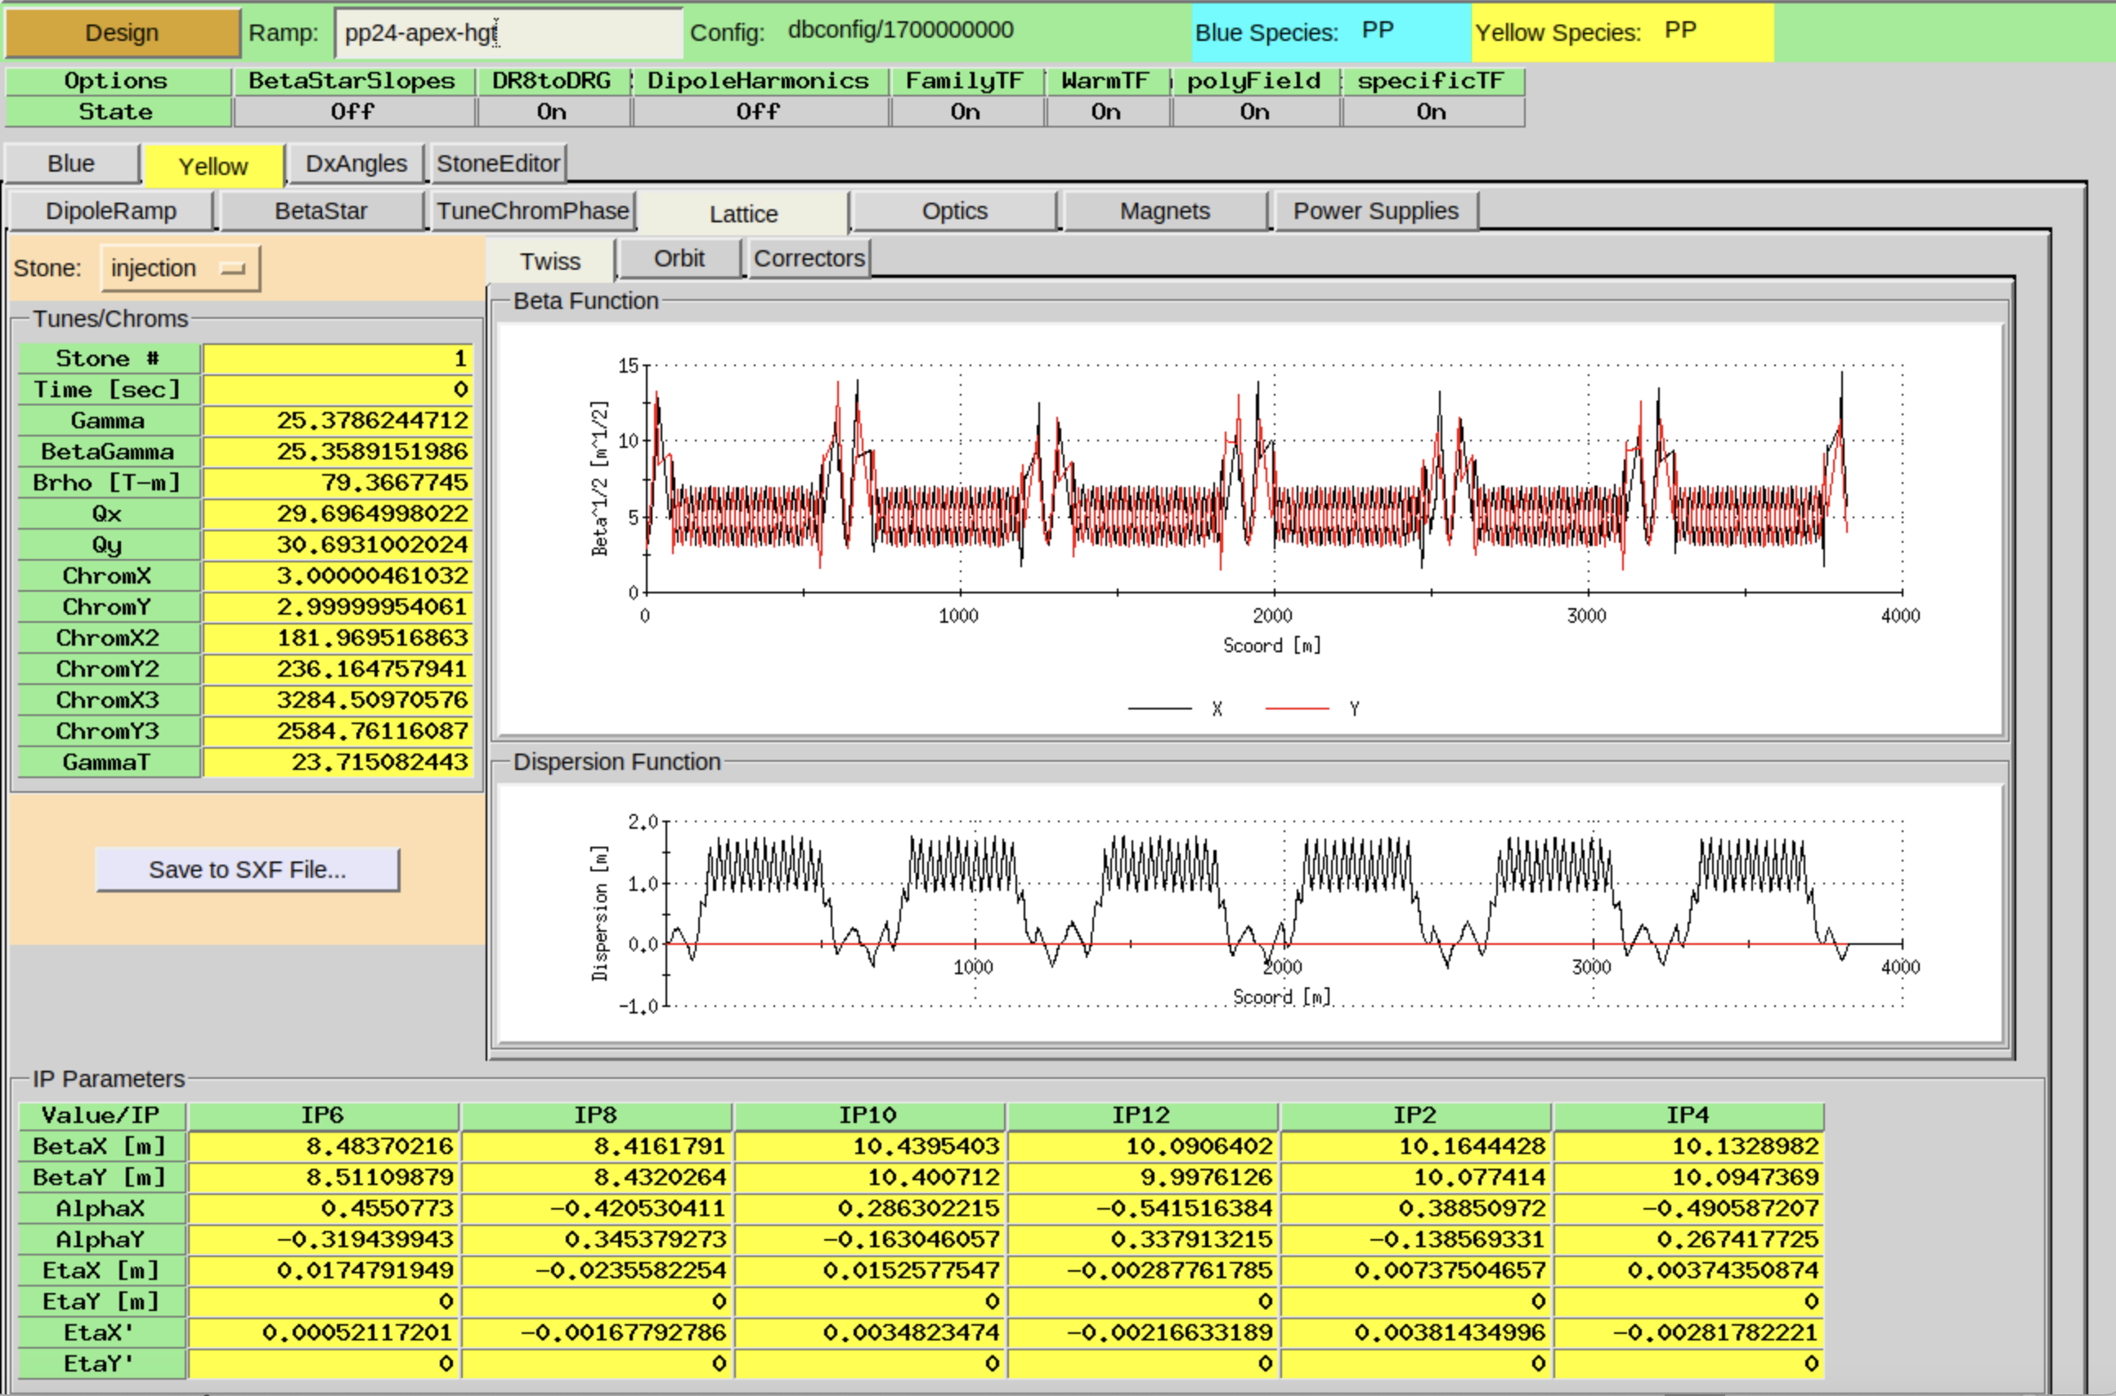
Lattice with $γ_{t}$=23.7
G. Robert-Demolaize

Slide 13
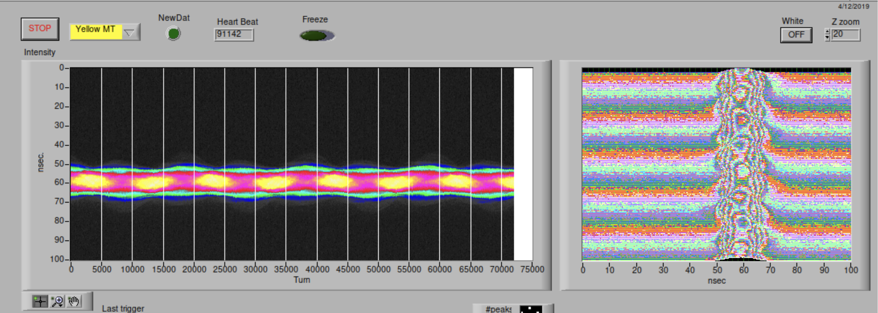
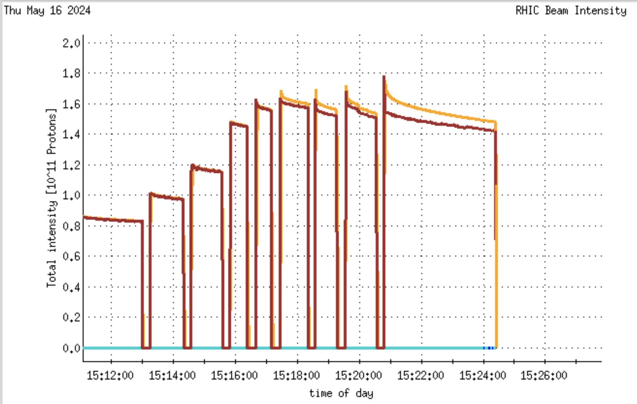
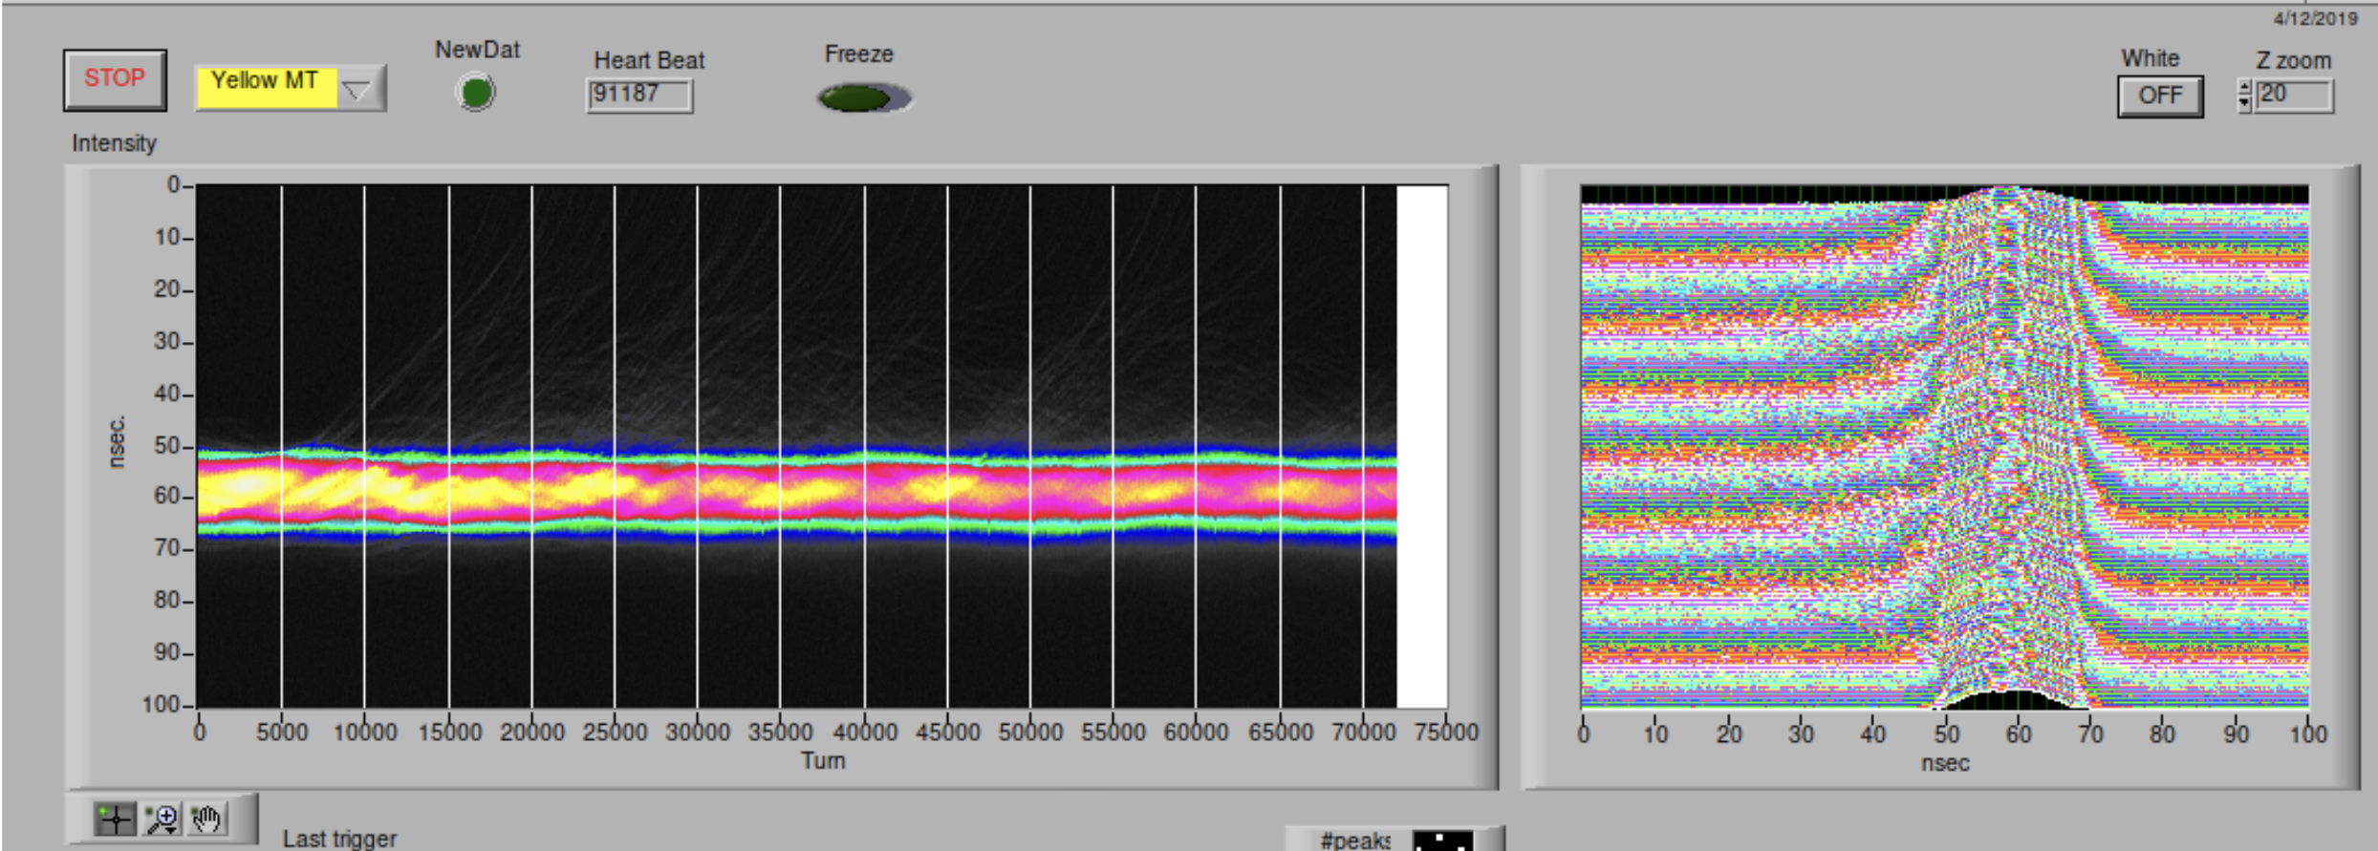
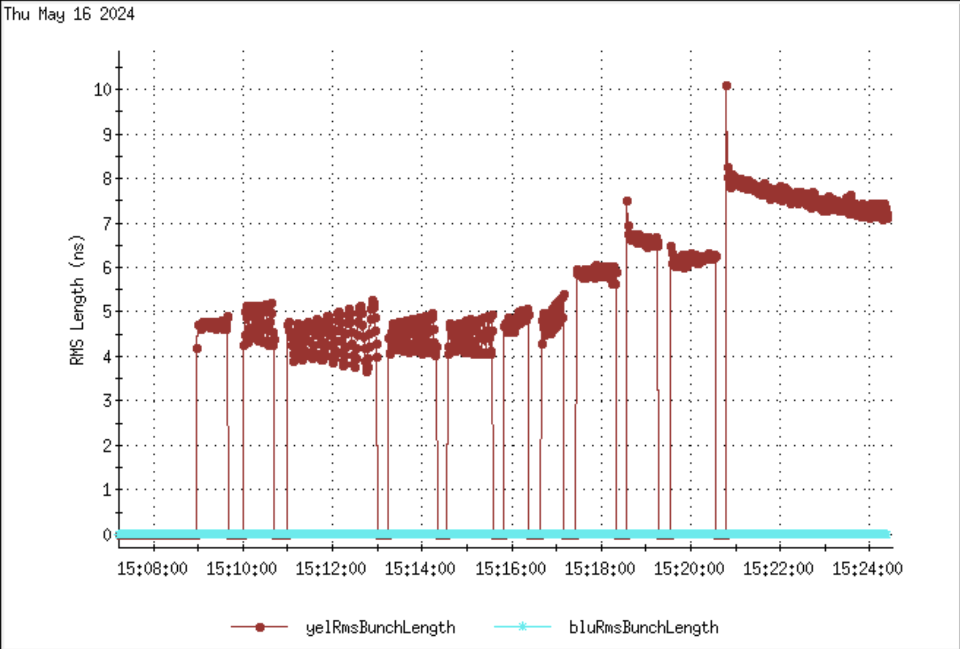
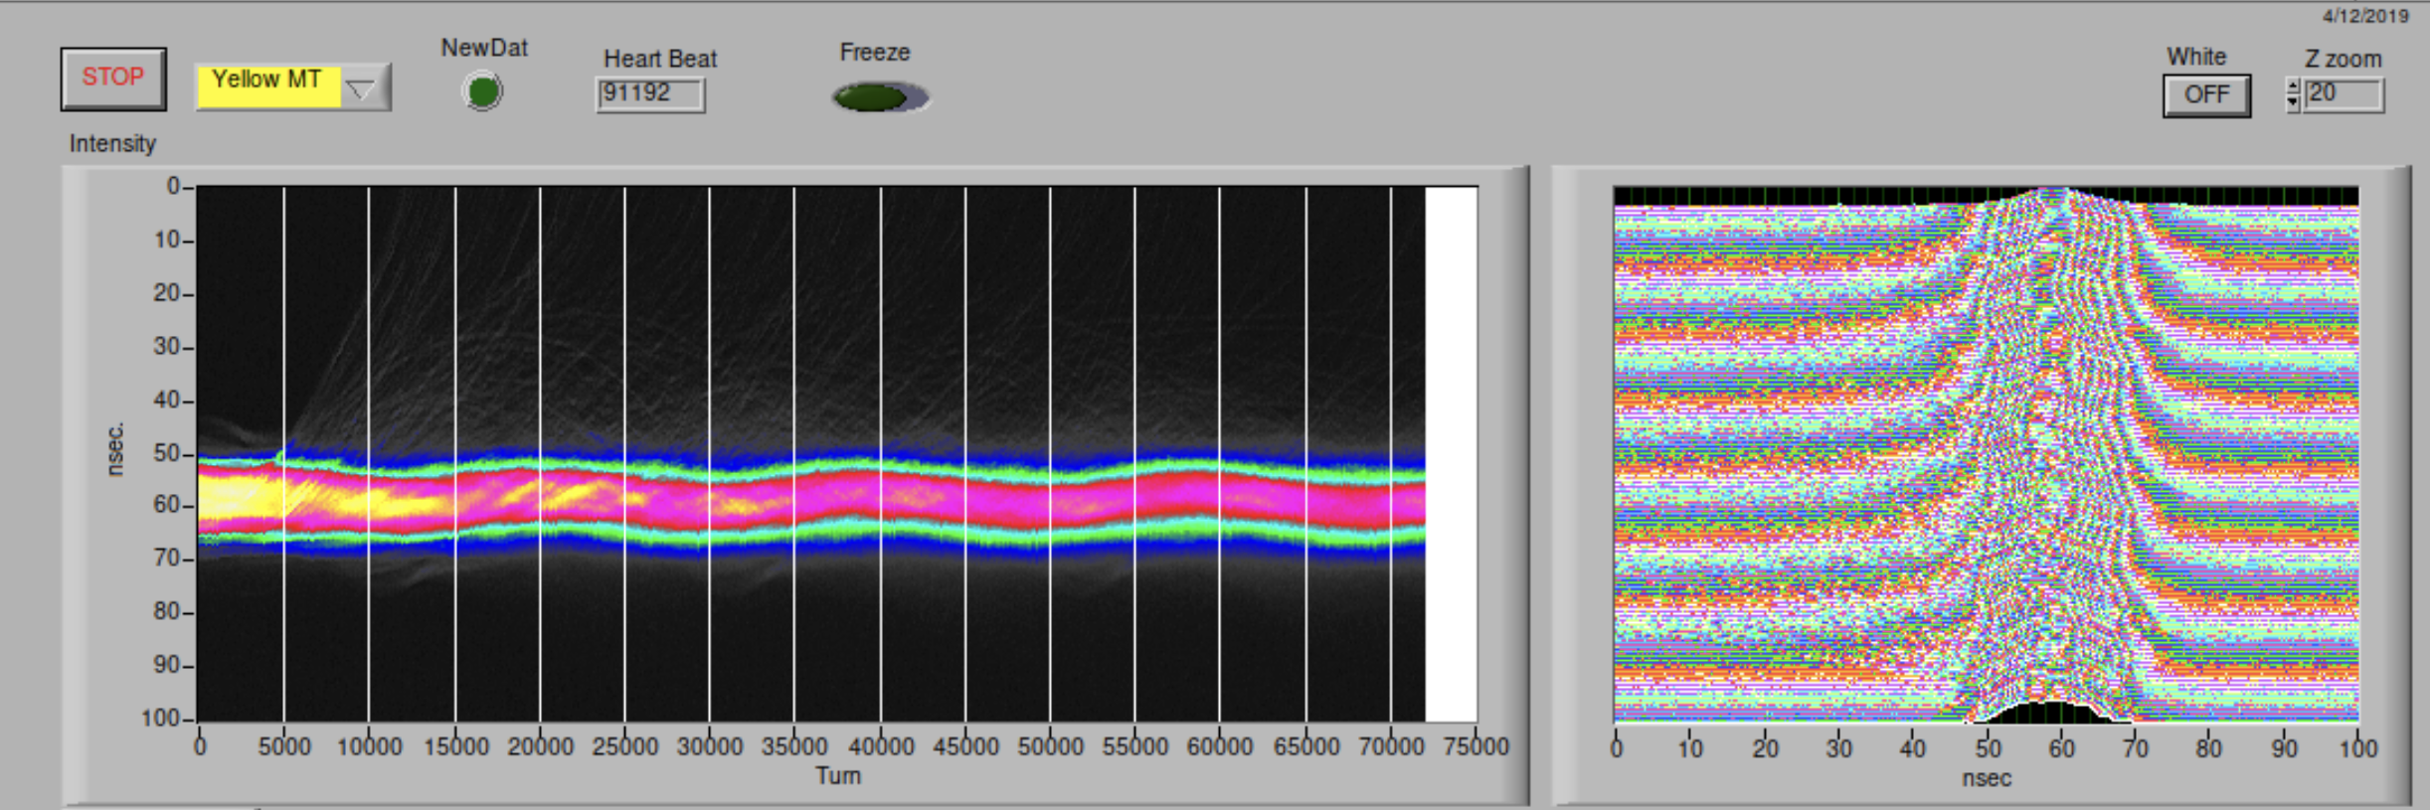
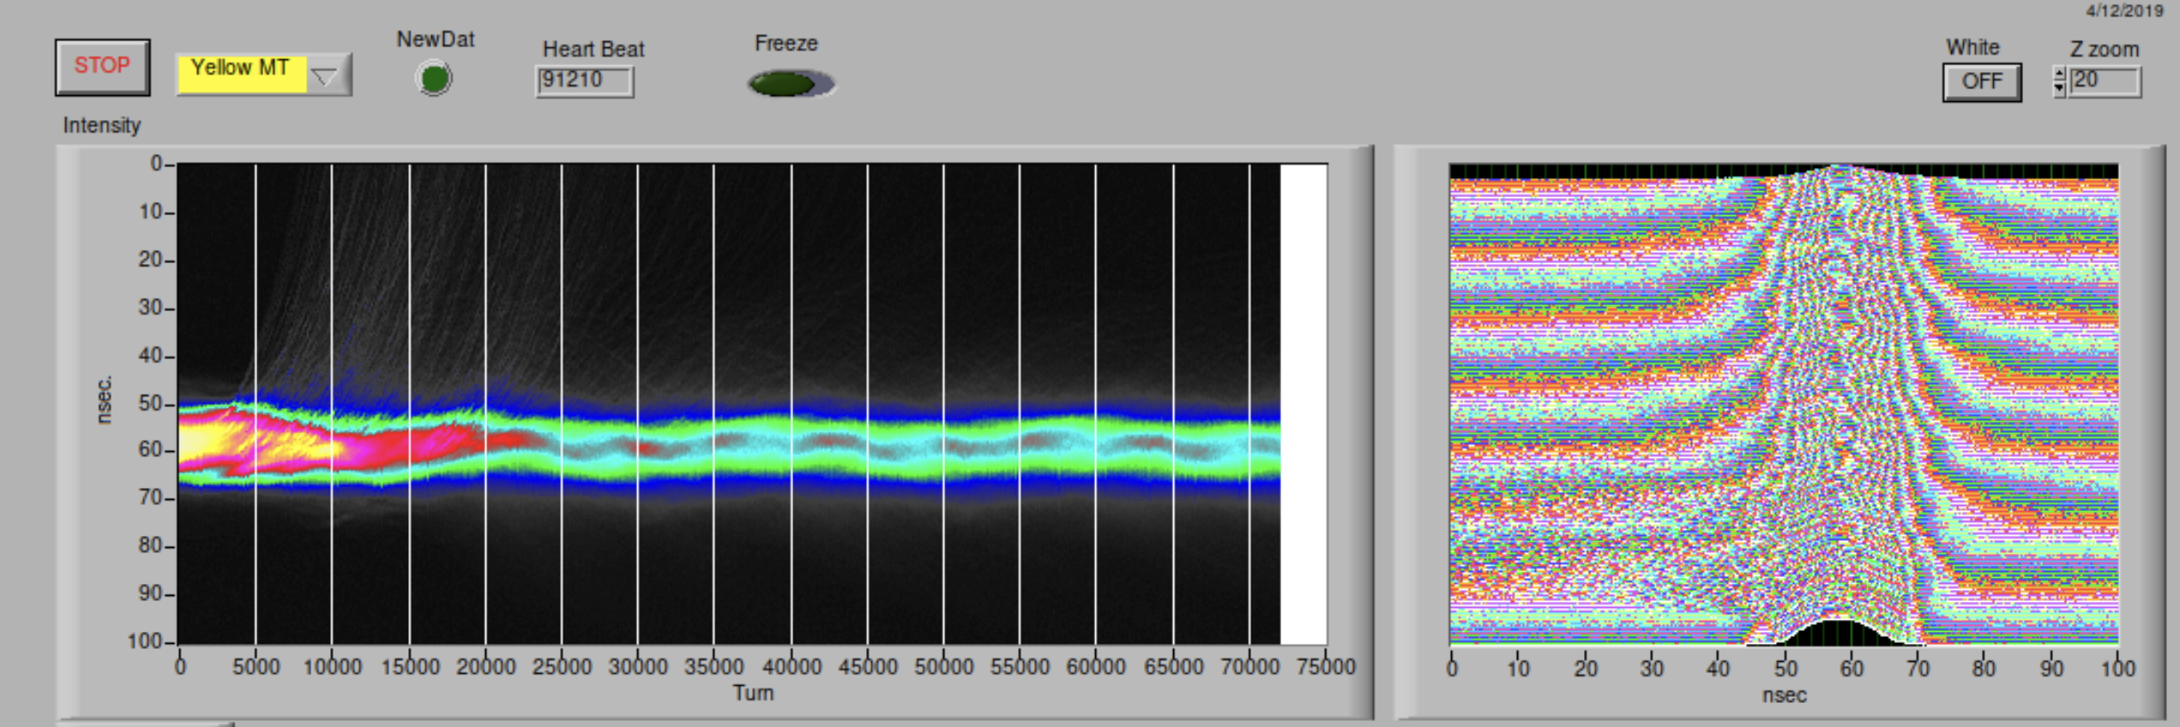
9 MHz RF cavity (new $γ_{t}$=23.7)
0.9e11
15:10
Instability related to beam intensity
Beam is unstable above 1.5e11
RF Voltage fixed at 15:12
Beam profile needs to be compared at different intensities
Evidence of Microwave Instability (MWI)
1.55e11
15:17
15:18
15:20
RF=18kV

Slide 14
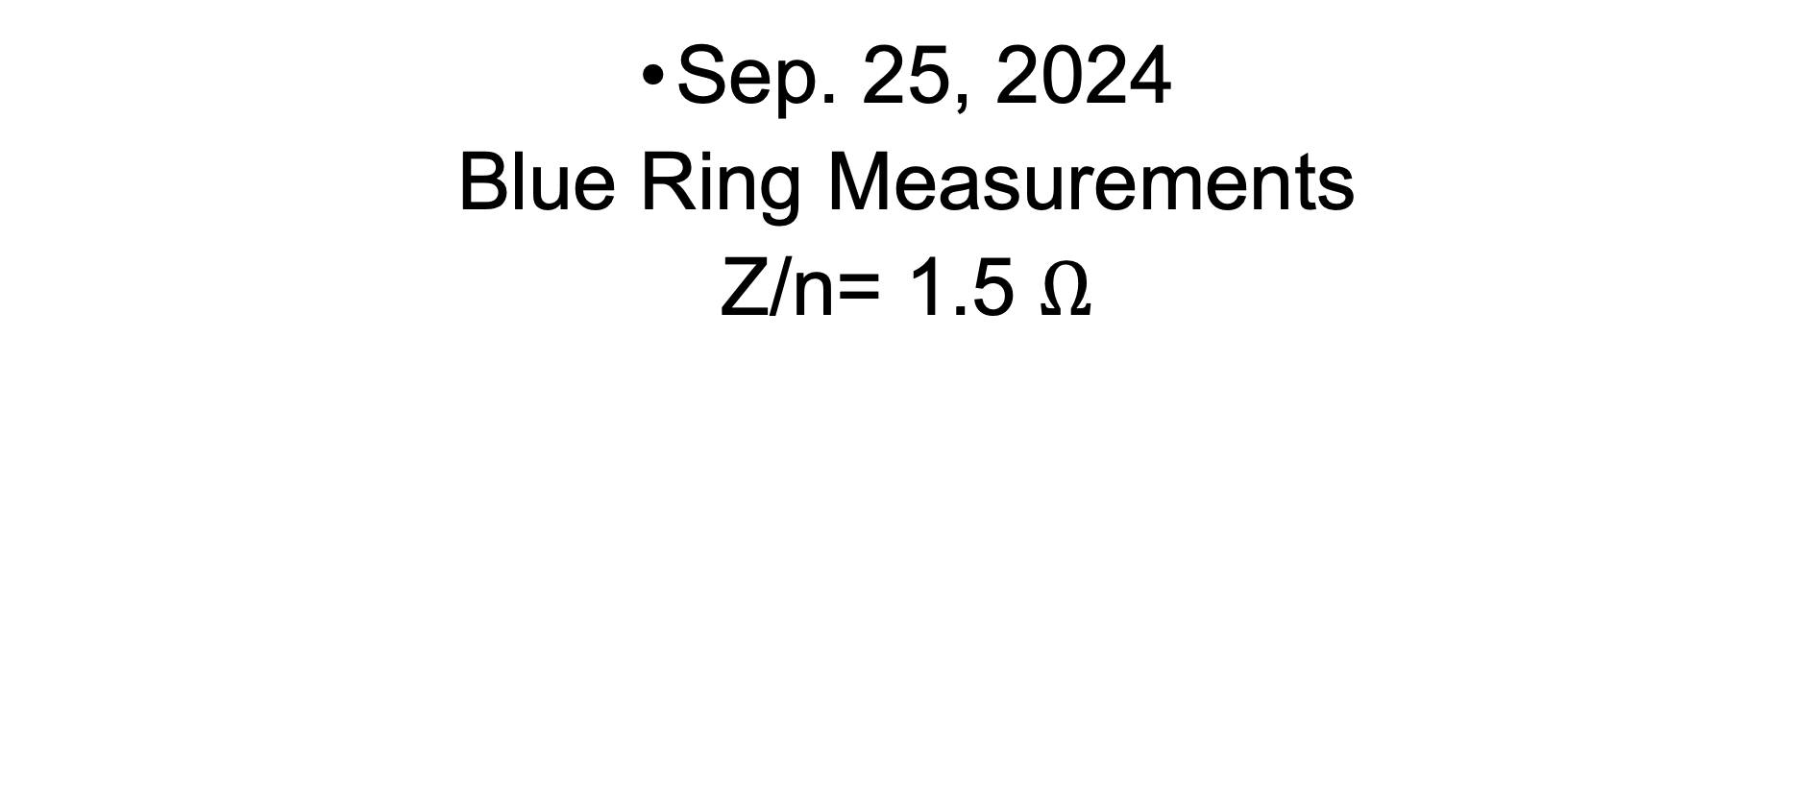
Sep. 25, 2024
Blue Ring Measurements
Z/n= 1.5 $Ω$

Slide 15
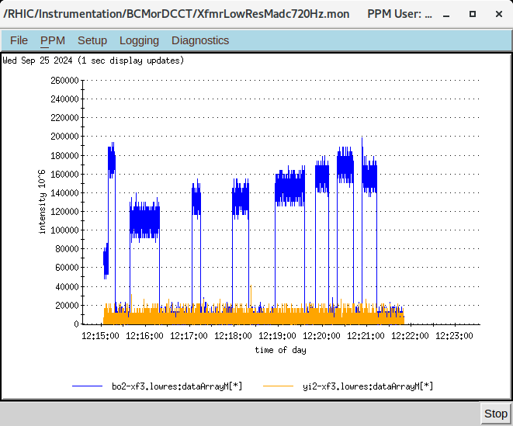
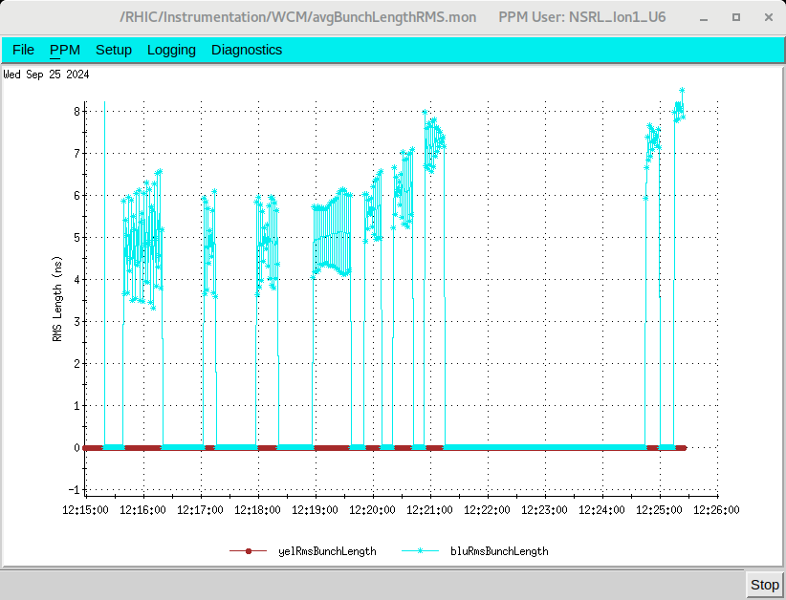
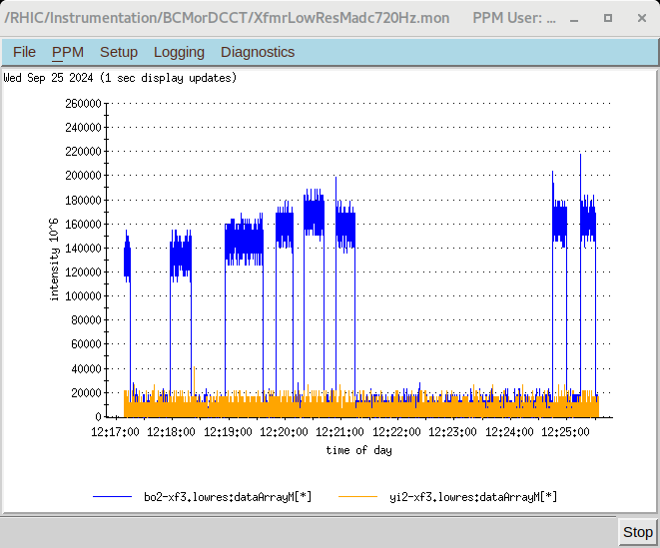
9 MHz RF Cavity ($γ_{t}$=23.7), V_{RF}=17 kV
2.0
2.0
2.2
1.7
1.1
1.6
1.3
1.3
1.5

Slide 16
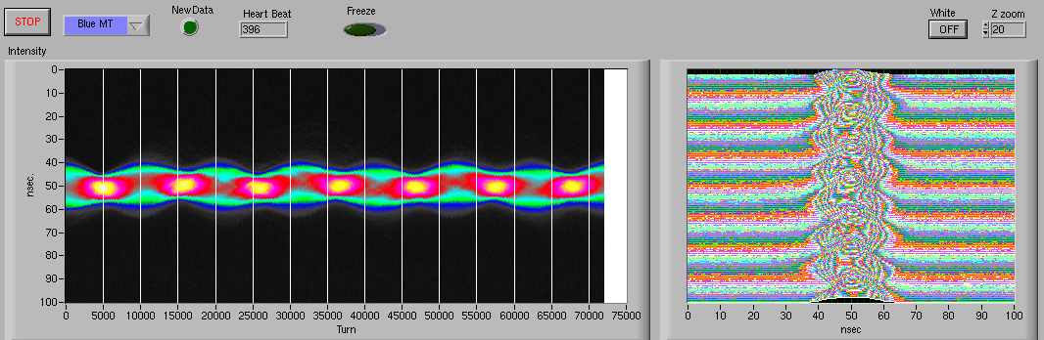
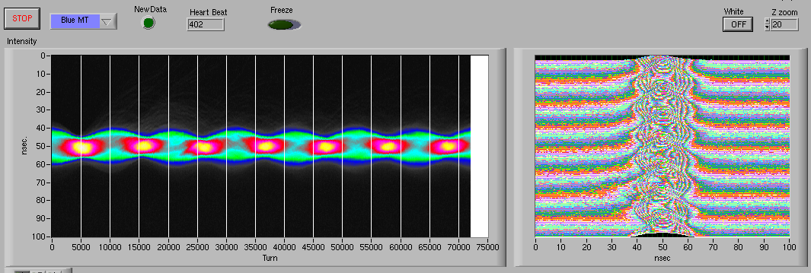
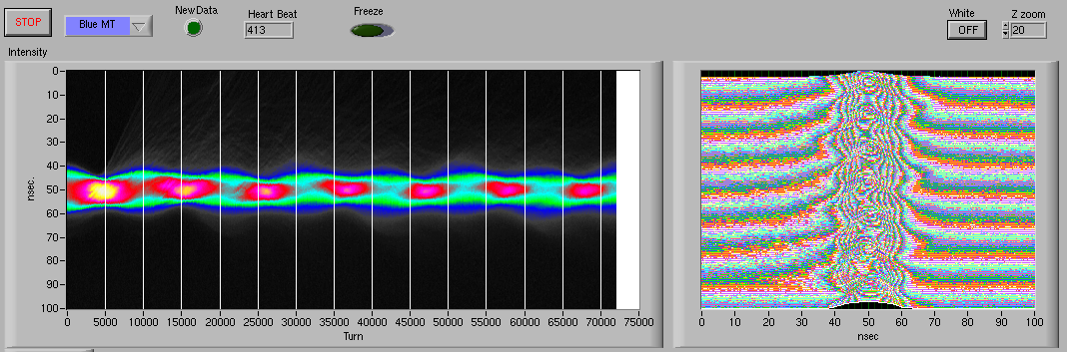
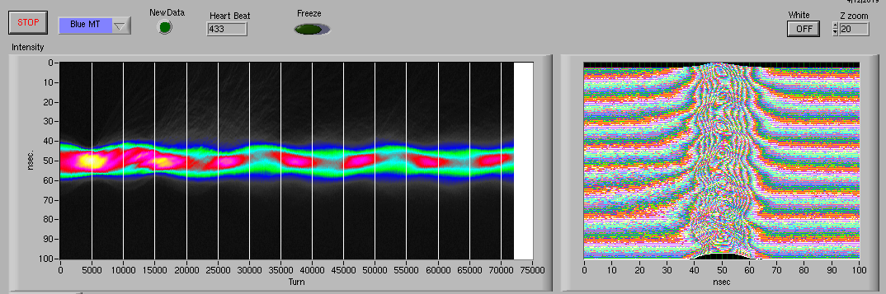
9 MHz RF Cavity (New $γ_{t}$=23.7), V_{RF}=17 kV
Beam Intensity
1.5e11
Beam is unstable at ~1.6 mA
The MWI threshold is approximately the same in both the Yellow and Blue Rings, while the geometric + RW impedance differs: Z/n = 1.5 Ω (Blue Ring) vs. Z/n = 5.4 Ω (Yellow Ring).
1.6e11
Bunch Length
1.7e11
2.0
2.0
2.2
1.1
1.6
1.7
1.3
1.3
1.5
2.0e11

Slide 17

Geometric + RW vs. Space Charge Impedance
Real Part of the Longitudinal Impedance
Imaginary Part of the Longitudinal Impedance
ReZ||($ω$) = 0 for Space Charge
The dominant effect on the microwave instability threshold is due to the space charge impedance.

Slide 18

APEX Summary
Accelerator Physics Experiment (APEX) in RHIC on MWI
  Yellow ring studies, where Z/n=5.4 $Ω$¹ (May 16, 2024).
  Blue ring studies, where Z/n=1.5 $Ω$¹ (Sep 25, 2024)
Beam Instability (Yellow Ring)
  Beam is single-bunch unstable at 1.9 mA (1.5e11) with 9 MHz RF at $V_{RF}$= 18kV (h=115)
    $γ_{t}$=23.7, $σ_{τ}$=4.5 ns ($σ_{s}$=1.36 m) and $σ_{δ}$=5.5e-4
  Beam is stable with 28 MHz RF at $V_{RF}$= 40kV (h=358)
    $γ_{t}$=23.7, $σ_{τ}$=4 ns ($σ_{s}$=1.2 m), $σ_{δ}$=12.8e-4
Space Charge Impedance
  $β_{x}$ = 33.3 m, $β_{y}$ = 32.1 m and $b_{ave}$=43 mm & $σ_{x}$=1.8 mm
  $Z_{||}/n$ = 2.2 $Ω$ (RHIC)
  $I_{th}$=2.6 mA ($σ_{δ}$=5.5e-4) & $I_{th}$=12.5 mA ($σ_{δ}$=12.8e-4)
[1] M. Blaskiewicz, J.M. Brennan, K. Mernick, doi:10.18429/JACoW-IPAC2015-MOPMN020

Slide 19
Summary
At injection energy, the microwave instability threshold is primarily influenced by the longitudinal space charge impedance.
APEX at RHIC for different rings confirms this.
The beam longitudinally is stable at 23.8 GeV
To perform particle tracking simulations, the Haissinski equilibrium is used as the initial distribution in ELEGANT.
The effect of vertical space charge and transverse dipole impedance on transverse beam dynamics is a work in progress.

