Slide 1
Low-energy Electron Cooling Experiments
Alexei Fedotov
on behalf of CAD Beam Cooling group
January 22, 2025

Slide 2
Outline
EIC Low-Energy Cooler (LEC) and APEX studies
LEReC cooling studies
LEReC/LEC high-current R&D
Readiness of experiments
2

Slide 3
Motivation for Low-Energy Cooler experiments
1. EIC Low-Energy Cooler (LEC) studies:
To guide LEC design, dedicated experiments are performed to establish proton beam conditions to be used for EIC at injection energy of protons.
2. Cooling studies using LEReC:
Cooling experiments are performed using LEReC accelerator to explore effects of electron beam on hadrons under cooling (such as recombination, “heating” of ions due to various effects, effects on lifetime of ions) and to address questions relevant to the design of electron cooler for EIC.
3. High-current experiments using LEReC:
EIC LEC requires stable long-term operation of electron source at around 75mA current. LEReC Gun is being used for such high-current studies.

Slide 4
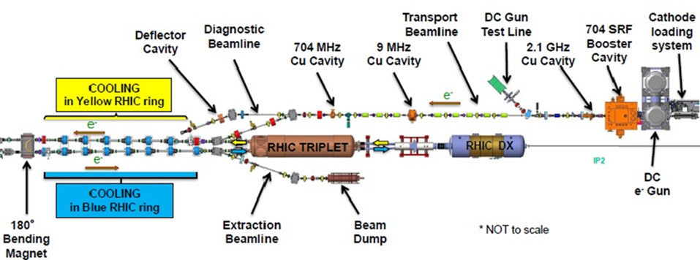
Operational Electron Cooler LEReC @ RHIC
LEReC was designed to operate at electron energies up to 2.6 MeV
(using single-cell SRF accelerating cavity).
LEReC is a fully-operational electron cooler which utilizes RF-accelerated electron bunches.
LEReC approach was chosen for the EIC LEC (12.5 MeV electron kinetic energy).
4

Slide 5
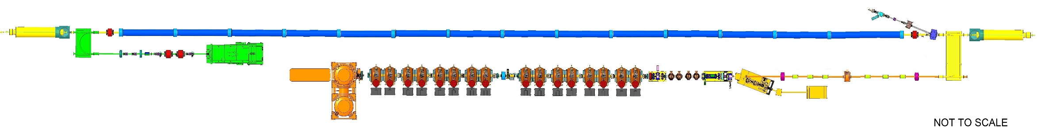
EIC Low-Energy Cooler (LEC) layout @IR2
180°Dipole
(U-turn)
RF diagnostics line with Deflecting cavity
LEReC
Cooling Solenoids
180° Dipole
Spectrometer
Mu-metal shielding
Quad
cooling
RF diagnostic
hadron
hadron
hadron
e⁻
HSR
e⁻
e⁻
HSR
extraction
transport
injection
Injector test
SC Quad
PM
Cathode transport
PM
PM
Solenoids
Laser
197 MHz
4x 591 MHz
NCRF correction Cavities
130 kW Beam Dump
Extraction line
900 kW Beam Dump
LEReC Gun
Injector/linac
Test line
24MHz
RF cavity
16x 197 MHz
NCRF LINAC
Not to scale
EIC LEC is LEReC scaled to higher energy (12.5 MeV electron kinetic energy).
5

Slide 6
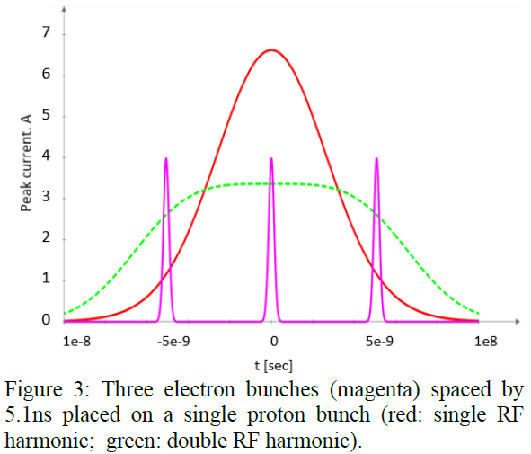
EIC LEC beam structure in cooling section
Protons bunch structure:
f_rep=24.6 MHz
N_p=2.8e11, I_peak=3 A (with 2nd harmonic)
Rms length=1m
Electrons bunch structure:
f_RF=197 MHz
Single bunch: Q_e=1 nC
Number of bunches in macro-bunch: 3
Rms length=0.04m
Electron bunches
Longitudinal profile of a proton bunch using 1st harmonic RF only
“Flat” longitudinal profile of a proton bunch using 2nd harmonic RF
Proton bunches during cooling:
2nd harmonic RF alleviates space-charge effects reducing peak current of protons to about 3A so the space charge tune shifts are ΔQ_{sc,x,y}=0.07, 0.13
Use of double RF system and making flattened bunch profiles was recently demonstrated at proton injection energy in RHIC (APEX May 8, 2024).
6

Slide 7
Experiments for EIC LEC
Completed in 2024:
APEX 24-07: Injection studies for the EIC (A. Fedotov et al.) – completed
APEX 24-06: Injection studies for the EIC with dual RF system (D. Kayran et al.) – completed
APEX 22-05: Emittance growth of ion beam due to interaction with bunched electron beam (S. Seletskiy et al.) – in process
APEX 22-06: Ion beam lifetime in the presence of the electron beam (S. Seletskiy et al.): - to be performed
Withdrawn:
APEX 22-07: Dispersive cooling (A. Fedotov et al.) – not directly relevant for LEC, and limited performance range with present 28MHz RF.
APEX 24-15: Recombination rate for proton beam (G. Wang et al.)- due to ASE limitation on the proton bunch intensity for CeC experiment.
Planned for Run-25:

Slide 8
Recently completed experiments
8

Slide 9
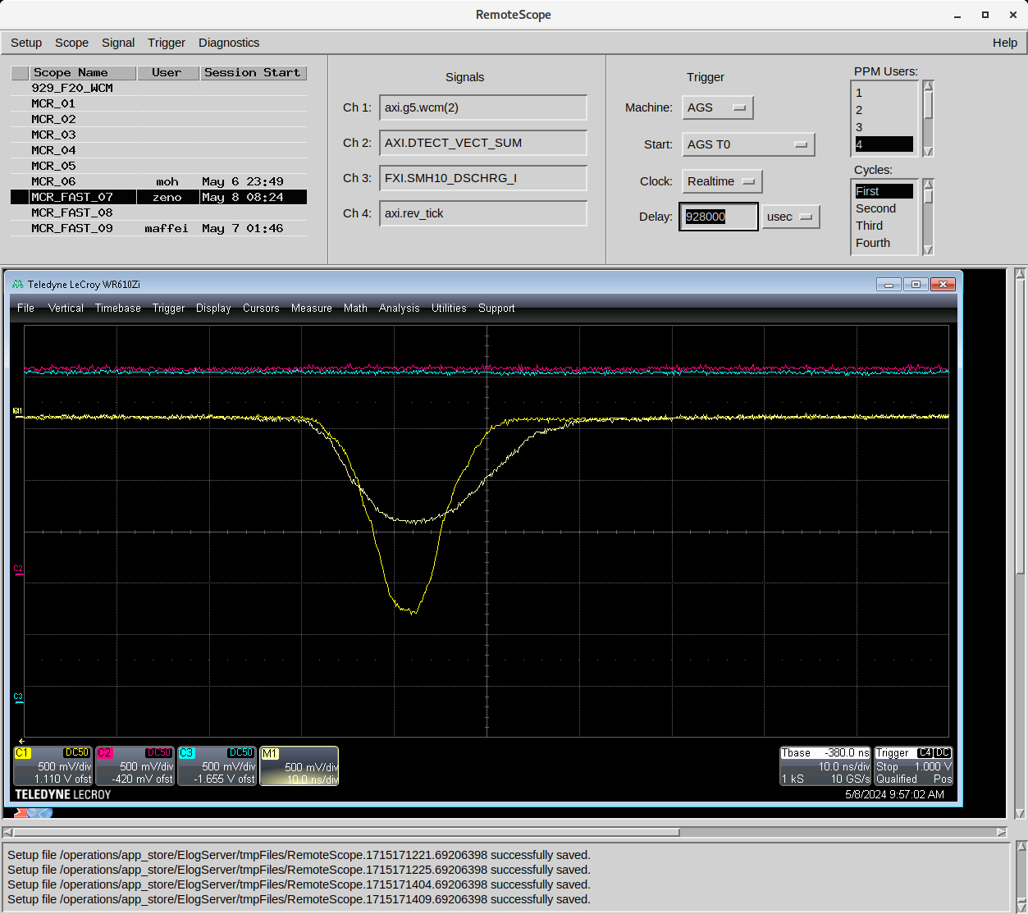
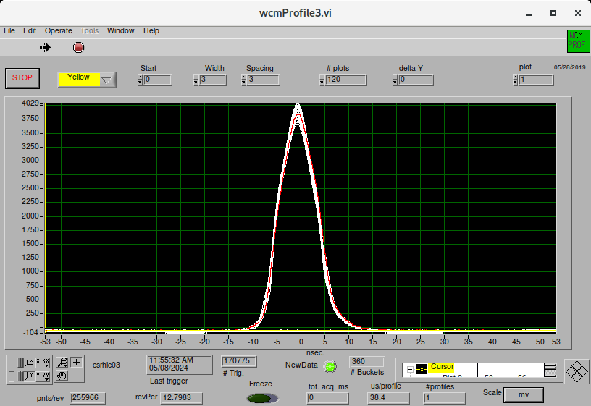
APEX #24-07 (A. Fedotov et al.), May 2024
In the EIC, high-intensity protons will be injected in modified 28MHz RF system, while presently in RHIC they are injected in 9MHz RF.
The goal of this experiment: Explore and establish proper beam parameters of high intensity protons at injection with 28MHz RF system
Two settings of quad pumping in AGS were tried:
Stable conditions in 28MHz RF were established.
Resulting beam parameters measured.

Slide 10
Summary of APEX #24-07
Experiment:
Explored injection into 28MHz RF with Quad Pumping in AGS, measured beam parameters:
Case 1: S₉₅=1.1eVs, Erms,s=0.06, sigma_s=0.7m, sigma_p=1.1e-3
Case 2: S₉₅=1.1eVs, Erms,s=0.06, sigma_s=1.0m, sigma_p=7.4e-4
Case 2 is better for cooling of protons at EIC injection energy - will use it as a baseline. It is also better than Case 1 since it corresponds to smaller peak current of 5.4A for the EIC bunch intensity. Double RF with flattened bunch profile should help to reduce peak current further ( see APEX #24-06).

Slide 11


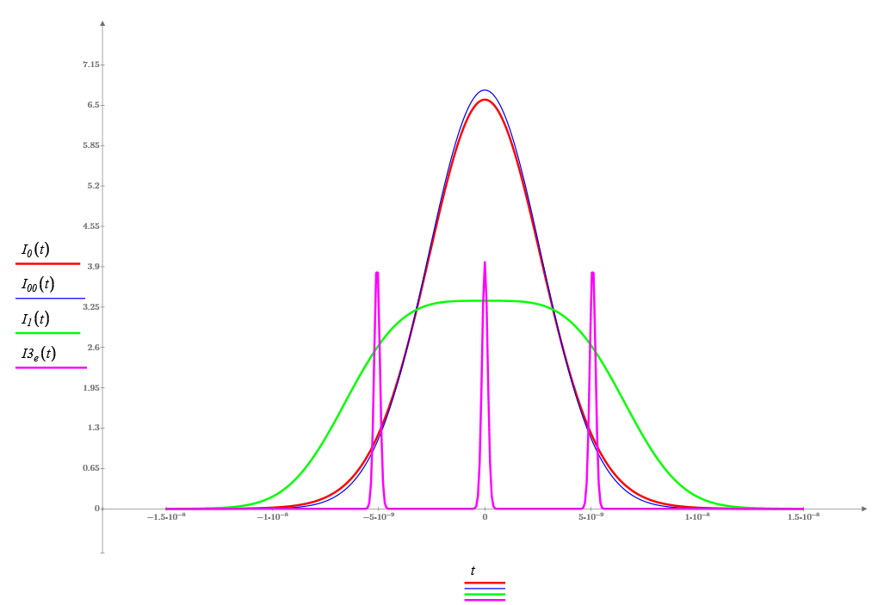
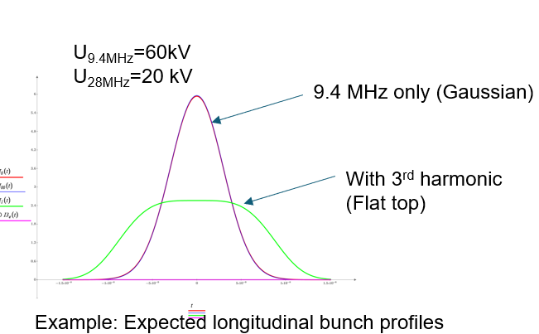
APEX #24-06 (D. Kayran et al.), May 2024
In the EIC, high-intensity protons will be injected in modified 28MHz (24.6 MHz) RF system just above transition energy. To allow strong cooling of vertical emittance and maintain good proton beam lifetime, requires reducing peak current of proton bunches. Such peak current reduction can be achieved by using higher frequency RF used in counter phase, which flattens longitudinal profile of proton bunch. However, above transition energy and especially very close to transition energy, this can lead to various beam instabilities. The goal of this experiment is to explore parameters of high intensity bunch at injection with dual RF system and study beam stability.
The closest to EIC configuration: main RF 28MHz and 2nd harmonic 56 SRF cavity for flattening profile. However, it was not possible to use 56 SRF system for APEX.
9 MHz system with 28MHz as a 3rd harmonic was used instead:
U_{25MHz}=25kV
U_{50MHz}=12.5 kV
Without 2nd harmonic (σ_{z}=0.8m)
With 2nd harmonic
Expected protons peak current reduction 2 folds.
Proton bunch and electron bunches longitudinal profiles during cooling at the injection energy

Slide 12
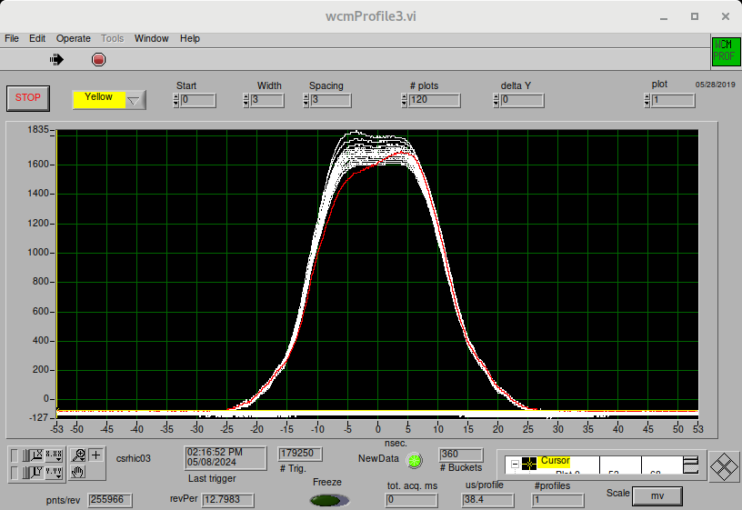
Summary of APEX #24-06
N_{p}=2.8x10¹¹
Ip=1.8 A
9 MHz system only
N_{p}=1.4x10¹¹
Ip=1.9 A
Established setup with dual RF system in the YELLOW ring at the injection energy (above transition energy) and reduced operational peak current by about factor of 2.
Demonstrated that highest required intensity proton bunch (2.8x10¹¹) can be injected and can be kept stable in the dual RF system above transition energy (flat longitudinal profile).
12

Slide 13
Ongoing Studies
13

Slide 14
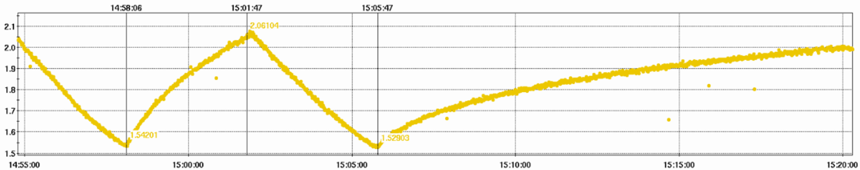
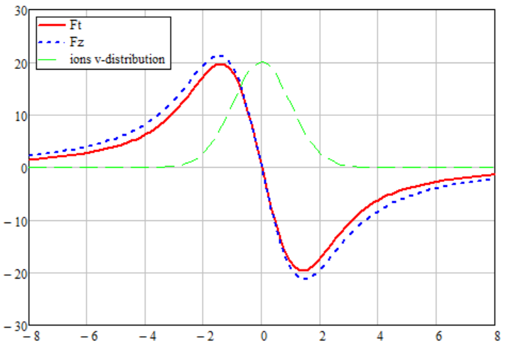
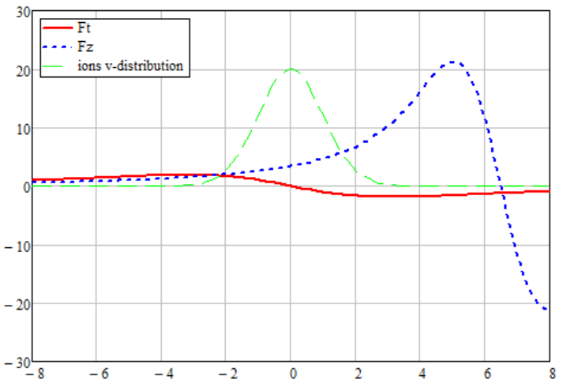


APEX 22-05: (S. Seletskiy et al.) Electron-ion heating experiment
In LEReC, in the presence of e-beam, we observed a much faster growth of the transverse size of the i-bunch than the IBS driven size growth. We called this additional growth of the emittance “the electron-ion heating”
pre-cooling
IBS + e-i heating
IBS
Vertical bunch size [mm]
pre-cooling
e-beam is turned off
Time
E-beam is 5 kV ($μ_{iz}≈6.3σ_{v_{ez}}$) off energy
E-beam is on energy
For measurements of the “heating effect”, to suppress cooling while keeping the electron beam, the electron beam energy was detuned by a few kV.
Friction force [eV/m]
Friction force [eV/m]
$$v_{it}/σ_{v_{et}};v_{iz}/σ_{v_{ez}}$$
$$v_{it}/σ_{v_{et}};v_{iz}/σ_{v_{ez}}$$
14

Slide 15
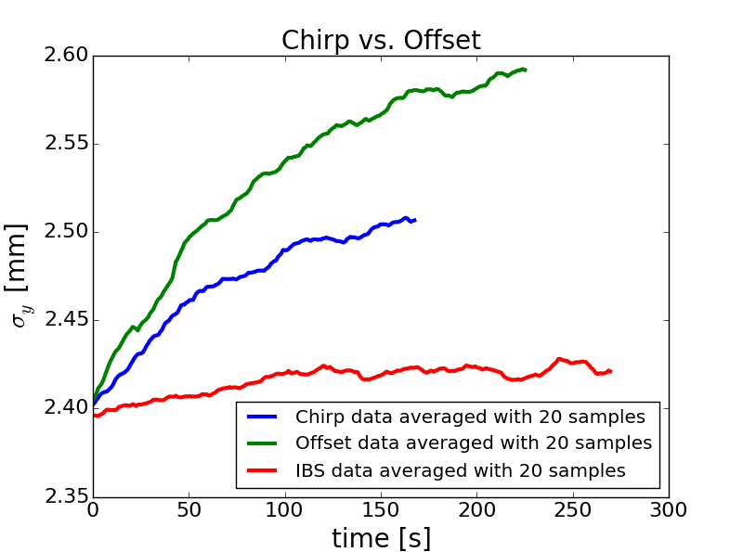
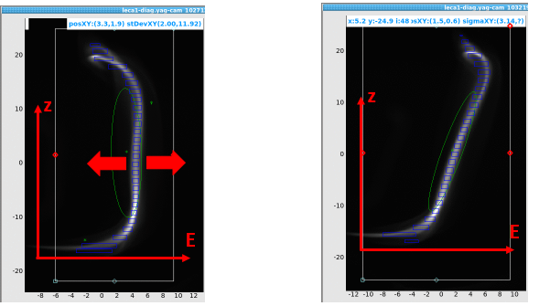
Example from 2022 heating studies
A substantial enough offset in electron beam energy creates a mechanism of longitudinal heating. This heating can be partially redistributed to transverse direction through coupling
To check whether we “create” transverse heating by offsetting beam energy we performed measurements with chirped e-bunch.
offset
chirp
Results:
Substantial part of emittance growth can be explained by the energy offset.
Remaining task:
Study “heating” with cooling suppressed by angular spread, no energy offset or energy chirp.
Time request for Run-2025:
Heating with large energy spread (6 hrs)
Heating with large trajectory angles (6 hrs)
Plus extra time for switching to/from 3.85GeV.
Additional needed time for setup:
RHIC setup for Au at 3.85GeV: 10 hrs
Cooling setup: 4 hrs
15

Slide 16
APEX 22-06: (S. Seletskiy et al.) Ion lifetime in presence of electron beam
Operational electron cooling at LEReC was associated with elevated ions losses.
Such an effect on ion beam lifetime was observed in several electron coolers and is not fully understood.
Part of the elevated losses is caused by recombination, but also there are additional, not recombination-related losses.
During the commissioning in 2019 we had set-ups for which the lifetime of a cooled ion bunch was comparable or even larger than the lifetime of ion bunch not interacting with the electron beam.
Studies of the elevated ion losses in the presence of the electron beam are critical for creating a feasible design of the EIC coolers (of any type).
The plan is to:
Reestablish a setup with a positive effect on ion beam lifetime.
Explore the dependence of ion losses on:
  Electron beam average size, current, density
  RHIC tunes (working point around 0.1 and working point around 0.23)
Time request for Run-2025:
1. Optimizing lifetime of cooled ions (with active cooling) (6 hrs)
2. Explore lifetime dependence on e-beam densities (6 hrs)
3. Repeat measurements 1-2 at a different working point (8 hrs)
16

Slide 17
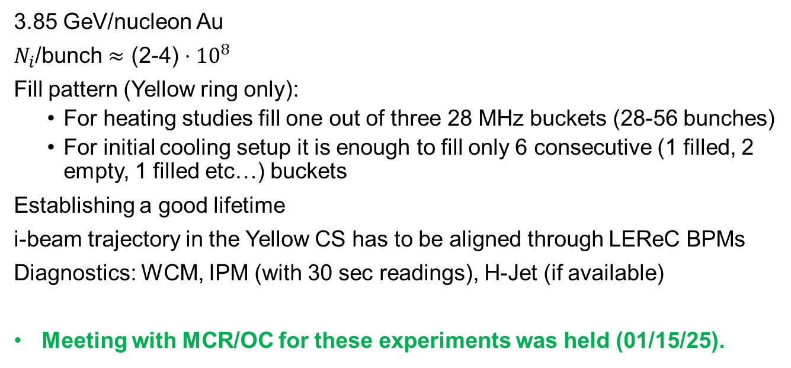
RHIC setup for APEX #22-05 and 22-06
3.85 GeV/nucleon Au
$N_{i}$/bunch $≈$ (2-4)$⋅{10}^{8}$
Fill pattern (Yellow ring only):
  For heating studies fill one out of three 28 MHz buckets (28-56 bunches)
  For initial cooling setup it is enough to fill only 6 consecutive (1 filled, 2 empty, 1 filled etc…) buckets
Establishing a good lifetime
i-beam trajectory in the Yellow CS has to be aligned through LEReC BPMs
Diagnostics: WCM, IPM (with 30 sec readings), H-Jet (if available)
Meeting with MCR/OC for these experiments was held (01/15/25).
17

Slide 18
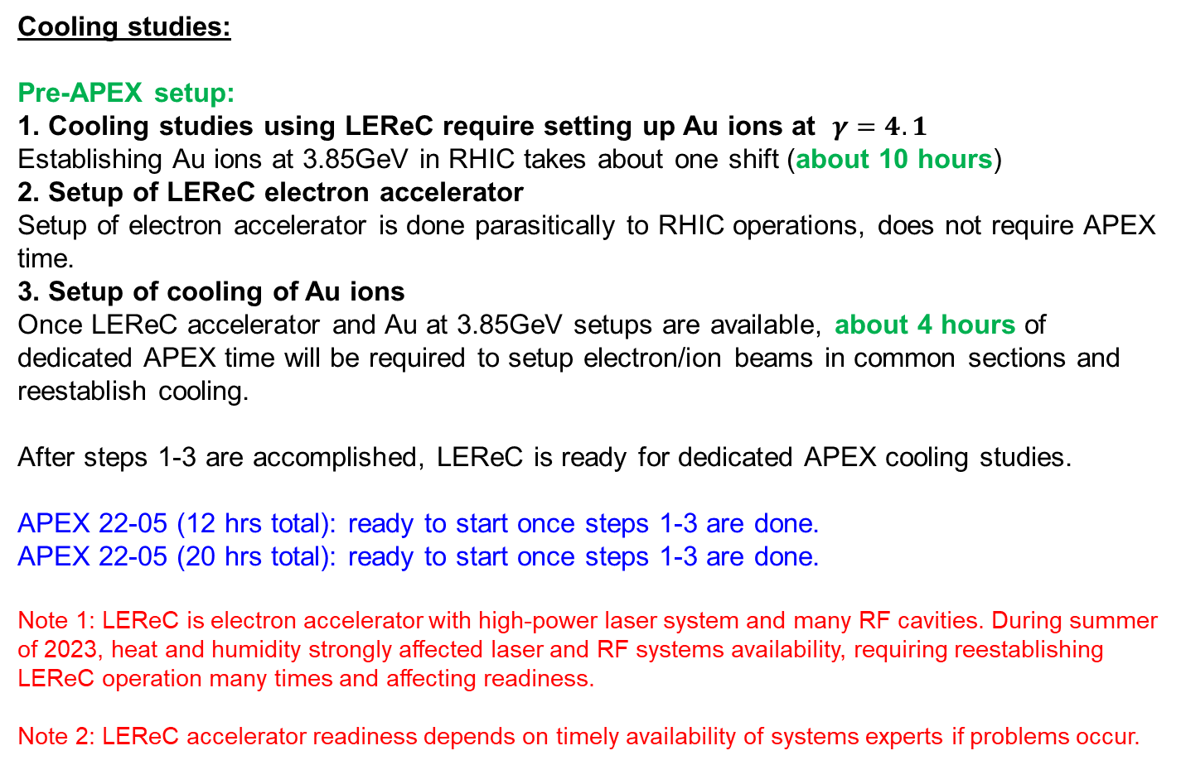
LEReC cooling experiments readiness
Cooling studies:
Pre-APEX setup:
1. Cooling studies using LEReC require setting up Au ions at $γ=4.1$
Establishing Au ions at 3.85GeV in RHIC takes about one shift (about 10 hours)
2. Setup of LEReC electron accelerator
Setup of electron accelerator is done parasitically to RHIC operations, does not require APEX time.
3. Setup of cooling of Au ions
Once LEReC accelerator and Au at 3.85GeV setups are available, about 4 hours of dedicated APEX time will be required to setup electron/ion beams in common sections and reestablish cooling.
After steps 1-3 are accomplished, LEReC is ready for dedicated APEX cooling studies.
APEX 22-05 (12 hrs total): ready to start once steps 1-3 are done.
APEX 22-05 (20 hrs total): ready to start once steps 1-3 are done.
Note 1: LEReC is electron accelerator with high-power laser system and many RF cavities. During summer of 2023, heat and humidity strongly affected laser and RF systems availability, requiring reestablishing LEReC operation many times and affecting readiness.
Note 2: LEReC accelerator readiness depends on timely availability of systems experts if problems occur.
18

Slide 19
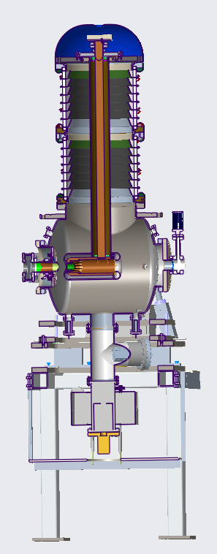
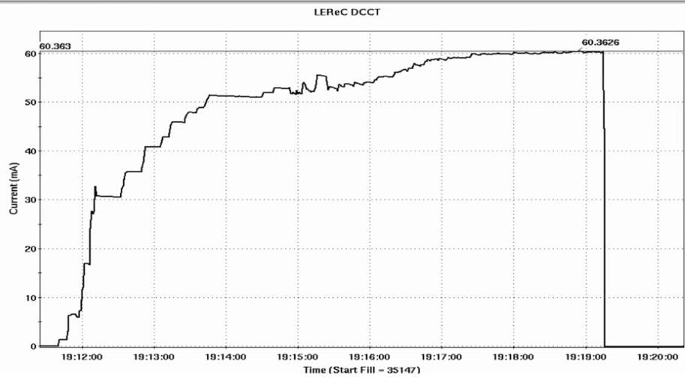
High-current studies
High current source is required for EIC LEC:
  The LEC requires stable operation at around 75mA current.
High-current source R&D:
  Explore LEReC Gun operation with high-current up to 80mA.
  Explore Gun and HVPS long-term stability at high currents.
  Explore Gun voltage limitations
  Explore operation with active cathode on center vs cathode off center.
  Explore large cathode area vs small active area. Explore various laser spot sizes on the cathode.
  Explore cathode QE at various laser powers with and without cathode stalk cooling.
  Test multi-alkali photocathodes using different growth methods.
LEReC DC gun tests (to injection beam dump):
Stable operation at 50mA in tests (April 2022)
60mA (October 2024):
19

Slide 20
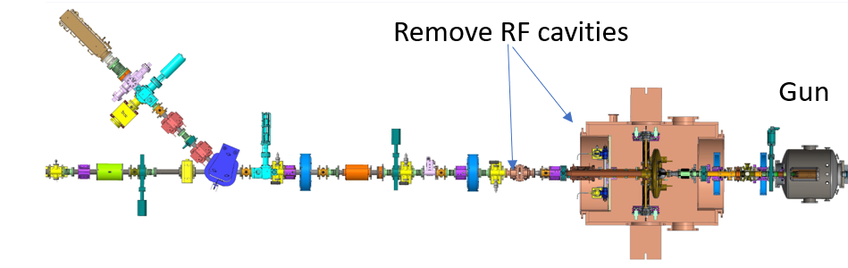
LEReC high-current experiments readiness (II)
High-current experiments:
Does not require RHIC ions, but injection dump is limited to 25kW.
Running to high-power beam dump (150kW) requires dedicated time without RHIC beam. One has to establish high-current electron beam transport over 100 meters with many RF cavities and through RHIC common sections.
There is a possibility to relocate high-power beam dump next to the Gun in IR2 after RHIC 2025 run.
Plan for 2025:
Explore Gun operation at high currents above 30mA to high-power beam dump (100 meters of beam line and RHIC common sections). So far, in nominal LEReC configuration, operated up to 30mA to high-power beam dump. We will explore reduced energy setup (1MeV) to reduce required power from SRF cavity amplifiers.
After 2025 RHIC run (TBD):
Moving High-Power beam dump closer
to the Gun and removing RF cavities.
20

Slide 21
Summary
Intensive program of the cooling studies and high-current R&D is underway. Several studies were successfully completed.
Ongoing cooling studies include ion heating, effects on ions lifetime and high-current R&D.
For cooling studies using LEReC, RHIC setup with Au ions at 3.85GeV will need to be established prior to APEX time.
LEReC accelerator will be set up for the studies.
Meeting on APEX studies with MCR/OCs was held and recommendations were followed up.
21

