Slide 1
Flat Beam Experiments: Acceleration & Collision
Yun Luo
2025 RHIC APEX Workshop
Snyder Seminar Hall, Building 911, BNL
Jan 22, 2025

Slide 2
Content
Introduction
24-03: Accelerating Flat Beam from 31GeV to 100GeV
25-01: Maximize Beam-Beam Parameter for Flat Beam
Summary

Slide 3
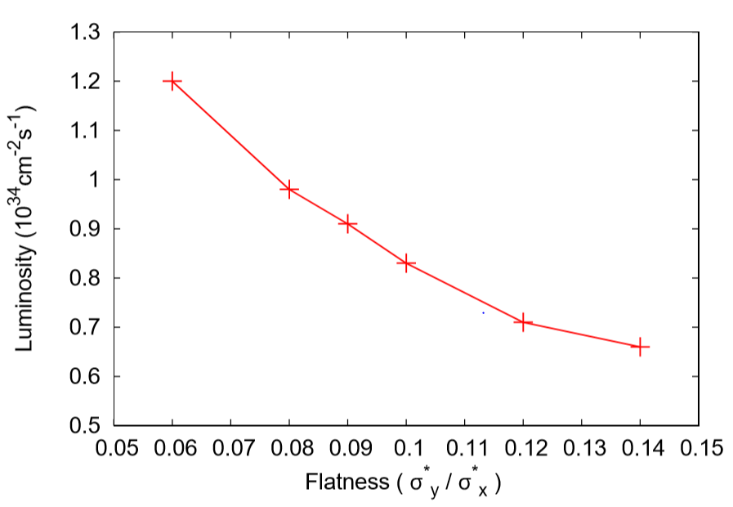
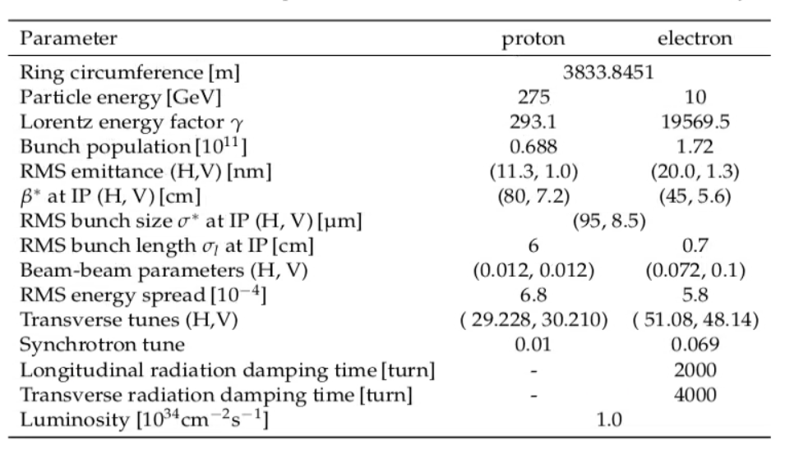
Why We Need Flat Beams at IP for EIC
Flat beams at IP is the key to reach high luminosity for EIC
For current design, transverse beam size ratio σ*_{y} / σ*_{x} ~ 1:11
By design, we have ε_{y} / ε_{x} ~1:11 and β*_{y} / β*_{x} ~ 1:11.

Slide 4
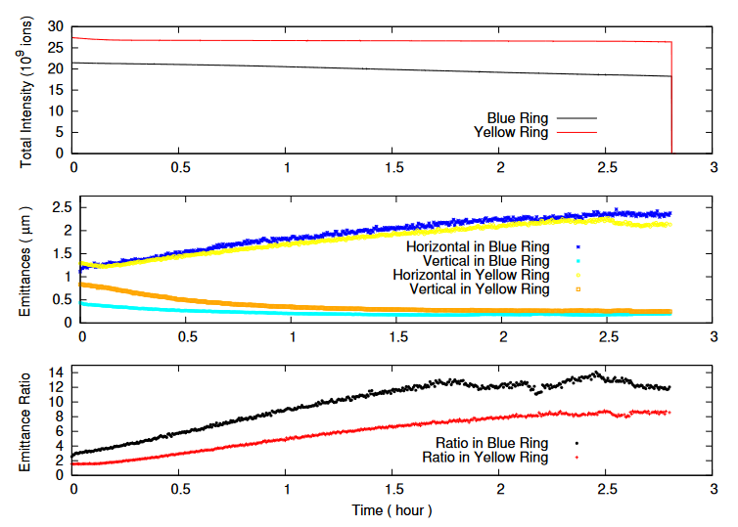
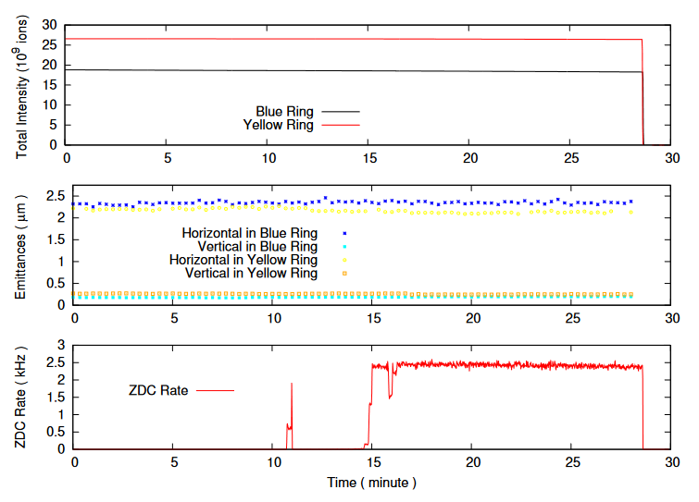
Demonstration of Flat Beams in RHIC
We experimentally demonstrated 11:1 transverse ratio in RHIC with gold ion beam at 100 GeV/nucleon with vertical stochastic cooling and fine decoupling.
We also collided flat beams with transverse beam size ratio about 3:1. The beam-beam parameter is about 0.004.

Slide 5
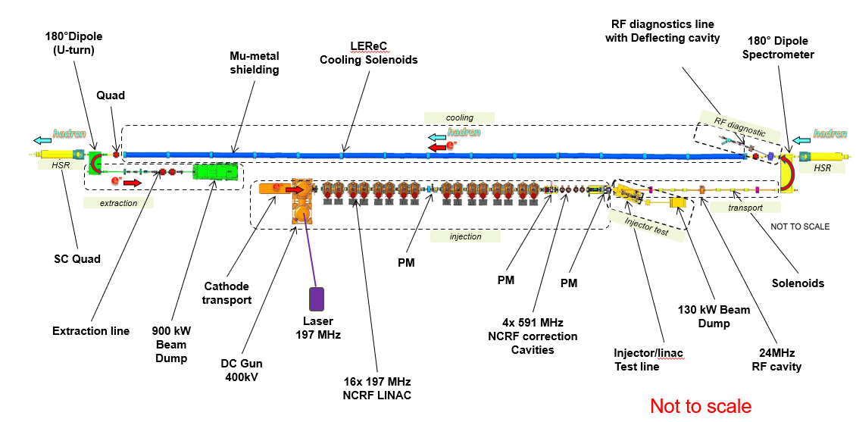
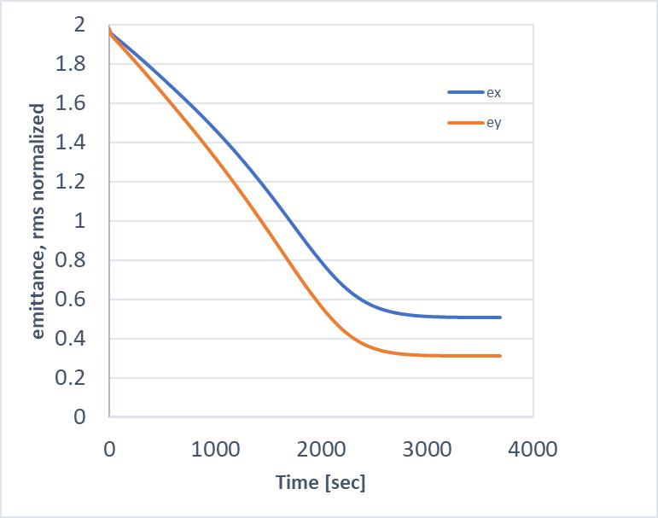
EIC/HSR Cooling Scheme
Protons are to be cooled at injection energy ~ 24 GeV. When the transverse emittance ratio reaches its design value, then we accelerate the large emittance ratio beam to store energies.
We are also considering cool both transverse emittances at low energy with a much smaller emittance ratio say ~ 2:1. Then accelerate this beam to store energies, where we blow up the horizontal emittance to achieve the design emittance ratio.
at 24GeV
@Alexei Fedotov

Slide 6
24-03: Accelerate a flat gold ion beam from 31 GeV to 100 GeV in the RHIC Yellow Ring
Goal :
To demonstrate accelerating `flat` gold beam with a large transverse emittance ratio 11:1 from 31 GeV to 100 GeV
- We choose 31GeV to pre-cool Au ion beam
- Only cool vertical emittance, but need longitudinal cooling
- Beam only in Yellow ring
Team members:
K. Mernick, G. Robert-Demolaize, T. Shrey, V. Schoefer, I. Blackler,
Y. Luo, D. Xu, C, Liu, C. Montag, M. Blaskiewicz
OC in this team: T. Shrey
Experiment rating: 0A

Slide 7
Experiment Condition
Experiment Conditions:
- 1-2e9 ions/bunch, 28 bunches in Yellow ring ( emittance measurement )
- need two new ramps: 9.8GeV->31GeV, 31 GeV-> 100GeV
- need stochastic cooling at 31 GeV ( used in previous d-Au run )
- need fine beam control on ramp ( particularly coupling correction )
orbit/tune/decoupling feedback, BBQ, IPM, etc.

Slide 8
Experiment Procedure
1st session:
16 hours, set up 31 GeV ramp , vertical and longitudinal cooling set up at 31GeV in Yellow ring.
2nd session:
16 hours, (continue cooling setup if needed ), ramp development 31->100GeV
3rd session :
16 hours, physics experiments, get flat beam at 31GeV in the Yellow ring and ramp up to 100GeV.
Totally beam time requested: 3*16 = 48 hours
8

Slide 9
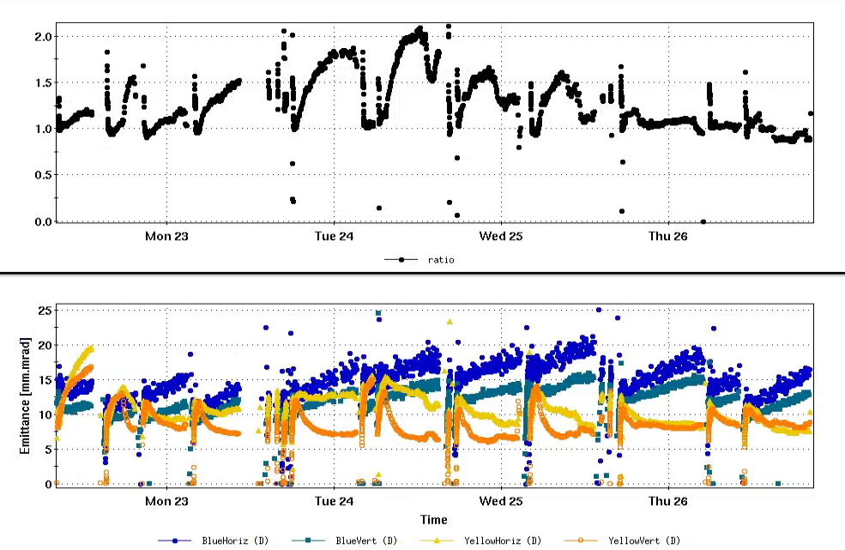
2016 d-Au Run with Cooling at 31.3GeV
Emittance ratio for Au in Yellow ring

Slide 10
Concerns (I):
We had a team meeting on Jan 13 and had a broad discussions on the experiment conditions and preparations.
Major concerns:
Only Yellow ring: ( normally Blue ring as a master ring )
Two ramps: both ramp files / tape sequences needed to be ready for session 1
RF cavities : mainly 28MHz ( even for cooling at 31 GeV ),
197MHz may be used for long. compressing
Cooling setup: longitudinal + vertical, may take a few hours

Slide 11
Concerns (II):
Emittance ratio: projected 11:1(depending on cooling), smaller acceptable
Ramp control: orbit, possible tunes( 0.235, 0.215), coupling feedback.
may interpolate or upload coupling angles at various ramp stones.
IPM calibration: beta measurement at 31GeV and 100GeV, ramp optics measurement may be done if time permits
Decoupling after ramp will help find back eigen emittances and maximize emittance ratio
Involved many parties, many experts, should avoid Ian’s overnight shift.

Slide 12
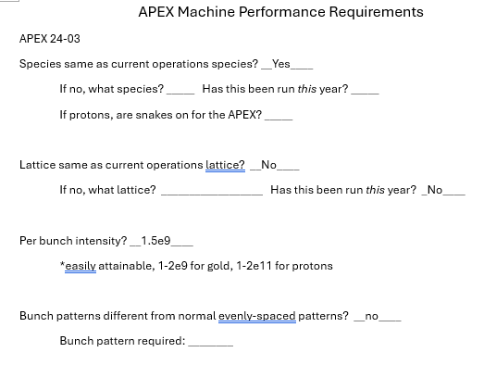
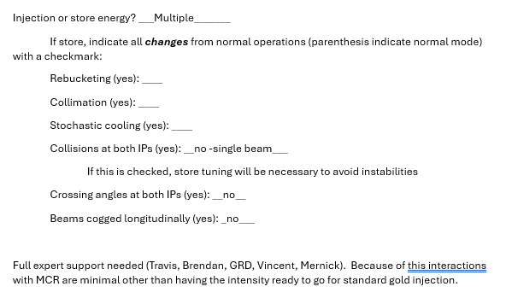
Operation Checklist
OC: Travis
( submitted, ready to go )

Slide 13
Readiness Check
This experiment likely be done in the beginning of operation ( ~1 month after physics declaration ).
Two ramp files : Guillaume
Ramp Tapes: Ian
Cooling setup: Kevin ( recall cooling settings in previous run )
Overall ramp development coordination: Travis
Ramp feedbacks: Chuyu ( orbit, tune, coupling )
We will have another discussion meeting before Run 25 start-up to check experiment readiness.

Slide 14
25-01: Maximize beam-beam parameter with flat beam collision in RHIC
Goal:
1) to demonstrate beam-beam parameter 0.015 with flat Au ion beam collision
2) take data of collision at store and model the luminosity and emittance evolution with flat beam collision
Team Members:
Travis Shrey, Kevin Mernick, Guillaume Robert-Demolaize, Ian Blackler, Vincent Schoefer, Chuyu Liu, Derong Xu, Will Bergan, Christoph Montag, Mike Blaskiewicz
OC in the team: Ian
Experiment Grade: 0A

Slide 15
Experiment Conditions
- Au ion 100GeV beams, 1-2e9 ions/bunch, 28*28 bunches
- Stochastic cooling at 100GeV to generate 11:1 beams
- Head-on collisions at IP6 and IP8
- WCM to measure intensities,
IPM to measure emittances, luminosity monitor, etc.

Slide 16
Experiment Procedure
- accelerator both Au beams in both RHIC rings from injection to 100GeV
- adjust coupling correction and cool both beams to emittance ratio about 11:1
- collide both beams first at IP6 with head-on, if needed, collide beams also at IP8 too to reach beam-beam parameter to 0.015 at least in vertical plane.
- keep beam in collision for 2-3 hours at store and take data of luminosity, beam intensities, emittances
Beam Time Request:
2* 6 = 12 hours
16

Slide 17
Concerns
No special requirements for this experiment.
Main points from the team discussion meeting:
- run 25 will focus on crossing angle collision for sPHENIX, how to switch to head-on collision condition?
- with a large beam-beam parameter, how do we collide the beams, transversely or longitudinally. During collision, the tune feedback doesn’t work well because of large tune spread.
- Since we will keep beams in collision for 3 hours, we need to fine tune store: tunes, chromaticities, orbit, etc.

Slide 18
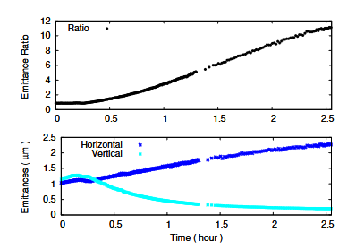
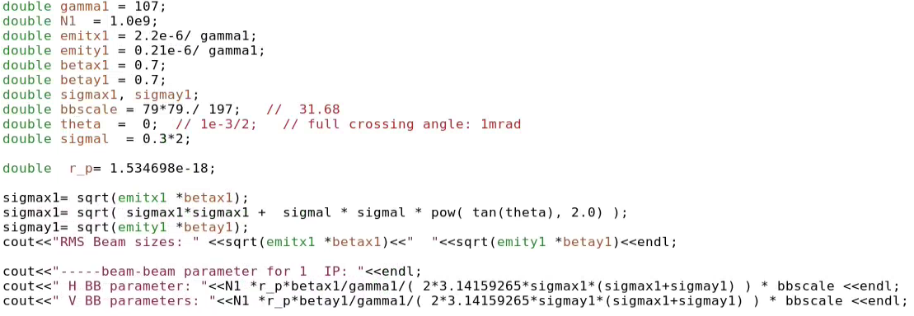
Estimate of Beam-Beam Parameter
Assume 11:1 flat beams have RMS normalized emittances (2.2um, 0.21um) . If ion bunch intensity 1.0e9, head-on collision at one IP, we likely have a beam-beam parameter (0.0269, 0.0087). Vertical BB parameter is larger than horizontal one.
With higher bunch intensity or 2 IPs, we can reach 0.015 BB parameter in vertical plan .

Slide 19
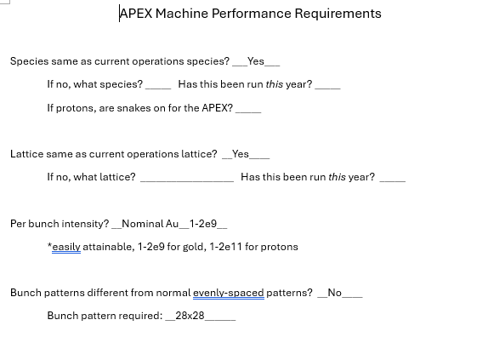
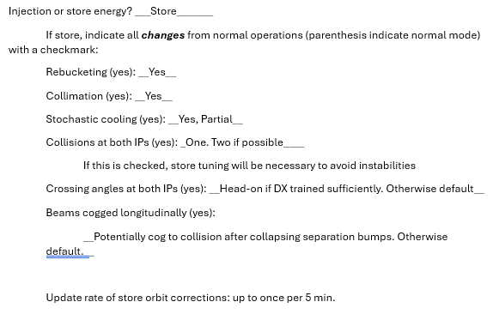
Operation Checklist
OC: Ian
( submitted, ready to go )

Slide 20
Readiness Check:
Switching from crossing-angle collision to head-on collision.
Make decision how to collide the beams: transversely or longitudinally, and plan ahead.

Slide 21
Summary
Both experiments 24-03: accelerator large emittance ratio Au ion beam from 31 GeV and 25-01: Maximize beam-beam parameter with flat beam collision in RHIC are important to inform EIC design.
We had a team discussion meeting and went over experiment conditions and procedures. Some concerns had been raised up. In the following we will work on them.
We will do another round of readiness check before Run25’ start-up to make sure these experiments are ready to go.

