Slide 1
Developments of Common Interest: Aerogel
Matt Posik & Bernd Surrow
Temple University

Slide 2
Aerogel QA Station
Two critical QA assessments for aerogel
Index of refraction
Transmittance
Temple contributed available infrastructure and invested ~$25k in components/materials towards aerogel QA for the ePIC collaboration
Build and commission LED system to measure light transmittance through aerogel tiles
Validate Temple’s LED system using UV/VIS monochromator/spectrometer at BNL
Measure index of refraction and validate Temple results with Aerogel Factory results
Recently expanded number of LEDs used (3→4) with financial support from the ePIC project/ pfRICH DSC
QA station can be used for general aerogel QA (e.g. pfRICH and dRICH)
Temple in discussion to join dRICH DSC with focus on aerogel QA

Slide 3
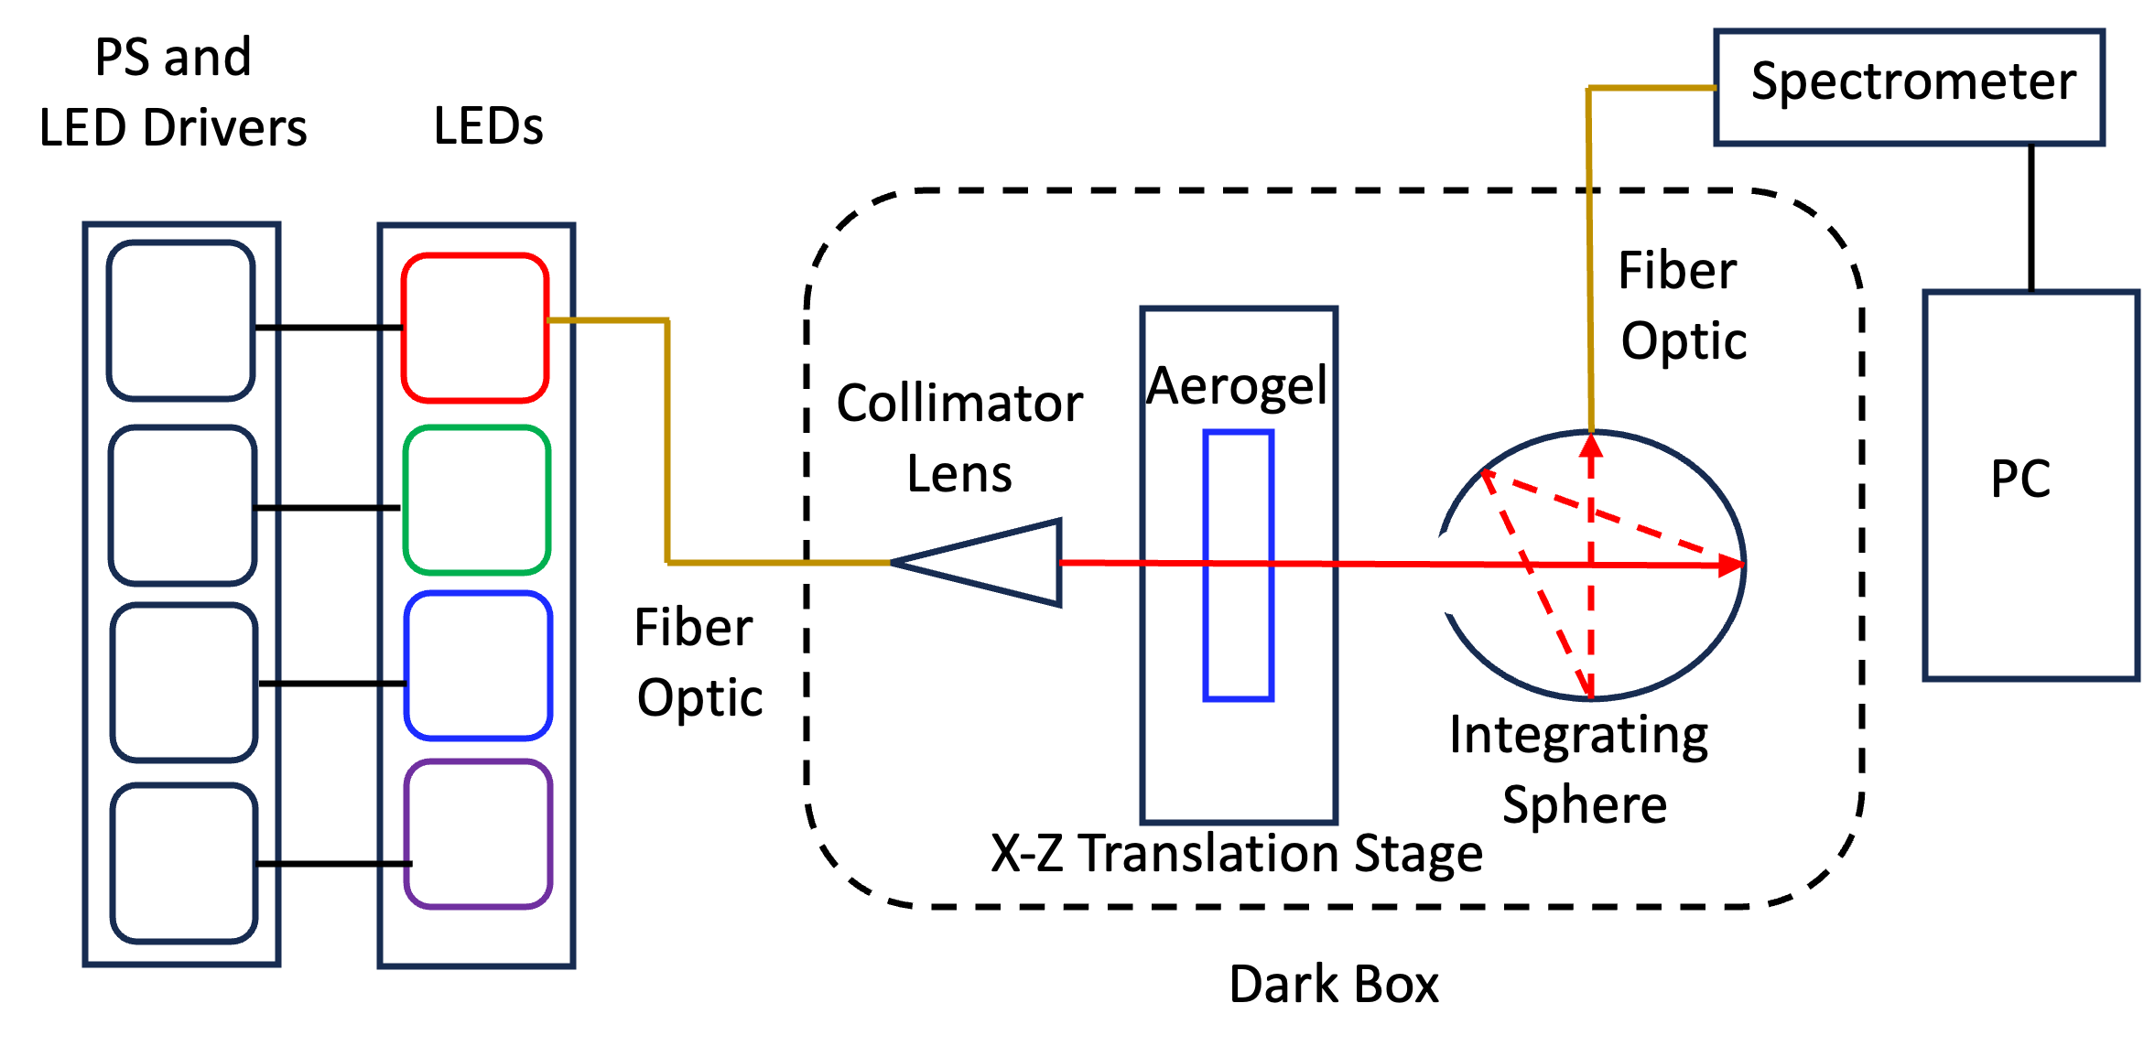
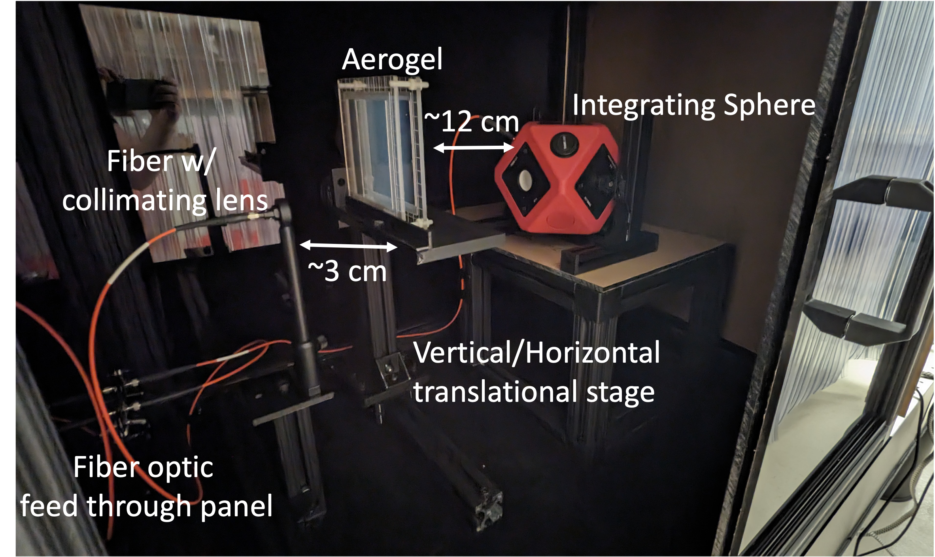
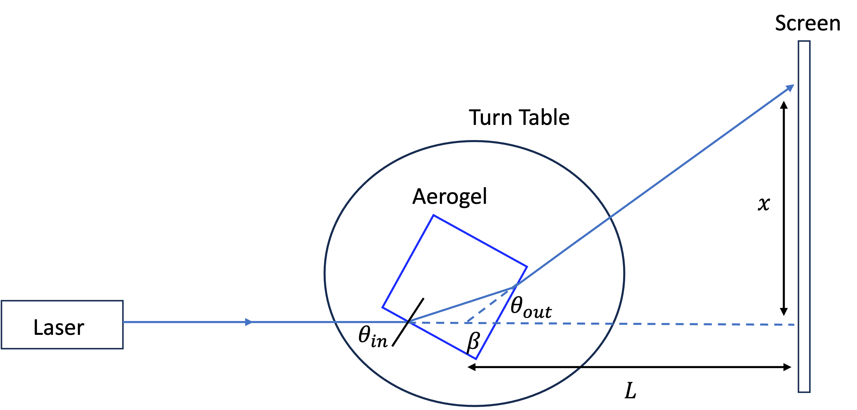
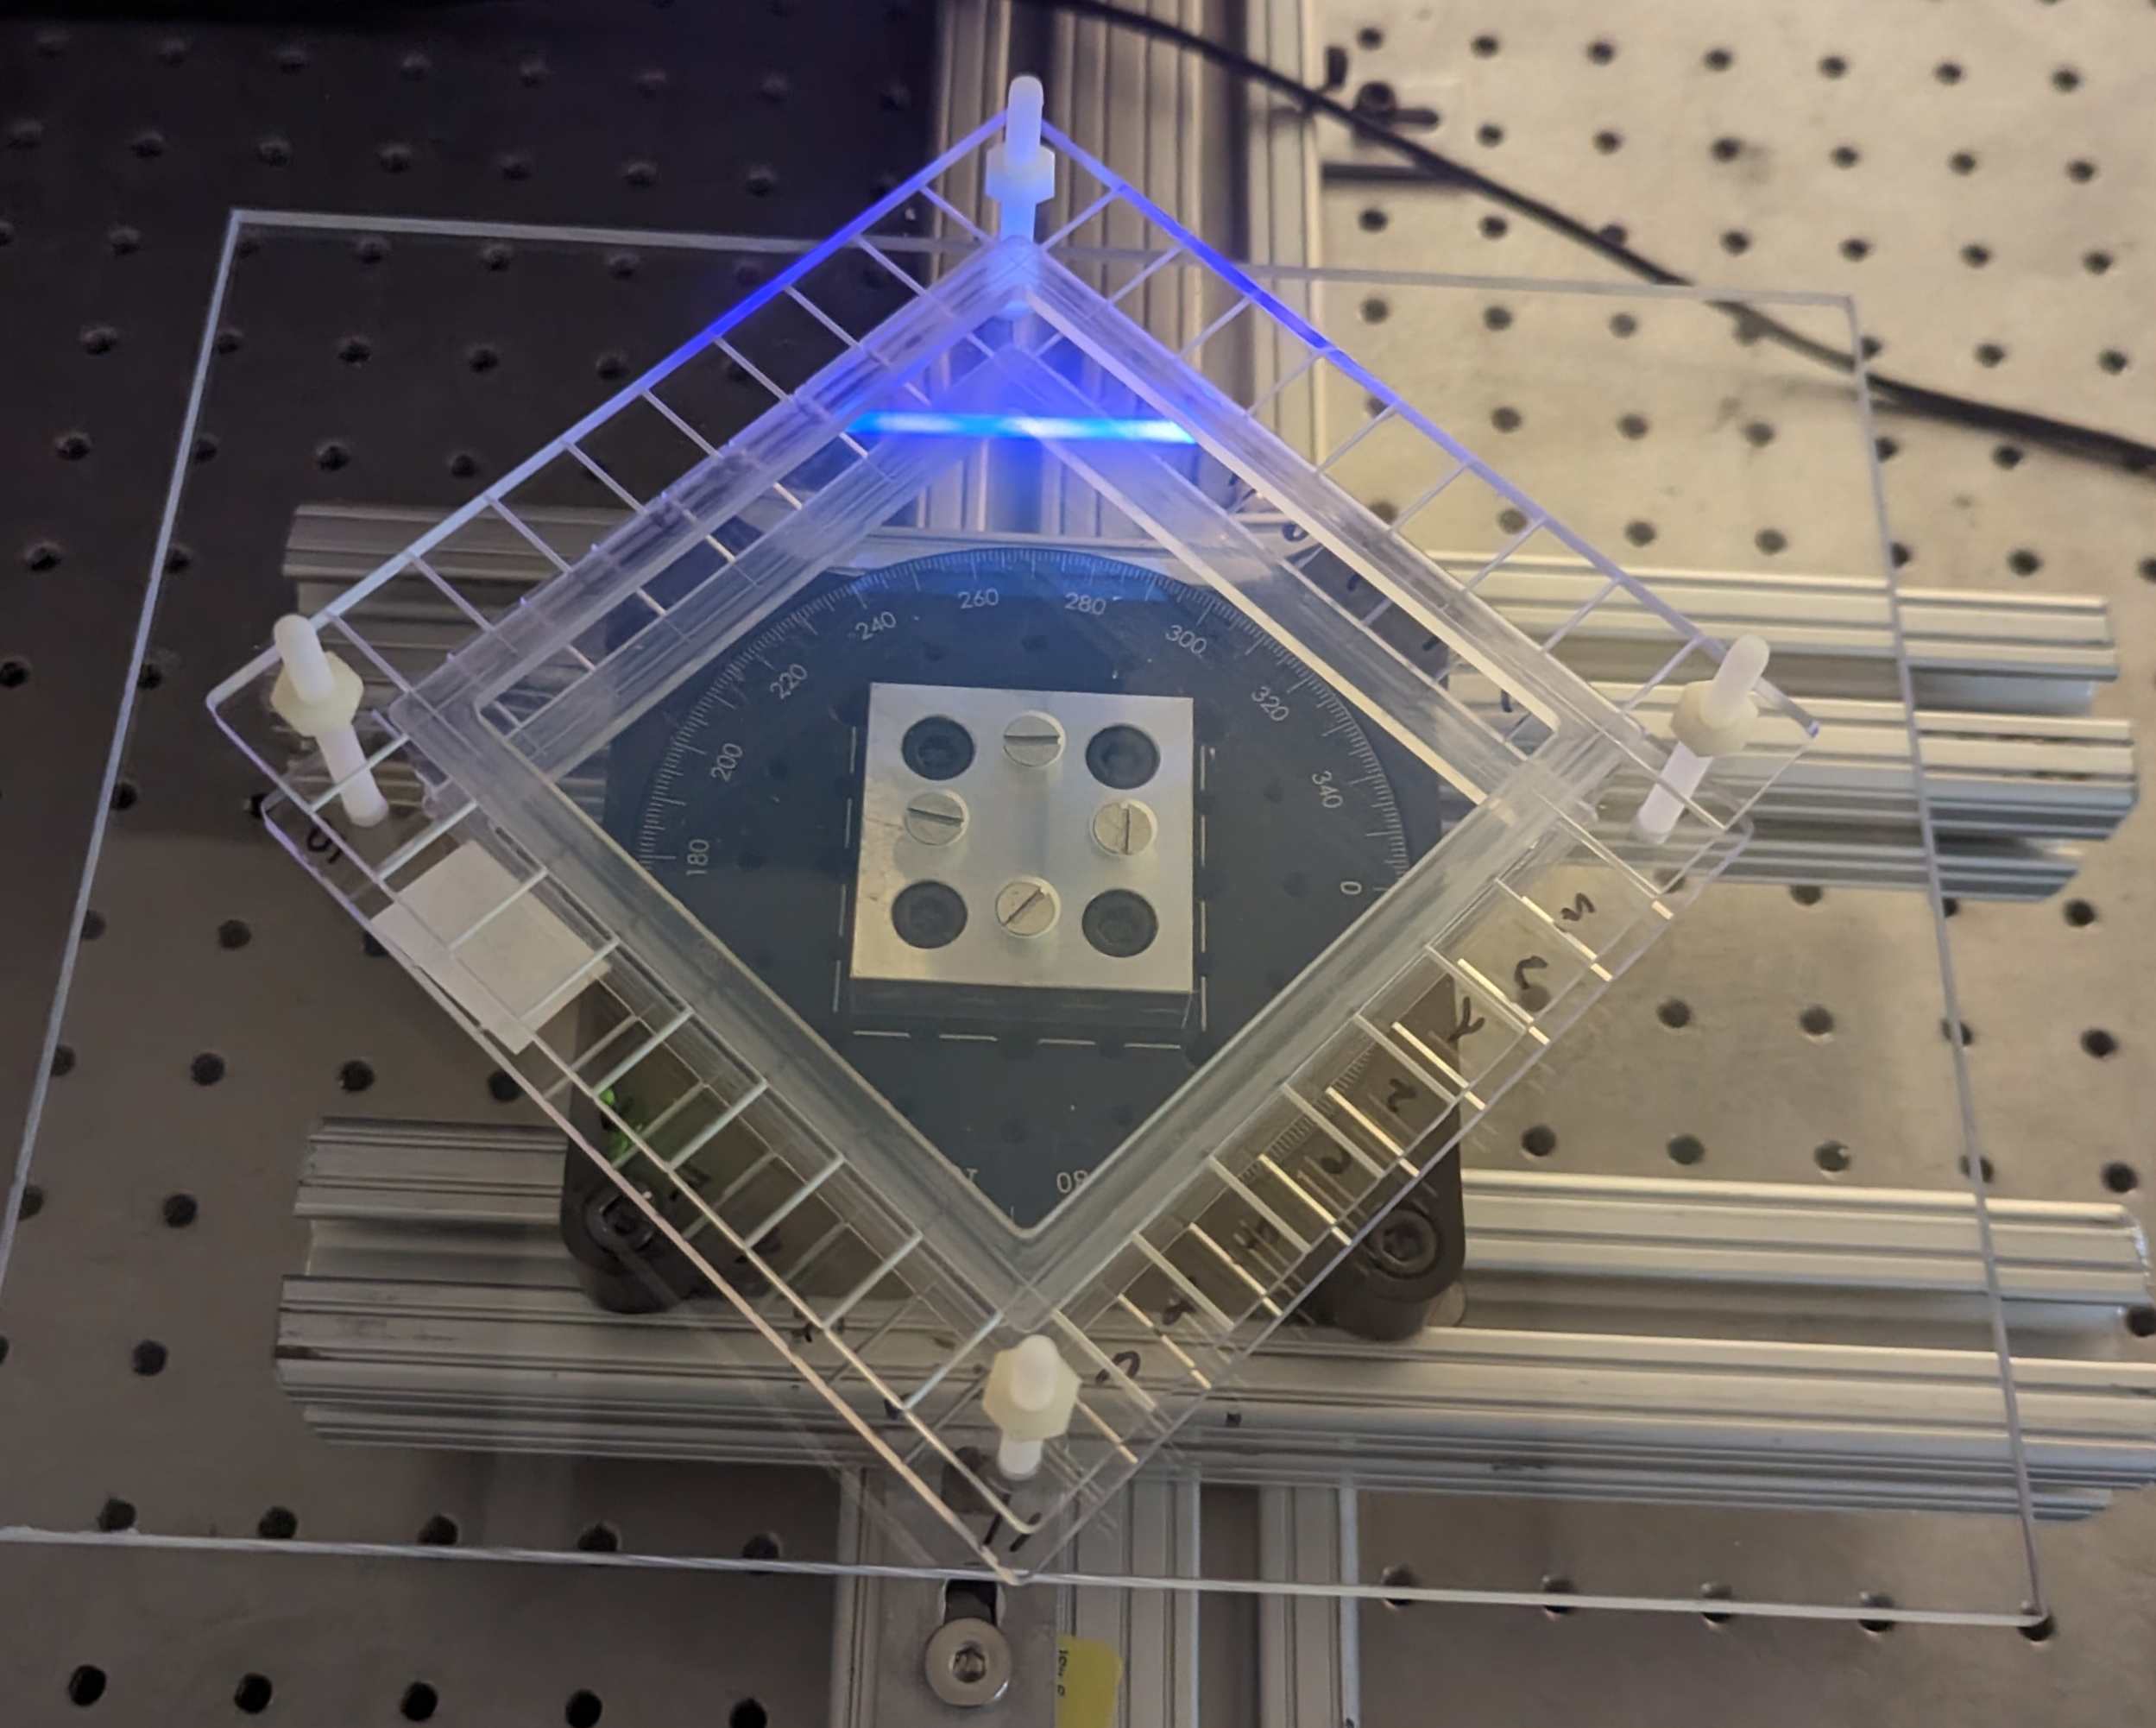
Aerogel QA Facility
LED based UV/VIS transmittance setup at Temple University
Refractive Index measurements
Measure deflection of light passing through the corner of the aerogel

Slide 4
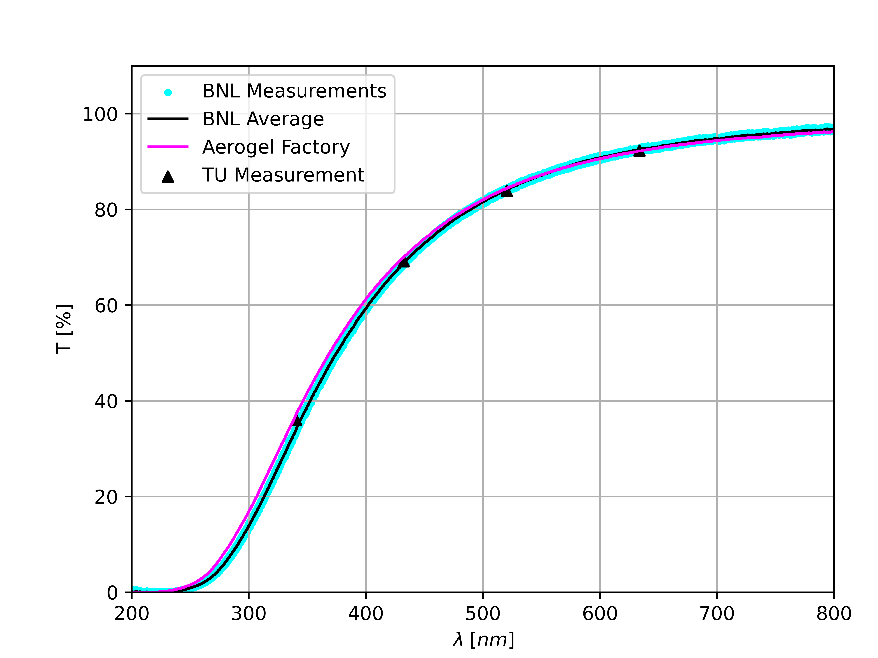
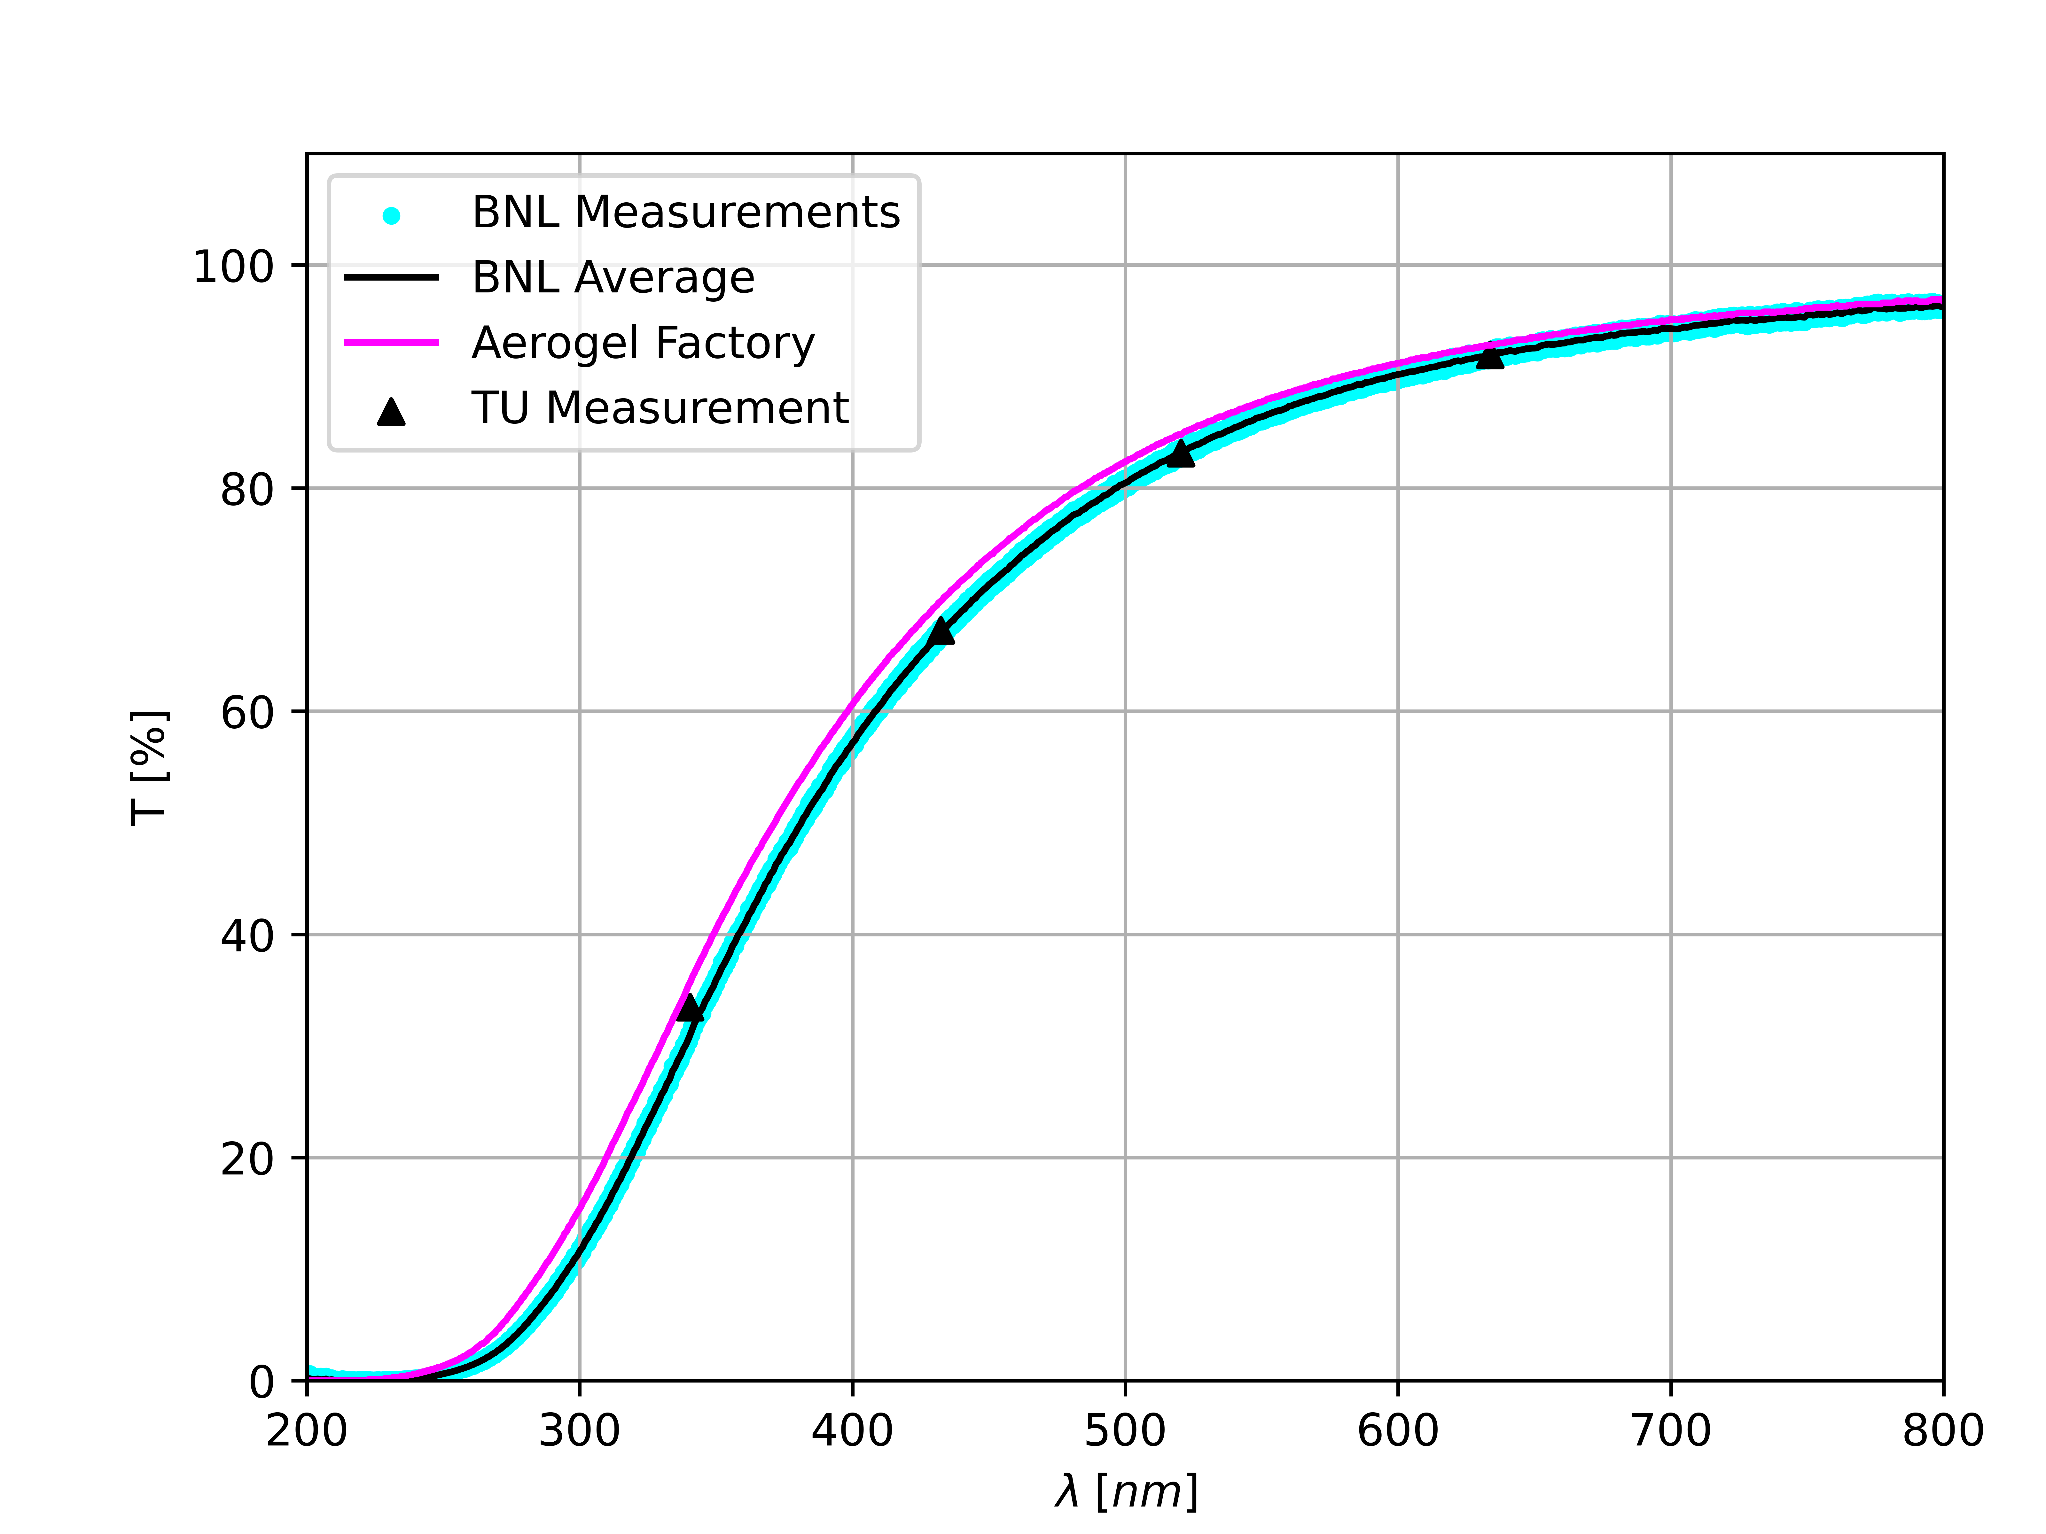
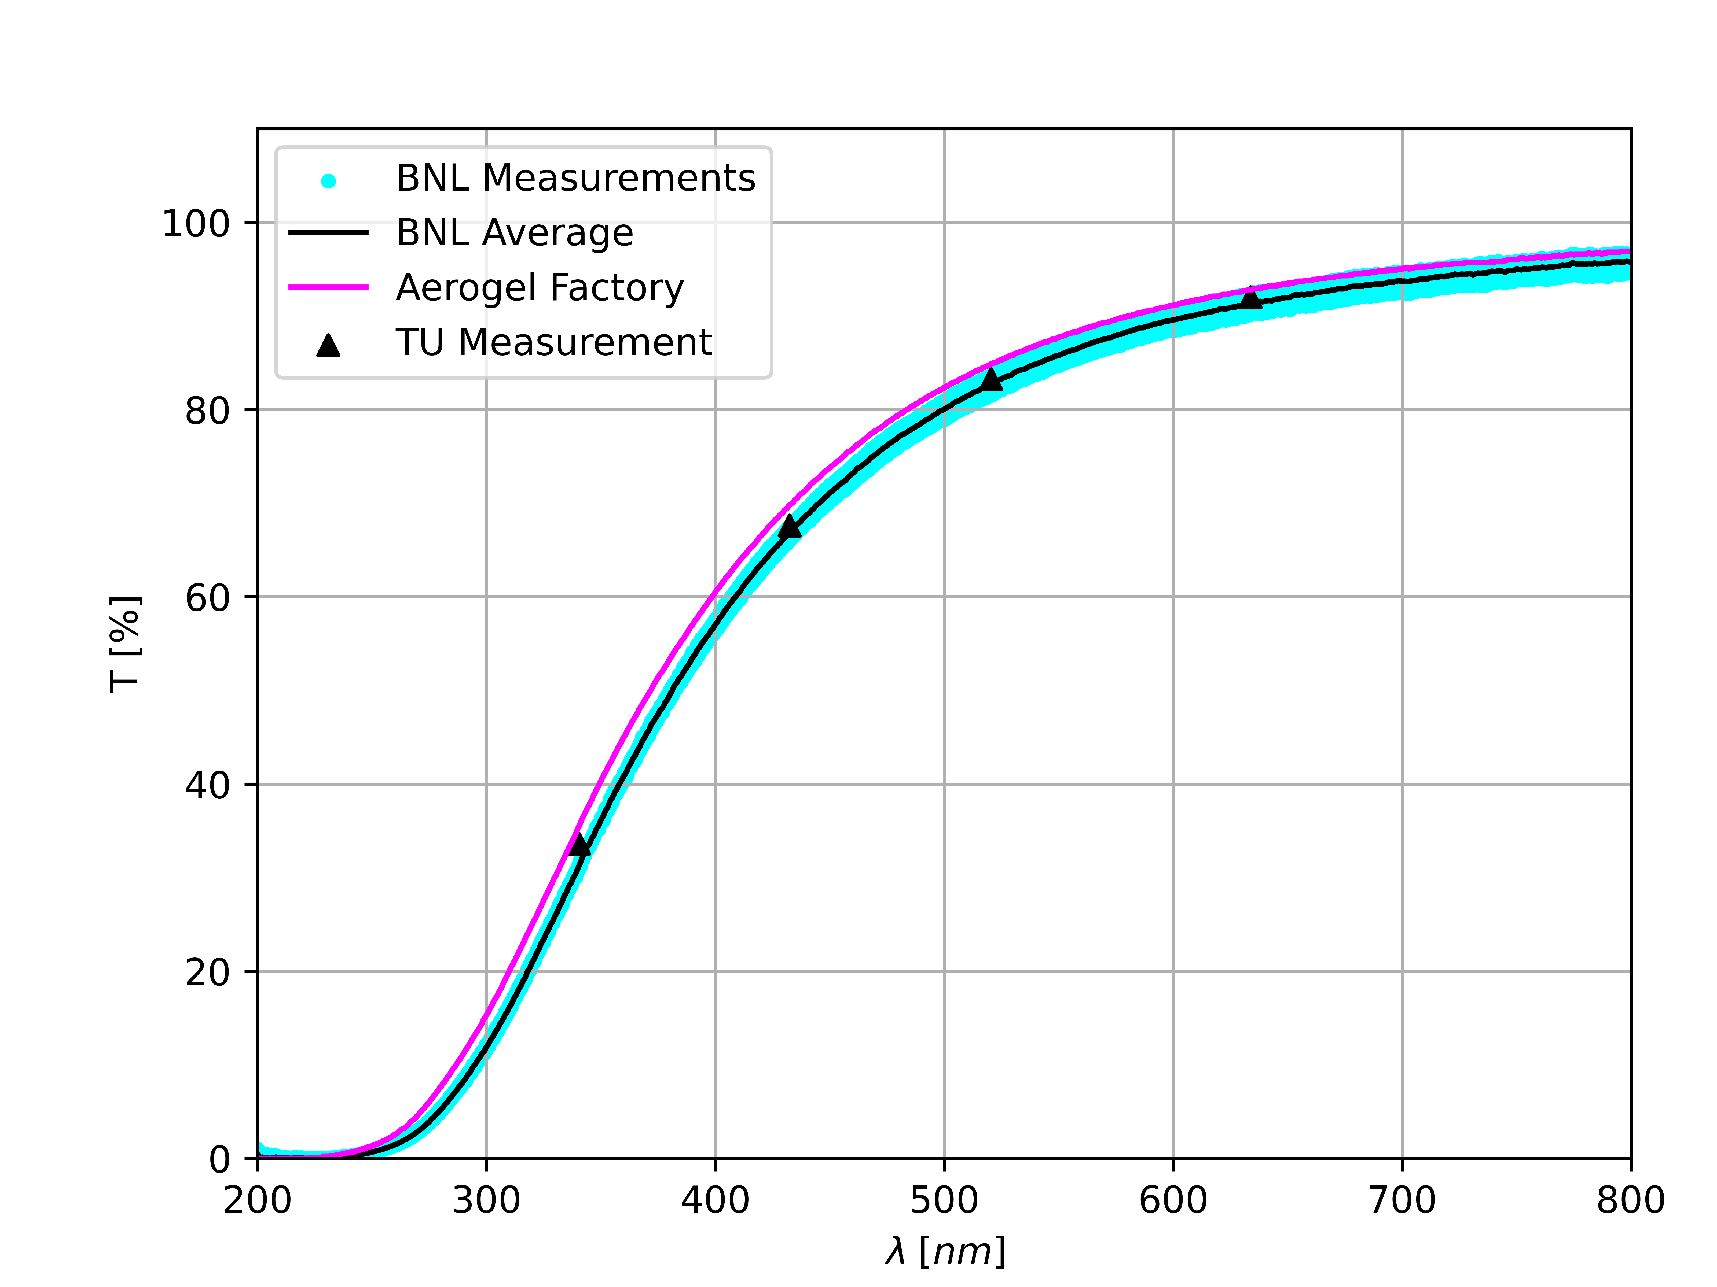
QA Validation
Index of refraction measurement comparison (Temple/Aerogel Factory)
Temple measurements consistent with Aerogel Factory and BNL measurements
Index of refraction and transmittance measurements validated
Tile | Temple (TU) $$(λ=403 nm)$$ | Aerogel Factory (AF) $$(λ=405 nm)$$ | (TU-AF)/AF [%]
TSA120-1 | 1.0413 +/- 0.0011 | 1.0404 | 0.087
TSA120-2 | 1.0401 +/- 0.0025 | 1.0401 | 0.000
TSA114-3 | 1.0383 +/- 0.0026 | 1.0377 | 0.062
Transmittance measurement comparison (Temple/BNL/Aerogel Factory)
$$T [\%]$$
$$T [\%]$$
$$T [\%]$$
TSA114-3
TSA120-1
TSA120-2
$$λ [nm]$$
$$λ [nm]$$
$$λ [nm]$$

Slide 5
Aerogel QA Facility: Next Steps
Local refractive index measurements
Measure change in light polarization to extract refractive index (via Brewster’s angle or ellipsometry)
Equipment in hand as part of pfRICH PED
Main effort to start in summer 2025
Sensor
Linear Polarizers
Aerogel
Laser
$λ/4$
Waveplate
Rotation Stage

Slide 6
Aerogel Inventory as of Jan. 24, 2025
Tiles from Aerogel Factory (Chiba University, Japan)
Values in table provided by Aerogel Factory
Serial Number | n (405 nm) | Lateral Size [cm] | Thickness [cm]
TSA88-1 | 1.0390 | 11.11 | 2.05
TSA114-3 | 1.0377 | 10.99 | 2.51
TSA120-1 | 1.0404 | 10.94 | 2.45
TSA120-2 | 1.0401 | 11.04 | 2.48
Serial Number | n (405 nm) | Lateral Size [cm] | Thickness [cm]
TSA122-1a | 1.0215 | 10.71 | 2.03
TSA122-2a | 1.0215 | 10.72 | 2.01
TSA122-2b | 1.0215 | 10.71 | 1.99
TSA153-2 | 1.0215 | 10.75 | 2.00
TSA153-3 | 1.0223 | 10.68 | 1.99

