Slide 1
European Strategy for Particle Physics Update and ePIC
J. Lajoie, S. Dalla Torre
January 14, 2025

Slide 2
European Strategy for Particle Physics
https://europeanstrategy.cern/
Mandated and organized by the CERN council
Seeks broad consultation with the grass-roots European community

Slide 3
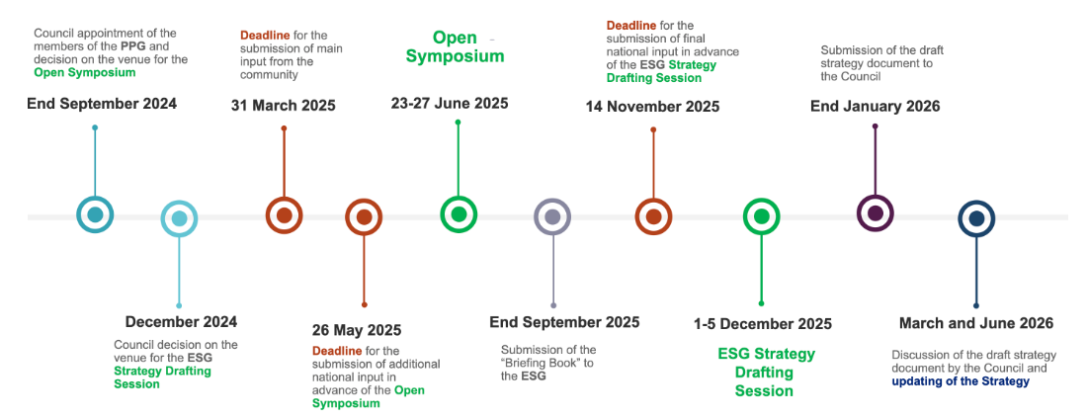
Timeline
Contributions emphasizing the EIC/ePIC are due here.

Slide 4
What has the EIC/EICUG done in the past?
During the 2018 Update there were several papers submitted in support of the EIC:
https://indico.cern.ch/event/765096/contributions/
EIC Accelerator Science - https://indico.cern.ch/event/765096/contributions/3295690/
DIS Paper – https://indico.cern.ch/event/765096/contributions/3296015/
Synergies with the EIC – https://indico.cern.ch/event/765096/contributions/3295735/

Slide 5
Planning for this cycle
The EIC project is working on an updated document on accelerator science and R&D
Paul Newman (Birmingham) is organizing a paper on DIS
Sylvia is working on a white paper on detector technologies and R&D
In the EICUG SC we have discussed if submitting an update to the “Synergies” paper would be useful:
It would seem to be conspicuous in its absence
Everyone is busy – need to be efficient, update 2018 paper (Radici and Boer)

Slide 6
Input from ePIC Physics PWG’s
Suggestion is to start from the 2018 input to the EPPSU and update it as necessary.
2018 document (and addendum) is attached to the Indico for this meeting
A lot has changed – for example, jets and HF were not such a strong component of the EIC physics program in 2018
Asking PWG conveners to do the following:
Look through the document, suggest changes
Marco will give access to the Overleaf for the 2018 document
Develop a specific, limited plan for changes – writing assignments by February
Submit a joint update on behalf of both the EICUG SC and ePIC
Authors to include PWG conveners
Internal review by ePIC PWG’s in early March?
Due March 31st

Slide 8
ePIC Resources
Public Website - https://www.bnl.gov/eic/epic.php
Mailing Lists – https://lists.bnl.gov/mailman/listinfo
Indico Agenda - https://indico.bnl.gov/category/402/
ePIC Software and Computing: https://indico.bnl.gov/category/435/
Wiki - https://wiki.bnl.gov/EPIC
ePIC Software Training:
Landing Page: https://eic.github.io/documentation/landingpage.html
Tutorials: https://eic.github.io/documentation/tutorials.html
Mattermost: https://chat.epic-eic.org
ePIC Zenodo Community: https://zenodo.org/communities/epic

Slide 9
EICUG Membership
The EICUG is a vital organization to promote the interests of the EIC community!
Without the EICUG we would never have gotten far enough to form ePIC!
Please register your institution!
Check with your EICUG IB representative to get registered as a member
https://www.eicug.org/content/join.html

