Slide 1




10 psTOF (mRPC) Update
Mickey Chiu

Slide 2
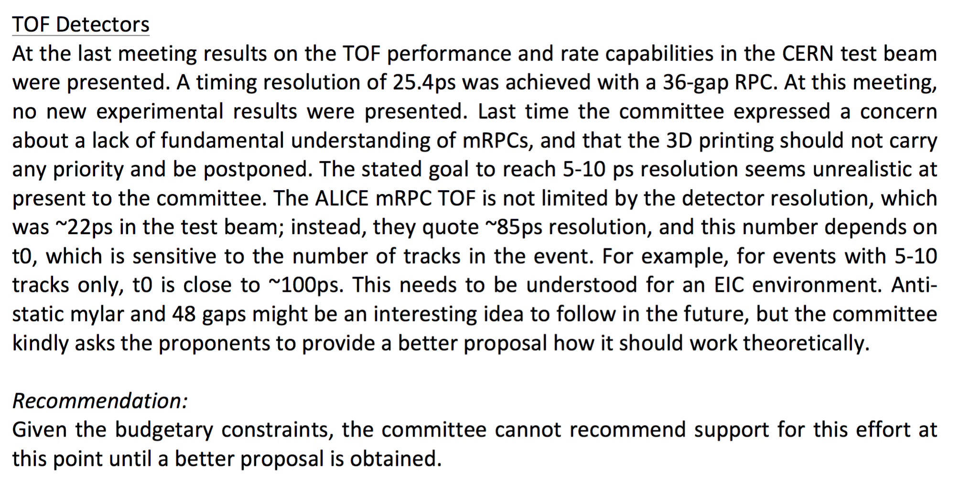
Response to Reviewer’s Report
ALICE mRPC was actually around 80 ps in the test beam. The 22 ps version was the advanced one that C. Williams built after ALICE mRPC. Test was only a few channels… didn’t have electronics that could scale for a full installation.
t0 at Alice is not sensitive to number of tracks, because they use a separate t0 detector
Self-determined t0 already used successfully in STAR, and my toy MC seems to show it is promising.
We requested ~$45K to build prototype electronics. We think we have good prospects for getting that funding from other sources (either China or Japan or both)

Slide 3
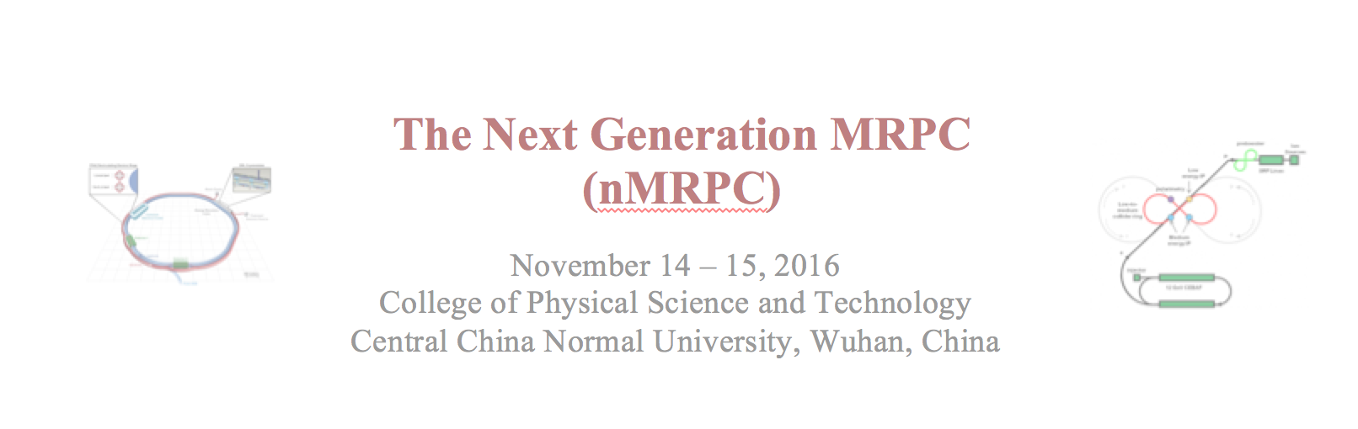
Next-Gen mRPC (China)
We had an initial Next-gen mRPC Meeting in China in Nov
Alexander Camsonne + MC (remotely), and Nu Xu (LBNL+CCNU), JP Chen (JLab), Yi Wang (THU), Xiangming Sun (CCNU), and Lei Zhao (USTC) in attendance
Develop high rate (10+ kHz/cm²?), 10-20 ps mRPC for sPHENIX, SoLID and EIC
For SoLID, main concern is rate capability, 20 ps is enough
For sPHENIX:
500 Hz/cm² would be good enough.
psTOF would stay and be reused for ePHENIX
ePHENIX could be transported to JLAB (I think)
Really want 10 ps for EIC to cover the necessary kinematics (but have 2 years of R&D for this)
If not, DIRC+psTOF would need to be built

Slide 4

TOF PID at RHIC/EIC
Momentum reach of TOF PID reaches interesting levels if one can achieve ~ 10 ps
Resolution | Distance | Pion-Kaon Separation | Kaon-Proton Separation
σ_{tot}=100 ps | 1m
σ_{tot}=10 ps | 1m
σ_{tot}=20 ps | 1 m
σ_{tot}=10 ps | 3m
TOF Positives
Compact (only 10 cm of space needed), allowing more room for other detectors
Can possibly contribute to electron identification using TPC dE/dx
Only technology feasible in high multiplicity of heavy ion collisions
TOF Negatives
Start counter needed??? Probably not needed.

Slide 5
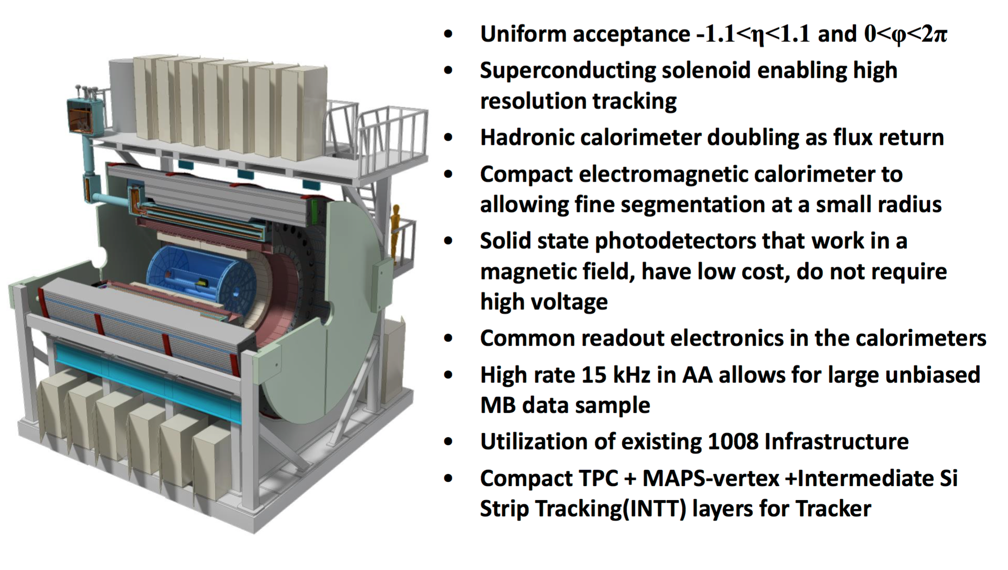
sPHENIX Reference Design
Designed to do:
Calorimetrically measured jet physics
Identified b-jets
High statistics, fully resolved Upsilon (1s, 2s, 3s well separated)
Recently received CD0 from the DOE ONP

Slide 6
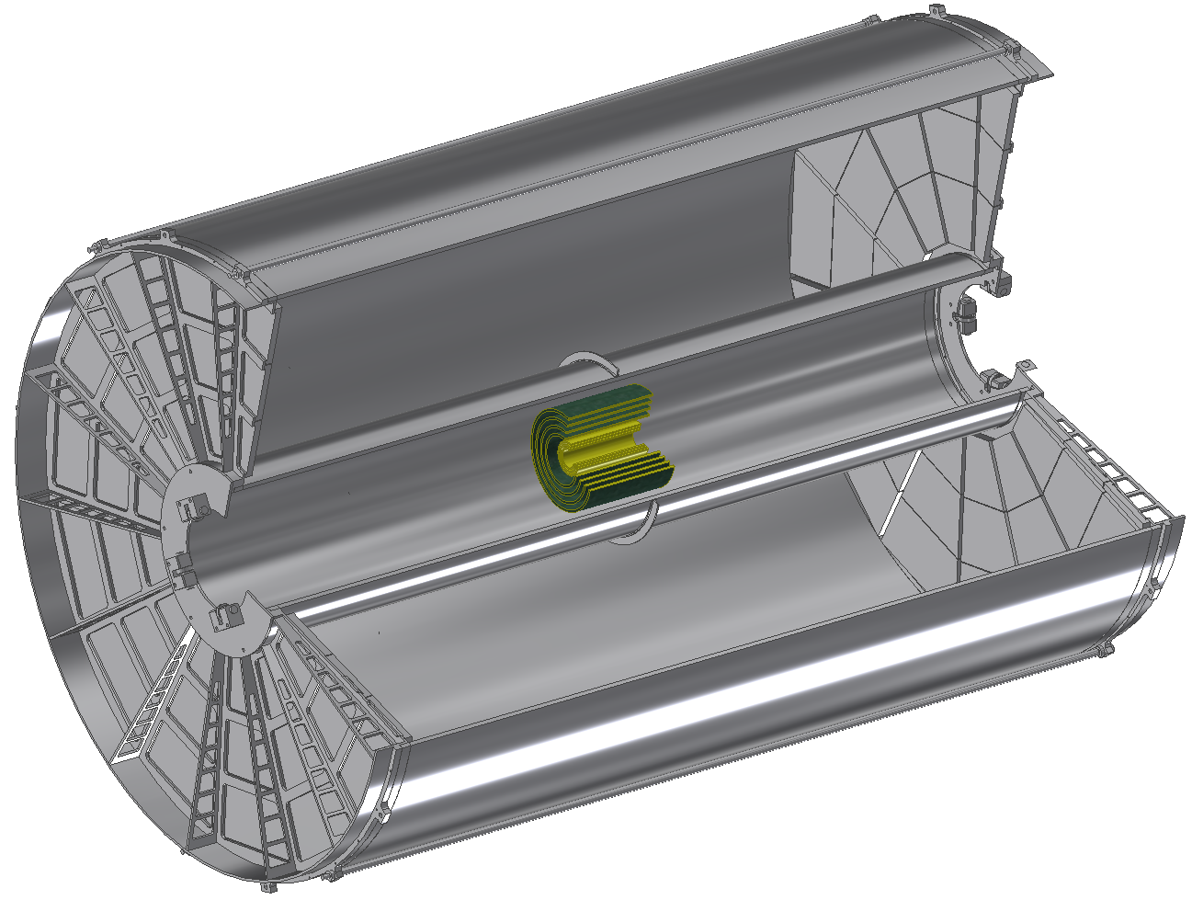
The sPHENIX Tracker
The Tracker system has three components:
Monolithic Active Pixel Sensors (MAPS) Three-layers identical to Inner ALICE ITS ( r = 2.3cm, 3.1 cm, 3.9 cm)
Intermediate Silicon Strip Tracker (INTT) Four layer Si strip detector. In kind contribution to sPHENIX from RIKEN. (r = 6 cm, 8 cm, 10 cm, 12 cm)
Compact Time Projection Chamber (TPC) (20 cm < r < 78 cm)
All cover at minimum | η | < 1.1 and 2π in azimuth
The TPC has been a Tracker option in sPHENIX for > 2 years. It is built on previous work for the STAR, ALICE and ILC TPC.
Possibly might have very poor dE/dx performance
234 cm
MAPS was proposed for sPHENIX ~ 1 year ago. It is a direct copy of the Inner 3 layers of the ALICE ITS. It received a recent boost by the approval of a LANL LDRD in support of its development for sPHENIX.
The INTT is a new concept in the past few months but is the outgrowth of an earlier all-Si tracker design for sPHENIX.It is funded by RIKEN
TPC
INTT
MAPS

Slide 7
Does mRPC TOF FIT in sPHENIX???
YES, it’s trivially obvious that it will fit!!!
r=20-78 cm
TPC
MAPS + INTT
sPHENIX has allocated only r=80-90 cm for PID
Module is 10 cm x 12 cm x 2.5 cm thick, and needs to fit in 10 cm radial space
Signals are expected to be 1 x 10 cm² strips, with long side running in phi (but also considering 1 x 5 cm² strips)
Covers |η|<1.1 or |z|<114 cm. Area = 2π(85cm)(228) = 12.2 m²
Occupancy: Expect ~1400 tracks in 0-5% central Au+Au events, so for ~10% occupancy, we need about 12000 1x10 cm² strips

Slide 8
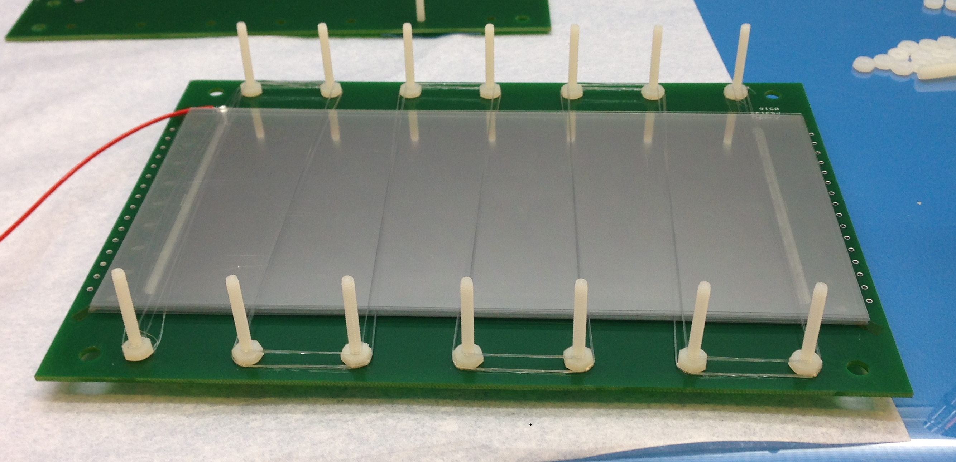
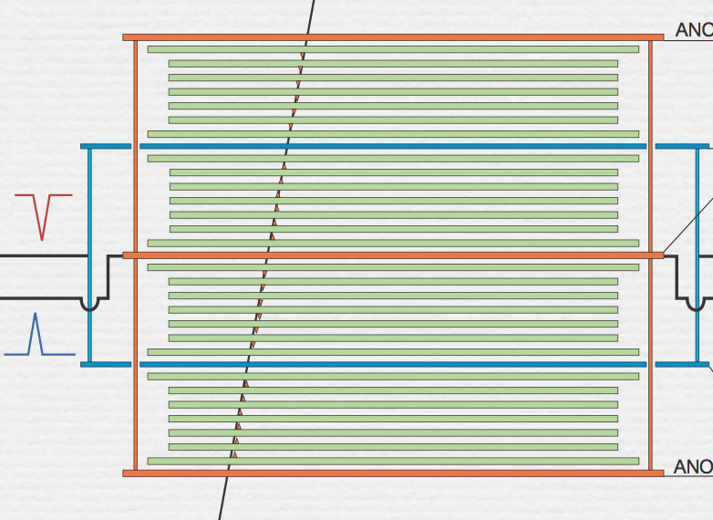
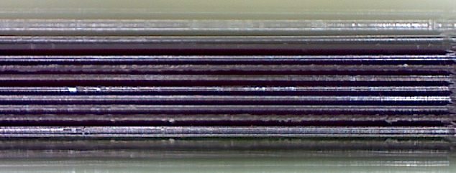
Use different material than glass (eg Mylar)?
Glass mRPC
Mylar mRPC
48 gas gaps!
One way to improve fast signal is to bring signal closer to pickup strips
Thinner glass gets very expensive (and starts to become flexible)
Mylar has much higher volume resistivities, 10¹⁹ Ω-cm2
Replace 200 um glass with 100 um Mylar, keep gas gaps the same.
Rate capability should be bad?
Possible major technical challenge: create flat mylar layer separated from next by ~100 um

Slide 9
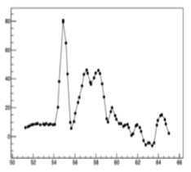
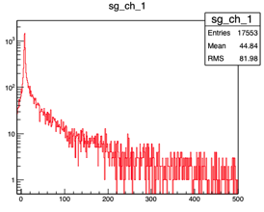
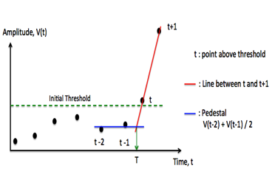
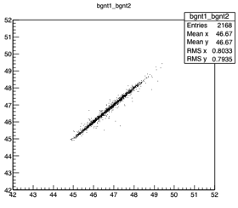
Paper Draft: MRPC Cosmic Ray Test
Channel Map
Ch1
MRPC1
Ch3
Ch2
MRPC2
Ch4
Scintillator
Sampling interval ~200ps
Pedestal σ < 1.5mV
Ch1
Signal
Ch1
ADC
Preamp
MRPC1
MRPC2
DRS4
(4 channels)
[ns]
[mV]
Lead
brick
Algorithm to find a ref. time T
Time Correlation
MRPC1_T(ch1)
MRPC2_T(ch2)
[ns]

Slide 10
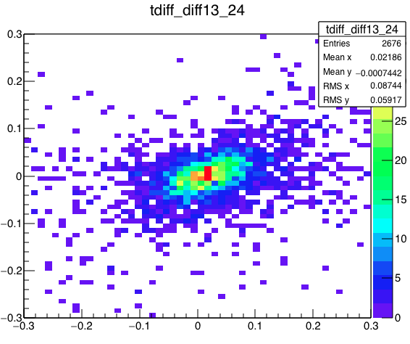
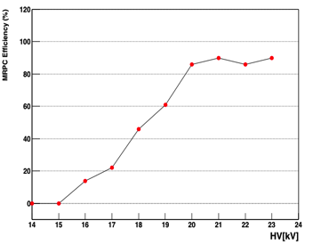
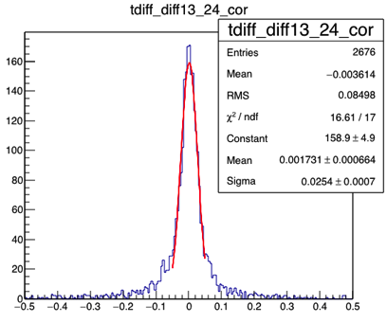
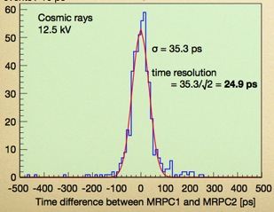
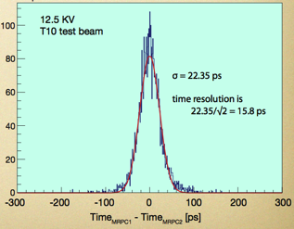
Paper Draft: Eff. and Time Resolution
Cosmic rays
22kV
Efficiency
[ns]
MRPC1- MRPC2
C. Williams
CERN, 2010
Cosmic rays
22kV
25.4ps / √2
~ 18ps
Preamp : NINO
10 GHz, Oscilloscope
MRPC1- MRPC2
[ns]

Slide 11
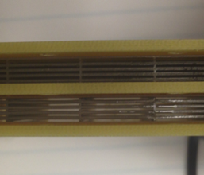
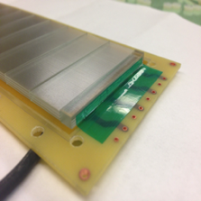
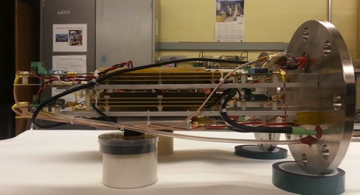
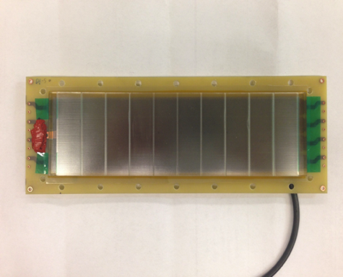
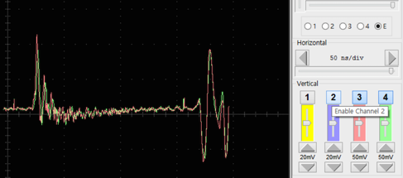
First Signals from the 3D Printed MRPCs
Two 3D printed gas gap MRPC assembled
Signals
2 stacks, 10 gas gaps, 0.3mm gas gap width
(No need to wire fishing lines)
Trigger bias
Signals captured at COMPASS hall
Not enough time to setup 3D MRPC properly for data taking before the COMPSS beam was end
Expected the first time resolution results in the beam test at Fermilab 2016!

Slide 12
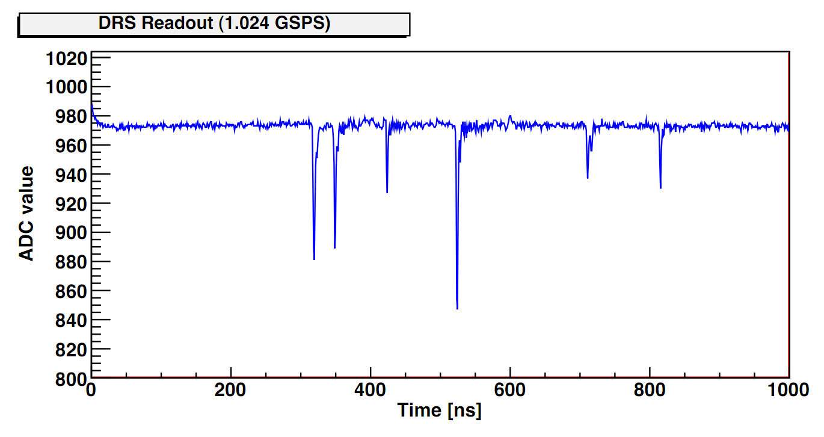
Region of Interest (Windowed) Readout
DRS4 running at 5 GSPS takes 200 ns to fill 1024 SCA buffer
Collider trigger signals require at least a few μs to be sent to FEM
PHENIX trigger latency is 4 μs >> 200 ns.
To solve this, we propose to use the ROI readout for the DRS4 – have a fast LOCAL threshold trigger on each channel, and digitize small window immediately
Need to generate accurate timestamp for ROI (my main worry right now)
Digitizing a 6 ns window with a 37.52 MHz ADC (4x RHIC clock), takes ~3 μs (1+2 overhead), where the DRS4 is dead
Q: What is deadtime effect? At 100 kHz Au+Au rate, we expect about 500 tracks on average per event, over 10K channels, or 5 kHz hit rate on one channel
Poisson prob P(N>=2; 5 kHz hits and 3 us deadtime) ~ 1.5% lost events

Slide 13
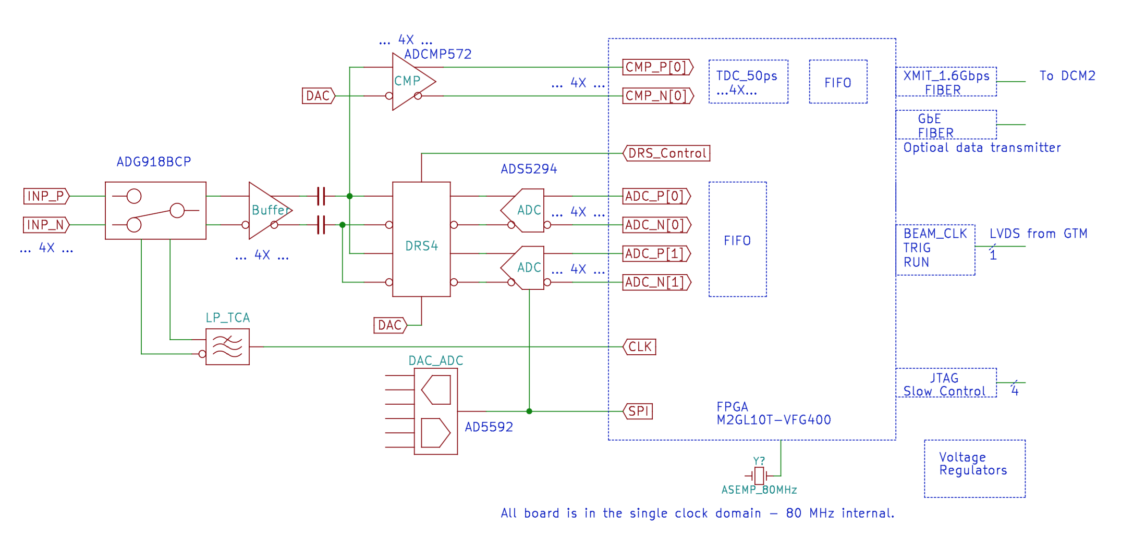
DRS4 ROI Electronics Block Diagram
sPHENIX psTOF DRS4 Board
PHENIX MPC-EX FEM Board
Preamp
Input
Block diagram for DRS4 prototype board using windowed readout for EIC
MPC-EX FEM Board exists and was used successfully with the sPHENIX DAQ (DCM2)
Capable of 15 kHz DAQ Rate
psTOF DRS4 Board needs to be laid out and built. Includes
Fast comparator for self-triggering and timestamp (CMP)
DRS4 ASIC + TI 80 MSPS ADC

Slide 14
sPHENIX Barrel mRPC TOF Cost
Barrel Area = 12 m² (R=85 cm, L=214 cm)
1500 4-stack glass or alternative mRPC modules: $2.0M
each 8 channels (one channel is a 1x10 cm² strip)
Cost is fully loaded (materials + labor + overhead)
25K total channels. Assuming DRS5 based board @ $100/ch: $2.5M
Project Cost excluding installation = $4.5M (fully loaded)
Cost Basis:
STAR TOF Total Project Cost = $7.0M
$2.3M from China for mRPC modules, $4.7M from US DOE for electronics/infrastructure
STAR TOF Coverage = 50 m², ie, $46K/m² for their 6 gap, single stack glass mRPC modules
I assume $200K/m², more than 4 times their cost, for our 4 stack mRPCs.
All the above numbers are for the Total Project Cost, including labor and overhead, and are very realistic since it comes from a real world example

Slide 15
Summary
We had a setback with the last EIC R&D proposal
We’re reasonably confident we can get our request funded through other sources
Will build DRS4 based digitizer,
Important to increase number of channels we can read out, from 4 (both ends of 1 set of strips on two mRPC) to 32 (8 sets of strips, covers a full module)
Have SULI student at BNL for spring semester to work on mRPC studies
Working on ~$4M project to install psTOF in sPHENIX, to be reused for ePHENIX. (Also for SoLID).
Working on paper draft of 18 ps cosmic ray result
Working on simulation of self-determined t0
UV sensitive MCP-PMT work perhaps may not make it for mid-report

