Slide 1
Signal Processing + DNN ROI in ICARUS
Gray Putnam (they/them)
SBN WG
Jan 9, 2025

Slide 2
Introduction
I have been working on getting the WireCell 2D signal processing working in ICARUS
Main steps:
Infrastructure adaptation (presented here previously, now done with work from Jacob C., Brett, others)
Filter optimization
DNN ROI
I’ll review what we have completed, and show progress on the DNN training (work by Avinay Bhat)

Slide 3
What are the Goals?
My goal is to get the WireCell signal processing at parity in ICARUS with where SBND is at
My hope would be that we could explore combining publication of the signal processing work across SBN
I’m hoping to continue that conversation here (and in future WireCell meetings)
Please let me know what you think, and what we need to do to get ICARUS to parity with SBND

Slide 4
Filter Optimization

Slide 5
Filter Optimization
WireCell has two filter stages:
Wiener-like filter for ROI finding
Gaussian filter for charge extraction

Slide 6
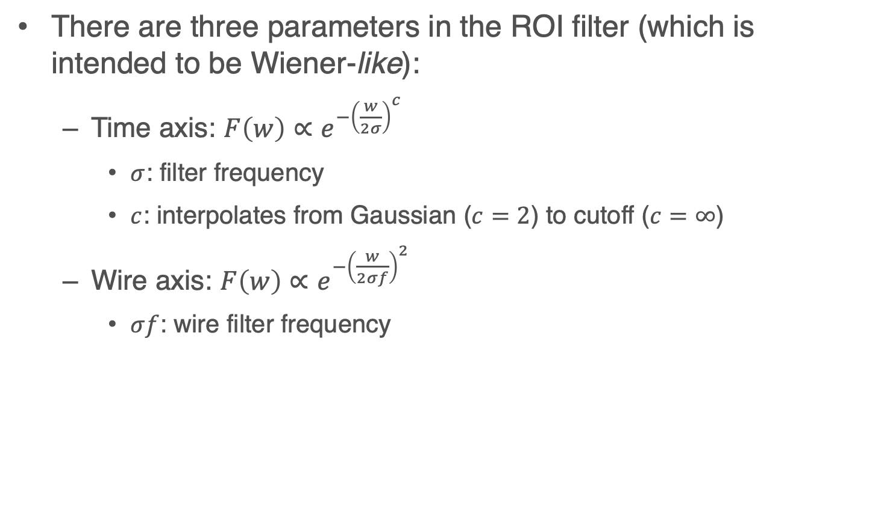
Filter Optimization Parameters: ROI
There are three parameters in the ROI filter (which is intended to be Wiener-like):
Time axis: $F\left(w\right)∝e^{−{\left(\frac{w}{2σ}\right)}^{c}}$
$σ$: filter frequency
$c$: interpolates from Gaussian ($c=2$) to cutoff ($c=∞$)
Wire axis: $F\left(w\right)∝e^{−{\left(\frac{w}{2σf}\right)}^{2}}$
$σf$: wire filter frequency

Slide 7
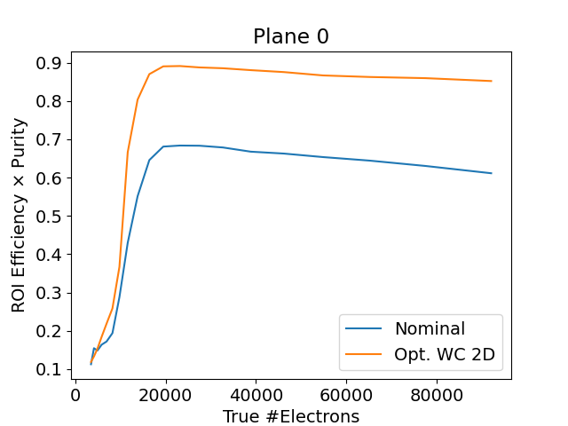
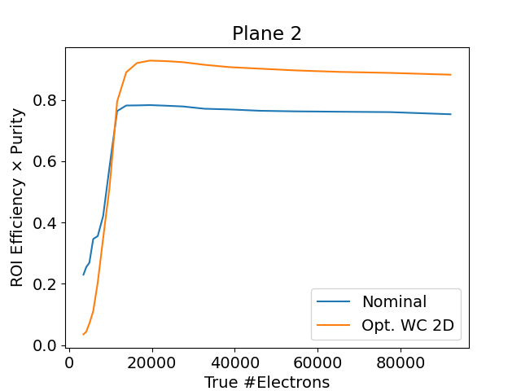
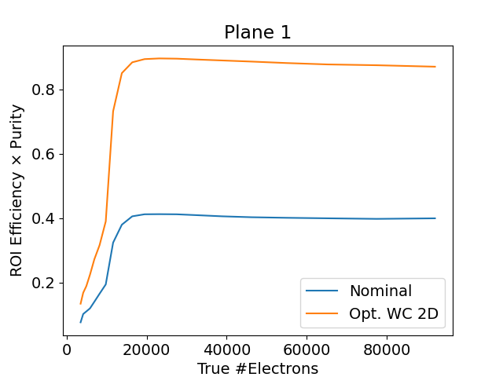
Filter Optimization Results: Improvement in ROI Identification
Efficiency x Purity comparison, Nominal 1D v Optimized 2D
See DocDB 38074
for details

Slide 8
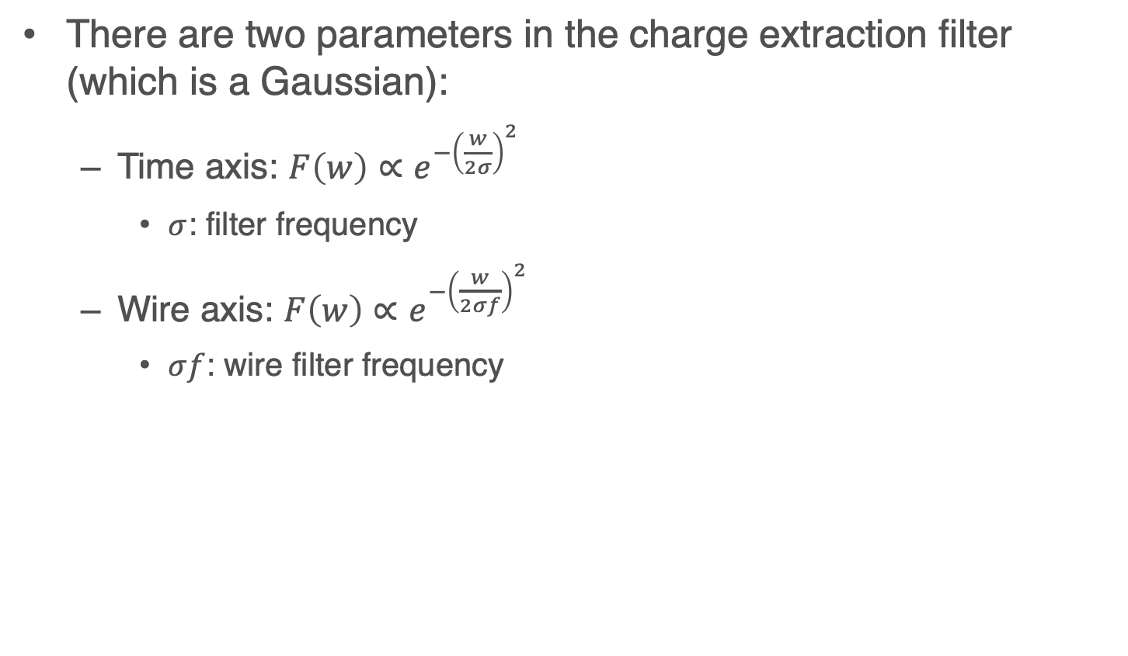
Filter Optimization Parameters: Charge
There are two parameters in the charge extraction filter (which is a Gaussian):
Time axis: $F\left(w\right)∝e^{−{\left(\frac{w}{2σ}\right)}^{2}}$
$σ$: filter frequency
Wire axis: $F\left(w\right)∝e^{−{\left(\frac{w}{2σf}\right)}^{2}}$
$σf$: wire filter frequency

Slide 9
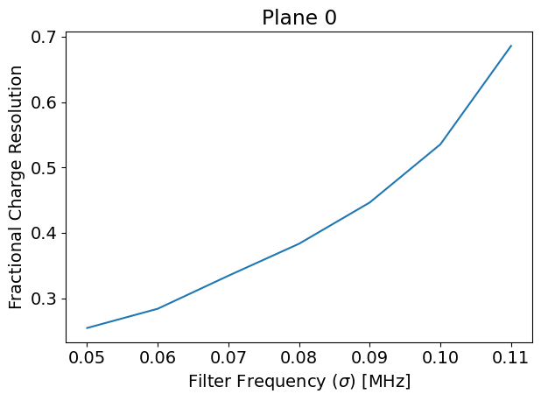
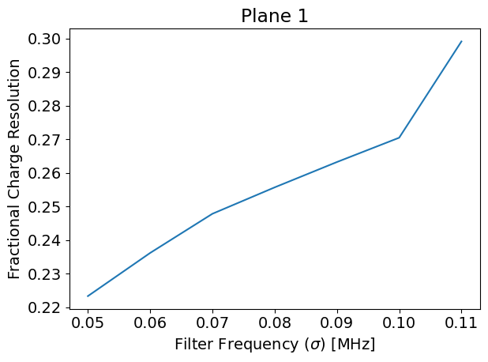
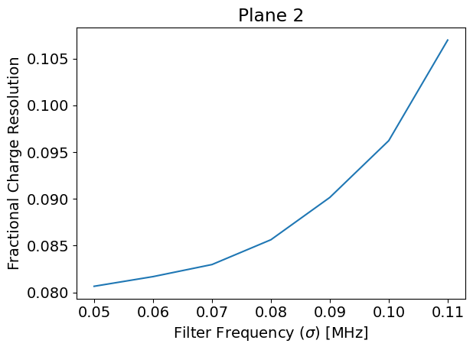
Charge Filter Optimization
Optimize for charge resolution, in space of Gaussian filter width

Slide 10
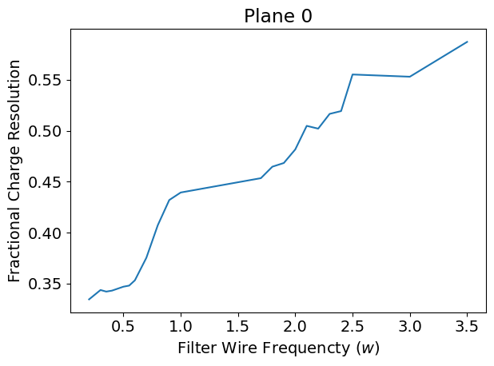
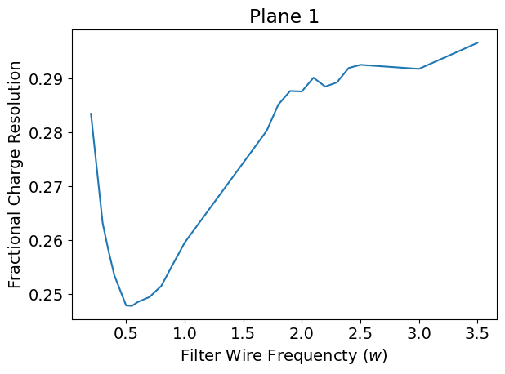
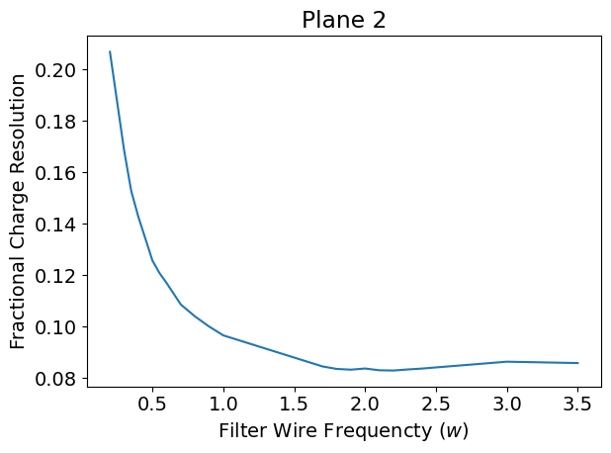
Charge Filter Optimization
Optimize for charge resolution, in space of wire filter width

Slide 11
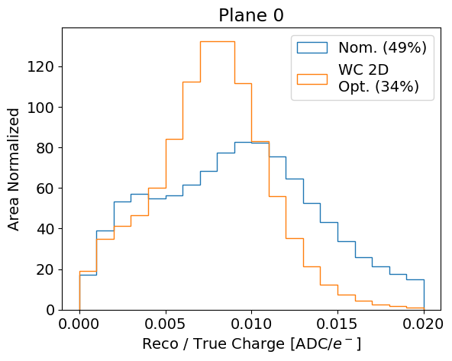
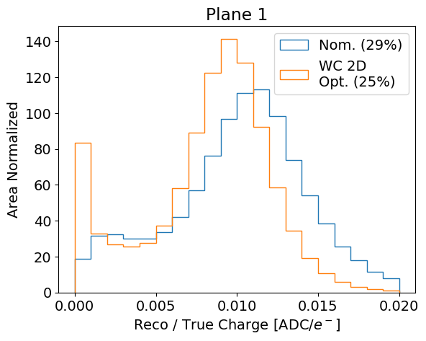
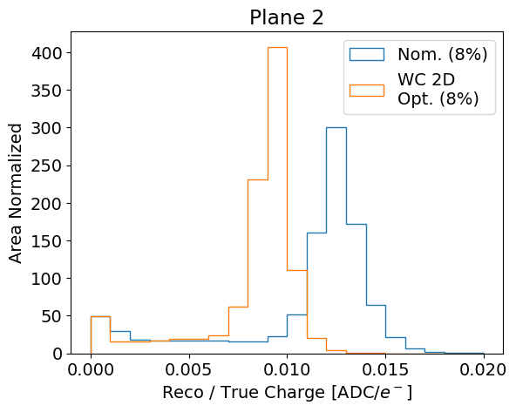
Improvement in Charge reconstruction
Nominal 1D v Optimized 2D
The change in charge scale is due to a WireCell configuration parameter that we have since fixed

Slide 12
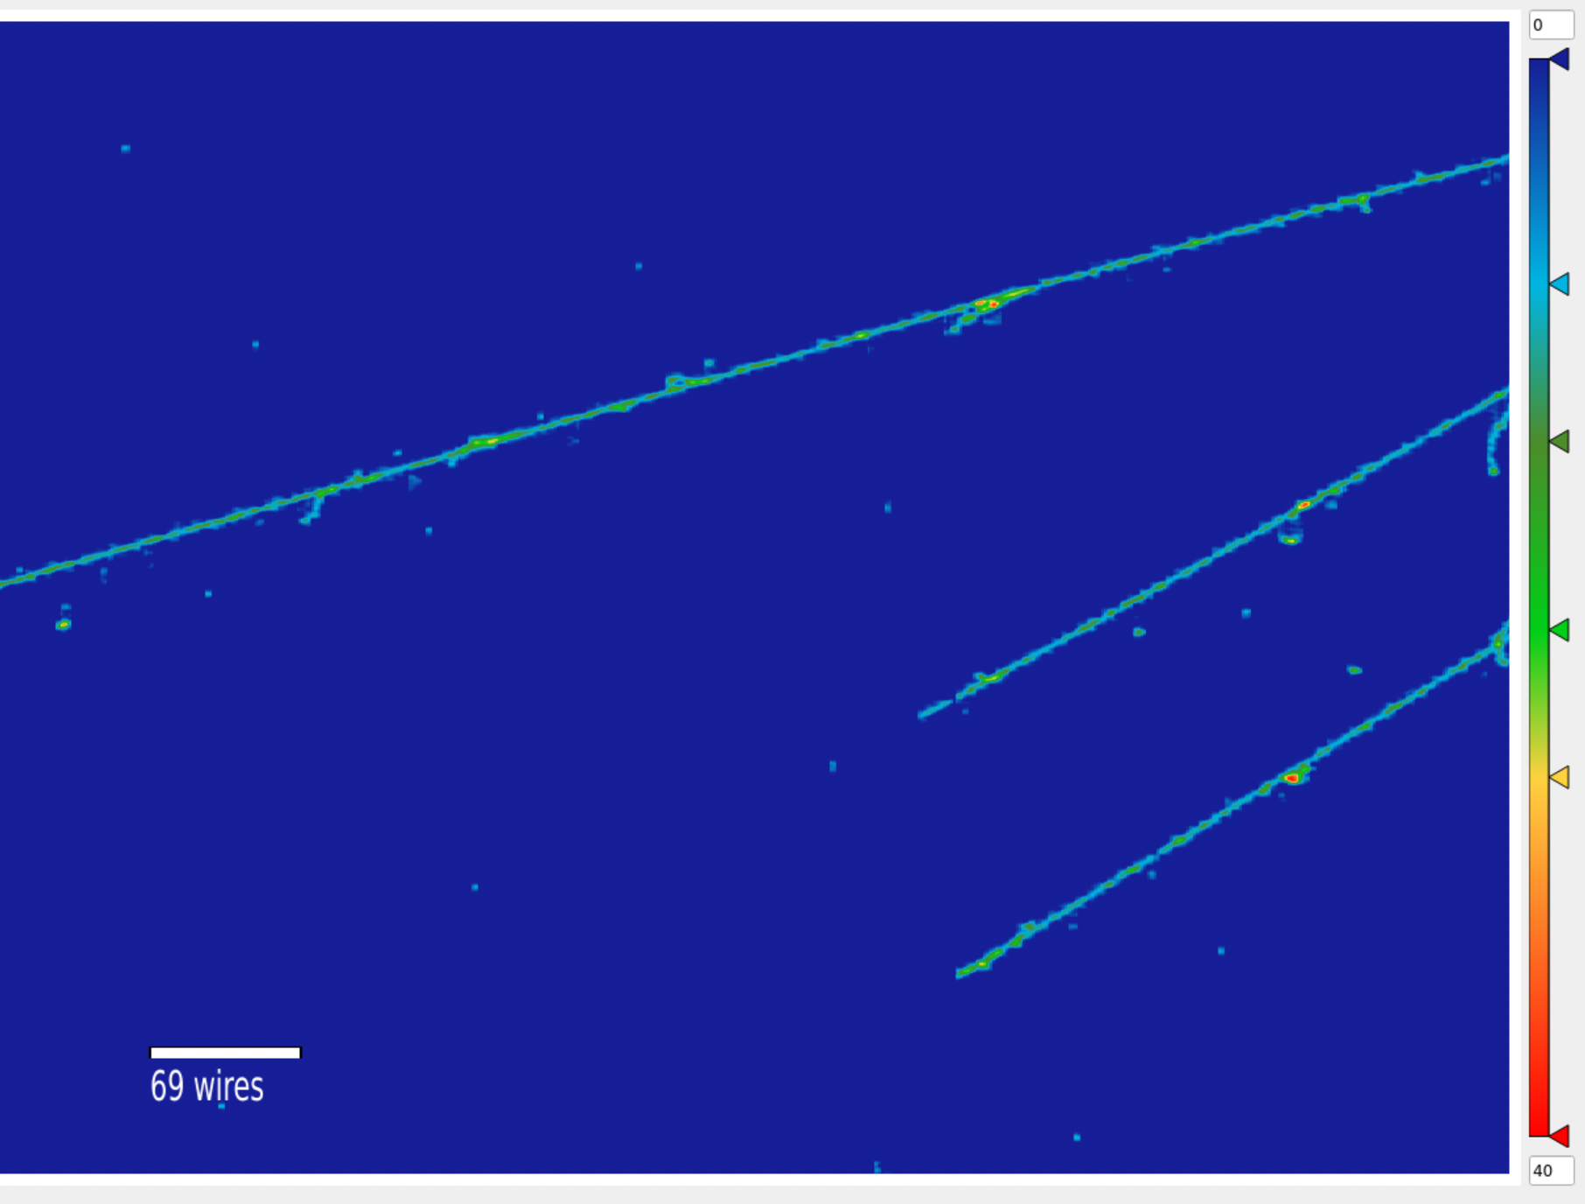
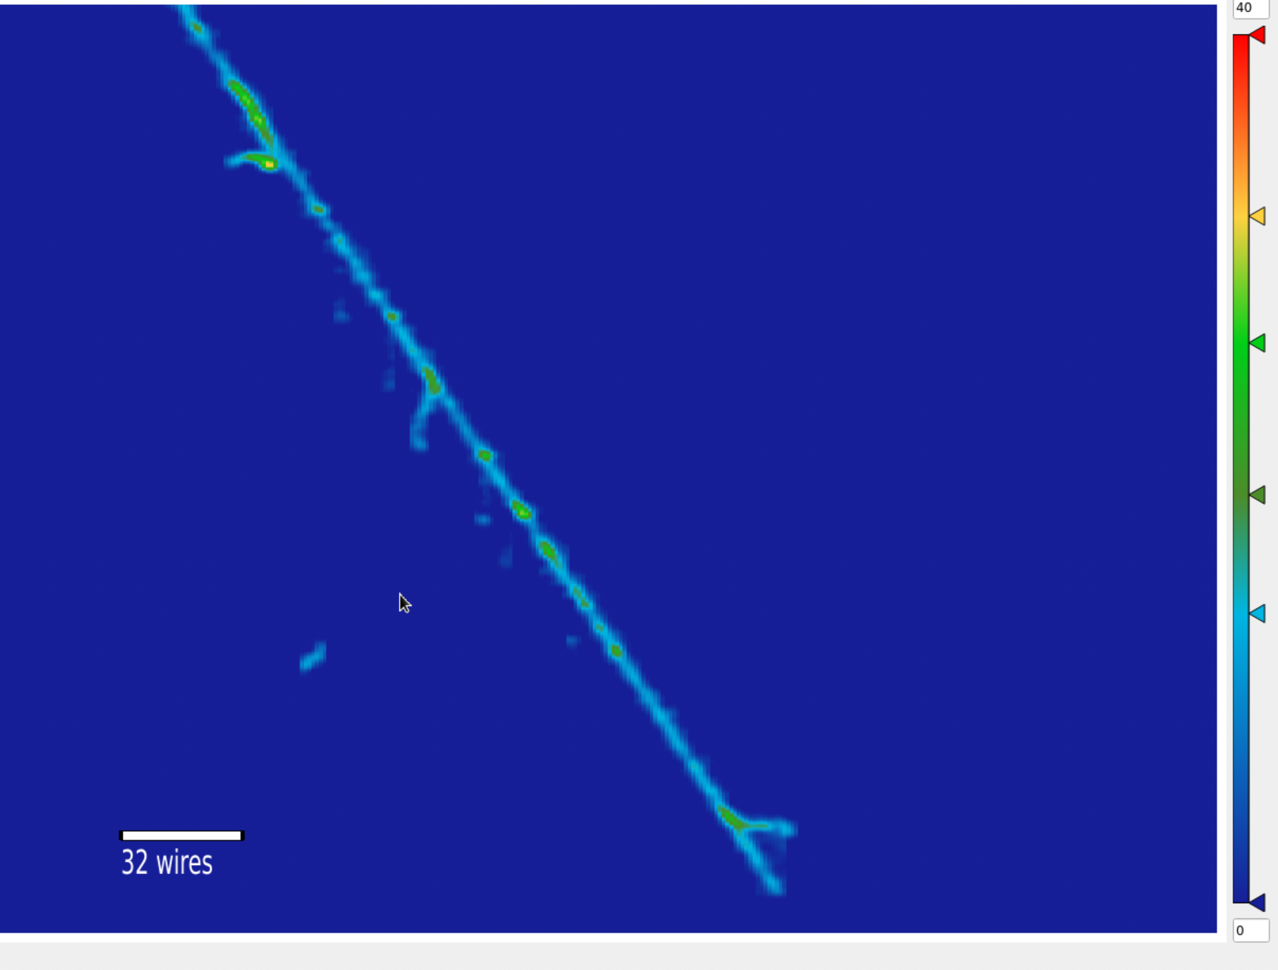
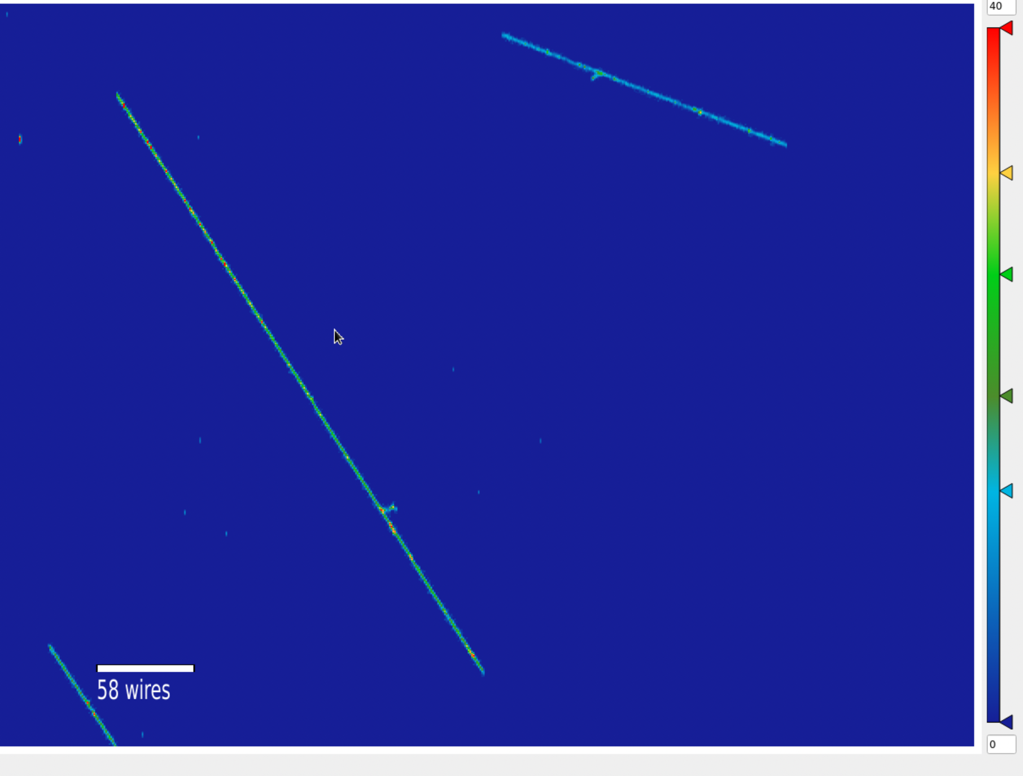
Event Displays
Plane 0
Plane 1
S/N is much improved!
The low wire-frequency cutoff smears charge across wires on the induction planes
Is this bad? We’ll have to look at higher level variables
Plane 2

Slide 13
DNN ROI Training

Slide 14
Sample Generation: Gen types
We are generating samples for training the DNN
(Today): Corsika cosmic-only MC
(Future): Cocktail of:
BNB neutrino + cosmic
NuMI neutrino + cosmic
Extended muons
Validation tests with HPS -> e+e- decays

Slide 15
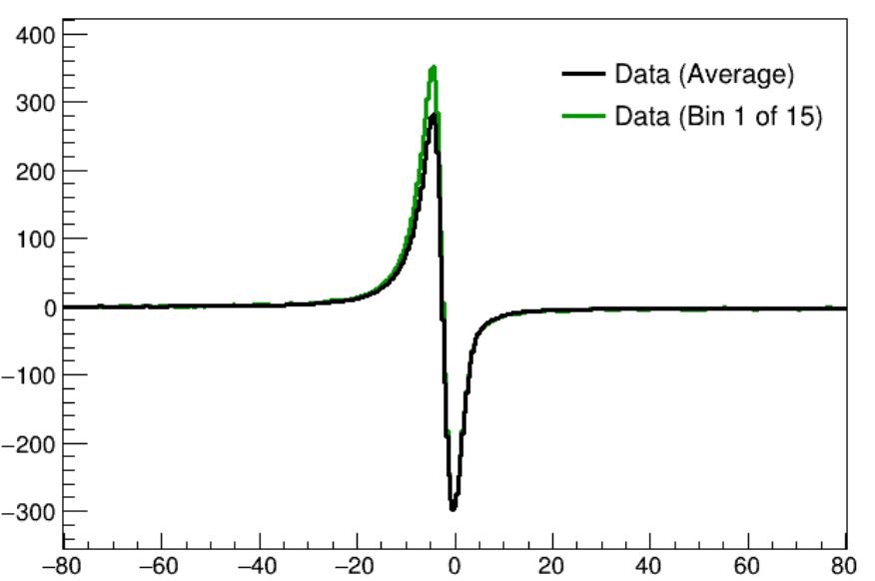
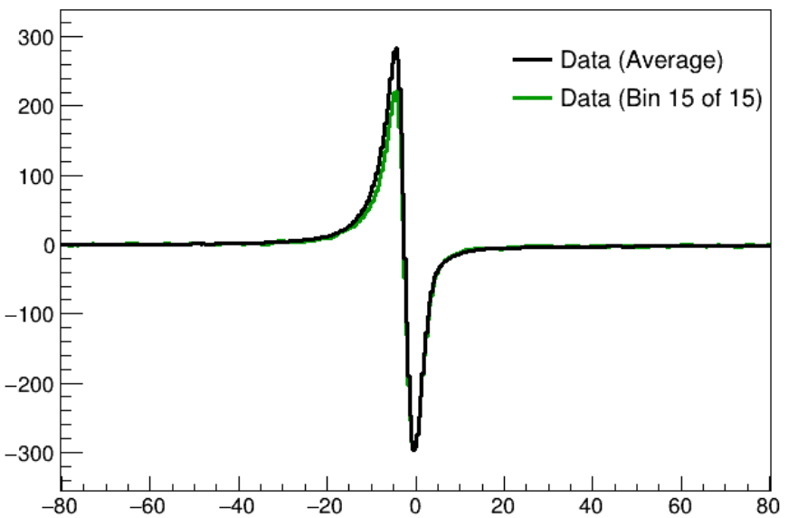
Sample Generation: Detector Simulation Types
Nominal detector simulation
“Opaque” detector simulation (middle induction signal shape with largest intransparency)
“Rand” detector simulation (Omnidetector)
2nd Ind. Signal Shape. Most intransparency
2nd Ind. Signal Shape. Least intransparency
SBN DocDB 32136
Arb. Amplitude
Arb. Amplitude
Time
Time

Slide 16
Sample Generation: Detector Simulation Types
Nominal detector simulation
“Opaque” detector simulation (middle induction signal shape with largest intransparency)
“Rand” detector simulation (Omnidetector)
Baseline variations in “Rand”:
Electron lifetime, uniform from 2-15 ms
Channel gain, gaussian 10% variation
Noise, gaussian 5% variation
Electronics response width, gaussian 5% variation
Middle induction signal shape, uniform from least to most transparent

Slide 17
Training the DNN
Avinay Bhat
Example training on front induction
Validation loss converges after a few epochs

Slide 18
Inference Results: Efficiency, Purity
Avinay Bhat

Slide 19
Inference Results: Efficiency*Purity
Avinay Bhat
Performance is stable, mostly independent of detector simulation
Not much difference in performance from different model trainings

Slide 20
How Precise are these Metrics?
Avinay Bhat
Compare eff*pur computed between two halves of each dataset
Result: difference on order of ~1-2%

Slide 21
Inference Results: Compared to Traditional
Avinay Bhat
Compared to traditional ROI performance (slightly different efficiency computation, nominal MC)
Signal Processing | Efficiency | Purity | Efficiency*purity
Plane 0, Nom. 1D | 0.87 | 0.74 | 0.65
Plane 1, Nom. 1D | 0.85 | 0.42 | 0.36
Plane 0, Trad. ROI 2D | 0.90 | 0.94 | 0.85
Plane 1, Trad. ROI 2D | 0.90 | 0.92 | 0.83

Slide 22
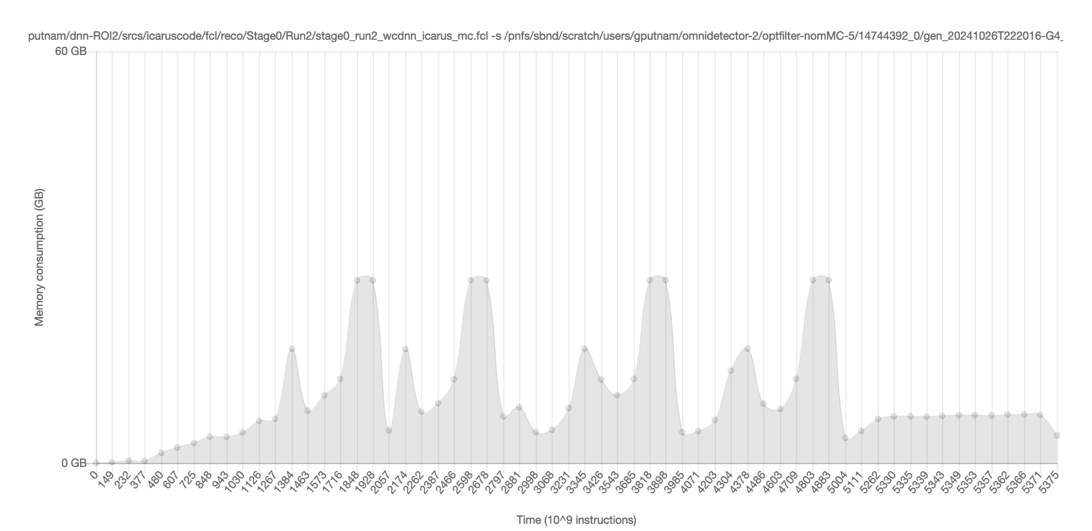
Running the DNN
At first, running the DNN inference took ~30GB of memory
Inference on ind 1
Inference on ind 0

Slide 23
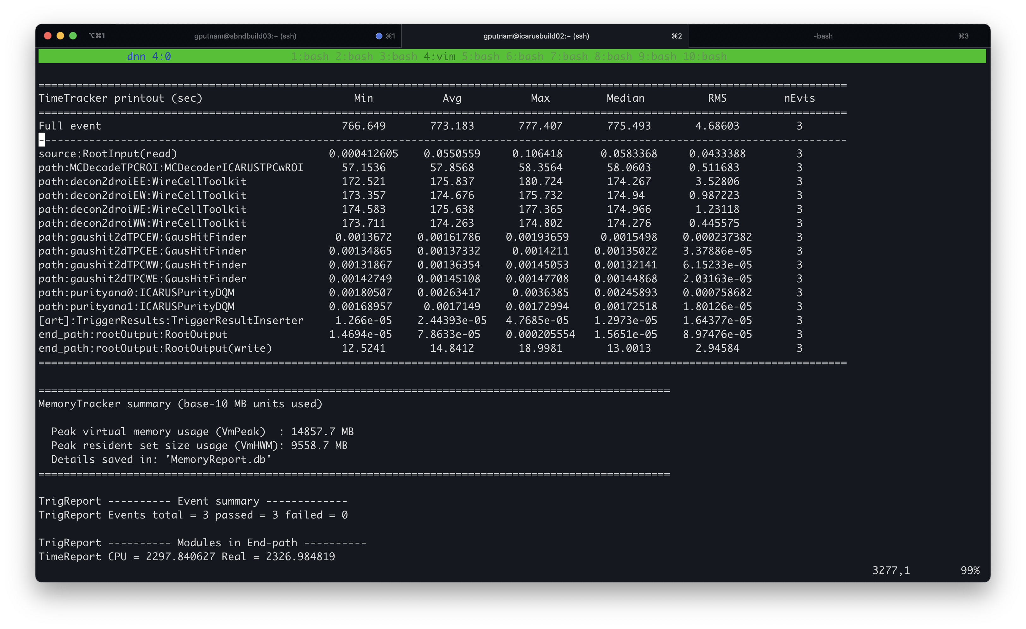
Running the DNN
Improved this by:
Separating operation of DNN into “chunks” along plane
https://github.com/WireCell/wire-cell-toolkit/pull/340
More aggressively dropping deconvolved arrays
12 minutes/event
10GB memory

Slide 24
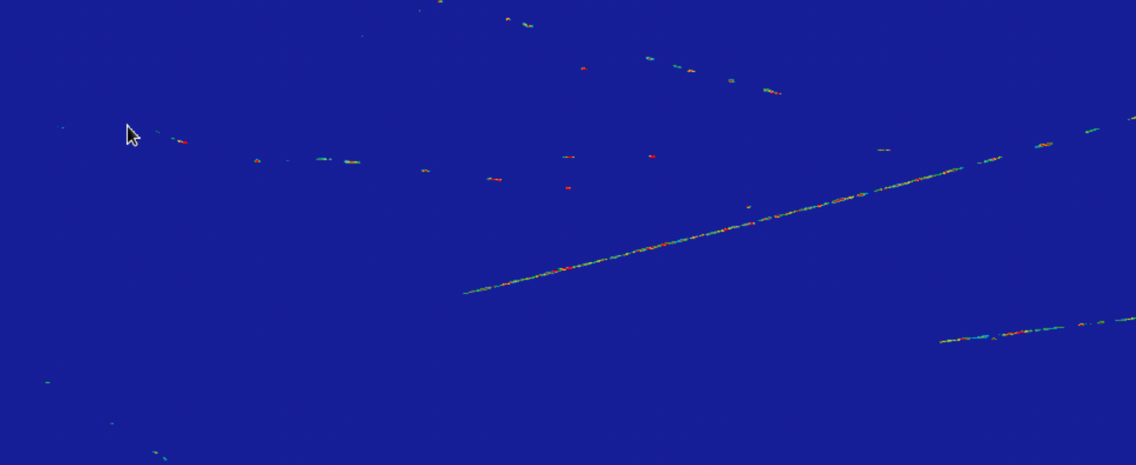
Integration Back into LArSoft
Event display of DNN ROI’d waveform
Not running correctly, still some bugs to work out
Plane 0

Slide 25
Integration Back into LArSoft
What do I need to configure to get DNN running correctly?
input_scale (1/2000.)
tick_per_slice (8)
Does anything need to be different for chunking?

Slide 26
Conclusion
The filter optimization and infrastructure adaptation to enable WireCell signal processing for ICARUS is now complete
DNN ROI training is ongoing
So far, looks like it will provide further improvements
Going to test a broader array of gen types and detector simulations
Few bugs to work out for running inference in LArSoft

