Slide 1
ePIC Electronics and DAQ WG
Agenda:
News
Update on VTRX+ pigtail lengths
Discussion of WG direction
What is working / What is not working?
Priorities for next year

Slide 2
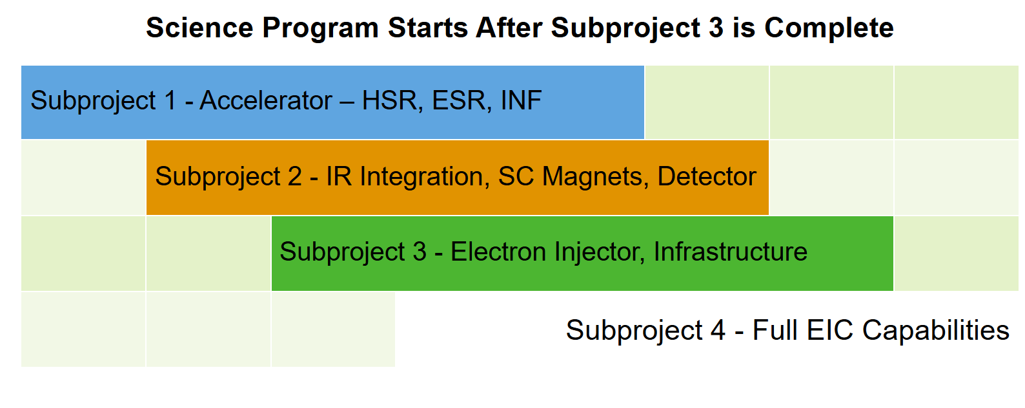
News (Part 1)
OPA CD-3B Review Last Week
Detector fared very well
Answer to all charge questions was “Yes”
Comments from reviewers were informational and aligned with detector needs:
eg.
Only recommendation was addition of new tunnel for collider access to sector 5 of the ring.
EIC project is dividing the collider into subprojects
EIC is still a single line item project, but 4 separate subprojects with regard to CD milestones
Still seems to be uncertainty as to whether there will be delays for the detector
Our work still under the same structure
Project recommendation for OPA review in 6 months for subproject management issues (but not full status review)
Strong Hadron Cooling out for now (in subproject 4?)

Slide 3
News (Part 2)
Collaboration Meeting Next Week
Monday |  | Plenary
 |  | Plenary
Tuesday | SRO 1 | SVT 1 (ASICS) | AC-LGAD (1 electronics talk ?)
 | SRO 2 | SVT 2 (?) | Integration 1 (mechanical)
Wednesday |  | Early Science
 |  | Excursions
Thursday | AI/ML Hackathon | SVT 3 (?) | Integration 2 (grounding)
 |  | Council
Friday | MPGD (Lots of FEB discussions) | SVT4 (?) | PID (no electronics currently listed)
 |  | Plenary
SRO Sessions (1 & 2)
Integrating DAQ ← → SRO milestones
Discussions
Support of test beam measurements
Streaming Orchestration
Streaming Challenges in (Echelon 0 & Echelon 1)
Distributed Data Challenges (Echelon 1 & Echelon 2)
Analysis (Echelon 3, in conjunction with services to be provided by Echelon 1 & Echelon 2)
Autonomous Experimentation and Control (Alignment, Calibration, Validation)

Slide 4
News (Part 3)
Electronics and DAQ Reviews on the horizon
Electronics & DAQ PDR 3 (~Late August) – 60% design review
Slow Controls PDR-1 (~December) – 40% design review
Slow controls integration (In DAQ CAM)
DAQ connection to slow controls
IOC’s running in DAQ
Slow controls data stored with data files
Collider integration
Detector participation
CD-2 (baseline) early 2026
Other news?

Slide 5
Pigtails…to Fernando

Slide 6
WG Direction (Part 1)
Priorities – need to move towards readiness for Baseline / Final Design Review in 2026
Continue to track ASIC R&D
Clear understandings of each ASICs streaming modes
Finalize readout chains for all detectors
FEB / RDO designs (or specific plans for designs)
Need credible, detailed design of protocols
Interfaces to ASICs
Interface to RDOs
Handling of the 40MHz / 100MHz systems
Design / Engineering Articles for GTU
Obtain FLX 155 & get experience with its interfaces
Echelon 0 Computing Framework
Components
Frameworks (e.g. CODA, NestDAQ, RCDAQ)
Data Formats
How to incorporate code from S&C
How to involve collaborators in the software tasks

Slide 7
WG Direction (Part 2)
Discussion – WG operation: what’s working and what’s not working?
Question to start:
Would it be better to change structure of WG?
E.g. Specific Rotation of topics (or)
[DSC type structure] --- Subgroups for ASICS, FEBs, RDOs, GTU, Echelon 0, Slow Controls (or)
Something else?
Other suggestions, gripes, etc…

