Slide 1




Trieste
Funded by the European Union
SPINFRAG
January 27, 2025
Spin-dependent hadronization in Pythia
Albi Kerbizi
Lund University and INFN Trieste

Slide 2
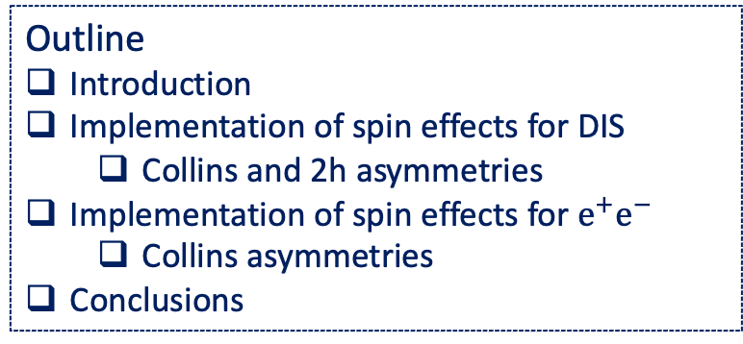
Trieste
Funded by the European Union
SPINFRAG
January 27, 2025
Spin-dependent hadronization in Pythia
Albi Kerbizi
Lund University and INFN Trieste
Outline
Introduction
Implementation of spin effects for DIS
  Collins and 2h asymmetries
Implementation of spin effects for $e^{+}e^{−}$
  Collins asymmetries
Conclusions

Slide 3
StringSpinner: spin in the Pythia generator
PYTHIA 8 standard tool in particle physics,
capable of simulating several processes: DIS, e+e-, pp, pA, ..
detailed and precise simulations, many physics ingredients
lacking of spin effects in hadronization

Slide 4
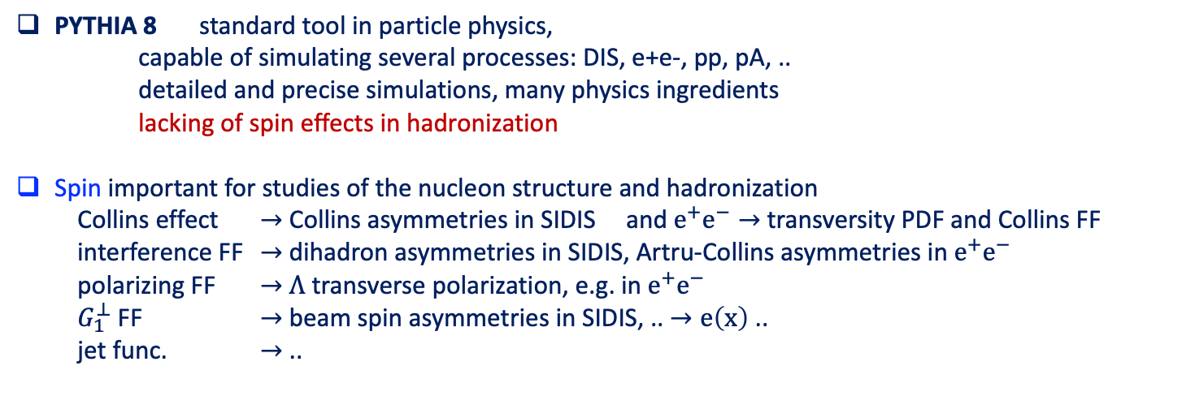
StringSpinner: spin in the Pythia generator
PYTHIA 8 standard tool in particle physics,
capable of simulating several processes: DIS, e+e-, pp, pA, ..
detailed and precise simulations, many physics ingredients
lacking of spin effects in hadronization
Spin important for studies of the nucleon structure and hadronization
Collins effect $→$ Collins asymmetries in SIDIS and $e^{+}e^{−}→$ transversity PDF and Collins FF
interference FF $→$ dihadron asymmetries in SIDIS, Artru-Collins asymmetries in $e^{+}e^{−}$
polarizing FF $→$ $Λ$ transverse polarization, e.g. in $e^{+}e^{−}$
$G_{1}^{⊥}$ FF $→$ beam spin asymmetries in SIDIS, .. $→e\left(x\right)$ ..
jet func. $→$ ..

Slide 5
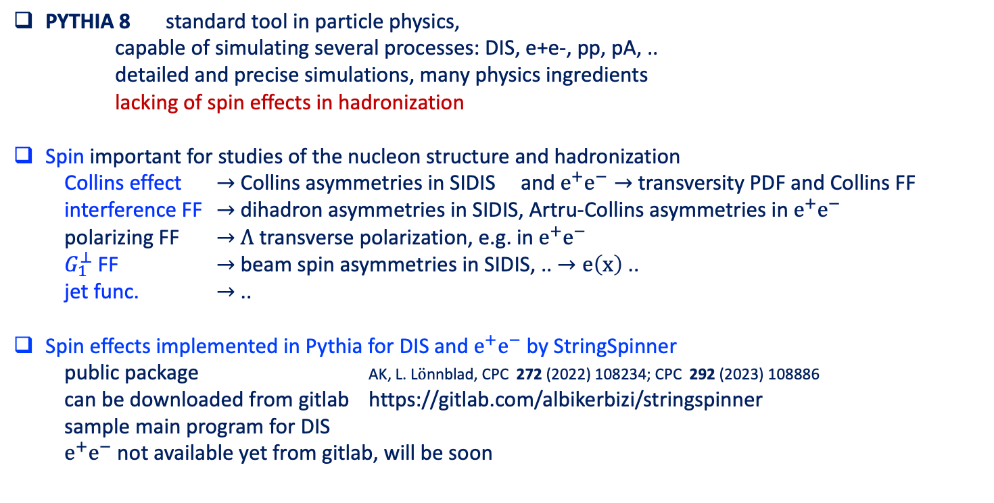
StringSpinner: spin in the Pythia generator
PYTHIA 8 standard tool in particle physics,
capable of simulating several processes: DIS, e+e-, pp, pA, ..
detailed and precise simulations, many physics ingredients
lacking of spin effects in hadronization
Spin important for studies of the nucleon structure and hadronization
Collins effect $→$ Collins asymmetries in SIDIS and $e^{+}e^{−}→$ transversity PDF and Collins FF
interference FF $→$ dihadron asymmetries in SIDIS, Artru-Collins asymmetries in $e^{+}e^{−}$
polarizing FF $→$ $Λ$ transverse polarization, e.g. in $e^{+}e^{−}$
$G_{1}^{⊥}$ FF $→$ beam spin asymmetries in SIDIS, .. $→e\left(x\right)$ ..
jet func. $→$ ..
Spin effects implemented in Pythia for DIS and $e^{+}e^{−}$ by StringSpinner
public package AK, L. L$\ddot{o}$nnblad, CPC 272 (2022) 108234; CPC 292 (2023) 108886
can be downloaded from gitlab https://gitlab.com/albikerbizi/stringspinner
sample main program for DIS
$e^{+}e^{−}$ not available yet from gitlab, will be soon

Slide 6
Implementation of spin effects for DIS

Slide 7




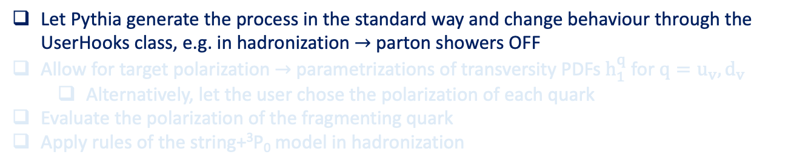



Spin in Pythia for DIS
Let Pythia generate the process in the standard way and change behaviour through the UserHooks class, e.g. in hadronization $→$ parton showers OFF
Allow for target polarization $→$ parametrizations of transversity PDFs $h_{1}^{q}$ for $q=u_{v},d_{v}$
  Alternatively, let the user chose the polarization of each quark
Evaluate the polarization of the fragmenting quark
Apply rules of the string+³P₀ model in hadronization
$$l$$
$$l′$$
unpolarized
q
$$γ^{∗}$$
$$\hat{σ}$$
$$π$$
unpolarized
q
$$K$$
$$ρ$$
$$π$$
$$ω$$
$$π$$
beam remnants
$$π$$
PDF
$$π$$
unpolarized
p,n
$$f_{1}^{q}(x,Q^{2})$$
$$π$$

Slide 8


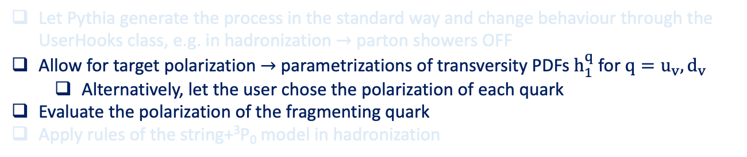

Spin in Pythia for DIS
Let Pythia generate the process in the standard way and change behaviour through the UserHooks class, e.g. in hadronization $→$ parton showers OFF
Allow for target polarization $→$ parametrizations of transversity PDFs $h_{1}^{q}$ for $q=u_{v},d_{v}$
  Alternatively, let the user chose the polarization of each quark
Evaluate the polarization of the fragmenting quark
Apply rules of the string+³P₀ model in hadronization
Spin density matrix
$$l$$
$$l′$$
polarized
q
$$γ^{∗}$$
$$\hat{σ}$$
$$π$$
polarized
q
$$K$$
$$ρ$$
$$π$$
$$ω$$
$$π$$
beam remnants
$$π$$
PDF
$$π$$
polarized
p,n
$$f_{1}^{q}(x,Q^{2})$$
$$p$$
$$π$$
Transversity $h_{1}^{q}\left(x\right)$
or arbitrary polarization of quarks
AK, L. L$\ddot{o}$nnblad, CPC 272 (2022) 108234; CPC 292 (2023) 108886

Slide 9
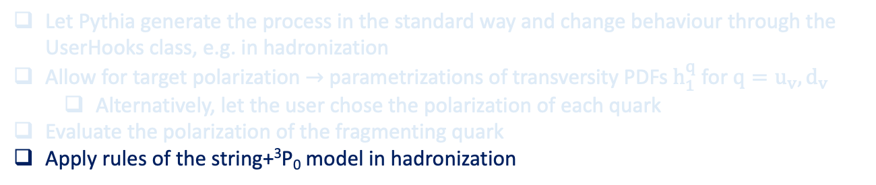
Spin in Pythia for DIS
Let Pythia generate the process in the standard way and change behaviour through the UserHooks class, e.g. in hadronization
Allow for target polarization $→$ parametrizations of transversity PDFs $h_{1}^{q}$ for $q=u_{v},d_{v}$
  Alternatively, let the user chose the polarization of each quark
Evaluate the polarization of the fragmenting quark
Apply rules of the string+³P₀ model in hadronization
Spin density matrix
$$l$$
$$l′$$
polarized
q
string+³P₀ model
$$γ^{∗}$$
$$\hat{σ}$$
$$π$$
polarized
q
$$K$$
$$ρ$$
$$π$$
$$ω$$
$$π$$
beam remnants
$$π$$
PDF
$$π$$
polarized
p,n
$$f_{1}^{q}(x,Q^{2})$$
$$p$$
$$π$$
Transversity $h_{1}^{q}\left(x\right)$
or arbitrary polarization of quarks
AK, L. L$\ddot{o}$nnblad, CPC 272 (2022) 108234; CPC 292 (2023) 108886

Slide 10
Spin in Pythia for DIS
Let Pythia generate the process in the standard way and change behaviour through the UserHooks class, e.g. in hadronization
Allow for target polarization $→$ parametrizations of transversity PDFs $h_{1}^{q}$ for $q=u_{v},d_{v}$
  Alternatively, let the user chose the polarization of each quark
Evaluate the polarization of the fragmenting quark
Apply rules of the string+³P₀ model in hadronization
AK, Artru, Martin, PRD 104, 114038 (2021)
string+³P₀ model:
adds spin to the Lund string model
$$l$$
$$l′$$
polarized
q
$$γ^{∗}$$
Elementary quark splitting
$$\hat{σ}$$
$$π$$
polarized
q
$$K$$
$$ρ$$
$$π$$
$$ω$$
$$π$$
beam remnants
$$π$$
PDF
$$π$$
polarized
p,n
$$f_{1}^{q}(x,Q^{2})$$
$$p$$
$$π$$

Slide 11
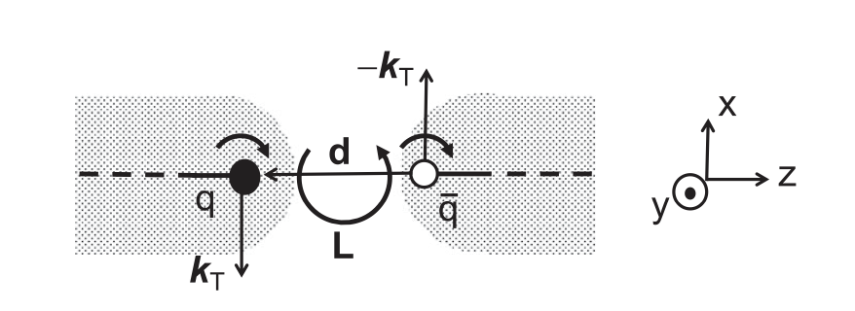
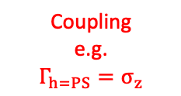
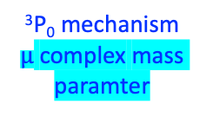
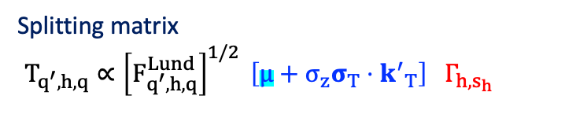
Spin in Pythia for DIS
Let Pythia generate the process in the standard way and change behaviour through the UserHooks class, e.g. in hadronization
Allow for target polarization $→$ parametrizations of transversity PDFs $h_{1}^{q}$ for $q=u_{v},d_{v}$
  Alternatively, let the user chose the polarization of each quark
Evaluate the polarization of the fragmenting quark
Apply rules of the string+³P₀ model in hadronization
AK, Artru, Martin, PRD 104, 114038 (2021)
string+³P₀ model:
adds spin to the Lund string model
$$l$$
$$l′$$
polarized
q
$$γ^{∗}$$
Elementary quark splitting
$$\hat{σ}$$
$$π$$
polarized
q
$$K$$
$$ρ$$
$$π$$
$$ω$$
$$π$$
beam remnants
$$π$$
Splitting matrix
$$T_{q^{′},h,q}∝{\left[F_{q^{′},h,q}^{Lund}\right]}^{1/2} \left[μ+σ_{z}σ_{T}⋅{k^{′}}_{T}\right] Γ_{h,s_{h}}$$
PDF
$$π$$
polarized
p,n
$$f_{1}^{q}(x,Q^{2})$$
$$p$$
$$π$$
³P₀ mechanism
$μ$ complex mass paramter
Coupling
e.g.
$$Γ_{h=PS}=σ_{z}$$
string

Slide 12
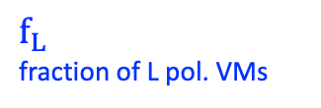
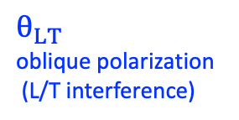
Spin in Pythia for DIS
Let Pythia generate the process in the standard way and change behaviour through the UserHooks class, e.g. in hadronization
Allow for target polarization $→$ parametrizations of transversity PDFs $h_{1}^{q}$ for $q=u_{v},d_{v}$
  Alternatively, let the user chose the polarization of each quark
Evaluate the polarization of the fragmenting quark
Apply rules of the string+³P₀ model in hadronization
AK, Artru, Martin, PRD 104, 114038 (2021)
string+³P₀ model:
adds spin to the Lund string model
$$l$$
$$l′$$
polarized
q
Coupling of quarks with VMs
$$γ^{∗}$$
$$\hat{σ}$$
$$π$$
polarized
q
$$K$$
$f_{L}$
fraction of L pol. VMs
$θ_{LT}$
oblique polarization
(L/T interference)
$$ρ$$
$$π$$
$$ω$$
$$π$$
beam remnants
$$π$$
PDF
$$π$$
polarized
p,n
$$f_{1}^{q}(x,Q^{2})$$
$$p$$
$$π$$

Slide 13
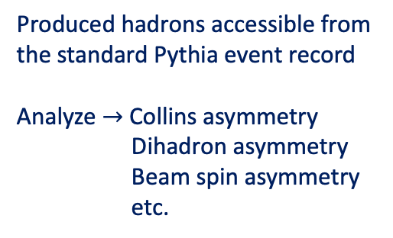
Spin in Pythia for DIS
Let Pythia generate the process in the standard way and change behaviour through the UserHooks class, e.g. in hadronization
Allow for target polarization $→$ parametrizations of transversity PDFs $h_{1}^{q}$ for $q=u_{v},d_{v}$
  Alternatively, let the user chose the polarization of each quark
Evaluate the polarization of the fragmenting quark
Apply rules of the string+³P₀ model in hadronization
$$l$$
$$l′$$
polarized
q
Produced hadrons accessible from the standard Pythia event record
Analyze $→$ Collins asymmetry
Dihadron asymmetry
Beam spin asymmetry
etc.
$$γ^{∗}$$
$$\hat{σ}$$
$$π$$
polarized
q
$$K$$
$$ρ$$
$$π$$
$$ω$$
$$π$$
beam remnants
$$π$$
PDF
$$π$$
polarized
p,n
$$f_{1}^{q}(x,Q^{2})$$
$$p$$
$$π$$

Slide 14
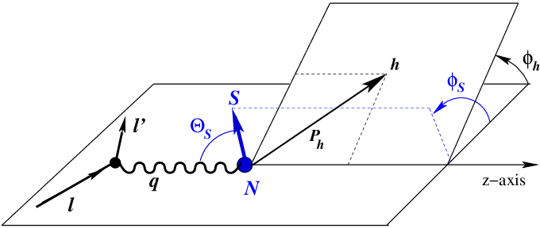
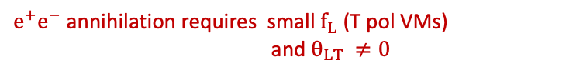
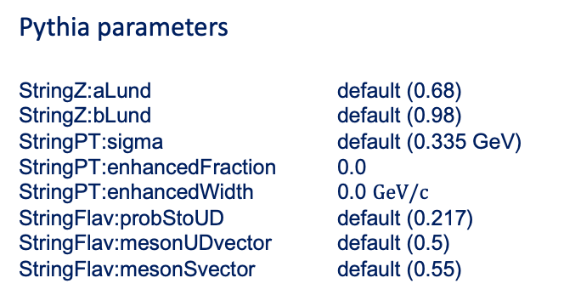
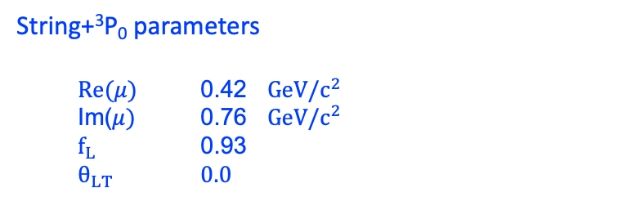


Results from simulations of SIDIS
@ COMPASS and HERMES kinematics
$$γ^{∗}$$
$$P_{T}$$
Pythia parameters
StringZ:aLund default (0.68) 0.9
StringZ:bLund default (0.98) 0
StringPT:sigma default (0.335 GeV)0
StringPT:enhancedFraction 0.0
StringPT:enhancedWidth 0.0 $GeV/c$
StringFlav:probStoUD default (0.217)
StringFlav:mesonUDvector default (0.5)
StringFlav:mesonSvector default (0.55)
String+³P₀ parameters
  $Re(μ)$ 0.42 $GeV/c^{2}$
  Im($μ)$ 0.76 $GeV/c^{2}$
  $f_{L}$ 0.93
  $θ_{LT}$ $0.0$
CPC 292 (2023) 108886
L pol. VM $→$ large Collins effect
$e^{+}e^{−}$ annihilation requires small $f_{L}$ (T pol VMs)
and $θ_{LT }≠0$

Slide 15


Transverse spin effects: Collins asymmetries
PLB 717 (2012) 376
Comparison with COMPASS
160 GeV muons off protons
AK, L. L$\ddot{o}$nnblad, CPC 292 (2023) 108886

Slide 16

Transverse spin effects: Collins asymmetries
PLB693 (2010) 11
Comparison with HERMES
27 GeV electrons off protons
AK, L. L$\ddot{o}$nnblad, CPC 292 (2023) 108886

Slide 17
Transverse spin effects: dihadron asymmetries
PLB 736 (2014) 124
Comparison with COMPASS
160 GeV muons off protons
AK, L. L$\ddot{o}$nnblad, CPC 292 (2023) 108886

Slide 18
Recipe for the simulation of e⁺e⁻ annihilation
AK, X. Artru, PRD 109 (2024) 5, 05402

Slide 19




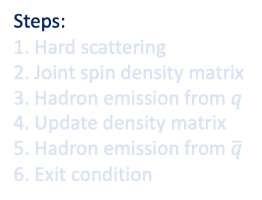


Recursive recipe for $e^{+}e^{−}$
Steps:
1. Hard scattering
2. Joint spin density matrix
3. Hadron emission from $q$
4. Update density matrix
5. Hadron emission from $\overline{q}$
6. Exit condition
$$e^{+}$$
$$q$$
$$γ^{∗}$$
$$\hat{σ}$$
$$e^{−}$$
$$\overline{q}$$

Slide 20
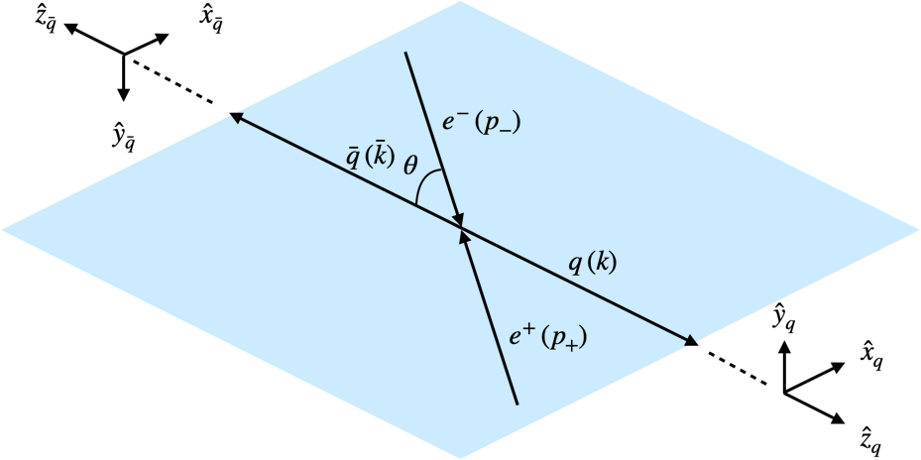
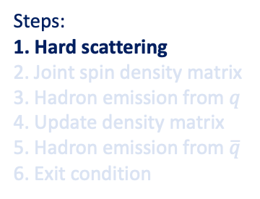
Recursive recipe for $e^{+}e^{−}$
Steps:
1. Hard scattering
2. Joint spin density matrix
3. Hadron emission from $q$
4. Update density matrix
5. Hadron emission from $\overline{q}$
6. Exit condition
$$e^{+}$$
$$q$$
$$γ^{∗}$$
$$\hat{σ}$$
$$e^{−}$$
$$\overline{q}$$
Set up the scattering $e^{+}e^{−}→q\overline{q}$ in the c.m.s
generate the quark flavors and kinematics using differential cross section
antiquark helicity frame
(AHF)
quark helicity frame
(QHF)

Slide 21

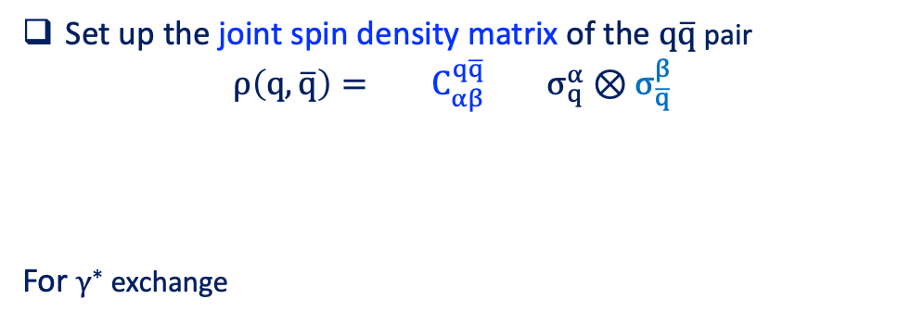
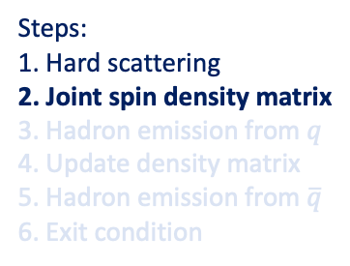

Recursive recipe for $e^{+}e^{−}$
Steps:
1. Hard scattering
2. Joint spin density matrix
3. Hadron emission from $q$
4. Update density matrix
5. Hadron emission from $\overline{q}$
6. Exit condition
$$e^{+}$$
$$q$$
$$γ^{∗}$$
$$\hat{σ}$$
$$e^{−}$$
$$\overline{q}$$
$$ρ(q,\overline{q})$$
Set up the joint spin density matrix of the $q\overline{q}$ pair
$$ρ\left(q,\overline{q}\right)= C_{αβ}^{q\overline{q}} σ_{q}^{α}⊗σ_{\overline{q}}^{β}$$
For $γ^{∗}$ exchange
correlation
coefficients
Pauli matrices along QHF and AHF
$α=0,x_{q},y_{q},z_{q}$
$β=0,x_{\overline{q}},y_{\overline{q}},z_{\overline{q}}$
$ρ\left(q,\overline{q}\right)∝1_{q}⊗1_{\overline{q}}−σ_{q}^{z}⊗σ_{\overline{q}}^{z}$ + $\frac{\sin^{2}θ}{1+\cos^{2}θ} [σ_{q}^{x}⊗σ_{\overline{q}}^{x}+σ_{q}^{y}⊗σ_{\overline{q}}^{y}]$

Slide 22


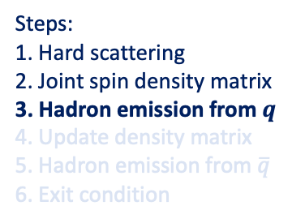

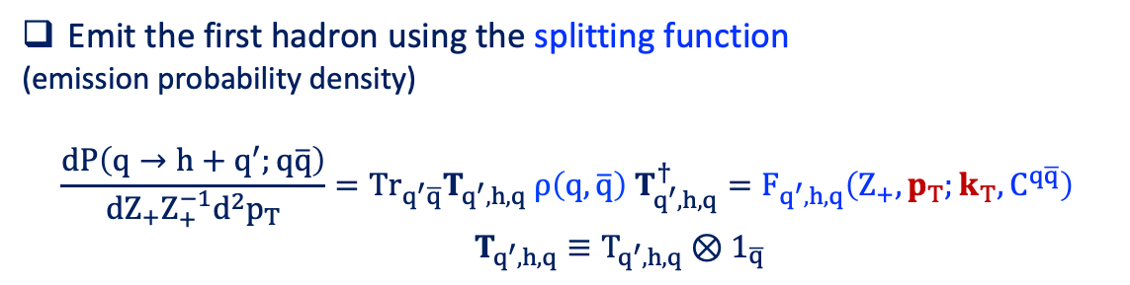
Recursive recipe for $e^{+}e^{−}$
Steps:
1. Hard scattering
2. Joint spin density matrix
3. Hadron emission from $q$
4. Update density matrix
5. Hadron emission from $\overline{q}$
6. Exit condition
$$h$$
$$e^{+}$$
$$q$$
$$q′$$
$$γ^{∗}$$
$$\hat{σ}$$
$$e^{−}$$
$$\overline{q}$$
$$ρ(q,\overline{q})$$
Emit the first hadron using the splitting function
(emission probability density)
$$\frac{dP\left(q→h+q^{′};q\overline{q}\right)}{dZ_{+}Z_{+}^{−1}d^{2}p_{T}}=Tr_{q^{′}\overline{q}}T_{q^{′},h,q} ρ\left(q,\overline{q}\right) T_{q^{′},h,q}^{†}=F_{q^{′},h,q}\left(Z_{+},p_{T};k_{T},C^{q\overline{q}}\right)$$
$T_{q^{′},h,q}≡T_{q^{′},h,q}⊗1_{\overline{q}}$
$$→$$
in the QHF
For VM emission need also to handle the polarized decay $→$ backup
$→$ evaluate the spin density matrix $ρ(q,\overline{q})$
$→$ emit the second hadron using the conditional probability
$$dP\left(q→h+q^{′}|h_{1}\right)=Tr 1_{q′}⊗T_{{\overline{q}}^{′},h_{2},\overline{q}} ρ\left(q^{′},\overline{q}\right) 1_{q^{′}}⊗T_{{\overline{q}}^{′},h_{2},\overline{q}}^{†}$$

Slide 23

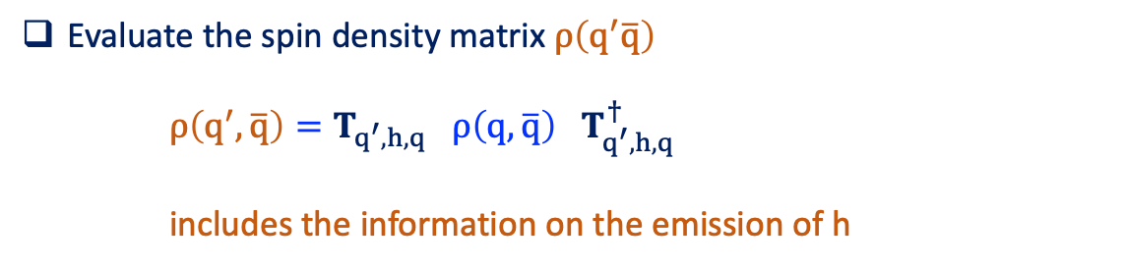
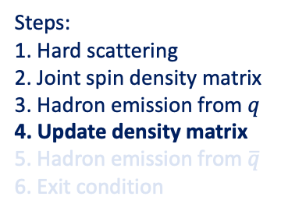
Recursive recipe for $e^{+}e^{−}$
$$ρ(q′,\overline{q})$$
Steps:
1. Hard scattering
2. Joint spin density matrix
3. Hadron emission from $q$
4. Update density matrix
5. Hadron emission from $\overline{q}$
6. Exit condition
$$h$$
$$e^{+}$$
$$q$$
$$q′$$
$$γ^{∗}$$
$$\hat{σ}$$
$$e^{−}$$
$$\overline{q}$$
$$ρ(q,\overline{q})$$
Evaluate the spin density matrix $ρ\left(q^{′}\overline{q}\right)$
$ρ\left(q^{′},\overline{q}\right)=T_{q^{′},h,q} ρ\left(q,\overline{q}\right) T_{q^{′},h,q}^{†}$
includes the information on the emission of h

Slide 24

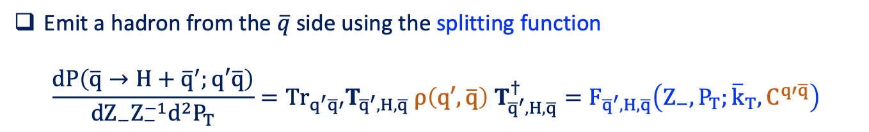

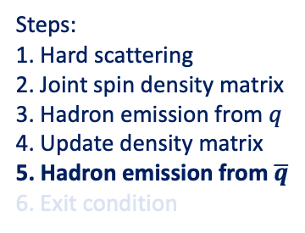

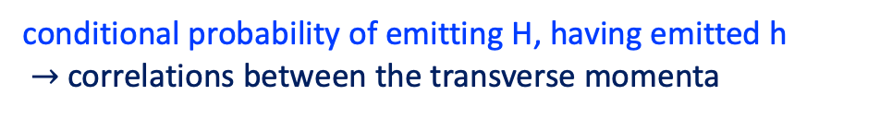
Recursive recipe for $e^{+}e^{−}$
$$ρ(q′,\overline{q})$$
Steps:
1. Hard scattering
2. Joint spin density matrix
3. Hadron emission from $q$
4. Update density matrix
5. Hadron emission from $\overline{q}$
6. Exit condition
$$h$$
$$e^{+}$$
$$q$$
$$q′$$
$$γ^{∗}$$
$$\hat{σ}$$
$$\overline{q}$$
$$\overline{q}′$$
$$H$$
$$e^{−}$$
$$ρ(q,\overline{q})$$
Depend on the azimuthal angle h
Emit a hadron from the $\overline{q}$ side using the splitting function
$$\frac{dP\left(\overline{q}→H+{\overline{q}}^{′};q′\overline{q}\right)}{dZ_{−}Z_{−}^{−1}d^{2}P_{T}}=Tr_{q^{′}\overline{q}′}T_{{\overline{q}}^{′},H,\overline{q}} ρ\left(q′,\overline{q}\right) T_{{\overline{q}}^{′},H,\overline{q}}^{†}=F_{{\overline{q}}^{′},H,\overline{q}}\left(Z_{−},P_{T};{\overline{k}}_{T},C^{q′\overline{q}}\right)$$
Expressed in the AHF
conditional probability of emitting H, having emitted h
$→$ correlations between the transverse momenta
[Collins NPB, 304:794–804, 1988, Knowles NPB, 310:571–588, 1988]

Slide 25

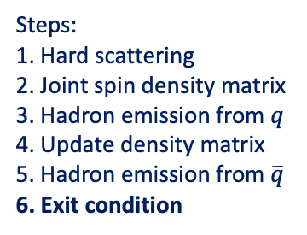





Recursive recipe for $e^{+}e^{−}$
Steps:
1. Hard scattering
2. Joint spin density matrix
3. Hadron emission from $q$
4. Update density matrix
5. Hadron emission from $\overline{q}$
6. Exit condition
$$e^{+}$$
$$q$$
$$γ^{∗}$$
$$\hat{σ}$$
$$q_{l}$$
$$h$$
$$\overline{q}$$
$${\overline{q}}_{n}$$
$$H$$
$$e^{−}$$
Iterate until the exit condition is called and the last quark pair is hadronized
more details in PRD 109 (2024) 5, 054029

Slide 26
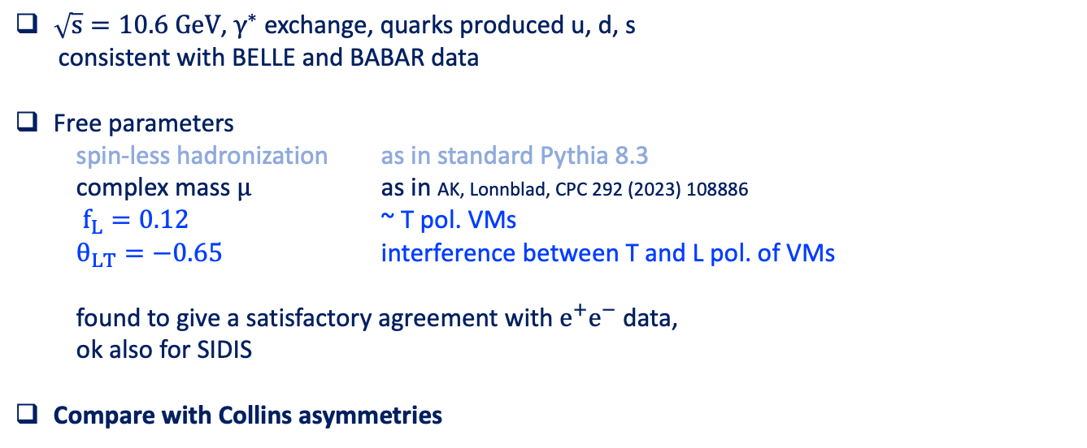
Simulations of e⁺e⁻ annihilation with spin effects
using Pythia 8.3 + StringSpinner
AK, L. Lönnblad, A. Martin, Phys. Rev. D 110 (2024) 7, 074029
$\sqrt{s}=10.6 GeV$, $γ^{∗}$ exchange, quarks produced u, d, s
consistent with BELLE and BABAR data
Free parameters
  spin-less hadronization as in standard Pythia 8.3
  complex mass $μ$ as in AK, Lonnblad, CPC 292 (2023) 108886
  $f_{L}=0.12$ ~ T pol. VMs
$θ_{LT}=−0.65$ interference between T and L pol. of VMs
found to give a satisfactory agreement with $e^{+}e^{−}$ data,
ok also for SIDIS
Compare with Collins asymmetries

Slide 27
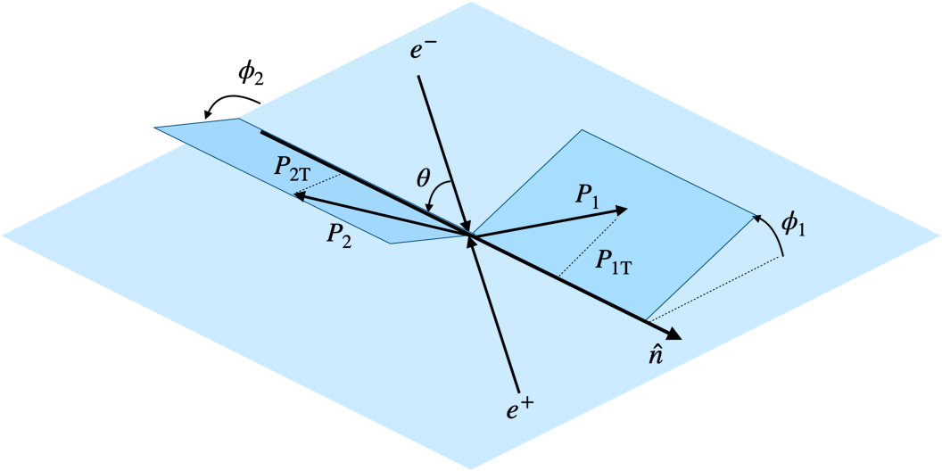

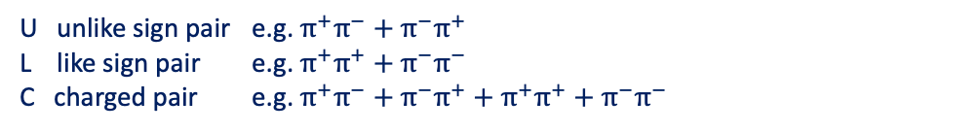
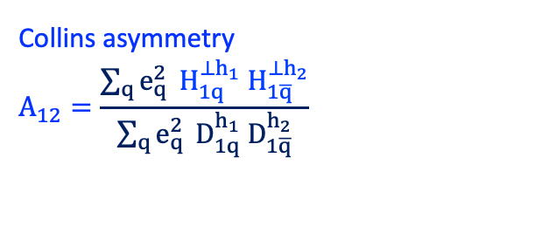
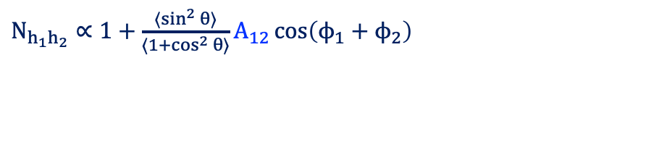
The Collins asymmetries in e⁺e⁻ for back-to-back h₁h₂
Thrust axis method
Measured asymmetry
Boer et al., NPB504, 345 (1997).
Boer, NPB, 806:23–67, 2009
Anselmino et al., PRD 92, 114023 (2015)
D’Alesio et al., JHEP 10 (2021) 078
..
$N_{h_{1}h_{2}}∝1+\frac{⟨\sin^{2}{θ}⟩}{⟨1+\cos^{2}{θ}⟩}A_{12}\cos\left(ϕ_{1}+ϕ_{2}\right)$
Collins asymmetry
$$A_{12}=\frac{\sum_{q}{e_{q}^{2}} H_{1q}^{⊥h_{1}}{ H}_{1\overline{q}}^{⊥h_{2}}}{\sum_{q}{e_{q}^{2}} D_{1q}^{h_{1}}{ D}_{1\overline{q}}^{h_{2}}}$$
$$A_{12}^{UL(UC)}≃A_{12}^{U}−A_{12}^{L(C)}$$
U unlike sign pair e.g. $π^{+}π^{−}+π^{−}π^{+}$
L like sign pair e.g. $π^{+}π^{+}+π^{−}π^{−}$
C charged pair e.g. $π^{+}π^{−}+π^{−}π^{+}+π^{+}π^{+}+π^{−}π^{−}$

Slide 28
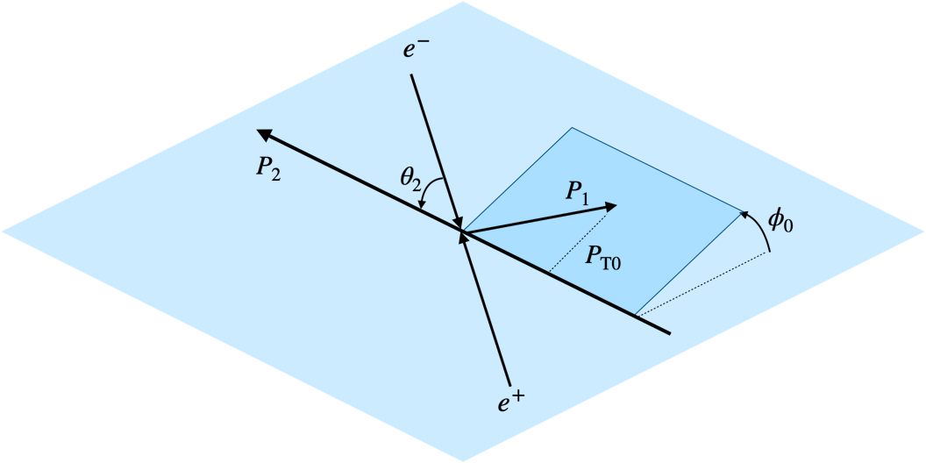
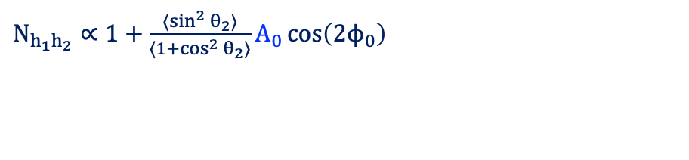

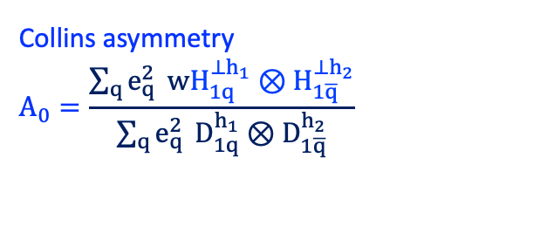
The Collins asymmetries in e⁺e⁻ for back-to-back h₁h₂
Thrust axis method
Measured asymmetry
Hadronic plane method
Measured asymmetry
Boer et al., NPB504, 345 (1997).
Boer, NPB, 806:23–67, 2009
Anselmino et al., PRD 92, 114023 (2015)
D’Alesio et al., JHEP 10 (2021) 078
..
$N_{h_{1}h_{2}}∝1+\frac{⟨\sin^{2}{θ}⟩}{⟨1+\cos^{2}{θ}⟩}A_{12}\cos\left(ϕ_{1}+ϕ_{2}\right)$
$N_{h_{1}h_{2}}∝1+\frac{⟨\sin^{2}{θ_{2}}⟩}{⟨1+\cos^{2}{θ_{2}}⟩}A_{0}\cos\left(2ϕ_{0}\right)$
Collins asymmetry
$$A_{12}=\frac{\sum_{q}{e_{q}^{2}} H_{1q}^{⊥h_{1}}{ H}_{1\overline{q}}^{⊥h_{2}}}{\sum_{q}{e_{q}^{2}} D_{1q}^{h_{1}}{ D}_{1\overline{q}}^{h_{2}}}$$
Collins asymmetry
$$A_{0}=\frac{\sum_{q}{e_{q}^{2}} wH_{1q}^{⊥h_{1}}⊗{ H}_{1\overline{q}}^{⊥h_{2}}}{\sum_{q}{e_{q}^{2}} D_{1q}^{h_{1}}⊗{ D}_{1\overline{q}}^{h_{2}}}$$
$$A_{12}^{UL(UC)}≃A_{12}^{U}−A_{12}^{L(C)}$$
$$A_{0}^{UL(UC)}≃A_{0}^{U}−A_{0}^{L(C)}$$
U unlike sign pair e.g. $π^{+}π^{−}+π^{−}π^{+}$
L like sign pair e.g. $π^{+}π^{+}+π^{−}π^{−}$
C charged pair e.g. $π^{+}π^{−}+π^{−}π^{+}+π^{+}π^{+}+π^{−}π^{−}$

Slide 29
Comparison with the A₁₂ asymmetry

Slide 30


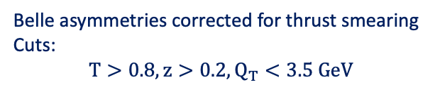
$A_{12}$ asymmetry for charged $π π$ pairs
PRD 78, 032011 (2008)
$$z_{i}=\frac{2E_{h_{i}}}{\sqrt{s}}$$
Belle asymmetries corrected for thrust smearing
Cuts:
$$T>0.8, z>0.2, Q_{T}<3.5 GeV$$

Slide 31
$A_{12}$ asymmetry for charged $π π$ pairs
PRD 78, 032011 (2008)
PRD 78, 032011 (2008)
$$z_{i}=\frac{2E_{h_{i}}}{\sqrt{s}}$$
Belle asymmetries corrected for thrust smearing
Cuts:
$$T>0.8, z>0.2, Q_{T}<3.5 GeV$$
StringSpinner reproduces trend and size

Slide 32

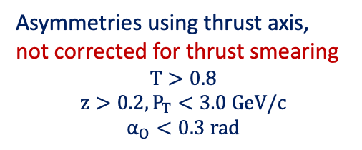
$A_{12}^{UL}$ asymmetry for charged $π π$ pairs
$P_{T1} × P_{T2}$ - dependence w.r.t thrust
PRD 100, 092008 (2019)
Asymmetries using thrust axis,
not corrected for thrust smearing
$$T>0.8$$
$$z>0.2, P_{T}<3.0 GeV/c$$
$$α_{O}<0.3 rad$$
StringSpinner reproduces the nearly linear trend observed by BELLE

Slide 33
Comparison with the A₀ asymmetry

Slide 34

$A_{0}$ asymmetry for $π π$ pairs:
PRD 78, 032011 (2008)
Cuts:
$$T>0.8, z>0.2, Q_{T}<3.5GeV$$

Slide 35

$A_{0}$ asymmetry for $π π$ pairs:
PRD 78, 032011 (2008)
Cuts:
$$T>0.8, z>0.2, Q_{T}<3.5GeV$$
Trend reproduced by string+³P₀
somewhat lower values in the last z₂ bin

Slide 36

$A_{0}$ asymmetry for $π π$ pairs:
PRD 92, 111101(R) (2015)
PRD 78, 032011 (2008)
Cuts:
$$T>0.8, z>0.2, Q_{T}<3.5GeV$$
Trend reproduced by string+³P₀
somewhat lower values in the last z₂ bin
BABAR asymmetries also ok

Slide 37
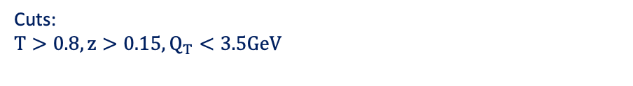
$A_{0}$ asymmetry for $π π$ pairs: $P_{T0 }$dependence
PRD 90, 052003 (2014)
Cuts:
$$T>0.8, z>0.15, Q_{T}<3.5GeV$$

Slide 38
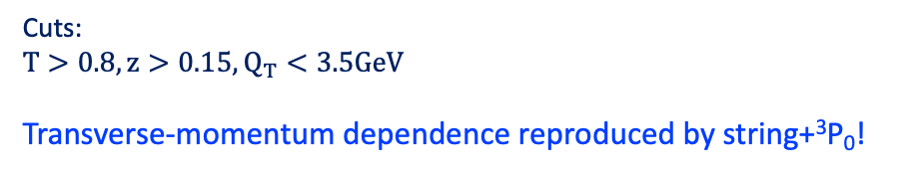
$A_{0}$ asymmetry for $π π$ pairs: $P_{T0 }$dependence
PRD 90, 052003 (2014)
Cuts:
$$T>0.8, z>0.15, Q_{T}<3.5GeV$$
Transverse-momentum dependence reproduced by string+³P₀!

Slide 39
Comparison with phenomenology

Slide 40
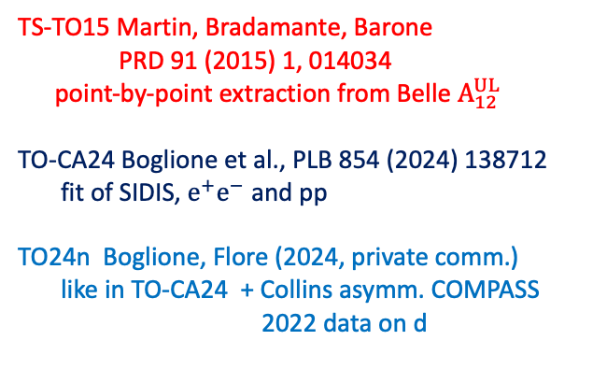
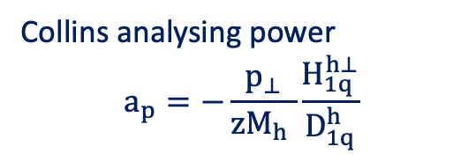


Comparison with phenomenology
Favoured,
$u^{↑}→π^{+}+X$
Collins analysing power
$$a_{p}=−\frac{p_{⊥}}{zM_{h} }\frac{H_{1q}^{h⊥}}{D_{1q}^{h}}$$
TS-TO15 Martin, Bradamante, Barone
PRD 91 (2015) 1, 014034
point-by-point extraction from Belle $A_{12}^{UL}$
TO-CA24 Boglione et al., PLB 854 (2024) 138712
fit of SIDIS, $e^{+}e^{−}$ and pp
TO24n Boglione, Flore (2024, private comm.)
like in TO-CA24 + Collins asymm. COMPASS 2022 data on d
Unfavoured,
$u^{↑}→π^{−}+X$

Slide 41
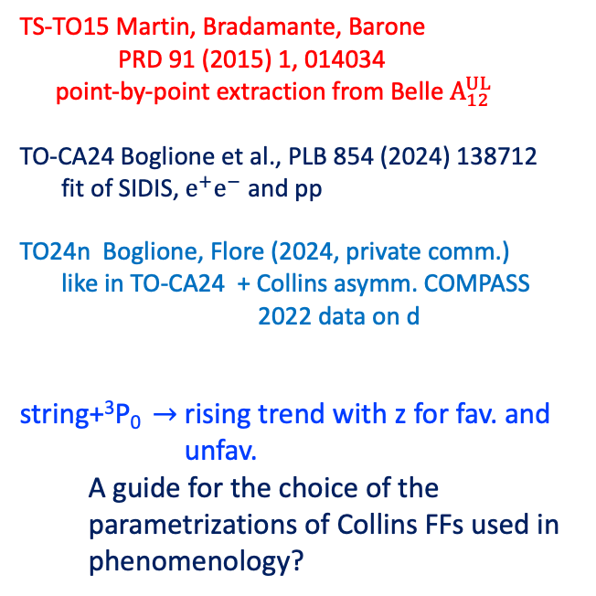
Comparison with phenomenology
Favoured,
$u^{↑}→π^{+}+X$
Collins analysing power
$$a_{p}=−\frac{p_{⊥}}{zM_{h} }\frac{H_{1q}^{h⊥}}{D_{1q}^{h}}$$
TS-TO15 Martin, Bradamante, Barone
PRD 91 (2015) 1, 014034
point-by-point extraction from Belle $A_{12}^{UL}$
TO-CA24 Boglione et al., PLB 854 (2024) 138712
fit of SIDIS, $e^{+}e^{−}$ and pp
TO24n Boglione, Flore (2024, private comm.)
like in TO-CA24 + Collins asymm. COMPASS 2022 data on d
string+³P₀ $→$ rising trend with z for fav. and unfav.
A guide for the choice of the parametrizations of Collins FFs used in phenomenology?
Unfavoured,
$u^{↑}→π^{−}+X$

Slide 42
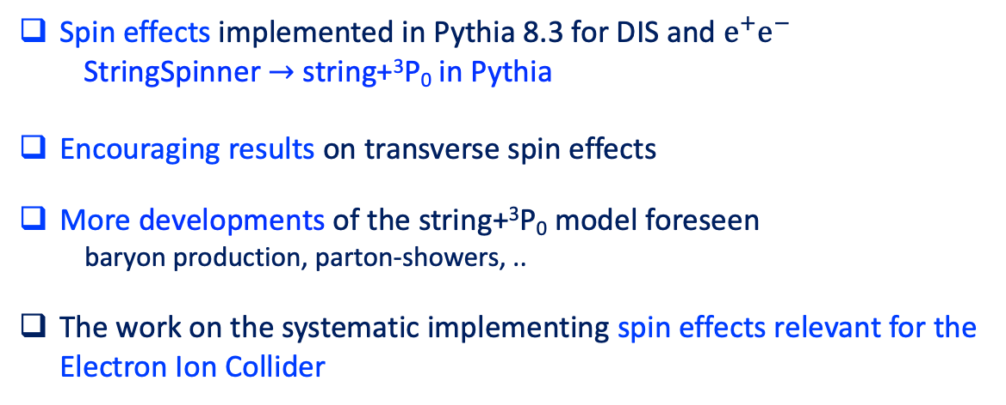
Conclusions
Spin effects implemented in Pythia 8.3 for DIS and $e^{+}e^{−}$
  StringSpinner $→$ string+³P₀ in Pythia
Encouraging results on transverse spin effects
More developments of the string+³P₀ model foreseen
baryon production, parton-showers, ..
The work on the systematic implementing spin effects relevant for the Electron Ion Collider

Slide 43
Backup

Slide 44
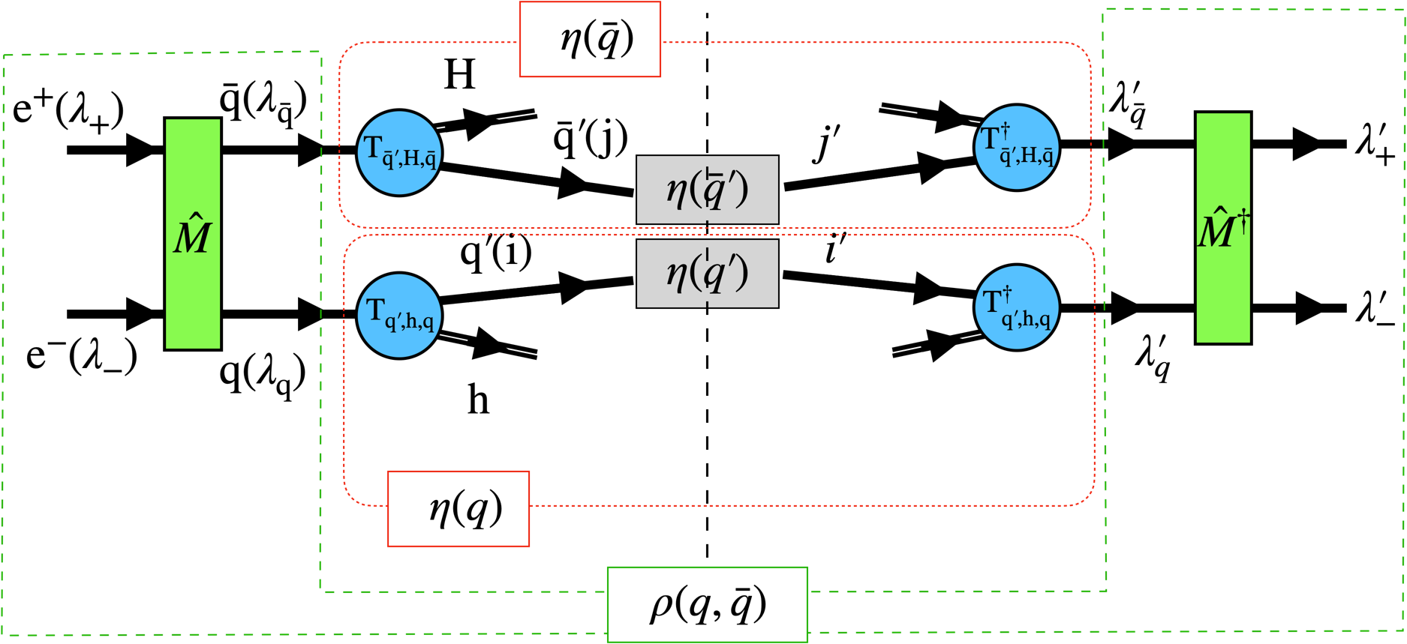

The recursive recipe for simulating $e^{+}e^{−}$ annihilation: VM emission
For a vector meson h=VM
$→η\left(q\right)=T_{q^{′},h=VM,q}^{a′†} η\left(q^{′}\right) T_{q^{′},h=VM,q}^{a}D_{a^{′}a},$ $η\left(q′\right)=1_{q′}$ and $η\left(\overline{q}\right)=1_{\overline{q}}$
Steps:
i) Emission probability density (summing over decay information, i.e. $D_{a^{′}a}=δ_{a^{′}a}$)
$$\frac{dP\left(q→h=VM+q^{′};q\overline{q}\right)}{{dM}^{2}dZ_{+}Z_{+}^{−1}d^{2}p_{T}}=Tr_{q^{′}\overline{q}} T_{q^{′},h,q}^{a} ρ\left(q,\overline{q}\right) T_{q^{′},h,q}^{a†}=F_{q^{′},h,q}\left(M^{2}, Z_{+},p_{T};k_{T},C^{q\overline{q}}\right)$$
ii) Calculate the spin density matrix of h=VM, and decay the meson
$$ρ_{aa^{′}}\left(h\right)=Tr_{q^{′}\overline{q}} T_{q^{′},h,q}^{a} ρ\left(q,\overline{q}\right) T_{q^{′},h,q}^{a′†}$$
iii) Decay the meson $p→p_{1} p_{2}..$
$dN\left(p_{1}, p_{2}..\right)/dΩ∝M_{dec.}^{a}\left(p→p_{1}p_{2}..\right) ρ_{aa^{′}}\left(h\right)M_{dec.}^{†a′}\left(p→p_{1}p_{2}..\right)$
iv) Build the decay matrix $D_{a^{′}a}\left(p_{1},p_{2},..\right)=M_{dec.}^{†a′}\left(p→p_{1}p_{2}..\right) M_{dec.}^{a}\left(p→p_{1}p_{2}..\right)$

Slide 45







The hadronization model: string+³P₀
string breaking by tunneling of $q\overline{q}$ pairs in ³P₀ state
quark splitting $q→h+q′$
Relevant variables:
$k_{T}=p_{T}+k_{T}^{′}$
$Z_{+}=p^{+}/k^{+}$
$ε_{h}^{2}=M^{2}+p_{T}^{2}$
Transverse vectors defined w.r.t. string axis
Quark splitting amplitude in the string+³P₀ model
$$T_{q^{′},h,q}∝ C_{q^{′},h,q} D_{h}\left(M^{2}\right) {\left(\frac{1−Z_{+}}{ε_{h}^{2}}\right)}^{\frac{a}{2}}\exp\left[−\frac{b_{L}ε_{h}^{2}}{2Z_{+}}\right] N_{a}^{−\frac{1}{2}}\left(ε_{h}^{2}\right) e^{−\frac{b_{T}{k^{′}}_{T}^{2}}{2}} \left[μ+σ_{z}σ_{T}⋅{k^{′}}_{T}\right] Γ_{h,s_{h}}$$
flavor
mass
transverse
momentum
(w.r.t string axis)
³P₀ mechanism
[$μ$ complex mass paramter]
Coupling
e.g.
$$Γ_{h=PS}=σ_{z}$$
Free param. Lund
Free param. string+³P₀
longitudinal momentum
AK, X. Artru, PRD 109 (2024) 5, 05402

Slide 46





$A_{12}$ asymmetry for charged $π π$ pairs
PRD 78, 032011 (2008)
PRD 78, 032011 (2008)
$$A_{12}^{UL}$$
Anselmino et al., PRD 92, 114023 (2015)
Belle asymmetries corrected for thrust smearing
Cuts:
$$T>0.8, z>0.2, Q_{T}<3.5 GeV$$
$$A_{12}^{UC}$$
StringSpinner reproduces trend and size

Slide 47



$A_{0}$ asymmetry for charged pions
PRD 78, 032011 (2008)
Anselmino et al., PRD 92, 114023 (2015)
Kang et al., PRD 93, 014009 (2016)
Cuts:
$$T>0.8, z>0.2, Q_{T}<3.5GeV$$
Trend reproduced by string+³P₀
somewhat lower values in the last z₂ bin
JAM, PRD 102, 054002 (2020)
A₀ asymmetry essential observable included in phenomenological fits

Slide 48

$A_{12}$ asymmetry for charged KK pairs
PRD 92, 111101(R) (2015)
Corrected for thrust smearing
Cuts
$$T>0.8, z>0.15, Q_{T}<3.5 GeV,α_{O}<π/4$$
$A_{12}^{UC}$ much smaller than $A_{12}^{UL}$ at large z
reproduced by string+³P₀

Slide 49

$A_{12}$ asymmetry for charged $π π$ pairs
PRD 92, 111101(R) (2015)
PRD 78, 032011 (2008)
PRD 78, 032011 (2008)
Belle asymmetries corrected for thrust smearing
Cuts:
$$T>0.8, z>0.2, Q_{T}<3.5 GeV$$
BaBar asymmetries corrected for thrust smearing
Cuts:
$$T>0.8, z>0.15, Q_{T}<3.5 GeV,α_{O}<π/4$$
StringSpinner lower than BABAR
BABAR and BELLE data different, unlike StringSpinner
PRD 90, 052003 (2014)

