Slide 1
DL nuClus
Jan 16

Slide 2
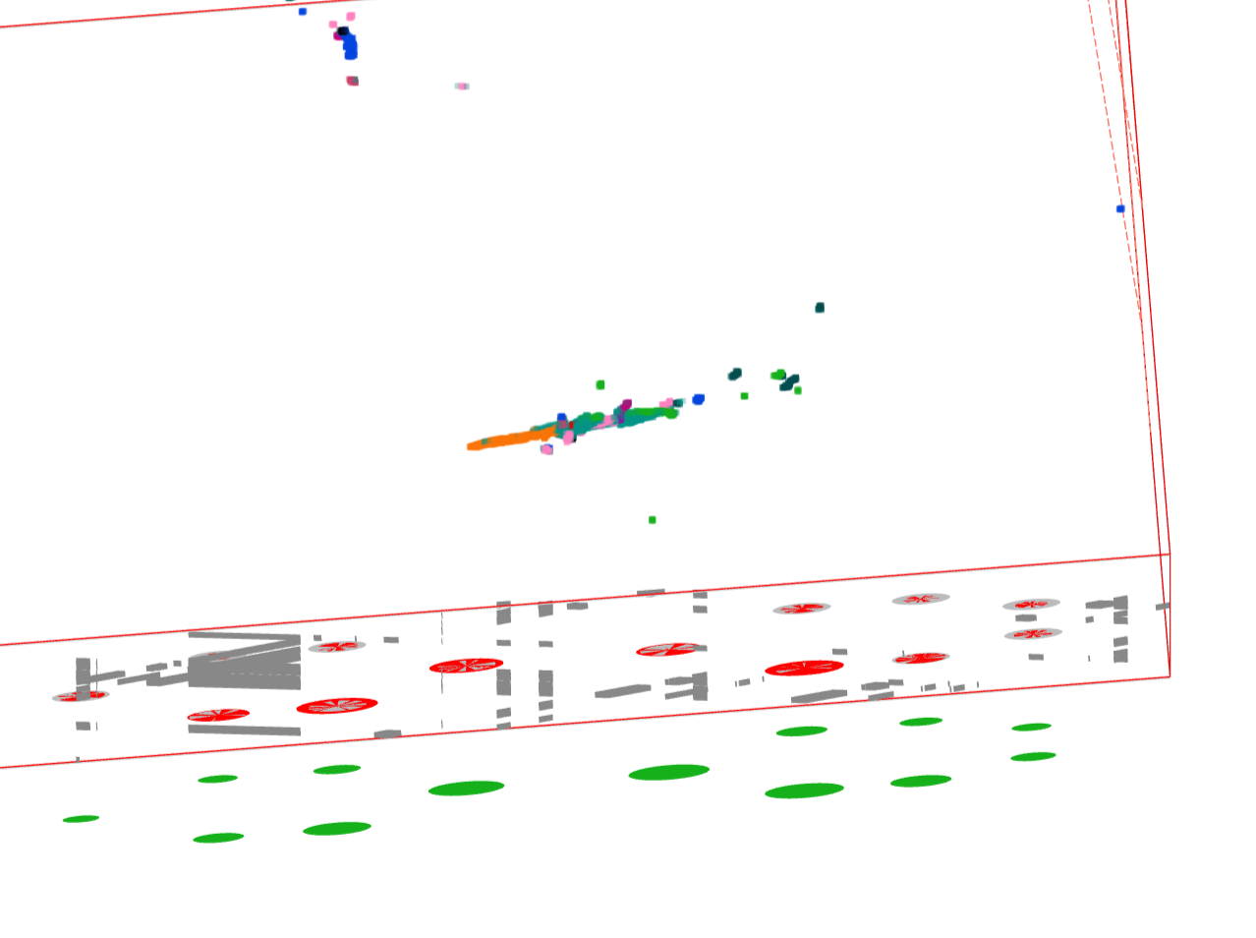
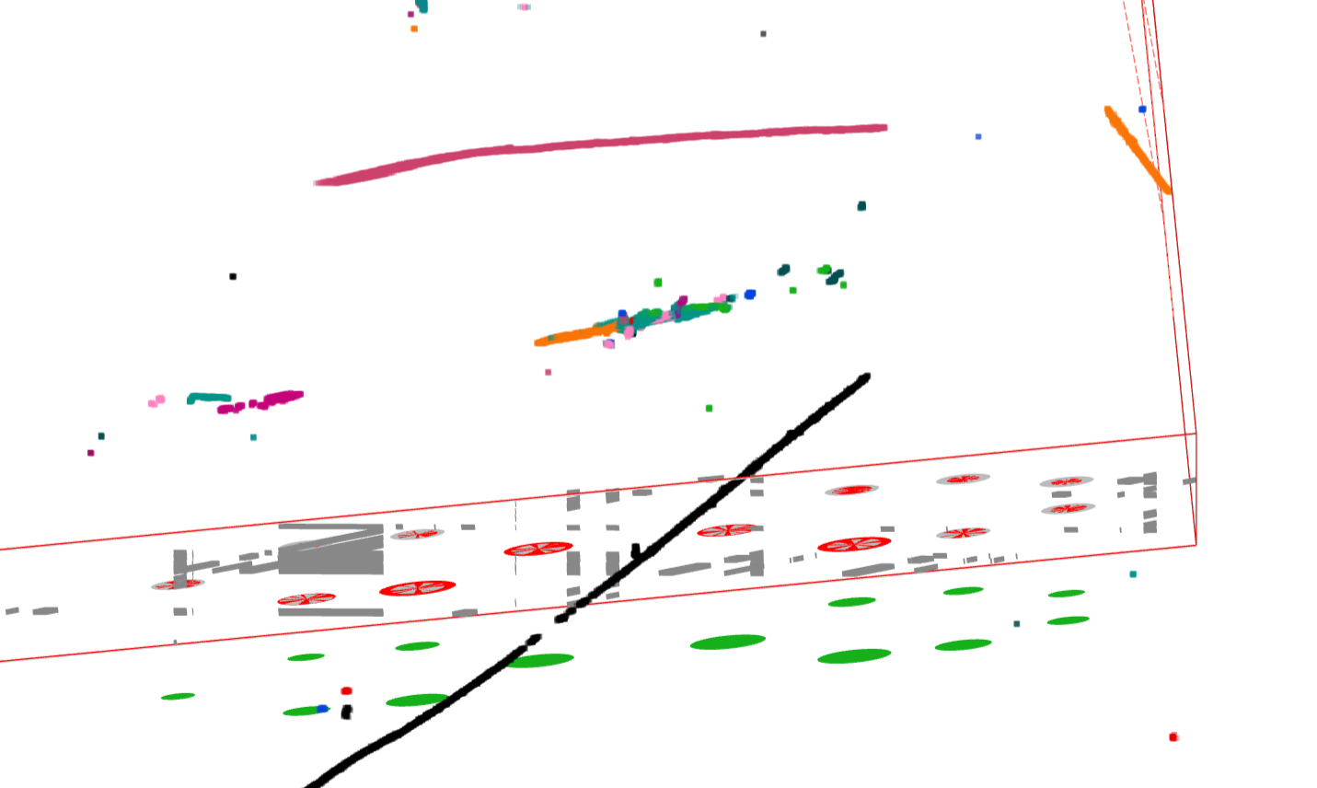
Another Identified Problem
Another problem identified
  Clustering of NCpi0 parts …
  Multiple activities, not be able to clustered together ….
  Clustering problem (before Q-L matching)
https://www.phy.bnl.gov/twister/bee/set/d620d2d4-0608-47b9-a5aa-169b9d743c4d/event/291/
Separate gammas are not clustered together for NCpi0 → important for SBND (Lee)

Slide 3
Tasks
1, Data preparation
2, Algorithm exploration

Slide 4
Data preparation
BlobDepoFill
currently fill charges
need modification to label Blobs
Depo
trackID
Clus
sampling -> 3D points (KDTree, PCA, Hough)
physcs-informed graph
Sim/SP/Img
Points or Graph
each point/graph-node has trackID information
Labeled data
trackID -> TruthInfo
Post processing

Slide 5
Algorithm exploration
Information available:
sampled 3D position/charge
projected 2D measurement for each 3D point
potential links between 3D points
NuGraph2: https://arxiv.org/abs/2403.11872
LArMatch - Chao’s slides attached
Before or After QL-Matching – provide extra information

Slide 6
GNN is like sparse-CNN
(Nn, Nf0) → (Nn, Nc, Nf1) → (Nn, Nc, Nf2) → ... → (Nn, Nc+1)
GNN is more flexible at edge constructing but carries extra overhead

Slide 7
Hidden: (Nn,Nc,Nf )
wire
time
q
uq
wire
time
q
uq
wire
time
q
uq
wire
time
q
uq
wire
time
q
uq
wire
time
q
uq
wire
time
q
uq
wire
time
q
uq
wire
time
q
uq

Slide 8
Next steps
Moon/Avinay:
Simulate NCpi0
Try current clustering
explore architectures
  try to run some example training
Haiwang:
prepare data

