Slide 1
Discussion Jan 14

Slide 2
WCP related topics
Wenqiang’s fix:
https://github.com/BNLIF/wire-cell-2dtoy/commit/863248ad08caca4c08eed9e34e07758fef0540bf
0_17_4
SparseConveNet:
Wenqiang was successful to install SCN and to run WCP apps with venv
Herb hand-made a new SparseConveNet
Ben’s dev:
https://github.com/BNLIF/wire-cell/pull/3
https://github.com/BNLIF/wire-cell-2dtoy/pull/1
https://github.com/BNLIF/wire-cell-pid/pull/1
Can Xin help to confirm these updates are OK?
Plan is to make 0_18_0 with Ben’s update
Goes into both MCC9 and potentially MCC10?
Reproducing previous results can use 0_17_4

Slide 3
QL-matching Plan
First, translate lower-level objects/functions
  Opflash
  FlashTPCBundle
  Photon_Library
    information hard coded in constructor
Second, translate higher level ones
  calculate_pred_pe, tpc_light_match
  extracting parameters are needed
  some factorization will be useful
    e.g., extract the uboone specific bundle filter
    Lynn has a better idea on this
Generalization to multiple APA/face
  SBND should be OK for now
  Merge Clusters from multiple Grouping?
    add APA/face ID to Blob/Cluster?
    some extension to Cluster is needed, e.g., pos-orig and pos-corrected?
caveat of this? (question to Xin)

Slide 4
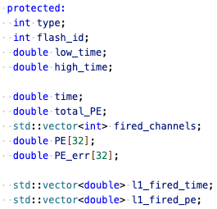
data/inc/WCPData/Opflash.h
Do we have all the information from larsoft::Opflash?
accurate, full waveform
integral time? to separate close flashes?
fire or not?
more sophisticated info?
not has to be 32 for uboone
do not have to use

Slide 5
Opflash in WCT
Information:
  ITensor:
    scalers
    PE
    PE_error
    l1_fired_time
    l1_fired_PE
ITensor -> Opflash -> ITensor
  We don’t need PointCloud for this?
Copy functions
We don’t have these red ones yet in larwreicell/qlmatching

Slide 6
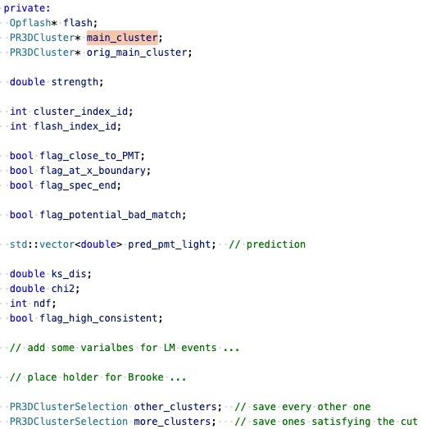
FlashTPCBundle in WCT
We can have pointers to OpFlash and Facade::Cluster
FlashTPCBundle can modify Charge PCTree
  examine_merge_clusters
    merge other_clusters to main_cluster
TH1::KolmogorovTest() – available in boost
More information on this from Xin?
quality flag
may add more for CRT

Slide 7
Matching output: T_match in WCP
essentially an edge list between charge cluster and Opflash
  cluster: grouping->children()[i]
  Opflash: ITensor -> flashes[j]
  Fixed length vectors, e.g, pe_pred[32]
  Other scalers
ITensorSet
Multiple ITensors
PointCloudTree
  Cluster
ITensor (2D)
Opflash
ITensor (2D)
T_match info

Slide 8
Develop procedure
Develop data object and alg. in larwirecell/qlmatching for now
https://github.com/LArSoft/larwirecell/pull/49
Opflash and FlashTPCBundle will not be iface objects
We can decide later what to bring back to main wct
  even bring the whole larwirecell/qlmatching back
Lynn work with Haiwang to establish the lower-level objects
Lynn will work on higher-level ones
Validation:
assuming we still want to match uboone results first
  can Xin provide a uboone example?
Lynn is working on to get some SBND samples

Slide 9
Backups

Slide 10
Concept relations
L0/ROOT
Grouping
ctpc_f%dp%d
Node/Facade
f%dp%d -> dead_chans
PointCloud
L1
Cluster
Facade local var.
graph
L2
Blob
live
scalar
3d
dead
scalar
corner

Slide 11
Concepts
general n-ary tree
  WireCell::NaryTree::Notified<Value>
  manages the tree structure, parent, children, notification
n-ary tree that holds PointCloud:
  WireCell::PointCloud::Tree::Points
  manages the PointCloud
main interface after BV’s refactoring:
  WireCell::PointCloud::Facade::[Grouping,Cluster,Blob]
  Facade has local variables
  Facade access PointCloud through Points::scoped_view

Slide 12
BV’s documents
https://github.com/WireCell/wire-cell-toolkit/tree/apply-pointcloud/util/docs
n-ary tree and facade:
https://github.com/WireCell/wire-cell-toolkit/blob/apply-pointcloud/util/docs/nary-tree-node.org
Point Cloud
https://github.com/WireCell/wire-cell-toolkit/blob/apply-pointcloud/util/docs/point-cloud.org
NFKDVec
https://github.com/WireCell/wire-cell-toolkit/blob/apply-pointcloud/util/docs/nfkdvec-tree.org

