Slide 1
Advancing Silicon Carbide(SiC) Technology for Radiation-Hardened and Low-Damage Applications
Proposal title: Advancing Silicon Carbide (SiC) Technology for Radiation-Hardened and Low-Damage Applications
Primary Investigator: Thomas Kubley
Other Investigators: Stefania Stucci(co-PI), Gabriele D’Amen
Indicate if this is a cross-directorate proposal: Yes ___ No_X__
Proposal Term: From: Oct-10-2025 To: Sept-30-2027

Slide 2
Expected Results, Motivation, and Implications
Expected Results:
Demonstrate a novel technique for deep ion implantations that minimizes lattice defects.
Develop SiC deep trench isolation for Low Gain Avalanche Detectors (LGADs) for future ECA work.
Motivation:
Improve processing of SiC wafers.
Securing the U.S. as a leader in energy technology.
Highlight the unique capabilities at the TVdG at BNL.
Implications:
More robust and efficient components for harsh environment.
Technical improvements in automotive, aerospace, energy and electronics.

Slide 3
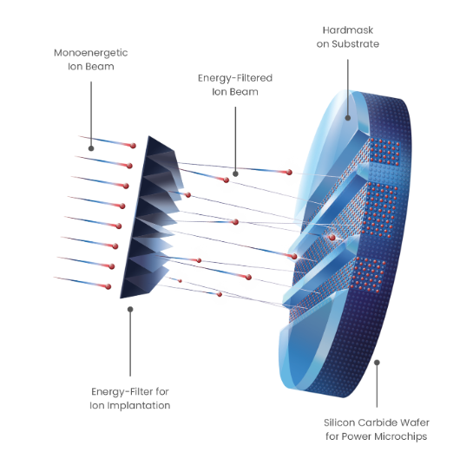
Implantation Technique
Conventional implants focus all ions and energy at a singular depth, resulting in significant damage to the implanted area.
A pyramid-shaped filter ensures uniform ion distribution from the surface to the desired depth within the wafer.
With this filter, the SiC bonds have sufficient time to recover before the arrival of the next ion.
The wafers will be tested to find optimal implantation specification.
Year One Focus

Slide 4
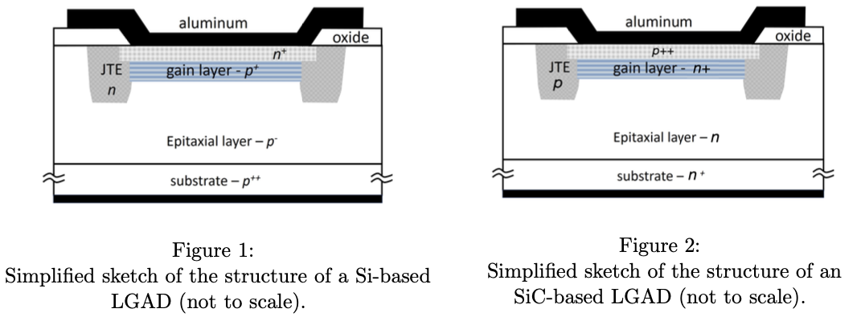
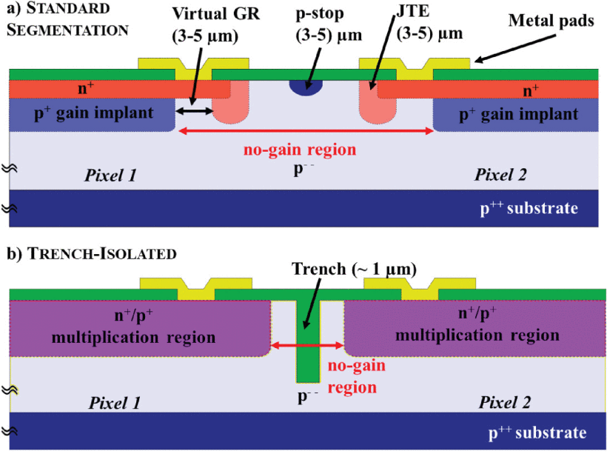
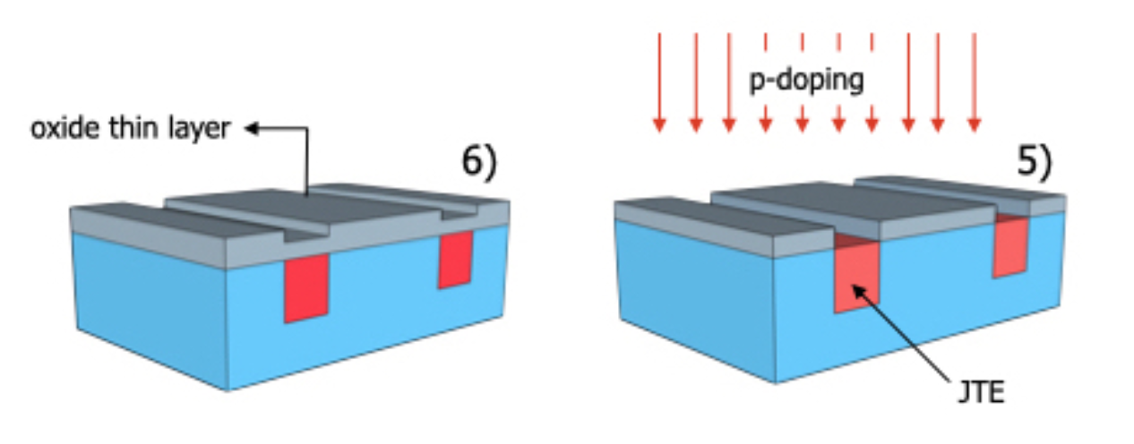
Isolation Strategy
Deep Trench Isolation would solve the problem of inactive area but are more challenging to produce (~1 um vs 5-7 um ).
Segmentation in Si-LGAD devices - we want to achieve the same results in SiC!
Year Two Focus

Slide 5
Goals and Timeline
Demonstrate a novel technique for deep ion implantations that minimizes lattice defects.
Develop SiC deep trench isolation for Low Gain Avalanche Detectors (LGADs) for future ECA work.
Year 1:
Mid Year
Complete three sets of irradiations at the TVdG
Begin Characterizing the results of the implants
Start fabrication of LGAD
End of Year
Complete characterization of implants
Determine ideal implant conditions
Generate manuscript on the results
Year 2:
Mid Year
Complete construction of LGADs
Complete implantation of LGADs
Activate wafers
End of Year
Complete testing of LGADs
Generate manuscripts on electrical tests
Personal: Stefania Stucci (BNL), Gabrielle D’Amen(BNL), Pavlidis Spryridon(NC State), Reza Gandi(GE aerospace)

Slide 6
Alignment with the Laboratory Mission and Vision
Techniques that increase the fabrication of SiC devices will catalyze the efficient transformation of the American energy system and secure the U.S. as a leader in energy technology.
This will also support a co-PI in becoming an Early Career Award (ECA) winner and developing a new direction for SiC device research and production.

Slide 7
Potential Future Funding
ECA
High energy physics
Expanding TVdG user base:
Industry
Defense
Aerospace

Slide 8
If ECA Eligible – How this LDRD Benefits Your Application
This project supports my ECA application by advancing SiC LGAD fabrication
including optimizing implantation for gain layer performance and
deep trench isolation for reduced crosstalk,
for improved edge breakdown control - key for radiation-hard fast-timing detectors in future colliders.

Slide 9
Names of Suggested BNL Reviewers
Implantation:
Mike Sivertz (C-AD)
Dannie Steski (C-AD)
SiC LGAD:
Alessandro Tricoli (PHYSICS)
David Lynn (PHYSICS)

Slide 10
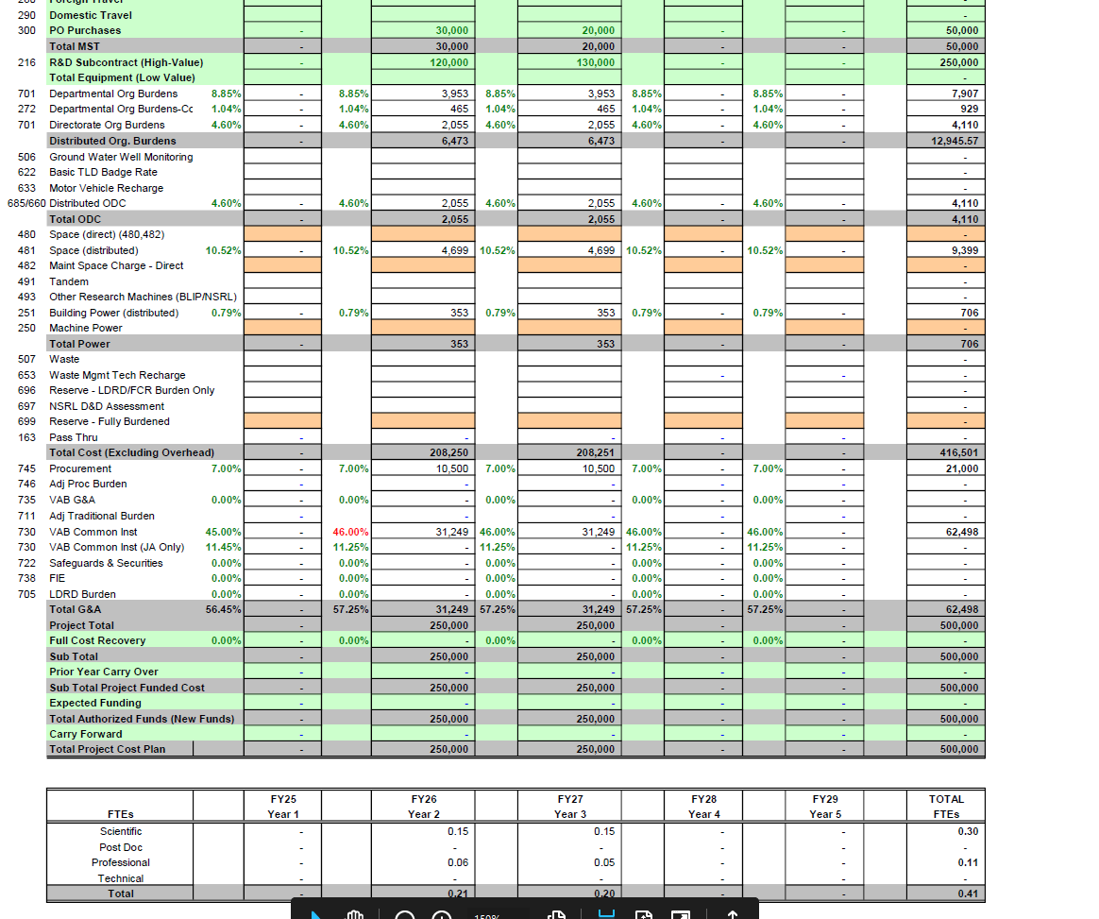
LDRD Funding Table from BOM

Slide 11
Summary
The development of new ion implantation techniques is crucial for increasing the production of SiC devices.
This proposal will lead directly to an ECA.
The results of this proposal will showcase the unique capabilities of the TVdG, thereby expanding its user base.

