Slide 1
A Flexible Open Source Neutrino Oscillation Global Fit
Principal Investigator(s): Peter Denton
List of the proposal participants and their organizations if other than NPP: None
ECA eligibility: No
Proposal term from: Oct 2025 to: Sep 2027
Annual funding: FY26 $250k FY27 $250k
2-4-25

Slide 2
Description of the LDRD
Motivation:
It is essential for the advancement of particle physics to discover the nature of the parameters in neutrino oscillations; these represent the only particle physics evidence we have for physics beyond the Standard Model. Several key unknowns remain: notably 1) the neutrino mass ordering which has implications for cosmology, neutrinoless double beta decay, and elsewhere, 2) CP violation which is an innately interesting aspect of particle physics, and 3) the octant of θ23 which is essential for understanding flavor models. The next generation of neutrino oscillation experiments: DUNE (with a large BNL contribution), HyperK, and JUNO (building off a previous BNL experimental effort) aim to resolve these remaining mysteries.
Due to the interconnected nature of all the parameters, these unknowns will almost certainly be first resolved by a theorist performing a global fit, and it should be done at Brookhaven.

Slide 3










Description of the LDRD
Physics in the fit:
Input Data: We will include data from each neutrino oscillation measurement:
1. Solar:
a) Homestake
b) Gallium experiments: SAGE, GALEX, GNO
c) SNO
d) Borexino
e) SuperK
f) DUNE , JUNO, HK
2. Reactor:
a) Daya Bay , RENO, Double CHOOZ
b) KamLAND
c) JUNO
3. Atmospheric:
a) SuperK
b) IceCube
c) KM3NeT, DUNE , HK, JUNO
4. Accelerator:
a) MINOS
b) NOvA
c) T2K
d) DUNE , HK
Interplay: Each experiment measures a complicated mixture of the parameters:
Solar: Measures mostly and also with a subleading contribution from
Reactor: Medium baseline measures mostly and with subleading effects from and
Long baseline measures and and will also measure the mass ordering and
Atmospheric: Measures and and has sensitivity to the mass ordering
Accelerator: Measures , , , and the mass ordering, and depends on all other oscillation parameters
Future experiments in green
Indicates BNL experimental involvement

Slide 4
Description of the LDRD
Previous global fits:
Three main groups have done global fits in the past:
Barcelona/Madrid group is most active
Valencia group
Bari group
No guarantee that they continue. Analysis is propriety: impossible to verify. Not user friendly. Out dated statistical treatments: assume Wilks’ theorem everywhere. Unclear or no treatment of joint systematics.
These issues will become increasingly relevant as DUNE, HK, and JUNO deliver high precision data and it is important to be ready for it.
My previous oscillation experience:
Neutrino oscillation theory:[1604.08167], [1806.01277], [1808.09453],[1902.00517], [1902.07185], [1907.02534], [1909.02009], [2006.09384], [2106.12436], [2309.03262], [2401.10326], [2405.02400]
Atmospheric experiments: [1811.01310], [2109.14575], [2109.14576], [2110.01148]
Long-baseline experiments: [2008.01110], [2109.14575], [2302.08513], [2401.10326]
Reactor experiments: [1804.03660], [2302.08513]
Solar experiments: [2302.08513], [2409.15411]
Plus reviews

Slide 5
Description of the LDRD
Details in the analysis:
Systematics: We will consider shared flux systematics¹ and their theoretical uncertainties among multiple measurements for atmospheric, solar, and reactor.
Code: We will develop an open source¹ code in two layers. The first is a full fit to each experiment’s published low-level data. This will be carefully validated against the experiment’s own analysis. The second is a faster fit¹ that reproduces all the relevant physics but can be performed computationally quickly. This will allow for the easy addition and subtraction of experimental results and the ability to project sensitivities for future experiments like DUNE.
Statistical fit: Existing analyses assume Wilks’ theorem to extract statistical significances. We will perform Bayesian¹ and frequentist¹ fits and quantify the significances using Monte Carlo (e.g. Feldman-Cousins) where necessary.
Usage:
1. Select which experiments to use:
a) All existing
b) Only the latest key measurements
c) All existing plus anticipated future
d) All existing minus one experiment
e) …
2. Select the data level:
a) Full data with all joint systematics
b) Effective measurements (fast)
3. Select the statistical approach:
a) Simple Wilks’ theorem (industry standard)
b) Bayesian regions
c) Frequentist intervals (e.g Feldman-Cousins)
4. Return the confidence intervals for the six oscillation parameters and the overall goodness of fit¹
¹Never done before

Slide 6
Description of the LDRD
Deliverables: The main deliverable will be in the form of a publicly available code hosted and maintained on github.com. This will also be accompanied by several publications describing the physics input to the code, the validation procedure, the usage cases, as well the actual numerical results of the best fits of all six oscillation parameters and the statistical preference for the mass ordering, for the ability to reject CP conservation, and the ability to reject maximal θ23 mixing and the wrong octant.
ROI: This LDRD will establish BNL as an international neutrino theory institution and the code will be maintained throughout DUNE’s run and will be a valuable asset to BNL, DUNE, and the community and aims to provide the defacto standards for reviews such as the PDG. It will provide an early indication of key fundamental parameters of nature before billion dollar experiments individually measure them. This flexible code will also allow for the expansion into new physics searches such as sterile neutrinos or non-standard neutrino interactions expanding the physics reach of DUNE and other experiments.
PI Capabilities: I have published many papers analyzing data from each class of experiments to be included in the fit: atmospheric, solar, reactor, and accelerator. I have written complicated neutrino oscillation codes before. I have publicly posted many of my neutrino codes online.
Budget justification: The majority of the budget will be to support a postdoc who will assist with experimental validation procedure and the code development. Some of the budget will also be spent on travel for dissemination of the results, and some of the budget will support the PI.

Slide 7
Alignment with the Laboratory Mission and Vision
Section 4.1.2 of the 2024 annual laboratory plan emphasizes BNL’s important role in pushing neutrino physics forward and contributing to neutrino experiments including DUNE. This LDRD will further enhance DUNE by providing a tool to see where DUNE fits within the global landscape and will allow for easy and robust extrapolation to different future scenarios in terms of both true oscillation parameters as well as experimental details such as neutrino vs. antineutrino run time. The same section also discusses BNL’s world-leading theoretical activities on these topics, which this LDRD will further enhance.

Slide 8
Potential Future Funding
Such a global fit will likely provide the first determination of fundamental parameters which will have a sweeping effect on neutrino physics and many other areas of particle physics and cosmology. In addition, by enhancing the physics case of DUNE, a multi-billion dollar experiment, this alone should justify its cost. This would also establish BNL as an international neutrino theory center. Thus the primary lab benefit would be reputational. It would also take maximum advantage of BNL’s institutional knowledge on reactor neutrino experiments (e.g. Daya Bay) and long-baseline neutrino experiments (e.g. DUNE). Finally, this code will maintained and operated for many years beyond the LDRD which could see additional opportunities for new funds down the road.

Slide 9
Names of Suggested BNL Reviewers
Elizabeth Worcester
Anze Slosar
Xin Qian
Mary Bishai
Chao Zhang

Slide 10
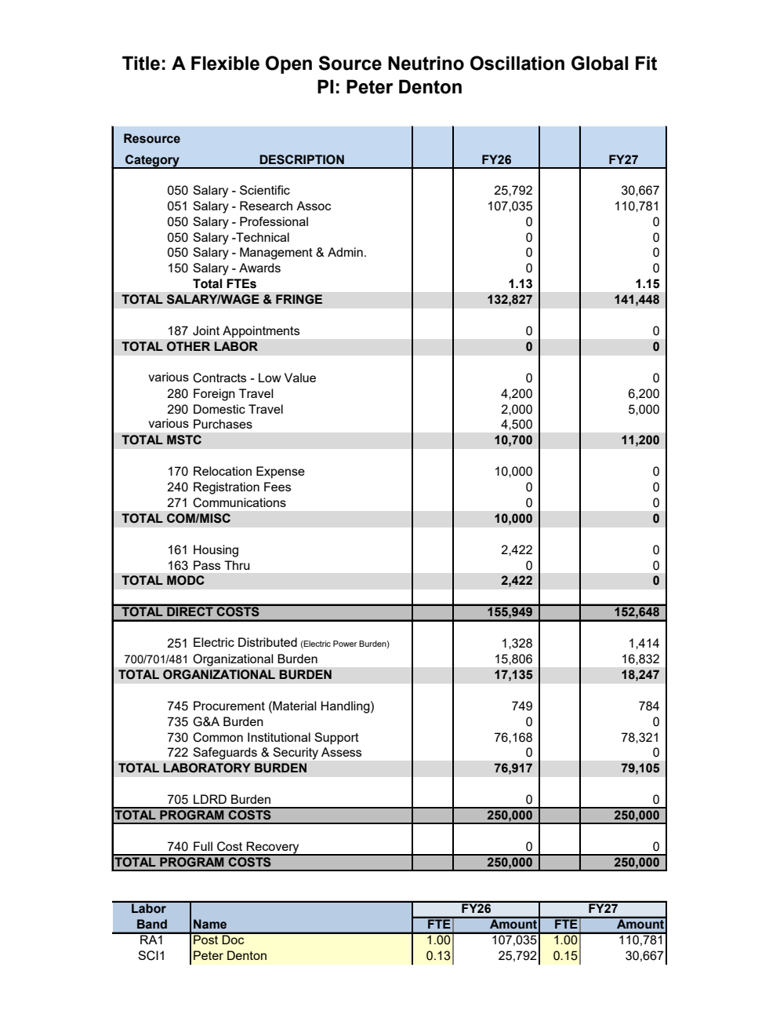
LDRD Funding Table from BOM

Slide 11
Summary Slide
Neutrinos are the only particles that give us a known window into new physics
Key foundational questions remain about the nature of neutrino oscillations, neutrino masses, and the flavor structure of neutrinos
The remaining neutrino oscillation parameters will be first determined by a global fit
Having an accessible and robust public code fitting neutrino oscillation will be an essential resource for the neutrino community
My expertise in neutrino oscillation theory combined with the experimental group’s experience with reactor and accelerator data make BNL the perfect place to perform such a fit
Theory expertise will also be useful for interpreting the results in the context of flavor models and any tensions
The code would be usable by theorists and experimentalists alike to understand the current and possible future scenarios
This undertaking would establish BNL as a strong neutrino theory group for many years to come

