Slide 1
Services to PHENIX IR
From Building 1008B
Paul Giannotti
12/7/2016

Slide 2
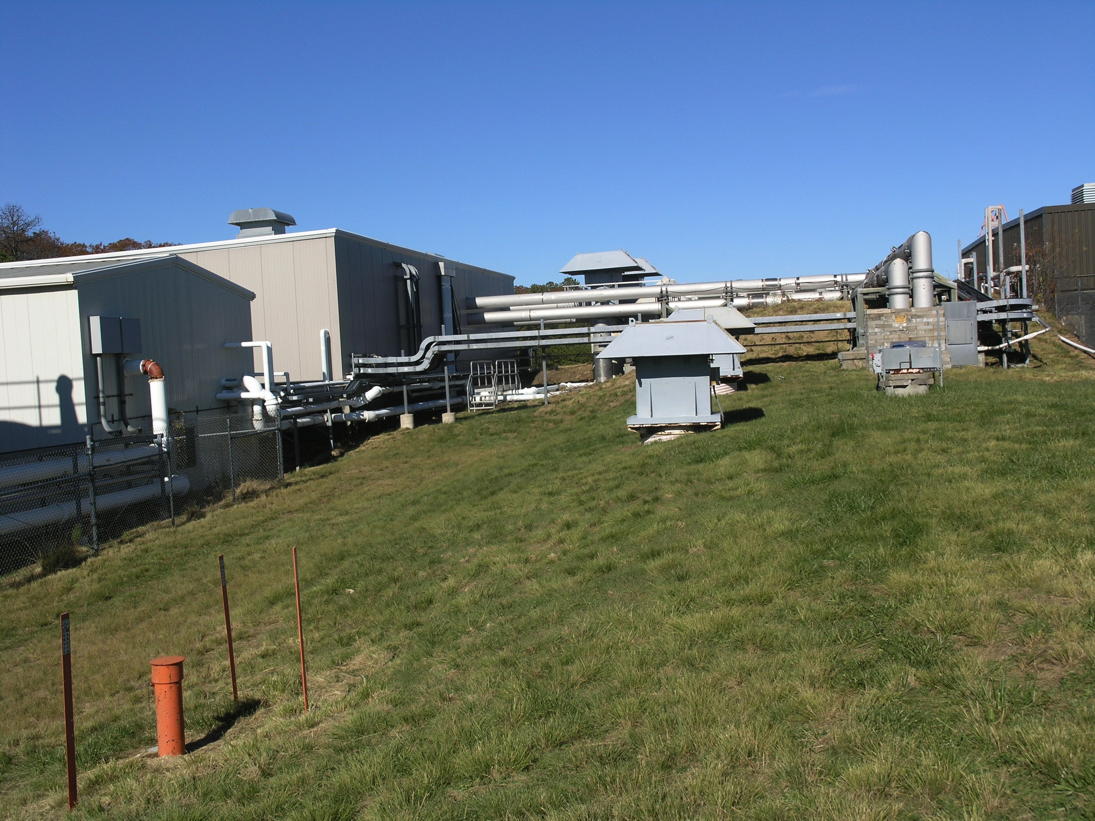
Services to IR from Building 1008B
(slide 1)
Area of Detail
N
Top of Tunnel
Sector 7
P. Giannotti 12/7/16

Slide 3
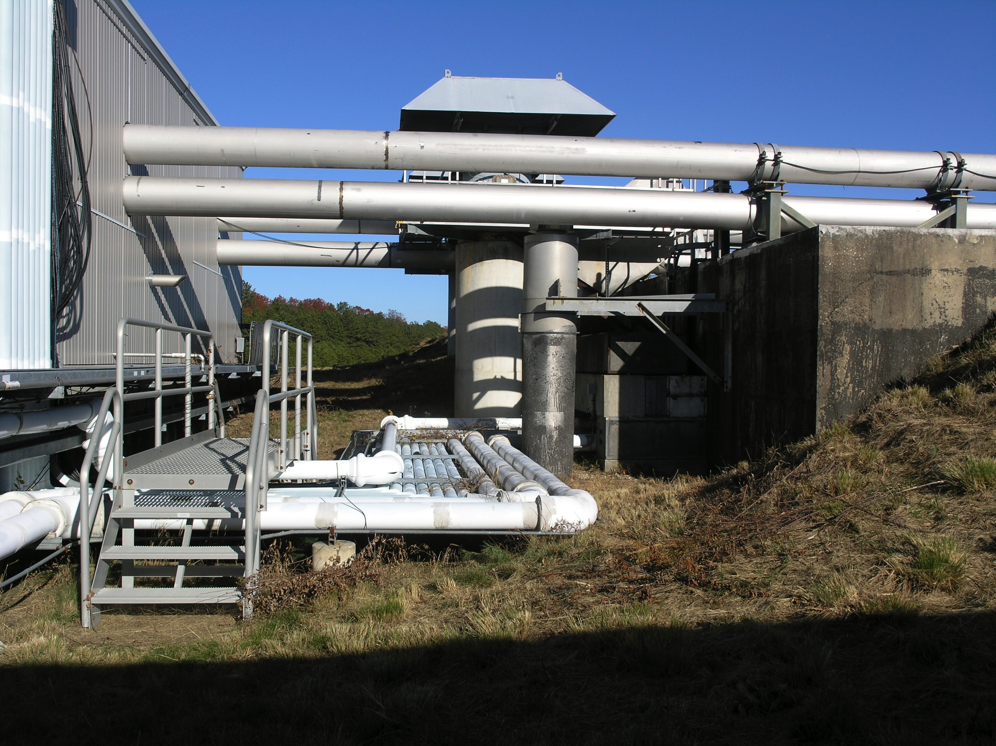
Services to IR from Building 1008B
(slide 2)
1008B
IR Exhaust Fan
Helium to Sector 7
Helium to Sector 9
IR
LCVS
Exhaust
Fan
Stack
IR Ceiling
South West
Corner
Shield
Blocks
View Looking North
P. Giannotti 12/7/16

Slide 4
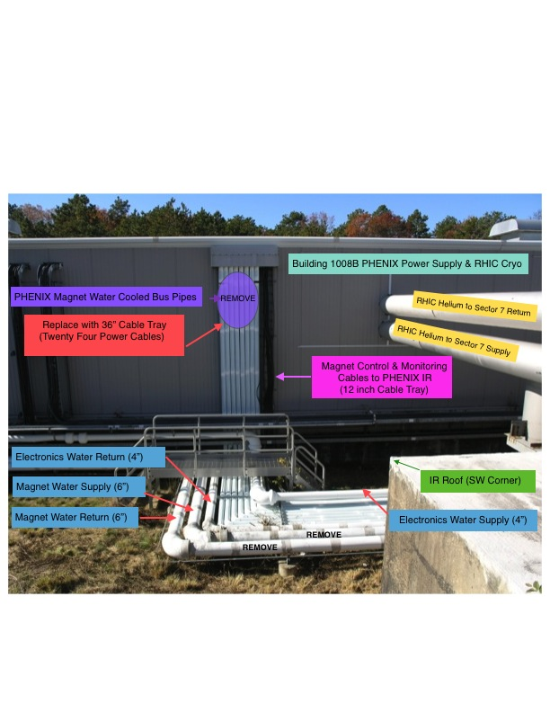
Services to IR from Building 1008B
(slide 3)
P. Giannotti 12/7/16

Slide 5
Services to IR from Building 1008B
(slide 4)
P. Giannotti 12/7/16

Slide 6
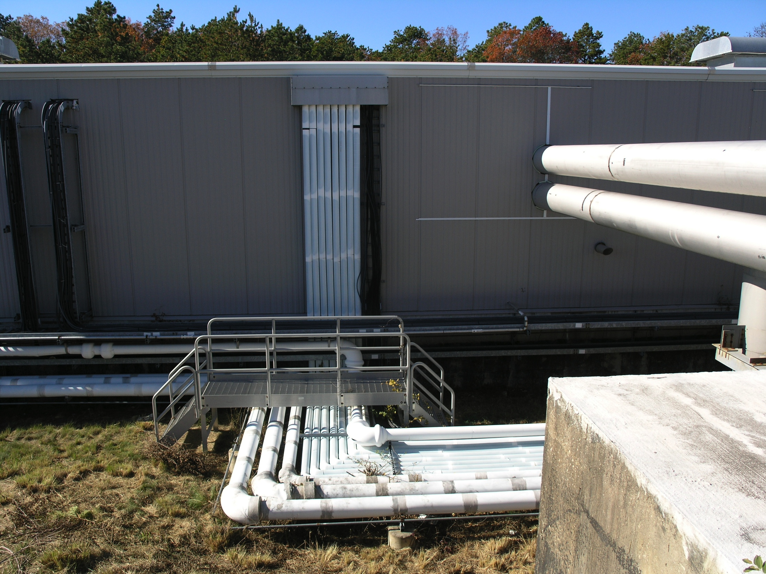
Services to IR from Building 1008B
(slide 5)
Water
Cooled
Bus
18 FT.
40 inches
P. Giannotti 12/7/16

Slide 7
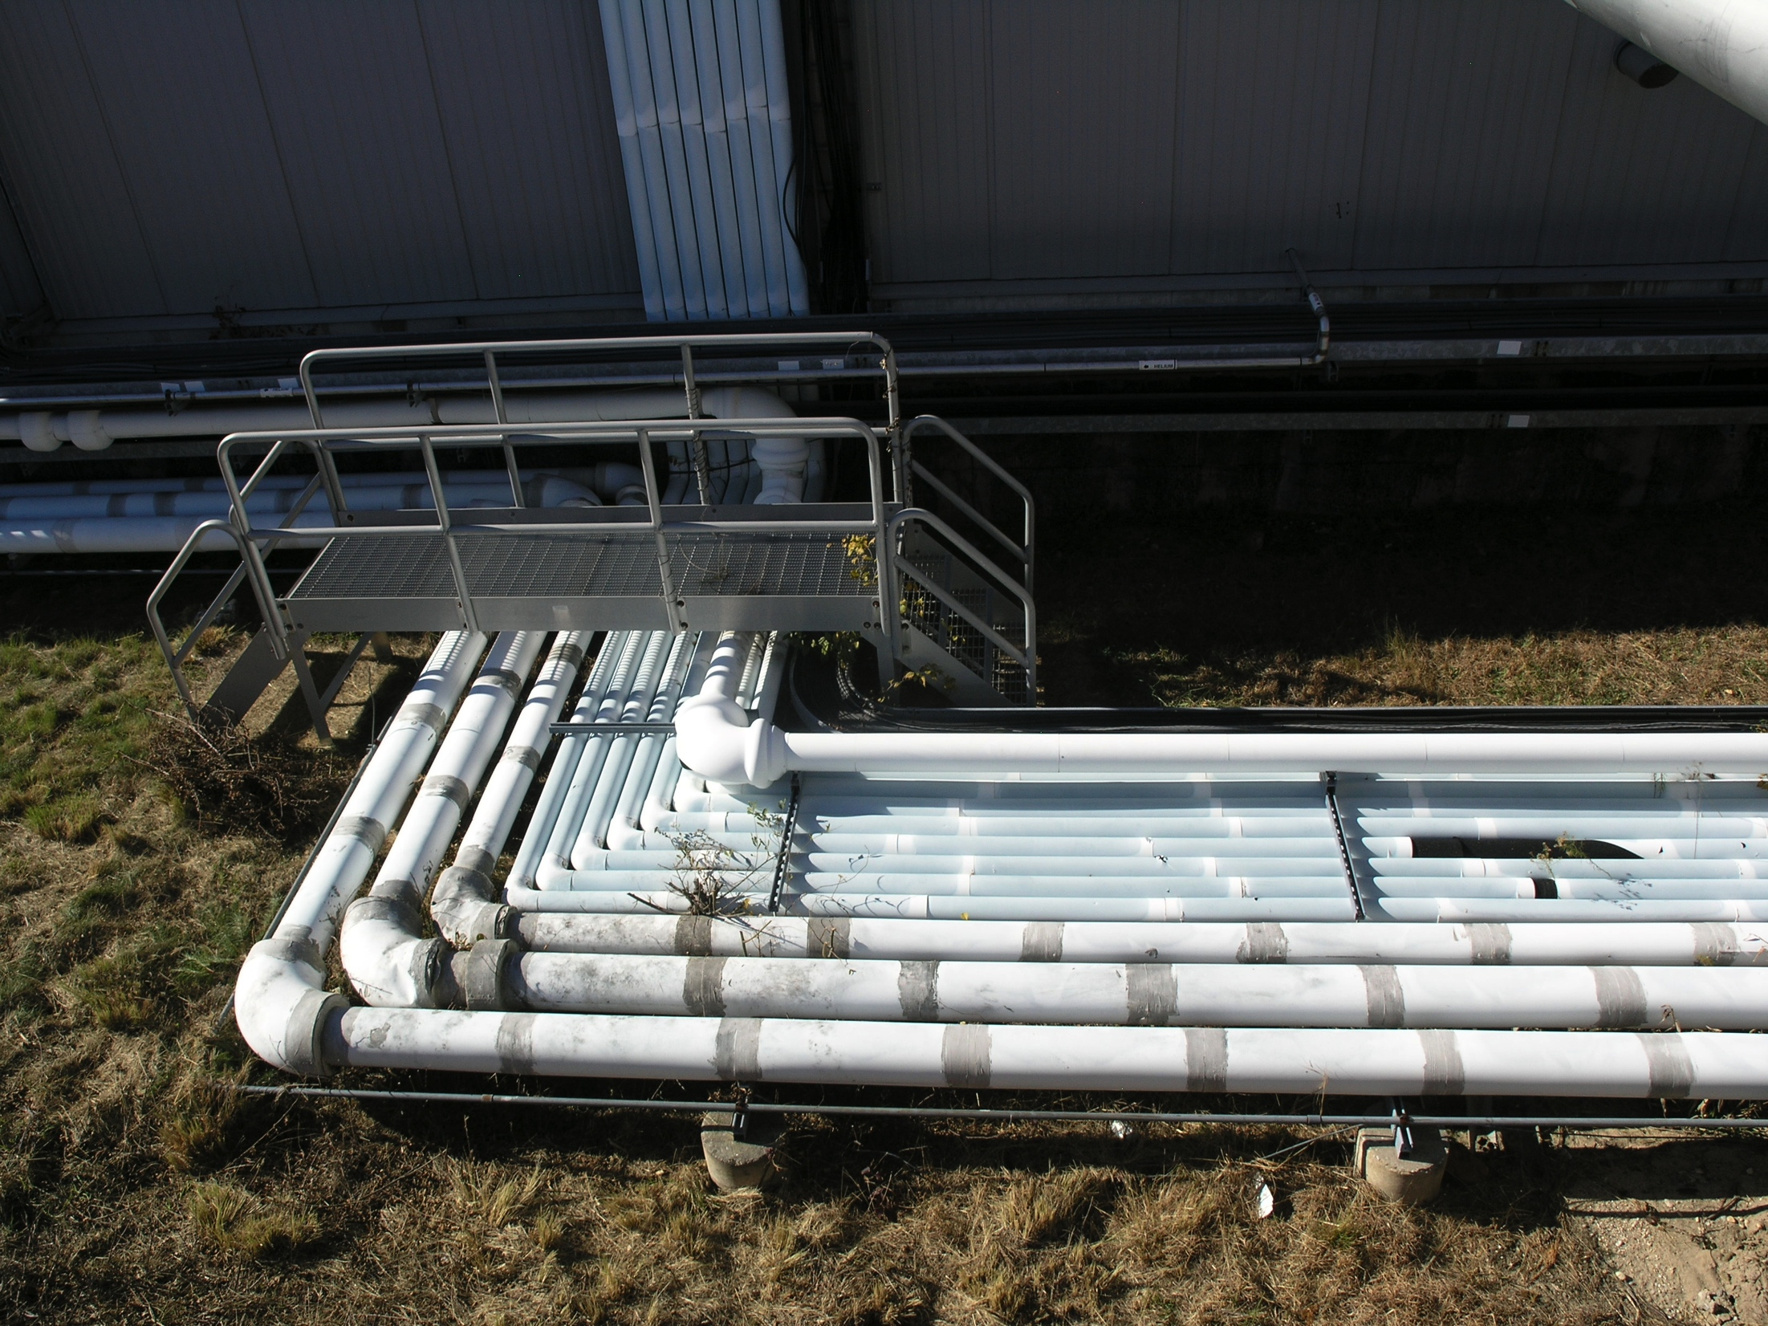
Services to IR from Building 1008B
(slide 6)
Water Cooled Bus = 18 FT.
out from wall
Electronic Cooling Water Supply
Water Cooled Bus Pipes
Electronic Cooling Water Return
Magnet Cooling Water Supply
Magnet Cooling Water Return
P. Giannotti 12/7/16

Slide 8
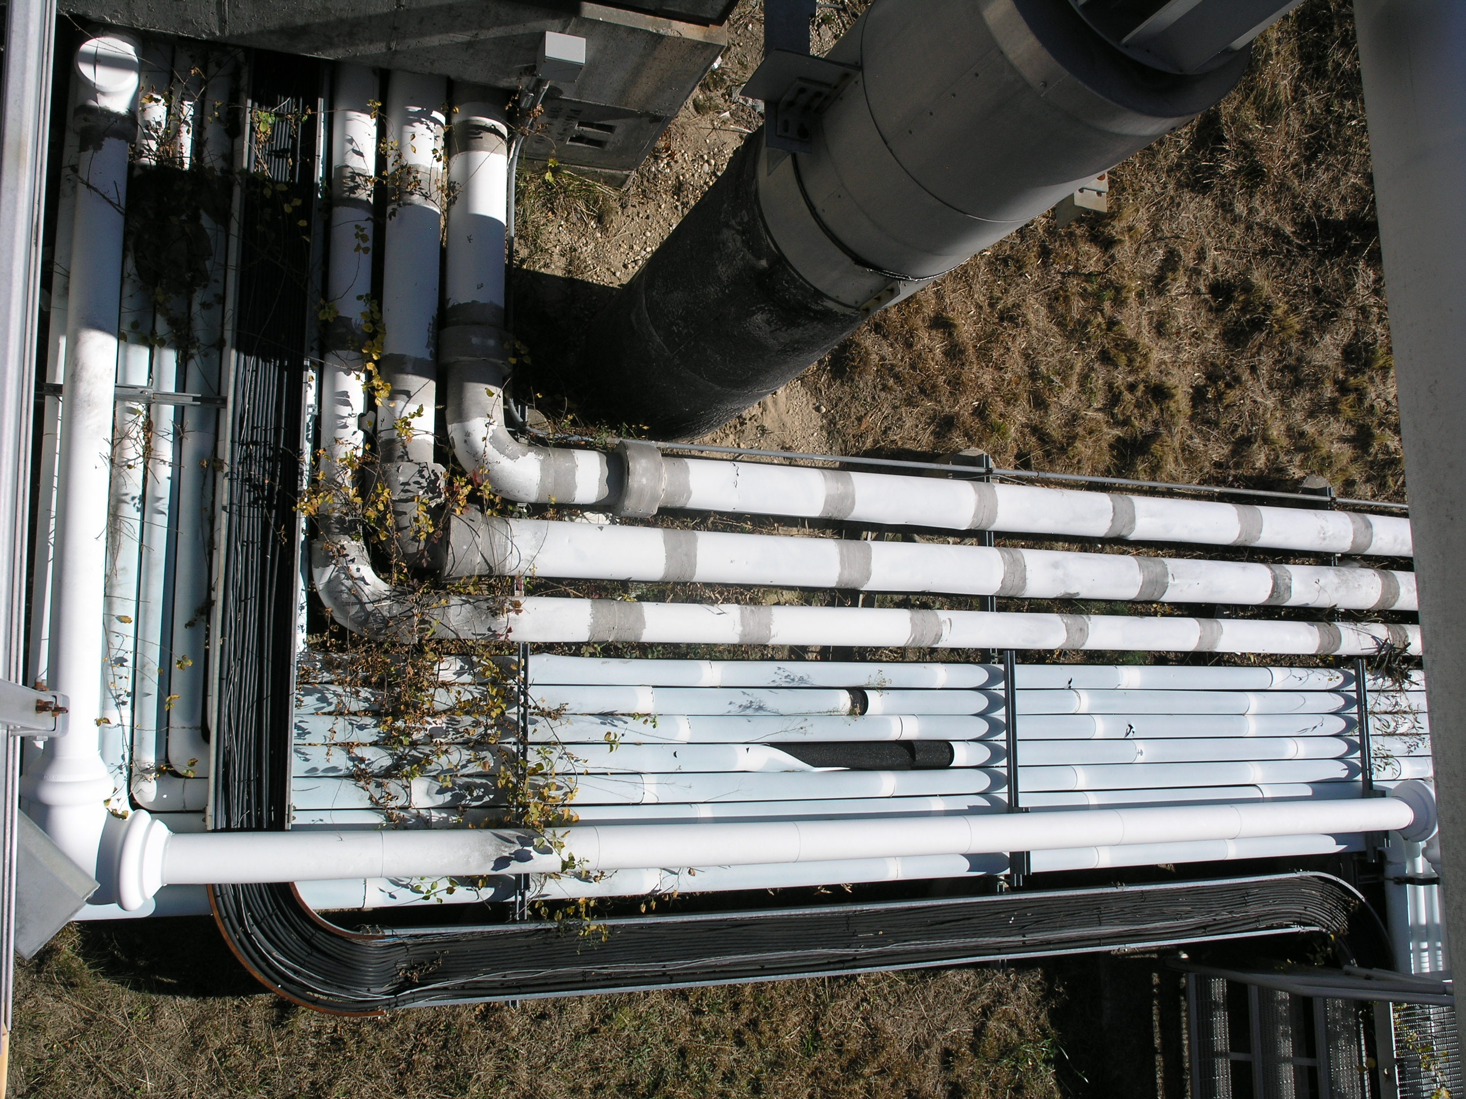
Services to IR from Building 1008B
(slide 7)
IR
LCVS
Exhaust
Fan
Stack
Shield Blocks
15’ End to End
Magnet Cooling Water Return
Magnet Cooling Water Supply
Electronic Cooling Water Return
Water Cooled Bus Pipes
24’ End to End
Electronic Cooling Water Supply
Magnet Signal & Control Cables
12’’ Tray
P. Giannotti 12/7/16

Slide 9
Services to IR from Building 1008B
Shield Block Face
(slide 8)
P. Giannotti 12/7/16

Slide 10
Services to IR from Building 1008B
Under Shield Block View 1
(slide 9)
P. Giannotti 12/7/16

Slide 11
Services to IR from Building 1008B
Under Shield Block View 2
(slide 10)
P. Giannotti 12/7/16

Slide 12
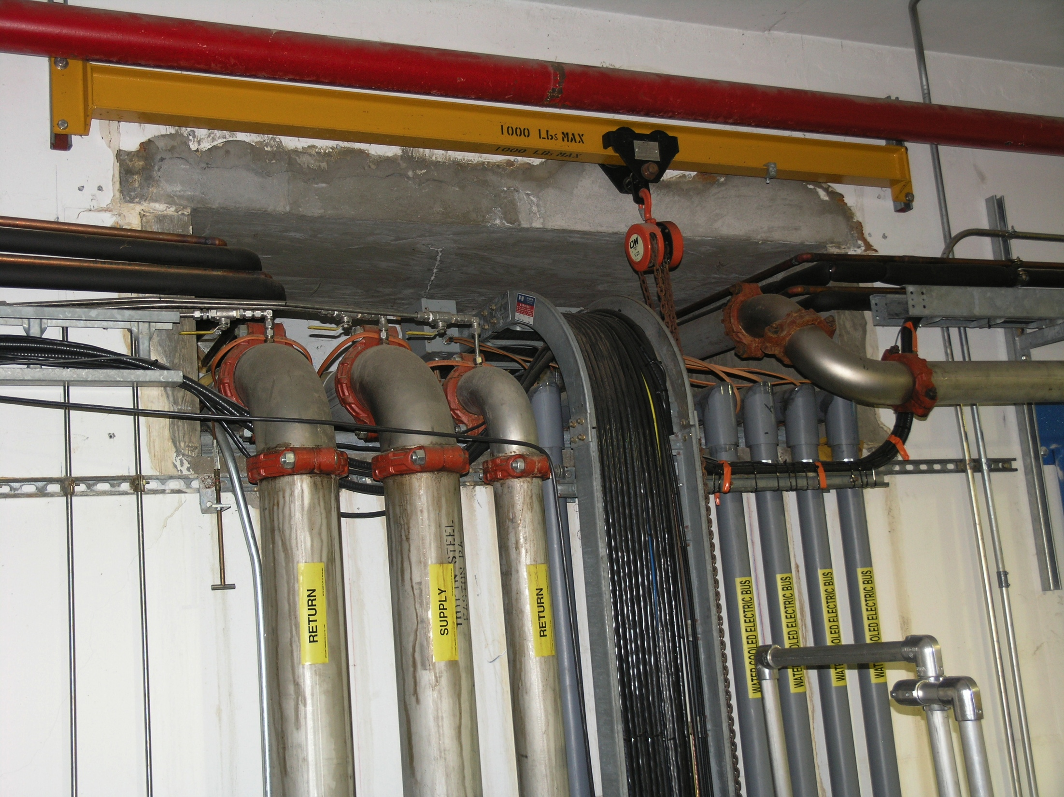
Services Opening IR Side
View 1
(slide 11)
6.5 FT.
3 FT.
ECW Supply
MCW Supply
Water Cooled
Bus
MCW Return
ECW Return
P. Giannotti 12/7/16

Slide 13
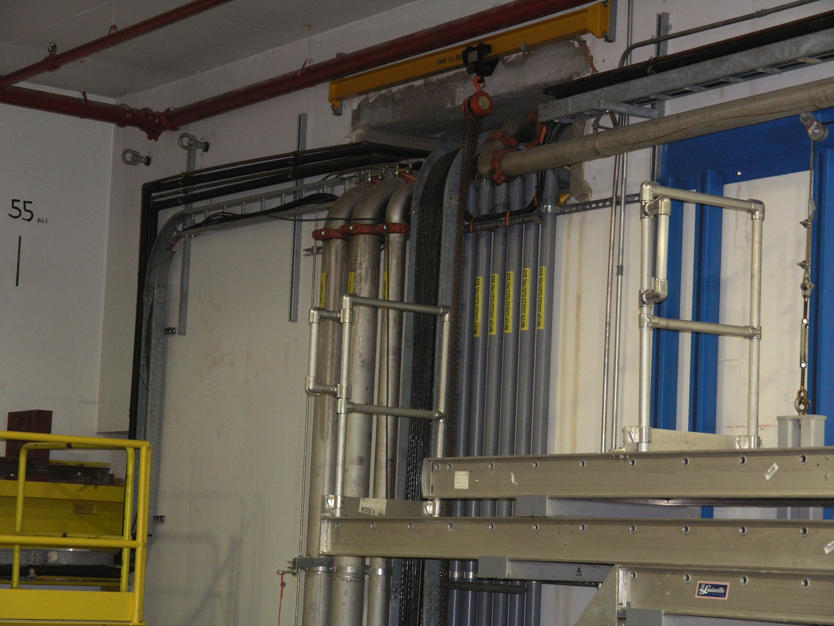
Services Opening IR Side
View 2
(slide 12)
ECW Supply
Coolant, Power,
& Signal Service
to south side HVAV
Air Handlers
P. Giannotti 12/7/16

Slide 14
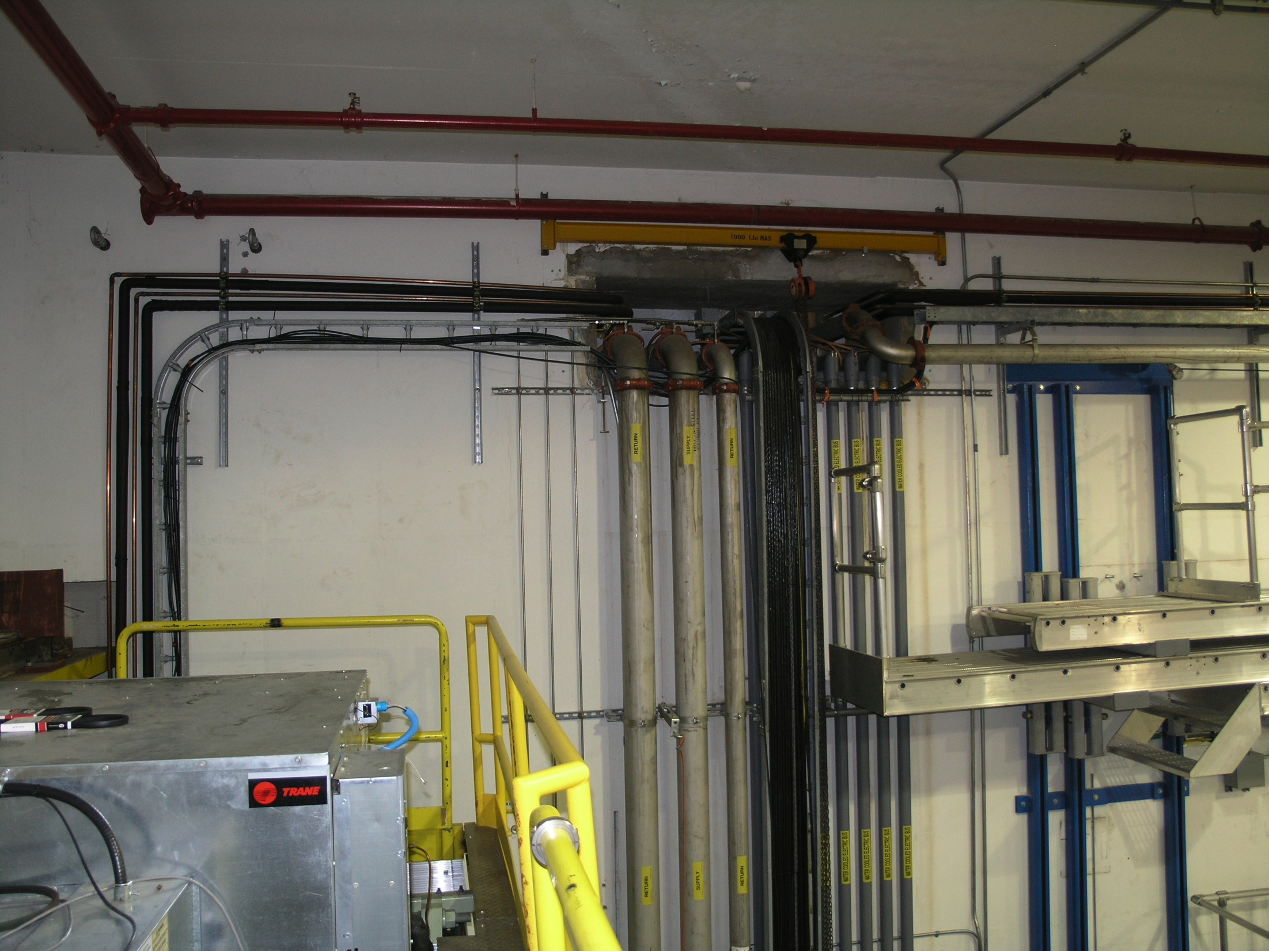
IR West Wall Vertical Runs
View 1
(Slide 13)
P. Giannotti 12/7/16

Slide 15
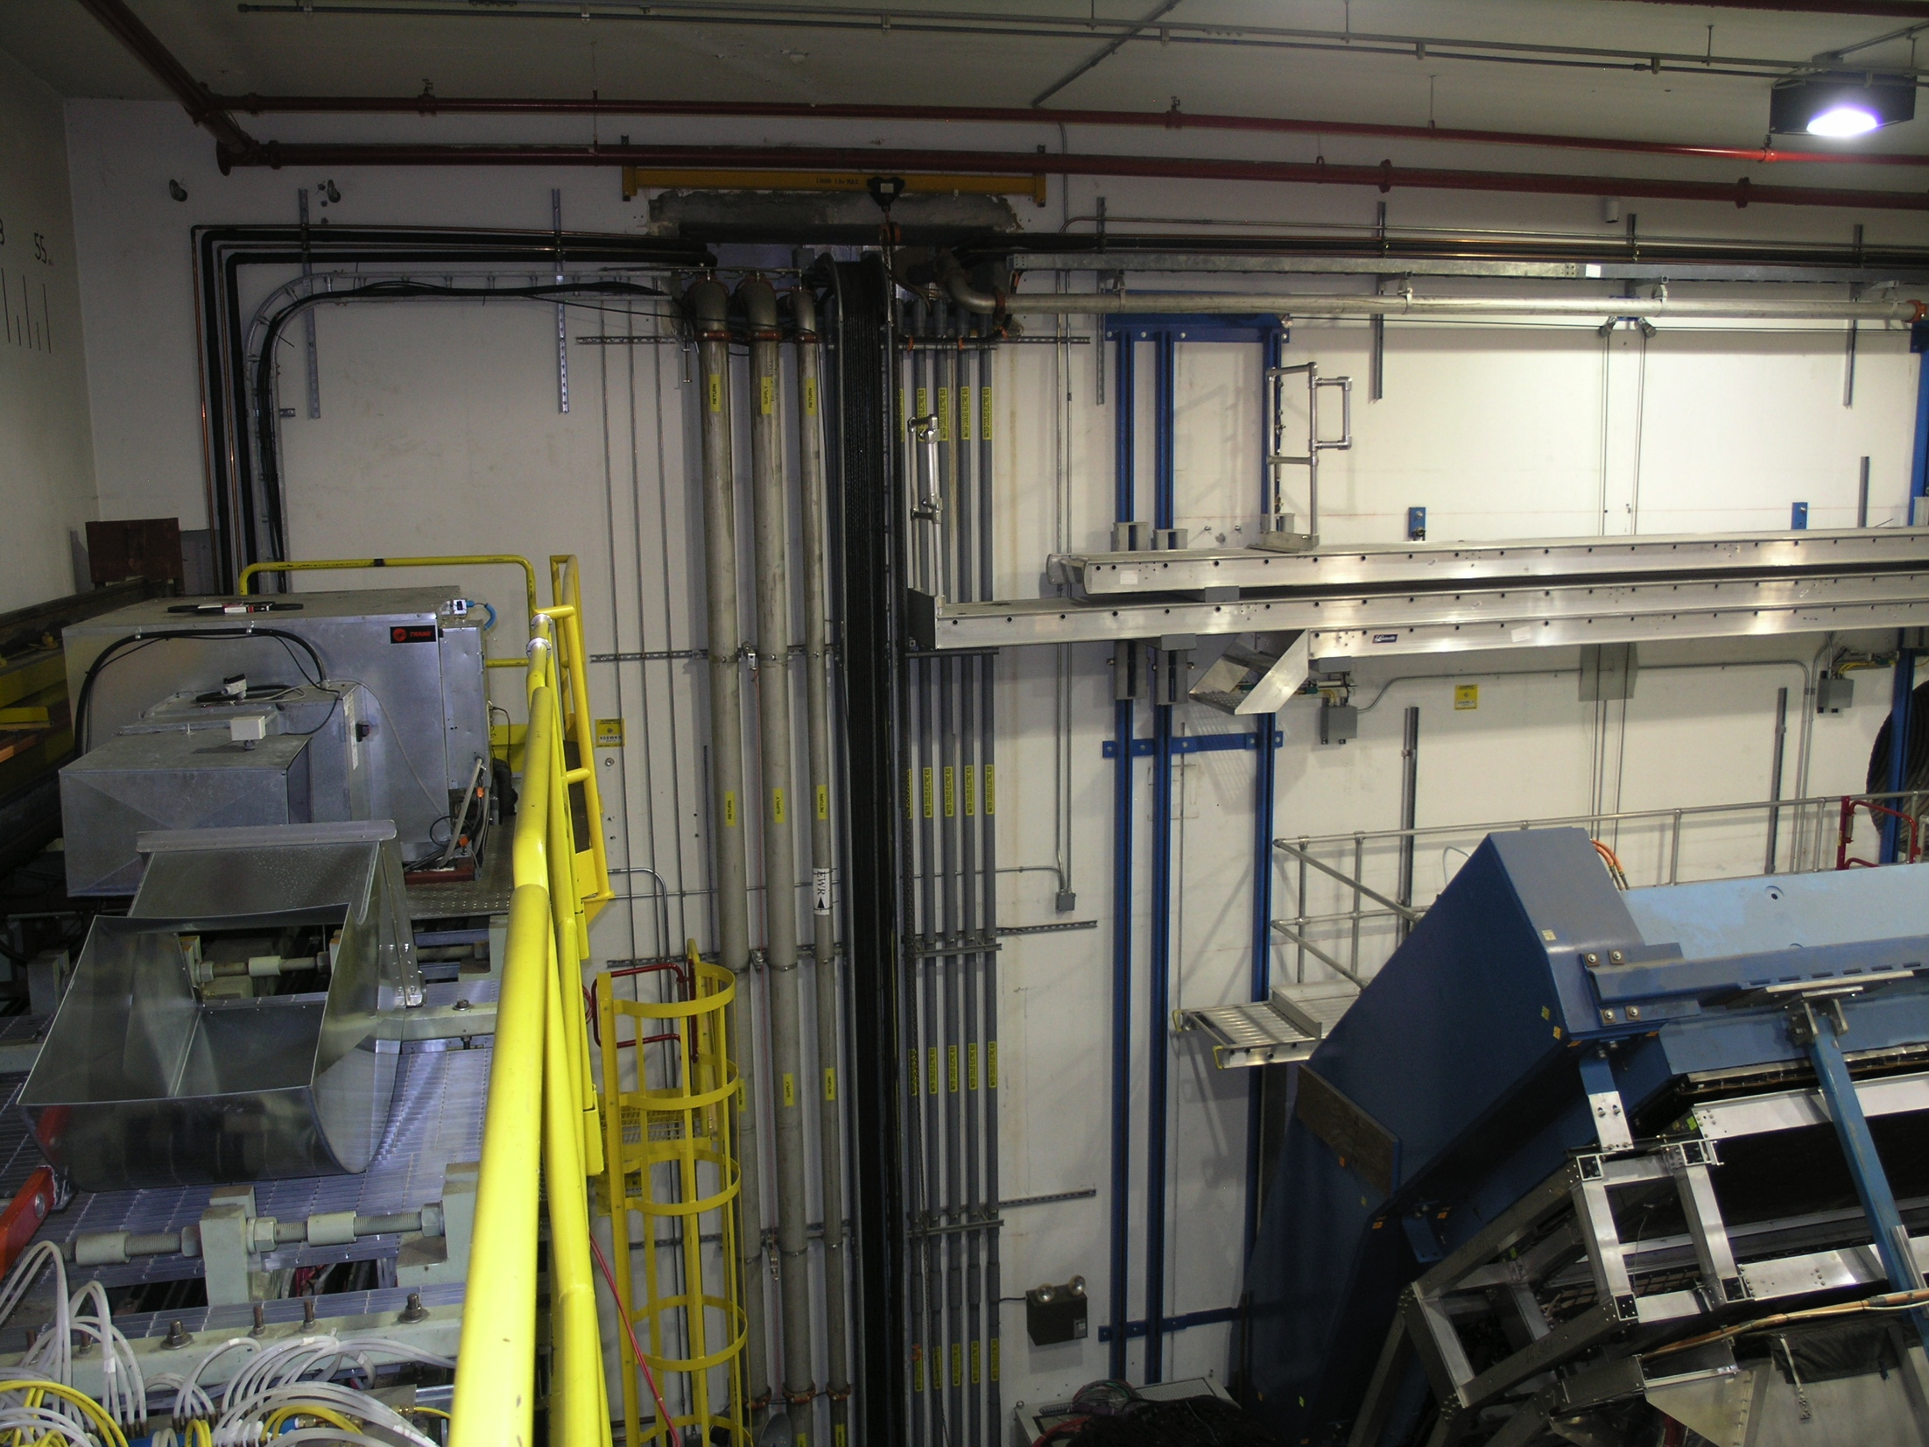
IR West Wall Vertical Runs
View 2
(Slide 14)
Valve Box Plus & Minus
Height from IR Floor
Level
32 FT.
P. Giannotti 12/7/16

Slide 16
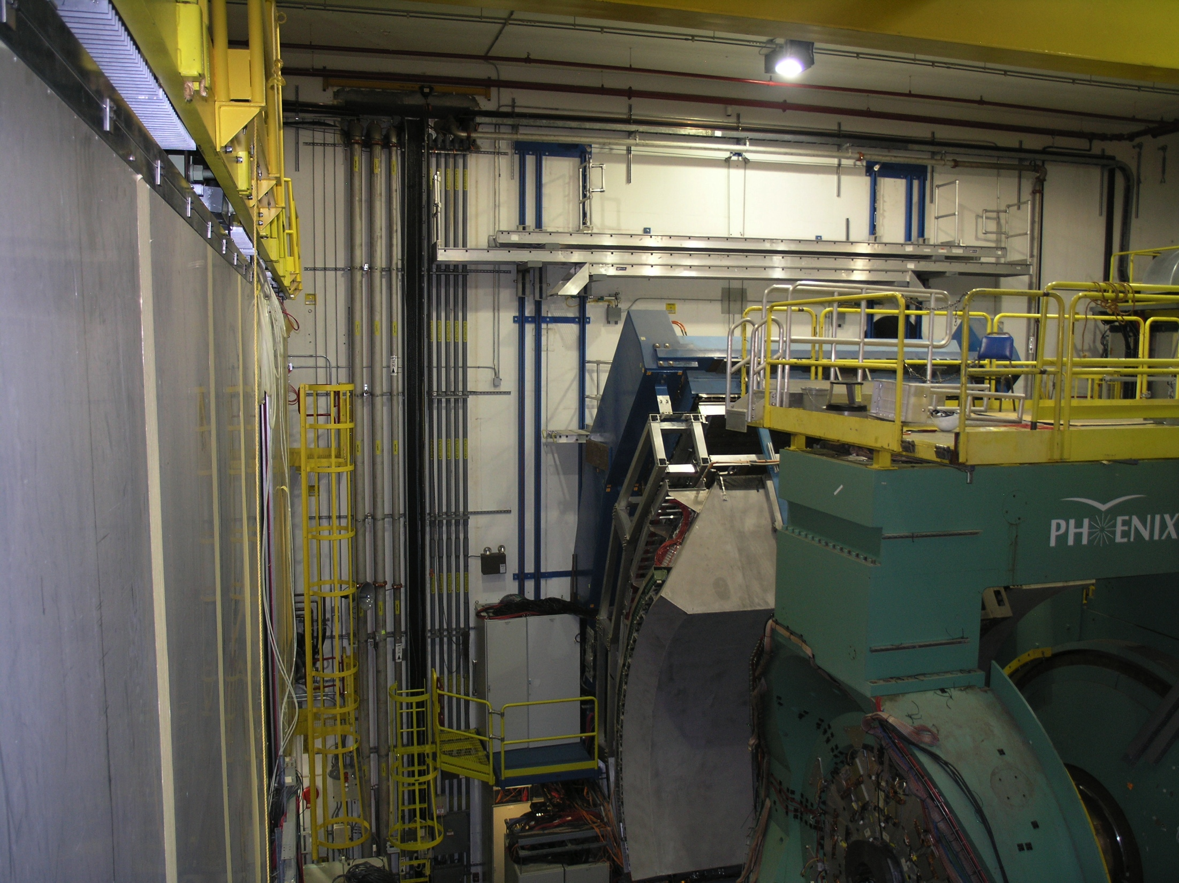
IR West Wall Vertical Runs
View 3
(Slide 15)
47 FT.
From Floor
To Ceiling
P. Giannotti 12/7/16

Slide 17
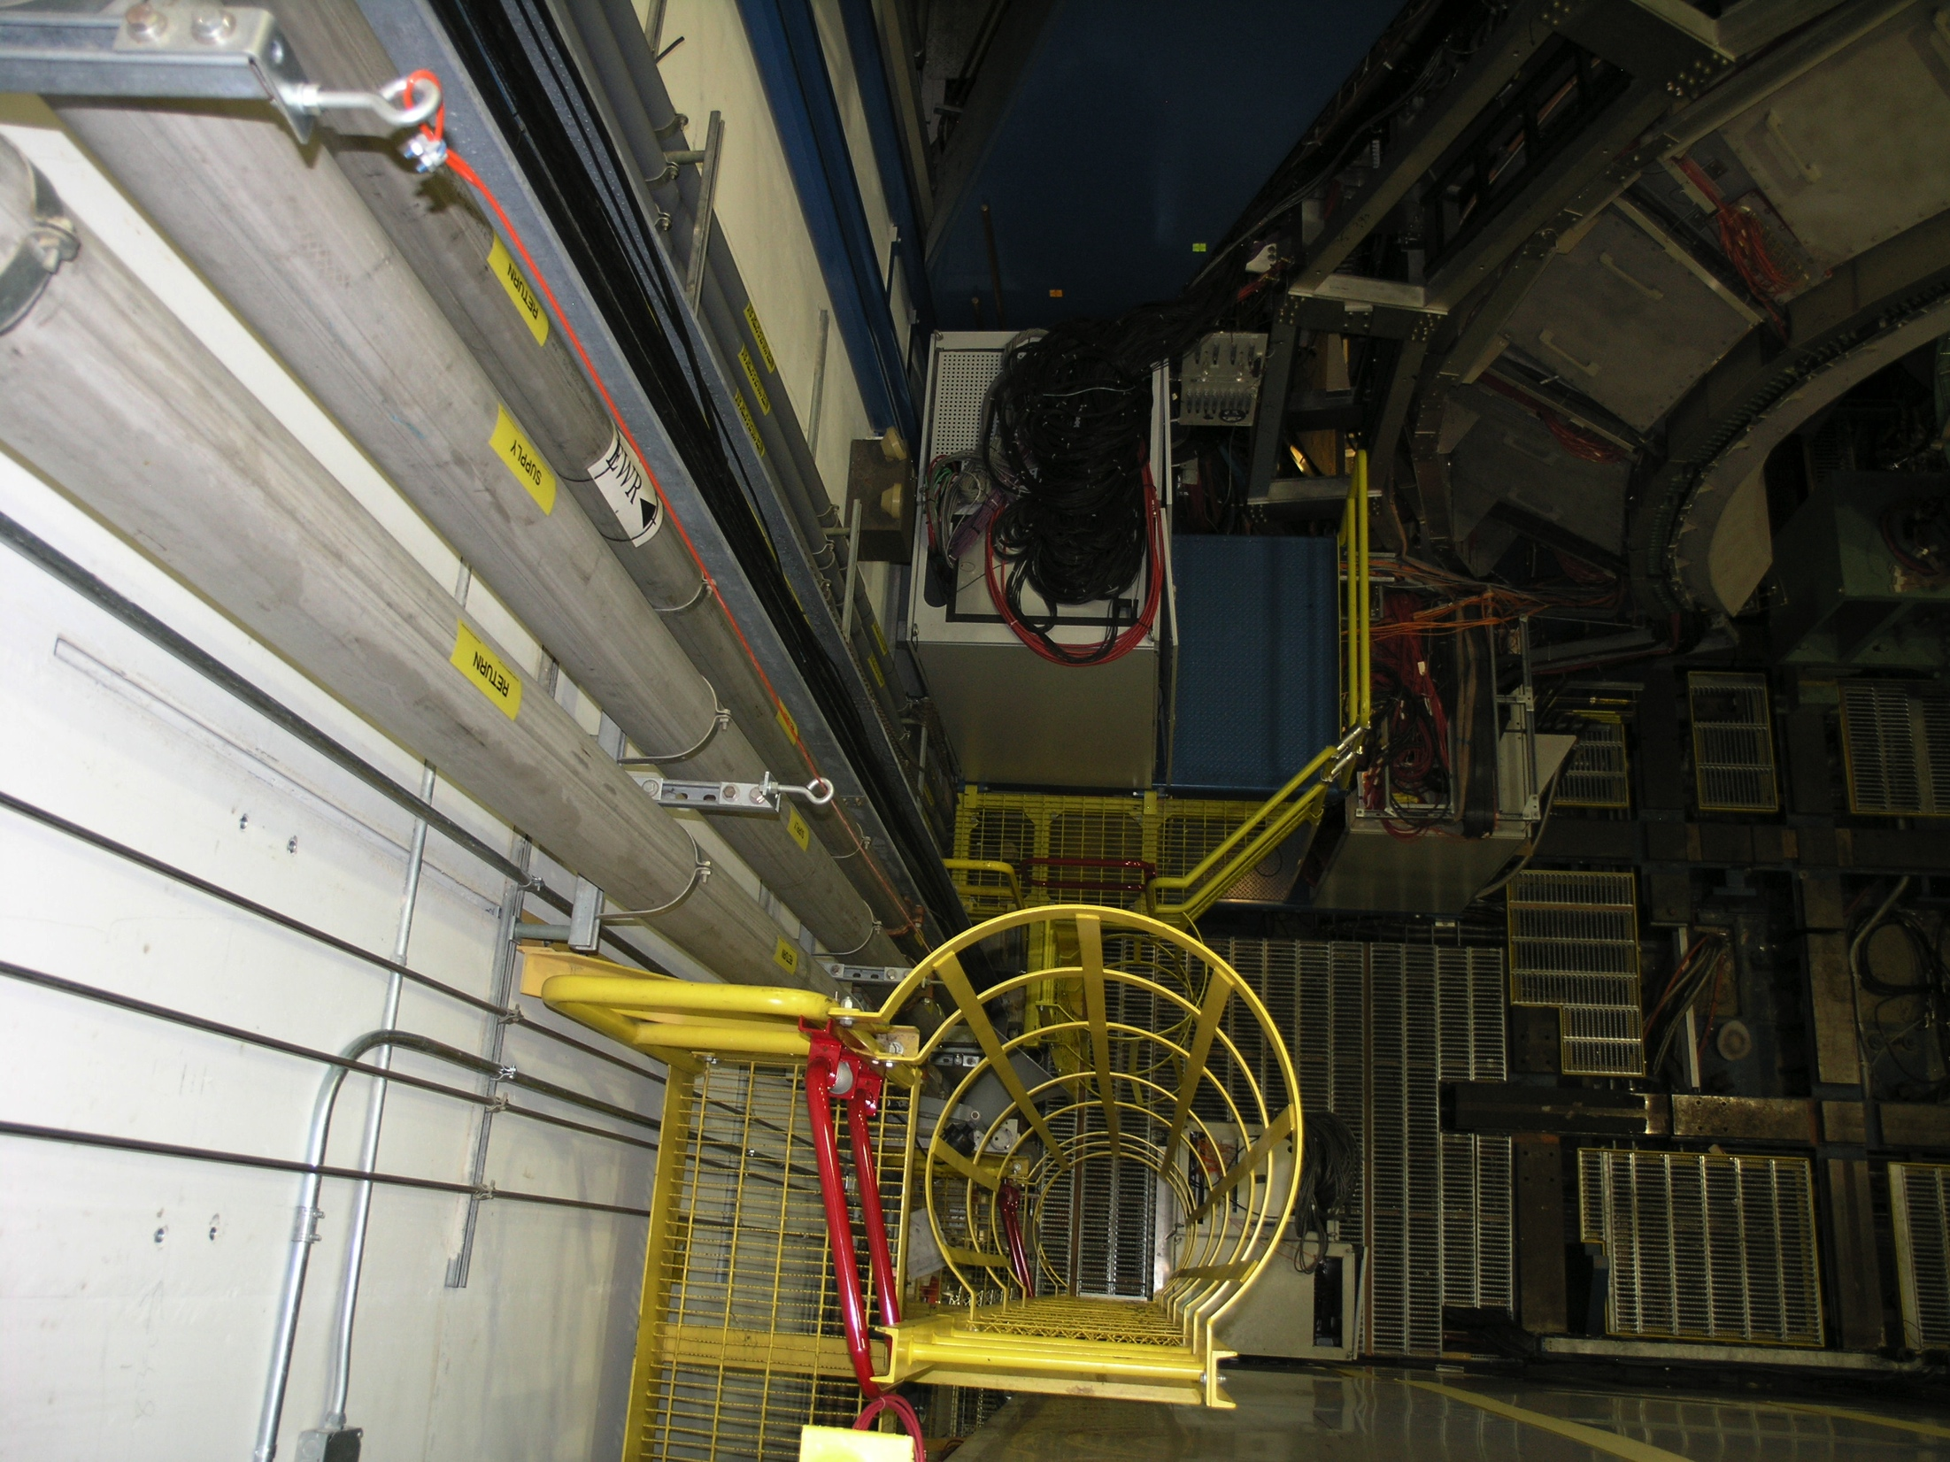
IR West Wall Vertical Runs
View 3
(Slide 16)
VB Power Leads
Height from Floor
= 32’
8 FT. = Data Taking
3 FT. = Service
Distance from South
Steel Wall
P. Giannotti 12/7/16

Slide 18
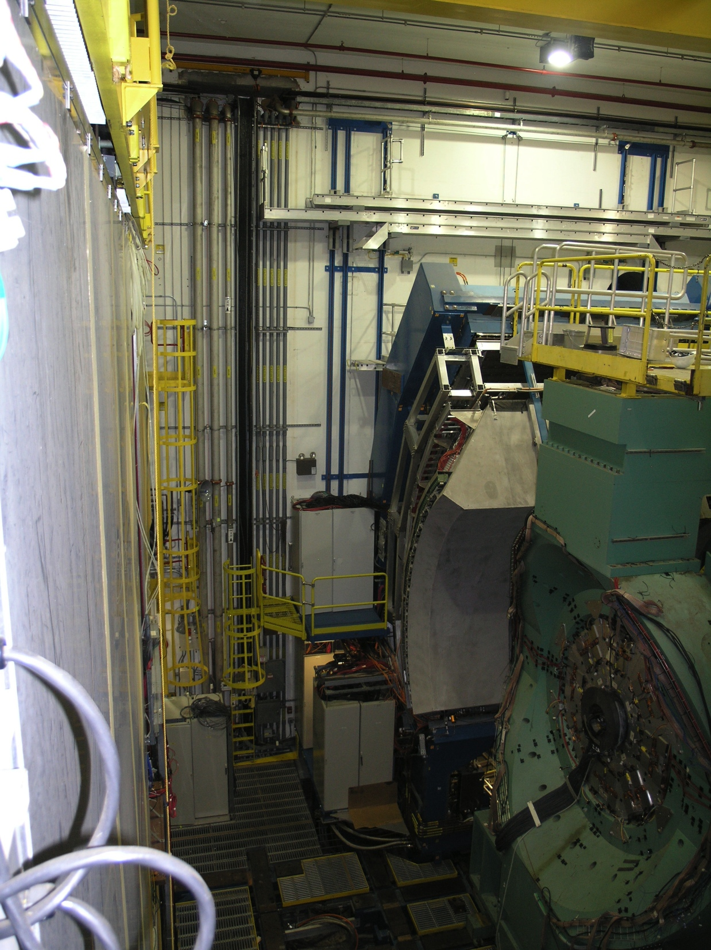
IR West Wall Vertical Runs
View 3 (slide 17)
Valve Box Plus & Minus
Height from IR Floor
Level
32 FT.
8 FT. = Data Taking
3 FT. = Service
Distance from South
Steel Wall
P. Giannotti 12/7/16

Slide 19
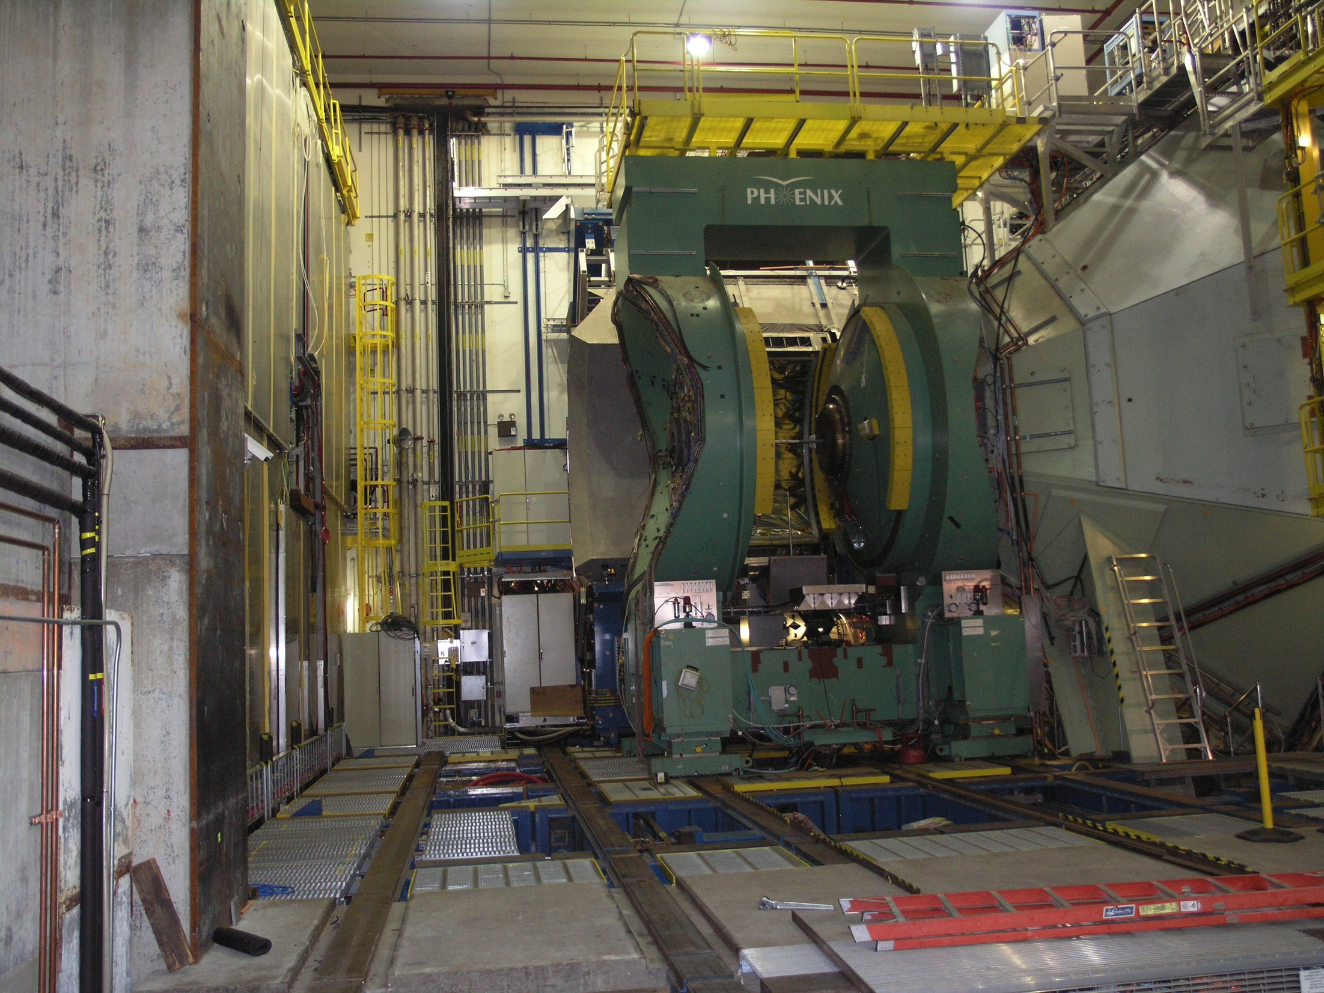
IR West Wall Vertical Runs
View 3 (slide 18)
32 Ft. Line
From Concrete Floor
P. Giannotti 12/7/16

Slide 20
Helium Feed Idea View 1
(slide 19)
P. Giannotti 12/7/16

Slide 21
Helium Feed Idea View 2
(slide 20)
P. Giannotti 12/7/16

Slide 22
Helium Feed Idea View 3
(slide 21)
P. Giannotti 12/7/16

Slide 23
Helium Feed Idea View 4
(slide 22)
P. Giannotti 12/7/16

Slide 24
Helium Feed Idea View 5
(slide 23)
P. Giannotti 12/7/16

Slide 25
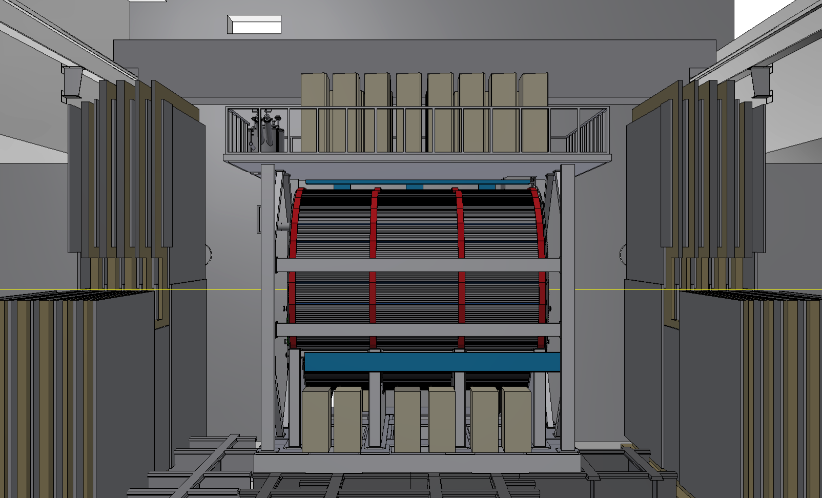

Slide 26
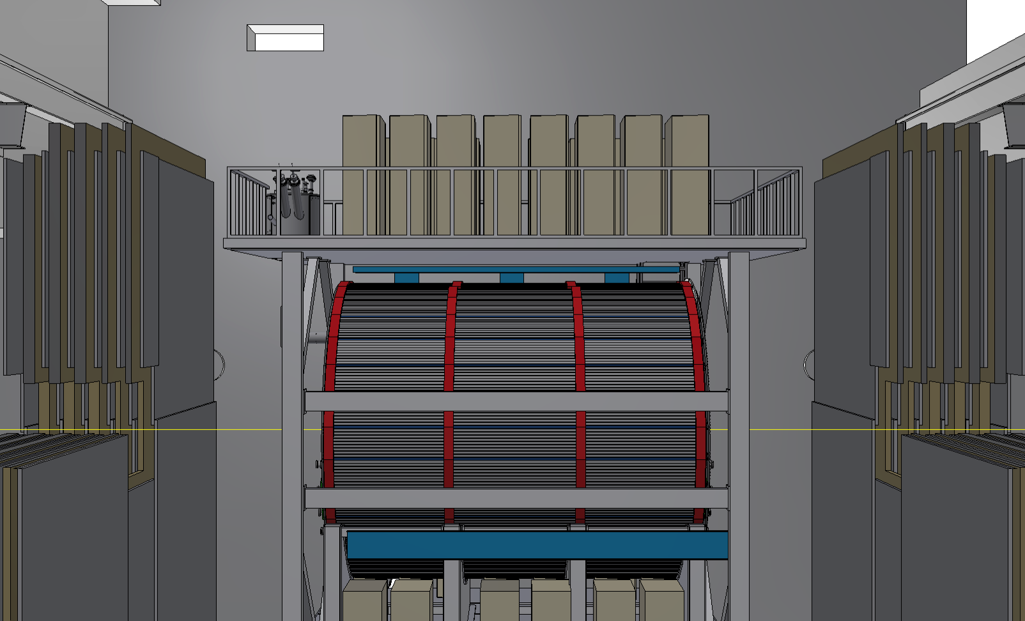

Slide 27
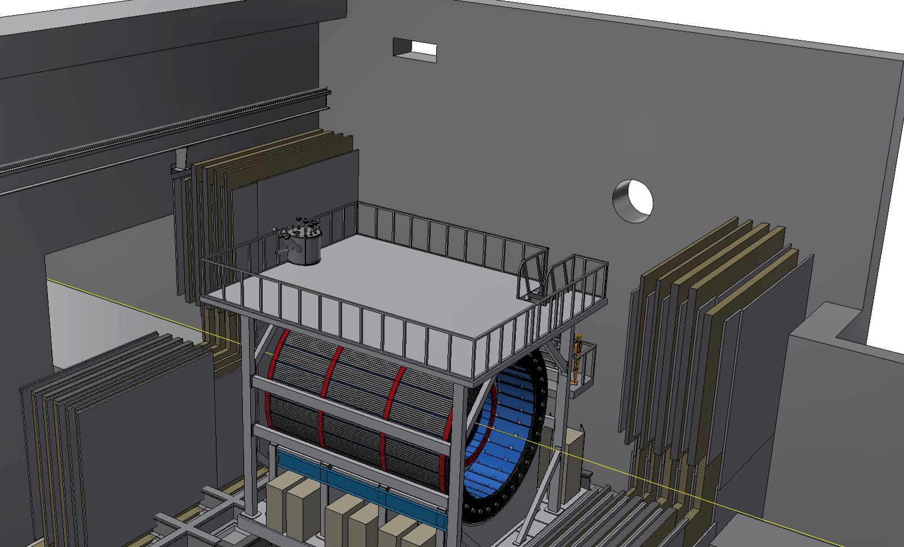

Slide 28
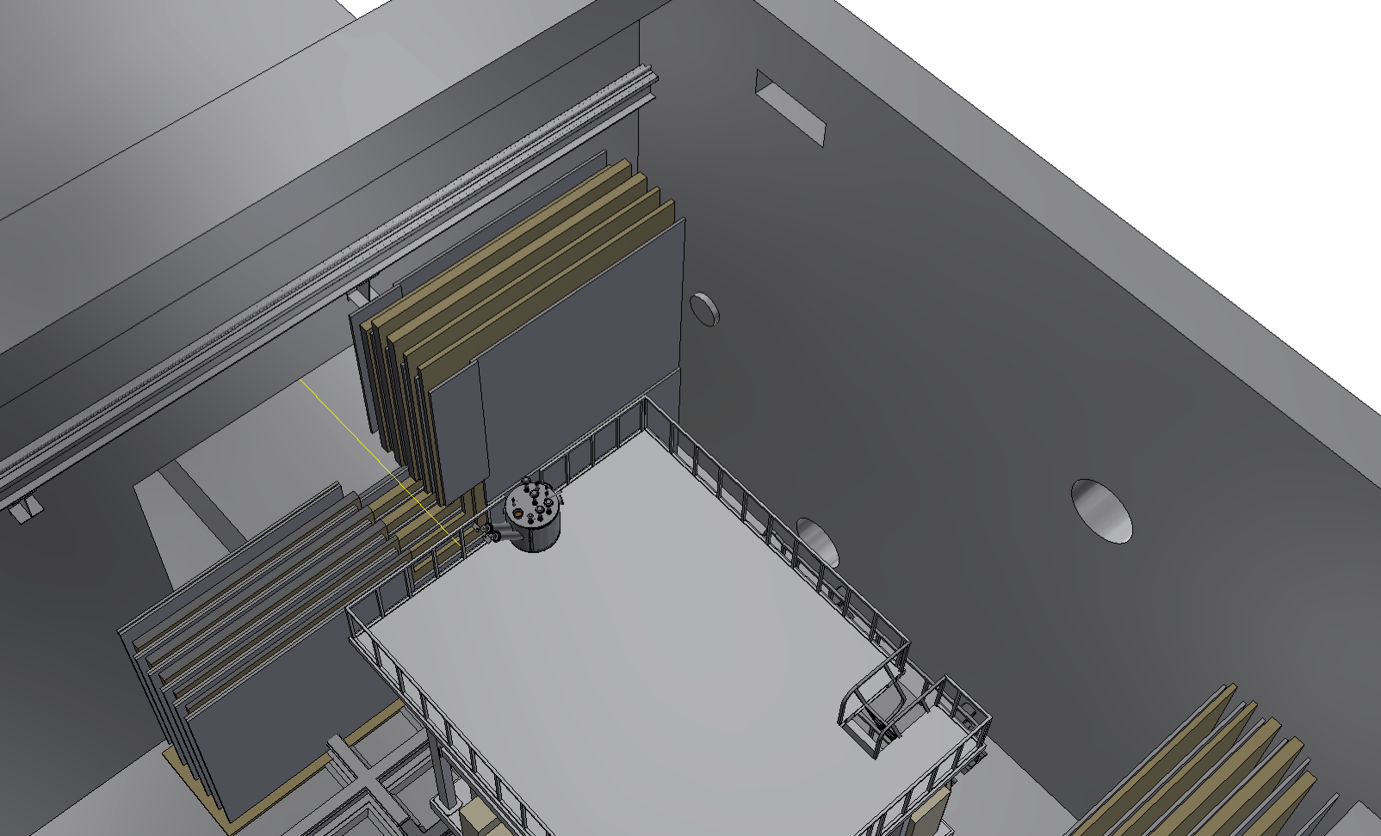

Slide 29
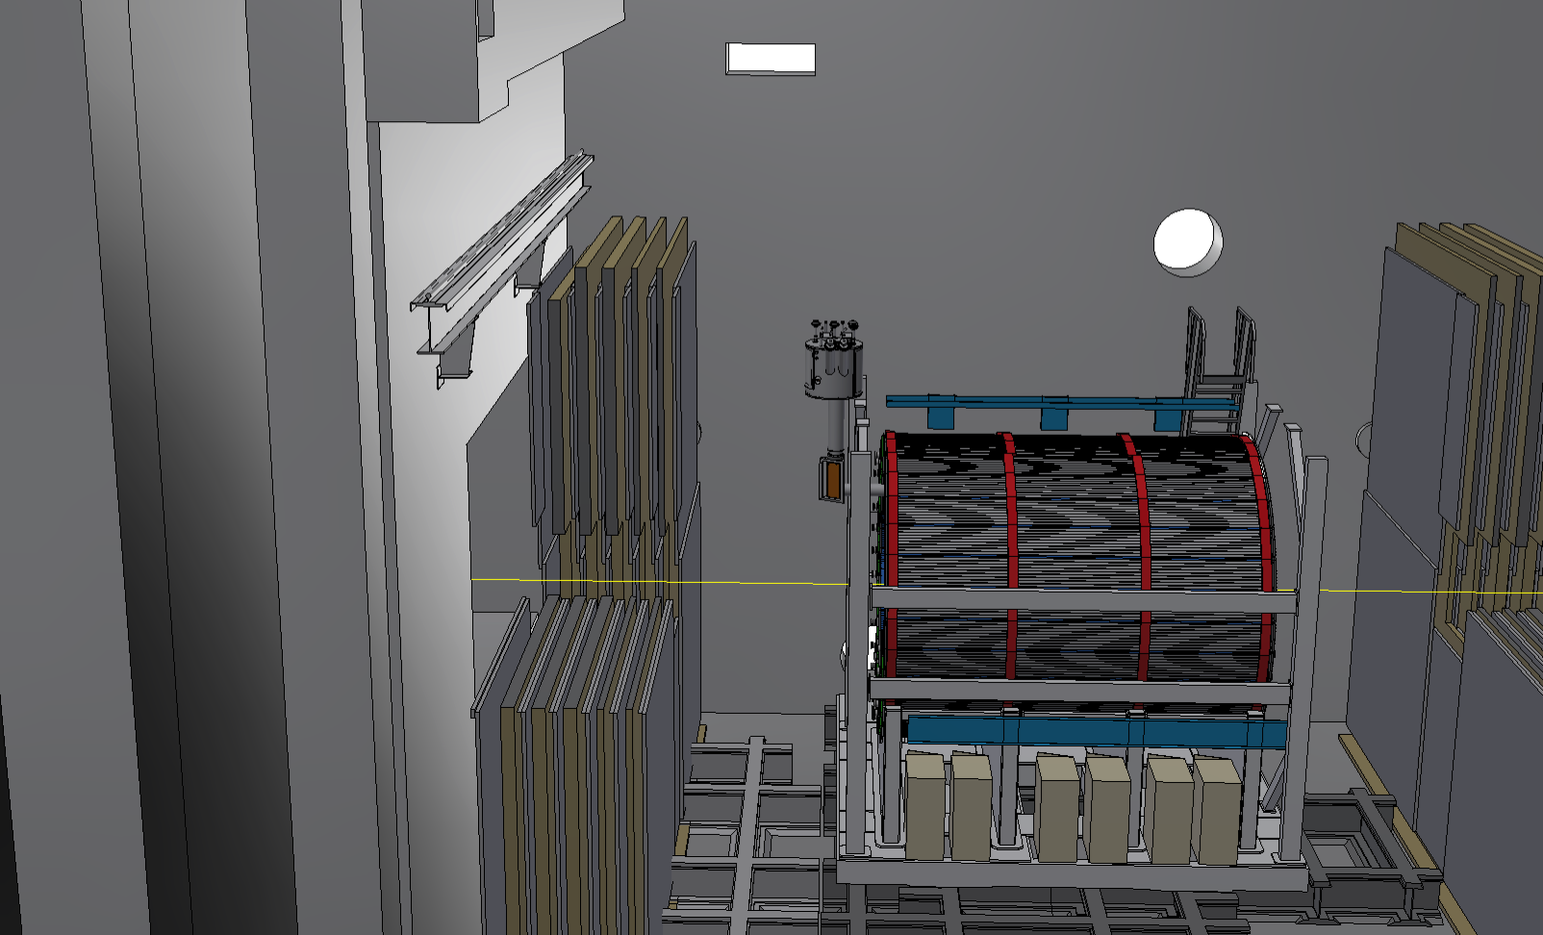

Slide 30
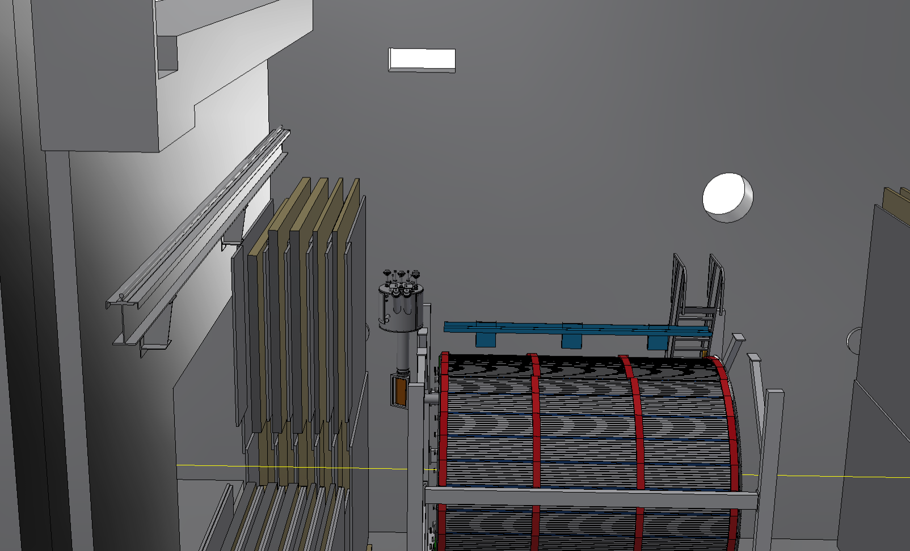

Slide 31
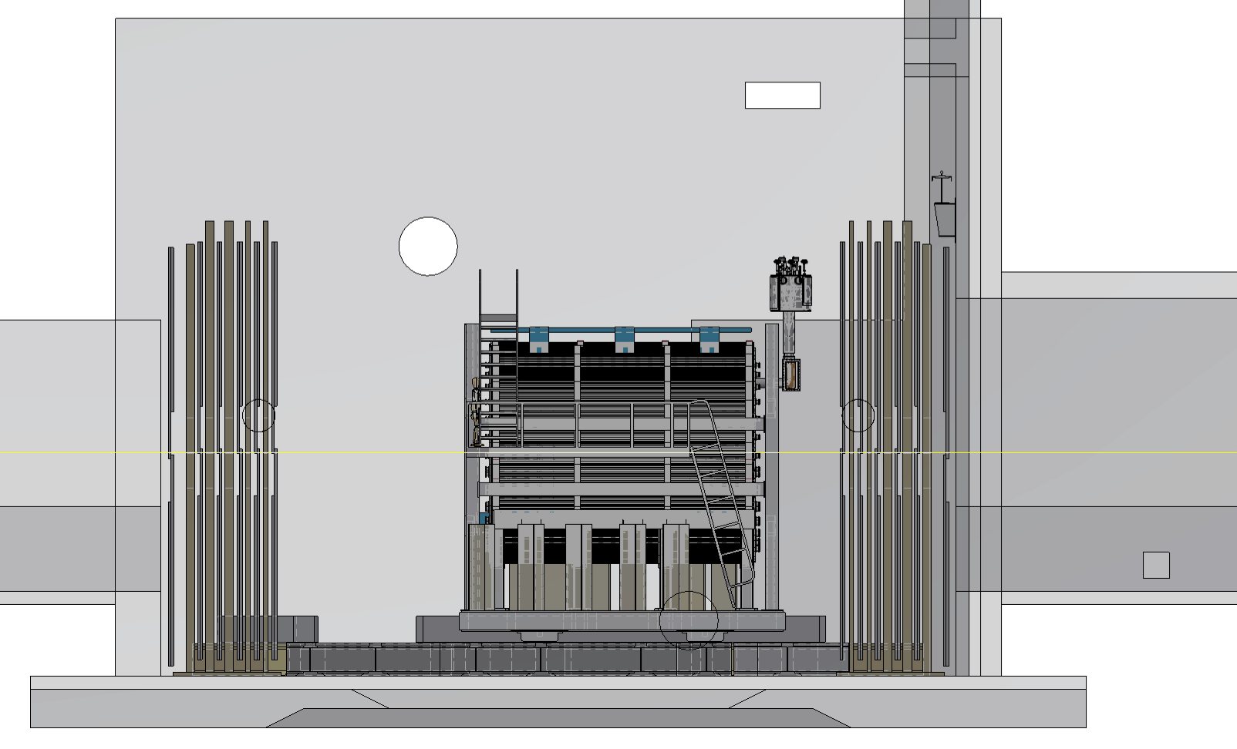

Slide 32
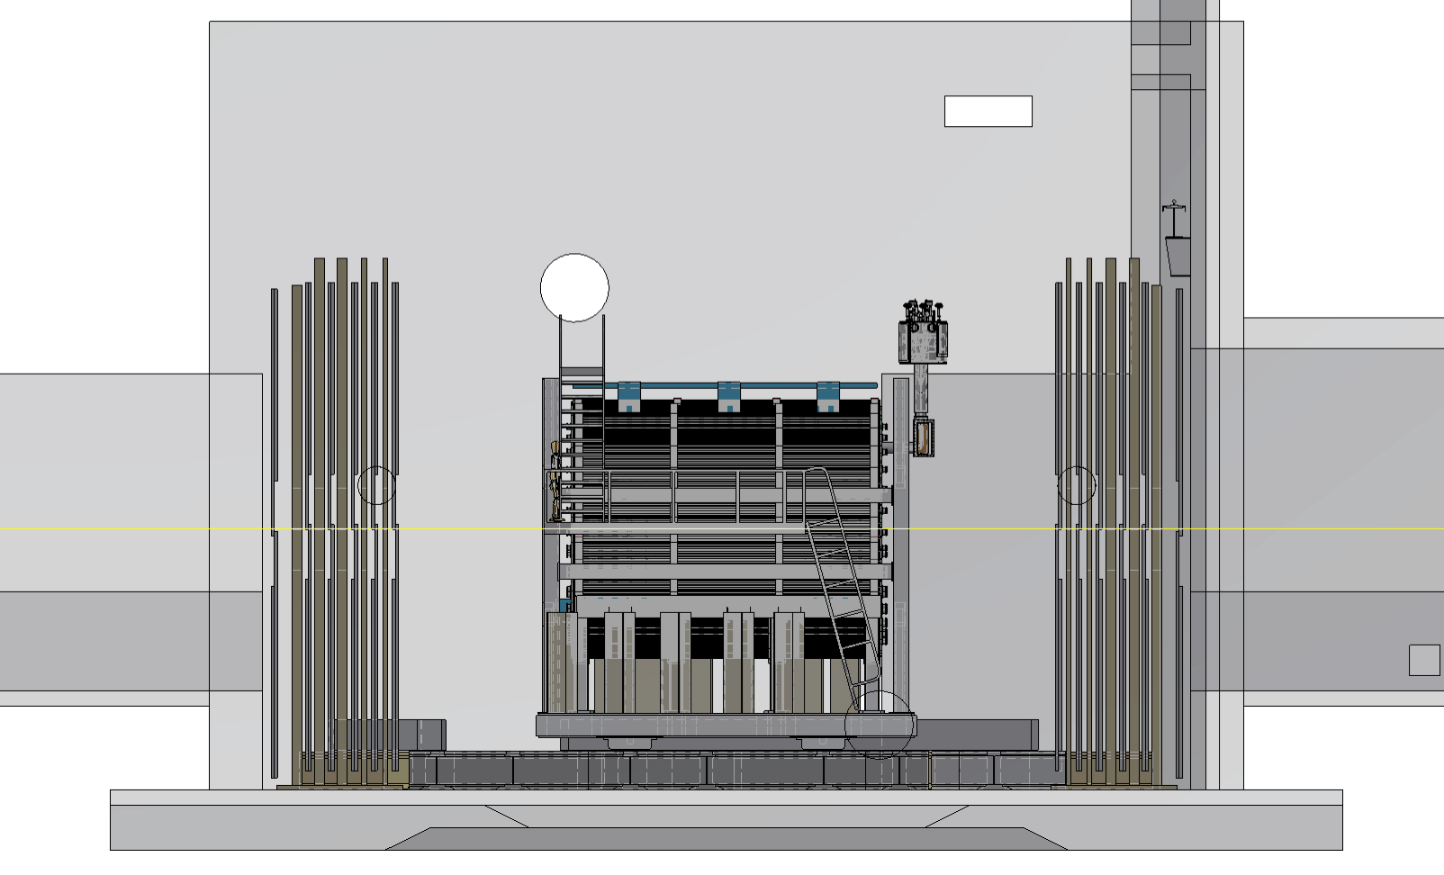

Slide 33
