Slide 1
Report from the EIC Advisory Committee
David J. Dean
Deputy Director for Science and Technology
Chief Research Officer
Jefferson Lab
EIC Resource Review Board
June 5-6, 2025

Slide 2
Outline
Overview
Highlights from the February 25, 2025 Meeting
Goal for the next Advisory Board Meeting scheduled for June 17th

Slide 3
EIC Advisory Board Overview
Chair: Kimberley Sawyer, JLAB Director
Purpose: To provide guidance and advice to the BNL Director on the design and construction of the EIC accelerator facility and on the efforts to establish partnerships, international and domestic, with institutions collaborating on the facility. The EAB provides a forum for high-level planning, communication, coordination, and resolution of issues affecting the EIC facility, appropriate at the level of the Laboratory Directors. The EAB will consider issues affecting the scope and/or resource allocations at BNL and the participant institutions.
Membership: Includes Laboratory Directors (or senior leadership) of institutions participating in the design and construction of the EIC accelerator facility. Board members may also include leaders of institutions with common accelerator Science and Technology interests
Participating Institutions: ANL, CERN, FNAL, IN2P3, INFN, IRFU-Saclay, JLAB, LBNL, ORNL, TRIUMF, STFC
Frequency: Meets 3-4 times annually

Slide 4
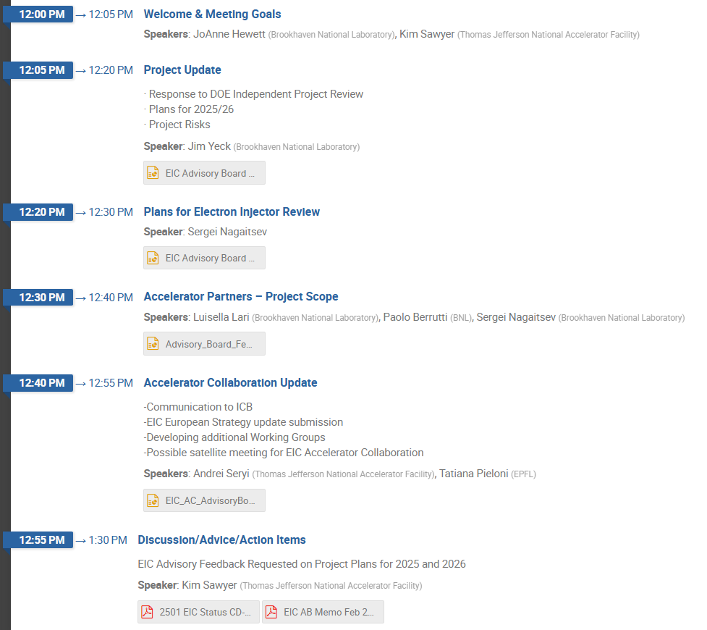
Highlights from the February 2025 Meeting
Goal: To continue the discussion about potential EIC subprojects and to discuss the CD-3B/Status.
Action Items & Recommendations:
Action: Review requirements for the DC electron gun for low energy cooling system that was in question from the most recent review.
Action: New DOE Secretary of Energy is planning to visit all national labs in 2025.
Recommendation: Going forward any project must be presented in a way that is much more flexible with changes in the funding profile.
Recommendation: Emphasis on getting things done “fast”. Think optimistically but also realistically.
Recommendation: Priorities need to be set for operations fund and project funds with the SC in order to optimize within funding constraints.
Agenda

Slide 5
Upcoming:
The next EIC Advisory Board Meeting is
Tuesday, June 17th via Zoom
11:30am-1pm EDT
Join ZoomGov Meeting:
https://bnl.zoomgov.com/j/1609054243?pwd=MwGaE6EahhUpAnV4s5PAeR0tYRgqd3.1
Meeting ID: 160 905 4243
Passcode: 000195

