Slide 1
Report from the Project Director
Jim Yeck
Associate Lab Director & EIC Project Director
Resource Review Board (RRB)
June 5-6, 2025

Slide 2
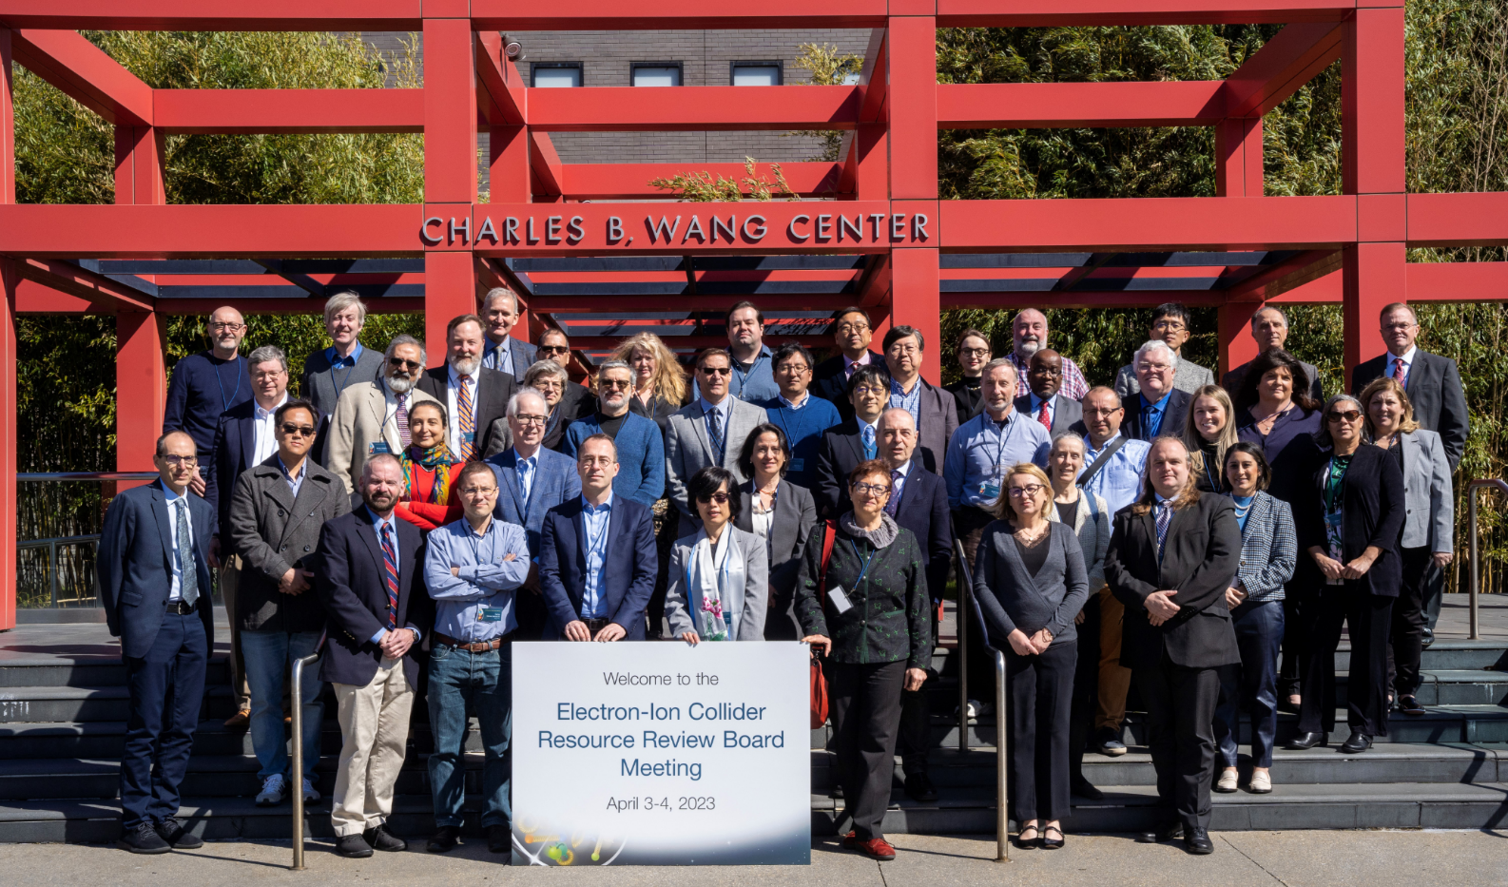
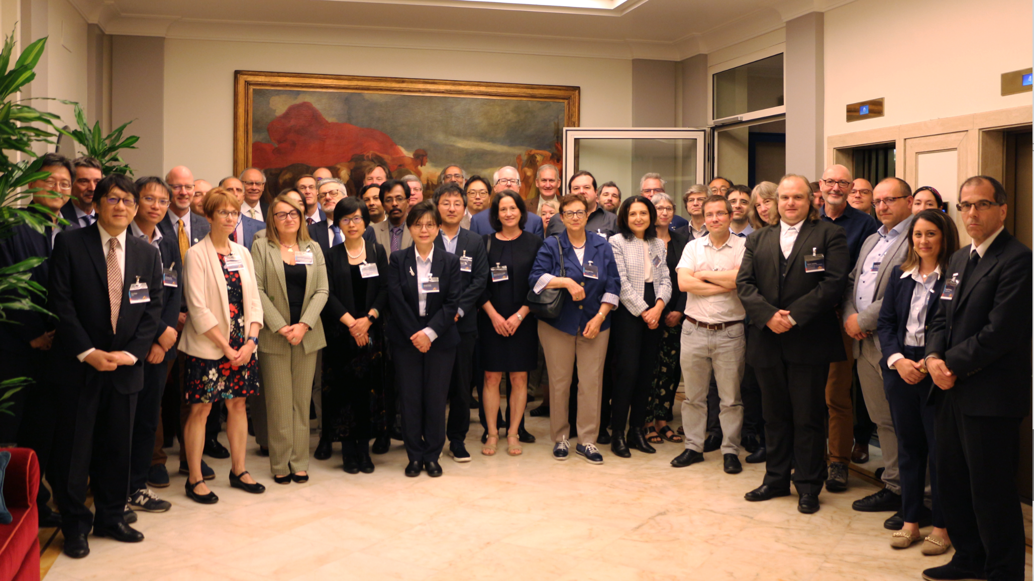
EIC RRB Meetings
April 3rd-4th, 2023 - Stony Brook University
New York, U.S.A
December 7th- 8th,2023 - Catholic University of America Washington, D.C, U.S.A
May 6th-7th, 2024 - INFN
Rome, Italy
November 12th-13th,2024 – BNL New York, U.S.A
June 5-6, 2025 – Czech Technical University
Prague, Czech Republic

Slide 3
EIC Project Highlights
Major Project Milestones
CD-3A Long Lead Procurement (LLP) of $90M approved in 2024 and most contracts already awarded.
Successful DOE CD-3B/Status review in Jan 2025.
CD-3B LLP of $66M ready for ESAAB approval.
Coordination of “EIC Portfolio” led by Erik Johnson.
Reviews, Boards, and Advisory Committees in 2025
Advisory Board meets quarterly.
Resource Review Board meets 2x each year.
Advisory Committees meet (PAC, MAC, DAC, ICAC).
IR SC Magnet Steering Group meets monthly.
Electron Injector Design & Cost Review in April.
“Red Team Review” in May 2025 – Focus on project delivery strategy via sub-projects.
DOE “Focused Review” on August 5-7, 2025.
Infrastructure
$100M New York State Grant for EIC buildings.
90% Detailed Design submission received in April 2025.
A/E Contract Modification for crab cavities CM awarded.
Accelerator
New Technical Director in Jan ‘24, Sergei Nagaitsev.
Reuse of Advanced Photon Source magnets processed at BNL and JLab.
Optimized design and scope to mitigate risk.
Electron injector design changed to remove Rapid Cycling Synchrotron (RCS) from RHIC tunnel.
International EIC Accelerator Collaboration established and working groups established.
Detector
R&D complete
ePIC Detector technical baseline defined and Preliminary Design Report in preparation.
Assessment of Baseline Readiness planned for Nov 2025.
Plans developing for the EIC Science Program.
RHIC to EIC Transition
DOE ONP Review of RHIC Operations in the EIC era planned for September 2025
RHIC Operations planned to conclude end of 2025.
Removal & Repurposing planned for January 2026.
3

Slide 4
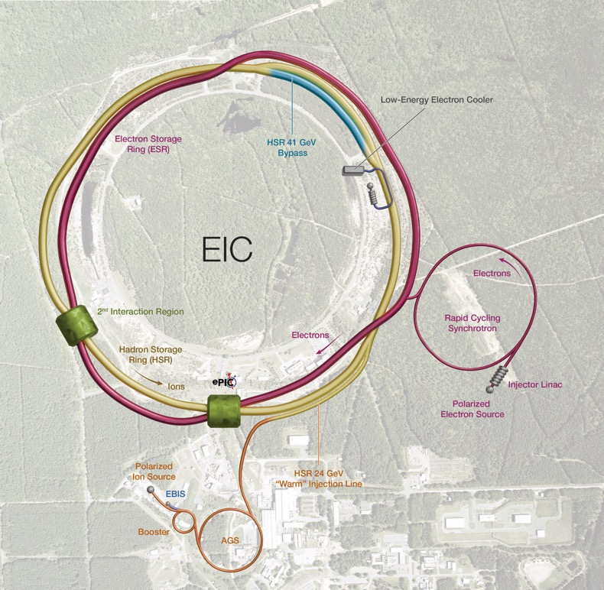


EIC Accelerator Concept and Parameters
Polarized ion/proton source
Ion injection and initial acceleration systems:
Linac (200 MeV)
Booster (1.5 GeV)
AGS (25 GeV)
Hadron Storage Ring (40-275 GeV)
Electron Pre-Injector (750 MeV Linac)
Electron Rapid Cycling Synchrotron (0.75 GeV – Top Energy)
Electron Storage Ring (5 GeV – 18 GeV)
Interaction Region(s)
Hadron Injection Cooling System

Slide 5
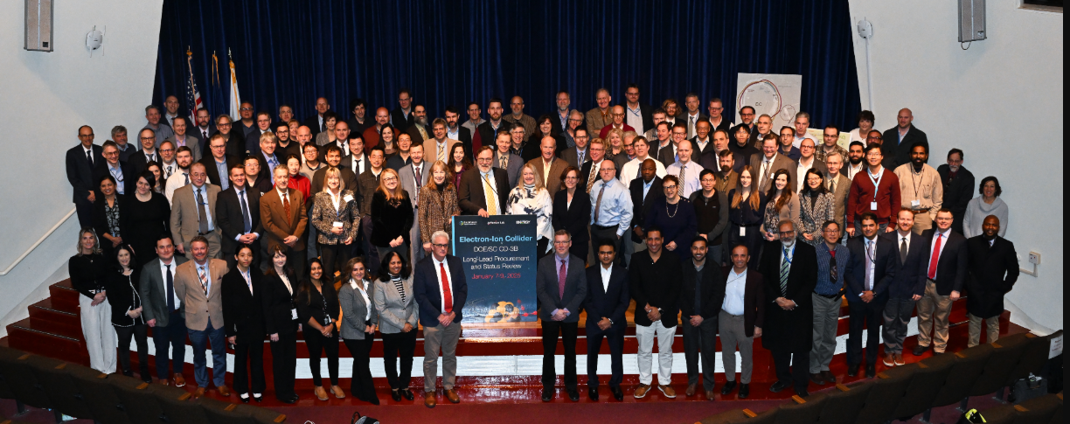
DOE CD-3B/Status Review Summary
Select DOE Independent Project Review (IPR) Committee Comments:
The project team has made excellent progress since the last review. There is an experienced team in place. A new Technical Director was recently hired and has already made a positive impact on the project.
The project has strong support from the BNL and JLab Directors. Communications between the labs are well established with bi-weekly meetings between the two lab Directors and Deputy Directors. This will be an excellent forum to facilitate constructive resolution of issues and risks as they arise.
Recommendations for the EIC Project:
Proceed to CD-3B
Path to baseline
In advance of the next IPR, document the scope of the EIC project and gain alignment with the Program Office on mission need achievement.
Develop details for the subproject strategy and work with the Program Office and FPD to conduct a focused IPR in 6 months.

Slide 6
Status of DOE Review Recommendations
Recommendations for EIC Project:
Proceed to CD-3B
- DOE CD-3B approval is expected in July.
Path to baseline
In advance of the next IPR, document the scope of the EIC project and gain alignment with the Program Office on mission need achievement.
Good progress clarifying the scope of the EIC project and the “EIC Portfolio” of off-project dependencies.
Ongoing discussion with DOE ONP on mission need requirements and design goals.
Develop details for the subproject strategy and work with the Program Office and FPD to conduct a focused IPR in 6 months.
DOE Independent Project Review (IPR) scheduled for August 5-7, 2025.

Slide 7
EIC Portfolio
Project Scope and Dependencies
DOE EIC Line-Item Project (Subprojects) |  | DOE Order 413.3B, Resource Loaded Schedule (P6), Earned Value Management System (EVMS), Reporting, etc. Contingency included to cover the risks associated with In-Kind Contributions and the NYS ESD Grant.
In-Kind Contributions Accelerator/Detector |  | Deliverables/specifications agreed with Partners and Partners secure funding. Milestones in P6 with schedule tracking and technical integration.
NYS |  | P6, EVMS, NYS ESD Grant Compliance.
Off-Project Scope and Dependencies
Accelerator & Infrastructure |  | Maintaining existing BNL accelerators, infrastructure, and lifetime extension needed for EIC. RHIC Removal and Repurposing (D&D) as needed for EIC.
Detector |  | BNL and JLab facilities and resources required for the success of the EIC experimental program.
Host Laboratory |  | BNL support for the EIC project, guests, and users.

Slide 8
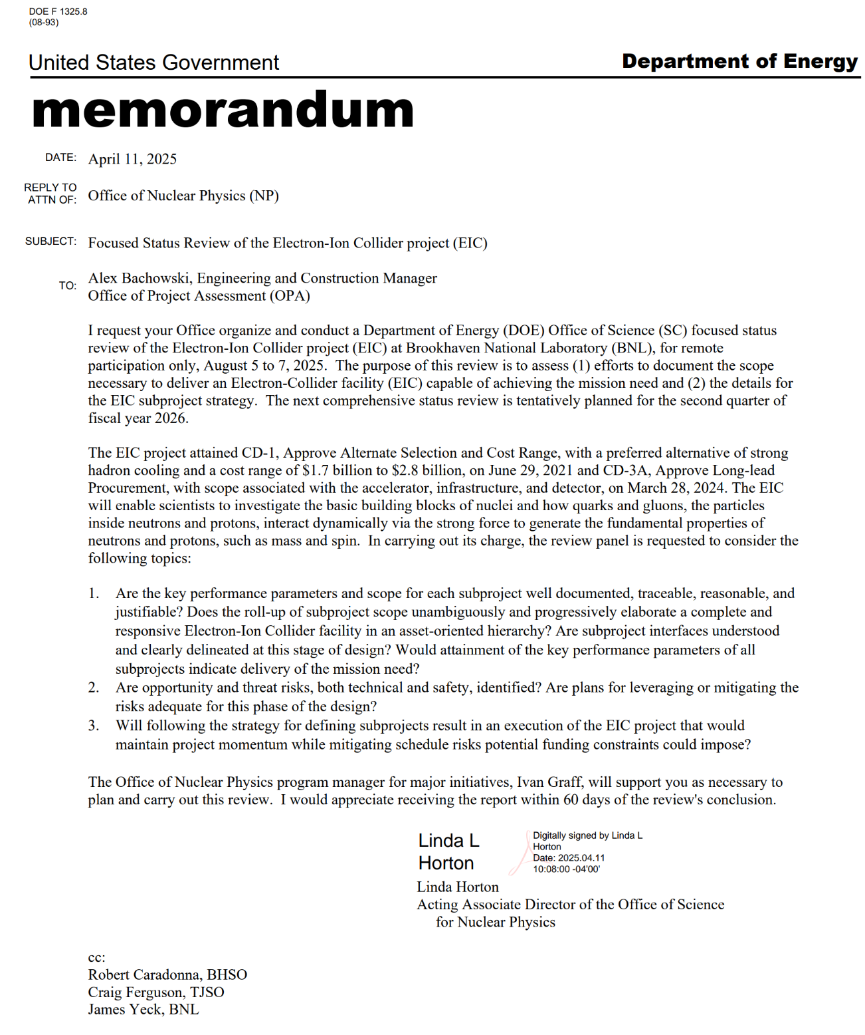
DOE IPR
Focused EIC Status Review on Aug 5-7.
A successful review would:
Confirm that the EIC facility design meets the DOE approved Mission Need.
Support the EIC subproject delivery strategy and plans.
Confirm that progress on the subprojects supports a reasonable understanding of the scope, cost, schedule, and funding requirements for the entire EIC line-item project.
Confirm adequate progress defining the scope of the EIC Portfolio (off-project dependencies) to move forward with EIC construction approvals.
Support for scheduling CD approval reviews of the Accelerator Storage Rings subproject (CD-2/3) and Detector (CD-2) in 2026.

Slide 9
DOE Aug 2025 IPR Charge and Status
Are the key performance parameters and scope for each subproject well documented, traceable, reasonable, and justifiable? Does the roll-up of subproject scope unambiguously and progressively elaborate a complete and responsive Electron-Ion Collider facility in an asset-oriented hierarchy? Are subproject interfaces understood and clearly delineated at this stage of design? Would attainment of the key performance parameters of all subprojects indicate delivery of the mission need?
Significant work to be completed within the next two months to support constructive answers to these questions!
Are opportunity and threat risks, both technical and safety, identified? Are plans for leveraging or mitigating the risks adequate for this phase of the design?
Goal is to start EIC construction in 2026. There is an opportunity to transition from RHIC operations into EIC construction in 2026 with the approval of the first EIC subproject, the Accelerator Storage Rings.
Will following the strategy for defining subprojects result in an execution of the EIC project that would maintain project momentum while mitigating schedule risks potential funding constraints could impose?
Yes. Providing we transition from R&D and design into the final design and construction phase.

Slide 10
Red Team Review May 20-21, 2025
Red Team Members
Thomas Glasmacher, MSU/FRIB (Chair)
Karsten Heeger, Yale University
Barbara Jacak, LBNL
Jim Kerby, FNAL
Jay Marx, LIGO-retired (Remote)
Ritchie Patterson, Cornell University
Elmie Peoples-Evans, ANL
Mark Reichanadter, SLAC-retired
Very experienced committee (EIC Project Advisory Committee plus two additional members).
Asked to identify strengths and weakness in the strategy for transitioning EIC into construction.
Recognized that many uncertainties, particularly funding, will not be resolved as we prepare to construction the EIC facility. Focus was on what the project can influence.
Common understanding of the importance of retaining and strengthening stakeholder support.
Results
Support for the Project Delivery Strategy.
Strong encouragement to move into construction in 2026.
Excellent discussion and lots of advice in the review, written report, and follow-up meetings.

Slide 11
EIC Project Delivery Requirements
Requirements:
EIC is a single, integrated line-item project.
Subprojects have well-defined deliverables, interfaces, and KPPs.
Subprojects enable start of the EIC science program.
Subproject plans are consistent with DOE annual funding guidance.
EIC Line-Item Project Scope:
Accelerator Storage Rings
Electron Injector
Interaction Region (IR) Integration – SC Magnets, RF Crab Cavities
Detector (ePIC)
Start Science Program
Energy and Luminosity Ramp-up (CD-4)

Slide 12
Project Delivery Strategy
Project Delivery Strategy: Deliver the full EIC facility scope as part of the line-item construction project using subprojects and the phased completion of the EIC project scope. The strategy enables the start of the EIC science program during collider commissioning and for the concurrent completion of the full capability required to meet the DOE Mission Need.
Global Project Integrated Support, CD-3A, CD-3B, Commissioning …. (L. Lari)
 | NYS Infrastructure Project (C. Folz)
First SP |  | Accelerator Storage Rings – Infras., HSR, ESR, Installation (C. Folz, SPM)
 |  |  | Detector, Integration, Install (R. Ent and E. Aschenauer, POCs)
 |  |  | IR SC Magnets, Crab Cavities, Integration, Install (S. Nagaitsev, POC)
 |  |  | Electron Injector – Infras., LINAC, RCS, Install (Q. Wu, POC)
Last SP |  |  |  |  |  |  |  | Energy and Luminosity Ramp-up (K. Wilson, POC)

Slide 13
EIC Construction Project
CD-3x & NYS Scope | CD-3A, Long Lead Procurement | 3A: ~40% scope in ASR; ~6% IR; 54% in DET
 | CD-3B, Long Lead Procurement | 3B: ~75% scope in ASR; 25% DET
 | NYS Civil Construction Project | Site Preparation work and construction of Service Buildings and support systems related to the ASR subproject.
Initial Science Program Scope | Accelerator Storage Rings (ASR) | Hadron Storage Ring Modifications, Electron Storage Ring (10 GeV) and related infrastructure.
x | Detector (DET) | ePIC Detector including SC magnet, detector systems, and integrateion and installation.
 | Interaction Region (IR) | Interaction Region including the SC magnets and 197 MHz crab cavities.
x | Electron Injectors (EIN) | Electron Injectors (LINAC, BAR & RCS @ 10 GeV) and related infrastructure.
Full Scope | Energy and Luminosity Ramp-up (ELR) | Accelerator scope required to increase Energy (18GeV e-, RCS SRF & Cryo, 394 MHz crab cavities, 41 GeV by-pass, ESR and HSR RF amplifiers, etc.)
PM & CX | Project Management and Global Services (PMG) | Project and Technical integration support to entire project and integration and commissioning.
In-Kind Contribution Plan: 5% or more of the accelerator scope and 30% of the detector scope. New accelerator opportunities.
13

Slide 14
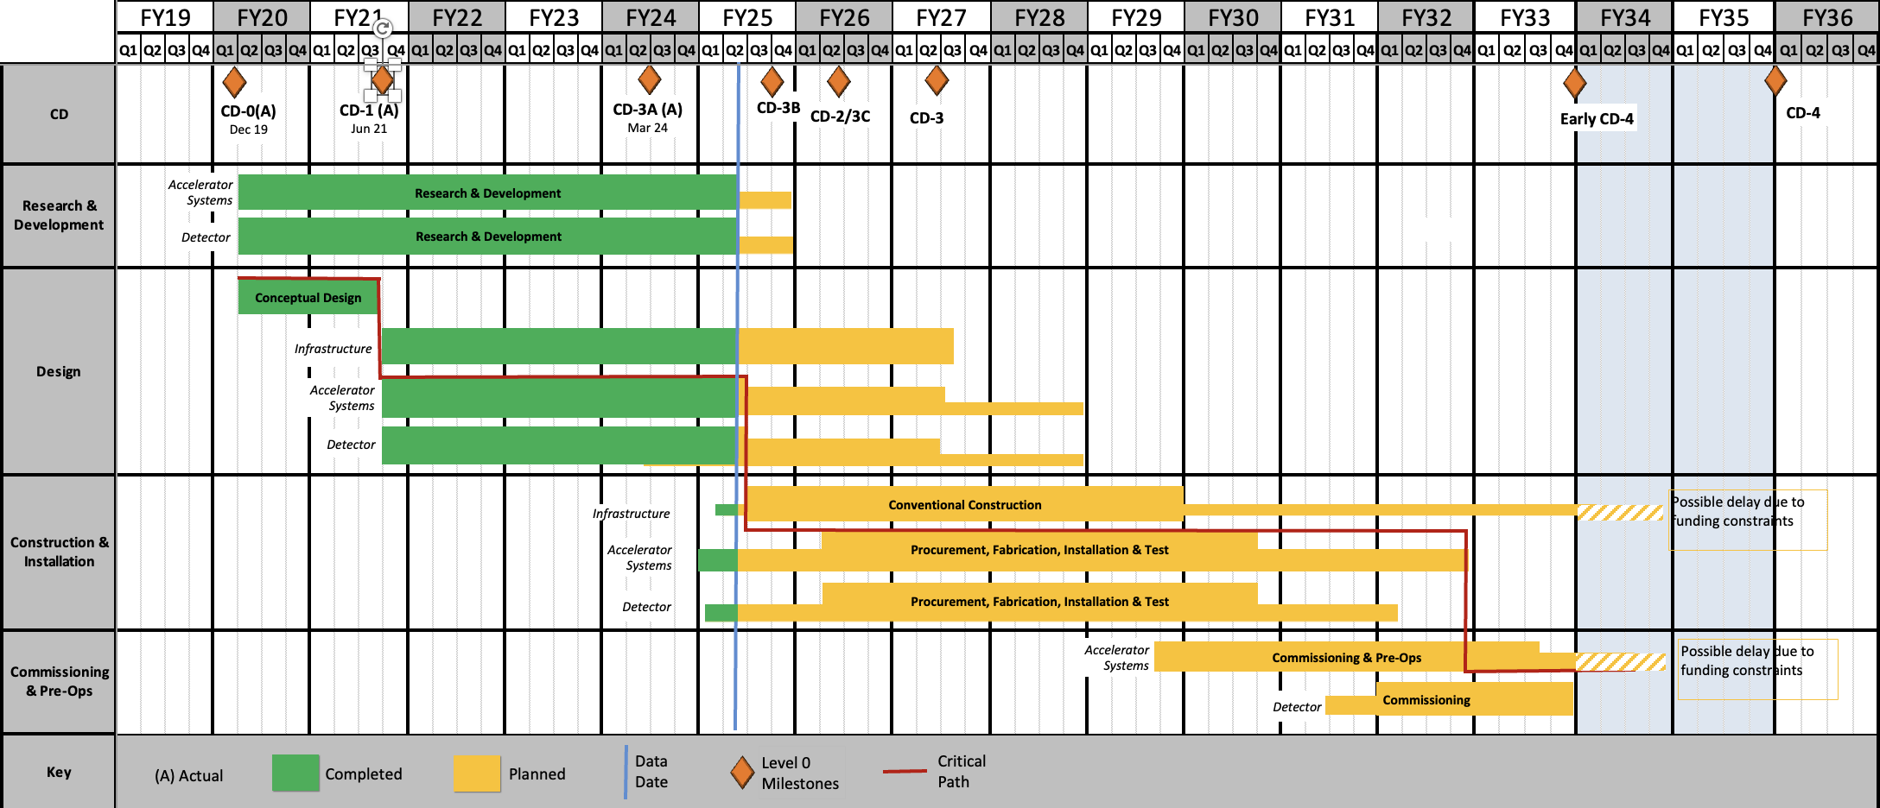
EIC Reference Schedule Before
Goal is to baseline and start construction of the EIC Accelerator Storage Rings in 2026.
RHIC Operations is planned for the end of CY2025
Revising based on delivery of subprojects and revised annual funding assumptions.

Slide 15
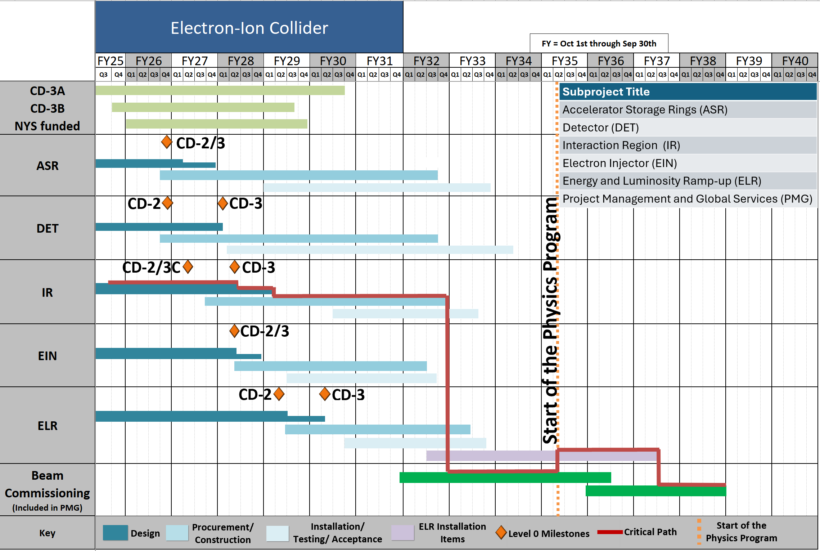
EIC Reference Schedule - Subprojects

Slide 16
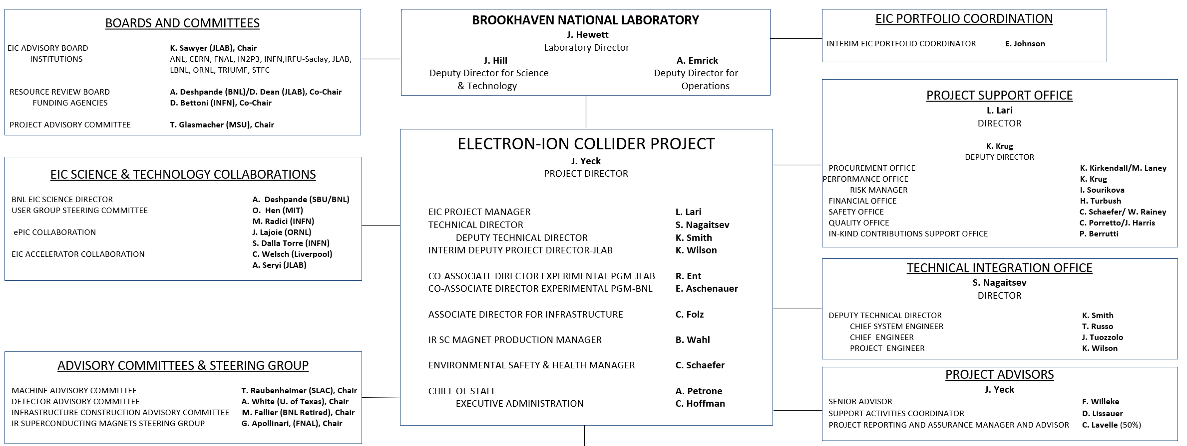
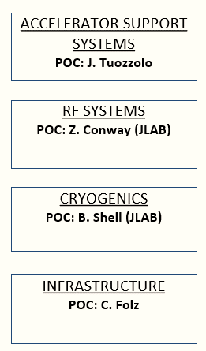
EIC Project Delivery Organization
Leadership of subprojects superimposed on the existing EIC project organization
Significant technical scope in Infrastructure, Accelerator Systems, RF, Cryogenics delivered in multiple subprojects.
Stronger technical integration effort will be required.

Slide 17
DOE and EIC Planning Dates
Milestone |  | Milestone
DOE Independent Project Review (IPR) | Jan. 7-9, 2025 | DOE RHIC R&R/Injector Operations Review | Sept. 8-10, 2025
Start Developing Scope of Subprojects | January 10, 2025 | Machine Advisory Committee Meeting | Sept. 16-18, 2025
IR SC Magnet Steering Group Meetings in 2025 | January 17, 2025 | Infrastructure Construction Advisory Committee | October 2025
Project Advisory Committee Meeting | February 11, 2025 | Resource Review Board Meeting (BNL) | Nov. 4-5, 2025
EIC Advisory Board Meeting | February 25, 2025 | Assessments of Baseline Readiness for SPs Detector Interaction Region Accelerator Rings Global and Energy and Luminosity Ramp-Up | End of 2025 Nov. 12-14, 2025 Nov. 18-20, 2025 Dec. 2025 TBD
Electron Injector Design and Cost Review | April 8-10, 2025
Infrastructure Construction Advisory Committee | April 16-17, 2025
Project Advisory Committee "Red Team" Review | May 20-21, 2025
Resource Review Board Meeting (Prague) | June 5-6, 2025 |  | 2026
Detector Advisory Committee Meeting | June 11-13, 2025 | RHIC Operations Conclude | ~End of 2025
EIC Advisory Board Meeting | June 17, 2025 | RHIC Removal and Repurposing (R&R) Starts | ~January 2026
DOE CD-3B ESAAB Approval | ~ July 2025 | DOE IPR and Independent Cost Review | ~June 2026
DOE IPR Focused Status Review | August 5-7, 2025 | DOE CD-2/3 Approval for Accelerator Rings | ~Sept 2026

Slide 18
EIC Planning Challenges
Challenges:
To deliver the EIC facility as a DOE single line-item construction project within a constrained and uncertain annual funding profile.
To continue to optimize cost and engage partners in the final design and construction of the project and the planning for operations.
Status:
CD-0, Mission Need, approved in 2019, and CD-1 approved in 2021. The CD-1 cost range is $1.7B to $2.8B, with an assumed peak annual funding at $325M/year in FY2026.
CD-2/3 for the Accelerator Rings and CD-2 for the Detector is planned for end of FY2026.

Slide 19
Assessments of Baseline Readiness
Assessments of baseline readiness for each subproject will measure status and evaluate future work needed to be ready for a DOE CD-2 IPR. The charge for these reviews includes technical, cost, schedule, and management. The charge will also evaluate plans to achieving cost.
Reviews will be completed by the end of 2025:
Electron Injector Complex April 8-10, 2025
Detector November 12-14, 2025
Interaction Region November 18-20, 2025
Accelerator Storage Rings (CD-2/3 Status) December 2025
Global Project and Energy and Luminosity Ramp-up December 2025

Slide 20
EIC Project Priorities
Execute the CD-3A procurements within acceptable cumulative schedule and cost metrics, award the final CD-3A procurements, and start to award the proposed CD-3B procurements.
Elaborate all the scope necessary for an EIC facility that is responsive to the mission need in the “EIC Portfolio,” to the level appropriate for baselining subprojects.
Conduct reviews to assess status of CD-2 preparations for each subproject and prepare the accelerator rings subproject and detector subproject for baseline approval in 2026.
Start RHIC Removal & Repurposing work after RHIC run concludes.
Prepare for the DOE reviews required to start EIC construction in 2026:
CD-2/3 – Accelerator Rings
CD-2 – ePIC Detector

