Slide 1
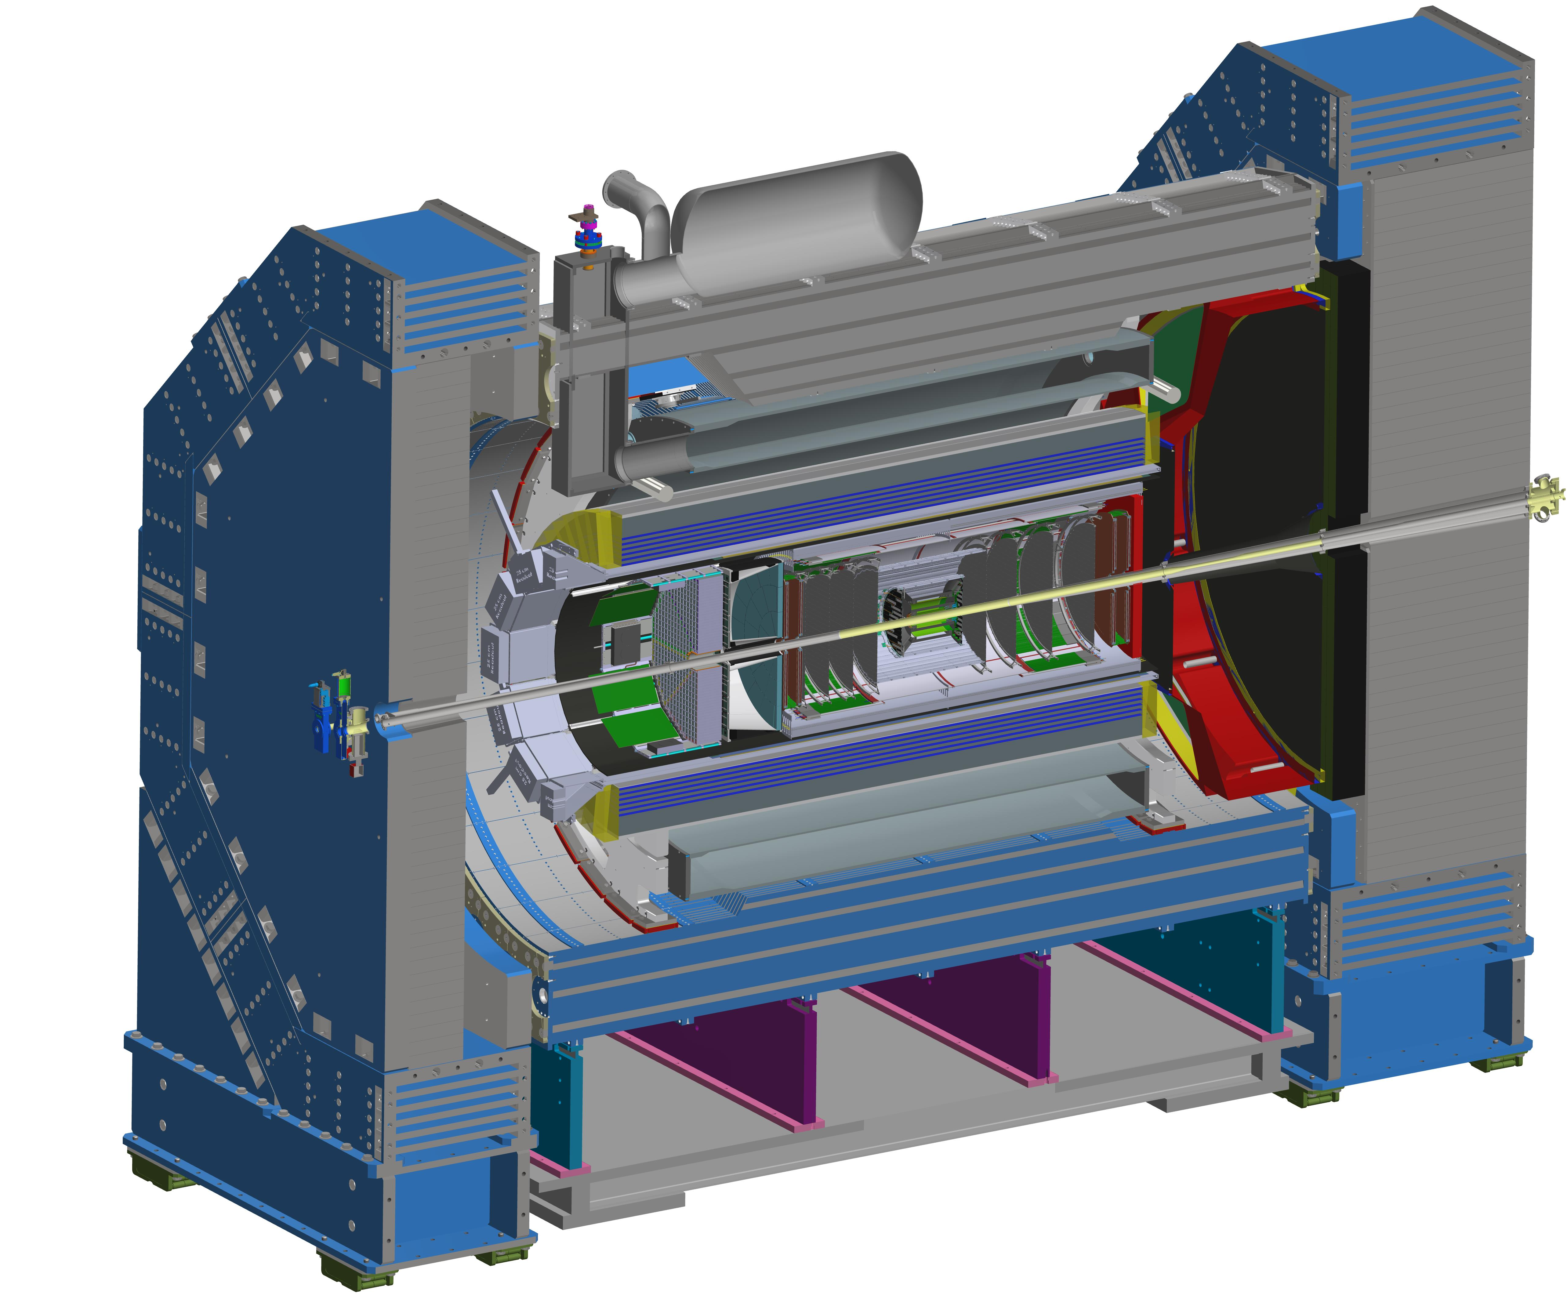



Report from the ePIC Collaboration Spokesperson
John Lajoie
Oak Ridge National Laboratory

Slide 2
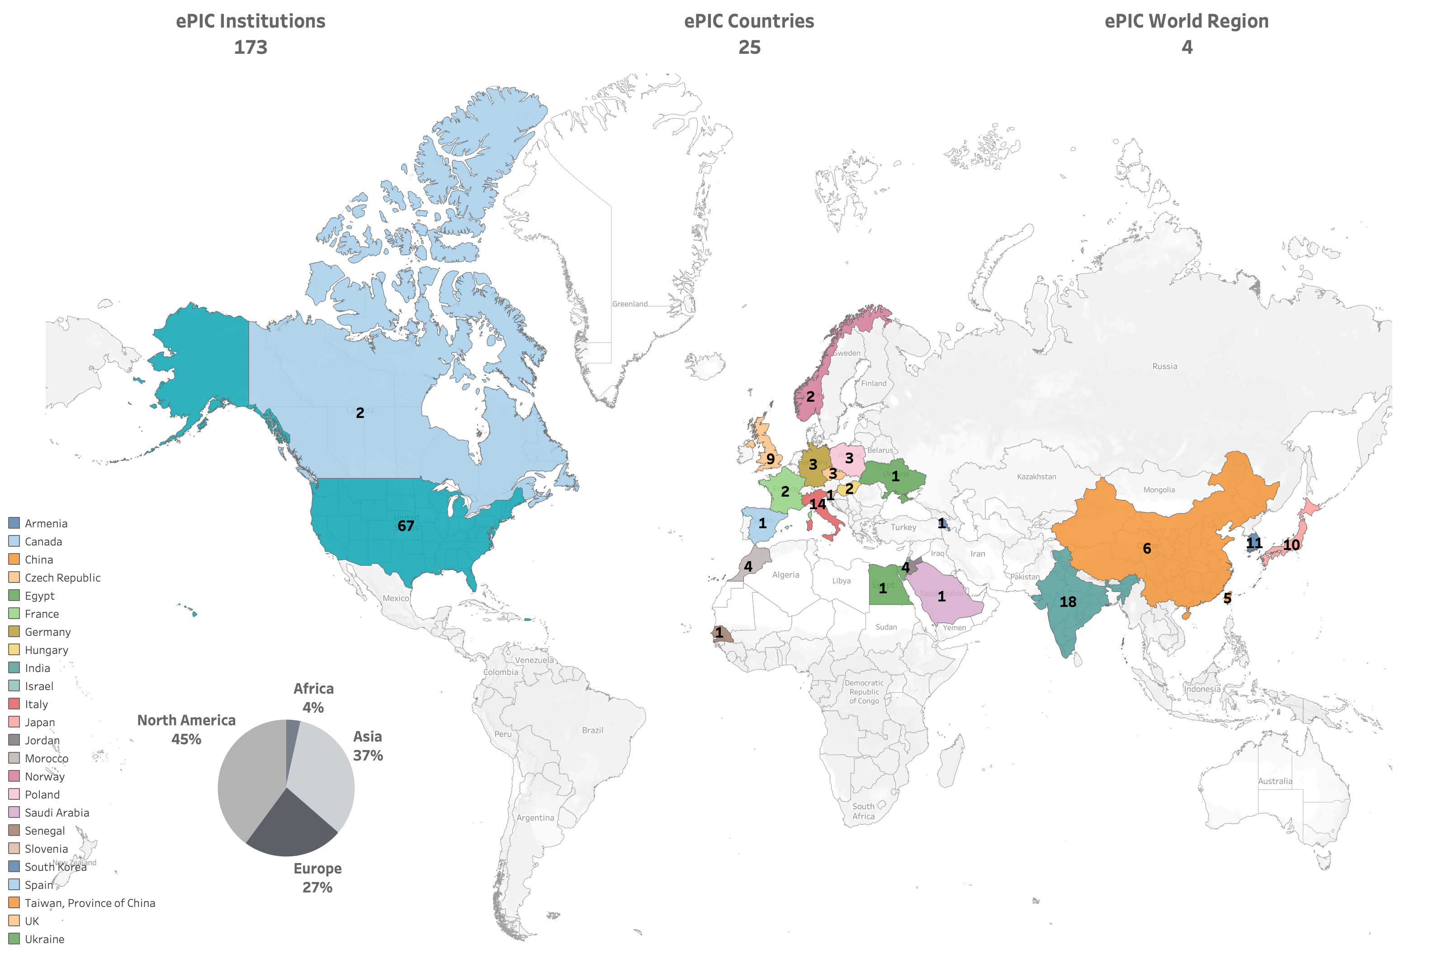
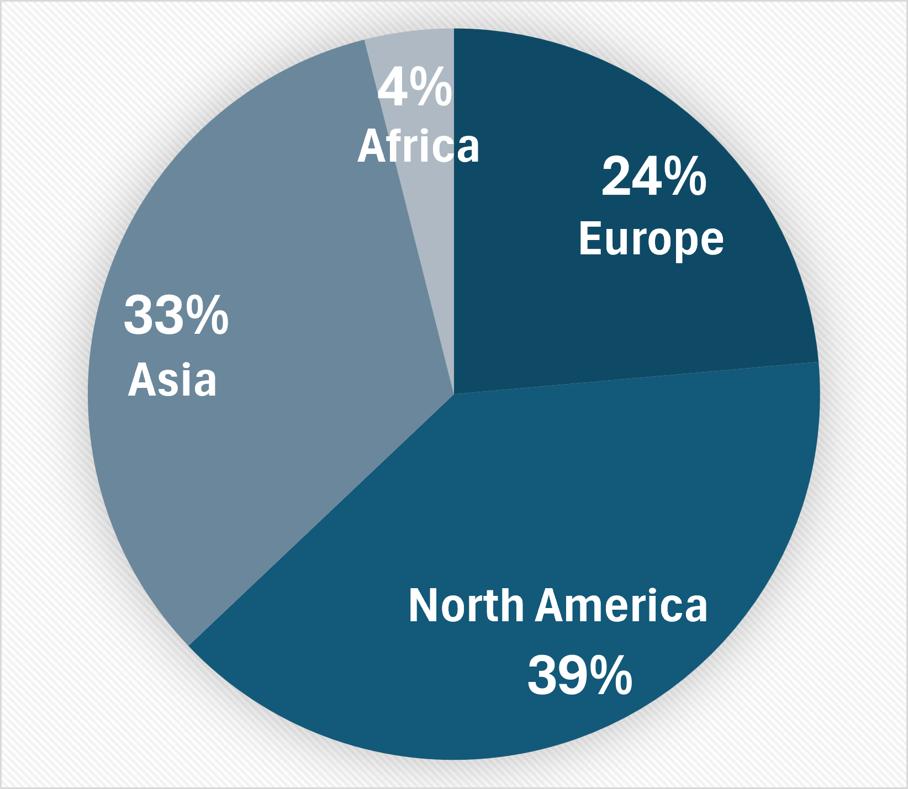
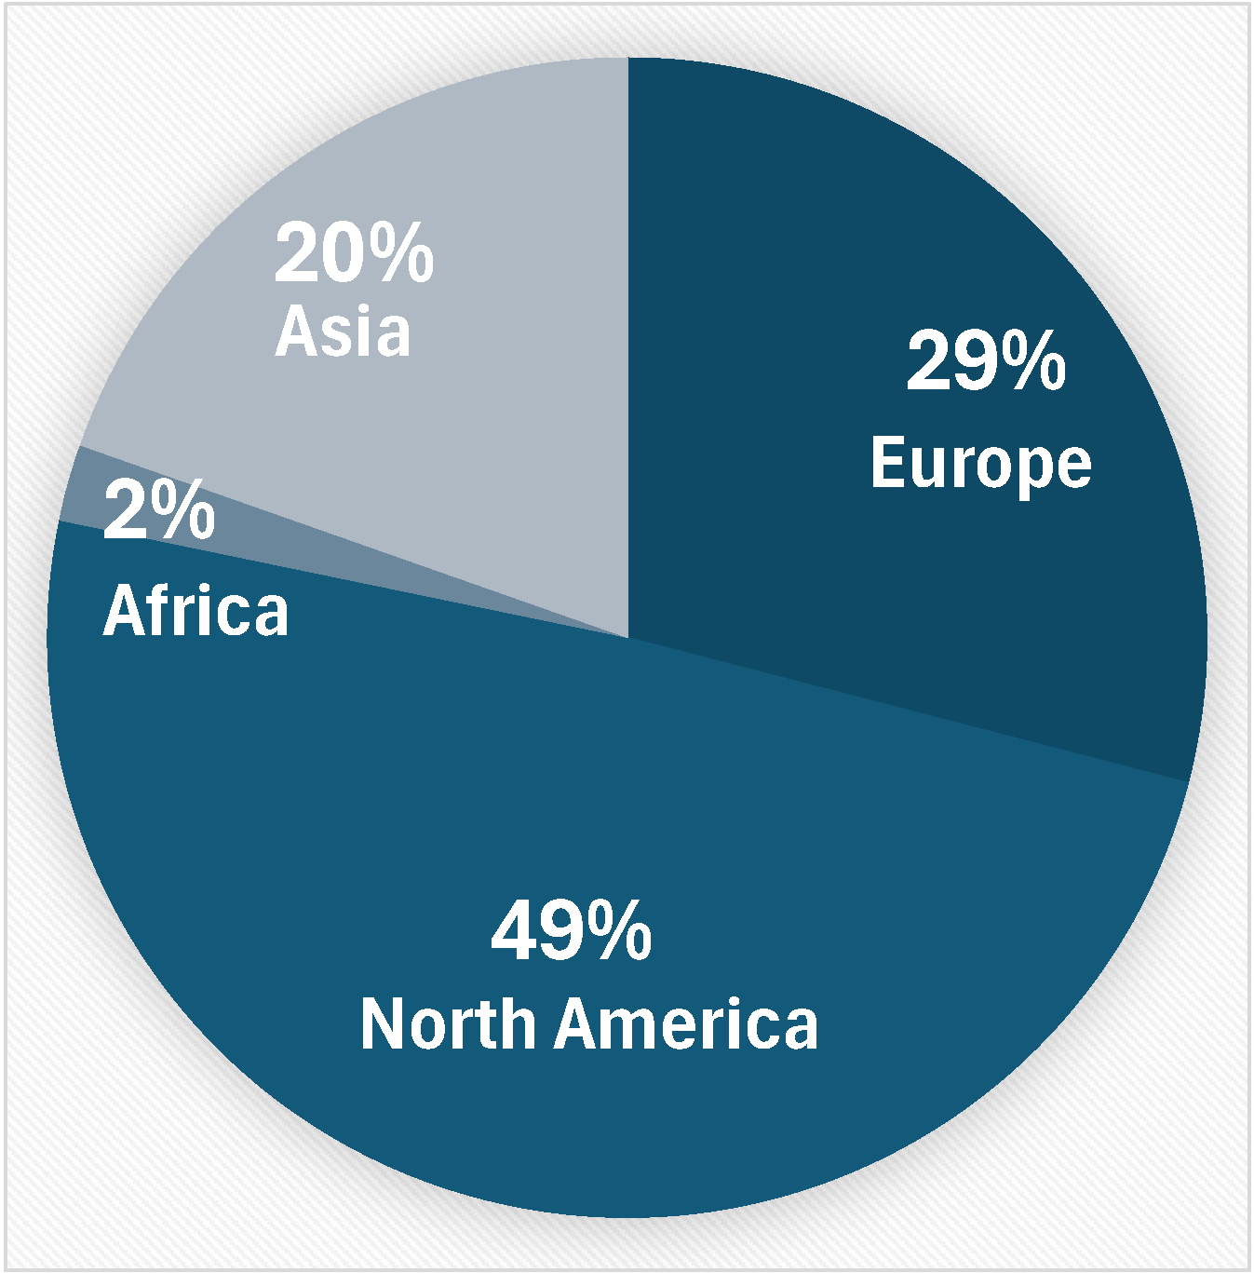
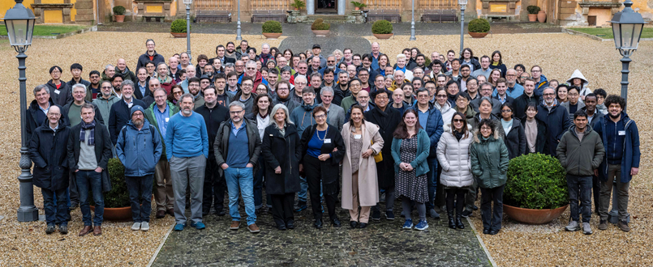
By the numbers…
180
4
Currently:
>1000 collaborators from 2025 survey
Institutions:
Collaborators:
Frascati – January 2025

Slide 3





New Institutions so far in 2025
Seoul National University
  CC Member Seonho Choi
Texas Southern University
  CC member Nissem Abdelrahman
Johannes Gutenberg University Mainz
  CC member Tyler Kutz
Mount Allison University
  CC member David Hornidge
University of Hawaii at Manoa
  CC member Jennifer Ott
17 new institutions added since the start of 2024!

Slide 4
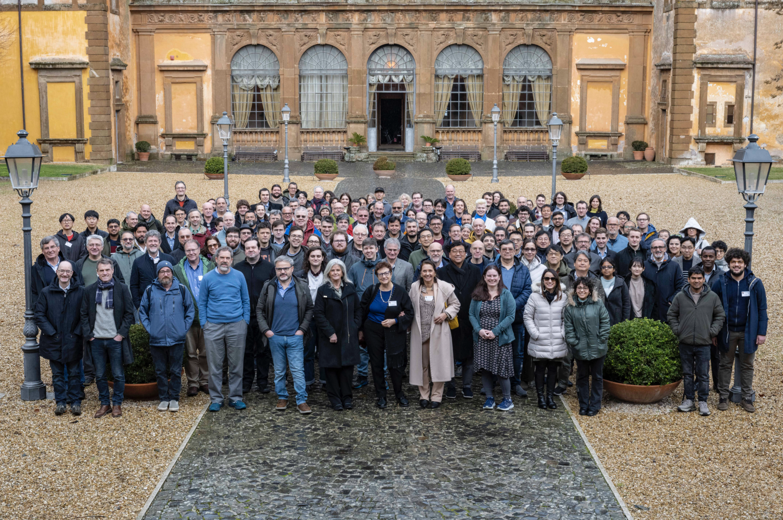
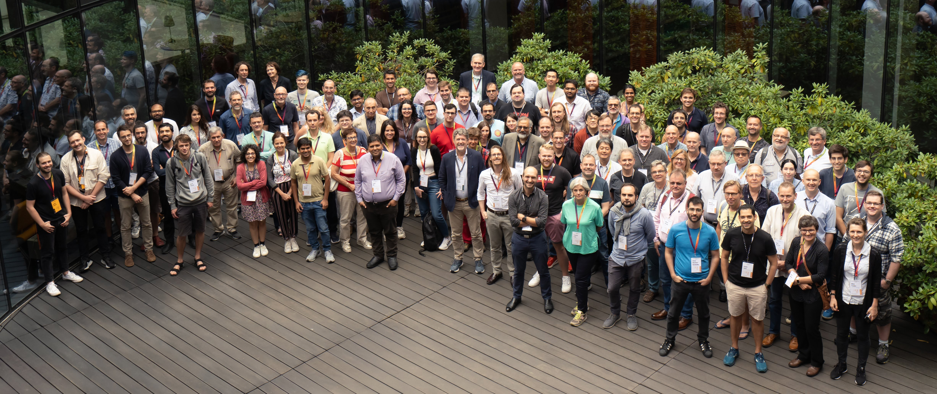
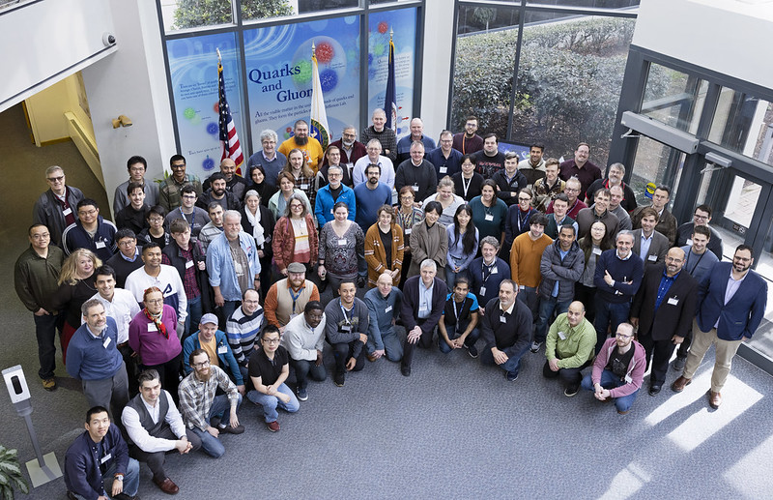
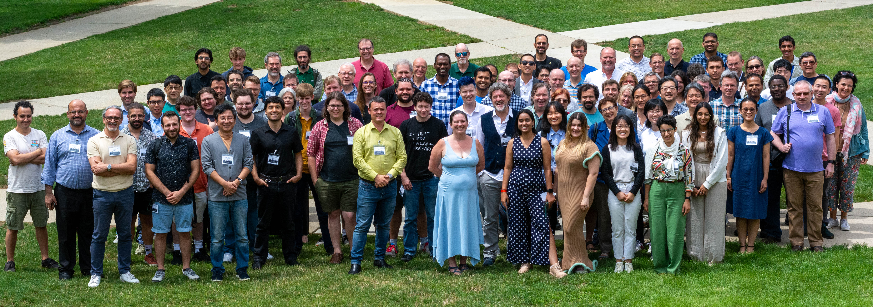
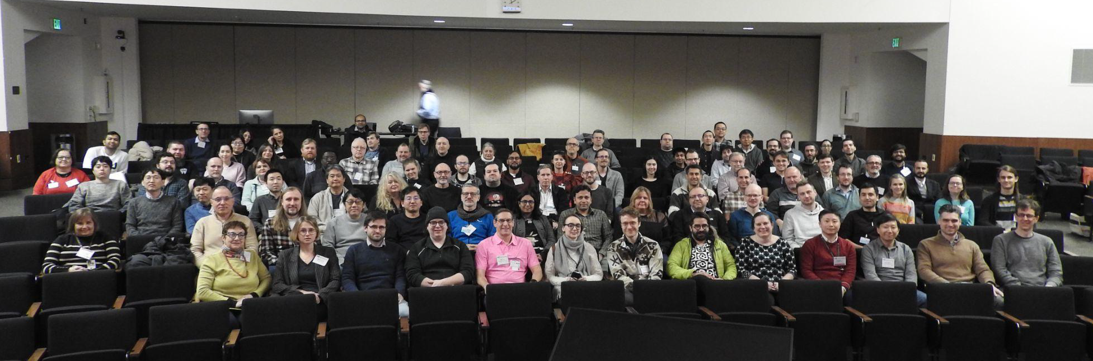
The Collaboration
JLab, Jan. 2023
Warsaw, July 2023
ePIC is a community of scientists dedicated to realizing the EIC science mission.
The ePIC Collaboration is as unique as the ePIC detector.
EICUG/ePIC Meeting – Lehigh, July 2024
Frascati, January 2025
ANL, Jan 2024

Slide 5
Second ePIC Spokesperson Election
Spokesperson election in February 2025
  Open call for nominations went out Oct. 25th , 2024
  Candidate presentation at Jan. 2025 collaboration meeting
John Lajoie elected to a second (final) term as Spokesperson
Silvia Dalla Torre continues as Deputy Spokesperson
We are both honored and humbled by the confidence the collaboration has placed in us!

Slide 6
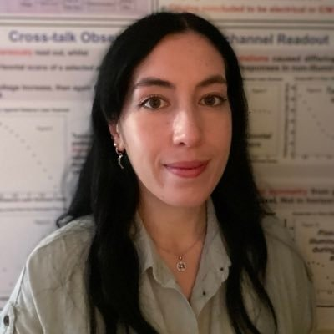
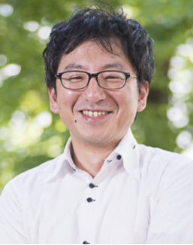

New Faces in ePIC Leadership
The Spokesperson’s Office nominated Rachel Montgomery
as a new Physics Analysis Co-Coordinator:
  Lecturer in Nuclear and Hadron Physics at University of Glasgow
  Former ePIC Diffractive and Exclusive Physics WG Convener
The Spokesperson’s Office nominated Taku Gunji as a new
Streaming Computing Model WG convener
  Associate Professor at the University of Tokyo, CNS
  SPADI Alliance member
The Spokesperson’s Office appointed John Haggerty as a new
Deputy Technical Coordinator
  sPHENIX CDR/TDR editor

Slide 7
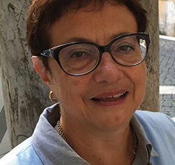
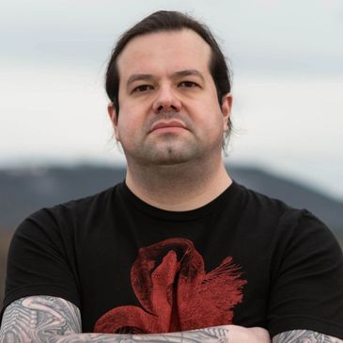
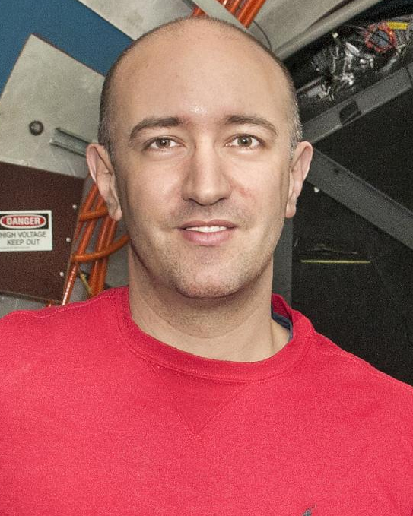



Reminder: ePIC Collaboration Structure
Collaboration Council
Institutional Representatives
Spokesperson’s Office
Spokesperson (SP)
Deputies
EIC Project
Executive Board
Standing Committees
Professional Conduct
Conferences and Talks
Membership
Elections
Publications
Ad-Hoc Committees
Technical Coordination (TC)
Software and Computing Coordination (SCC)
Physics Analysis Coordination
(AC)
Technical Coordinator (Acting)
• Silvia Dalla Torre (INFN)
Deputy TC’s:
Prakhar Garg (Yale)
John Haggerty (BNL)
Oskar Hartbrich (ORNL)
Matt Posik (Temple)
SCC Coordinator
• Markus Diefenthaler (JLab)
Dmitry Kalinkin
(Kentucky, Deputy SCC for Development)
Torre Wenaus
(BNL, Deputy SCC for Infrastructure)
Wouter Deconinck
(U. Manitoba, Deputy SCC for Operations)
Physics Analysis Co-Coordinators
• Rachel Montgomery
(Glasgow)
• Salvatore Fazio
(Univ. Calabria)
Rosi Reed (Deputy, Lehigh)

Slide 8
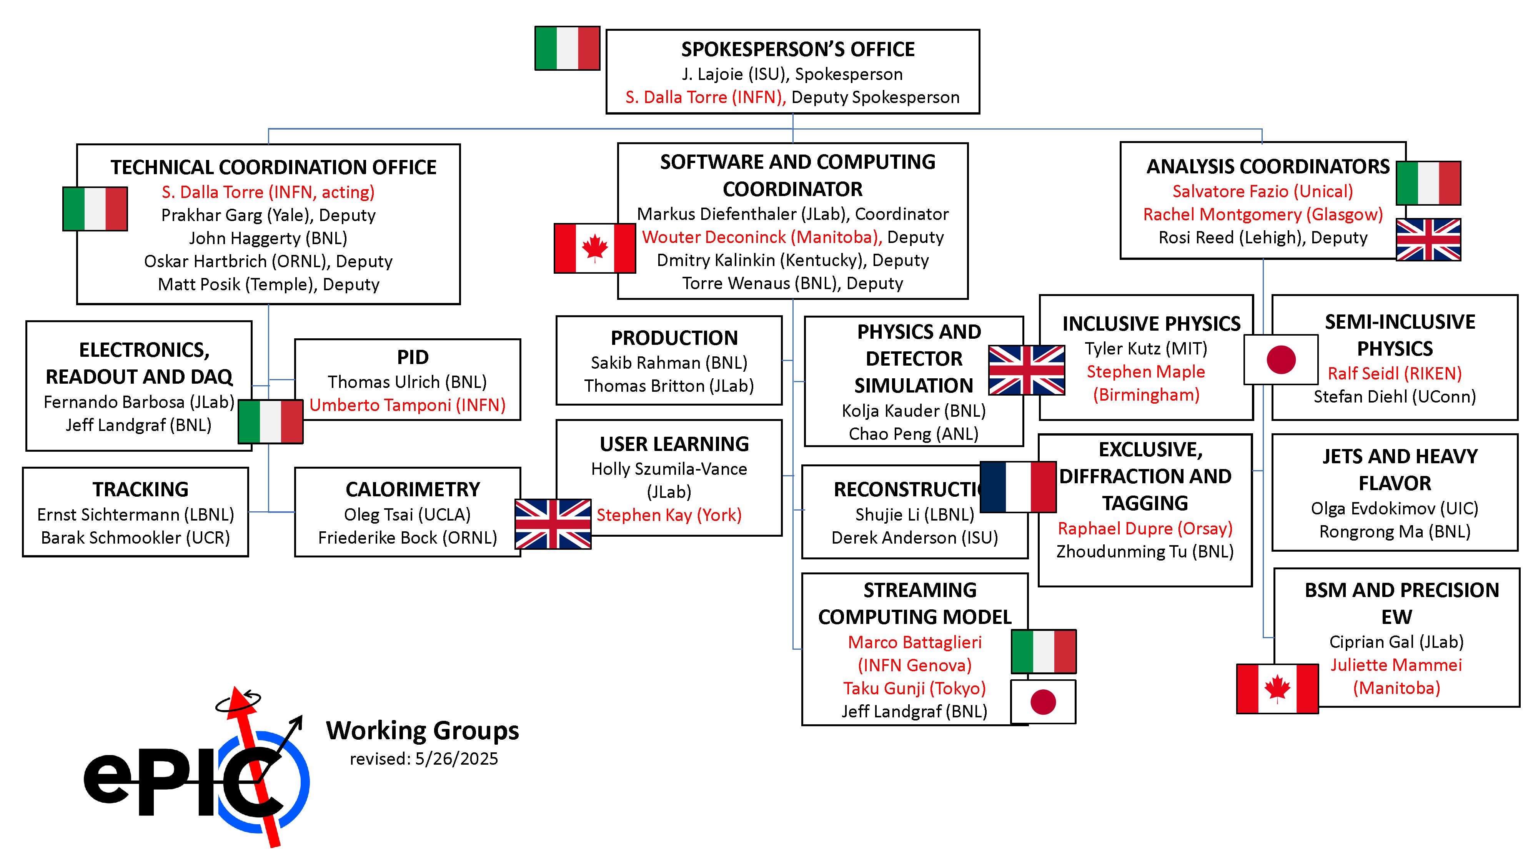
Reminder: ePIC Working Group Structure
*the Validation WG was deactivated and folded into Development

Slide 9
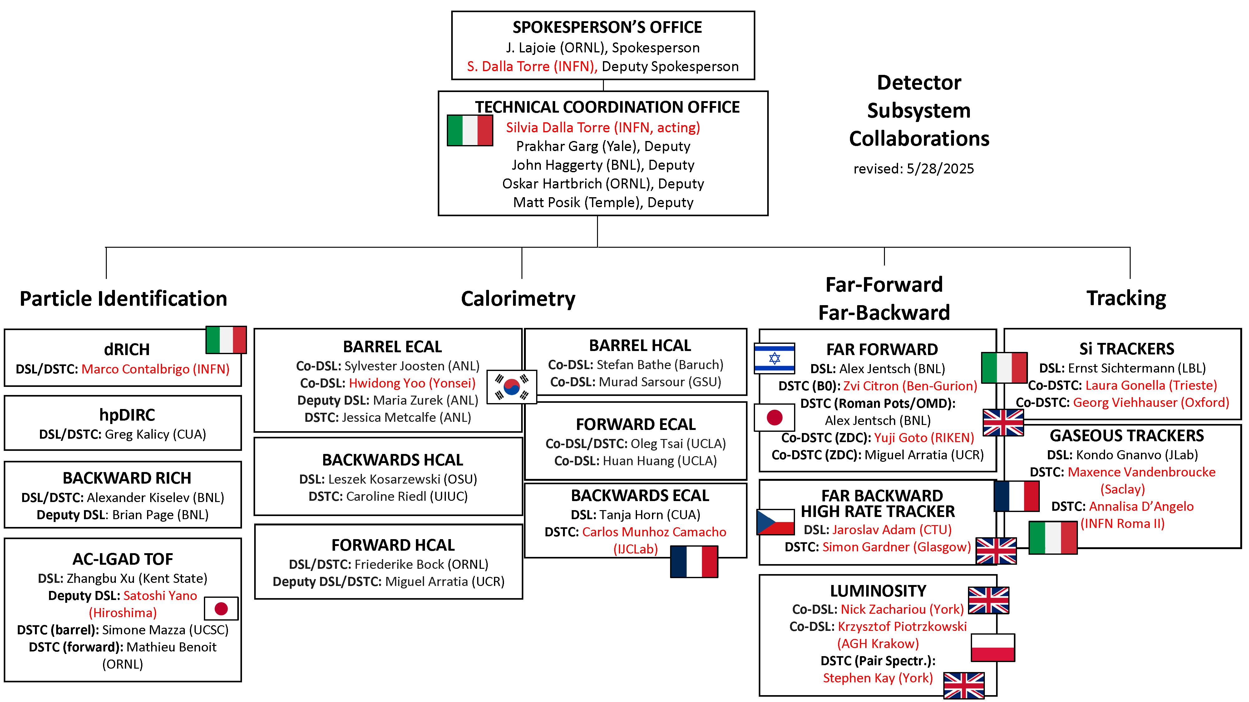
Reminder: ePIC DSC Structure
New personnel since last RRB

Slide 10



2025 -2026
DOE OPA Status
5-7th August, 2025
PDR2: Polarimetry
Sept./Oct 2025
10th Detector Advisory Committee
June 11-13th 2025
PDR: DAQ - Slow
Controls
Nov./Dec. 2025
PDR2: Cerenkov PID
April 1-2, 2025
FDR: BABAR DIRC Bar Refurbishment
ePIC Early Physics Workshop
April 24-25, 2025
PDR2: Backwards HCal
~Sept. 2025
ePIC pre-TDR
V2.1
PDR3: Barrel EMCal
~August 2025
ePIC Software and
Computing Review
~Oct 2025
BIC In-Person Workshop
April 9-11,
2025
ePIC Software and
Computing Technical Interchange – May 12th
SVT Summer
Workfest
June 9-11,
2025
DOE IPR and ICR, 13-16th Jan. 2026
PDR: Magnet/Cryo Infrastructure
Sept./Oct. 2025
PDR3: IR Integ.
& Aux. Det
Nov./Dec. 2025
PDR3: Elec./DAQ
August 2025 (late)
Frascati
Jan 20-24,2025
EICUG/ePIC Collab. Mtg. July 14-18
CD-2/3 Review
late 2026
Calorimetry
Workshop
June 5-9th, 2025
6th EIC RRB Meeting
Nov. 4-5th 2025
PDR: Integ. + Installation
(outside GST)
Nov/Dec 2025
EICO
2-4th April 2025
FDR: Backward & Forward EM Calorimetry, Barrel & Forward HCAL
July 2025
PDR2: Si Tracking Detectors
Fall 2025
HSF-India/ePIC Workshop
May 13-17th, 2025
PDR2: MPGD Detectors
Summer 2025
PDR2: AC-LGAD Detectors
Fall 2025
Detector Subproject Baseline Readiness Director's Review
12-14 Nov. 2025
PDR: Integ. + Installation
(inside GST)
Nov/Dec 2025
5th EIC RRB Meeting
June 5-6th 2025
Detector R&D Day (ePIC/Project)
16-17th April 2025

Slide 11
Common Themes from Frascati Priority Discussion I
There is a need for better communication within the
collaboration, across multiple different entities
  Not a single problem with a single solution - something
  that we need to continually work on. Tailor the
  communication to collaboration needs
  (newsletter, minutes of meetings, etc.)
  Accelerate development of and transition to the website
Evolve technical coordination into less of a reporting body, with a proactive coordinating effort supporting the DSC’s
  Organize and coordinate preTDR effort
  Increase the direct engagement of the TC-Office with DSCs and CC WGs,
  TC Office presence in DSC meetings
  Set standards/requirements for DSC internal reviews, assist with organization
  Facilitate communication with CAMs and EIC Project
  Organize common solutions – cooling, grounding, database,…
This list is a synthesis of the group exercise by the SP Office the Coordinators.
Sub-bullets are examples that support the priority but are not exhaustive.

Slide 12
Common Themes from Frascati Priority Discussion II
Need a better way to grow/onboard analysis efforts
  Not just software! Onboard analysis as well
  Common reconstruction tools facilitate higher-level
  analysis efforts
  Use Early Science studies as a focus for efforts in analysis
  and engagement with theory
Need to define a set of 2025 milestones for progress in simulations
  This includes simulation framework, fidelity to the mechanical design, inclusion of backgrounds, and reconstruction and common tools
  Work with DSC’s to set software goals, SCC to support
  Define how we work towards simulation reconstruction in timeframes
Workforce and Engagement
  Need to increase workforce and support engagement across all three coordination offices
This list is a synthesis of the group exercise by the SP Office the Coordinators.
Sub-bullets are examples that support this priority but are not exhaustive.

Slide 13
ePIC preTDR and Publication Plan
process design phase
writing
(TDR/notes)
Prepare
papers for
publication
structuring the
effort
preTDR v2.0
Review v2.0
(internal/external)
December 2025 pre-TDR v2.1
NIM Special
Issue
mid-2026
Mid Jan.24
Mid Mar.24
preTDR v1.0
Dec. 24
July 2025
Formation of Editorial Board
It is still our intent to publish a super-set of the material prepared for the preTDR.
  Longer articles on subsystems, physics performance, early science, etc.
  Important for collaborators to have a published product for all their hard work!
Plan to open a NIM Special Issue at the end of 2025, open for ~6 mos
  Still working to understand Open Access requirements

Slide 14



ePIC Committees
Membership Committee:
Chair: Peter Steinberg (BNL)
Vice-Chair: Pietro Antonioli (INFN-Bologna)
Friederike Bock (ORNL), Helen Caines (Yale), Doug Higinbotham (JLab), Bedhanga Moharty (NISER), Silvia Niccolai (IJCLAB), Marzia Rosati (ISU)
Collaboration Council
Institutional Representatives
Professional Conduct Committee:
Chair: Megan Connors (GSU)
Vice-Chair: Christine Nattrass (UTK)
Francesco Bossù (CEA-Saclay), Wouter Deconinck (University of Manitoba), Narbe Kalantarians (Virginia Union University) , Iris Ponce Pinto (Yale University) , Maya Shimomura (Nara Women’s University) , Allison Zec (University of New Hampshire)
Standing Committees
Professional Conduct
Conferences and Talks
Membership
Elections
Publications
Ad-Hoc Committees
Conferences and Talks:
Chair: Maria Zurek (ANL)
Vice-Chair: Brian Page (BNL)
Barbara Jacak (Berkeley), Daniel Brandenburg (OSU), Dmitry Kalinkin (Kentucky), Nick Zachariou (York), Xuan Li (LANL), Nicola Rubini (Bologna), Wouter Deconinck (Manitoba)
Publications Committee:
Chair: Rene Bellwied (U. Houston)
Vice –Chair: Annalisa Mastroserio (INFN Bari)
Lokesh Kumar (Panjab U.), Michela Chiosso (Torino), Prithwish Tribedy (BNL), Markus Diefenthaler (JLab), Sevil Salur (Rutgers),
ex-officio w. Conferences and Talks Committee:
Daniel Brandenburg (OSU)
Elections Committee:
Chair: Helen Caines (Yale)
Vice-Chair: Ken Barish (UCR)
Past-Chair: John Arrington (LBNL)
Maria Stefaniak (OSU), Domenico Elia (INFN)

Slide 15
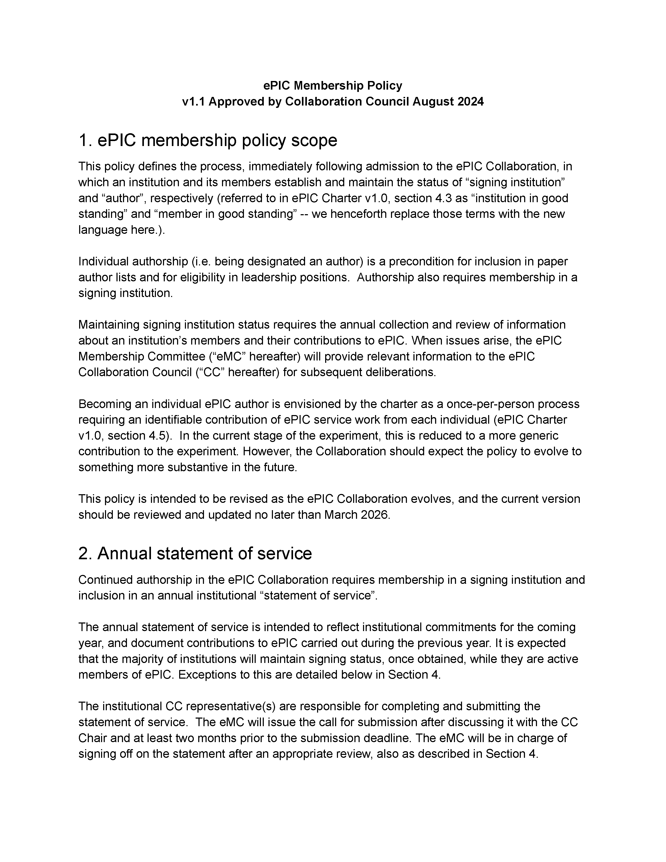
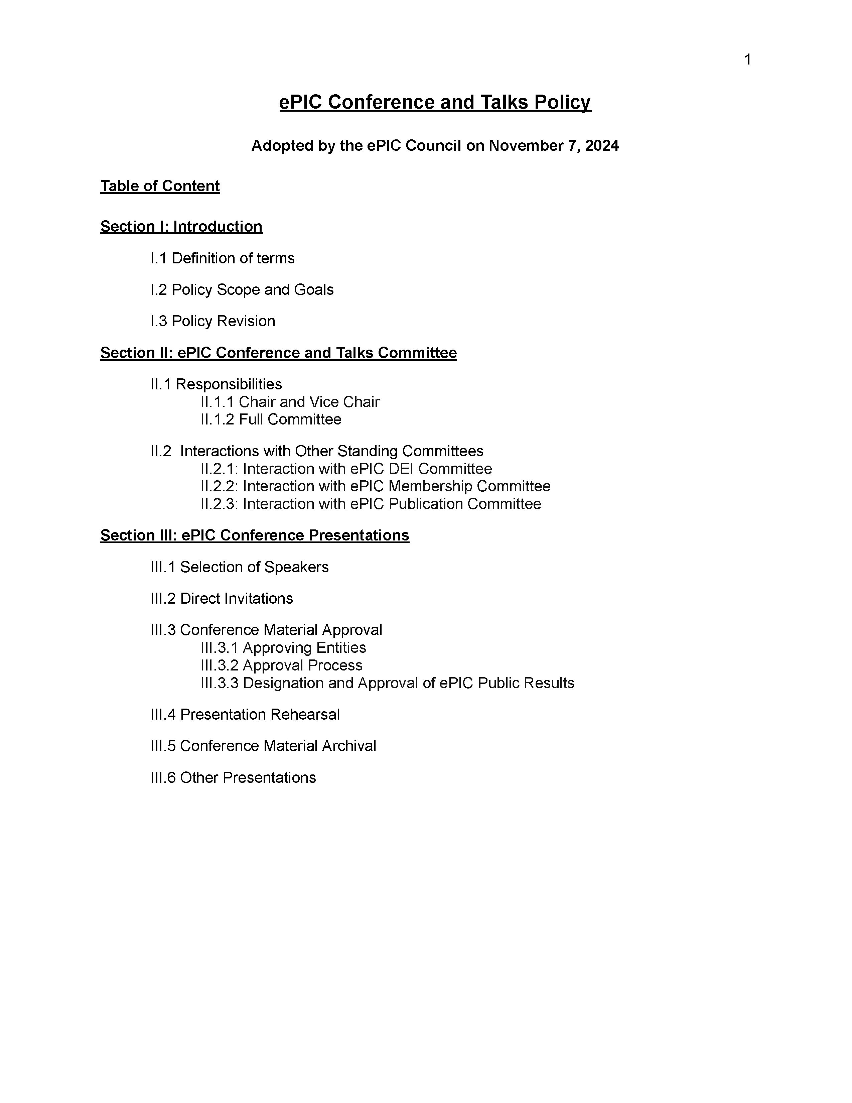
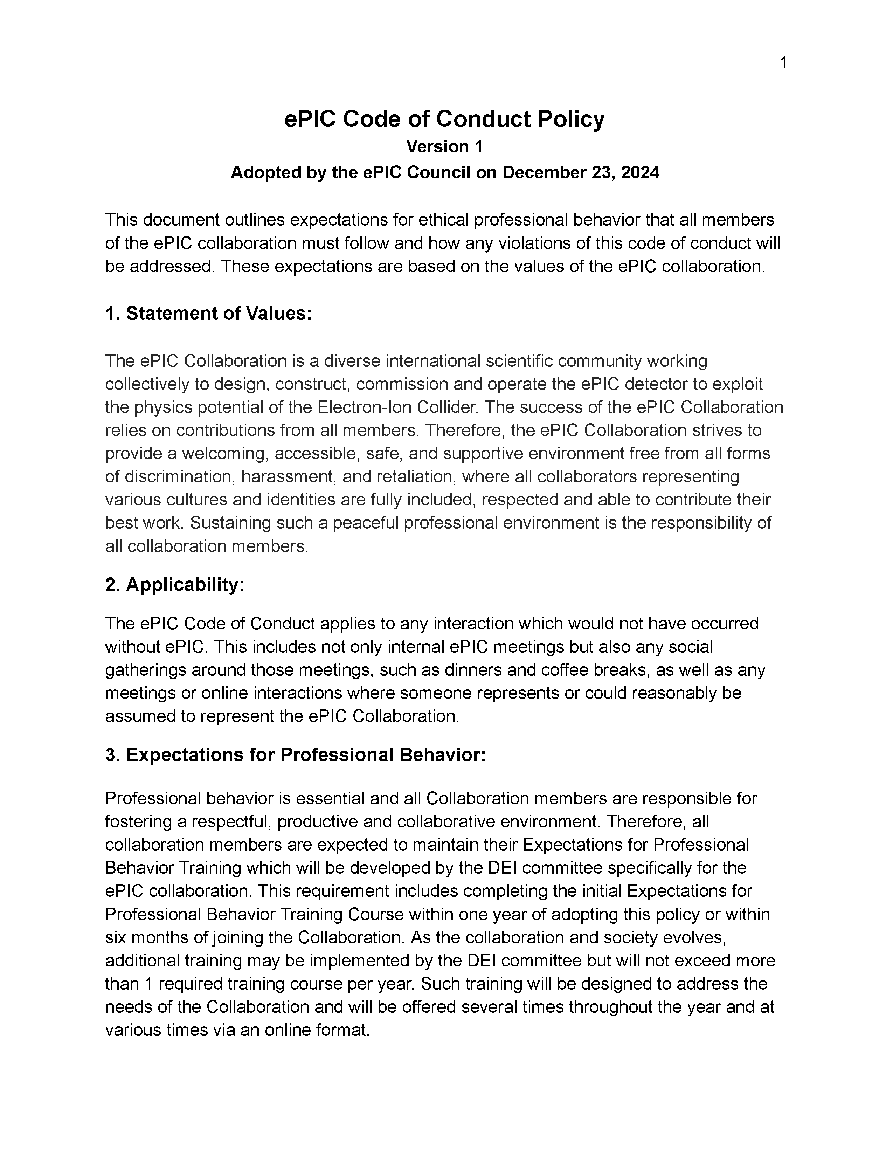
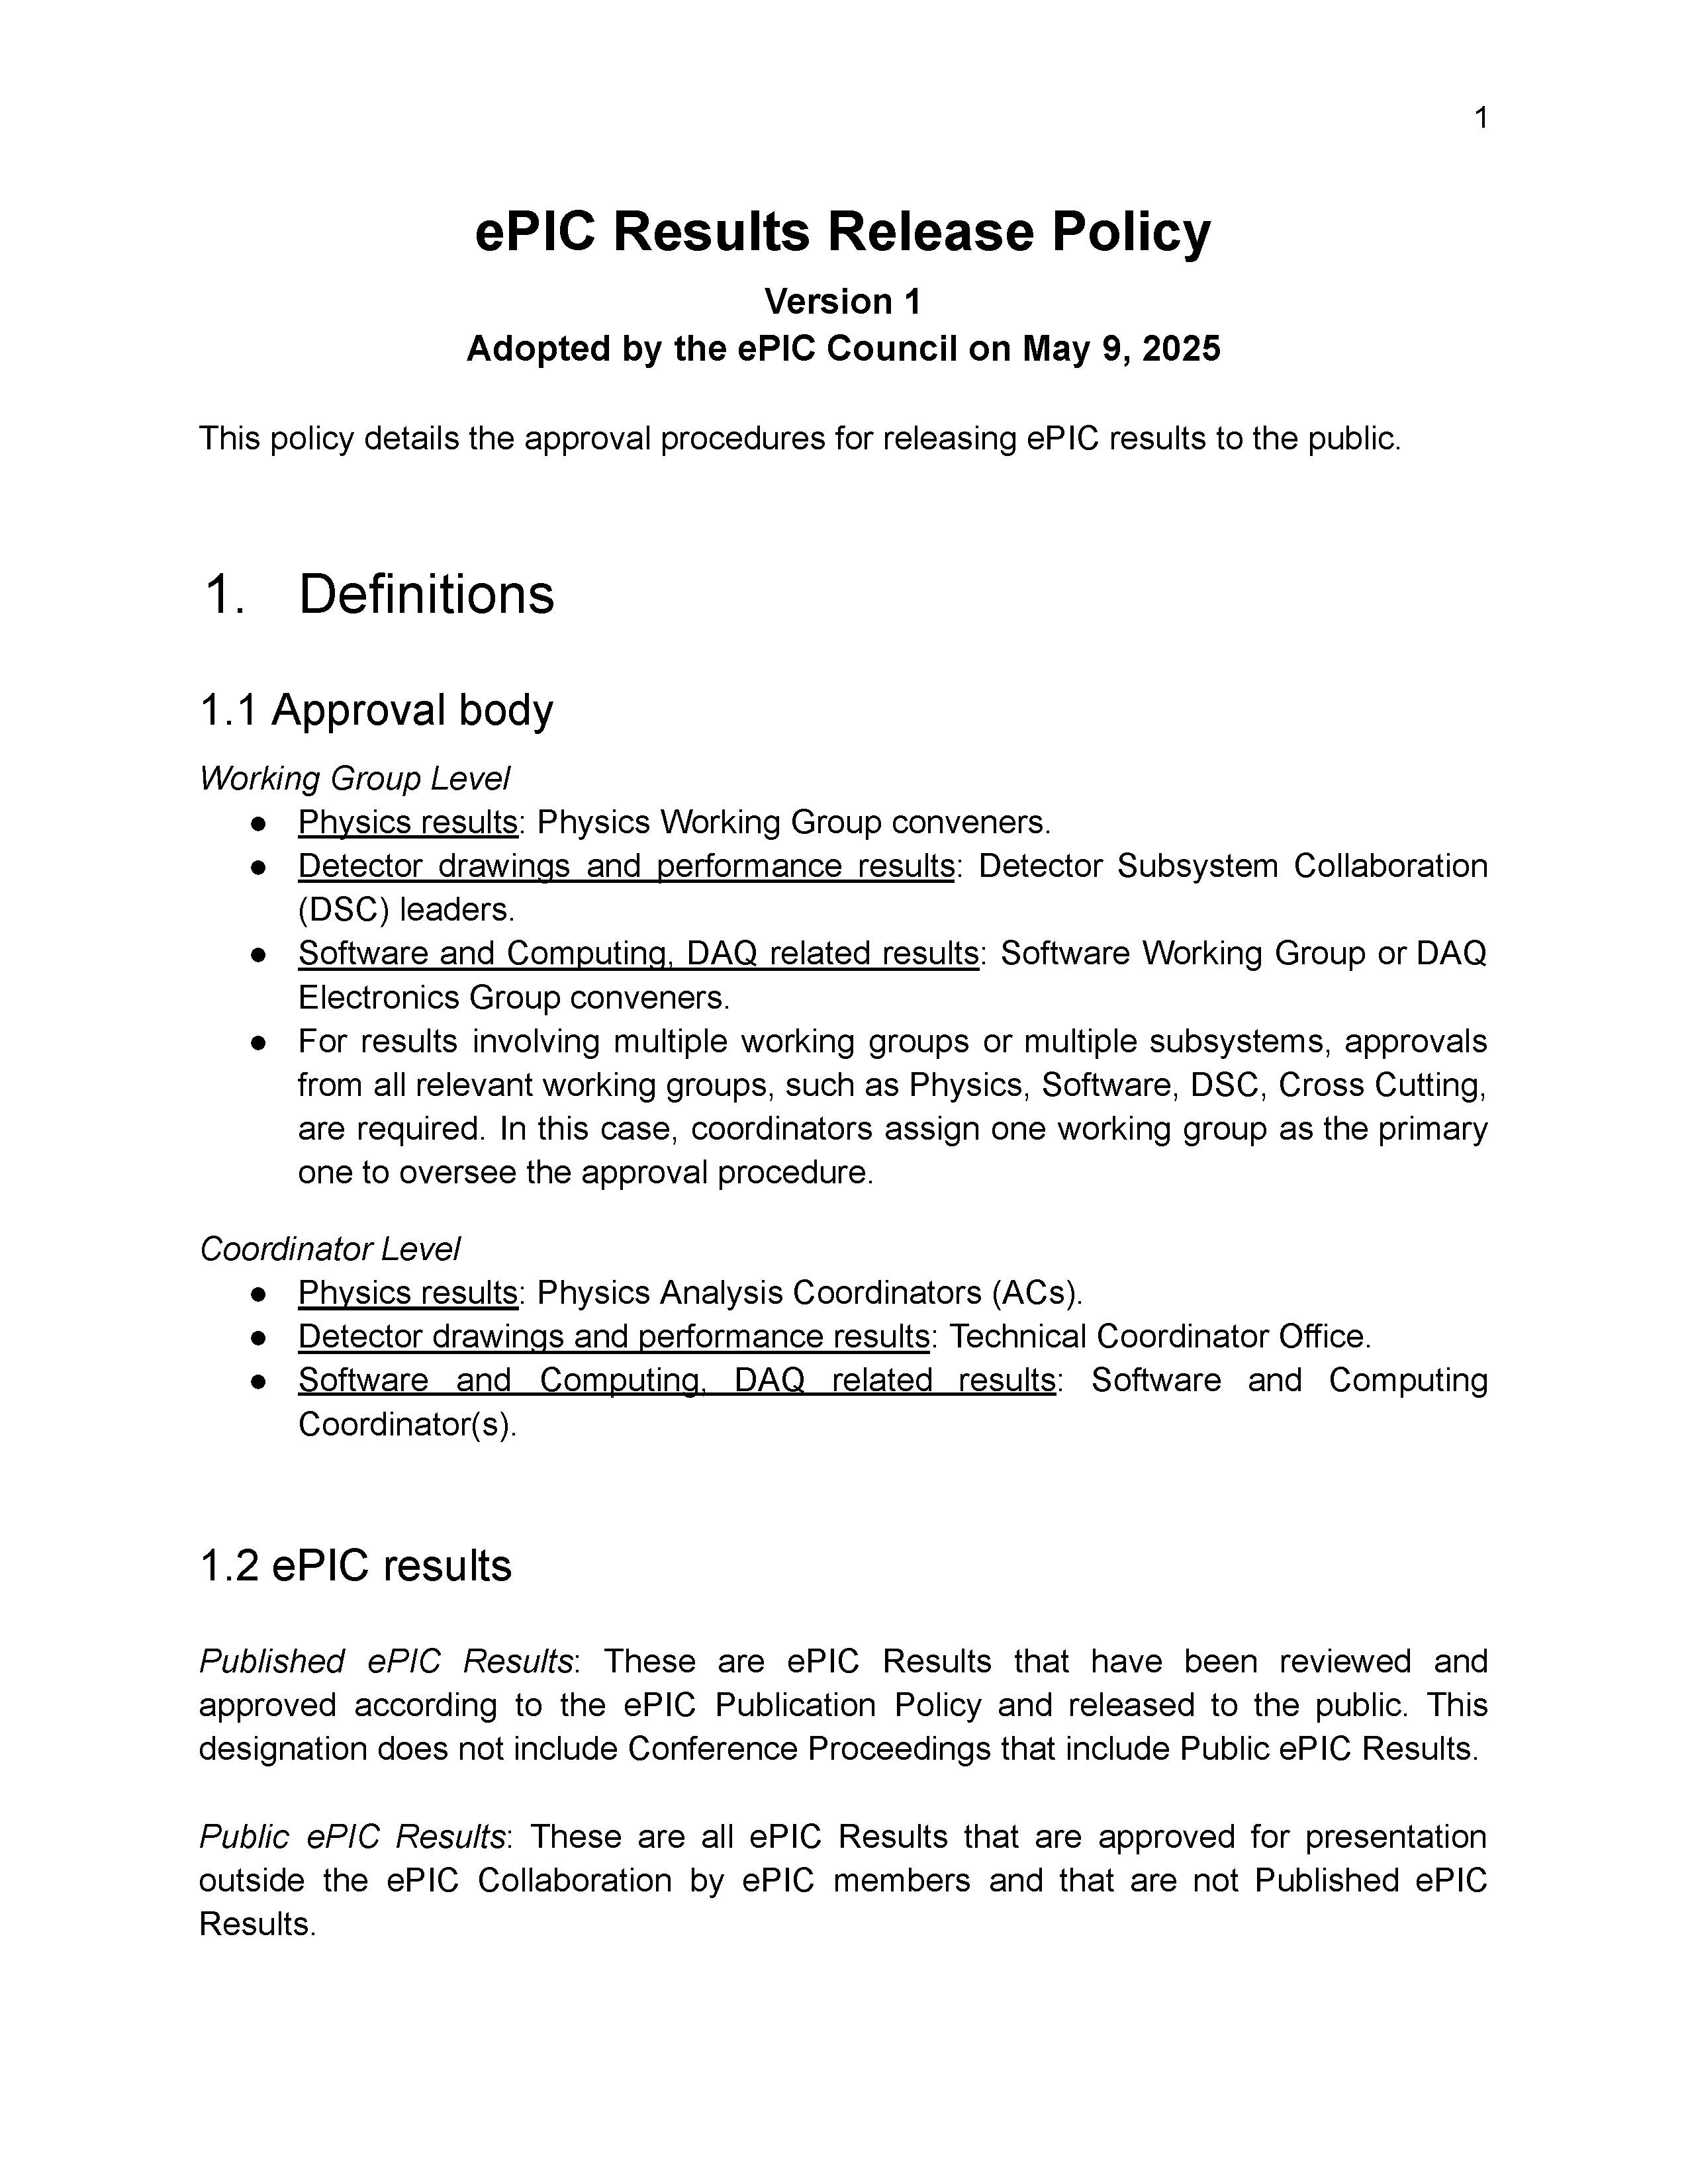
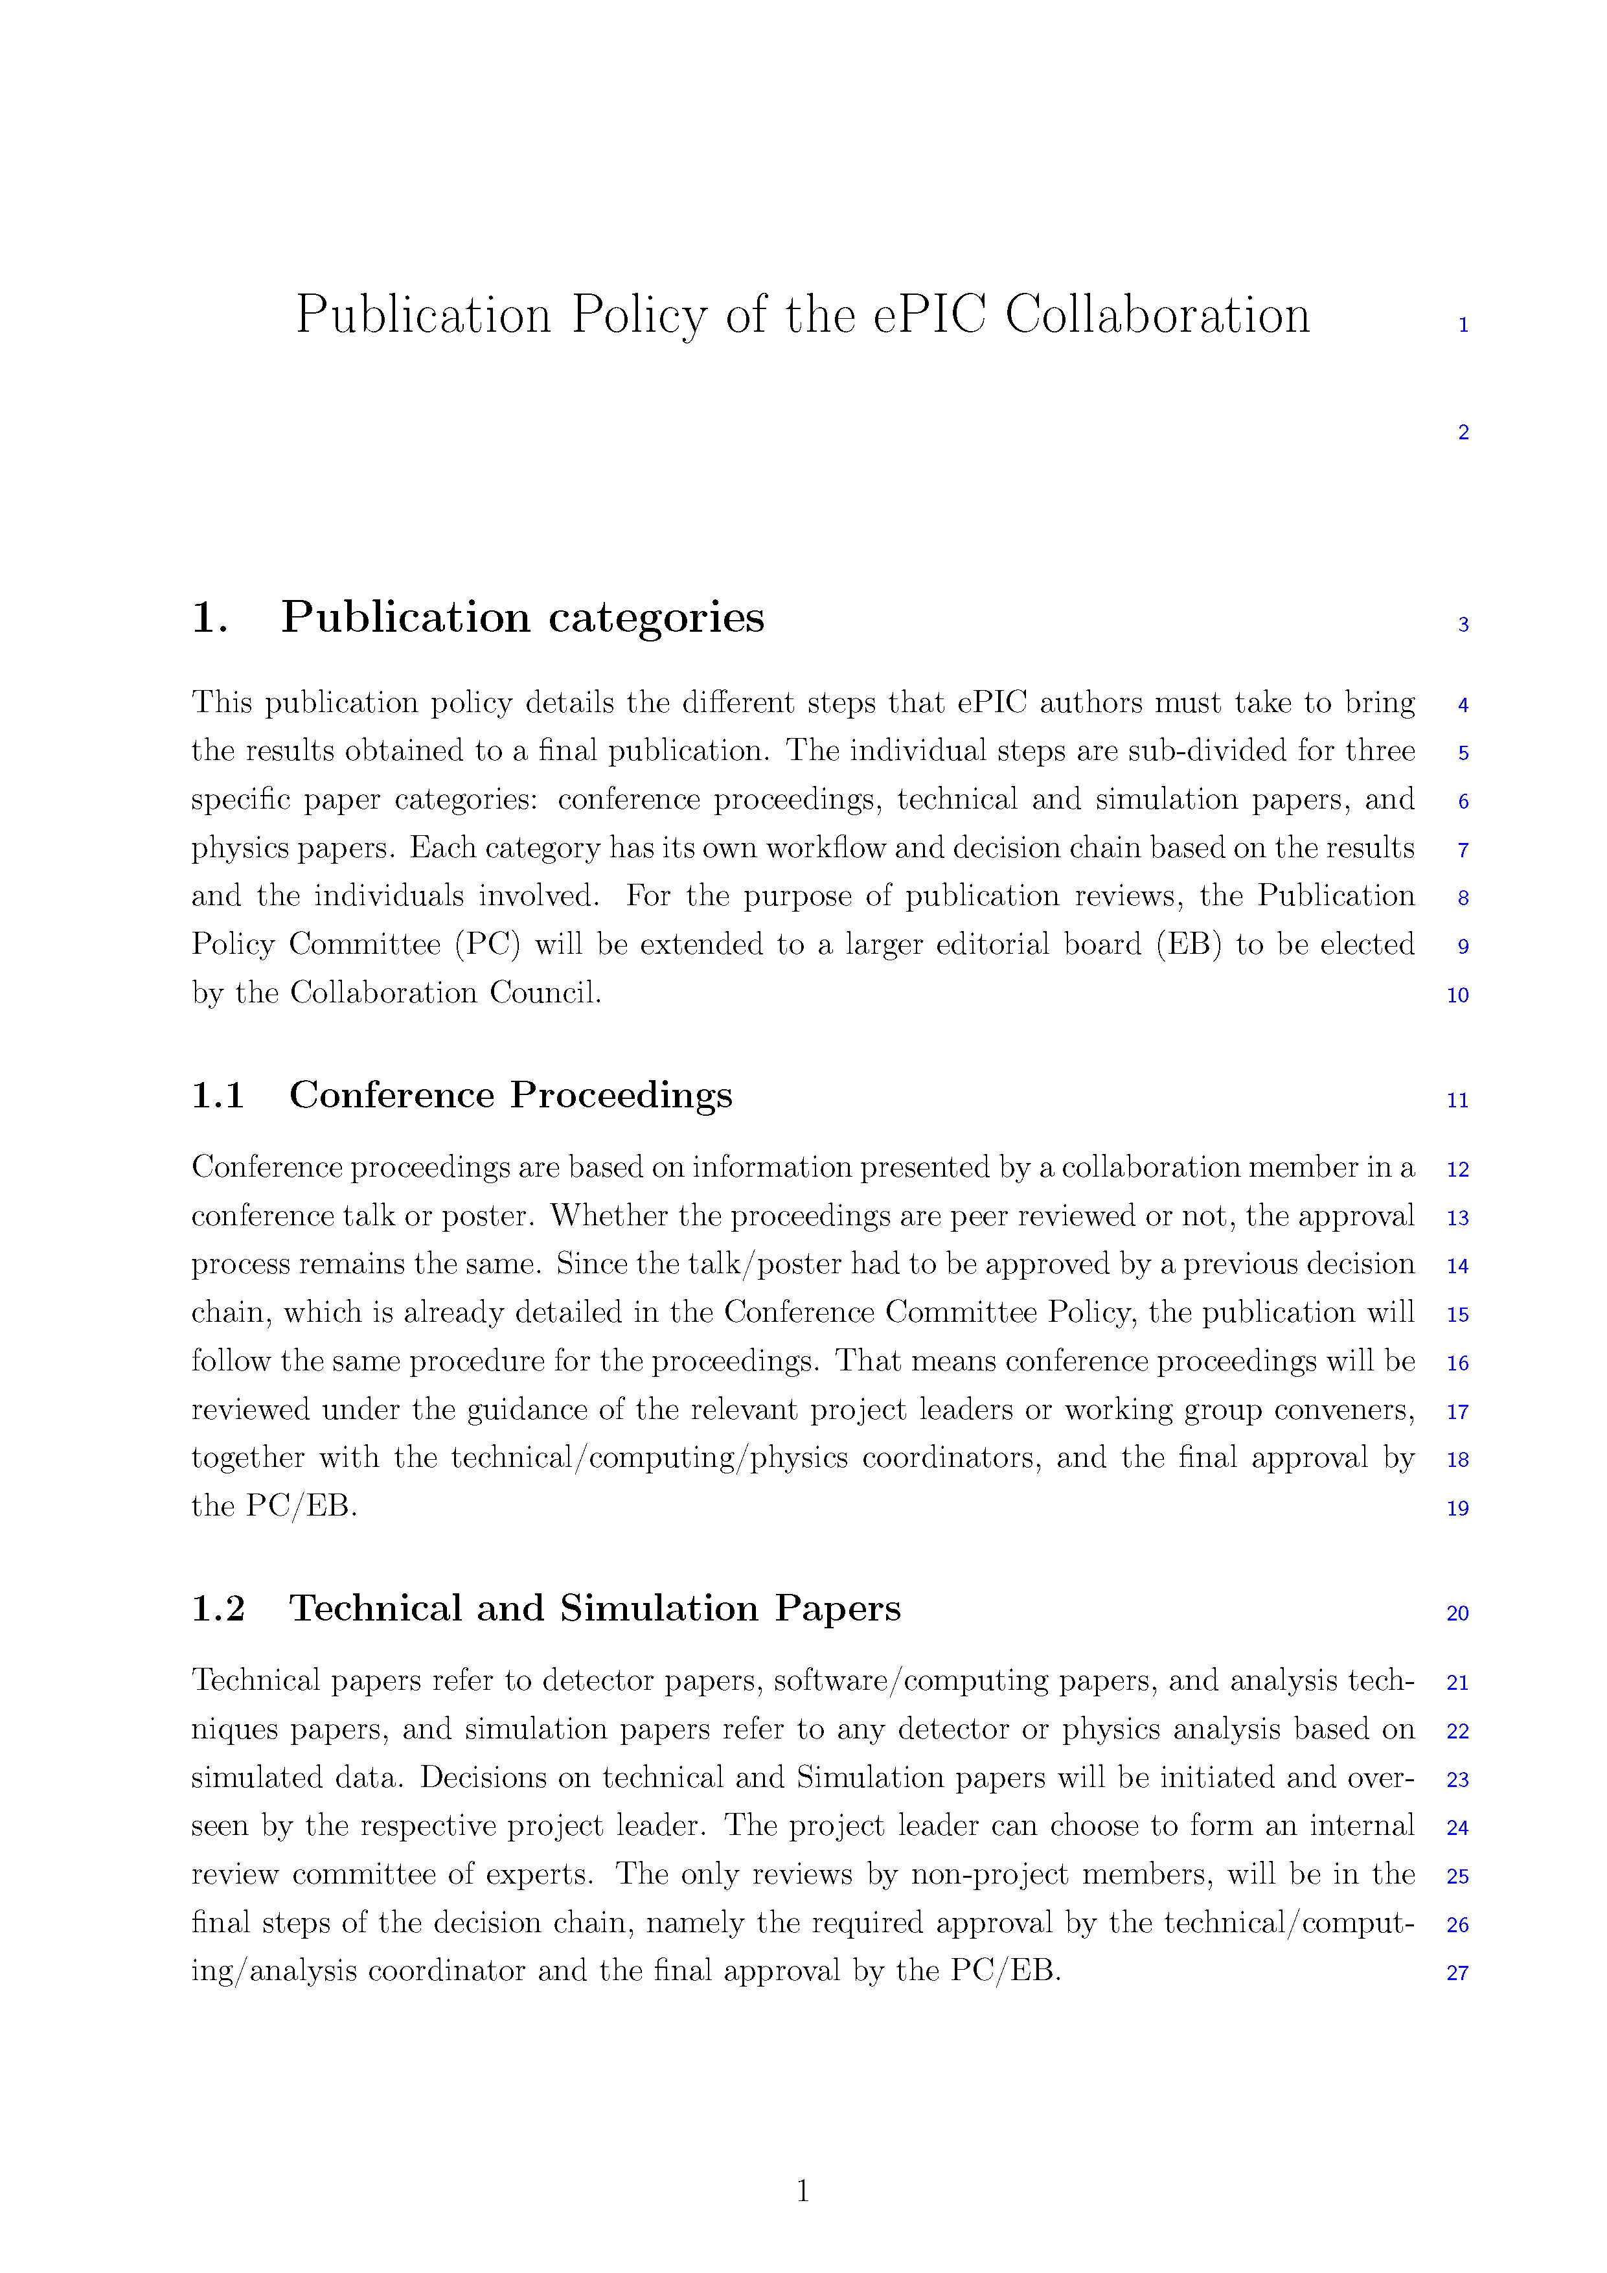
Formation of ePIC Policies
The Membership Policy was endorsed by the Collaboration Council August 2024.
The Conference and Talks Policy was endorsed by the Collaboration Council November 2024.
The Code of Conduct was endorsed by the Collaboration Council December 2024.
The Results Release Policy was endorsed by the Collaboration Council May 2025.
The Publication Policy is in an advanced draft, discussed in CC meetings in January and April 2025.

Slide 16
ePIC Statements of Service 2025
From the ePIC Membership Policy:
Continued authorship in the ePIC Collaboration requires membership in a signing institution and
inclusion in an annual institutional “statement of service”.
The annual statement of service is intended to reflect institutional commitments for the coming
year, and document contributions to ePIC carried out during the previous year. It is expected
that the majority of institutions will maintain signing status, once obtained, while they are active
members of ePIC.
67% of collaborators intend to qualify for authorship in 2025
  176.4 FTE on detector,
  23.1 FTE on Physics Analysis
Survey data made available to DSC’s, WG’s to improve engagement

Slide 17
Projections from 2025 Survey
GUIDANCE FOR INFORMATION TO BE FILLED IN THE TABLE
Fill the table with total workforce that you plan to dedicate to ePIC - expressed in FTE - of the nine different personnel types. Do not include personnel paid by EIC/ePIC R&D, PED or construction funds. The information requested is for any effort on behalf of the ePIC Collaboration, not just construction of ePIC.
Also please identify the two main areas of efforts of your group contributing to ePIC for each year. We expect this will evolve year to year, and we also understand that most groups do not have firm plans past the next few years.
For the purposes of this survey, please assume a constant total level of effort for your group, across all activities (both ePIC and non-ePIC), for the time period of the projection. Assume that there are no increases in students, postdocs or faculty working on ePIC due to new positions, but only redirection of effort from other group activities that may be winding down. In this way the overall effort on ePIC may increase over time, as workforce is redirected from other projects.
For purposes of this survey assume that the first physics run of ePIC is in 2034.
In addition to commitments for 2025, also requested projections for how collaborations might see the evolution of their engagement in ePIC
~70% of institutions responded
  Same fraction US/international

Slide 18
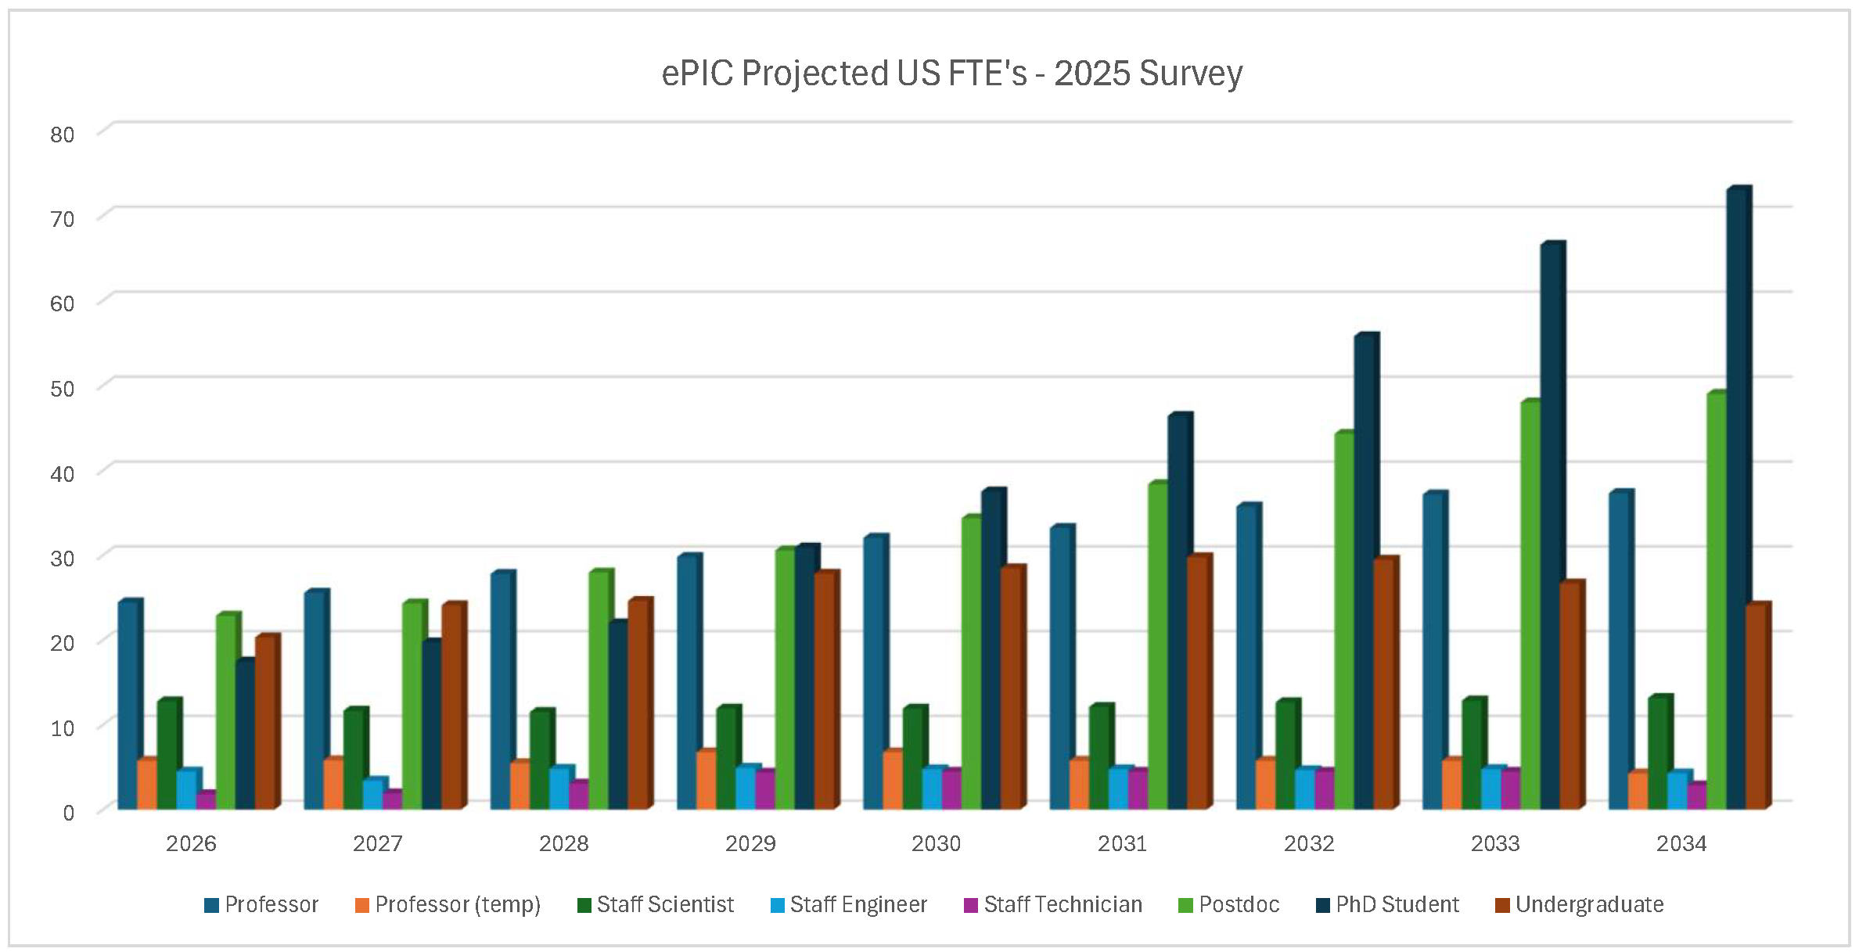
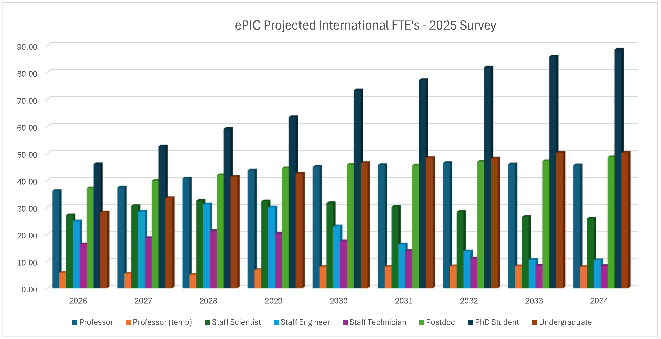
Projections Results from 2025 Survey
Both US and international institutions project the effort will scale up as we move into construction, especially students and postdocs, although there are differences in details.
This information will be useful as we discuss ramping up support for the collaboration, and were used to inform the profile for common funds Category C.

Slide 19
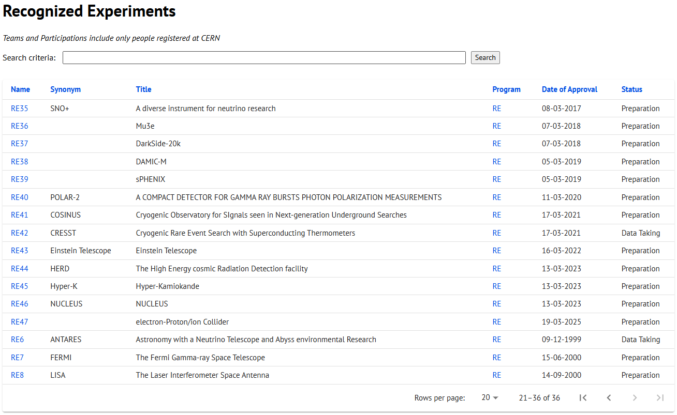
CERN Recognized Experiment Status: RE47
ePIC now appears in the CERN Grey Book database as RE47:
https://greybook.cern.ch/experiment/recognized
Two steps to get ePIC Collaborators registered at CERN:
CC Representative needs to register as team leader with
CERN Users Office:
  https://usersoffice.web.cern.ch/
  https://usersoffice.web.cern.ch/team-leaders-corner
  Users.Office@cern.ch
CC member can then certify registrations of team members
Several ePIC groups successfully registered

Slide 20
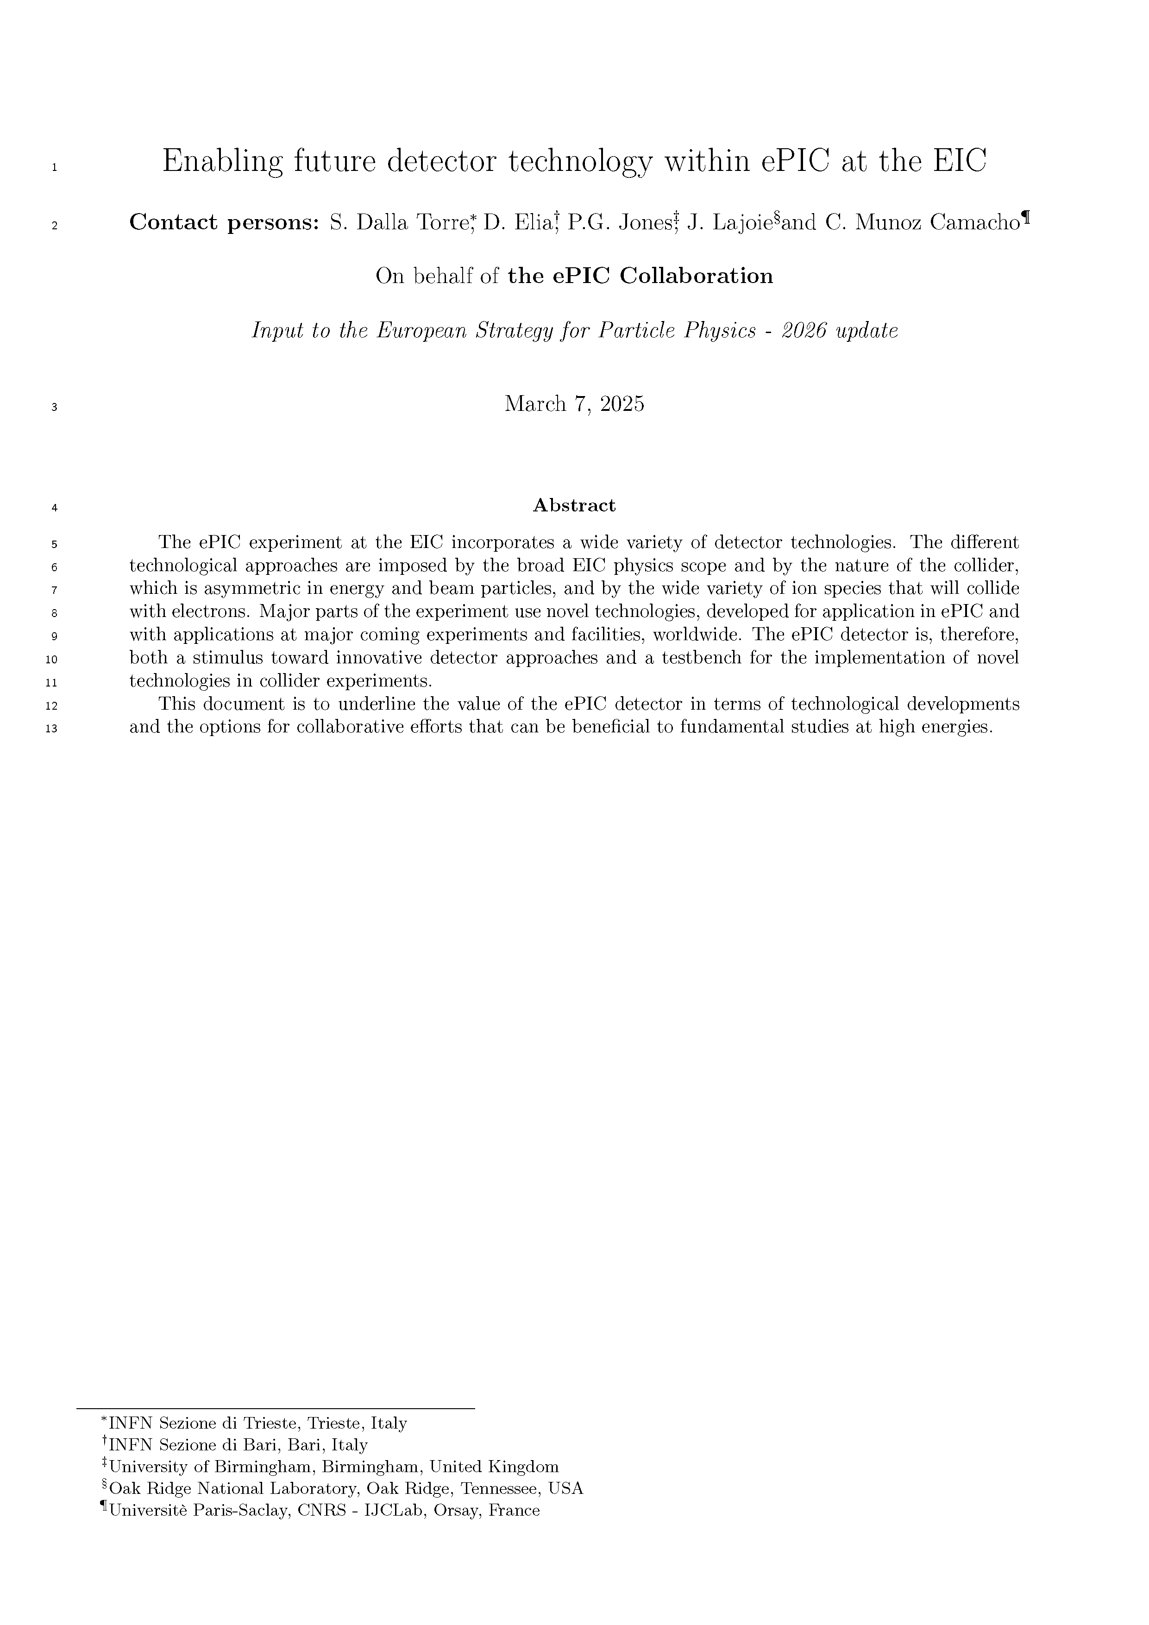
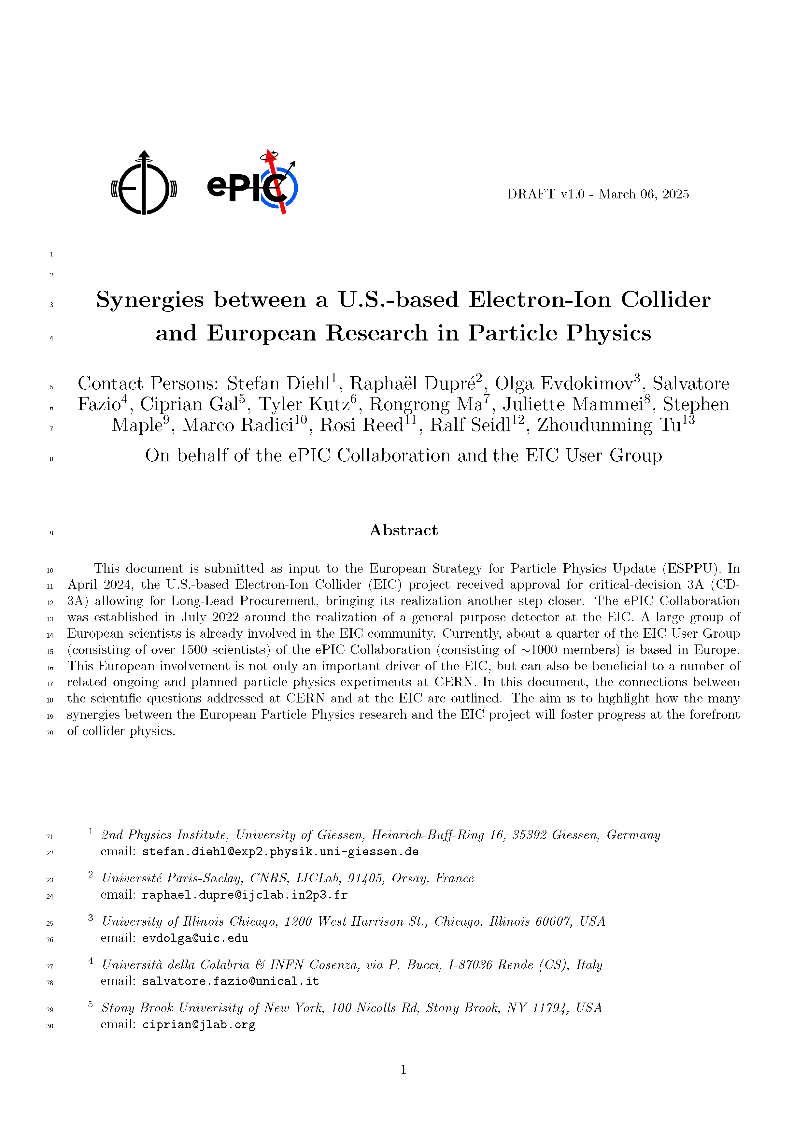
EPPSU White Papers
Two EPPSU white papers submitted directly by the collaboration:
  “Enabling future detector technology within ePIC at the EIC”
    Led by TC Office
  “Synergies between a U.S.-based Electron-Ion Collider and European Research in Particle Physics”
    Led by AC Office

Slide 21
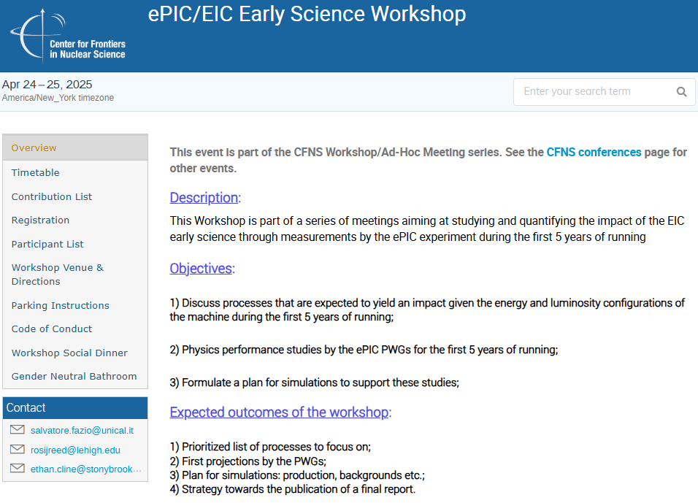
Third Early Science Workshop
Held September April 24-25th:
https://indico.bnl.gov/event/27576/
Supported by CFNS, with some travel support
for EC participants and theory guests.
Format of the workshop:
• 2 days in hybrid format
• Day 1 – theory discussions
• Day 2 – projections by PWGs, discussions
on software, individual contributions
82 registered participants with 33 in-person!
First years: EIC will already double the combined HERA luminosity for protons and add more capabilities: ion species from light to heavy, polarization of beams…

Slide 22
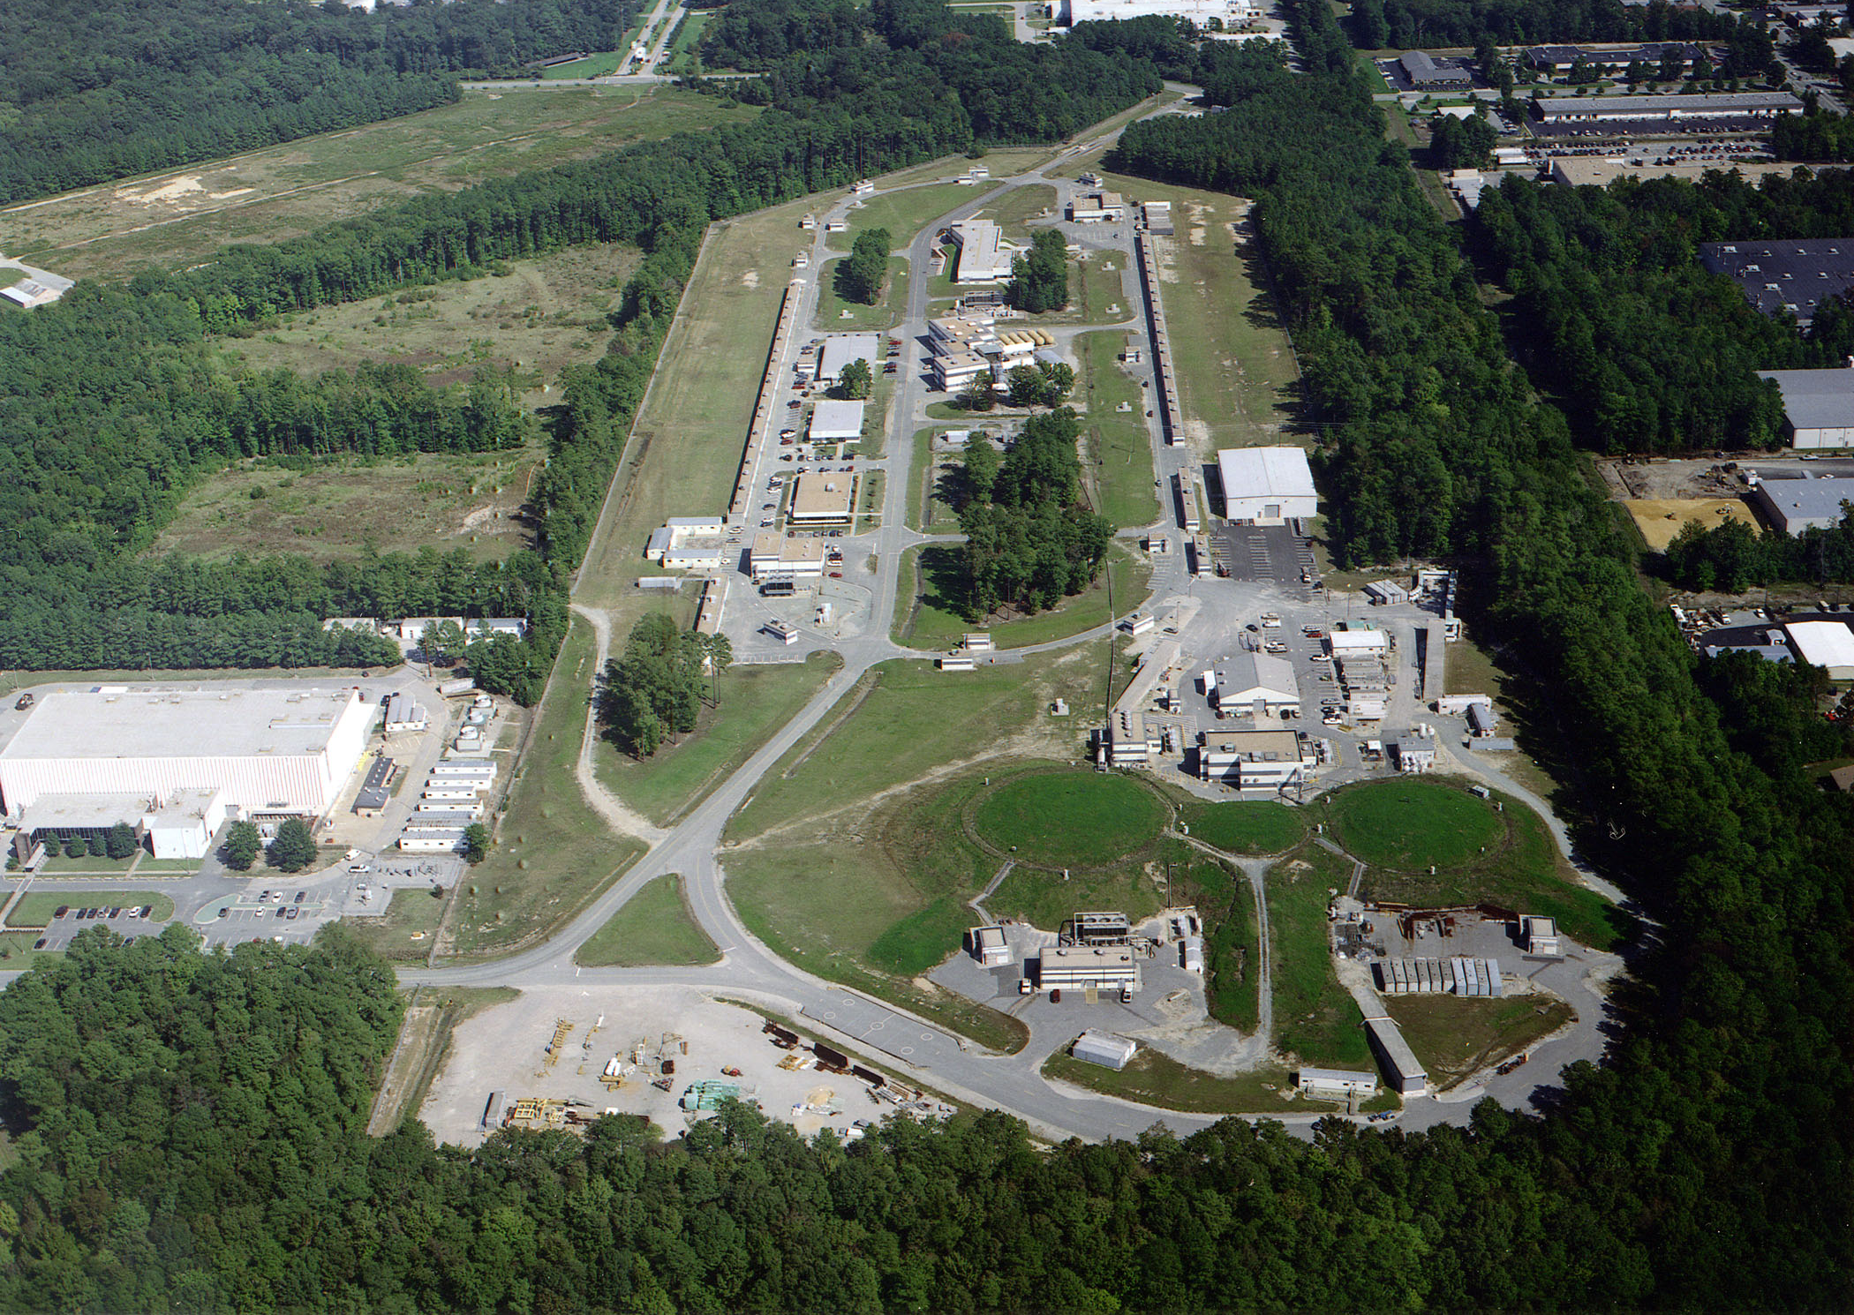
Summer 2025 EICUG/ePIC Collaboration Meeting
July 14-18th at JLab
EICUG Early Career Workshop
July 11-13th
Registration is now open:
https://indico.jlab.org/event/934/

Slide 23

Other News
Established a procedure for submission
of technical and analysis notes:
  https://www.epic-eic.org/documents/note_process.html
  Notes stored in Zenodo
Shifted alternate GM time to 10PM ET
to help improve engagement in Asia
  This corresponds to (next day):
    11AM in Tokyo/Seoul
    10AM in Taipei
    7:30AM in Mumbai
Elections underway for next ePIC
CC Vice-Chair

Slide 24
The Status of the Collaboration
The ePIC Collaboration is strong, active and growing!
International participation is key to the success of ePIC
  International collaborators play key roles in collaboration leadership
New leaders are emerging from within the collaboration
The collaboration is working together to identify and implement priorities
There has been good progress on the preTDR and plans for publications
Key collaboration policies are in place
The 2025 collaboration survey has provided important data about the composition and plans on collaborating institutions.
ePIC is engaged in developing the Early Science program at the EIC
The ePIC experiment is exercising its status as a
CERN Recognized Experiment
We are continuing very productive collaboration meetings with strong international participation

Slide 25


Slide 26
July 2025 Meeting Block Schedule
Early Career Workshop
Summer 2025 Joint EICUG/ePIC Collaboration Meeting
 | F July 11th | S | S | M July 14th | T | W | Th | F
Morning Sessions | Last part of MC4EIC | 2nd Session | 4th Session | Joint ePIC/ EICUG Plenary | Parallel/ Workfests | Parallel/ Workfests | ePIC CC Meeting | ePIC Closing Plenary
Lunch | Not Provided | Provided | Not Provided | Provided | Provided | Provided | Provided | Not Provided
Afternoon Sessions | 1st Session | 3rd Session | ( free ) | Accelerator/ JLab physics talks | EICUG/ Awards | Parallel/ Workfests | Parallel/ Workfests | ( free )
Goal is to integrate the EICUG/ePIC sessions as much as makes sense, make the agenda accessible to JLab users.

Slide 27
ePIC Resources
Public Website - https://www.bnl.gov/eic/epic.php
Mailing Lists – https://lists.bnl.gov/mailman/listinfo
Indico Agenda - https://indico.bnl.gov/category/402/
  ePIC Software and Computing: https://indico.bnl.gov/category/435/
Wiki - https://wiki.bnl.gov/EPIC
ePIC Software Training:
  Landing Page: https://eic.github.io/documentation/landingpage.html
  Tutorials: https://eic.github.io/documentation/tutorials.html
Mattermost: https://chat.epic-eic.org
ePIC Zenodo Community: https://zenodo.org/communities/epic

Slide 28


EICUG Membership
The EICUG is a vital organization to promote the interests of the EIC community!
  Without the EICUG we would never have gotten far enough to form ePIC!
Please register your institution!
Check with your EICUG IB representative to get registered as a member
https://www.eicug.org/content/join.html

Slide 29
Spokesperson Office Focus Items for Next Term
Continue to develop the infrastructure of the collaboration to support communication:
  An effective and well-maintained website
Restructure technical coordination to better support the DSC’s
  Continue to explore paths that lead to a full-time ePIC TC stationed at BNL
Work with the project to evolve the project plan
  A pre-TDR and a project review in 2026 is essential to maintaining momentum in ePIC
Substantially improve engagement in Physics Analysis
Communicate the need for explicit support for EIC research within DOE NP and international funding agencies
Pursue dedicated funding for ePIC Software and Computing
Updates to the ePIC Charter now that policies are in place (working with CC)
Put ePIC Common Funds on a path to starting with ePIC construction
Pursue increased engagement from the JLab community
Actively develop the next generation of ePIC Leadership

