Slide 1
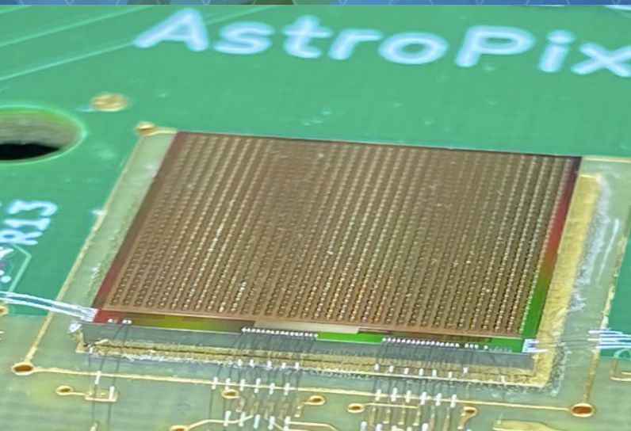
Barrel Imaging Calorimeter
News
The ePIC Barrel Imaging Calorimeter
Jessica Metcalfe, Maria Zurek, Sylvester Joosten
BIC General Meeting
Argonne National Laboratory
February 14, 2025

Slide 2
Organization Chart
Introduced at the last in-person workshop.
Fully implemented.
Reinforce the structure for more efficient work within the BIC collaboration.

Slide 3
Organization Chart
Green Team Leaders
-Manoj
-Sylvester
-Zisis
-Maria
→ Technical Managers = main point of contact for their technical area, responsible for the deliverables

Slide 4
BIC Meeting Schedule
Green Team or Technical Area Meetings:
Wafers: Manoj
Mondays at 4 pm Central—bi-weekly (next: Feb 17)
Modules & Staves: Manoj
Mondays at 4 pm Central—bi-weekly (next: Feb 24)
Mechanics & Sectors: Sylvester
Fridays at 1 pm Central
ESB, DAQ, & Readout: Zisis
Tuesday at 8 am Central—bi-weekly (next: Feb 18)
System Test: Maria
Tuesday at 8 am Central—bi-weekly (next: Feb 25)
Simulations: Maria
Tuesdays at 2 pm Central
BIC General Meeting:
~Monthly
Fridays at 8 am Central
Weekly Summary:
Mondays @ 4pm
Tuesdays @ 8am
Tuesdays @ 2pm
Fridays @1pm

Slide 5
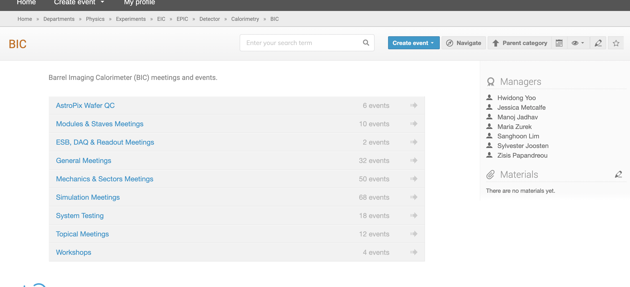
BIC Meeting Schedule
Indico link
All meetings can be found on indico
You can add the meetings to your calendar
  All of the BIC meetings from the BIC category
  Or some by going to a sub-category and using the calendar link on that page
Calendar link to add (past) future meetings → automatically updates your calendar as new meetings are added

Slide 6
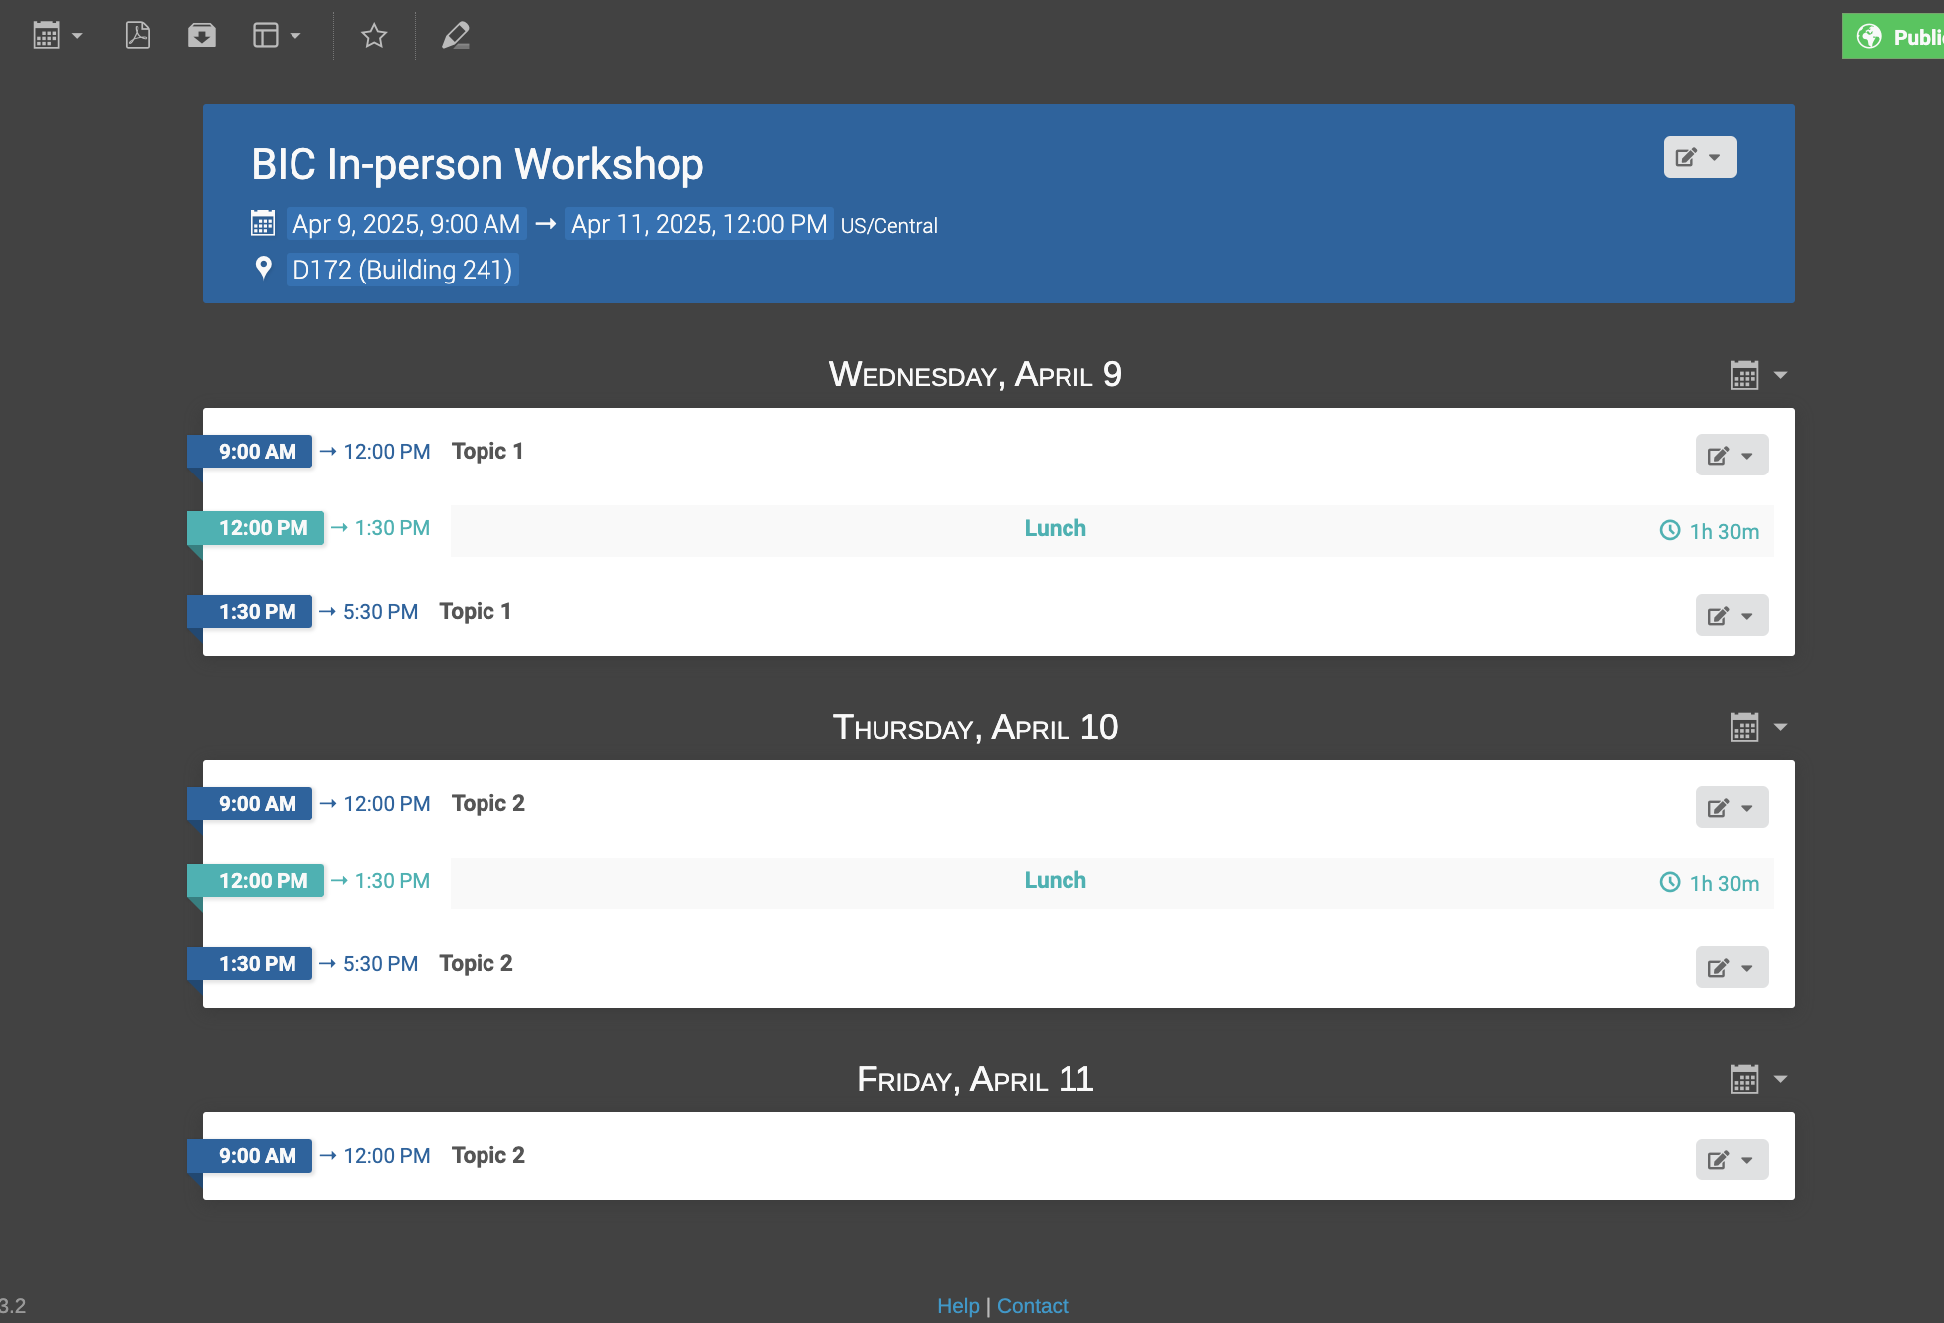
BIC In-person workshop April
Next In-person Workshop at Argonne: April 9 – 11
2.5 days, ends at noon on Friday
More info coming soon: registration, agenda, etc.
Workshop link

