Slide 1
Update on gas system and monitor
dRICH Office
January 5th, 2025
Silvia Dalla Torre and Fulvio Tessarotto

Slide 2
Items for PID review
Previous review: July 2023
Radiator gas choice
Conceptual design of the gas system
Needed monitoring tools
Interferometer development
Studies of C₂F₆ – CO₂ separation system
C2F6 fraction from sonar
Transparency in the visible
today
discussion

Slide 3
Items for PID review
Studies of C₂F₆ – CO₂ separation system

Slide 4
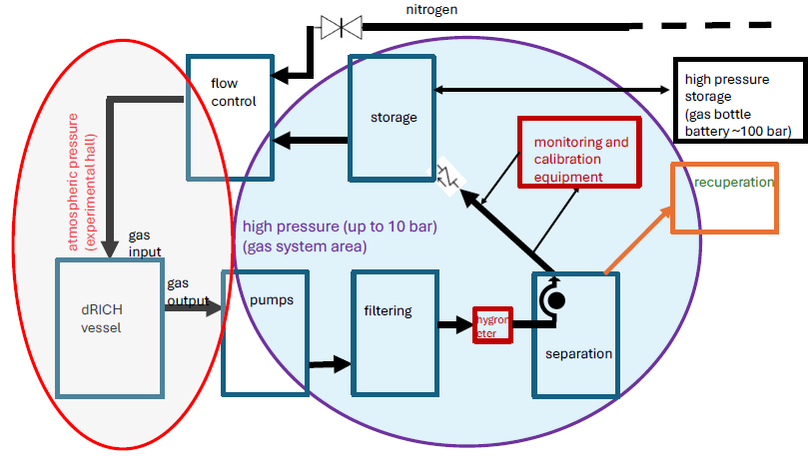
Block diagram of the dRICH gas system

Slide 5
Block diagram of the dRICH gas system
Studies for a possible separation system

Slide 6
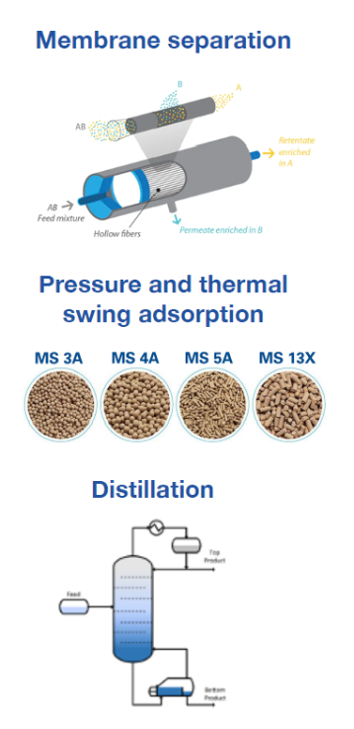
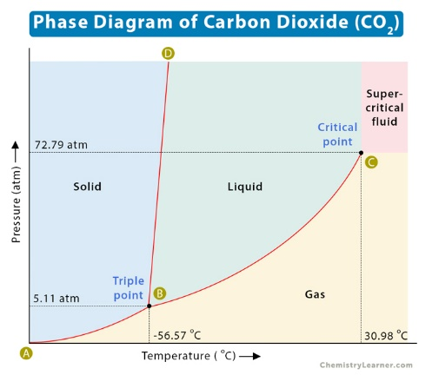
Separation possibilities
Phase separation by liquefying the radiator gas
→ implies operating at very low temperatures
2) Phase separation by liquefying the other gas
→ implies using CO₂ as neutral gas instead of nitrogen
3) Separation by membrane filtering
implies developing a dedicated system
fraction of C2F6 in the vented-out gas
REMINDER
temperature (˚C)
Damiano Galassi (EP-DT chemical Engineer)
Is studying for us the behavior of C2F6-CO2
mixture and phase separation options:
partial condensation , crystallization, …

Slide 7
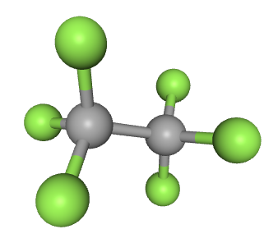
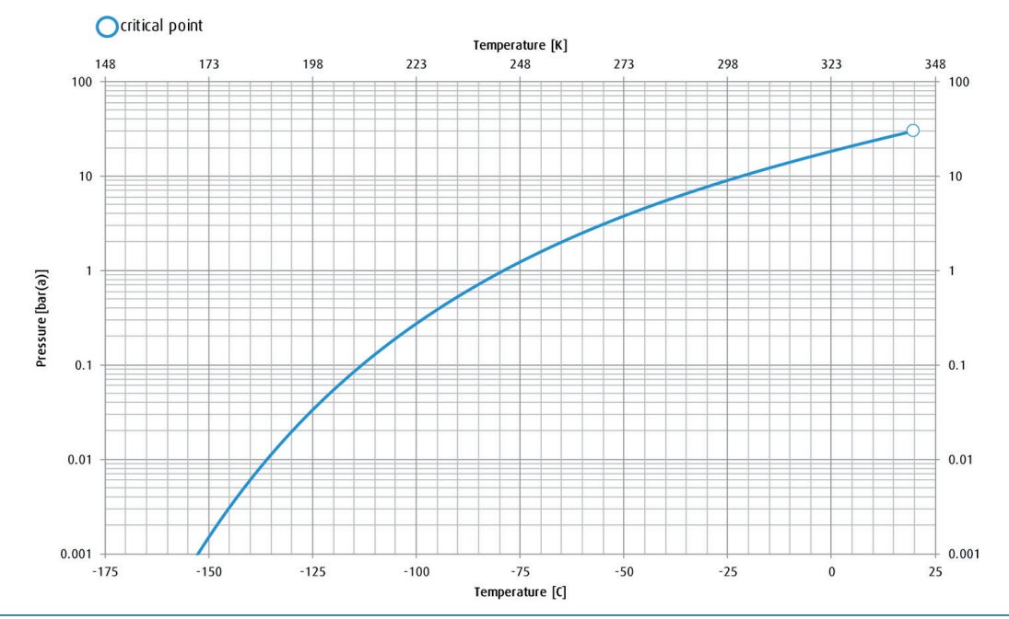
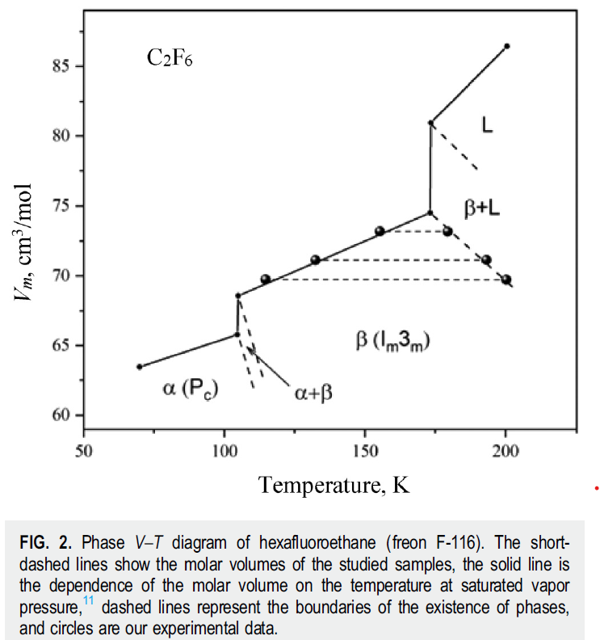
Physical properties of C₂F₆
C₂F₆ molecular weight: 138.01 g/mol
boiling point: -78.1 °C
melting point: -100.6 °C
density: 5.734 kg/m³ at 24 °C
density: 16.08 kg/m³ at -78 °C
1 covalent bond
6 hydrogen bond
hexsafluoroethane
REMINDER
liquid
gas

Slide 8
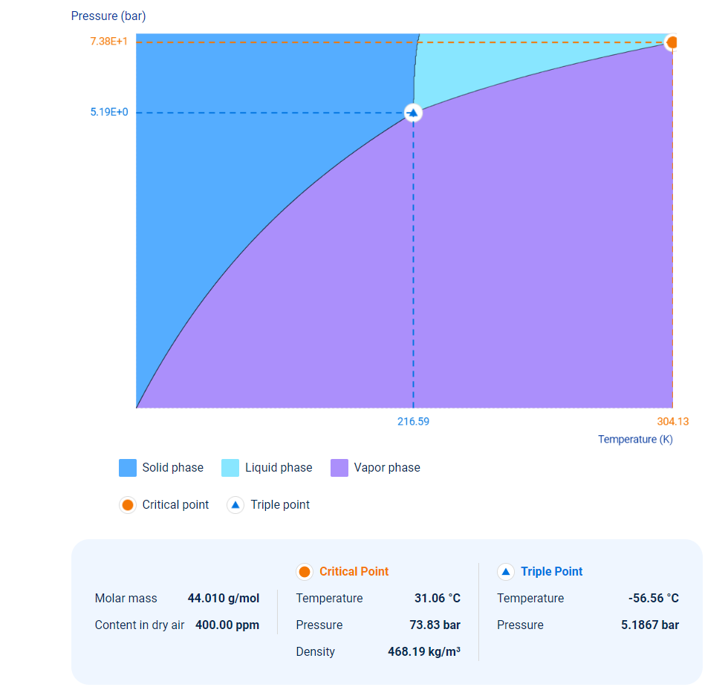
Physical properties of CO₂
No liquid below
-56.6 ˚C

Slide 9
An approach for vessel filling
Using CO2 as stand-by gas
CO2 requires reasonable P, T conditions for liquefaction
Studies of CO2-C2F6 separation

Slide 10
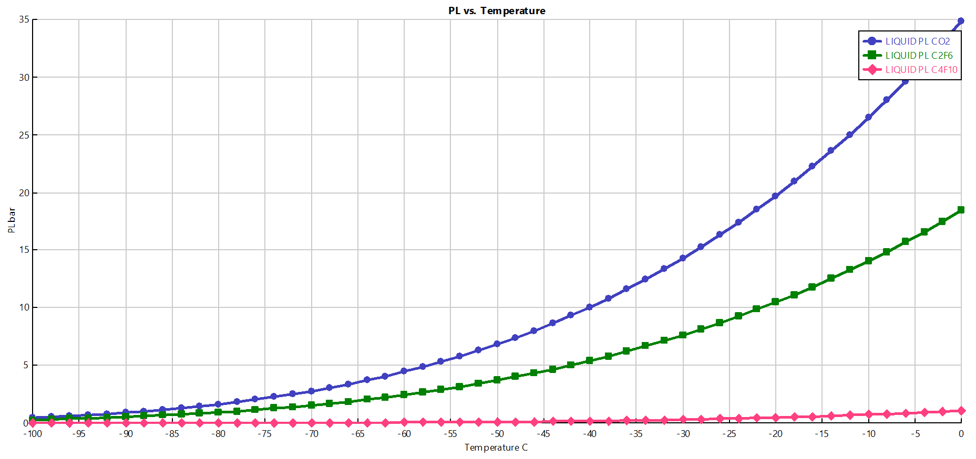
Separation of C₂F₆ from CO₂
Preliminary Studies: CO2 – C2F6 Binary Mixture
Investigation performed by Damiano Galassi, chemical and process Engineer, EP-DT-FS Gas team, CERN, Nov. 2024
Liquefaction Pressure (PL) versus temperature
CO2
Triple point -57 C and 5.2 bar
Possible condensation point (T,P) = (-53, 6) expressed in C, bar
C2F6
Triple point -100 C and 0.3 bar
Possible condensation point (T,P) = (-37, 6) expressed in C, bar

Slide 11
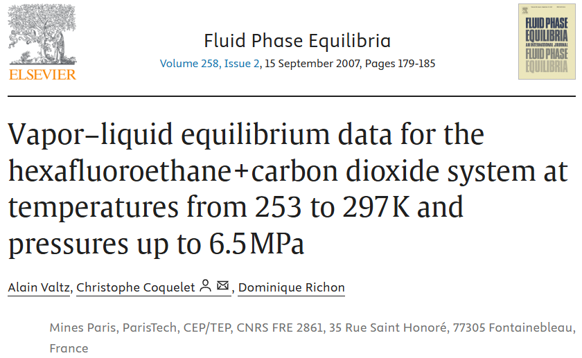
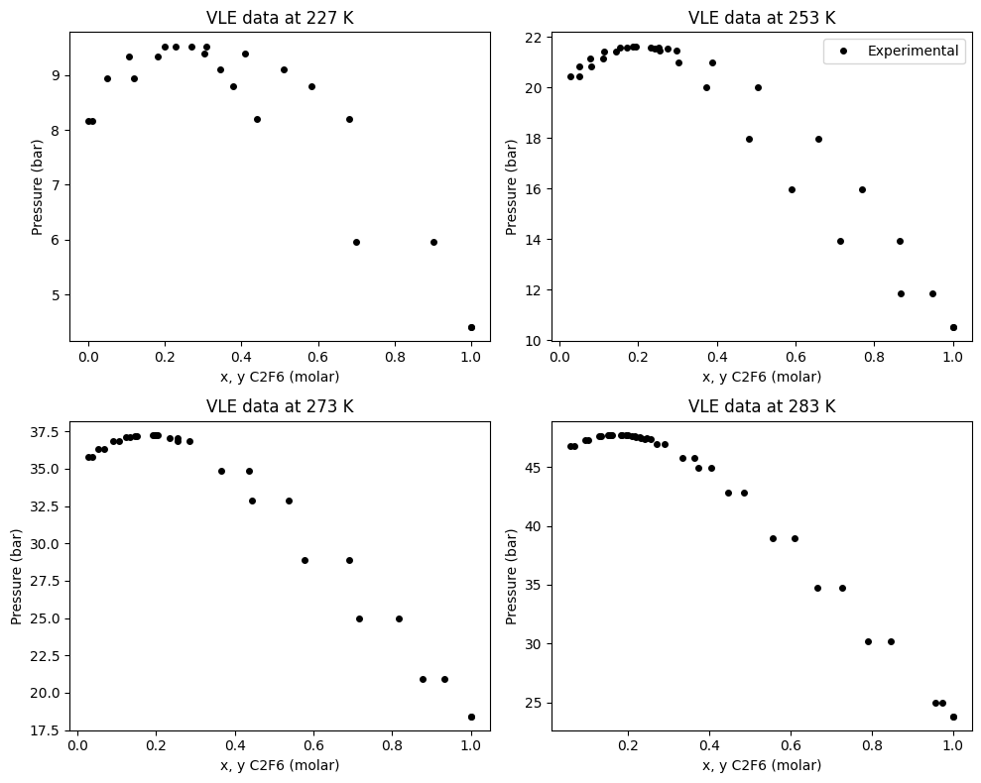
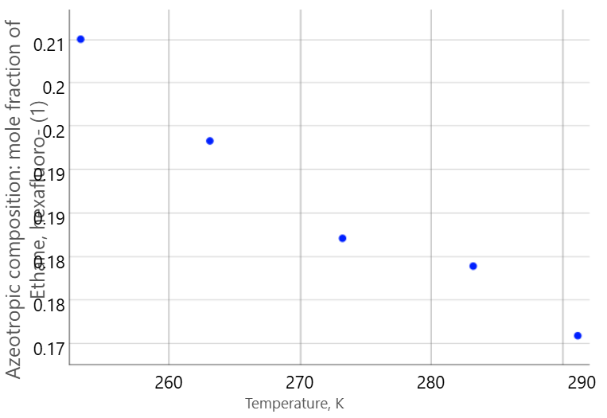
C2F6 - CO2 gas mixture
Experimental data from literature on Vapor-Liquid Equilibrium (VLE) versus CO2 fraction
azeotropic behavior ➔strong interaction between the two molecules
Fraction of C2F6 in azeotropic composition

Slide 12
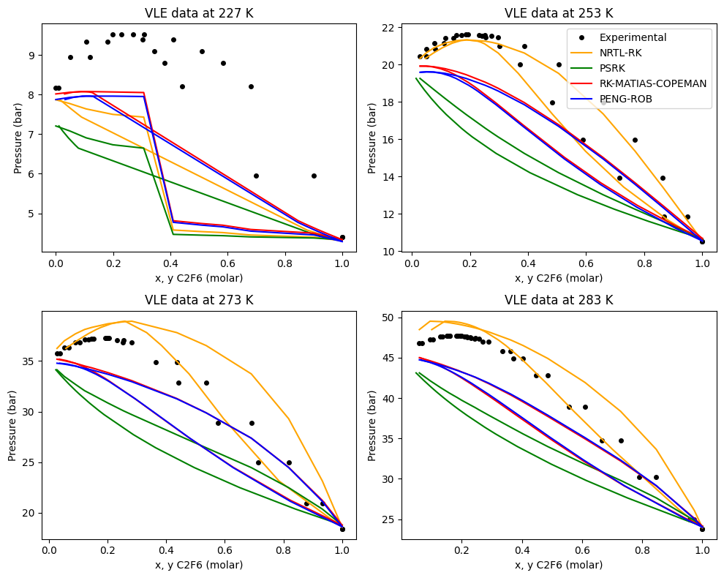
C2F6 - CO2
Comparison with various models
NRTL-RK (Non-Random Two Liquids) to model liquid phase and its deviation from ideality coupled with Redlich-Kwong’s cubic equation of state to simulate the vapor phase.
PSRK (Predictive Soave Redlich-Kwong) which uses EOS (equation of state) both for the vapor and liquid phase and corrects the attractive forces by using Wong-Sandler mixing rules.
RK-ASPEN (Redlich-Kwong + Mathias-Copeman alpha function) which follows the same rules of PSRK but corrects the attraction with the MC alpha function.
PR (Peng-Robinson) which is another cubic EOS mostly suitable for hydrocarbons in extreme conditions (usually of high pressures)
Existing Models do not reproduce the data in the interesting region
-46 ˚C

Slide 13
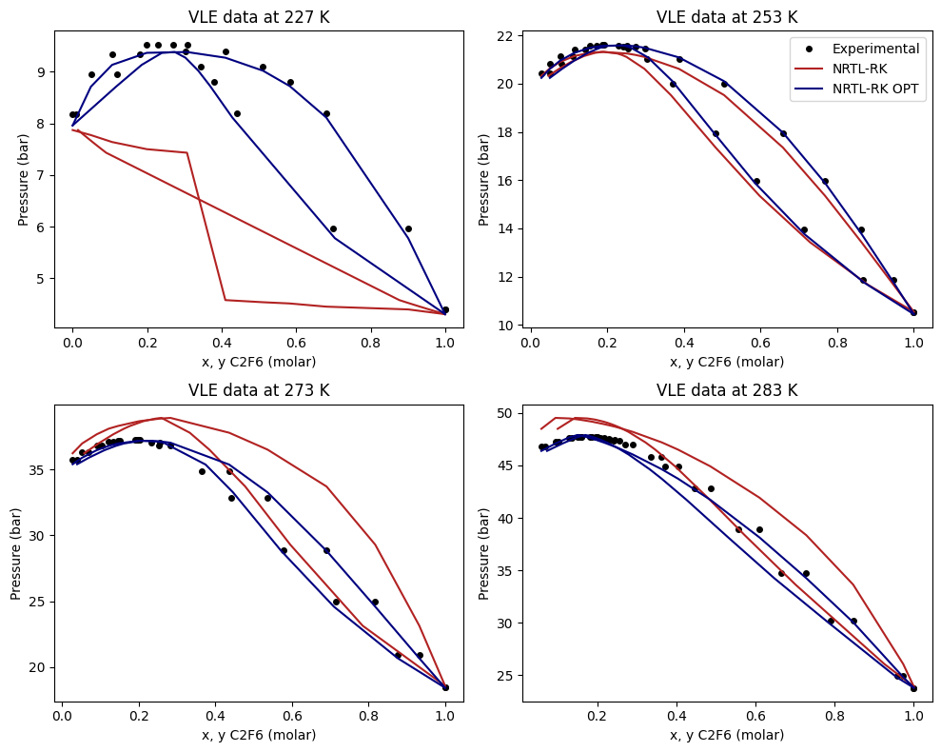
C2F6 - CO2
The model improved by Damiano Galassi
Improved Model obtained by fitting the parameters on the data
Allows for identification of optimal separation procedures

Slide 14
Separation of C2F6 from CO2
10 bar
5 bar
2 bar
1 bar

Slide 15
Separation of C2F6 from CO2
10 bar
5 bar
2 bar
1 bar

Slide 16
Separation of C2F6 from CO2
CO₂/C₂F₆ 50/50 gas
10 bar
CO₂/C₂F₆ 26/74 liquid
5 bar
2 bar
1 bar

Slide 17
Separation of C2F6 from CO2
CO₂/C₂F₆ 26/74 gas
CO₂/C₂F₆ 50/50 gas
CO₂/C₂F₆ 12/88
10 bar
CO₂/C₂F₆ 26/74 liquid
5 bar
2 bar
1 bar

Slide 18
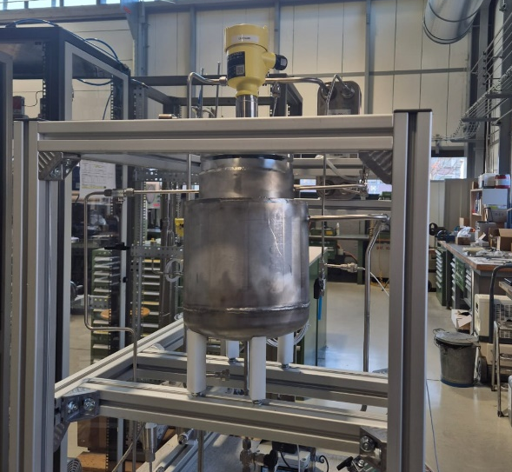
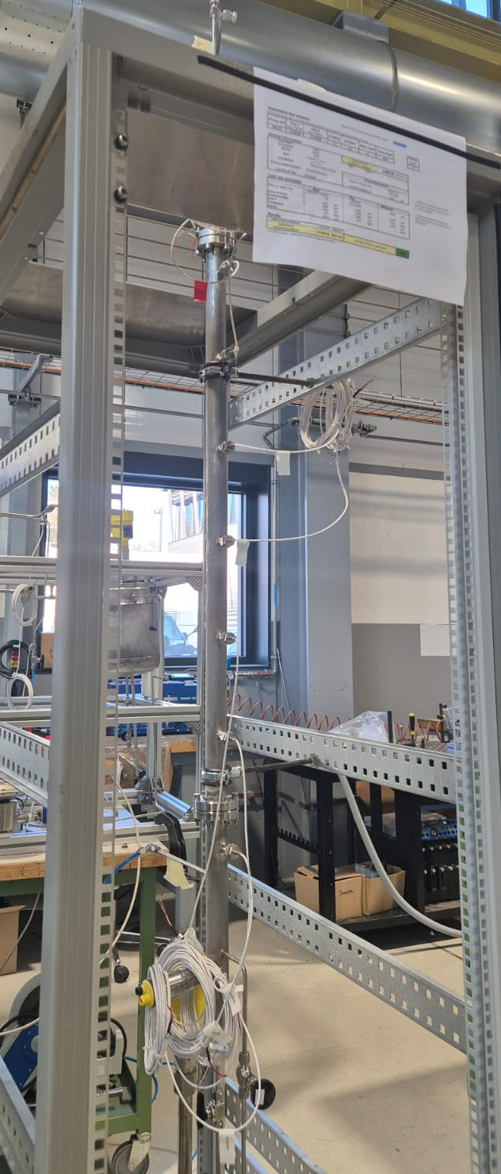
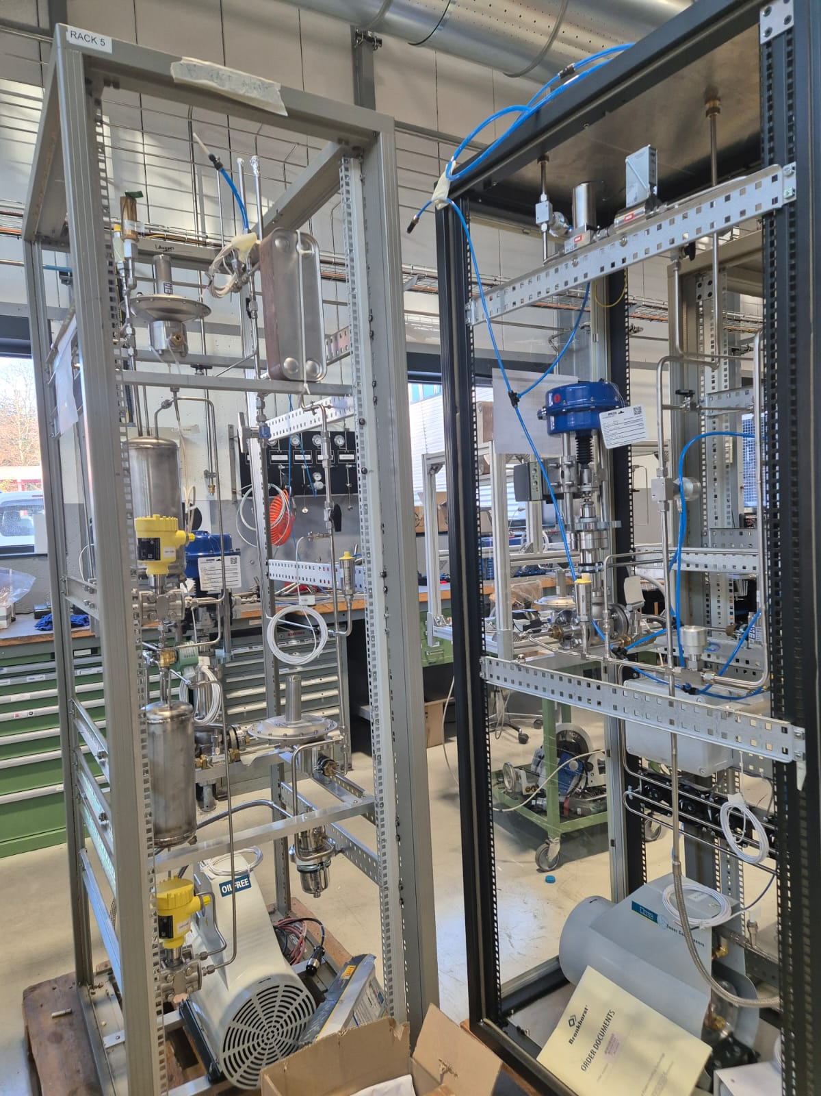
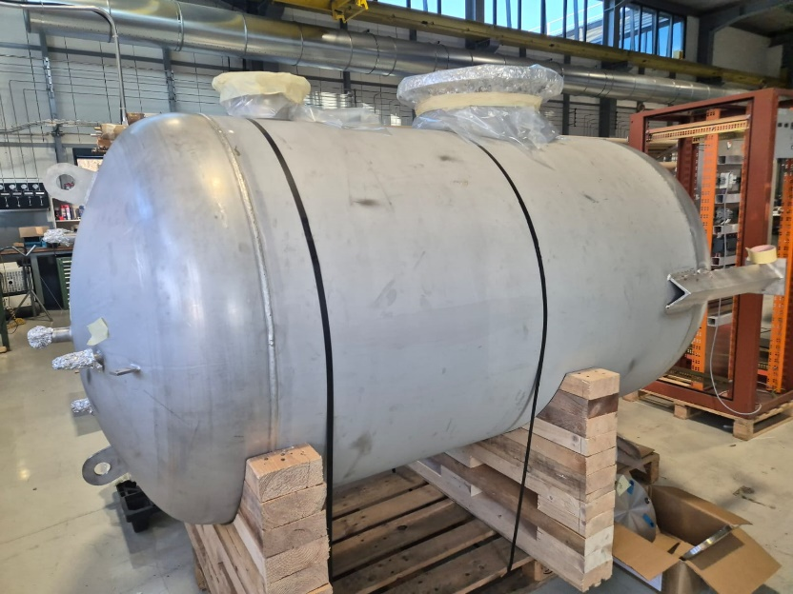
CERN setup
Elements of a setup for separation with distillation column at CERN
our sonar measurement

Slide 19
C2F6 - CO2
The system is being prepared at CERN for a different application
Limited in maximum pressure up to 3.5 bar
Temperature down to -90 C
Could be used by us for a test of C2F6-CO2 separation:
an interesting option being explored.

Slide 20
An approach for vessel filling
C2F6 fraction from sonar

Slide 21
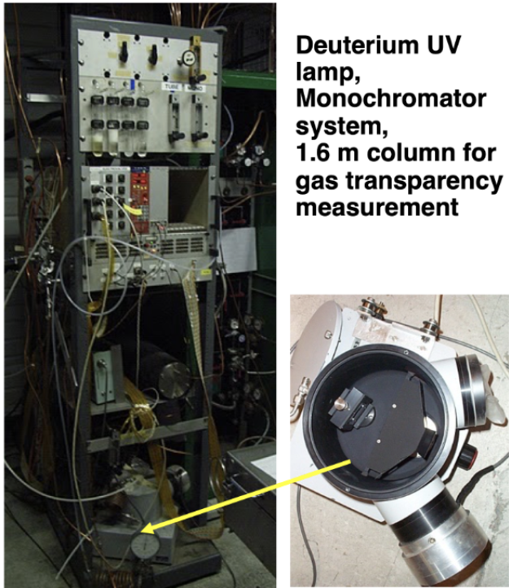
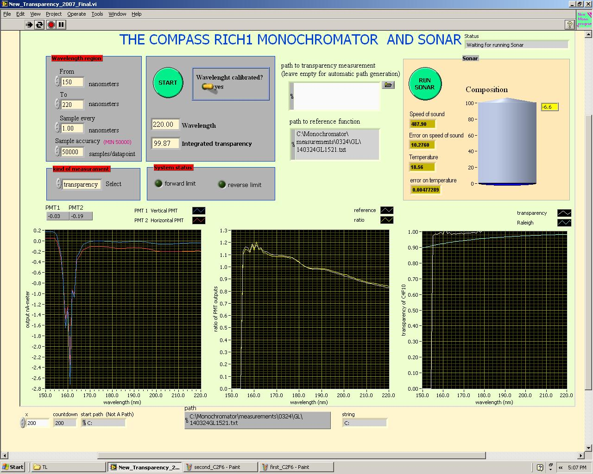
VUV Trasparency of C₂F₆
Exafluoroethane 5.0 at CERN
Used for a test-beam
REMINDER
Measured in the COMPASS setup
transparency > 98%
for 170 nm < λ < 220 nm

Slide 22
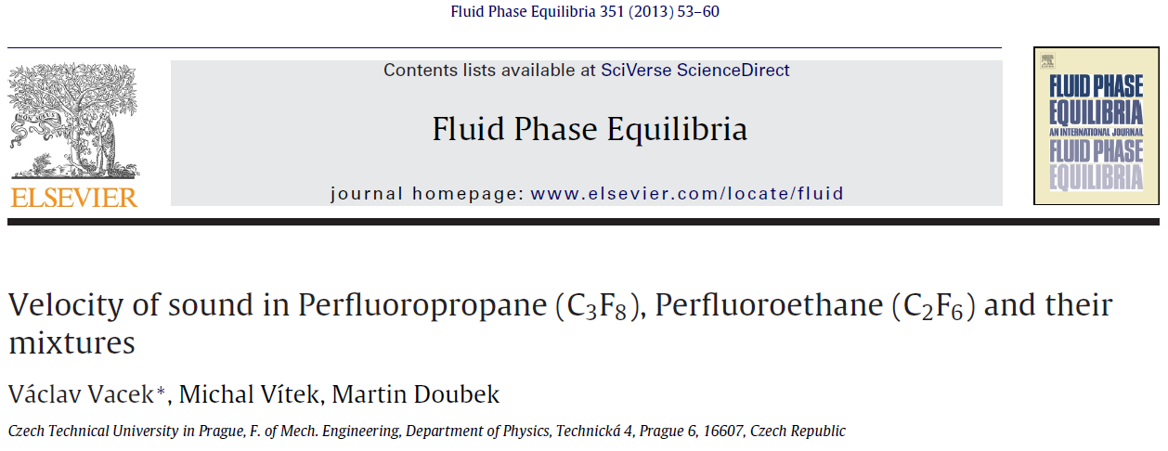
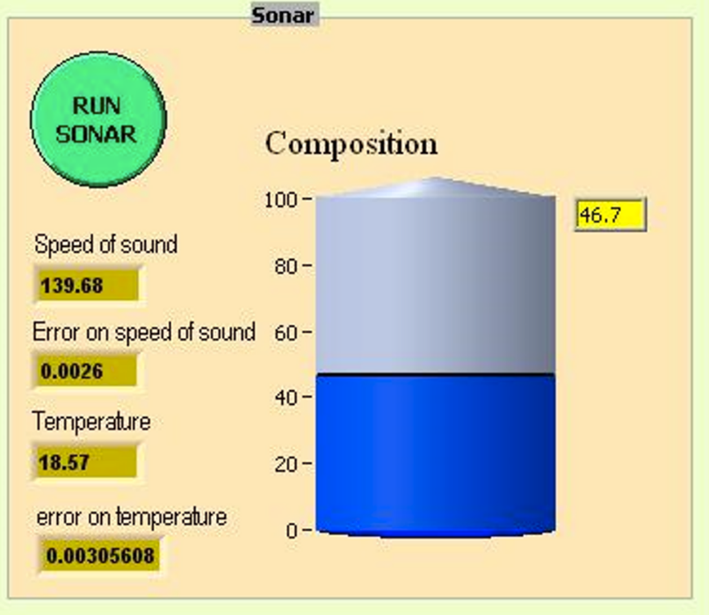
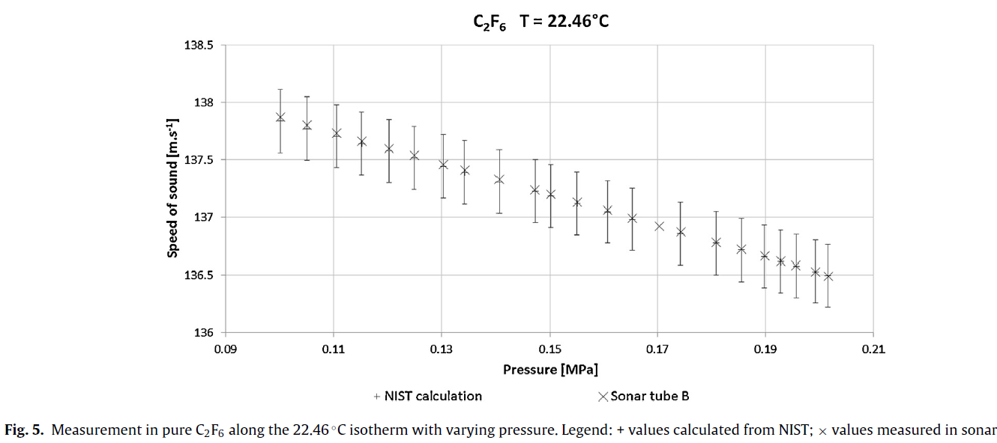
C₂F₆ speed of sound
C₂F₆ flushed at 50 l/h for
40 minutes (~3 volumes)
Speed of sound: 139.7 m/s
our sonar measurement
Thanks to this measurement we can state that we were very near to 100% C2F6
Sonar in the system can be very useful

Slide 23
Other separation options
Transparency in the visible range

Slide 24
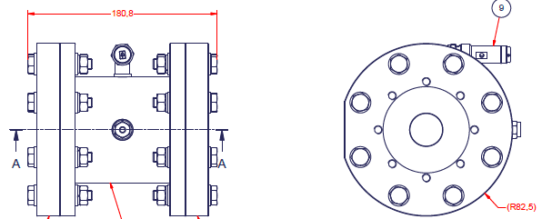
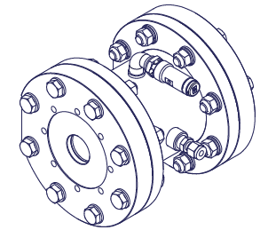
Strategy of measurements
In the visible range commercial devices can be used: spectrophotometers
This imposes short sample cell size, therefore pressurized gas cell
10 cm at 10 bar equivalent to 1 m long cell at 1 bar
A cell for transparency measurements of C2F6 is in preparation (designed by Ferrara)

Slide 25
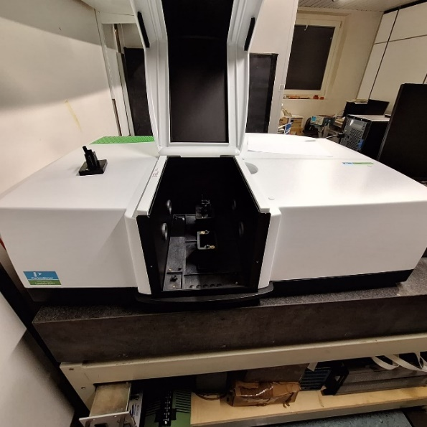
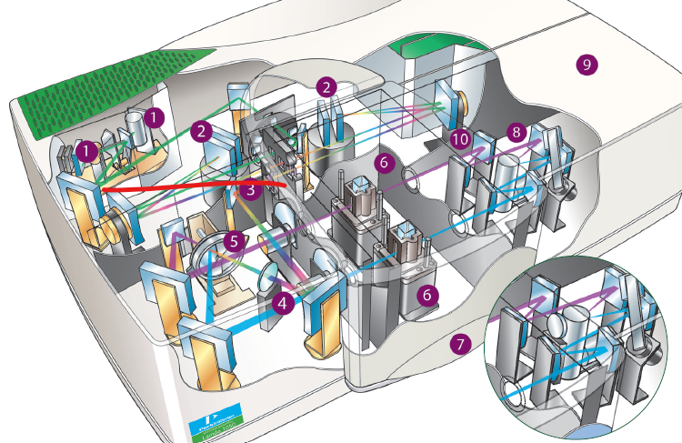
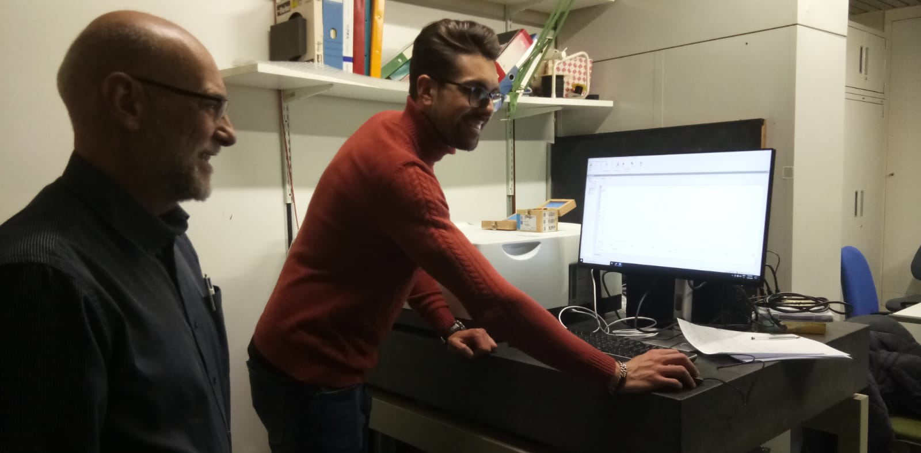
Purchase of Perkin Elmer 850+
Financed by INFN at the end of 2024
Selected: PE850+ by Perkin Elmer
PE 850+ installed in Trieste and commissioned by Perkin Elmer personnel on 30.01.25

Slide 26
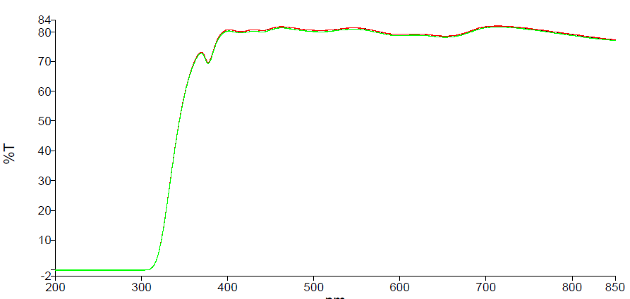
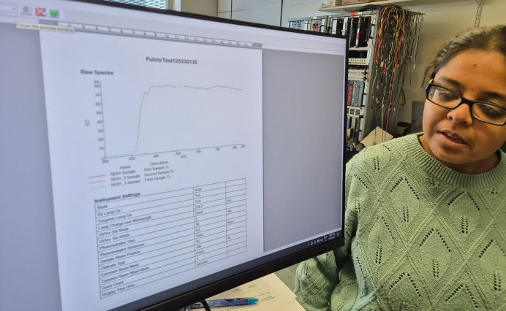
first measurement with Perkin Elmer 850+
We performed 3 consecutive measurements of a filter of OD=0.1
Great reproducibility!

Slide 27

first measurement with Perkin Elmer 850+
We performed 3 consecutive measurements of a filter of OD=0.1
Thorlabs datasheet
Superimposed (blue)

Slide 28
Interferometer development
Bachelor thesis of Gabriele Furlani
(Trieste University), this summer

