Slide 1
TAKE FIVE for Safety- Work Planning and Control
Frank Craner
March 25, 2025

Slide 2
Work Planning and Control
Work Control Coordinator
Screens the work per Work Planning and Control Subject Area Screening Tool:
Worker Planned
Permit Planned
Prescribed
Plans work within one of the three categories above
Screens the work for USI per OPM 1.10.1
If the work involves Electrical Hazards:
Electrical Competent Person completes Electrical Planning and Briefing
Independent Electrical Reviewer completes review

Slide 3
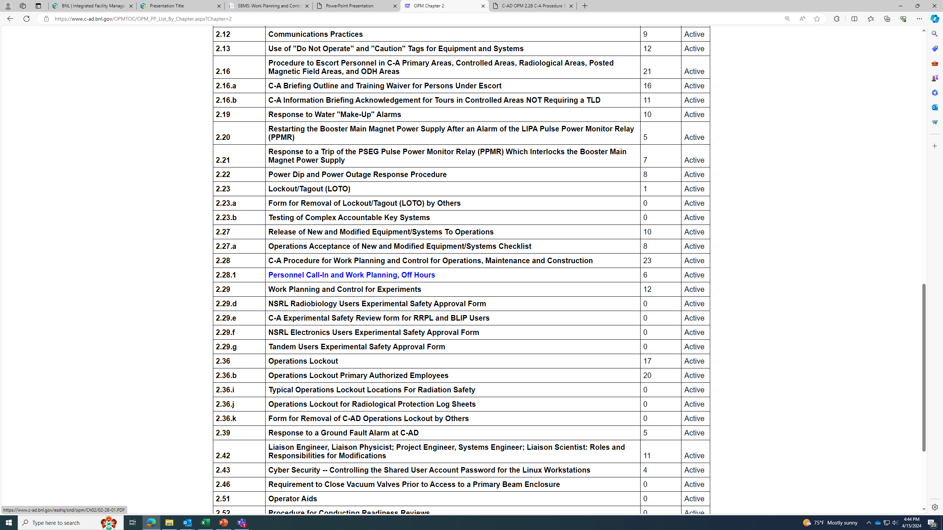
Off-Hours Work- OPM 2.28.1

Slide 4
Safe Conduct of Research in Work Planning
Everyone is personally responsible for ensuring safe operations.
Staff raise safety concerns because trust permeates the organization.
Cutting-edge science requires cutting-edge safety.
A questioning attitude is cultivated.
Hazards are identified and evaluated for every task, every time.
A healthy respect is maintained for what can go wrong.

Slide 5
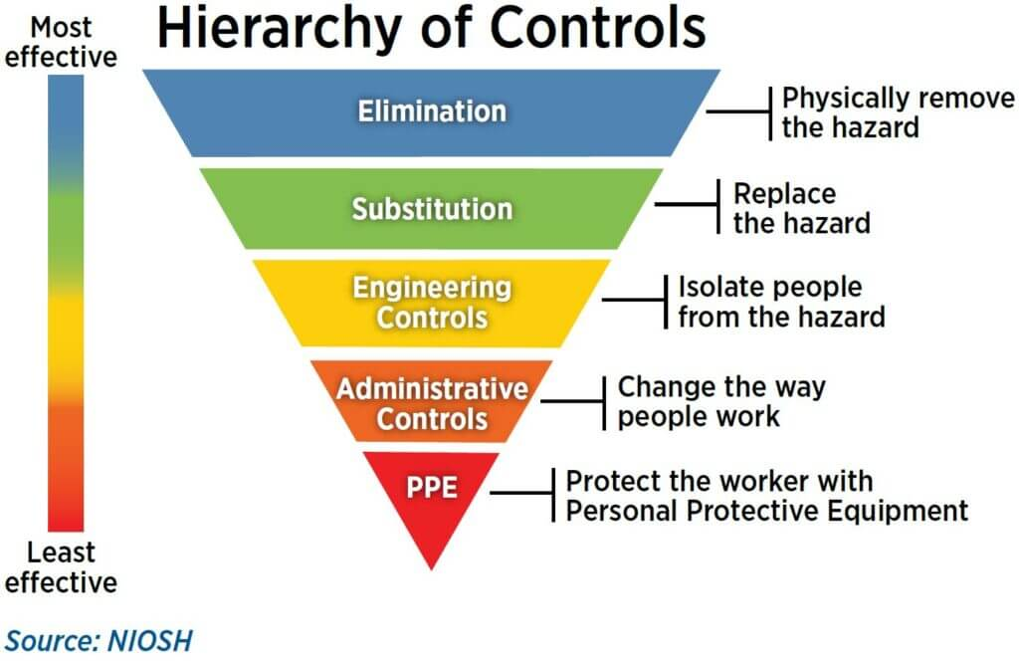
Identify, Evaluate, and Control Hazards
Hazardous Energy
Chemical Use
Radiation
Noise
Lasers
Heights/Fall Hazards/Ladders
Working Surfaces
Material Handling
Moving Machine Parts
Confined Spaces
Atmospheric Hazards (ODH, Toxic Fumes, Gases, etc)
Environmental Hazards
Etc.

Slide 6
Consider Human Performance Factors
People are fallible, and even the best people make mistakes.
Error-likely situations are predictable, manageable, and preventable.
Individual behavior is influenced by organizational processes and values.
People achieve high levels of performance because of the encouragement and reinforcement received from leaders, peers, and subordinates.
Events can be avoided through an understanding of the reasons mistakes occur and application of the lessons learned from past events (or errors).

Slide 7
Key Messages
The Planning must ensure conformance with several requirements in SBMS, including (but not limited to) Work Planning and Control, Accelerator Safety, Electrical Safety, Lockout-Tagout.
The Work Planning process is the same, regardless of the time of day or sense of urgency.
Planning can ensure that we identify and mitigate hazards.
Time pressure and Stress are recognized Error Precursors; These can be managed through planning.

