Slide 1
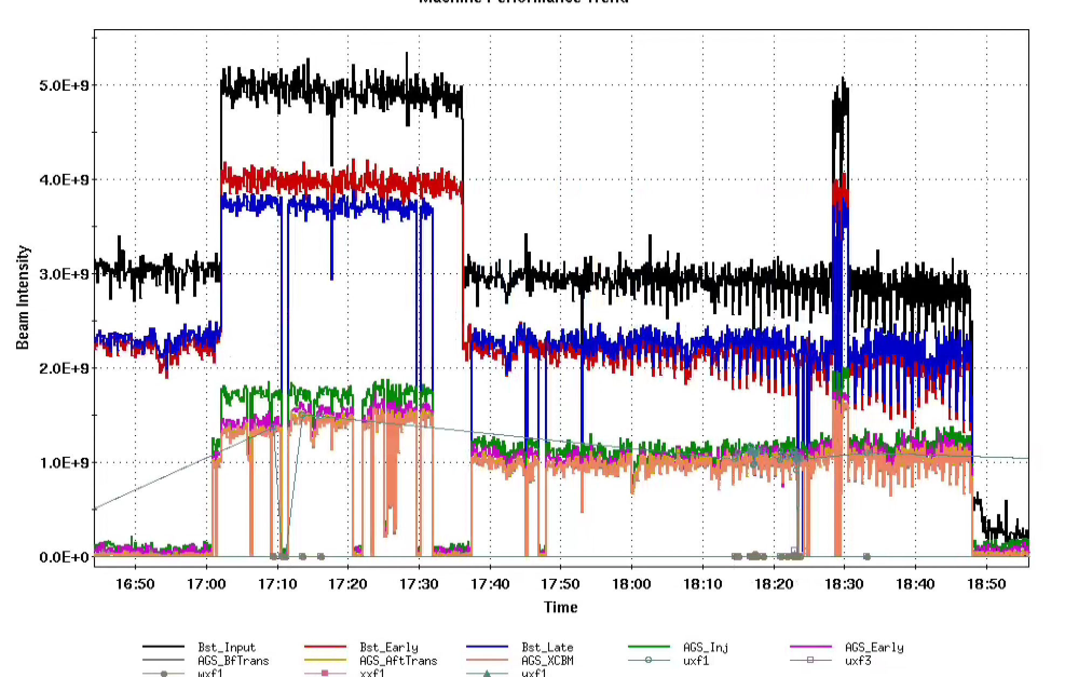
AGS Status: Time meeting 3/25/25
Tandem Au up to 1.5e9/bunch at AGS extraction
extracted to W-dump Fri 3/21
Resolved problems with AGS extraction kicker G10 and G09 BLW resolved
Mysterious change in Booster to AGS optics (relative to end of Run 24) still outstanding
Quad required substantial retuning

