Slide 1
sPHENIX status
Kin Yip
sPHENIX Director of Operations
Shutdown Time Meeting
Mar. 25, 2025

Slide 2
sPHENIX Status during Shutdown
Preparation for the 2025 run is completed including (recently):
Verified all detector rack interlocks
AESRC walkthrough, Magnet Inspection and Laser inspection
Donut counters installed & test-fitted Collars are in open positions
Magnet pole-tip doors closed yesterday (Mar. 24)
New bufferboxes in our DAQ have been in use with more disk bandwidth.
Cooling improvement: New AC in the 1008 chiller platform has been installed, inspected and switched on (thanks to C-AD and F&O, a multi-month effort).
The modified 1-Ton cranes in 1008 IR have passed inspection and will be cleared for use after some preventive maintenance.

Slide 3
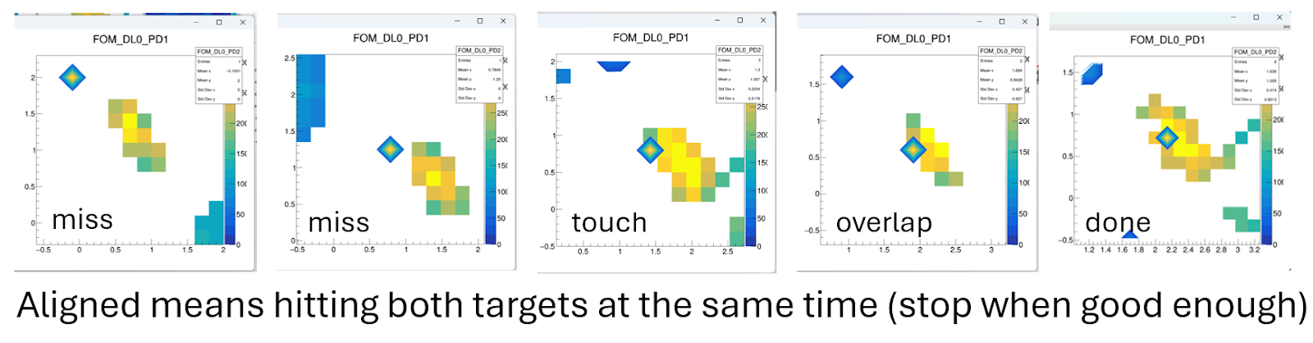
TPC line laser alignment etc.
A lot of works have been done to automate the alignment procedure for the TPC line lasers.
TPC also performed extensive gain scans successfully, with only occasional trips.
Ramp procedures are now scripted for easy shift-screw operation.

Slide 4
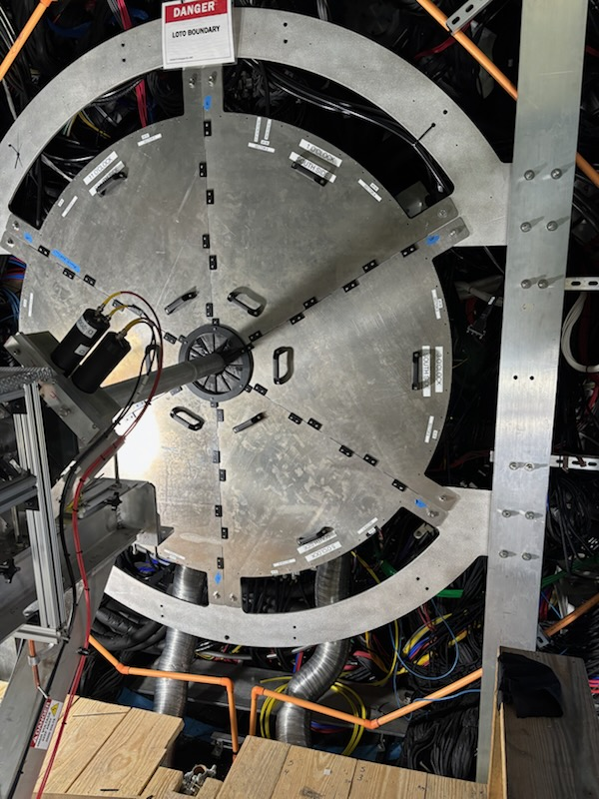
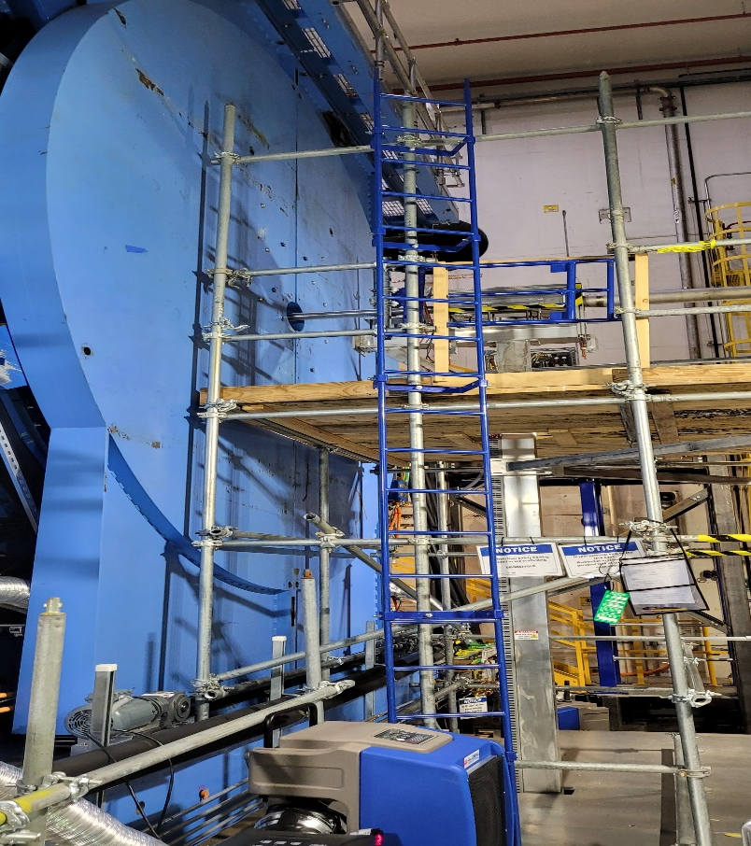
Detectors and Magnet
All detectors have been installed (last one: sEPD)
Magnet doors were closed on Monday.
Mar. 24 Magnet cooldown to ~4.8 K
Mar. 25 cold hipot (Carl, Kin)
Mar. 25-26 interlock verification (CAS)
We will do Magnet power supply test/ramp (Pablo & CAS), on Mar. 27 or whenever the interlock verification is completed.

