Slide 1
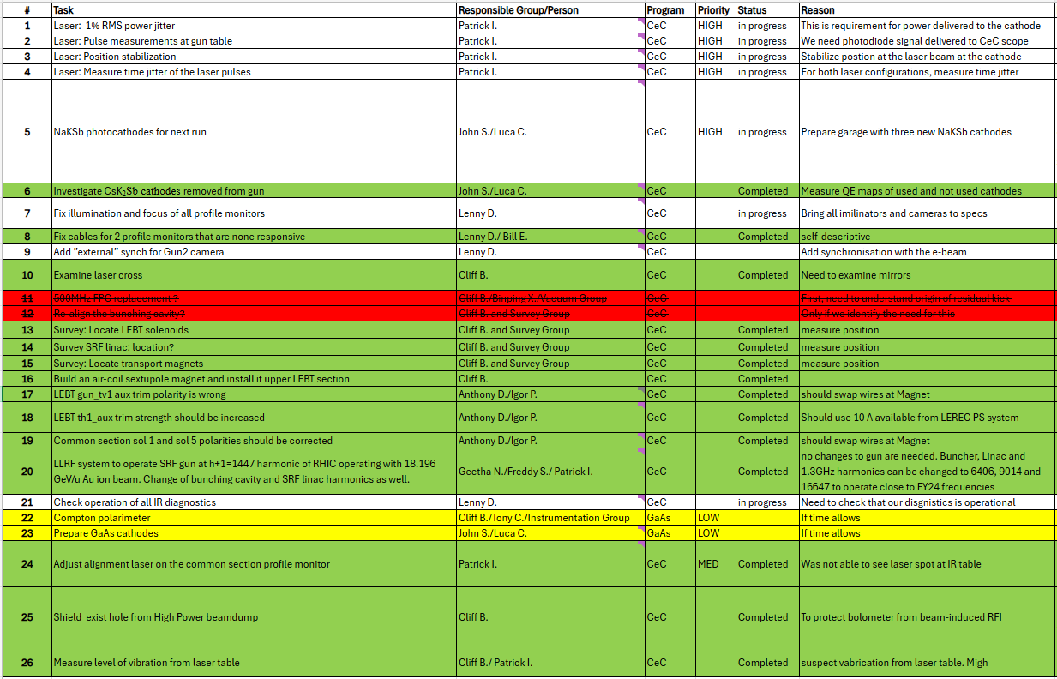
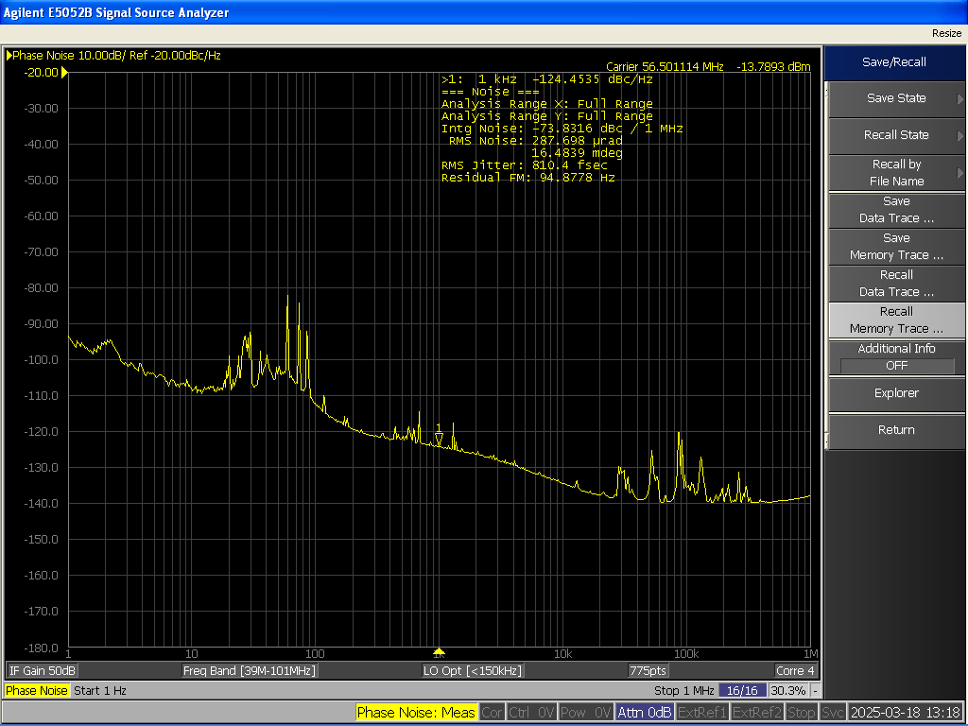
CeC status, 3/25/25
Readiness for Run 25
Cathode – CeC will start with 2 available CsK2Sb cathodes in the garage installed.
New NaKSb cathode showed progress in QE uniformity (+/-10% p2p in ROI) and will be installed when further optimization and growth of new garage is finished.
Laser – RMS intensity jitter (1.5%) and RMS time jitter (~ 810 fs) have been measured. Will check with the electron beam when system is up.
SRFs – cavities will be cold by the end of the week. Frequencies/Harmonics will be tuned for new operational mode (lower beam energy).
CeC sub-system dry run has been completed and issues found have been fixed.

