Slide 1
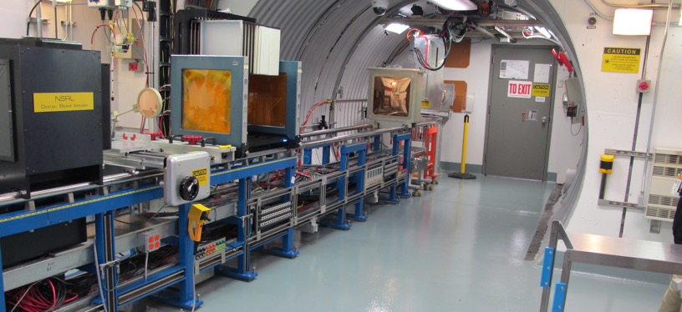
NSRL Time Meeting Report
25 March 2025
Michael Sivertz

Slide 2
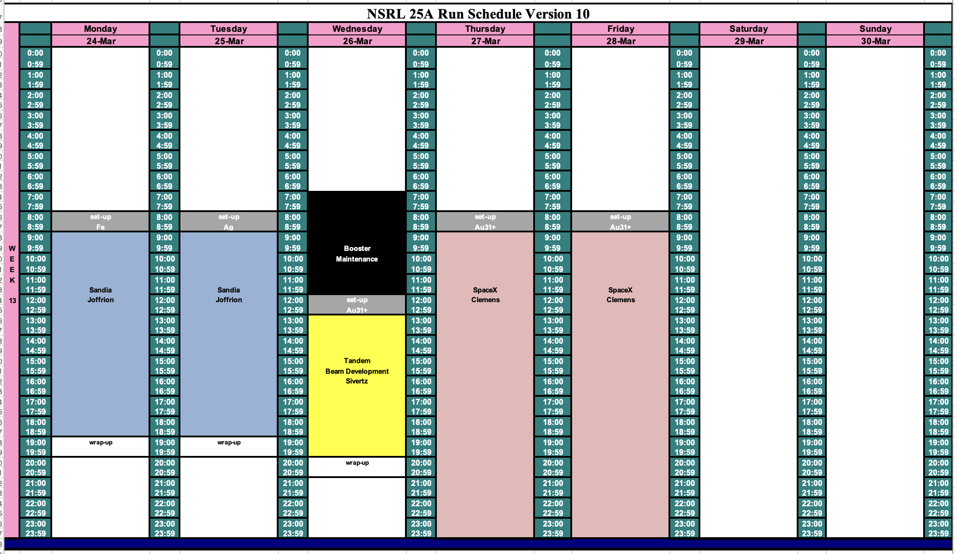
Schedule for this week

Slide 3
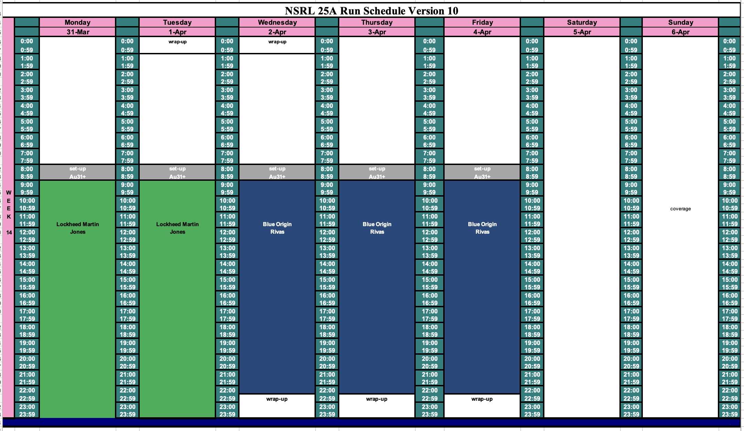
Schedule for next week

Slide 4
Future Schedule
This week, we switched Sandia so they could get Fe (23 March)
and Ag 24 March (Stayed with Fe instead) beams from Tandem.
26 March Tandem switches to Au full time for RHIC.
NSRL will do beam studies after maintenance ends.
Au31+ beam intensity from Tandem has been very good.
In the process of rescheduling many of the research groups testing in March/April/May because of need for EBIS.

