Slide 2
Data courtesy C. Naylor

Slide 3
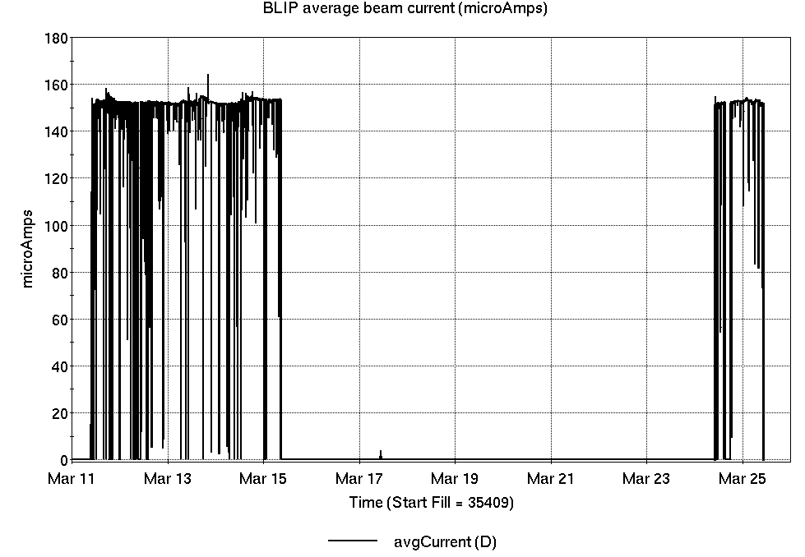
Operations for BLIP
3/11-25/2025:
Following repair to Mod5, 200 MeV production continued another 5 days on same target. After a brief low intensity exposure last Monday, a second Th production run began this Monday and is ongoing.
108.32 hr production
3.20 hr setup
9.52 hr failures
Availability: 92.1%
No BLIP
this past week

Slide 4
NSRL activity past 2 weeks: 3/11-25/2025 (as of 0800)
NSRL running continues, with various users running
Tandem produced Fe, I, Au for single ion modes, including some higher charge state setup. Protons in use from Linac.
Running 25-A schedule since 3 February. Schedule posted, updates to 9 May for beams & users.
Availability: 62.6%

Slide 5
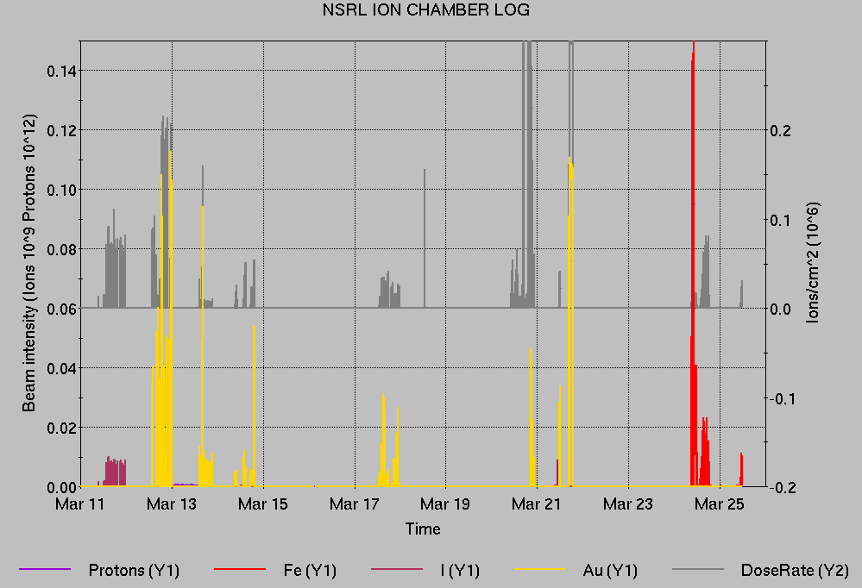
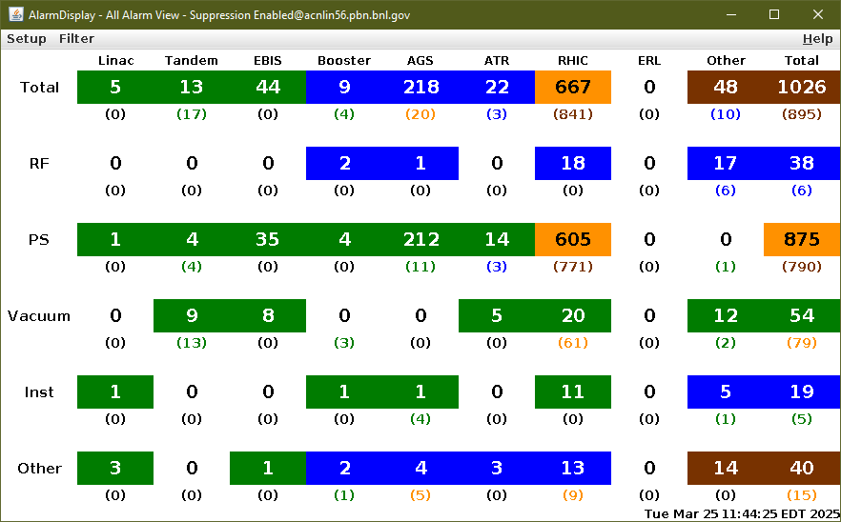
Notes from Operations
Notable failures (>1 hr)
Tandem MP7 chain failure, entry for repairs
Linac Mod 5 failure, internal tank repairs concluded
Linac Mod 4 failure, replace 7835 input
section
Linac MEBT q1 PS failure, replaced
AGS L20 septum PS failure, door
interlock repaired.
AGS RF IJ anode failure, ongoing.
Multiple accesses for investigation & repair
AGS J13 vacuum valve failure, access for limit
switch repair
AGS G10 kicker PS failure, modules
retuned/retimed
AGS G09C BLW PS noise problem, ongoing
AGS E17 gamma-tr PS failure, board replaced
Other notes
Various Tandem spark recovery, foil changes, retuning
Multiple power dips
Au Booster/AGS setup, AtR extraction concurrent with Au to NSRL, over 39 hours
Linac Mod 7 beam loading, reduced beam current while investigating beam losses

Slide 6
Reminder from Operations
MCR beam operations continue
  Operator/OC shifts continue for NSRL users, 2 shifts/5 days this week and next.
  NSRL limited to Au, protons after 26 March, pending EBIS restart.
  BLIP production continues through 4 April.
  RHIC beam setup anticipated this week; ORC pending for RHIC.
Note: MCR will not (quite) be occupied continuously.
  No OC on duty overnight until 3/26
  24/7 beam operations begin 0800 Wednesday 26 March
  Contact CAS in off hours (x2024) for urgent issues when MCR is not staffed.
Work continues with Teams phone setup. No more Cisco (remove Cisco phones) Identify anomalies outstanding. Contact ITD, Maintenance Coordinator
Changes? Time to update is now. Expect calls at all hours.
  http://directory.pbn.bnl.gov/
    CHECK AND EDIT YOUR OWN CONTACT INFO
  https://www.cadops.bnl.gov/Operations/personnel/call_in_lists/
    CHECK YOUR CALLIN LIST: expect contact off-hours
  Alarm response instructions: Groups prompted for updates

Slide 7
Keytree notes
Remote keytree systems require a database lookup to validate and authorize distribution of keytokens. The Keytrak system’s database is available for lookup functionality, but can no longer be modified in any way to add or edit qualified personnel.
Personnel affected:
New employees, experimenters arriving after 12/1/2024 could not be enrolled in database
Existing employees & experimenters, not already enrolled, cannot be added or modified in database
Remote keytrees affected:
Iris scan @NSRL
BNLID scan @AGS South gate, North Conjunction Gate
Iris scan @RHIC STAR, sPHENIX, IP12, IP4
Keytrees NOT affected:
BNLID scan @Linac, Booster
BNLID scan @RHIC IP2
MCR keytrees

Slide 8
Keytree notes, continued
Mitigation:
Choose entrants that are currently enrolled to perform the work in the enclosure under Controlled Access (CA).
Obtain CA keys from MCR for remote gate watch
Arrange for local gate watch using other tokens for entrants.
Arrange for Restricted Access, and allow for delays incurred to sweep areas.
CAUTION
Follow procedures. Gate Watch staff will remain vigilant.
  No “piggy-backing” – one key/token per entrant.
  Access keys are not candy! Authenticated entrant retains possession.
Radiological Controls and the Access Controls System are not to be circumvented. This is (has been) enforced with disciplinary action (dismissal).

Slide 9
Notes:
Reliability comparisons to previous runs

Slide 10
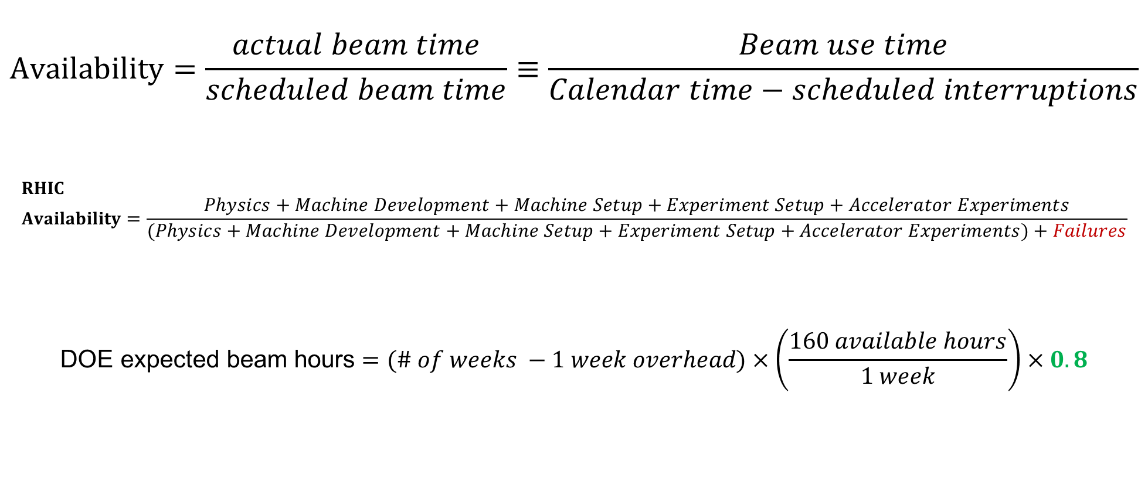
Availability, expected beam hours
$$Availability=\frac{actual beam time}{scheduled beam time}≡\frac{Beam use time}{Calendar time−scheduled interruptions}$$
$$RHIC \\ Availability=\frac{Physics+Machine Development+Machine Setup+Experiment Setup+Accelerator Experiments}{(Physics+Machine Development+Machine Setup+Experiment Setup+Accelerator Experiments)+Failures}$$
$$\text{DOE} \text{expected} \text{beam} \text{hours}=(\# of weeks −1 week overhead)×\left(\frac{160 available hours}{1 week}\right)×0.8$$
Notes:
Normally hidden. Explains how the 85% from DOE comes in to play, & general availability metrics

