Slide 1
AEPX Report
March 25, 2025

Slide 2
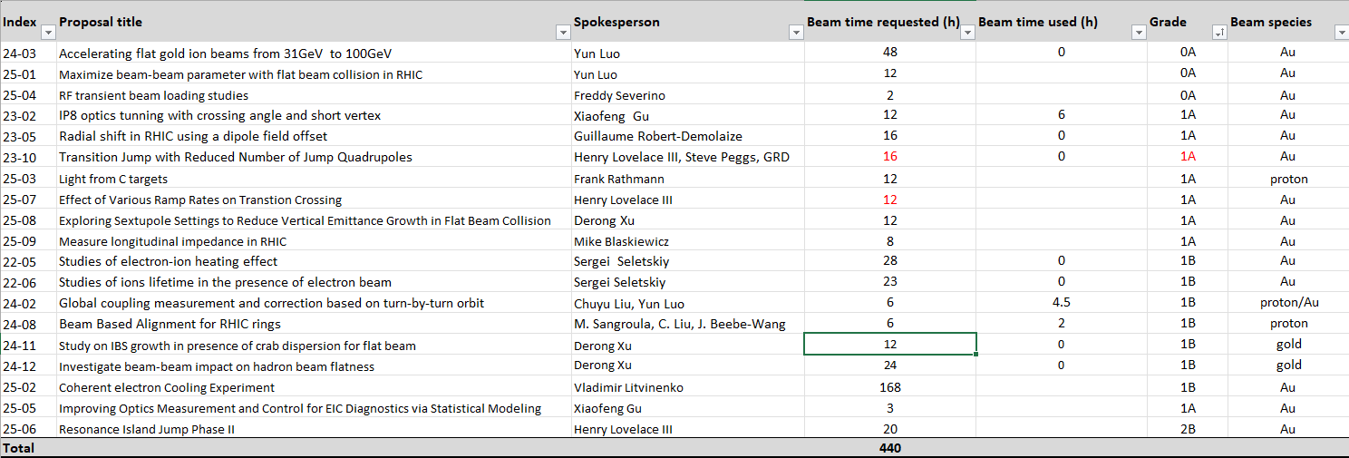
All APEX Proposals
Totally 440 hours requested.
We will plan experiments according to their ratings
Possible extended APEX session in the end of RHIC run’25

Slide 3
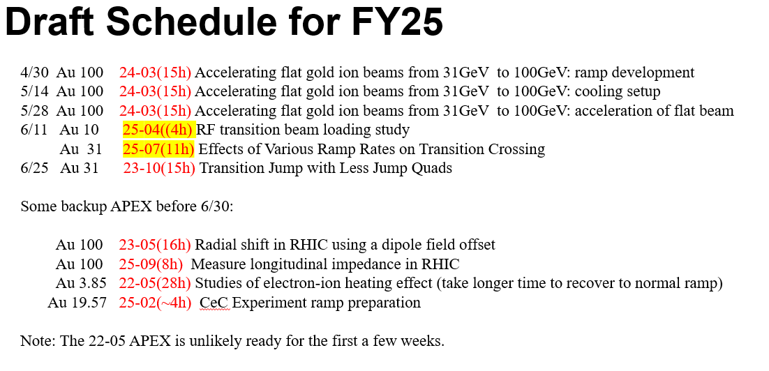
@Haixin

Slide 4
Progress Report
Serious discussions how to improve APEX program
- to bridge gaps between MCR and experimenters
- to relieve machine specialists
- introduced OC approval form this year
Successful APEX workshop on Jan 22, 2025
https://indico.bnl.gov/event/26073/
APEX bi-weekly Meeting started Feb 07, 2025
four meetings to check readiness of experiment proposals

