Slide 1
Preinjector Status
J. Ritter
Time Meeting
April 1, 2025

Slide 2
Tandem
Tandem was delivering Au beam RHIC setup.
Today Ag 107 for NSRL
MP6 work to repair charging system problem
Tandem Control Room staffed 6:00 – 24:00 for NSRL.
Will go back to 24/7 operation when needed for RHIC setup

Slide 3
EBIS
LION2: Up to 500 uA beam delivered to entrance of EBIS. Working on tuning injection line and debugging equipment.
Collector PS: Work continues supply oscillation issue. Last week failed line filter removed, neutral cable connected, still showing oscillation. Yesterday resistor installed between platforms and initial tests went well. Today electricians are working on removing ground loops. After completion of electrician work correct resistor will be installed and testing will continue.

Slide 4
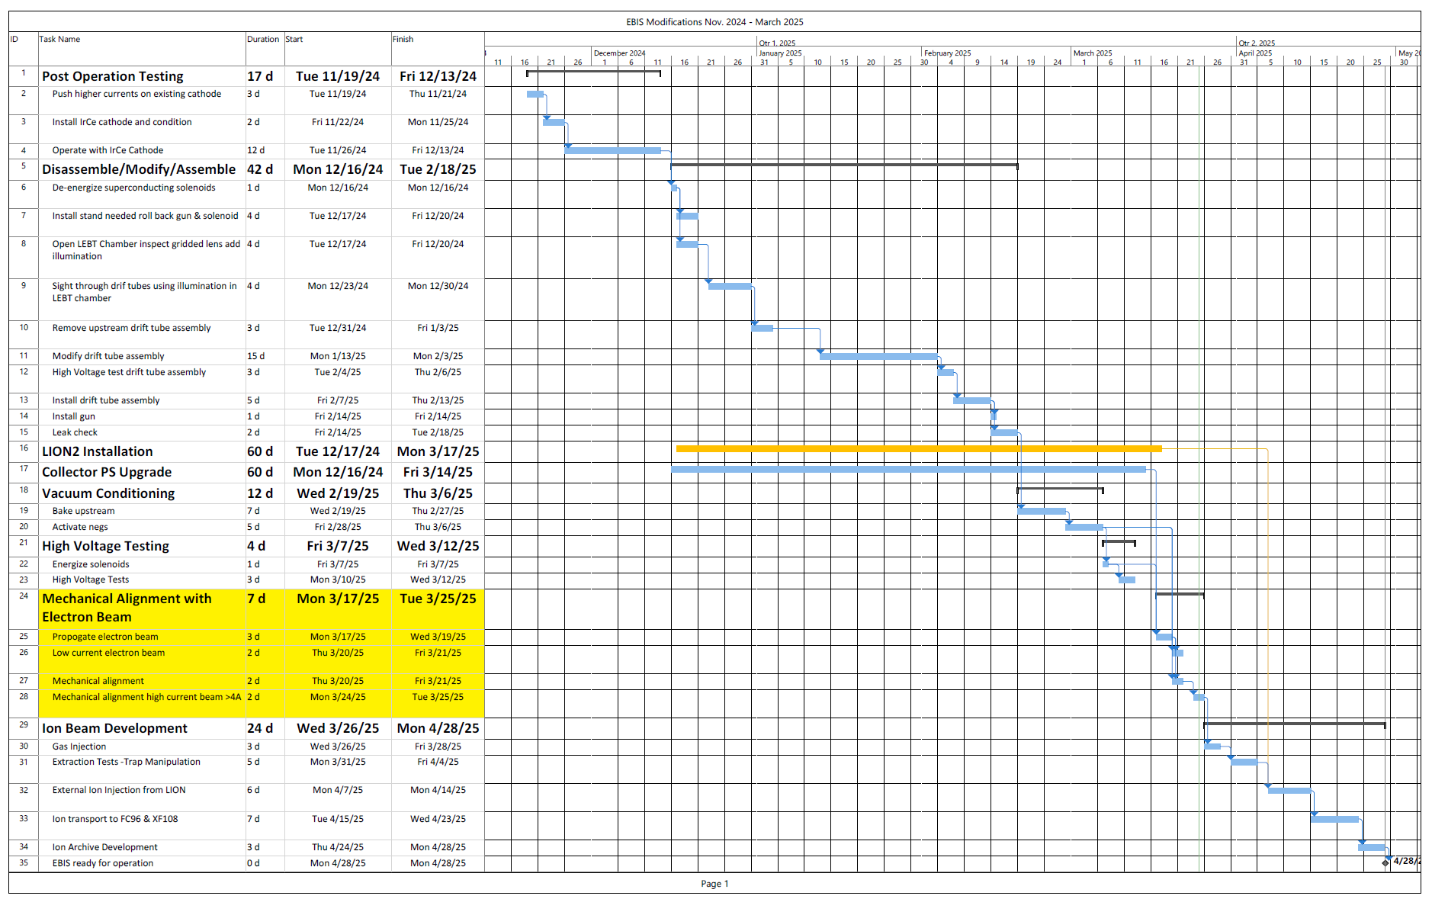
EBIS Schedule

Slide 5
Linac
BLIP 200 MeV 150uA run ends Friday
^{Mod 2 7835 cavity change}
OPPIS testing, 83% polarization.

