Slide 1
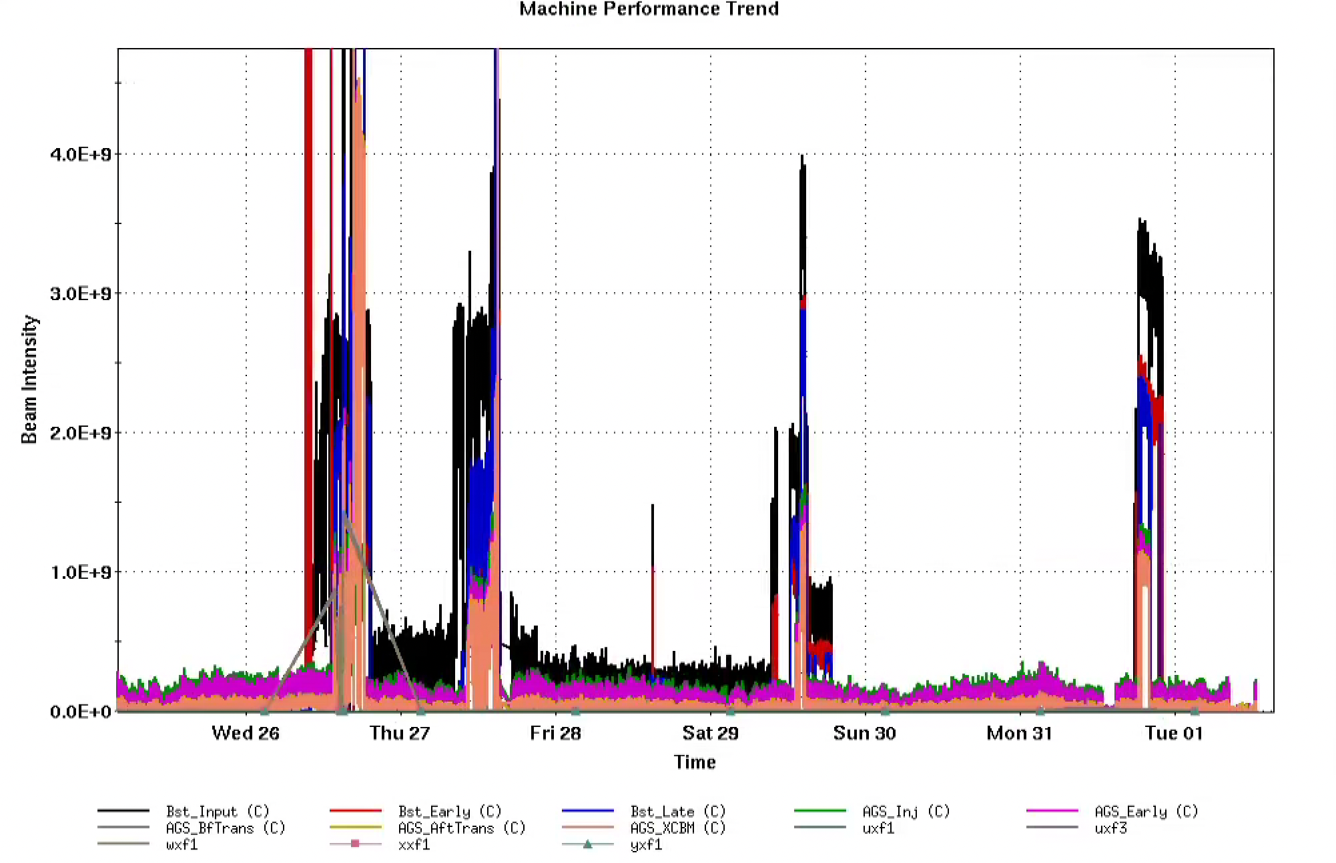
AGS Status: Time meeting 4/1/25
Booster E6 cavity RF supply fire 3/27
Thanks to everyone who responded to that and to the safe recovery process
A6 cavity sufficient for Au operation
Beam restored on 3/29
Recurrent problem with AGS extraction G09 backleg
Root cause not understood
Thermocouple installed for diagnostics
BtA optics problem fixed: swap of the controls of Q6 and 7
Thanks to Keith for diagnostic and tune-around efforts
Thanks to MCR operators Trevor Dankworth and Anthony Holmes for finding the root problem.

Slide 2
Injector development plans
RHIC delay allows for more setup in the AGS. Meeting tomorrow to go over details.
Au 3.85 GeV ramp and extraction (for APEX)
Polarized proton development
Low energy horizontal resonance checks
Model and AI/ML optimizations
Booster, AGS injection with Xopt/Badger tools
BBA in Booster
Linac to Booster coupled beam measurements
BPM calibrations and offsets

